Slide 1
Mobile Devices and Apps

Slide 2
Overview
Mobile Devices
Apps
Overview of Follow-Up Activities
Q&A

Slide 3
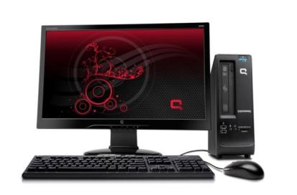
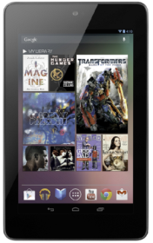
Mobile Device Basics
=
Notes:
Touchscreen
Power typically a button on top near camera
Camera
Used like a computer

Slide 4
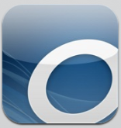
Mobile Device Basics
=

Slide 5
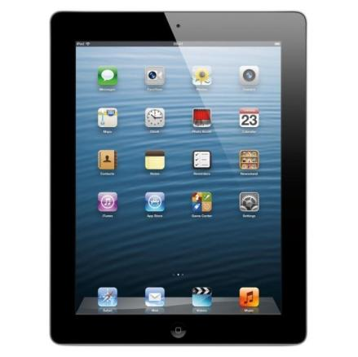
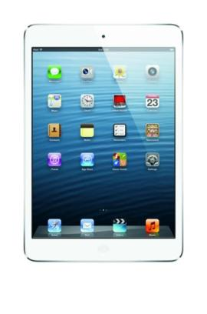
Popular Tablets
Notes:
iPad / iPad Mini
Nexus 10 / 7
Asus EEE pad Transformer
Samsung Galaxy Tab / Note
Microsoft Surface

Slide 6
Popular Tablets
Notes:
iPad / iPad Mini
Nexus 10 / 7
Asus EEE pad Transformer
Samsung Galaxy Tab / Note
Microsoft Surface

Slide 7
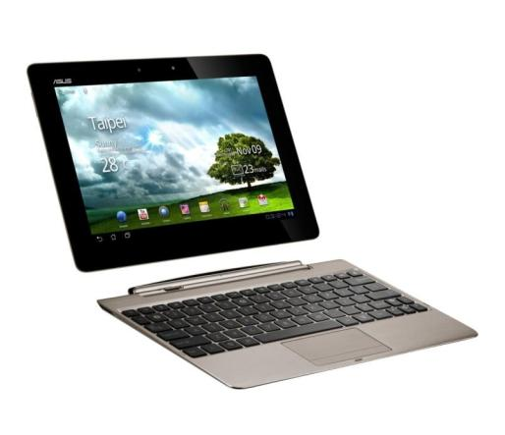
Popular Tablets
Notes:
iPad / iPad Mini
Nexus 10 / 7
Asus EEE pad Transformer
Samsung Galaxy Tab / Note
Microsoft Surface

Slide 8
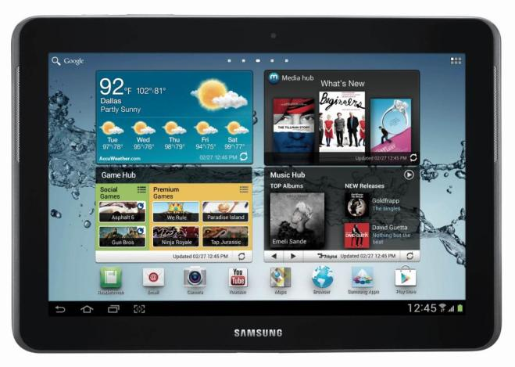
Popular Tablets
Notes:
iPad / iPad Mini
Nexus 10 / 7
Asus EEE pad Transformer
Samsung Galaxy Tab / Note
Microsoft Surface

Slide 9
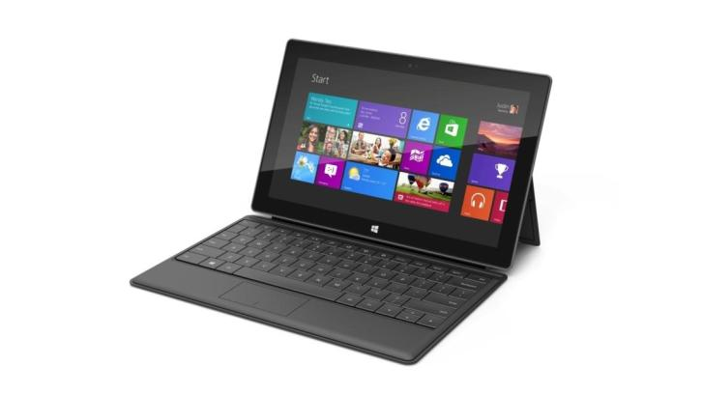
Popular Tablets
Notes:
iPad / iPad Mini
Nexus 10 / 7
Asus EEE pad Transformer
Samsung Galaxy Tab / Note
Microsoft Surface

Slide 10
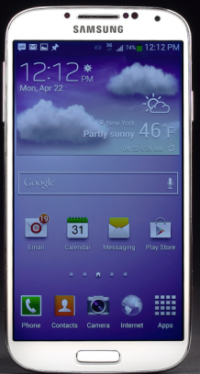
iOS vs Android
OR
Notes:
Not much!
If already an itunes person, maybe ios
If you like to customize your device, android
If you like the feel and shape of android devices... more variety
Very similar, more accessories for iPad, iOS is pricier

Slide 11
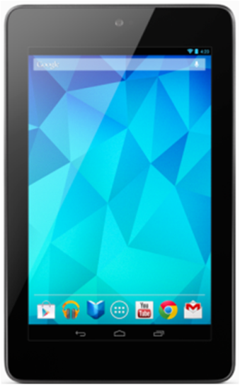
Common Features
Apps
Notes:
All use apps
Buttons are rare
Wi-Fi
Bluetooth
LCD screens

Slide 12
Common Features
Indicator Bar
Battery
Wi-Fi
Bluetooth
Time
Notes:
All use apps
Buttons are rare
Wi-Fi
Bluetooth
LCD screens

Slide 13
Common Features
Camera
Notes:
All use apps
Buttons are rare
Wi-Fi
Bluetooth
LCD screens

Slide 14
Common Features
Home button
Home icon
Notes:
All use apps
Buttons are rare
Wi-Fi
Bluetooth
LCD screens

Slide 15
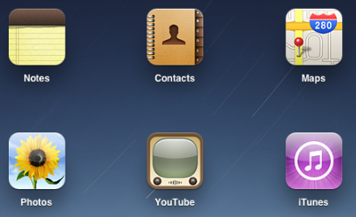
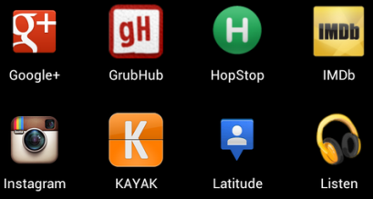
What is an App?
“An application (program), especially a small one designed for a mobile device”
Notes:
Software that runs on your mobile device
Just like you have programs (or software applications) that run on your computer to allow you to check email, watch movies, or create documents, apps
They usually look like little icons that you can tap on to use.

Slide 16
Where do I get apps?
Apple App Store
Google Play Store
Blackberry App World
Windows Marketplace
Notes:
The app store that is associated with your device
Apple App Store
Google Play
Blackberry App World
Windows Marketplace

Slide 17
How do I download apps?
You need:
Your mobile device
Your account information
Username
Password

Slide 18
How do I download apps?
Open the App Store
Search for the App
Tap on “Install”
Tap on if “Accept & download” if asked.
The app will download and an icon will appear on your home screen.
Notes:
Demo on a device

Slide 19
What about apps that cost money?
Payment can be made with:
Giftcards (iTunes)
Pre-loaded credit cards
Your own credit card
Notes:
Many apps are free –not all are.
Library apps are always free
All of our recommended apps today are free
Apps to do basic tasks – internet browsing, email, taking photos, are all free.
Reasons for not being free:
Some are free to try, but after a period of time require a subscription (Guardian Crossword, Wine Align),
Some have a free and paid version, with the paid version having more features
Some others have costs for features and help in app (usually games)
Some apps are free, but require a subscription (Netflix)
Some just cost money
iTranslate Voice ($0.99)
iOS Numbers ($9.99)
Paper Camera ($1.99)
Photoshop ($9.99)

Slide 20
Can I return an app?
Rarely.
Apple Apps: Requires a problem to be reported about the app.
Android Apps: Refunds within 15 minutes, or contact the app creator.
Notes:
Refunds are often difficult to come by:
iTunes – need to go to your purchase history and “report a problem” for the app, and the reason will be reviewed before a refund is issued
Google: 15 minutes, easy return, after 15 minutes, you have to contact the app developer directly.
Blackberry doesn’t appear to offer refunds/cancellations
Windows, you contact customer support

Slide 21
How do I remove apps?
Apple Apps:
Tap and hold home button
Tap x in app corner
Android Apps:
Go to Settings > Apps
Find app, choose “Uninstall”
Notes:
iPad/iPhone
Tap and hold on the home button until the app icons begin to shake
Take on the ‘x’ in the top left corner to delete.
The iPad will confirm the deletion.
Android
Navigate to Menu > Settings > Applications > Manage applications (on devices running Android 4.0 Ice Cream Sandwich, Settings > Apps).
Scroll through the list of apps to find the one you’d like to uninstall.
Tap on the app you’d like to uninstall.
Tap “Uninstall.
Windows
From the Start Screen, tap/hold the app tile and drag it towards the bottom of the screen.
Move the tile just a bit and let go. When you release the tile, a menu bar pops up at the bottom of the screen with various options.
You'll see option uninstall the app. Just tap that option, confirm the deletion and the Surface tablet takes care of the rest.
Blackberry
Homescreen > Options > (Advanced Options in some OS levels) > Applications
Tap the X button and delete the app.
Note:
Not all apps can be deleted. Most apps that came with your device are considered “system apps and cannot be deleted.

Slide 22
What apps are good?
Notes:
Purpse – ones we have recommendeed to patrons, and ones that shouldn’t be used in activity 4

Slide 23
Read
Overdrive Media Console
Zinio
OneClickdigital
Goodreads
Notes:
Overdrive Media Console
Download library ebooks and audiobooks.
Zinio
Access library magazines and read them with or without an Internet connection.
OneClickdigital
Download Audiobooks from the library using the OneClickdigital lending platform.
Goodreads
Find book reviews, book recommendations, and create an account to share and keep track of what you have read.

Slide 24
Listen
Freegal
CBC Music
Songza
Notes:
Freegal Music
Access almost 3 million MP3 songs from the Sony Canada catalogue. You get 3 downloads a week.
CBC Music
CBC Music gives you instant access to the best in emerging and established music.
Songza
Free music streaming and recommendations.

Slide 25
View
TED Talks
National Film Board
Sky Map
Notes:
Ted
TED presents videos of talks from some of the world's most fascinating people.
NFB
Watch National Film Board productions on your mobile device.
Sky Map
Turns your device into a window on the night sky. Mapping the constellations and locating planets.

Slide 26
Research & Learn
Mango Languages
WebMD
Google Translate
Notes:
WebMD
Check your symptoms, access treatment information, and find local health listings.
Google Translate
Translate words and phrases between more than 65 languages.
Mango Languages
Access over 34 foreign language courses & 14 English as a second language courses. Interactive lessons cover vocabulary, pronunciation, grammar and culture.

Slide 27
News
CBC News
The Weather Network
BBC News
Flipboard
Notes:
CBC News
Keep track of local and national news.
The Weather Network
Access current conditions, short term, long term and hourly forecasts and much more.
BBC News
Get the latest world and regional news from the BBC’s global network.
Flipboard
Flipboard brings together world news and social news in a beautiful magazine.

Slide 28
Get Organized
Pocket
Dropbox
Mint
Evernote
Notes:
Mint
Mint pulls in all your personal finance accounts into one place. This will help you track your spending and create a budget.
Evernote
Evernote is an easy-to-use, free app that helps you remember everything across all of the devices you use.
Dropbox
Share files from your computer to your phone or tablet. Get at least 2GB of storage for free.
Pocket
Create offline copies of articles, web pages, videos and images for when you do not have an Internet connection.

Slide 29
Travel
Kayak
Gas Buddy
TripAdvisor
Google Maps
Notes:
Kayak
Compare flights, hotels and rental cars, track flights, get travel deals.
Trip Advisor
Millions of traveler reviews, photos, and maps from TripAdvisor. This will help you plan a trip.
Google Maps
Find directions and routes for driving, walking, biking, or using public transit. Good for local and global maps.
Gas Buddy
Helps you find the cheapest gas prices.

Slide 30
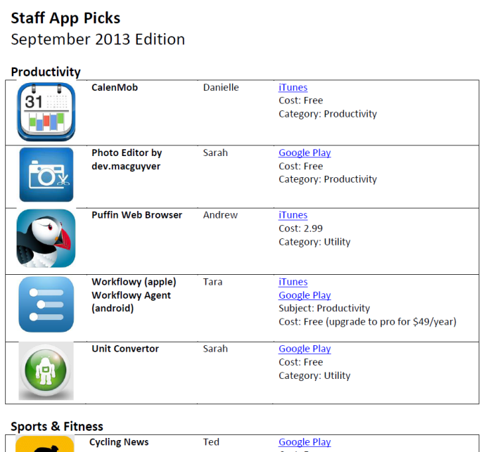

Slide 31
Where can I find more good apps?
Use the ratings and reviews
Watch CTV’s App Central
Visit sites like:
Common Sense Media http://www.commonsensemedia.org/app-reviews
PC Magazine http://www.pcmag.com/reviews/mobile-apps

Slide 32
Follow-Up Activities!
Borrow a Staff Device to Complete!
All 4 activities need to be completed.
Due by December 3

Slide 33
Questions?

