Slide 1
How to Develop a Risk Management System in Your Library
Debra Giles, Avnish Mehta, and Rob Macaulay
Calgary Public Library Board
April 28, 2017

Slide 2
What will we talk about today
What is risk?
Why the focus on risk?
Why we need a risk management system?
What is a risk management system?
Risk we care about
Risk reporting
Risk categories
Risk matrix
Risk measures
Reputation risk
Heat map
Summary
Q&A
?

Slide 3
What Is Risk?
Historically meant “bad things happening”
Was often managed by the purchase of insurance
ISO 31000 definition: the effect of uncertainty on objectives
Wikipedia definitions:
Risk is the potential of gaining or losing something of value
Risk is the consequence of action taken in spite of uncertainty
Our definition: risk is the potential of not achieving your strategy

Slide 4
Why The Focus On Risk?
Is the world a riskier place?
Evolution of good governance by Boards
Concern about liability – driven by the U.S.
Every enterprise has risk

Slide 5
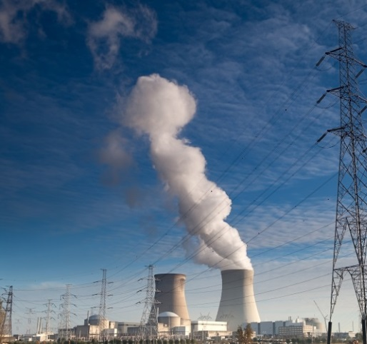
Risky Businesses
Just a few risky businesses:
Is a library a risky business?
What are some examples of risk in a library?

Slide 6
Why We Need A Risk Management System?
Result of focus on risk
Every Board is responsible for monitoring and maintaining risk at an acceptable level within their organization
Very important to stakeholders: funders (governments, donors), patrons, taxpayers
We want to ensure the Library achieves its strategic plan within a risk tolerance
Does NOT mean you should not take risk
Means the organization needs to recognize, measure and monitor risk
It is a Board responsibility; should not be delegated to Board committees

Slide 7
What Is A Risk Management System?
Identifies, measures and monitors risk
Provides a method of reporting on risk to the Board
A focused approach with a manageable level of information for senior management and the Board
A “tool” to facilitate the discussion of risk around the Board table
It is the conversation about risk which is most important

Slide 8
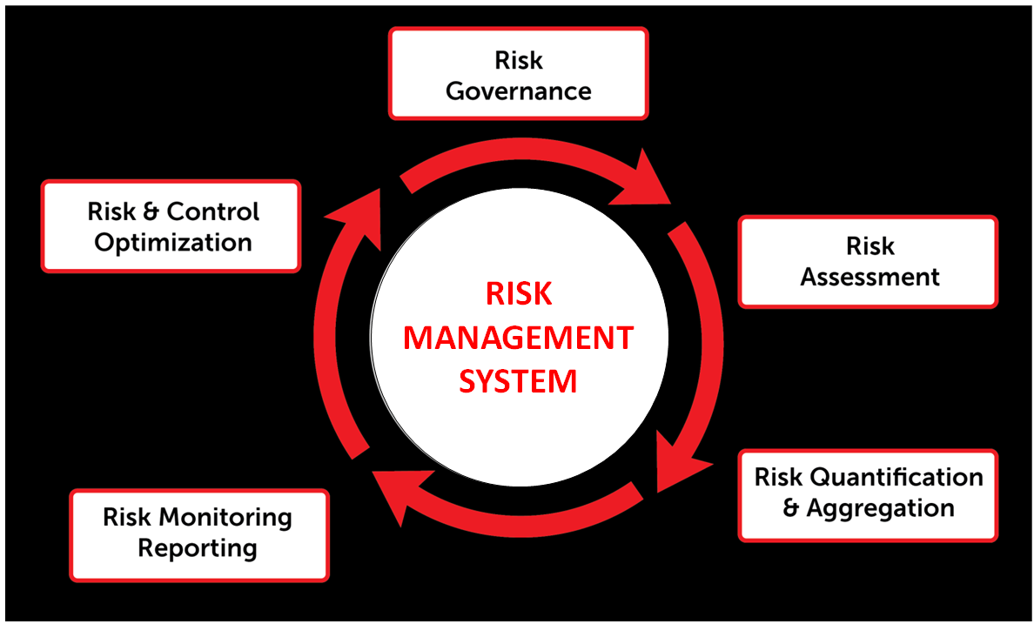
Risk Management System

Slide 9
Calgary Public Library’s Board Policy on Risk Management (2015)
“The Board shall make every prudent and reasonable effort to safeguard the Library’s reputation, assets, operations, staff, volunteers, and patrons against risk. To the best of its ability, the Board will ensure risks are identified and managed to a level which meets the Board’s tolerance for risk.”

Slide 10
Risks We Care About
Strategy 1 | Strategy 2 | Strategy 3
Strengthen Neighbourhoods in a Growing City | Bring the Library into More People’s Lives | Focus on Services That Make a Difference

Slide 11
Our Risk Categories
Strategy
Finance
People
Operations
New Central Library
Security

Slide 12
Risk Matrix
Strategy
(posted on conference website and copies available at the door)

Slide 13
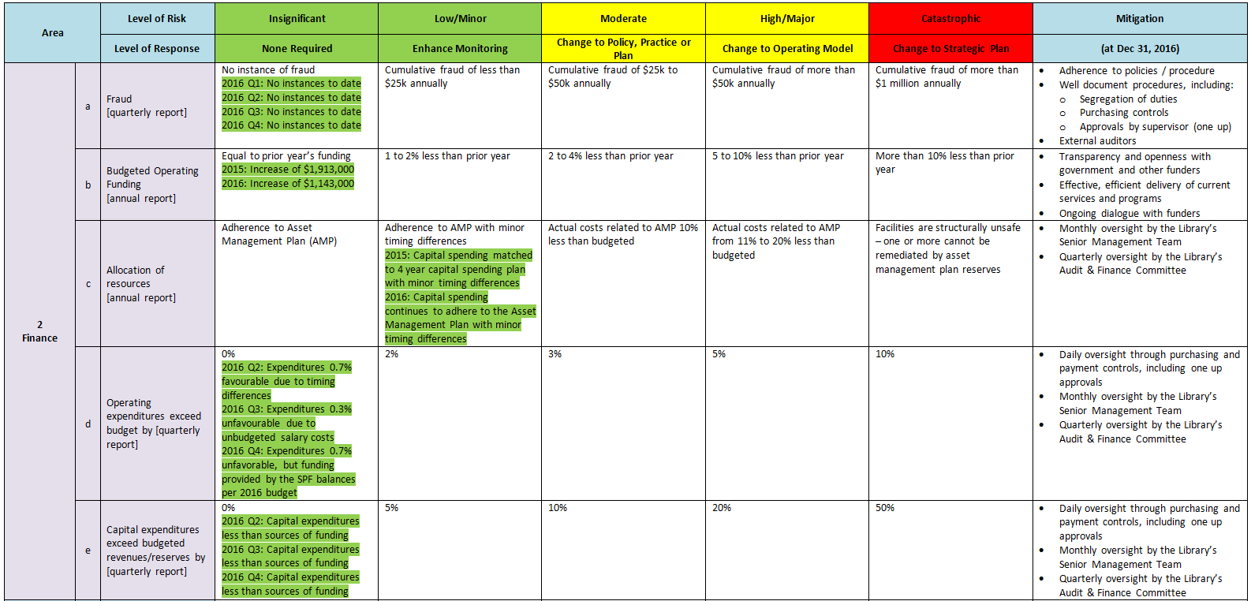
Risk Matrix
Finance
(posted on conference website and copies available at the door)

Slide 14
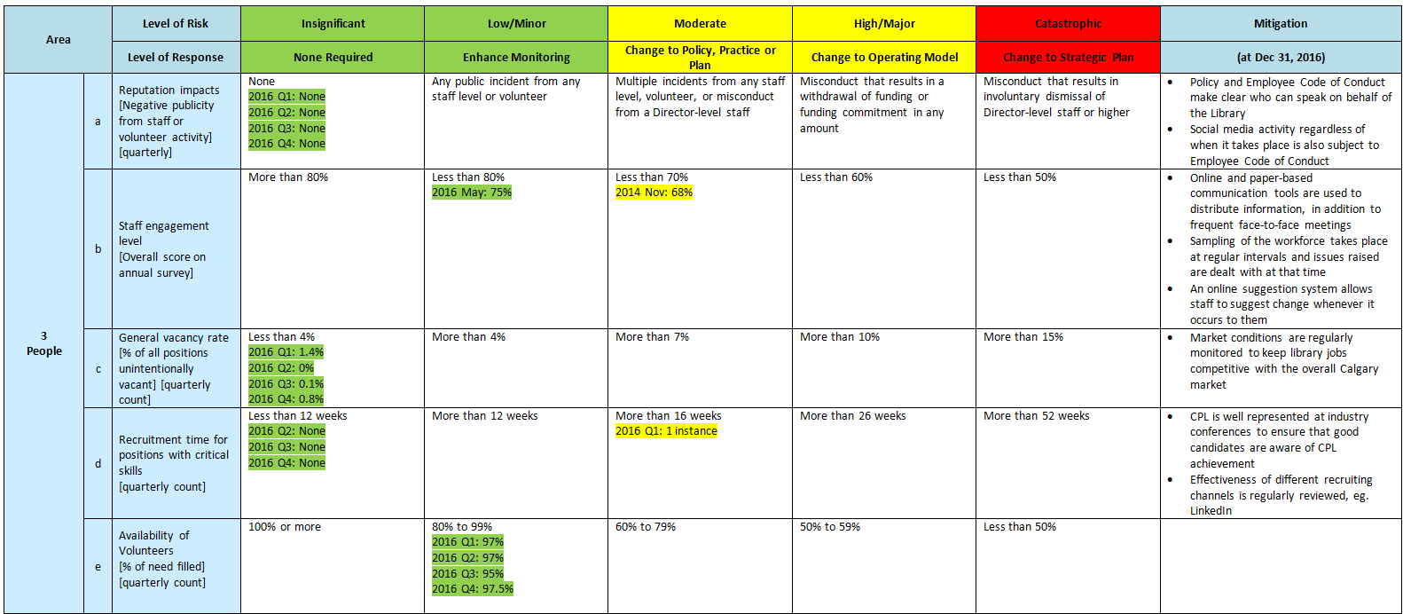
Risk Matrix
People
(posted on conference website and copies available at the door)

Slide 15
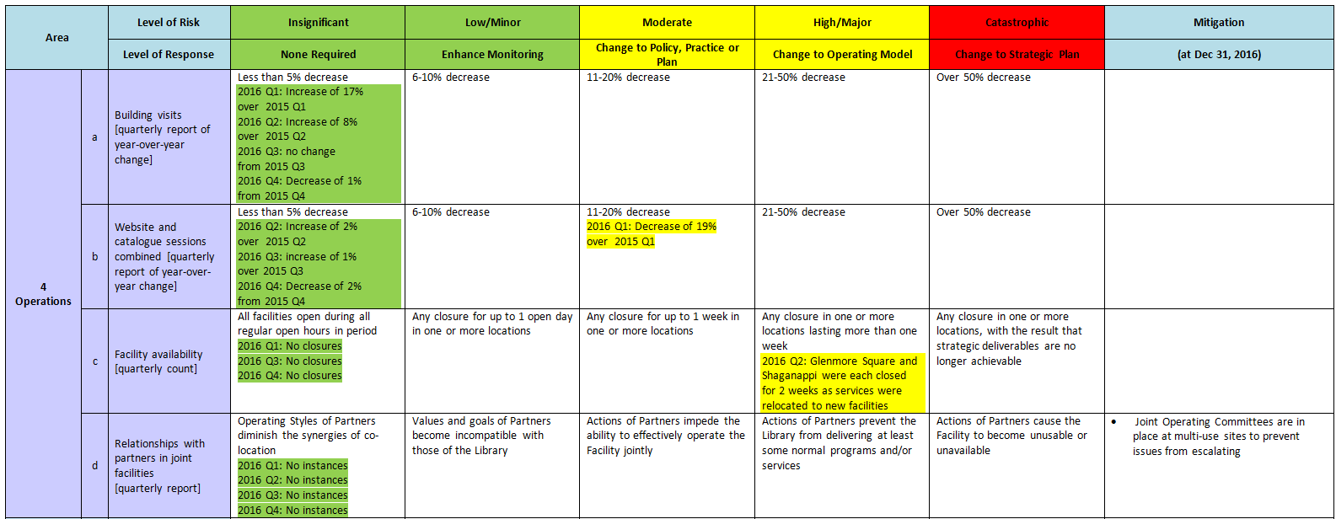
Risk Matrix
Operations
(posted on conference website and copies available at the door)

Slide 16
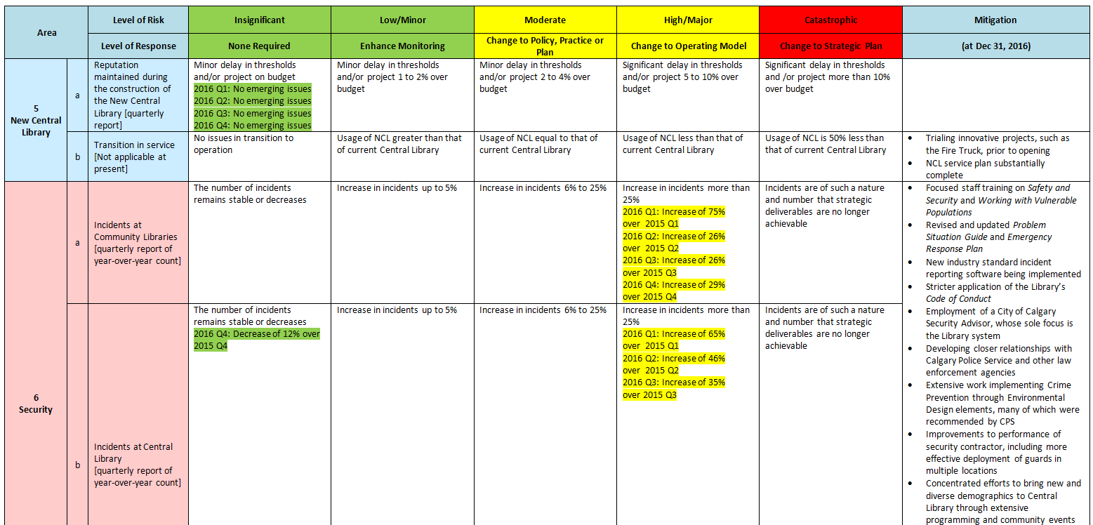
Risk Matrix
New Central Library and Security
(posted on conference website and copies available at the door)

Slide 17
Risk Measures
2 to 4 measures per risk category
5 levels of risk per measure
From Insignificant to Catastrophic
Each level of risk carries an implied response
From None Required to Change to Strategic Plan

Slide 18
Risk Measures
Good risk measure:
Active members/capita
Captures our goals of increasing membership, retention, and keeping up with the growth of the city
Okay risk measure
Community partner involvement in programs
Does not capture all partner involvement
More partners may not all be good partners
Do not have to be perfect; can be changed
Actual measures compared to level of risk on a quarterly basis
Response adjusted appropriately

Slide 19
Reputation Risk
Part of every risk – reflects upon reputation in community
Some are very obvious: risk of misleading through advertising, inappropriate behaviour of senior management
Others not: level of fraud
We included in level of risk measures
Who is this man?
NOT reputation risk

Slide 20
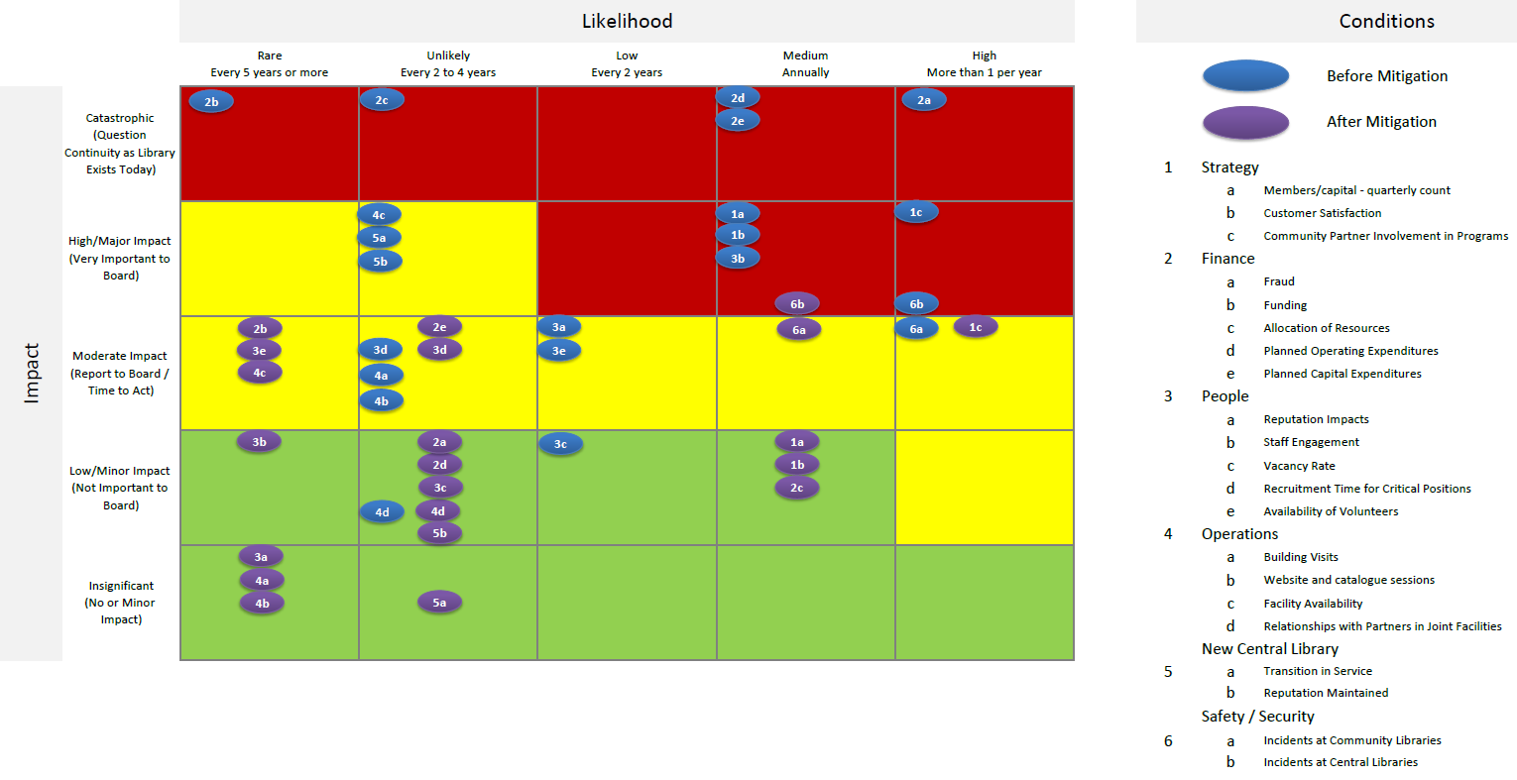
Heat Map
(posted on conference website and copies available at the door)

Slide 21
Heat Map
Indicates risk before and after mitigation
Reviewed annually
Board focuses on risks in “red”; reviews mitigation strategies to ensure they are still effective
Also must ask yourselves if there are any risks we are missing

Slide 22
Heat Map

Slide 23
CPL Risk Management System
Requested by City of Calgary
This is our 2nd iteration; 1st resulted in a risk register
Updated quarterly; became unwieldly
City very pleased with result
Other agencies are utilizing framework

Slide 24
Summary
Risk is a Board responsibility
Libraries have risk
Risk register and heat map are monitoring tools
This is a continuous process
Measures can change
Conversation is important

Slide 25
Q & A

