Slide 1
RISE Coffee Break
Finding Videoconference Content
Notes:
Welcome and introduction(s) – talking about VC content from 3rd party providers

Slide 2
Cleveland Museum of Art (2010)
Content Providers
While there are many programs shared between libraries throughout the RISE Network, there may be times when you may want to seek content from a content provider.
Content Providers are organizations who provide videoconference programming either for free or for a fee.
Many museums, zoos, and other cultural and educational organizations offer prepared video conference content.

Slide 3
Content Providers
Content can be pre-set or designed for you.
Benefit → easy! (because it is pre-packaged)
Before booking videoconferences with fees, speak to your RISE Consultant.
Be aware that your library will be responsible for any fees.
Consider sharing costs with other RISE libraries, but be aware that some videoconferences with fees may only be able to be broadcast to one library (in other words, you would not be able to cost share).

Slide 4
Content Providers
Also, before booking videoconferences, please confirm with your system headquarters IT RISE support that the videoconferencing from the content provider will work with the RISE equipment. Testing may also be necessary.
Pograms available from content providers are often intended for school audiences; however, many organizations will be more than willing to adapt their programs for public audiences.
Plan ahead if you plan to use a content provider as their schedules fill up quickly – especially during the school year.

Slide 5
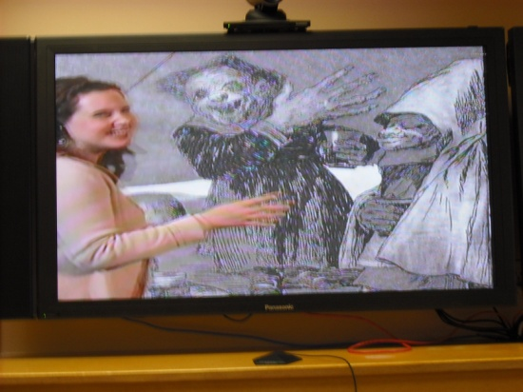
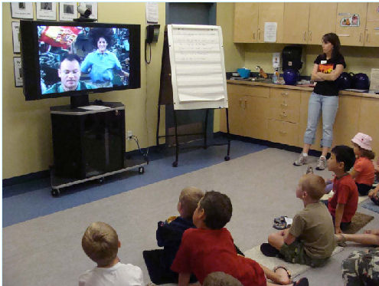
Content Providers
See the RISE Toolbox Tip Sheet on Content Providers!
CILC: Center for Interactive Learning and Collaboration http://www.cilc.org/search.aspx Search by subject (music, careers, etc.), by content provider (Rock and Roll Hall of Fame and Museum, Alberta Parks, New York Yankees, etc.), or by cost (free, $25, $50, etc).
IVC Playground Wiki http://ivcplayground.wikispaces.com/Content+Providers
2Learn.ca and Gateways to Learning http://www.gateways2learning.ca/

Slide 6
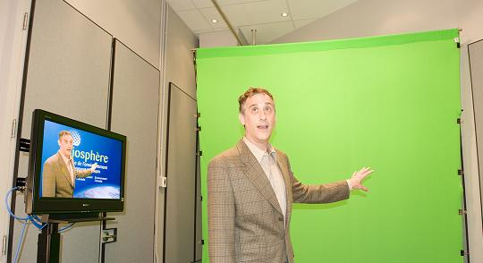
Content Providers
See the RISE Toolbox Tip Sheet on Content Providers!
Environment Canada
http://www.ec.gc.ca/biosphere/default.asp?lang=En&n=2154B8C5-1
Canadian Space Agency
http://www.asc-csa.gc.ca/eng/educators/tele-learning/
Bamfield Marine Sciences Centre
http://www.bms.bc.ca/computing/videoconf/

Slide 7
Content Providers
See the RISE Toolbox Tip Sheet on Content Providers!
Royal Tyrell Museum
Ontario Science Centre
Royal Botanical Gardens
NASA
Rock and Roll Hall of Fame & Museum
AT&T Knowledge Network Explorer - Videoconferencing for Learning
http://www.kn.pacbell.com/vidconf/index.html

Slide 8
Thank You!
QUESTIONS?
alison@marigold.ab.ca
Notes:
Questions or comments?
Suggestions for other Content Providers?
Tip sheet with more content providers on the RISE website.
Thanks! ☺

