Slide 1
Outcomes, Value and Impact
Metrics for Library Success
Sept 28-29th
Summary of notes
Presented by Phillippa Brown, Planning Coordinator

Slide 2
Introduction: Where are we?
“Libraries” is an “industry” with no agreed upon success measures
Libraries do not accept a culture of assessment easily
Libraries use ‘traditional statistics’ to measure the past (inputs and outputs) eg. # of programs/ attendance
Libraries make decisions based on staff’s ‘community knowledge’
Notes:
Map of Paris 1576

Slide 3
However…..
Traditional statistics do not measure how the community uses our facilities
They cannot show how our services and programs impact peoples’ lives
With increase in self-service, staff are interacting directly with fewer patrons (only 5-10% US Study)
Do we really know what our patrons want or need?

Slide 4
One wonders…
Are we aligned with our community’s priorities?
Can we demonstrate accountability?
Can we demonstrate our value in a meaningful way?
Can we demonstrate the return on their investment to our cities, donors or residents?

Slide 5
It is overwhelming!

Slide 6
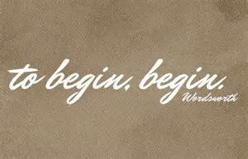
Takeaway #1 Where to begin?
What is the impact you want to make?
What is your goal?

Slide 7
What ARE Inputs, Outputs and Outcomes?
Input: resource perspective
The resources we invest
eg. a librarian, a room and 10 picture books
Output: Operational perspective
The product/activity
eg. modeled 1000 stories before Kindergarten activities to x parents and children
Outcome: User perspective
What the users perceive they gained
eg. x parents enjoyed being read to and gain confidence they could do this with their children
Notes:
The logic model

Slide 8
But what is an Impact?
It is a long term change in the human condition from the stakeholder’s perspective:

Slide 9
For example:

Slide 10
Just a minute!
Before you go shooting for the stars, you want to think about:
Is this goal/impact part of your strategic plan?
Is it part of your community’s or shareholder’s priorities?
Do you know what the stakeholders in the community believe is a priority?
Ever talked to them about what they are working on?
Notes:
Before you go off exploring all the galaxies of goals out there….

Slide 11
To really have impact!
Know the community you operate in……

Slide 12
Keep in mind you will need to….
Build relationships with stakeholders based on mutual interests
Work together to define what success looks like for your community
Work together to bring about “community betterment” (impacts)
Work together to develop measures that are meaningful
MORE ISN’T ALWAYS BETTER

Slide 13
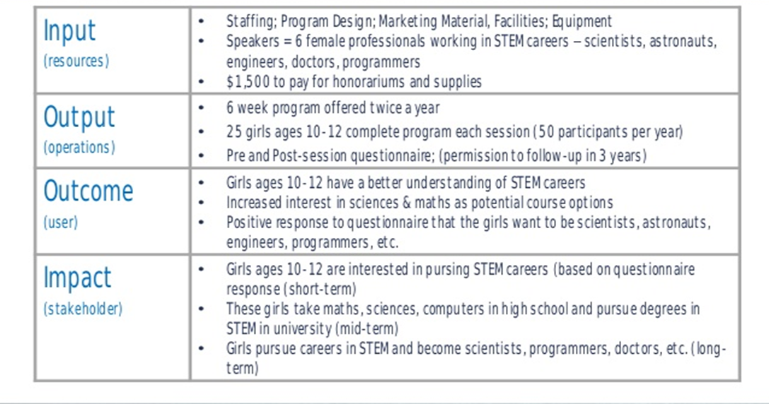
Sample of Public Library Program

Slide 14
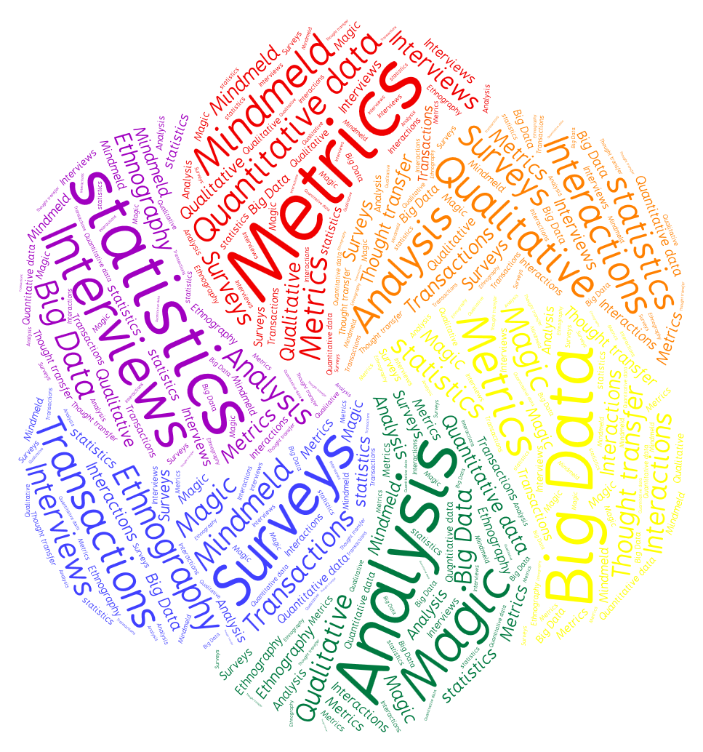
Takeway # 2 What measurement method to use?

Slide 15
In a Balanced and Judicious way…
Use measurements when you need:
To determine if high value initiatives have contributed to the intended long term change
To assess if an existing service is meeting its goal
To evaluate if new proposal(s) can contribute to your desired impact
Notes:
We don’t need to know the Impact of every activity.

Slide 16
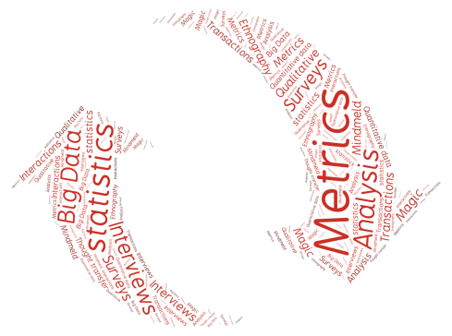
Use a Broad Comprehensive Approach
Traditional Statistics to:
Surveys and interviews to
Measure your inputs and outputs
Count your attendance
Count your visits
All very valuable tracked over time
Big Data
Metrics on a global scale
Over time provide patterns to interactions/transactions
Help measure customer satisfaction
Determine the importance of a service or program
Extract perceived outcomes
Gain permission for long term follow up.
Analytics
Help put results into context and provide explanations

Slide 17
Case studies: High Value Initiative:
Vancouver Inspiration Pass
Did it meet its goals?
How does it compare against accepted standards or competitive programs?
How effective was it?
Should it be continued and/ or expanded?
Methodology
Surveys of participants (pass users)
Focus Groups of participants (pass users)
Interview with VPL Staff and representatives of a number of program partners were conducted to identify challenges and positive outcomes

Slide 18
Case studies: Existing Services
Sno-Isle:
Information services Project
Methodology
What do our customers want/expect?
Open staff communication during the survey development
Customer survey
Stakeholder partnership interviews
Statistics measuring changes in public behaviour over time
“PROFOUND SHIFT IN THE WAY WE THINK ABOUT WHAT WE DO”

Slide 19
Case studies: New proposals
Sno-Isle Libraries: Proposing Projects with Purpose
Methodology
Project Management framework for quality control (measures)
Staff survey
360 degree perspective in the feedback

Slide 20
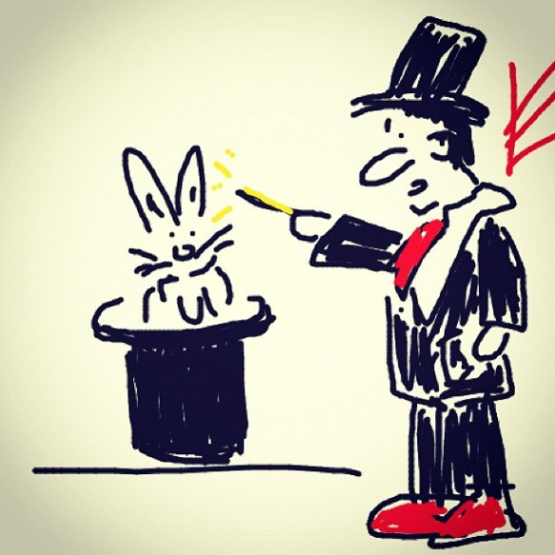
Takeaway #3 How to communicate Value?
We all know:
Its challenging
Its expensive
It needs special expertise
It needs clarity around shared goals
It needs a long term commitment
There are no magic tools but there are lots of options

Slide 21
Start by
Defining your goals
Getting very specific how you will demonstrate how you met those goals before you begin
Identifying resources/recommendations/ reviews of tools
Is there anyone close by who has the specialized knowledge /expertise you need
Finding out if anyone else has already done it and if you can use their work

Slide 22
Work toward
A new way of thinking about what we do
A new way of interacting with our community
A new way of developing services and resources.

Slide 23
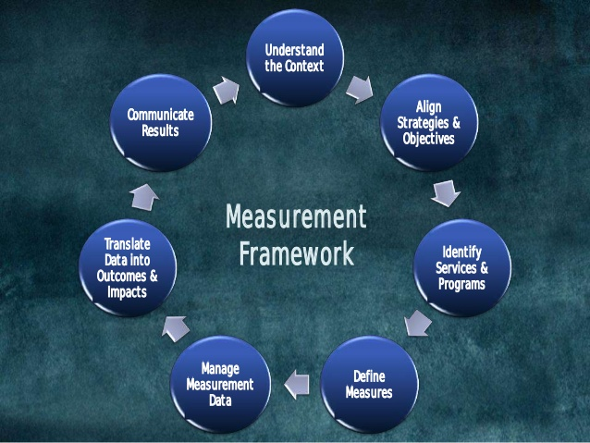
Conclusions
Need buy-in from top down
Developing impact measurements is part of a cycle of continuous improvement

Slide 24
Resources
http://www.metricsandlibraries.org/program.html (links to all slide decks are in the Program)
Impact Report samples:
Stephen Abrams’ slideshare on the Federation of Ontario Public Libraries (FOPL) Province wide approach contains far more information than he presented at the symposium http://www.slideshare.net/stephenabram1/vancouver-metricsabramspeech
Surrey Public Library Literacy Day report http://www.surreylibraries.ca/about/5767.aspx
Outcomes Based Evaluation:
PLAs Project Outcomes site: https://www.projectoutcome.org/ provides surveys to get you started.
More information in Public Libraries online article: http://publiclibrariesonline.org/2015/09/project-outcome-helping-libraries-capture-their-community-impact/
Vancouver Public Library toolkit: https://www.vpl.ca/images/uploads/file/pdf/Outcomes_Based_Evaluation_Toolkit.pdf
Visualization tools:
Greg Notess’ presentation gives an array of suggestions http://www.slideshare.net/stephenabram1/metrics-notess
The Library Toolshed is a depository to share resource. It currently does not have a section with measurement tools but welcomes them: http://librarytoolshed.ca/source-library/british-columbia-library-association

