Slide 1
Blogging 101: Part 2

Slide 2
Today
Review Last Week
Create a Blog!
Create a Post!
Marketing Tips

Slide 3
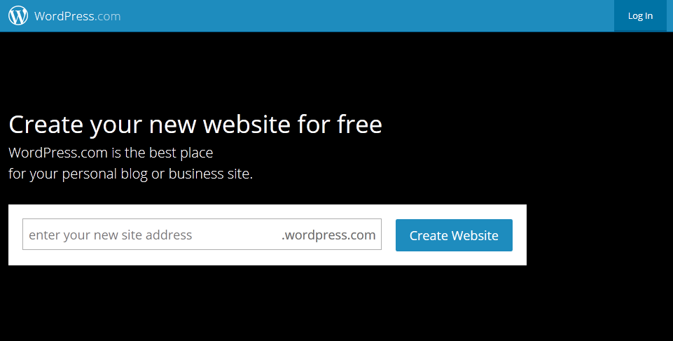

Slide 4
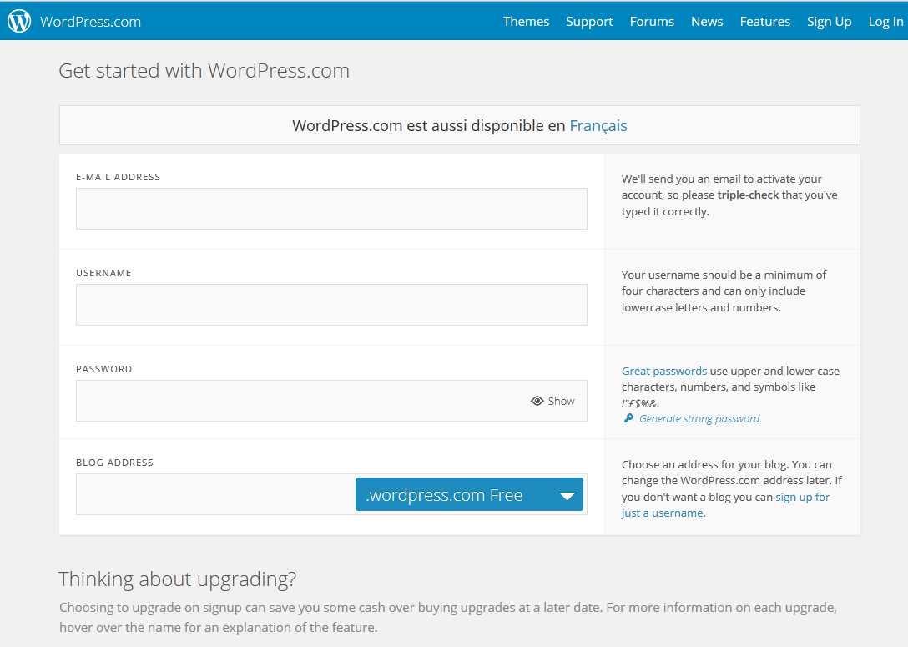

Slide 7
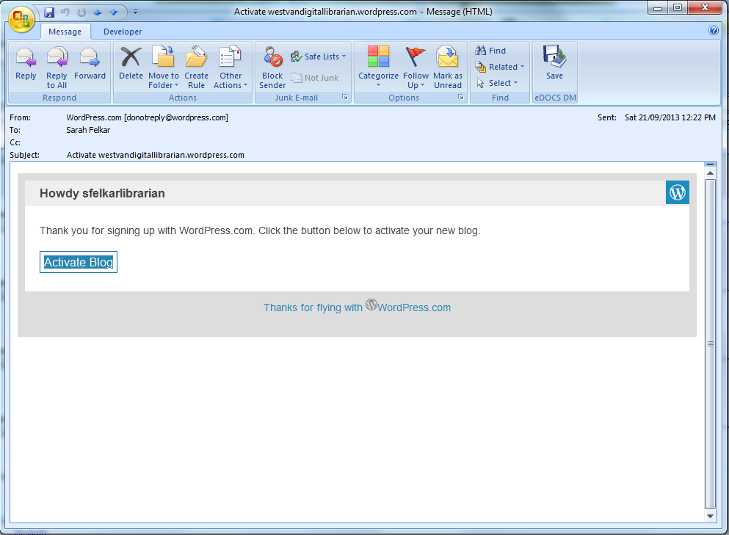

Slide 8
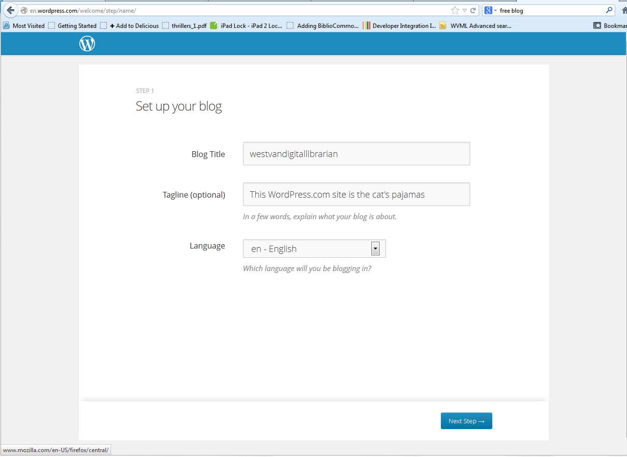

Slide 9
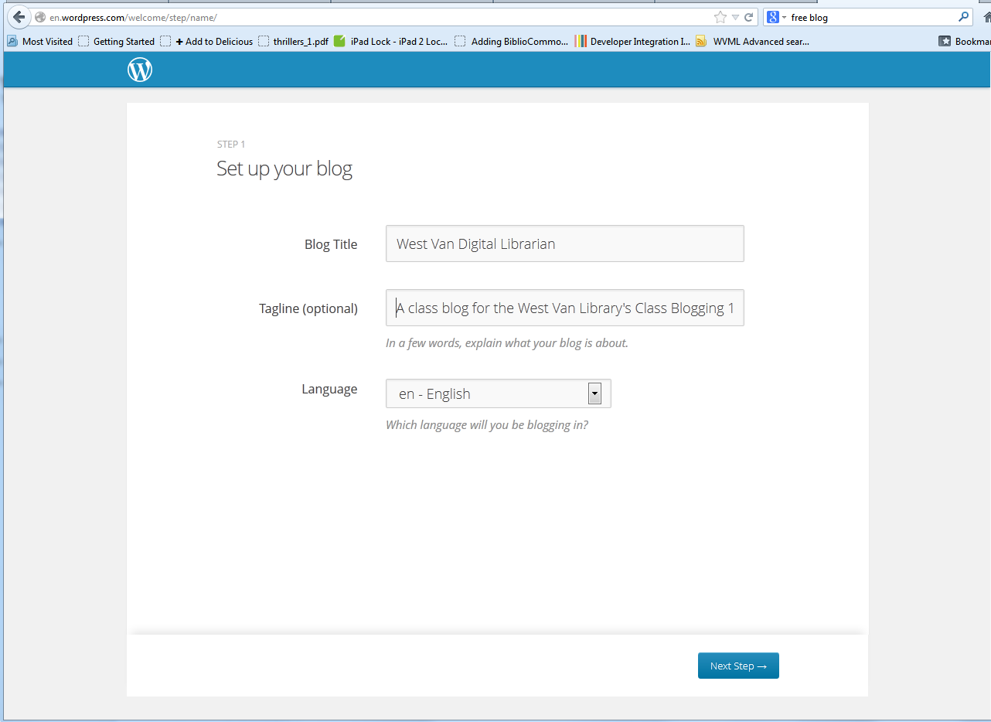

Slide 10
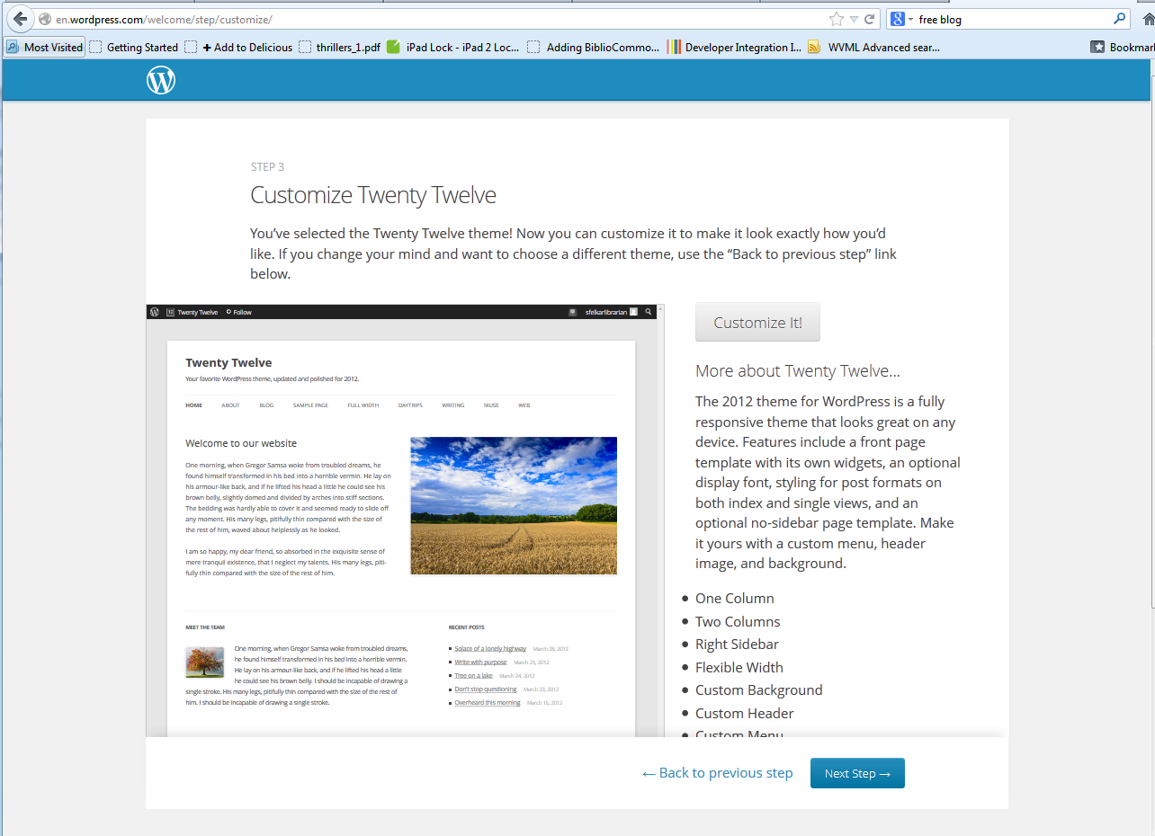

Slide 11
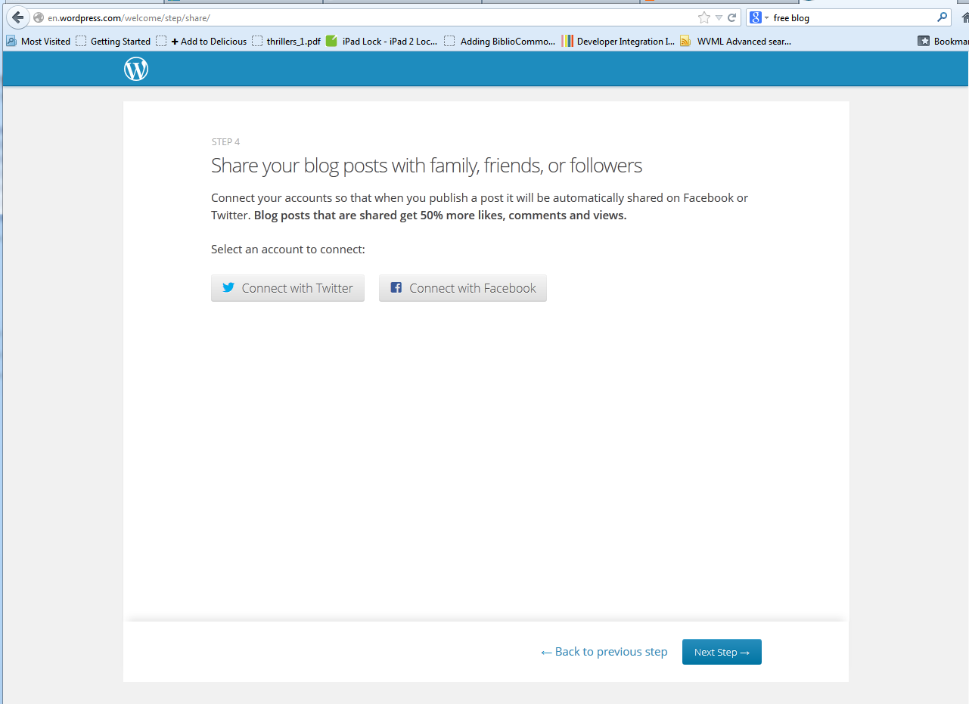

Slide 12
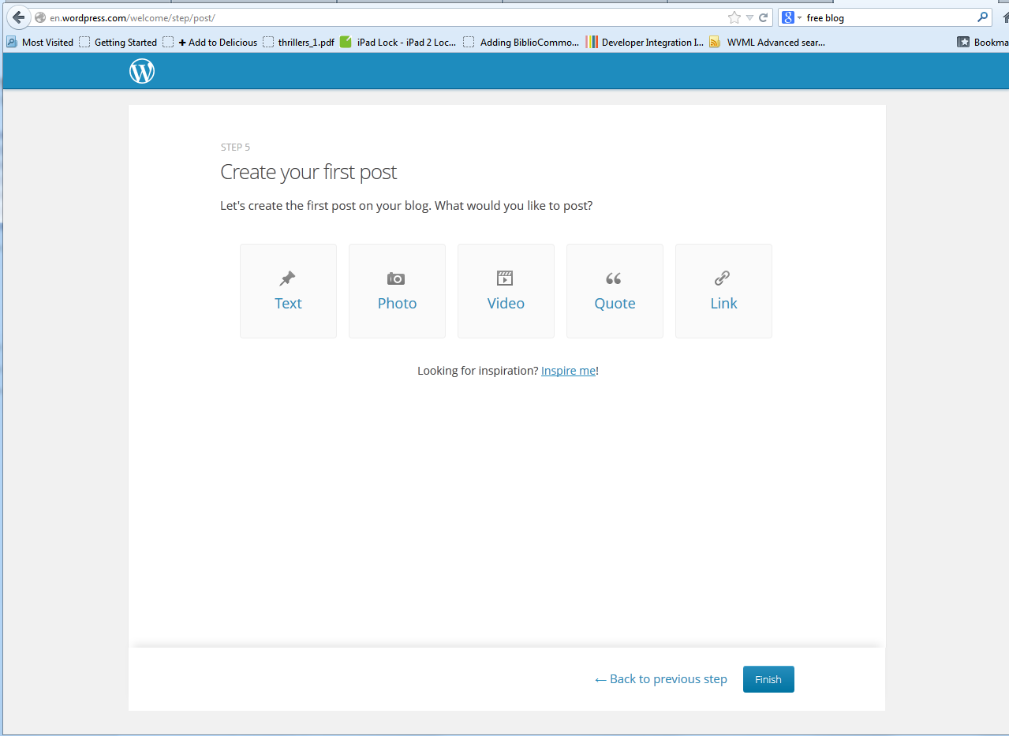

Slide 13
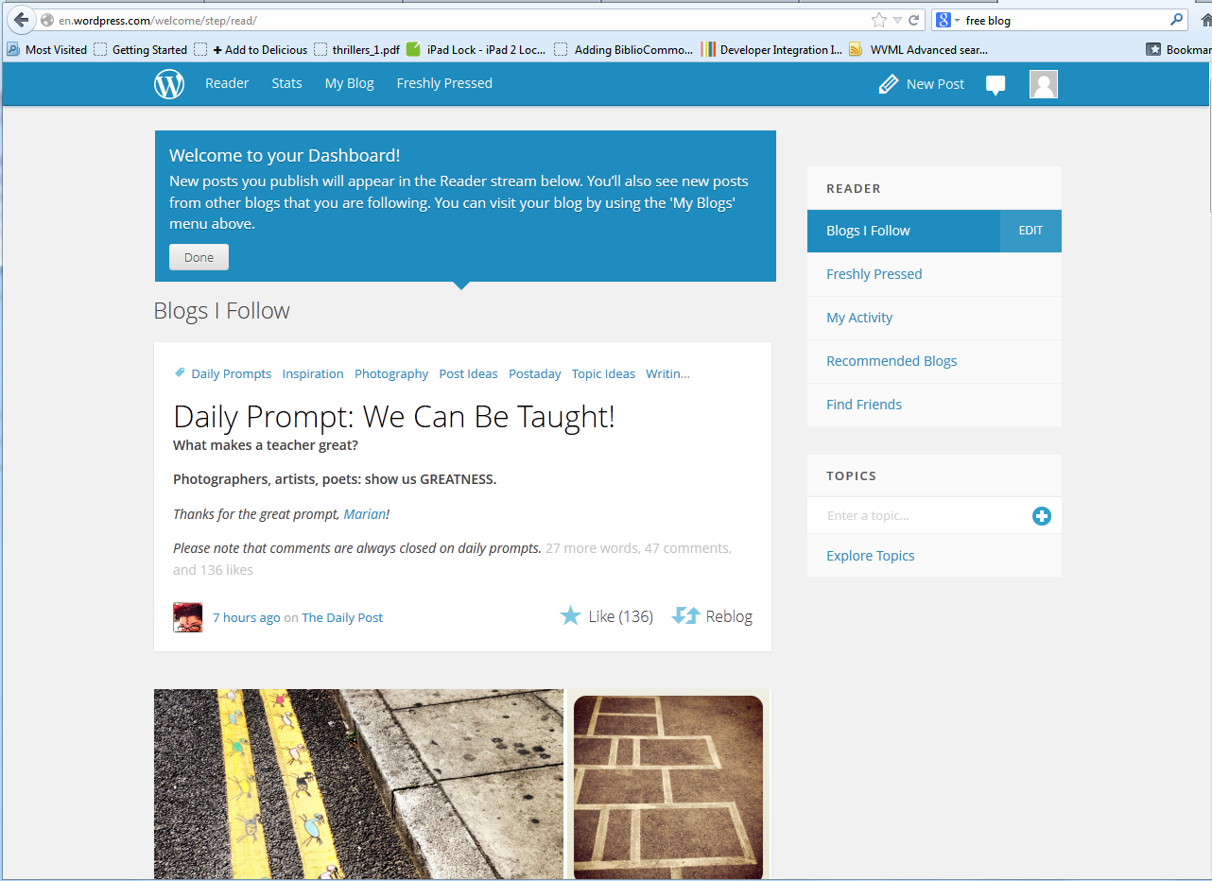

Slide 14
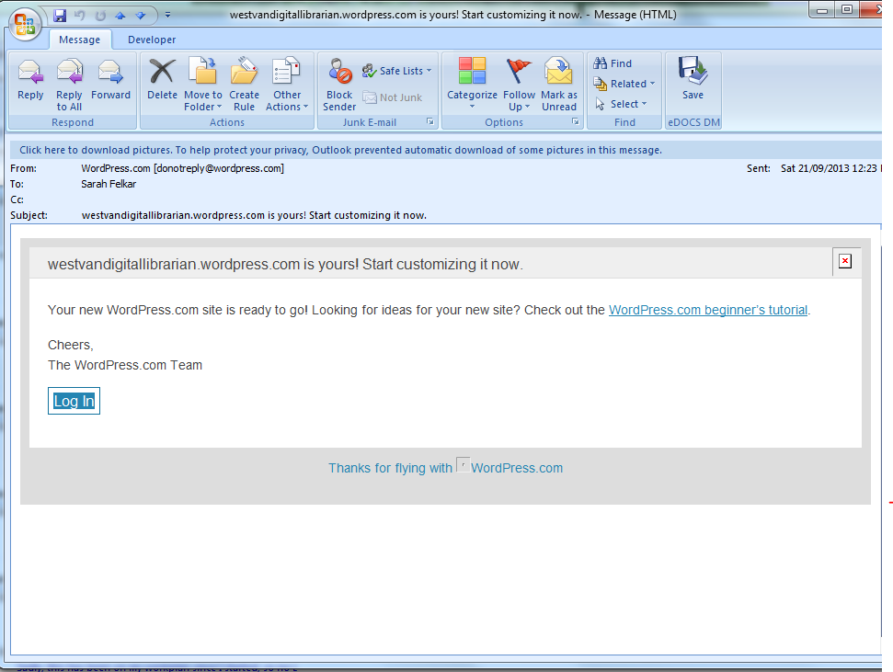

Slide 15
TIME TO CUSTOMIZE

Slide 16
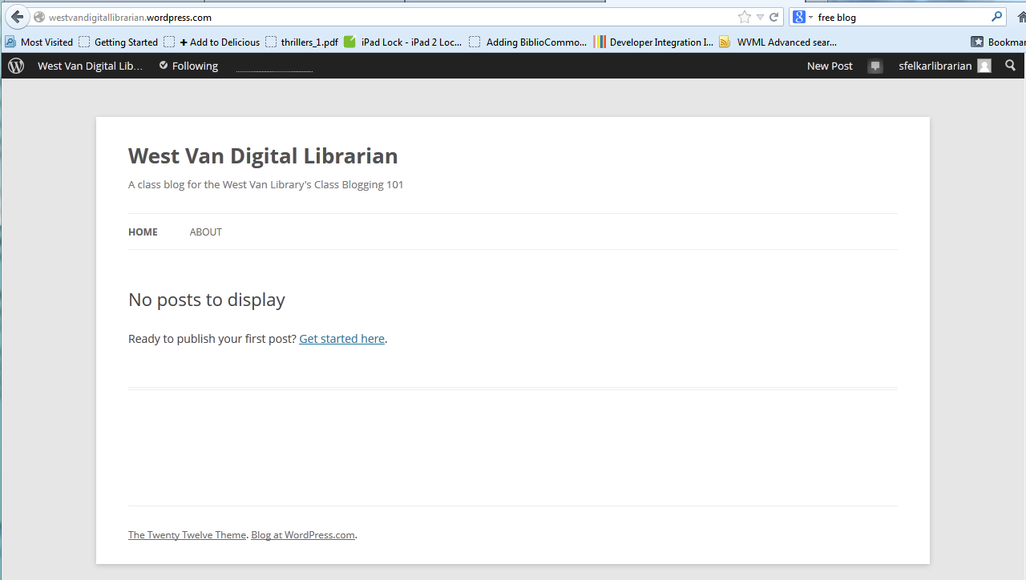

Slide 17
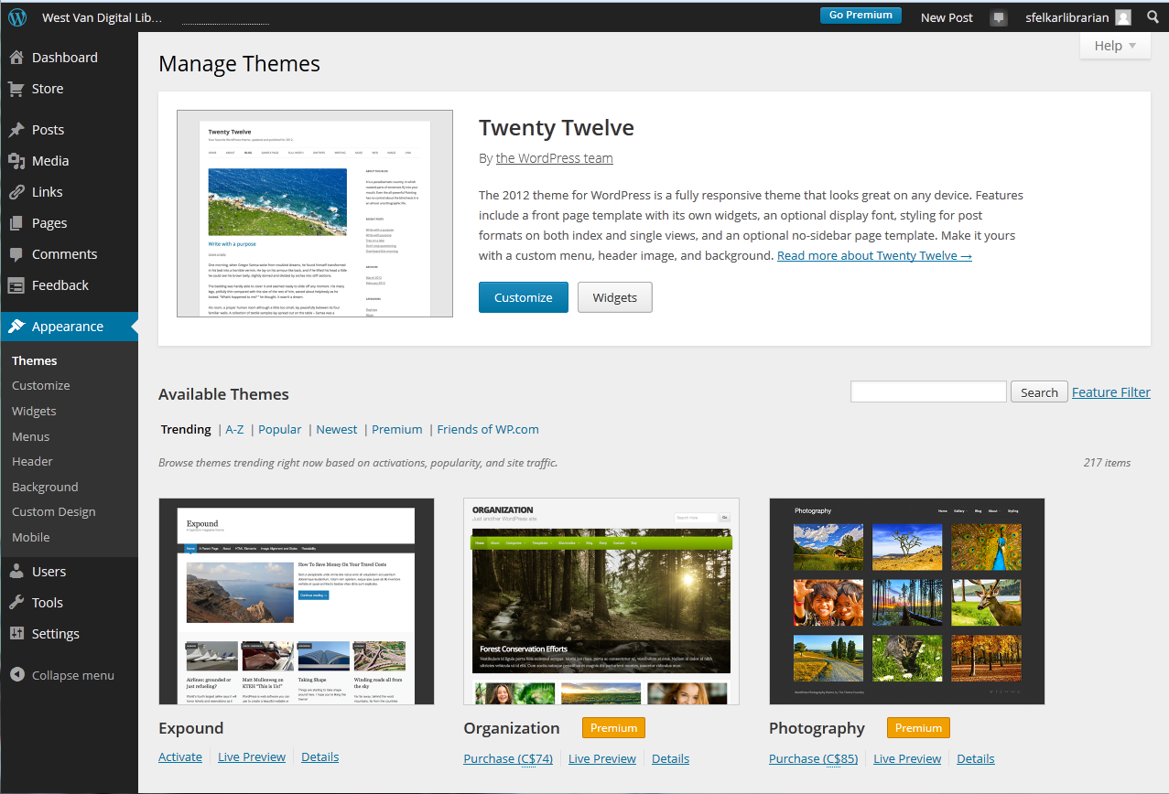

Slide 18
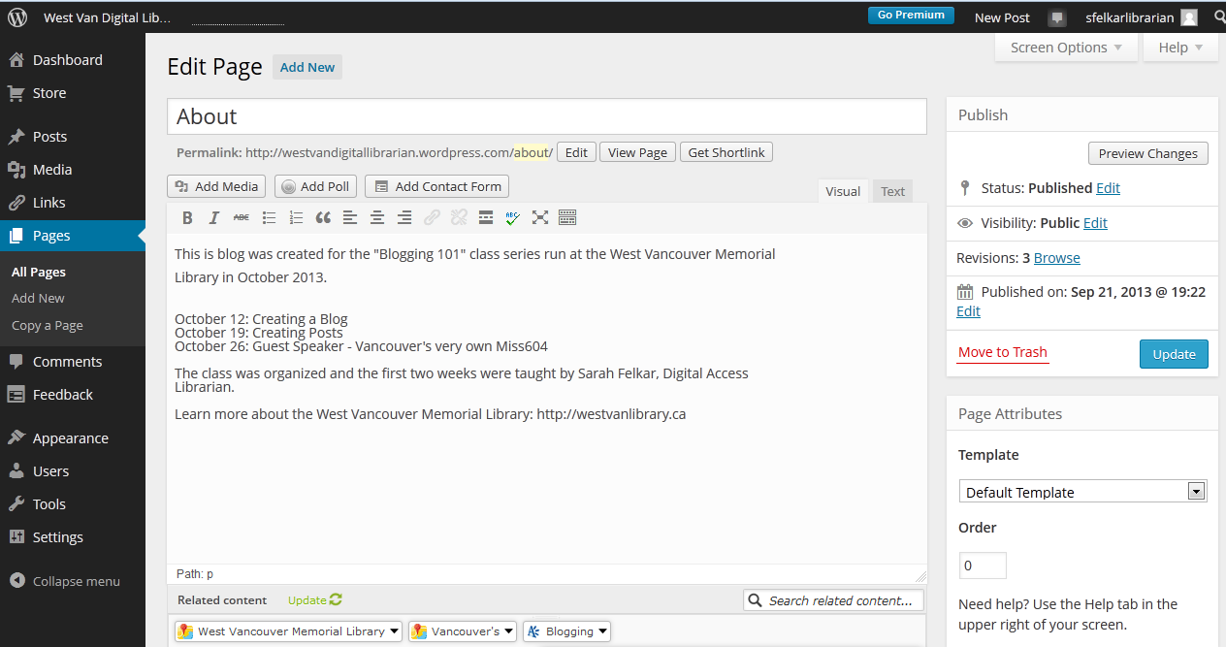

Slide 19
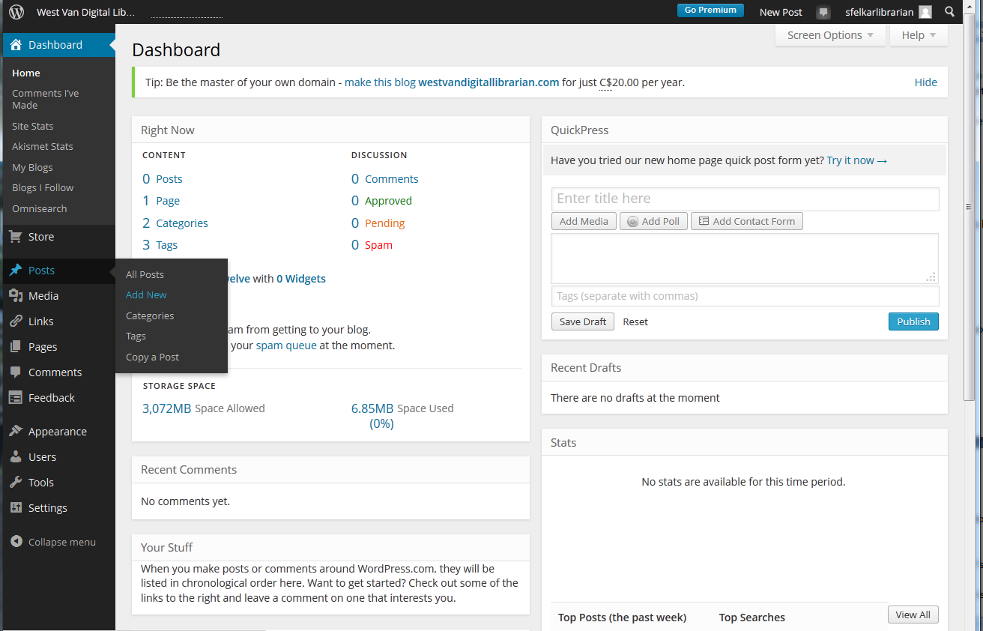
Creating a Post

Slide 20
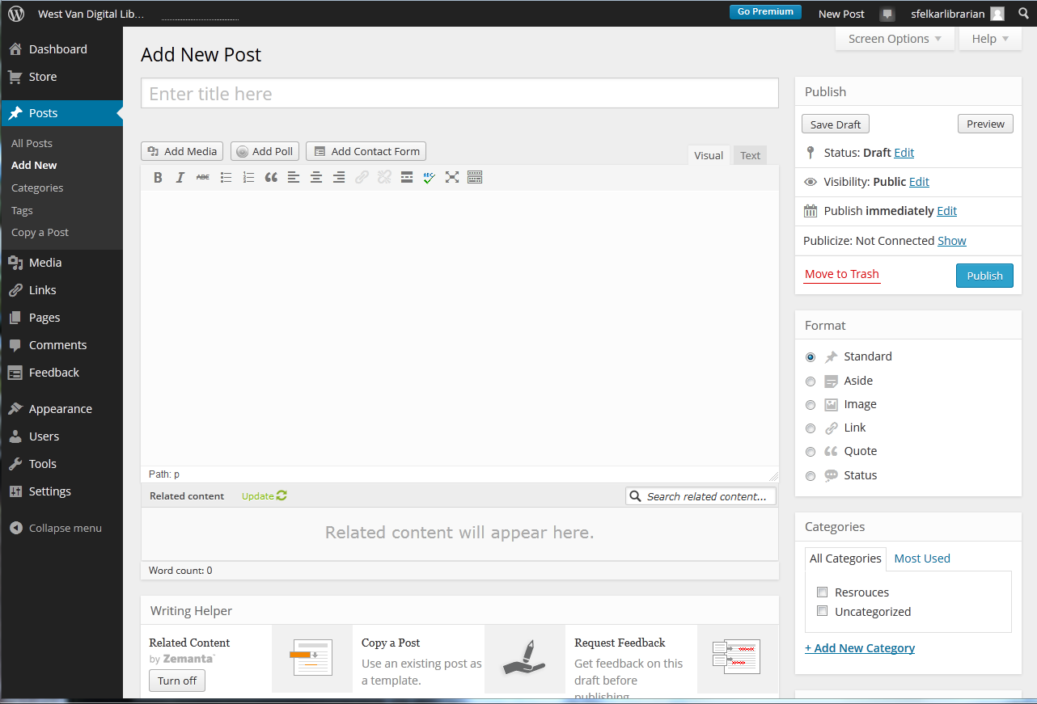
Creating a Post

Slide 21
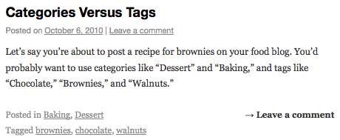
Categories & Tags

Slide 22
Using Images from the Web
When using images from the web
Check copyright
Credit
Article: http://www.techsoup.org/support/articles-and-how-tos/finding-and-using-images-from-the-web

Slide 23
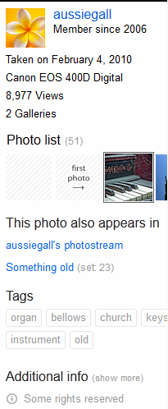
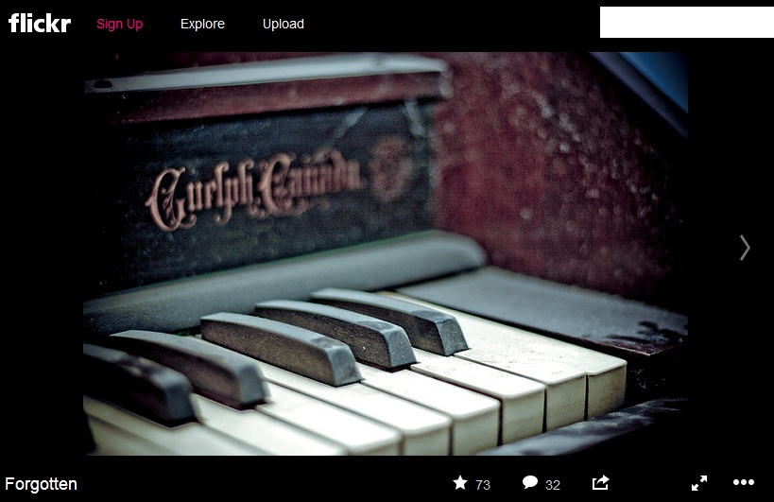
Using Images from the Web

Slide 24
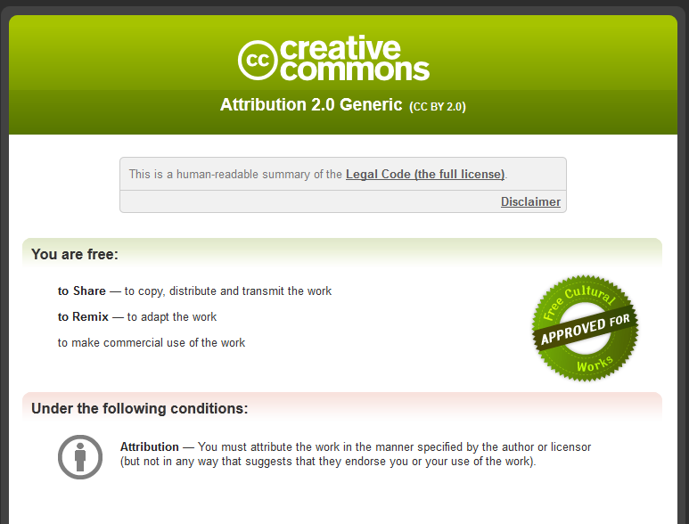
Using Images from the Web

Slide 25
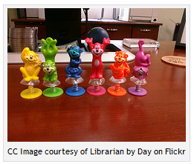
Using Images from the Web
http://librarianbyday.net/2009/09/28/how-to-attribute-a-creative-commons-photo-from-flickr/

Slide 26
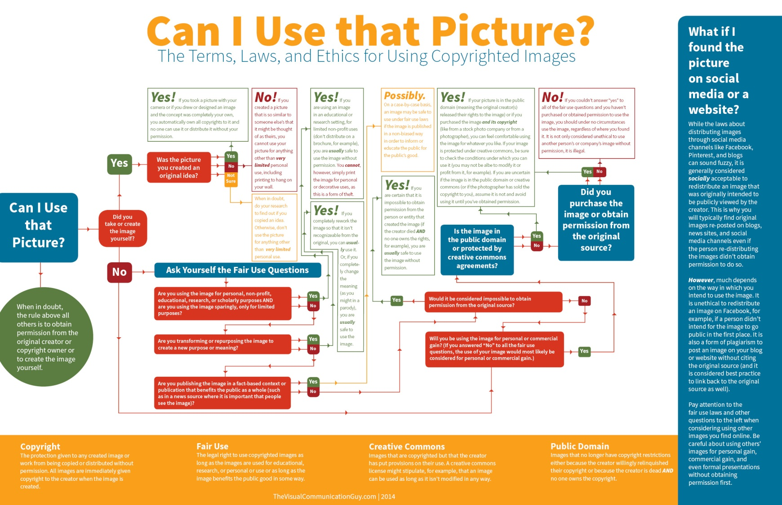
Link: http://www.mediabistro.com/galleycat/files/2014/08/Infographic_CanIUseThatPicture4.jpg
Notes:
Copyright made as simple as possible

Slide 27
Using Images from the Web
visipix
morguefile
iStock Roalty Free Photos
freedigitalphotos.net
Or
Flickr
Creative Commons Search
Freeimages.co.uk
FreePhotosBank
From Old Books
openphoto
PD Photo
stock.XCHNG
stockvault
Unprofound

Slide 28
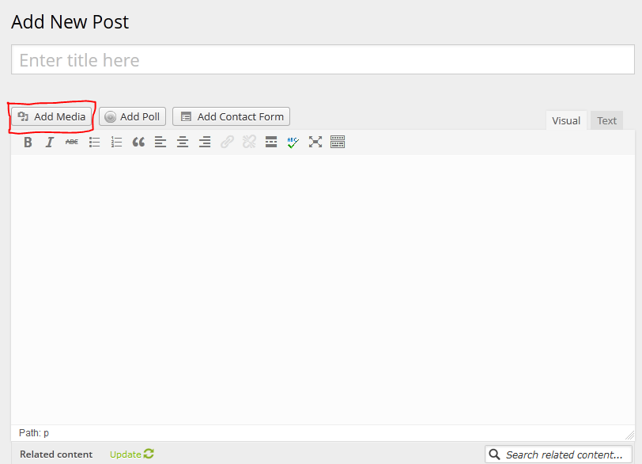
Adding Images

Slide 29
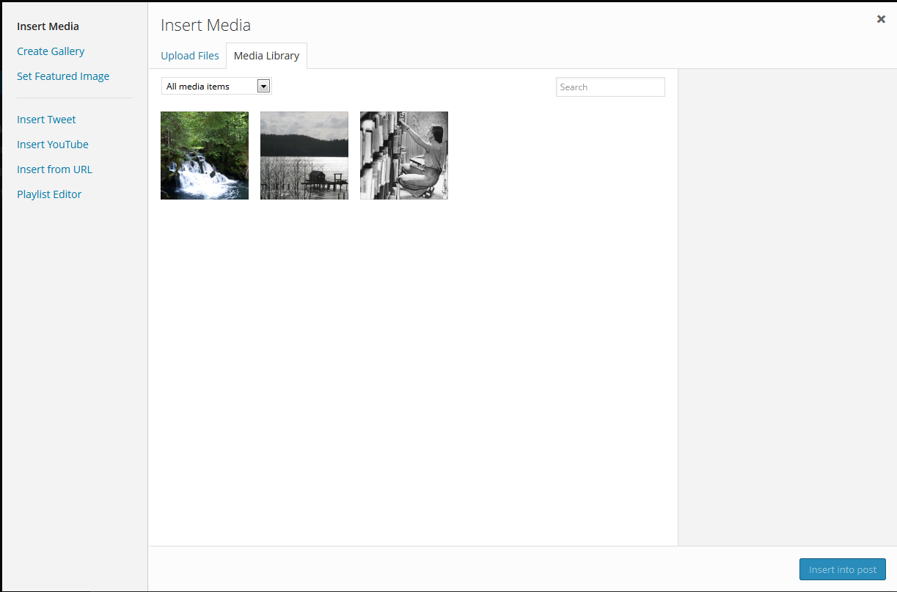
Adding Images

Slide 30
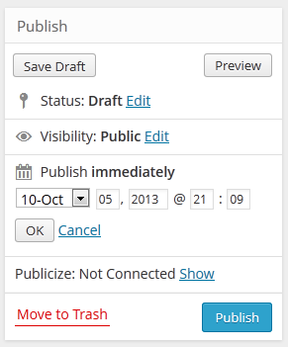
Posting

Slide 31
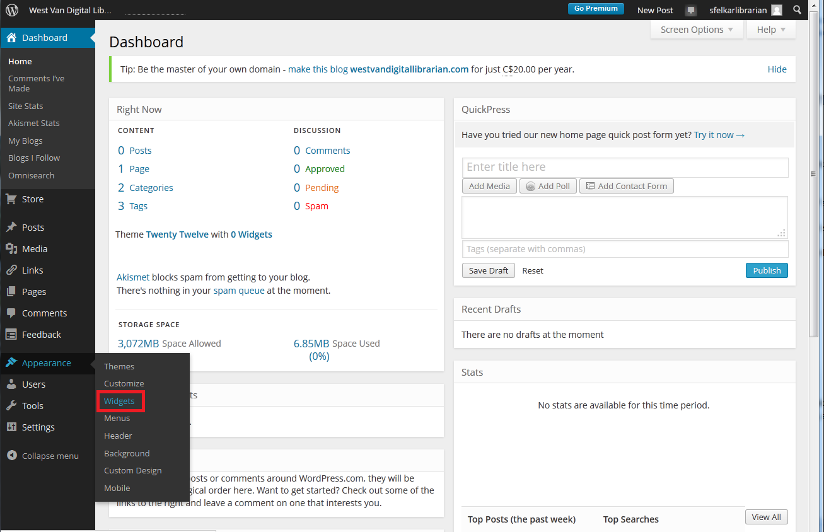
Widgets

Slide 32
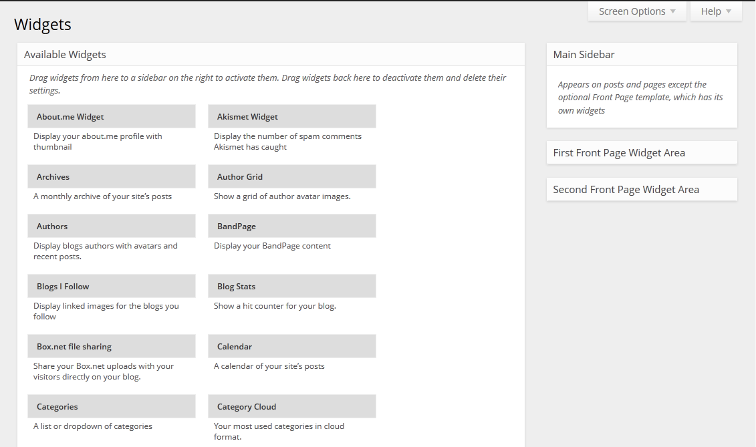
Widgets

Slide 33
Blogging Tips

Slide 34
Thank you!

