Slide 1
KLF-CBAL Workshops Fall 2015 (focus on library services for seniors using iPads)
Presented by Sabina Iseli-Otto, BC Libraries Co-operative

Slide 2
Step 1
Download the app.

Slide 3
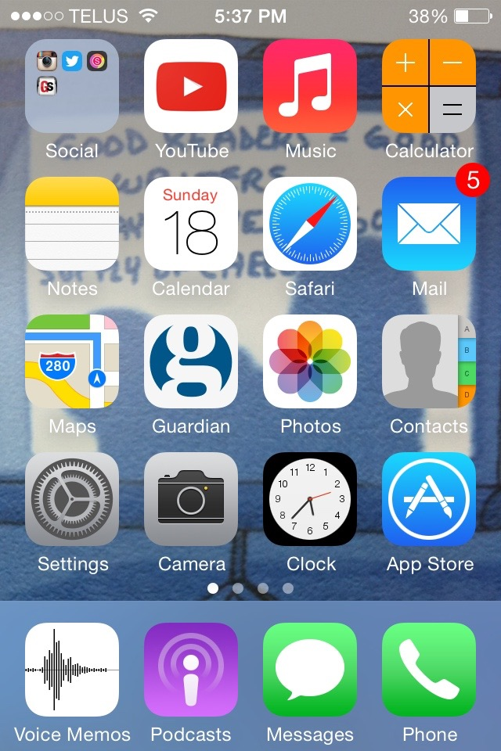

Slide 4
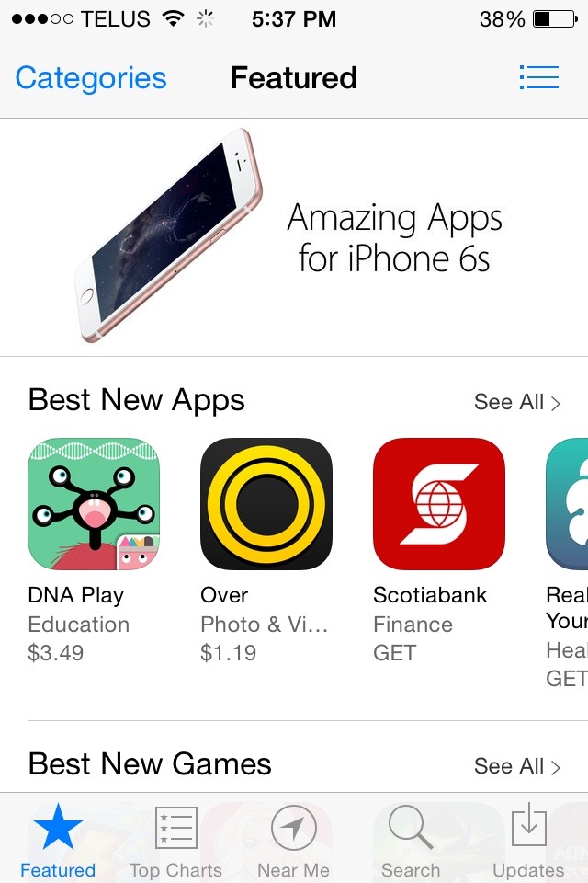

Slide 6
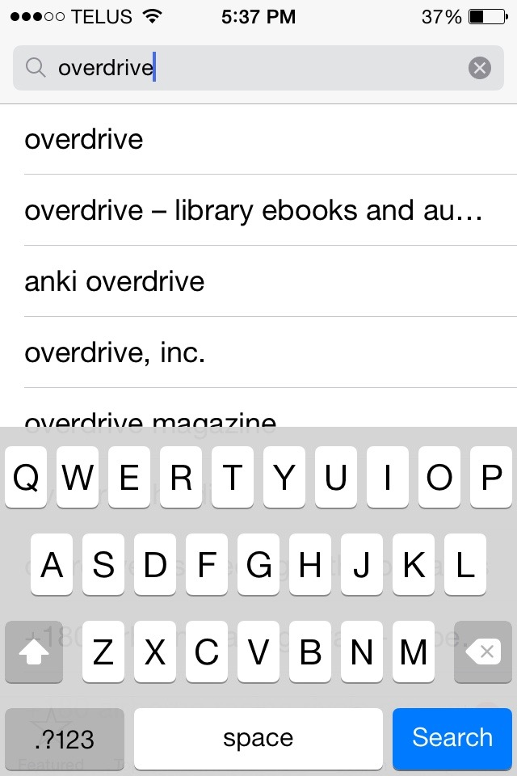

Slide 7
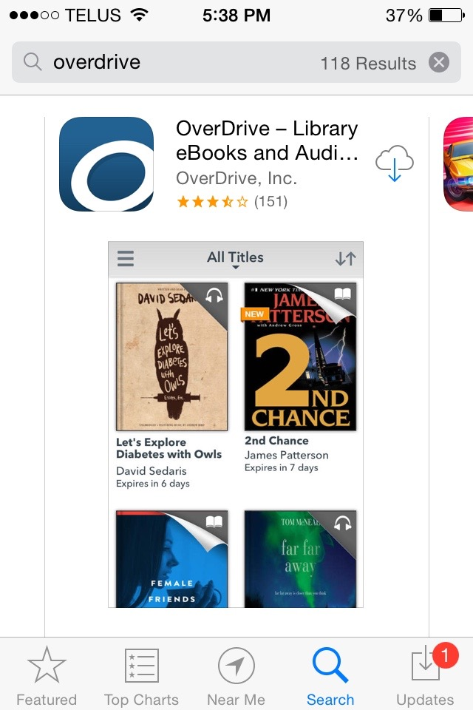
Notes:
This is an example of a “clue”: new users might not know that the cloud and arrow symbol mean “download and install this app.”

Slide 8
Notes:
This is the point at which the device will often ask for the password for the Apple ID. If your patron left her/his password at home, please send them home to retrieve it. This approach causes fewer complications with: iCloud and Apple ID, syncing across devices, and other problems that can popup. It is possible to reset someone’s password, however they must either know the answers to their security questions, or have their email password handy. To reset: go to iforgot.apple.com and follow the links.

Slide 10
Step 2
Create OverDrive account & “authorize” your device.

Slide 11
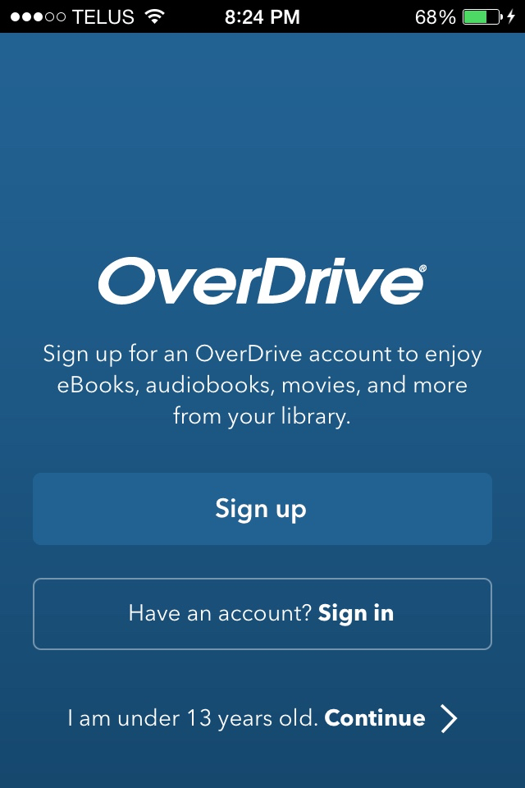

Slide 12
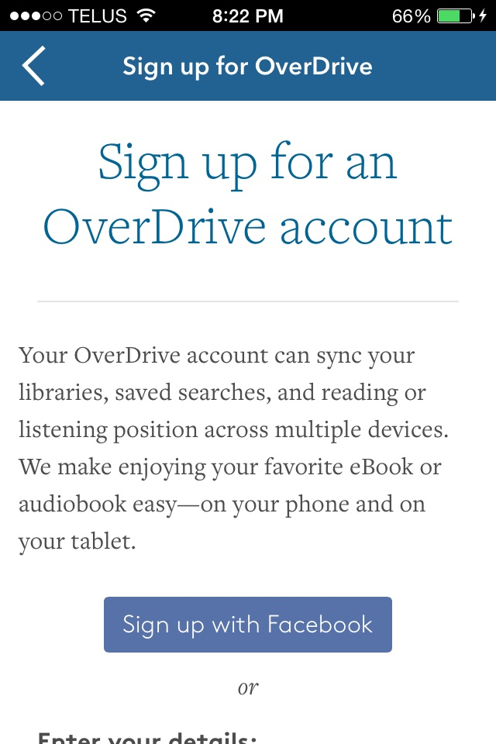
Notes:
Discourage people from signing up for anything library-related (or anything, really) using Facebook.

Slide 13
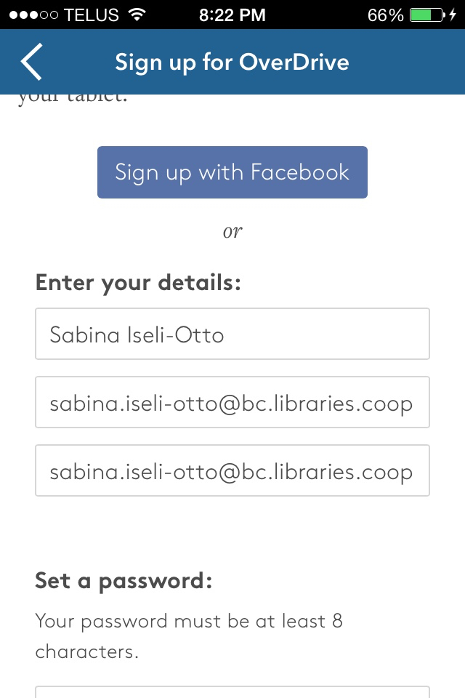

Slide 14
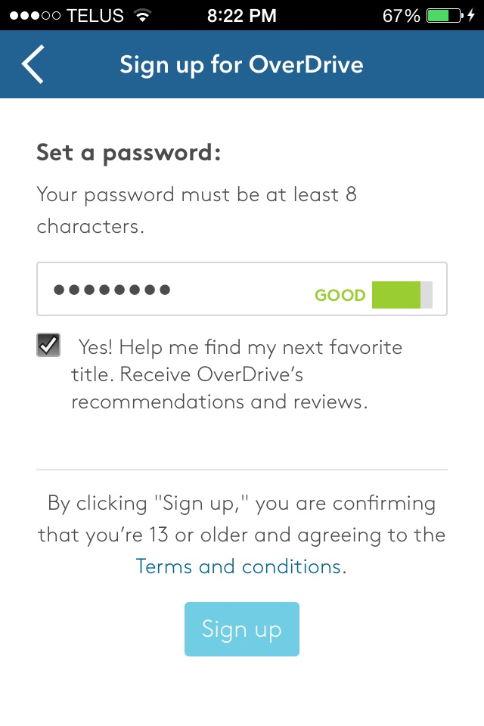

Slide 15
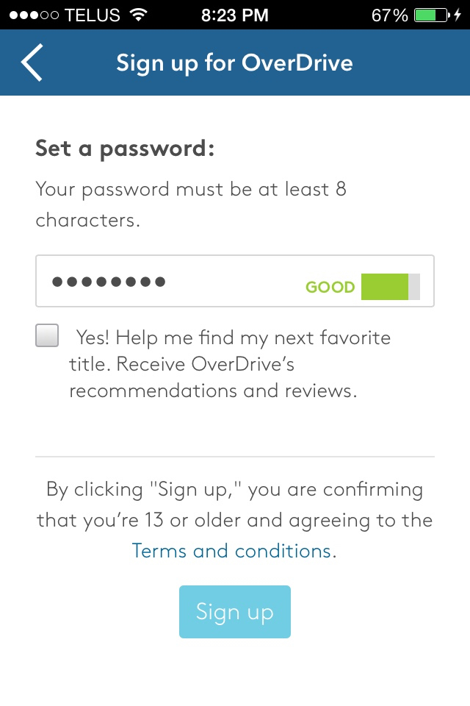

Slide 16
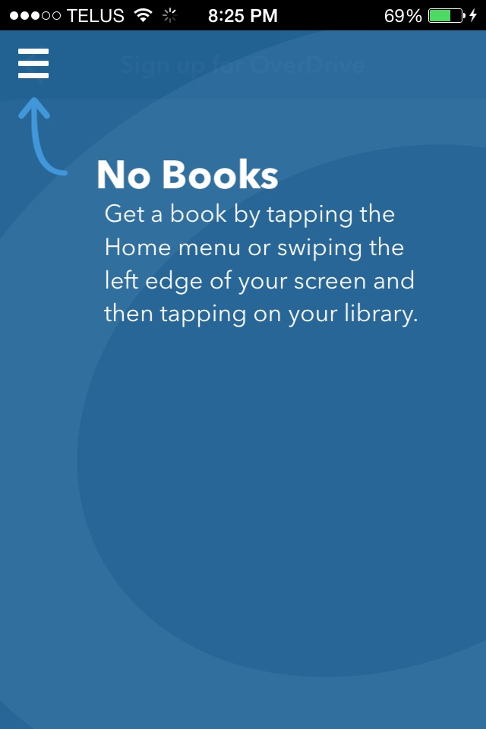

Slide 17
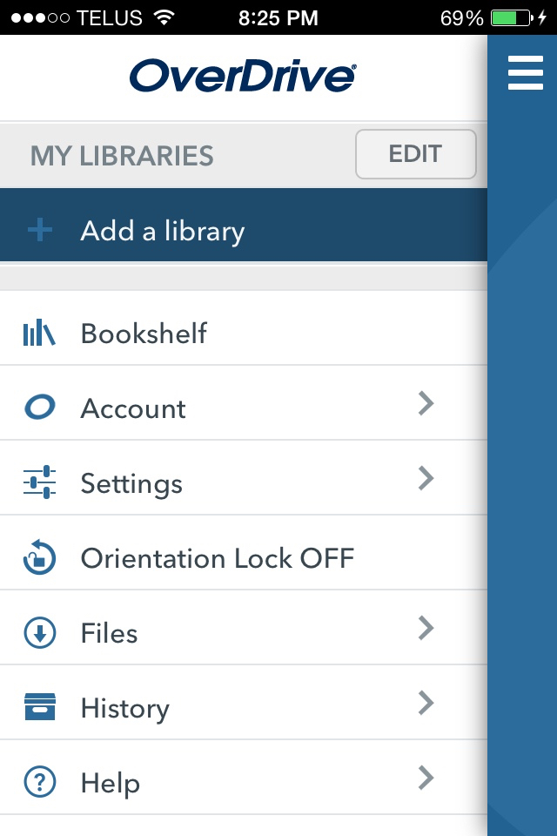

Slide 18
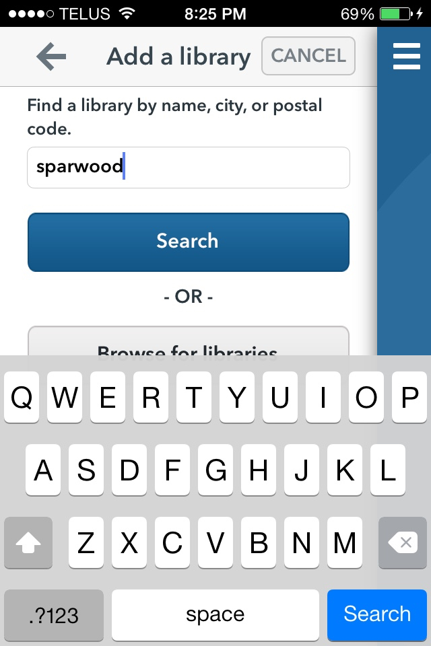

Slide 19
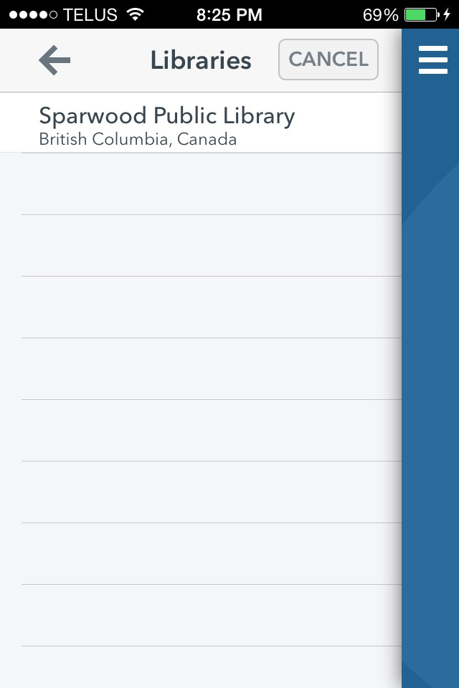

Slide 20
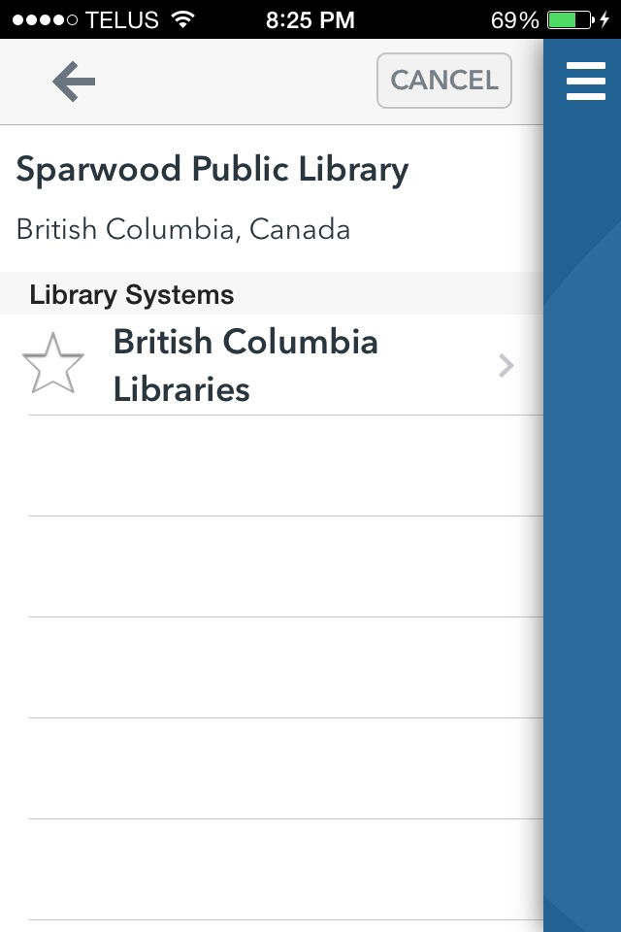

Slide 21
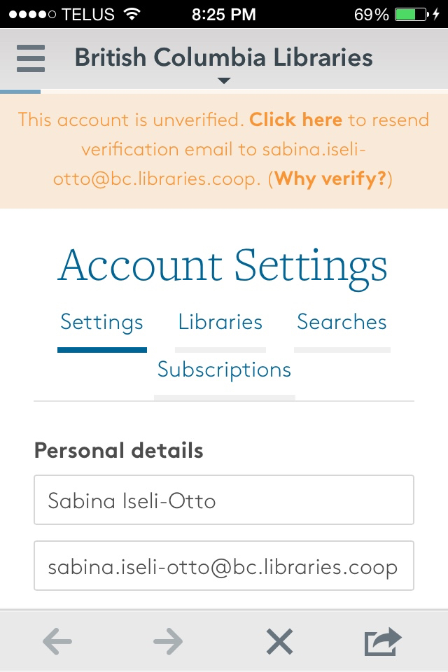

Slide 22
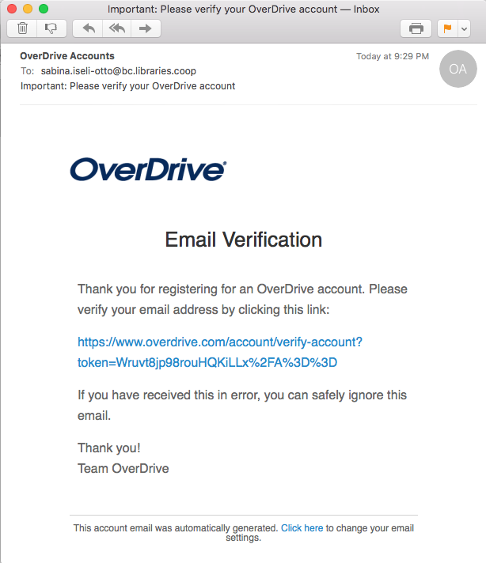

Slide 23
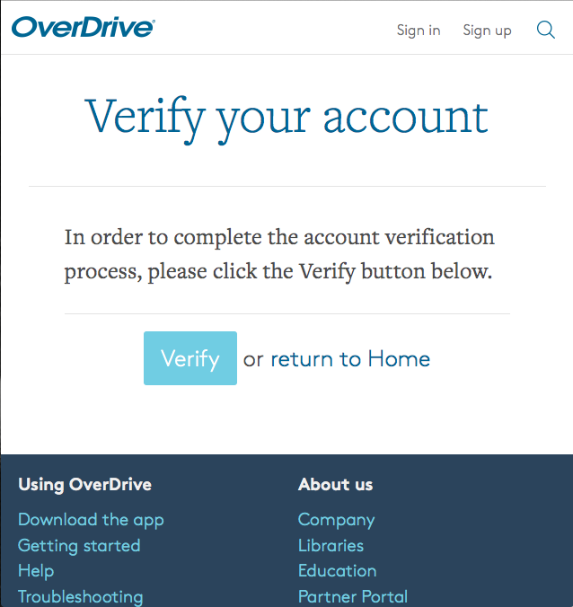

Slide 24
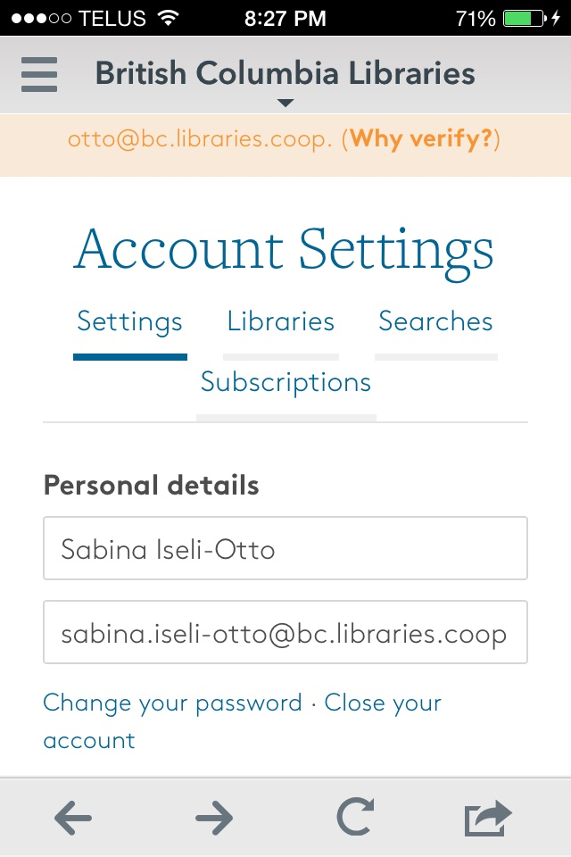
Notes:
The “Why verify?” orange zone disappears once the email account is verified; these screenshots were taken in the wrong order (sorry).

Slide 25
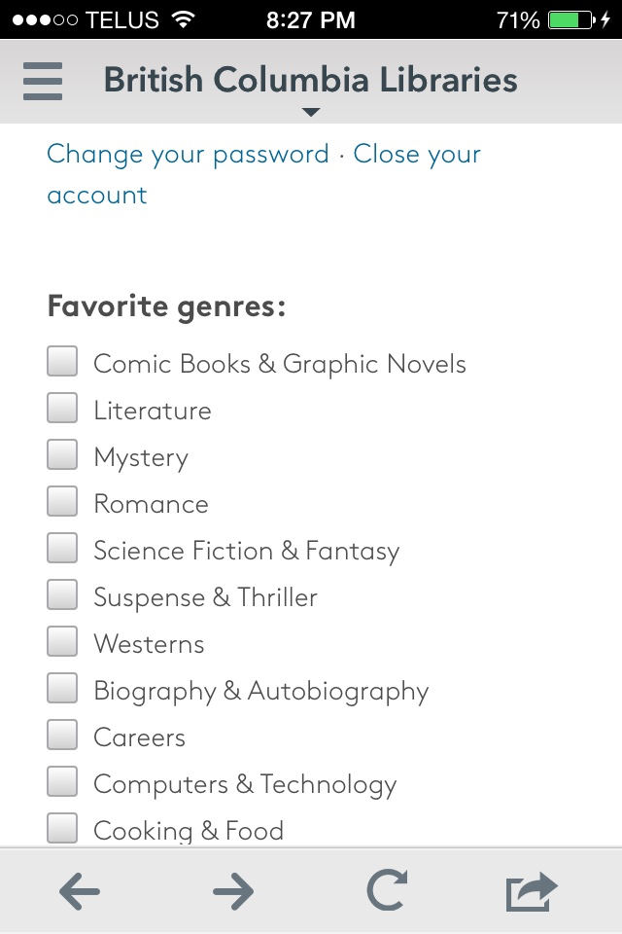

Slide 26
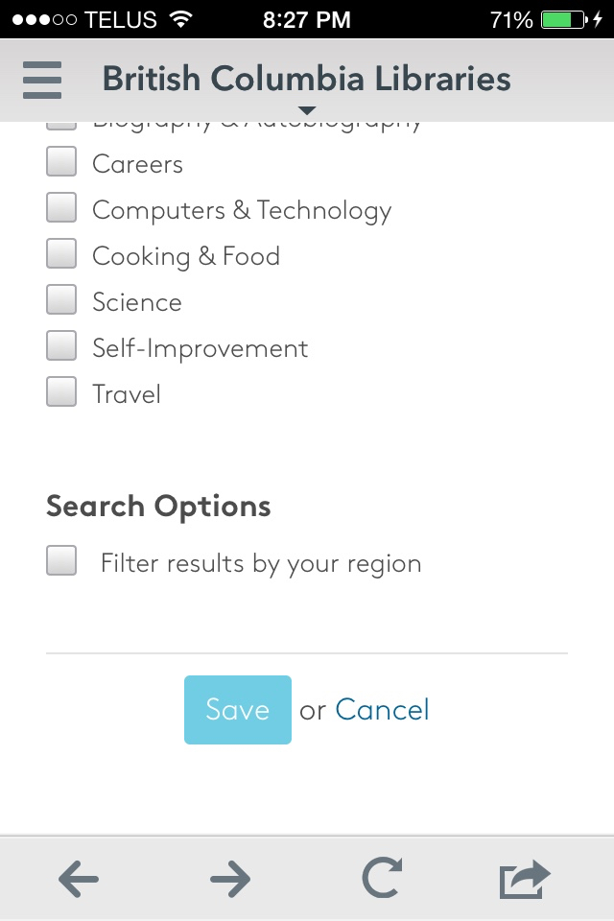

Slide 27
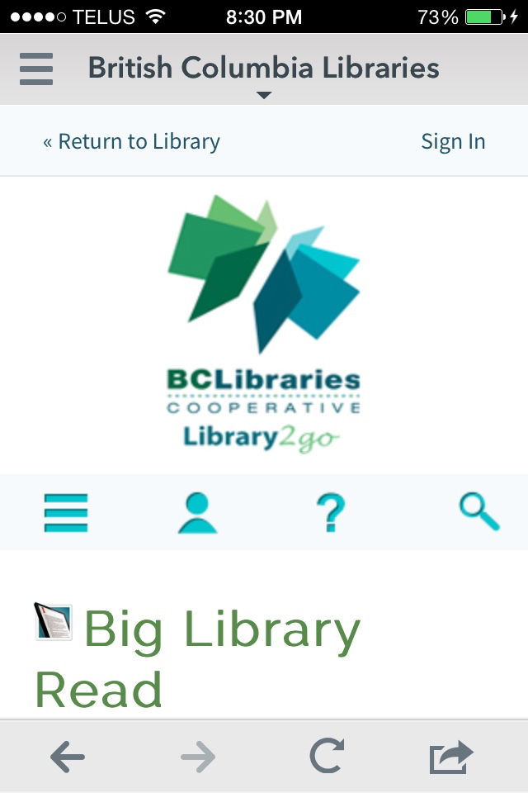

Slide 28
Step 3
Connect your library card.

Slide 30
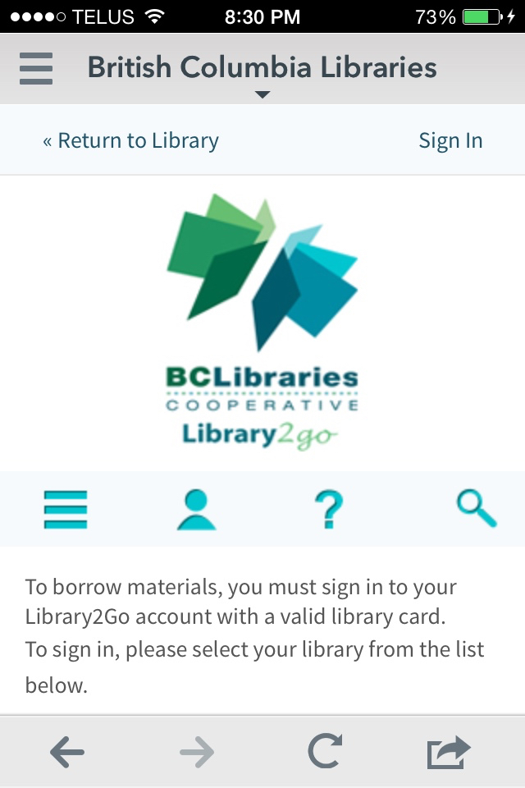

Slide 31
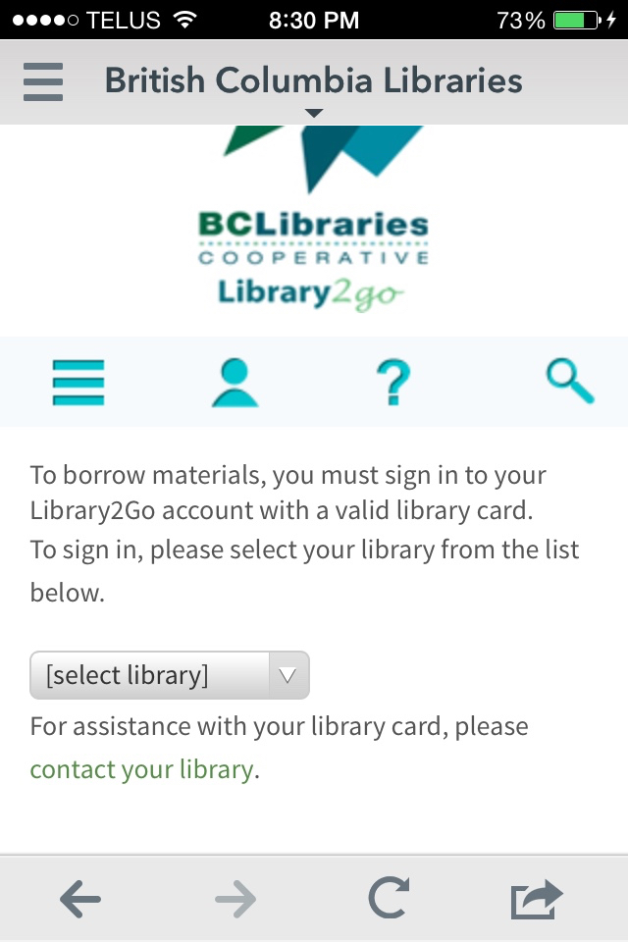

Slide 32
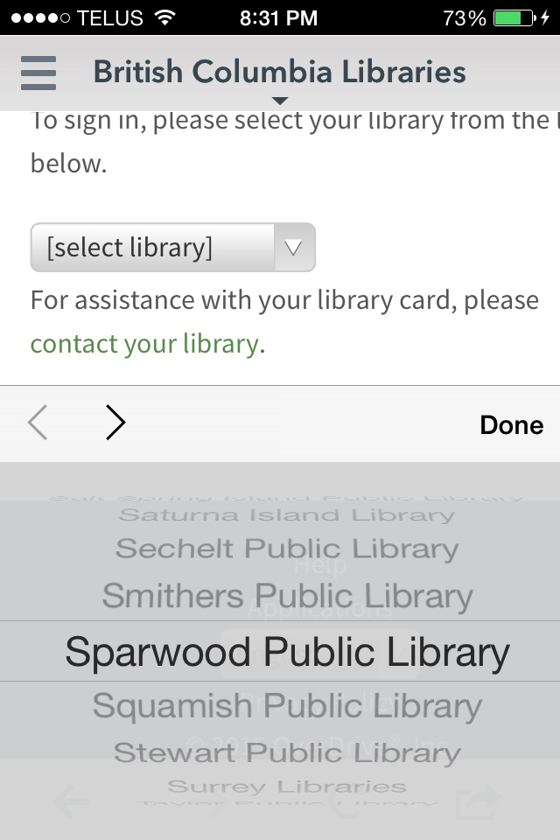

Slide 33
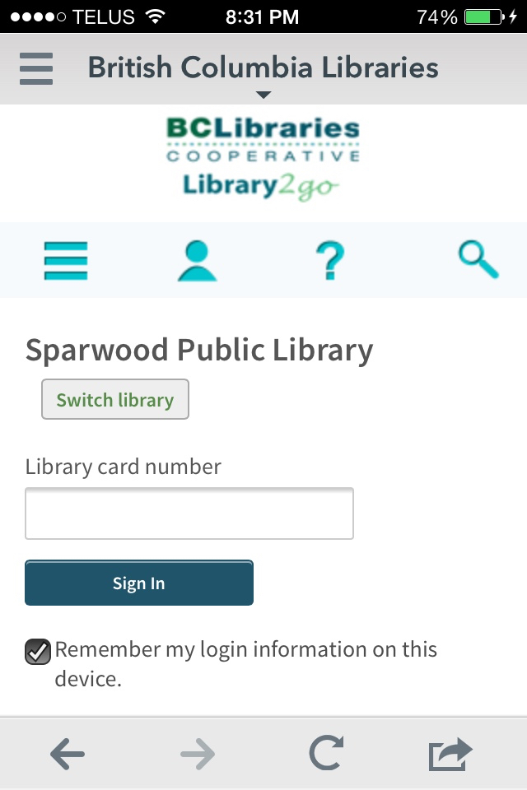

Slide 34
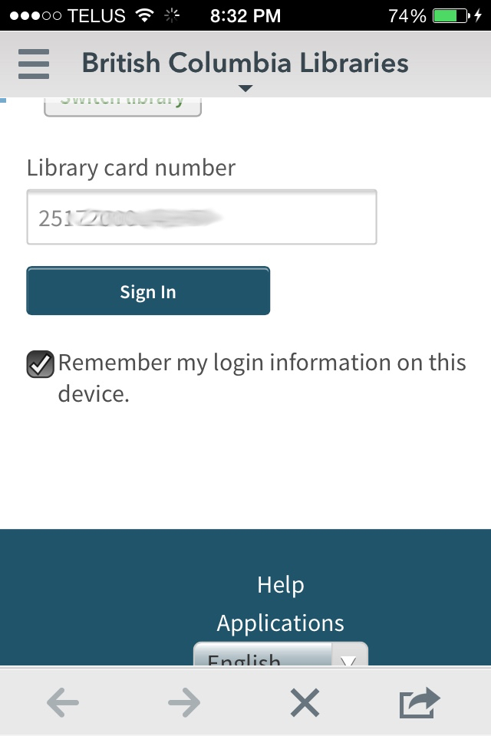

Slide 35
Step 4
Find & download books.
Searching for books can be done on the device, but this task is often easier with a larger screen and proper keyboard.

Slide 37
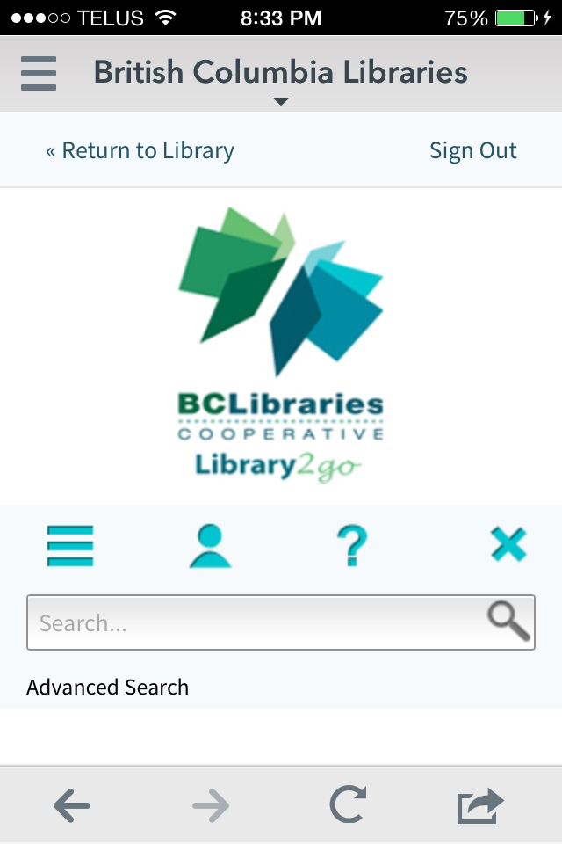

Slide 38
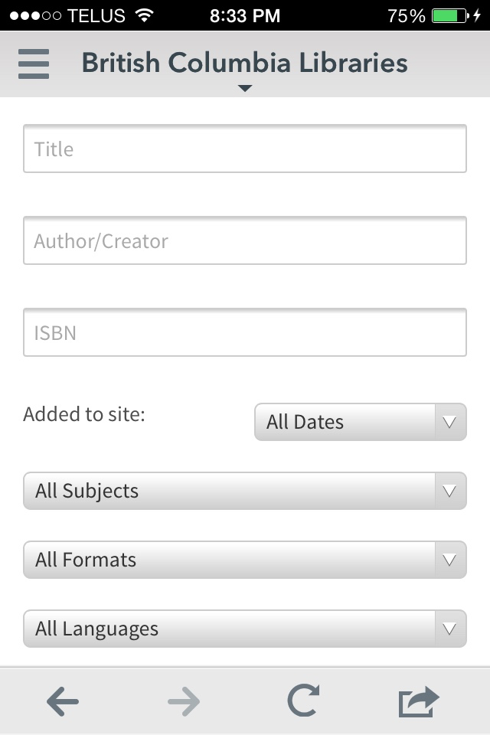

Slide 39
Formats in Advanced Search
All eBooks
All Audiobooks
eBook Formats
OverDrive Read: read in browser; doesn’t require app or Adobe Digital Ed. Most devices can read offline by going to OverDrive Read menu and selecting “offline access” and then the cloud icon to cache (download) the ebook. (~
EPUB eBook: if you don’t need page numbers; enlarging text wraps lines to screen. (~15,850 titles)
Open EPUB eBook: as above but compatible with more devices (~150 titles)
PDF eBook: if you need page numbers; enlarging text does not wrap lines to screen. (~11,200 titles)
Open PDF eBook: as above, but compatible with more devices. (~100 titles)
Audiobook Formats
OverDrive Listen: streaming through browser; requires internet connection but no app or Adobe Digital Editions.
OverDrive MP3 Audiobook: can download; can burn to CD.

Slide 40
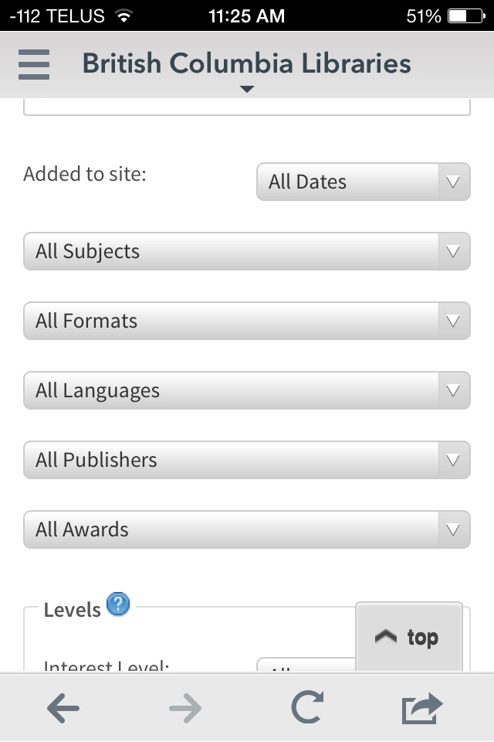

Slide 41
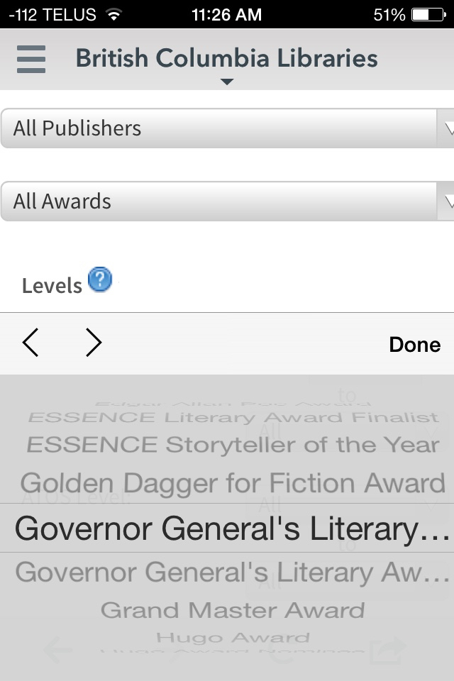

Slide 42
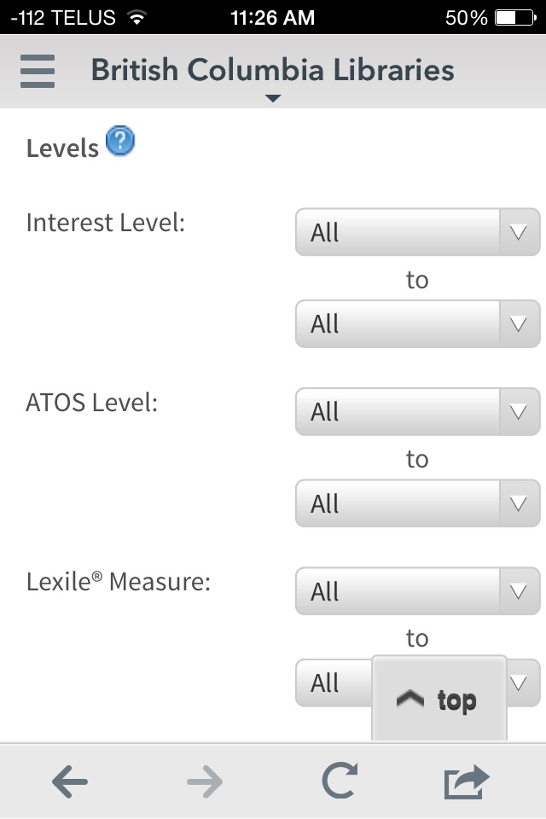

Slide 43
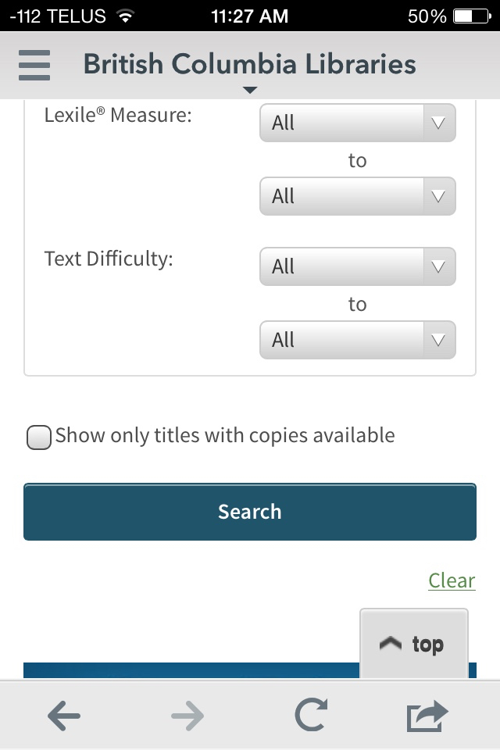

Slide 44
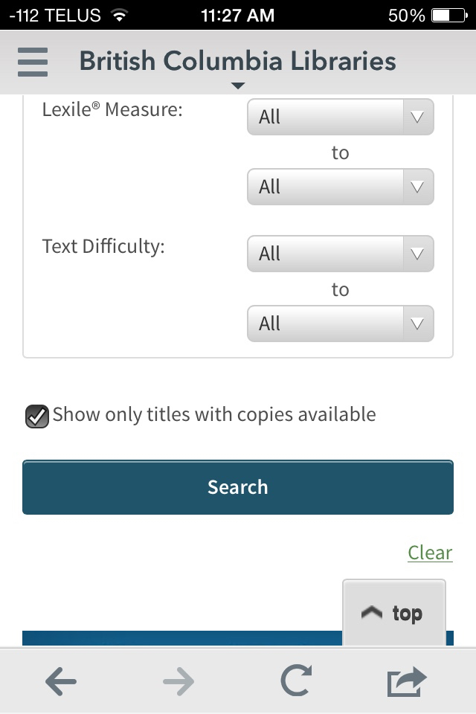

Slide 45
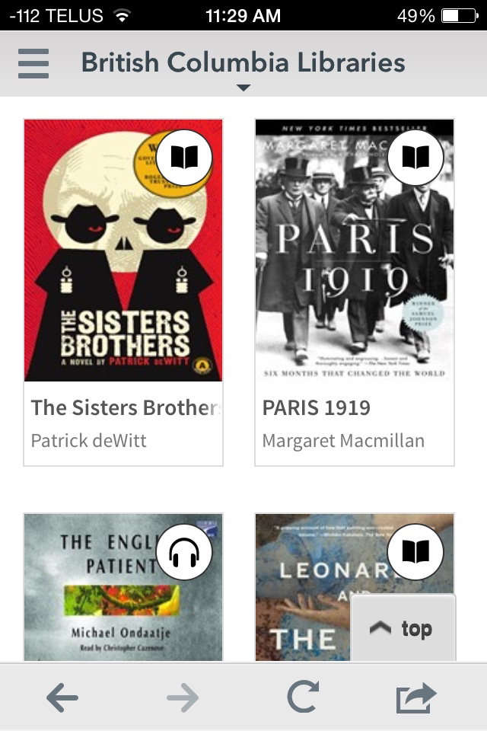
e-book
audiobook

Slide 46
Digital Content in Overdrive
Most titles are one copy/one user model.
Unlimited simultaneous use:
Public domain "Always available ebooks”
Blackstone audiobooks - 25 of ‘em
Metered access:
HarperCollins: titles expire after 26 checkouts.
Macmillan: titles expire after 52 checkouts or 24 months.

Slide 47
Dear readers,
Please sample Overdrive e-books and audiobooks before borrowing them. All books in Overdrive have a “sample” option.
Yours truly,
Libraries.
Notes:
Also, for training and demo purposes: email sabina.iseli-otto@bc.libraries.coop for a list of the 25 Blackstone audiobooks that allow unlimited simultaneous check-outs.

Slide 48
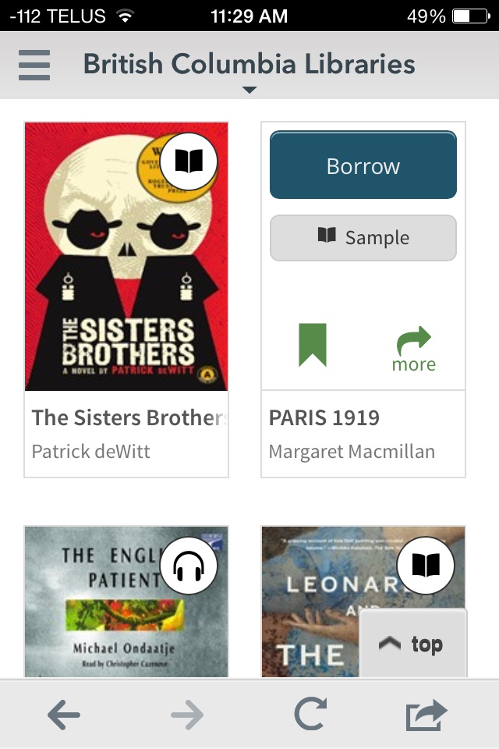

Slide 49
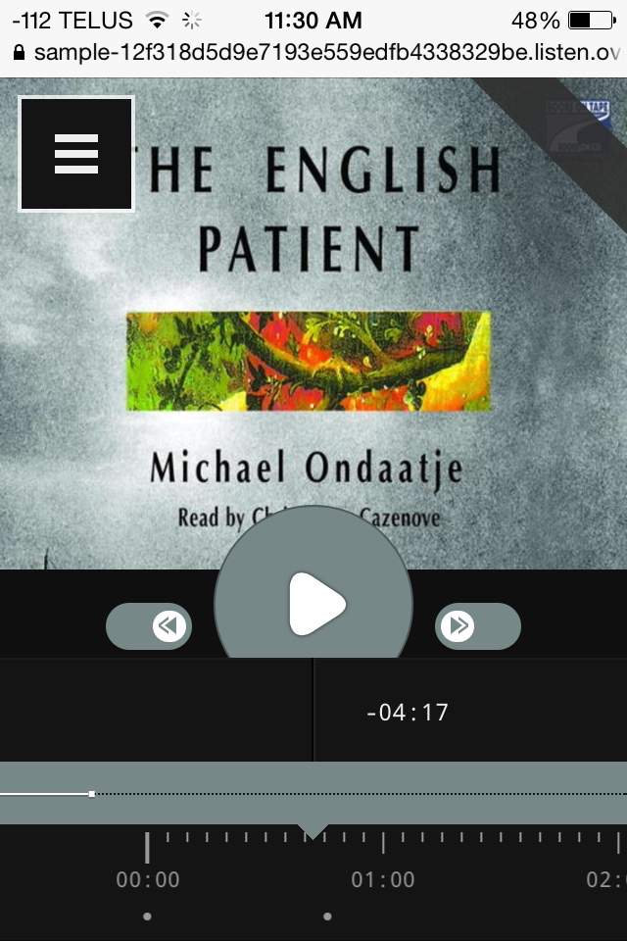
Tap play to sample

Slide 50
Finding App Settings
These are different from the Device Settings.
Inconveniently, both are called “Settings”.

Slide 52
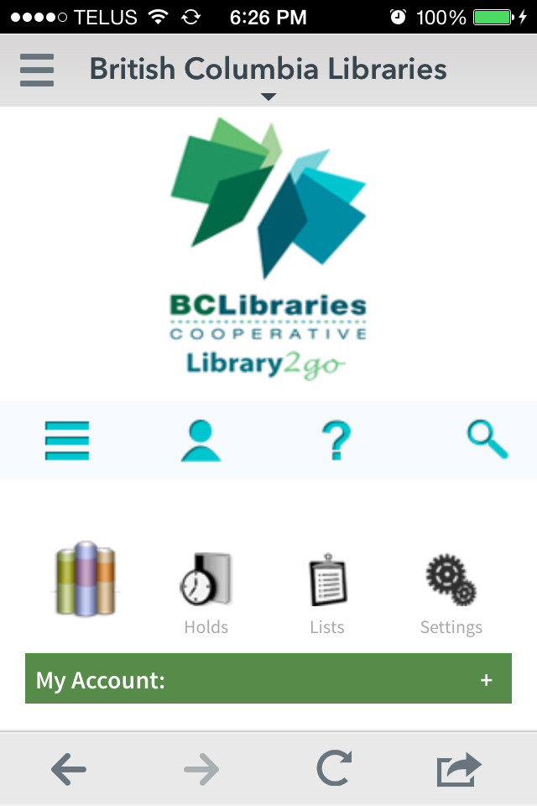

Slide 53
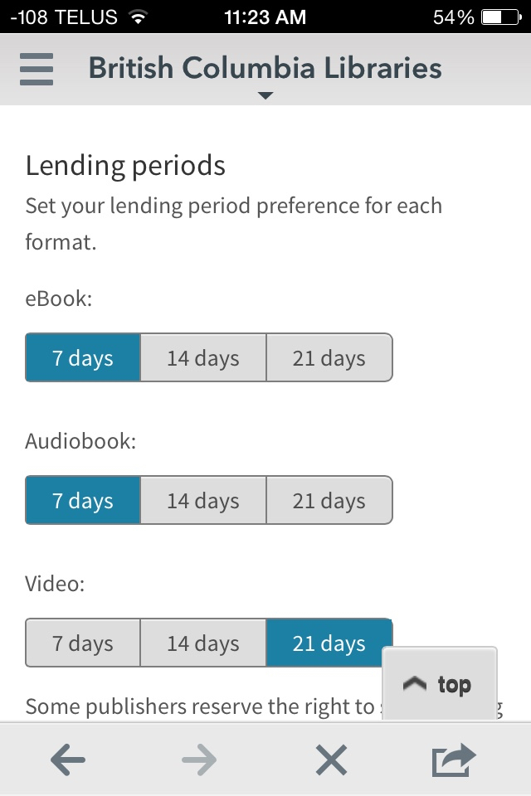

Slide 54
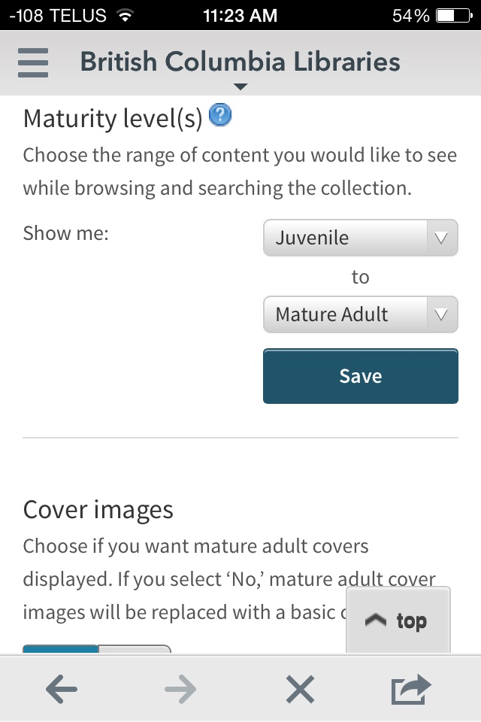

Slide 55
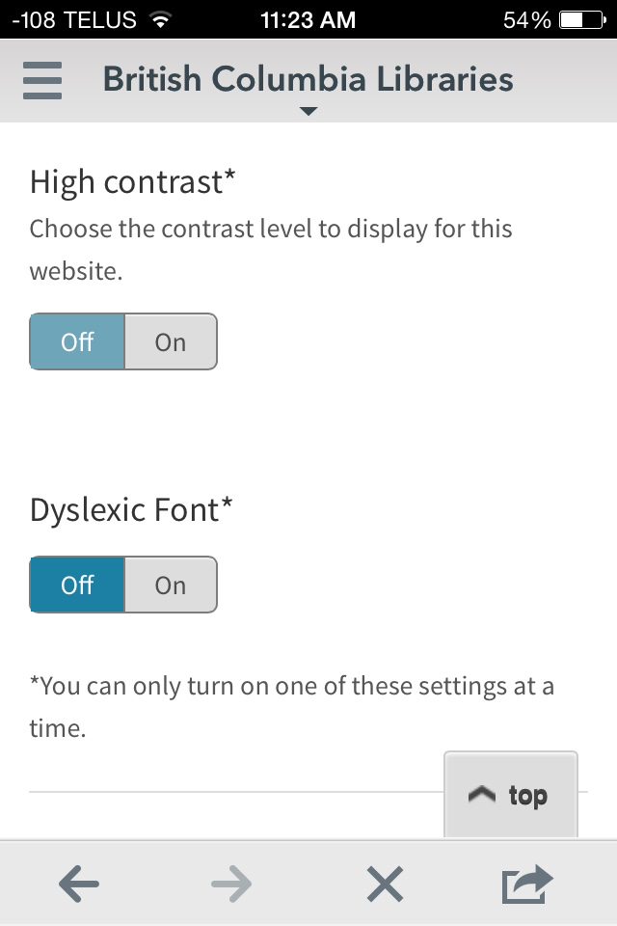

Slide 56
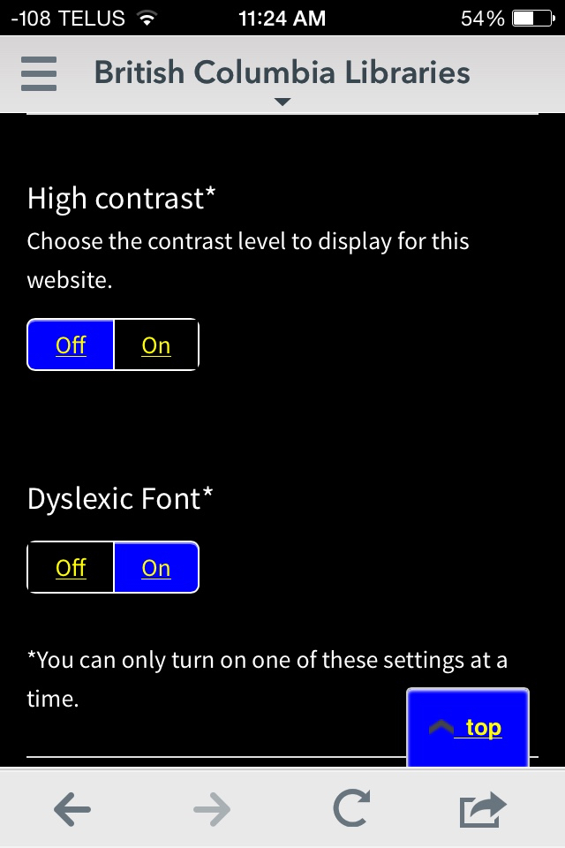

Slide 57
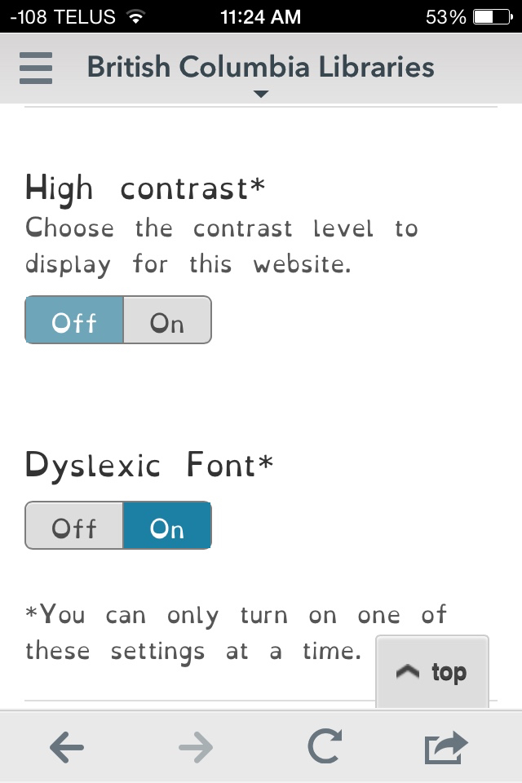

Slide 58
If you did your searching and checking out from a computer, the following slides will help you download the books from the “bookshelf” in the sky to the “bookshelf” on your device.

Slide 59
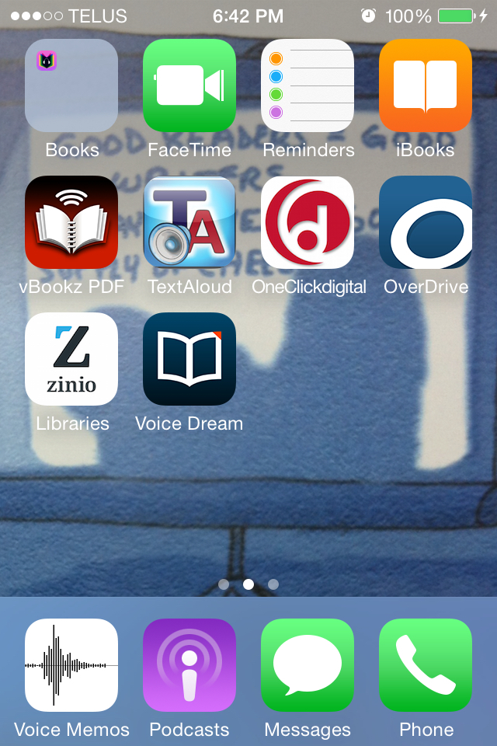

Slide 61
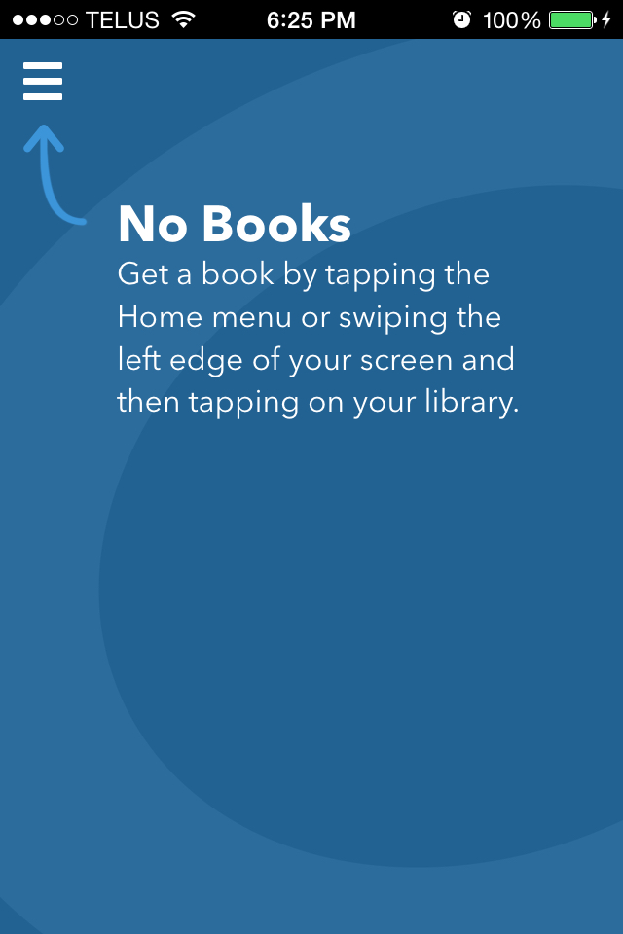

Slide 62
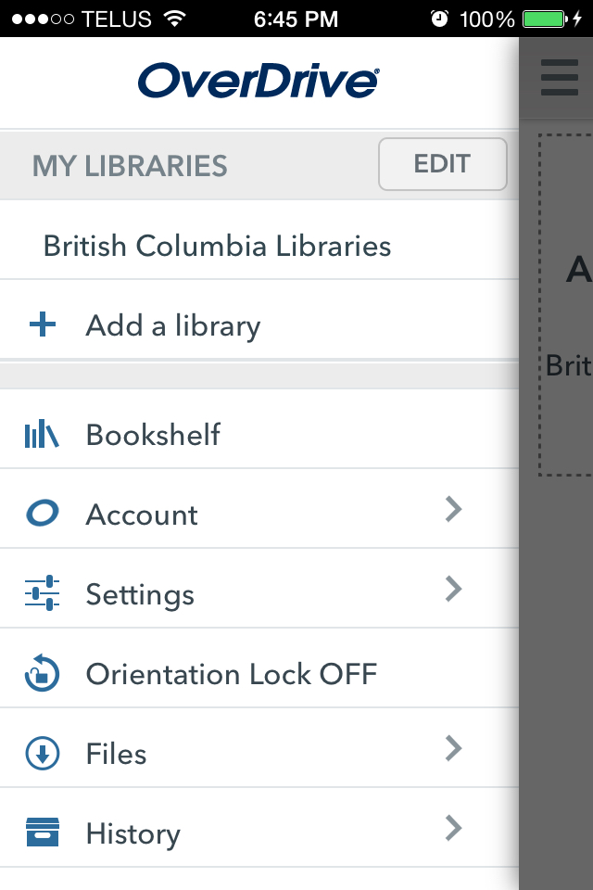

Slide 63
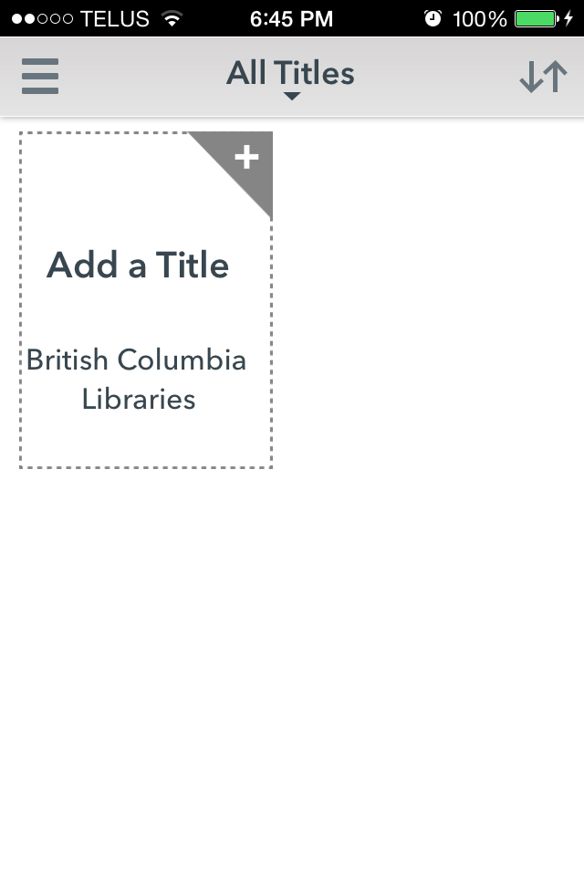

Slide 64
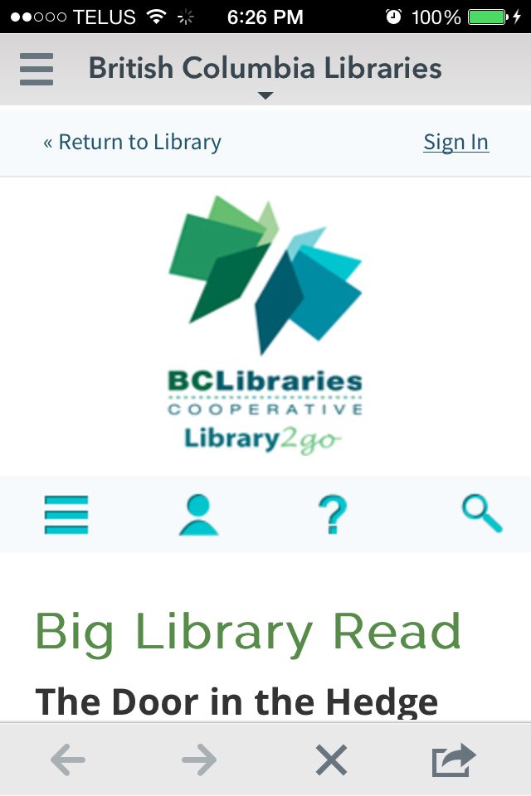

Slide 65
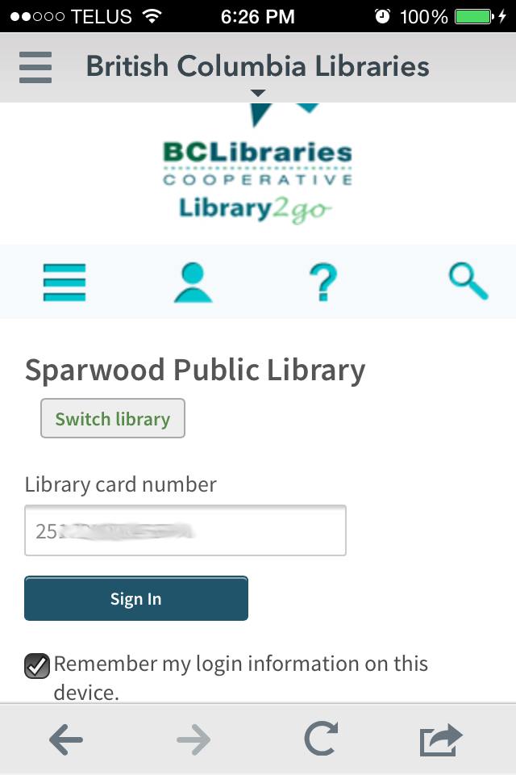

Slide 66
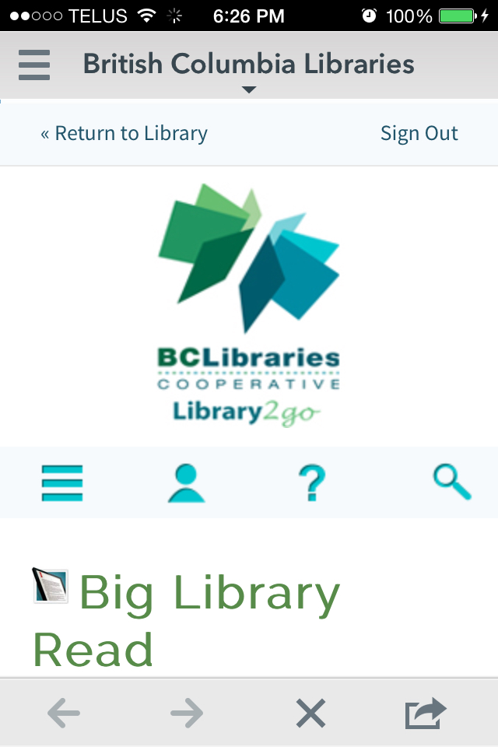

Slide 68
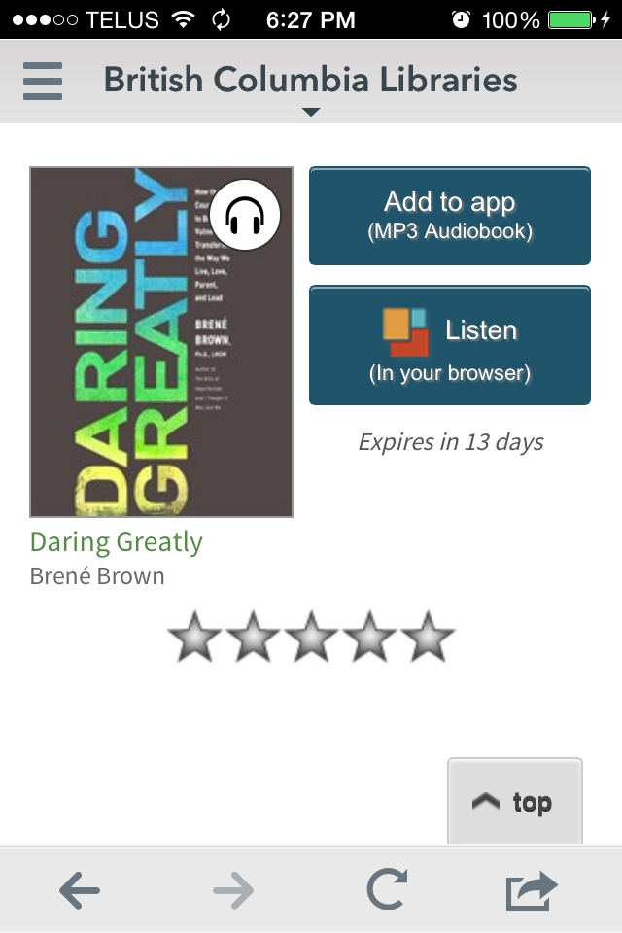

Slide 72
Device Settings
Once again, the reminder: these are different from the App Settings.

Slide 75
On Apple devices, you can also control which apps can use cellular data by going to Settings > Cellular, and then scrolling down to the list of apps.

Slide 78
Finally:
it’s time to read a book.

Slide 80
This image shows tutorials turned on in the app settings.

Slide 85
When You’re Done:
“Return” the book.
“Delete” is not “return”.

Slide 86
Press and
hold to see return options.

Slide 88
Extra Info for Staff
help.overdrive.com is actually helpful.
marketplace.overdrive.com allows you to reset downloads, collect statistics, and contact Overdrive help directly.

Slide 89
Happy reading!

Slide 90
Fun with Tech (and Reading)
Brought to you by :
BC Libraries Cooperative
Columbia Basin Alliance for Literacy
Kootenay Library Federation
Slides created by Sabina Iseli-Otto (support@nnels.ca), October 2015. No copyright on these contents, so please feel welcome to modify and share as you wish.
This project is funded by the Government of Canada’s New Horizons for Seniors Program.

