Slide 1
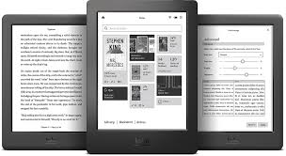
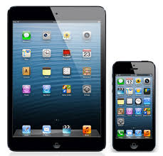
Helping patrons get the most out of eLibraries Manitoba!

Slide 2
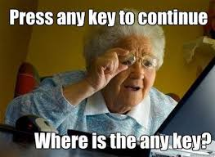
What are patrons looking for? Common Questions:
What device should I buy?
How do I log into eLibraries Manitoba?
How do I find a book and how many can I check out?
How do I get those books from my computer to my e-reader?
How do I download books on my iPad or tablet?
How do I deal with error messages or service interruptions?

Slide 3
How can we help?
Know the differences between devices
Become familiar with the eLM website and policies
Provide “how to” guides, including links on library websites & social media platforms
Offer one-on-one support by appointment
Train staff on the basics and provide handouts to patrons
Follow up with patrons who have asked for help
Instill confidence in patrons – you really can’t “break” your iPad!
Notify patrons when sites are down

Slide 4
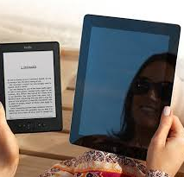
“What Should I Buy: E-Reader or Tablet?”
The differences between an e-reader (Kobo, Sony) and a tablet (iPad, Samsung Galaxy) are price and function. An e-reader is strictly for reading and is less expensive. A tablet is more like a portable computer and allows you to surf the internet, check e-mail and social media, watch movies and use apps.

Slide 5
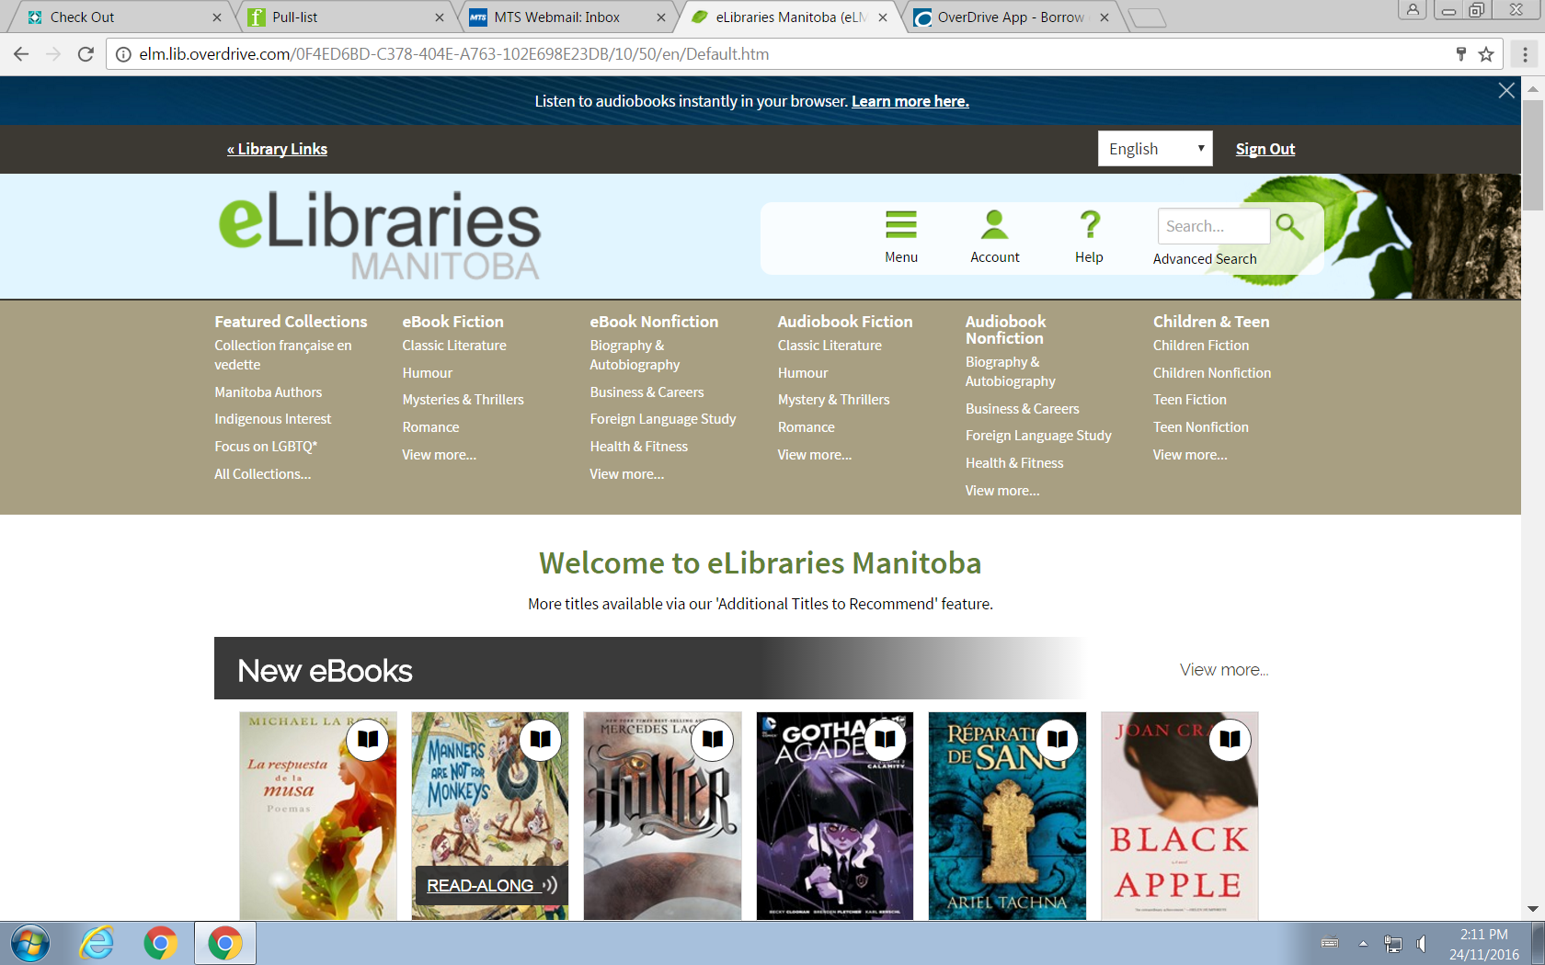
How do I borrow books from eLibraries?
eLibraries Manitoba offers books in two ways:
If you are using an e-reader, (Kobo),you must download them onto your computer first, then transfer them to your Kobo using Adobe Digital Editions and the USB cable that came with your device.
If you are using a tablet (iPad, Samsung or smartphone), download the Overdrive app, then download books directly on to the tablet and read them from your Bookshelf.

Slide 6
What is Adobe Digital Editions (ADE)?
The transfer of ebooks from computer to Kobo requires software called Adobe Digital Editions (often referred to as ADE)
Patrons will need to download and install this free software on their computer before beginning.
Patrons will need to set up an account with a username and password and authorize their devices (computer and Kobo)

Slide 7
How Do I Authorize my Device?
The first time a patron uses ADE she will have to authorize both her computer and her Kobo. This allows copyrighted material to be transferred onto each device.
To do this, click on “Help” and choose “authorize computer”.
To authorize a Kobo, plug it into the computer. It will show up on the left side as “Kobo”. Click on the Kobo and do the same thing to authorize.

Slide 8
How Do I Log into Elibraries Manitoba?
Patrons will first need to sign in to the site by choosing the “sign in” option in the top right, then finding their library in the dropdown menu.
Once logged in, patrons can browse for books by genres or they perform a search for a specific title in the search bar at the top.

Slide 9
How Do I Download a Book?
Look for books with the open book icon in the top right. Titles with the headphones icon are audio books which cannot be added to a kobo
If a title has the open book icon greyed out, this means that title is already in use by another patron. Clicking on the title will allow patrons to place a hold. They will be notified by email once the title becomes available.
Once a patron has decided on a title, they simply click on it and an option to “borrow” will appear.

Slide 10
How Do I Check Out a Title?
Click on “borrow”, then “go to checkouts”
The next screen is the checkout screen and there are two options: “download” or “read in browser”. To add a book to a Kobo later on, you must choose “download”. “Read in browser” limits reading to the computer only and requires an internet connection.
Click “download” and then click on the file in the bottom left corner. The book will automatically open in ADE

Slide 11
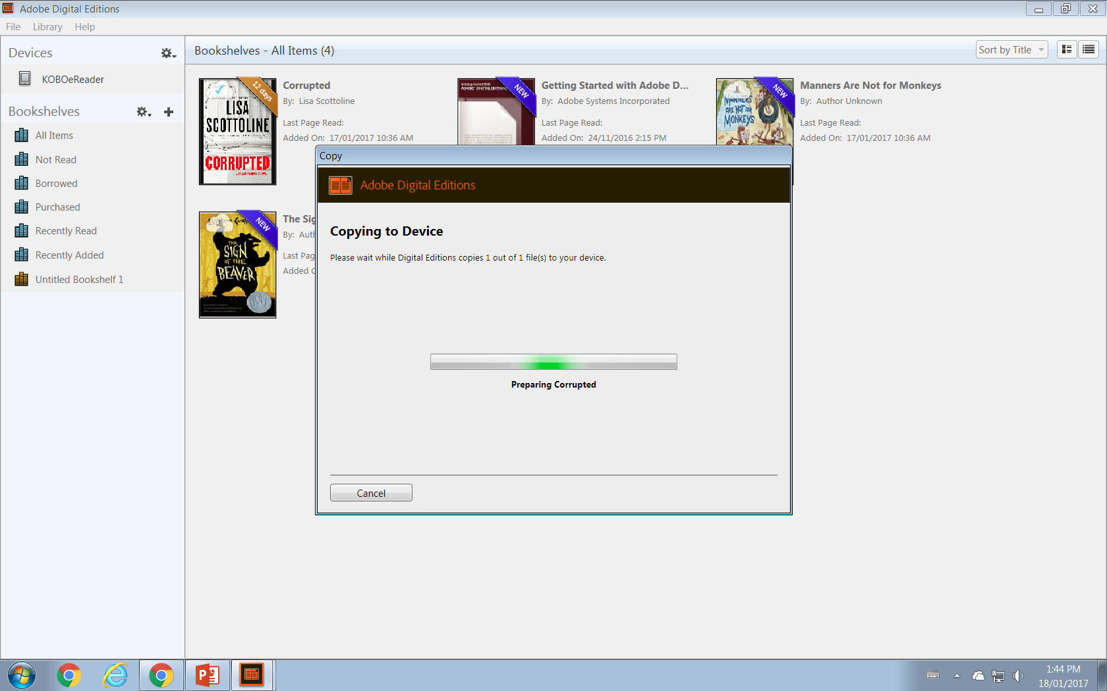
How Do I Get those books from computer to Kobo?
Once the Kobo is plugged into the computer, click “connect” on the Kobo and it will show up as a device in the left column
You will see the book(s) that were downloaded from eLibraries in the main library of ADE
Simply click on the book that you want to transfer and drag it into the Kobo until you see a green + sign. Let go and the book will copy to the device

Slide 12
How Do I Return a Book?
One of the biggest advantages of electronic borrowing is no overdue books! The title simply disappears from the patron’s device once the due date arrives.
Patrons can return titles by simply opening them in the library view, right clicking on the title and choosing “return”.

Slide 13
iPads, iPhones & Android Tablets
The advantage of mobile devices is that patrons can browse, download and read all in one place.
To use eLibraries on a mobile device, patrons must first download the free OverDrive app in the App Store or Google Play Store.
Patrons will be asked to create an OverDrive account. This is separate from their eLibrary account and provides reading recommendations and allows patrons to read on multiple devices and not lose their page!

Slide 14
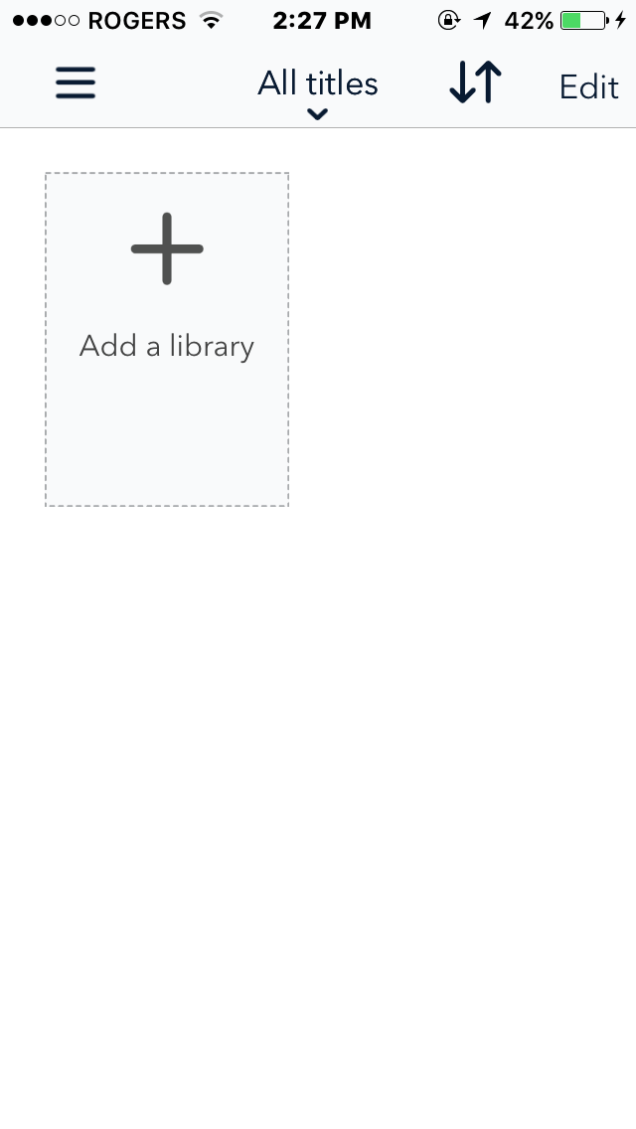
How Do I Download Books to a Mobile Device?
Open the OverDrive app and click “Add a Library”
Click “sign in” at the top right corner, search for your library in the drop down menu and use the username and password for eLibraries Manitoba
Start browsing! The same rules apply: black book icons mean the book is available; greyed out icons mean you can request a hold; headphones indicate audio books

Slide 15
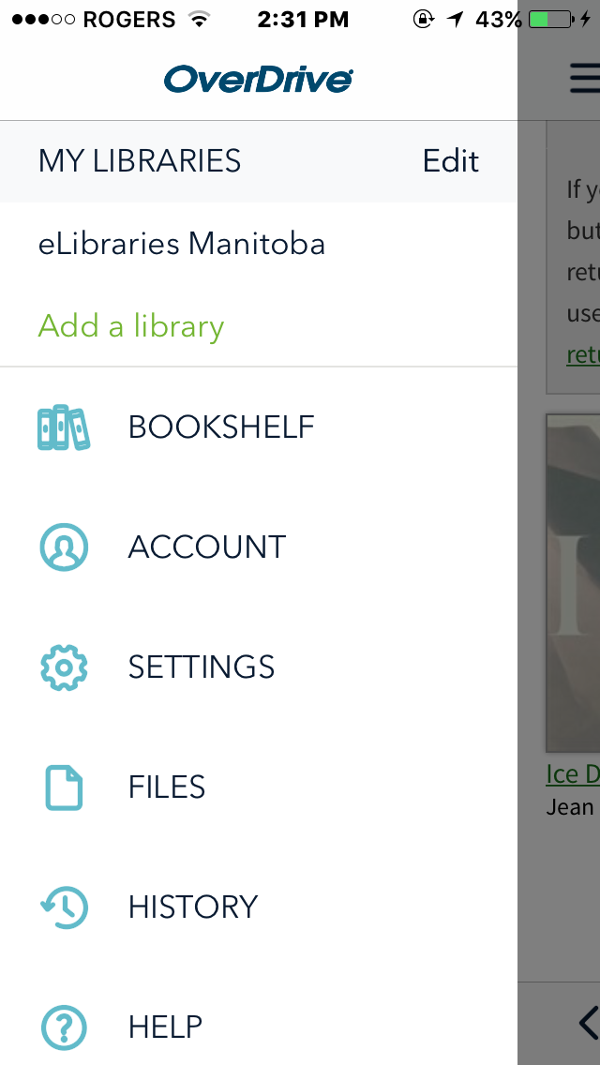
How Do I Checkout My Book?
To checkout a book, simply click on it, choose the green “borrow” button, then click on “go to checkouts”.
Here there are two options: “add to app” or “read in browser”.
Choosing “add to app” means the book will download on to your device and will remain there until its due date. You can read the book anywhere and do not require an internet connection. This is the recommended choice.
“Read in browser” limits reading to online only and requires an internet connection (so you can’t read on the beach!)
To find your book later, go to “Bookshelf”

Slide 16
Audiobooks
Audiobooks are also available on eLibraries Manitoba
They are downloaded directly onto a patron’s iPhone, iPad or iPod touch and can be accessed in virtually the same way as ebooks
Audiobooks will automatically download to the Bookshelf but take a little longer to download than ebooks due to file size

Slide 17
Troubleshooting: Common Problems
Mobile Devices:
Try a simple restart
Delete the cookies from the OverDrive App by going into “settings”, “delete app cookies”.
Delete the OverDrive App and reinstall it
Desktop Site/E-Readers:
Make sure computer and reader are both authorized on Adobe Digital Editions
Restart both the computer and the e-reader
Encourage patrons to use the “help” menu on OverDrive and Elibraries Manitoba

Slide 18
To Sum Up…
We can best help patrons by reassuring them and having easy access to support
Provide handouts for patrons to take home to help them achieve success
Offer one-on-one workshops
Provide staff with basic training and make sure to follow up with “difficult” cases
Post troubleshooting solutions often on websites and social media
Maintain contact with PLS for support and advice

