Slide 1
Customer Relations
From the inside out
Presented by Tanya Thiessen and Lois Peterson, 2013
Notes:
Presenter intros / Workshop goals
Did you know that you are in a giving profession? Our primary job at Surrey Libraries is to serve our customers. (written on fullscap) – couple statements that we think are profound and that we wanted to share with you…something to help us focus our time together…
Hi everyone, welcome again to our presentation today, Customer Relations from the inside out. My name is Tanya Thiessen, and this is Lois Peterson, and we will be bringing you this workshop based on a collective experience of working in customer service. We’ve called this workshop “customer relations from the inside out” because we’re going to be looking inward at our own beliefs and values around customer service and how that influences our interactions with customers, as well as the library’s expectations are regarding customer service. We will be asking you to do some self-reflection, to participate in small groups, and also help us with brainstorming ideas as part of our larger group – I can assure you though, there will be no role playing. If you have any questions, please feel free to ask.
Our major goal of this workshop is for you to come away with a good understanding what exceptional customer service looks like, and some specific strategies of how to achieve it in your own work. On a bigger scale, we will be collecting your contributions at the end and use them in developing a Customer Service procedure manual of sorts for staff.
Mention bathrooms. Break at about 10:15. Make sure everyone signs sheet. Should we do a quick round robin – say your name & which branch you are at, so we can put names to faces.

Slide 2
Happy Secret to Better Work – Shawn Achor
The lens your brain views the world…raise your positivity in the present…
Notes:
But before we launch in to the content too far, we’re going to show you a video to help set the tone for our time together.
Inspiring, eh?

Slide 3
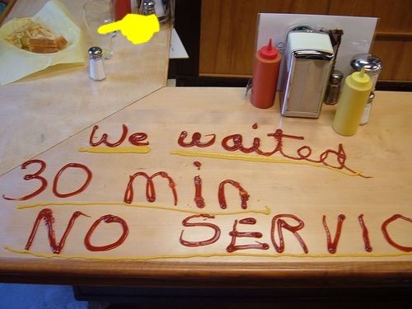
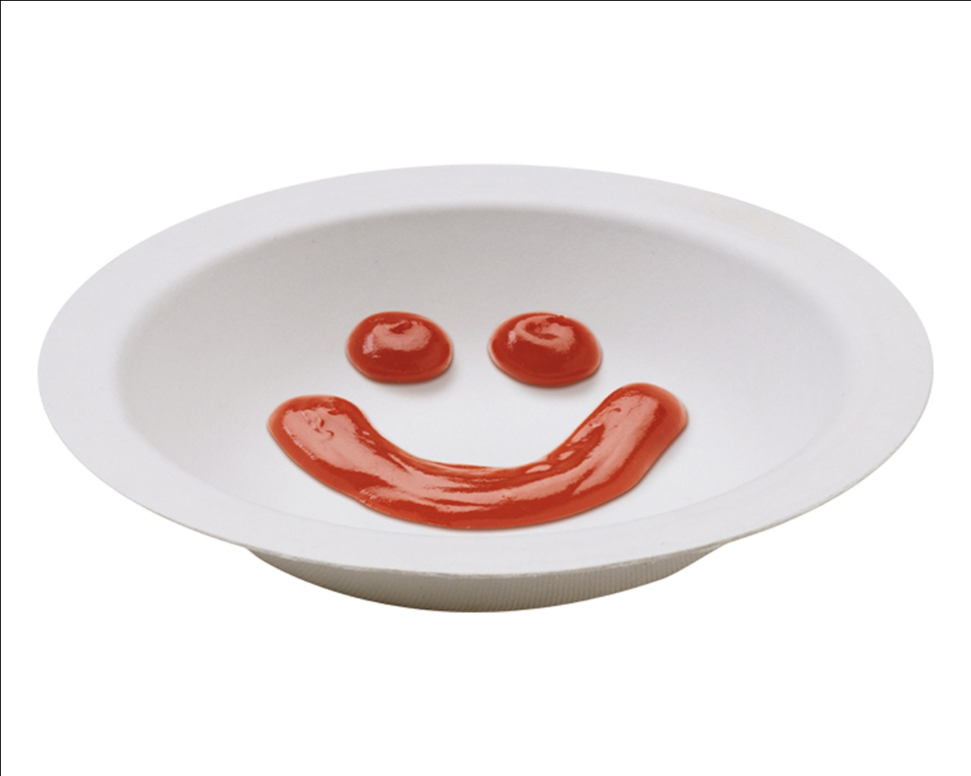
Pass the ketchup
Notes:
Even when you deliver exemplary service, you will always have more complaints than compliments.

Slide 4
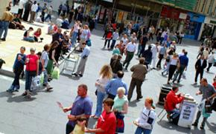
YOU the customer
Share a recent experience
you have had as a customer.
Describe the general situation.
List the service person’s actions.
Describe the attitude their actions conveyed.
Notes:
Large group to elicit input and comfort with group participation 15 min.
So we’re going to launch into our first exercise. I want you to think about a positive experience you had as a customer. I want you all to take a couple minutes to think, and then if you feel comfortable, share it with the larger group. We’ll write these experiences down as we’ll want to come back to them later in the session.
If silence, use example of Trader Joe’s – people go out of their way to find you something if you can’t find it, they give out samples, coffee, very friendly staff – store is clean, they’ll help you to your car and bag your groceries, they have lollipops for your kids and “find the Yeti”. They have public bathrooms. They have rovers who pick up misplaced items and put them back – staff take pride in their work.
So now we’re going to go from looking at your experiences of good customer service, to look at the library’s expectations of customer service.

Slide 5
Attitudes & Beliefs
COMMUNITY position
SYSTEM philosophy and policies
BRANCH values and practices
YOUR view of The role and purpose of libraries How customers should behave Extent and limits of service YOU are willing/able/trained to provide
Notes:
Library expectations – we don’t have clear written “rules” or expectations of customer service, but we’re going to train you on that hear, and the we’re going to develop a clear statement on customer service and outline the expectations in a document to follow.
Re. procedures and policy manual

Slide 6
Behaviours & Best Practices
The role of environment in creating a welcoming, inclusive space
Space, signage and stance
Lore and language How we talk about/interpret library rules and practices (Jargon, e.g. ‘Circulation Desk’, ‘ILL’
Personal perspectives
Notes:
LP
- Include body language. Eye contact, getting up out of our chairs to take people to the shelf, take pride in your work

Slide 7
Expectations & obstacles
What expectations do you have of service providers in your own transactions?
What obstacles might service providers have in giving you what you want/need?
Notes:
TT
Whole group
Relating back to positive experience discussion – this is an awareness exercise. By looking at our own experiences and expectations around customer service, this influences our own customer service interactions. Ask people who gave examples in exercise #1.
Using my TJ’s example:
1. Polite, respectful, fast, knowledgeable, friendly – because of my experience at TJ’s they set the bar for service (might depend on the situation – service provider tunes in to my “need”)
2.Time constraints – too many demands at once, not enough product knowledge, they’re having a bad day/personal issues, they don’t have a good attitude – service provider doesn’t “get” me
The last customer influences the next customer

Slide 8
Expectations & obstacles
1. What expectations are library customers likely to have of you?
2. What experiences and obstacles might customers bring to transactions with you in the library?
3. What makes it difficult for you to provide excellent customer service?
Notes:
TT
So we’ve just talked about your expectations and experiences around customer service in other service situations, now we’re going to split up into twos and talk with your partner about your customer service expectations and experiences in the library environment (#1 and #2) for the next 5-10 minutes, and then we’ll chat as a group about #3.
Small/pairs/indiv
Report back to large group
#1 – Read the question…So what do people expect in terms of service at the library? (adjust to different needs)
#2 – Read question…use your empathy skills and think about what is happening for the customer you are serving.
#3 – Read the question…what gets in the way?

Slide 9
Strategies that work
Do you:
Give priority to customer over other staff activities or tasks?
Make eye contact?
Smile
Listen more than you talk?
Use I/we more than you?
Let silence do some of the work?
Take customers in turn? Acknowledge waiting customers?
Go as far as you can with each customer
Maintain confidentiality
Keep shop talk away from the Info/Circ Desk
Do you jump in to help your peers at their request?
Do you treat each new transaction as the first one of the day?
Do you contribute to a welcoming environment?

Slide 10
The Fish Philosophy
http://www.youtube.com/watch?v=gNDP9jLuzXU&feature=related
Notes:
Choose your attitude – this is key! Be the one to take the initiative and look about to see what you can do to contribute to the branch, the customers, and your colleagues.
Make their day – surprise your colleagues and your customers with phenomenal customer service. Anticipate what would be helpful to others. Strive to be world famous.
Be present – fully engage with your work. Be aware of what needs to be done and be the person who does it.
Have fun. Play. Take pride in your work. Enjoy the friendship of your colleagues and the camaradarie with our customers.
Be curious – if something isn’t working, look into it.
Be flexible
Communicate!

Slide 11
Four ways to answer a direct question
1. Yes
2. No
3. Yes, and
4. No, but

Slide 12
Customer Complaints

Slide 13
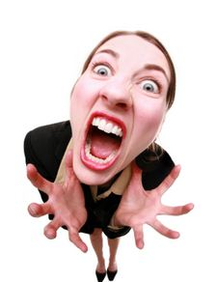
Customer Complaints = Dissent
Dissent ‘To be of a different opinion’
Notes:
Some of you have already participated in the Emotional Intelligence workshop. While it can be challenging to have a difficult customer, what is helpful is to remember that the person just has a different opinion.
Know your own buttons/triggers – EMOTIONS ARE CONTAGIOUS. Learn to monitor your physical reactions - do what you can to keep positive & keep your emotions separate to maintain calm.
Take a breath before you respond – 437 technique
and seek help if needed/be aware and support a colleague if required. Ex. “Good question, let me get someone who can help us solve this problem together…”
Be proactive. Learn strategies by watching how other staff deal with challenging situations – read problem reports, Security Manual. Review/debrief challenging situations that you experience to help you learn your triggers & en

Slide 14
Outcomes vs behaviour
We can control our own behaviour
we cannot control outcomes
Notes:
Let the other person OWN their behaviour by focusing on the library problem.
Something to consider as well for all our interactions, whether it be with customers or fellow staff.

Slide 15
Customer Complaints
See it as an opportunity to build relationship (and help the customer learn a little more about libraries)
Hear them out
Watch your body language
Clarify and ask questions
Empathize
Ask what remedy they seek
Do what you can
Explain the limits
Refer if necessary
Explain next step – for you and them
Thank them for the input Remember Yes, and / No, but
Notes:
LP

Slide 16
Three personal customer relations goals expressed in terms of behaviours
In every transaction, I undertake to:
One
Two
Three
Create Your Own Legacy…
Notes:
Just as we choose our attitude, we can create our own reputation or the legacy we want to have for our service delivery. Choose what impact you want your behaviour to have on those around you.
Take a moment to reflect on what we’ve talked about this morning, and come up with 3 goals or ways that you can make your customer service, your relationships with customers, even better. Then we’ll go around and if your comfortable, please share with the group.
One way to think about the exercise is to consider, “What would you like your customers/co-workers to say about your service delivery?” Try to focus on core behaviours that you want to demonstrate on a consistent basis.
For example, I will try to keep in mind that complaints are only different opinions. I will try to limit shop talk at the desk, and limit bringing down all my ordering.
Individual exercise – then round-robin

Slide 17
Five Customer Service Goals expressed in terms of behaviours
As an organisation, our goal is to provide excellent customer service:
One
Two
Three
Four
Five

Slide 18
When the customer comes first, the customer will last.
Your customer doesn’t care how much you know until they know how much you care.
Nothing is so contagious as enthusiasm.

Slide 19
for joining us for this workshop.
Help us evaluate this workshop:
What was MOST helpful or useful?
What could we do differently next time?
Any other comments or suggestions?

