Slide 1
How to Make an Ebook
Thursday, January 14, 2016, 5:30 p.m.

Slide 2
Outline
What is an Ebook?
History
Ebook Types
Digital Locks
Creating an ebook
Sharing / Selling an Ebook

Slide 3
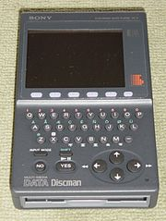
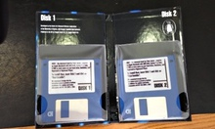
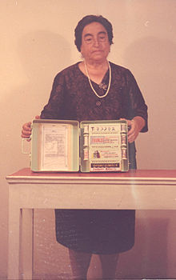
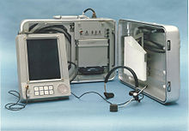
History

Slide 4
Ebook Types

Slide 5
File Types
EPUB: Ebook format
AWZ: Kindle format
PDF: for documents to print
HTML: for websites

Slide 6
Digital Locks
From: http://electricbookworks.com/

Slide 7
Putting Together your Ebook
Notes:
Formatting your book (12 minutes)
Depending on the type of book that you have written and who your expected audience is, there are some tools you can use.
Sometimes you can do all of the formatting / publishing in one spot
Smashwords
Pressbooks
Accelio
inckle

Slide 8
What is needed
Cover
Title page/Front Matter (incl. editors, contributors, authors)
Dedication / foreword
Body of book
Acknowledgements / about / other books
Copyright notice

Slide 9
Microsoft Word
Or other word processors can be used for formatting you book
Familiar interface
But, cannot see what readers will see until file is converted for sale
Notes:
Can also save as pdf (for ease of printing) or sharing an un-editable copy via email.

Slide 10
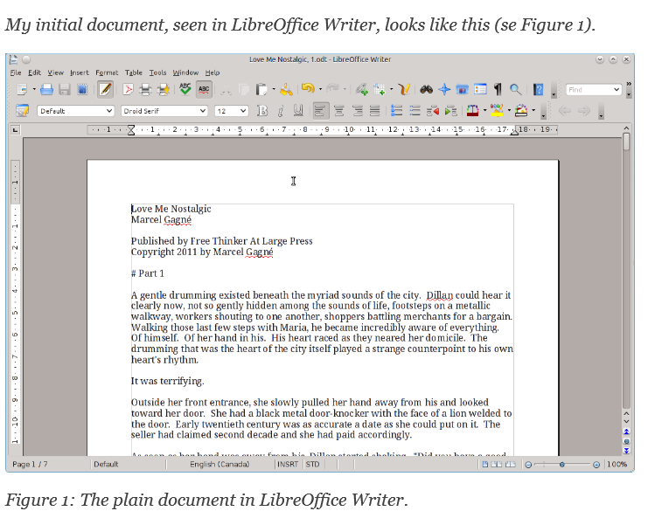
From: http://download.kobobooks.com/learnmore/writinglife/KWL-Content-Conversion-Guidelines.pdf

Slide 11
Formatting Tip
If you are using Word, Pages, or other word processing software, use Headings
Ex. Heading 1 for Chapter headings

Slide 12
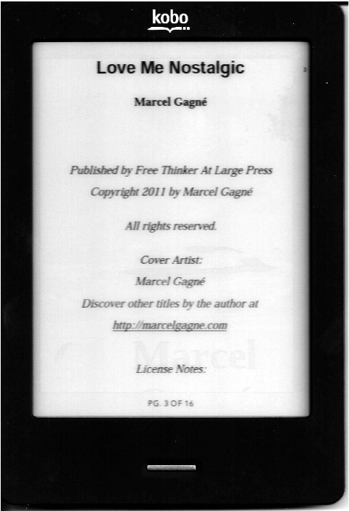
Formatting Tip
Centre your front matter

Slide 13
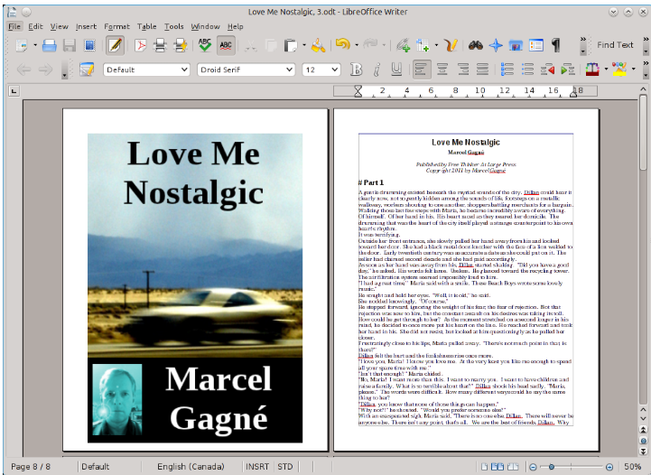
Notes:
Add cover in the ebook doc

Slide 14
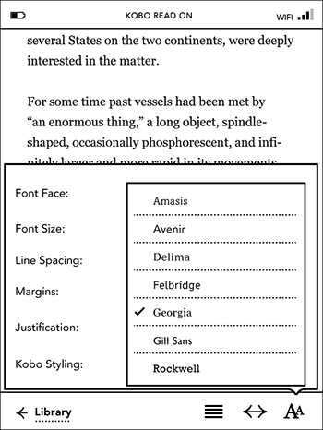
Formatting Tip
Don’t get too creative!
Readers will want to change font size and other aspects, but may not be able to if you use complex formatting.

Slide 15
Step-by-step guide
Themes can be applied to your book
Do it yourself, or use their professional service
http://guide.pressbooks.com
Notes:
Do a demo of editing content, showing how to add and remove content
Demo an export: login sfelkar & regular simple password.
Include the upgrade to remove promotion material in export$10 for one book. EBOOK PRO

Slide 16
Software for managing ebooks, as well as creating them
Converts files to .epub
Allows you to edit and clean up your ebook once converted

Slide 17
Software for writing and creating your book
Available for Windows and Mac OSX

Slide 18
Downloadable program
Allows you to create and format ebooks
Compatible with all computer types
Free

Slide 19
More Offline Options
Easy: MS Word, Pages, Word Perfect, Scrivener, Sigil
Medium: MS Publisher
Hard: Adobe InDesign, Quark Xpress
From: http://www.thebookdesigner.com/2010/11/book-design-page-layout-software-a-guide-for-diy-authors/

Slide 20
Cover Design
Notes:
Covers (10 minutes)
[something about the importance of a good cover]
Cover art:
DIY: http://www.hongkiat.com/blog/designing-book-covers/
Think about what you like best!
But once you have an edited book and cover in hand, you have everything you need to publish! Or are you?

Slide 21
Covers
DIY
Jo Sabin from DesignCrowd.com http://www.hongkiat.com/blog/designing-book-covers/
Completely Novel: http://completelynovel.com/self-publishing/writers-toolbox-cover-design
Publisher’s Weekly: http://www.publishersweekly.com/pw/by-topic/authors/pw-select/article/60851-diy-how-to-design-an-indie-book-cover.html
Notes:
Suggested size is 1600x2400 pixels for most websites.
http://ebookindiecovers.com/ebook-cover-size-requirementsspecifications/

Slide 22
Publishing & Distributing Your Book
From: http://digital.westvanlibrary.ca/index.php/4132-wvml;dc

Slide 23
Things to consider
Keywords
Subject Headings
Description of the book (blurb) both short and long

Slide 24
Notes:
Publishing & Distributing Your Book (12 minutes)
Kobo Writing Life:
(Includes pay structure info) http://www.pocket-lint.com/news/122530-kobo-writing-life-makes-it-easy-for-authors-to-publish-their-ebooks-in-just-five-steps
Kindle Direct
Payment method info: https://kdp.amazon.com/self-publishing/help?topicId=AE24XS35AM53P
Kindle’s Create Space
Book Baby: http://www.bookbaby.com/ebook-services
Smashwords
How to publish on smashwords - http://www.smashwords.com/about/how_to_publish_on_smashwords
LuLu
This is a long established self-publishing platform, it has been around since the early 2000’s. Mostly used for print materials, it does have an e-publishing side as well.
iBooks:
If a fee is charged for the work and it is in the .ibooks format, the work may only be sold through the iBooks Store. If the work is in a different format, such as PDF or ePub, this restriction does not apply.

Slide 25
A “Do it yourself” solution
They provide materials like video workshops and books with types on style, formatting, and marketing.

Slide 26
Distribute through as many channels as you wish, including making your book available to libraries
Earn 60% of price from retailers, and 85% of price from Smashwords
No other cost

Slide 27
Have your book ready
Upload information
Choose price
Choose markets
Paid 2x a year
Notes:
Use Kobo as an uploading example
Personal Information that they need:
Enter your email and password
Enter your name, publisher name (optional), email (auto-populates from previous page), phone (optional) and PREVIOUS Kobo publishing account ID – if applicable
Scroll down to input country, street address, city, state, zip
Accept terms of service
Respond to email to confirm registration
Enter payment information – bank, routing number, branch address, etc, and save info
Click on “ebooks” in the top right menu bar
Click on “create a new ebook”

Slide 28
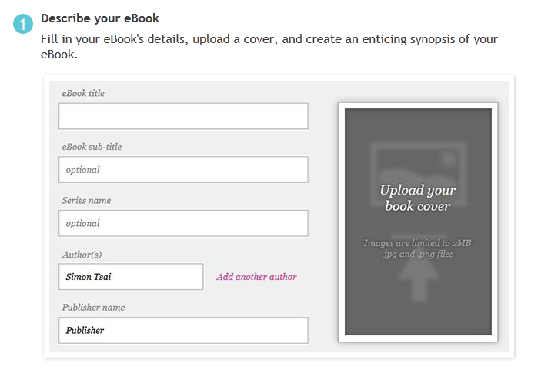

Slide 29
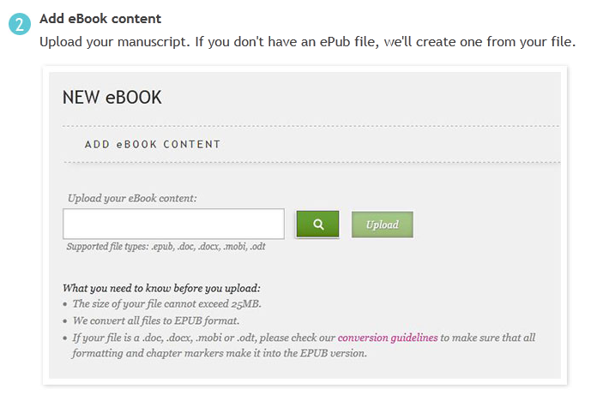

Slide 30
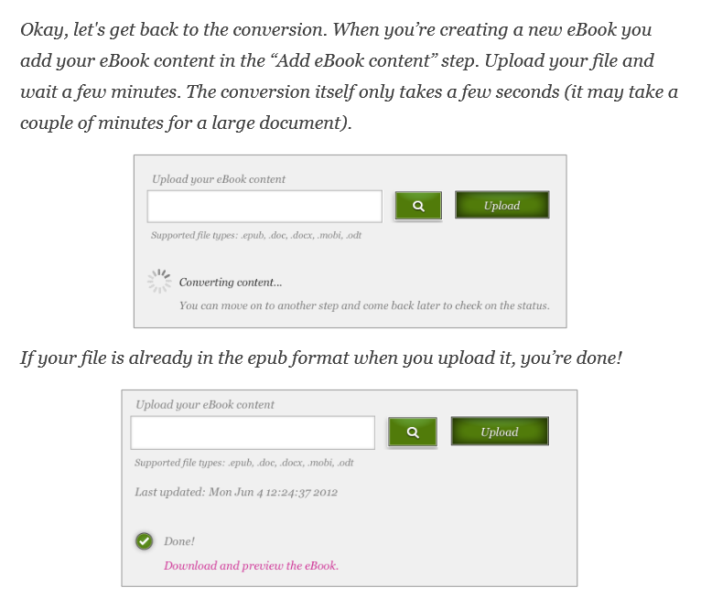

Slide 31
Notes:
This is your chance to check the book for formatting errors, and the look and feel before it goes public

Slide 32
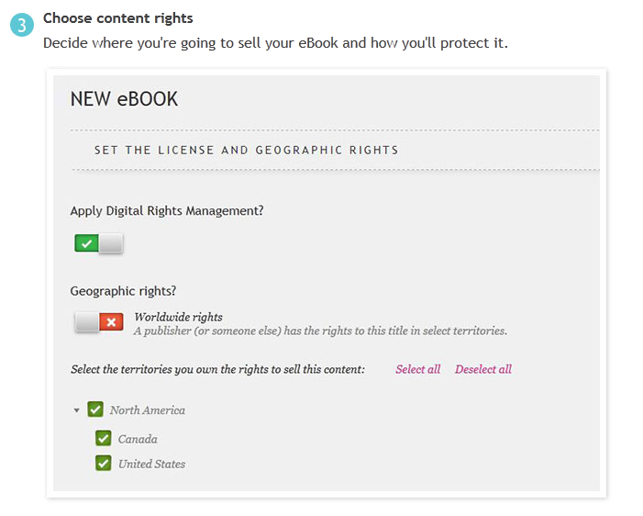

Slide 33
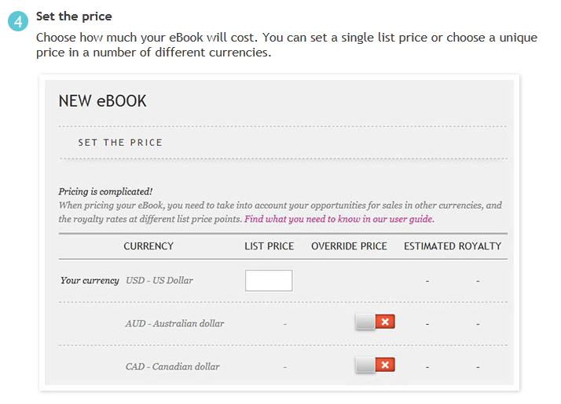

Slide 35
Promotes combining ebook and print distribution
About $49 per book
Plus extras

Slide 36
You have your book ready to publish and distribute
Earn up to 70% royalty

Slide 37
Free and paid services
Print items
Owned by Amazon

Slide 38
You pay to have this service distribute your book
After the initial payment, you collect all revenues

Slide 39
Ebooks or print books
Paid services available
Company has been in service since 2002

Slide 40
iBooks
If you publish in .ibooks format you can not publish your book anywhere else.
If you use EPUB, you can distribute elsewhere.

Slide 41
Other Resources
Smashwords Ebook Publishing Workshops: http://blog.smashwords.com/2013/10/smashwords-ebook-publishing-workshops.html
Editors’ Association of Canada: http://blog.editors.ca/
Author Learning Center: https://www.authorlearningcenter.com/
Free Sites to Promote Your eBook: http://www.mediabistro.com/galleycat/free-ebook-promotion_b52130

Slide 42
Other Resources
The Book Designer: http://www.thebookdesigner.com/
Self-Publishing on Writers’ Digest: http://www.writersdigest.com/editor-blogs/there-are-no-rules/self-publishing
The Creative Penn: http://www.thecreativepenn.com/2013/01/15/how-to-publish-a-book-101/

