Slide 1


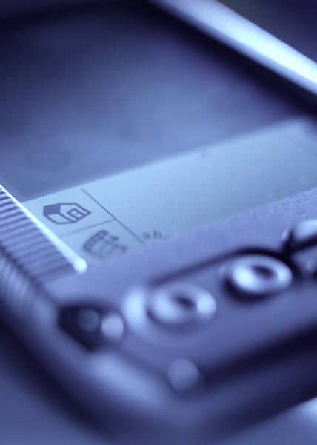


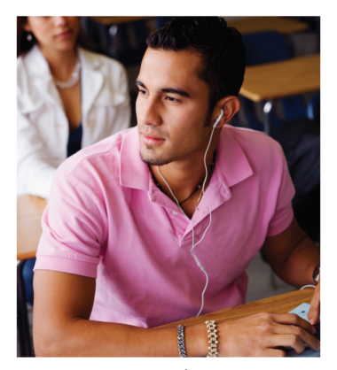



Getting Started with E-Books:
BlackBerry PlayBook
Notes:
Checklist:
Kobo Handout
Adobe Digital Editions Handout
Sneak Preview card
Evaluation forms

Slide 2












How does it work?
  Choose from popular items including fiction and non-fiction, children’s and teen
  Download e-books and e-audiobooks
  Check out up to 5 items at a time with your library card
  If someone else has an item checked out – place it on hold, get an email when it is ready for you to check it out

Slide 3










  Browse, check out, and download with your library card … anytime, from anywhere!
  Use your BlackBerry Playbook with OS 2 (purchased in Feb 2012 or later). Also works on almost all other computers and mobile devices

Slide 4











  What’s Required
  A valid library card
  A compatible BlackBerry PlayBook
  An Adobe ID (see next slide)

Slide 5
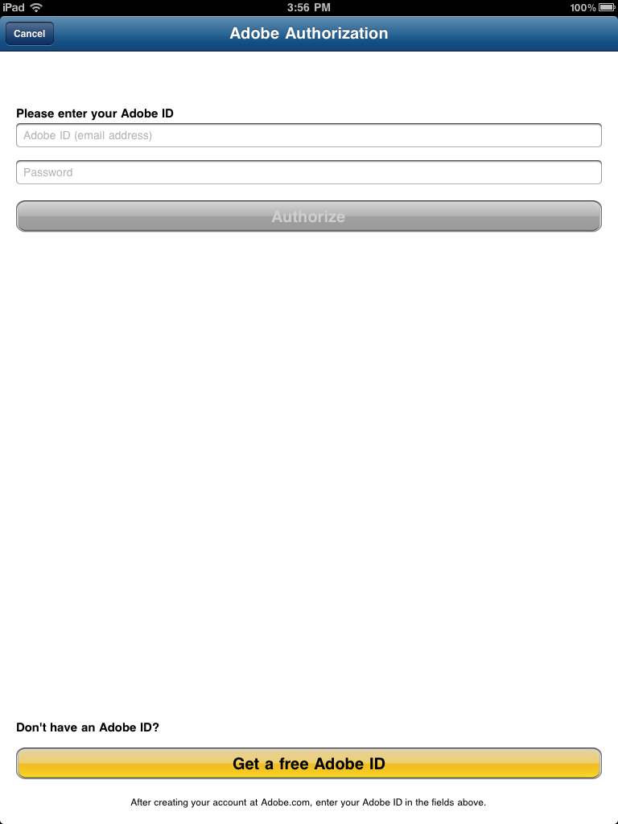
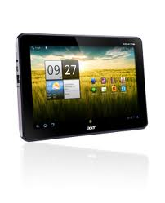
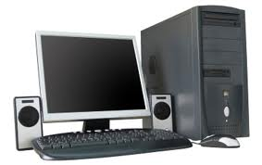
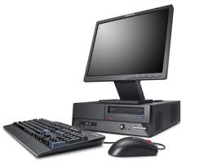

How to…
Authorize your device
Jocelyn
Adobe ID: jbadley@sclibrary.ab.ca
I “authorize” all my devices with my email and password
Tablet Home computer Work computer Phone
Now I can download and read the same library book on all my devices!

Slide 6
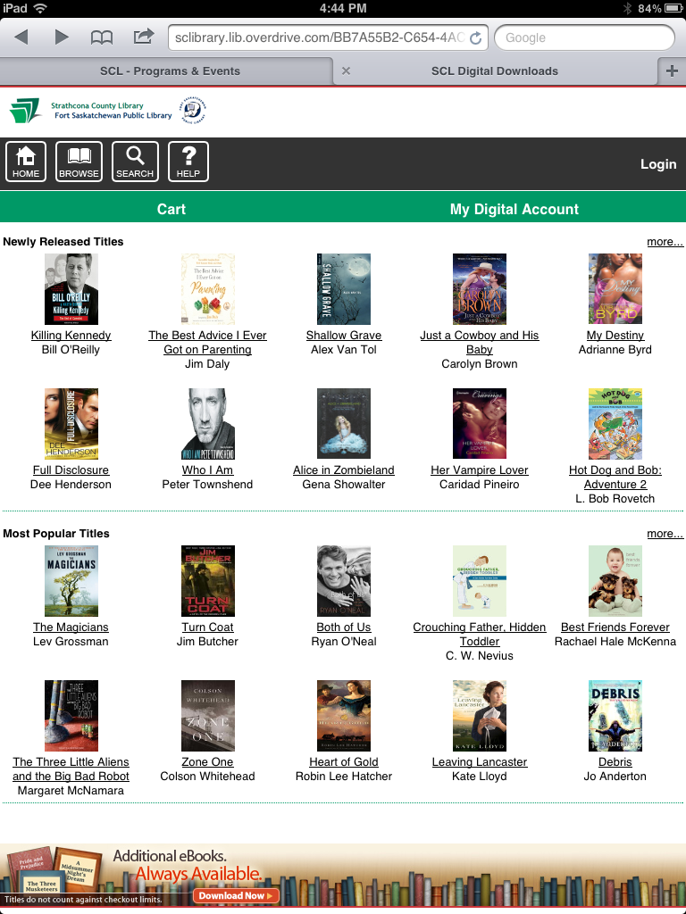
Mobile site tour
Left: Home, browse, search
Right: My Digital Account login
Newly released and most popular titles

Slide 7






Get to Know
OverDrive’s Formats
Text formats:
E-audio formats:
Adobe PDF/OPDF – Portable Document Format. A format that is familiar to most of us, used for screen-readable, printable documents with limited re-formatting. OverDrive PDFs include DRM.
WMA – OverDrive’s version of the proprietary Windows Media Audio format. Only compatible with Windows devices, including Windows computers and the Microsoft Zune. Includes DRM.
EPUB/OEPUB – Electronic Publication. An open e-book standard developed by the International Digital Publishing Forum. EPUB books’ text can be resized and reformatted. OverDrive EPUBs are the Adobe version and include DRM.
MP3 – One of the web’s most popular audio formats. Compatible with most portable devices. MP3s take up more space than WMAs, but have similar audio quality. They have no DRM, meaning that can also be burned to a CD.

Slide 8
Connect to the Internet
Install OverDrive Media Console app
Authorize your device
Overview
Add SCL to Your Libraries
Browse, Check Out & Download

Slide 9
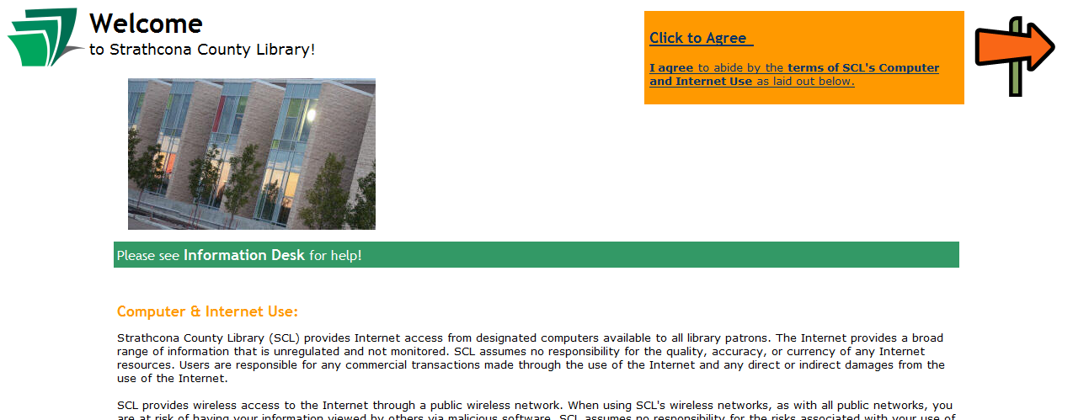
1
Connect to the Internet
On the Status Bar, tap > WiFi
Connect to Library-Public
When the Library Welcome screen comes up, tap on click to agree

Slide 10

2
Install OverDrive Media Console app
Enter the App World on your PlayBook. Look for this icon:
Search for “OverDrive Media Console”
Tap the “Download” button. The app will download, and you will see a green progress bar fill up. This may take a couple of minutes.

Slide 11


3
Authorize your device
Load the OverDrive Media Console app, if you haven’t already done so. The app icon looks like this:
In the app, swipe down from the top bezel to access the menu.
Tap on App Settings:
Get a free Adobe ID. (or use an existing one if you have one)
Return to the app and enter the information you just chose and then tap “Authorize.” You may want to write it down on your handout, as well.

Slide 12
4
Add SCL to Your Libraries
Swipe down from the top bezel to access the menu.
Choose “Get Books.”
Add a library. Search for Strathcona County Library. When it comes up, tap the star next to it to add it to your libraries.
Tap the words “Strathcona County Library” to visit our e-book site.

Slide 13
5
Browse, Check Out & Download
Browse or search for a book that interests you. If you can’t find anything you want, you can check out something and return it right away for practice.
Proceed to checkout. Enter your login information when asked.
Enter your whole library card # with no spaces.
Your PIN is the last 4 digits of your phone number.
Tap “Download.” The book you chose will appear in your library.

Slide 14
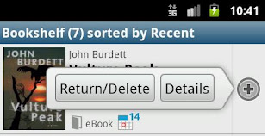
Returning Items Early
On the Library screen, tap the small plus sign that appears to the right of the item you want to delete.
Tap “Return/Delete” to return the item to the library.

Slide 15
Returning Items Early
Some file types cannot be returned early
MP3 audiobooks and EPUB ebooks can be returned early.
OEPUB ebooks cannot be returned early. If you check out one of these books, set it to a shorter checkout period, or delete it from your device and then wait for it to expire from your account.

Slide 16
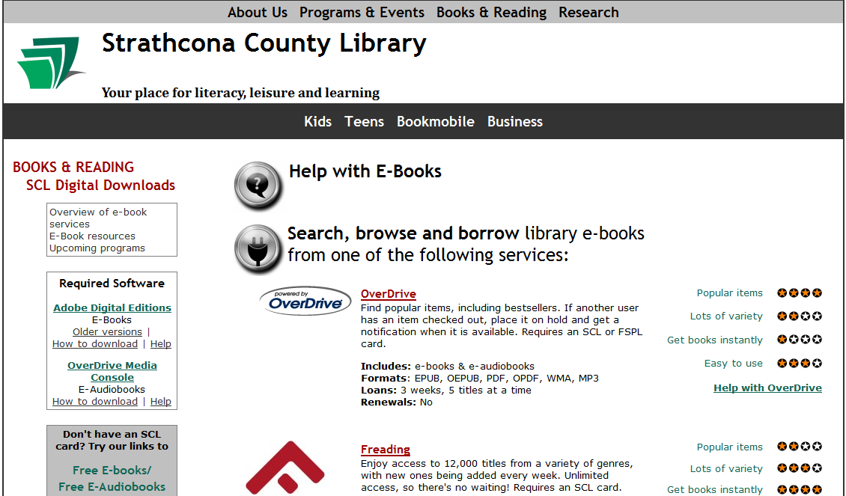
SCL
Downloads
This page is your portal for all things digital.
Help resources, apps, request a title for purchase, new e-books newsletter & more.
http://www.sclibrary.ab.ca/download.htm

Slide 17
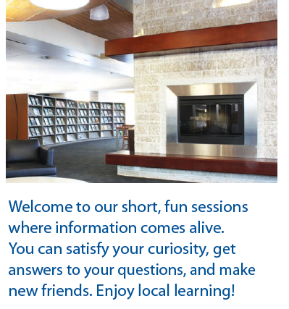

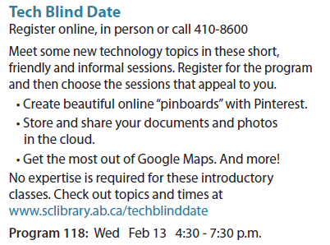
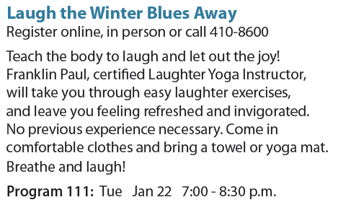
Don’t miss these upcoming programs!

Slide 18
Thank you for coming!
CAN WE HELP?
Email: info@sclibrary.ab.ca
Phone: 780.410.8601 (Talk to a human being!)
Or come by either of our Information Desks.
Happy Downloading!

