Slide 1
Summary of a Study: A Look at Young Adult Use of Ebooks in Public Libraries
Robyn Gray, Battle River School Division
@RobynG8
Notes:
Hello everyone! My name is Robyn, and today I’m going to give a very brief summary of a research project that I conducted in my last year at Dalhousie University in 2016. Hopefully this project will introduce a few new thoughts about e-book usage by teenagers, and hopefully it can enable you to reflect on the changes that have happened even in the past two years since I distributed this survey.

Slide 2
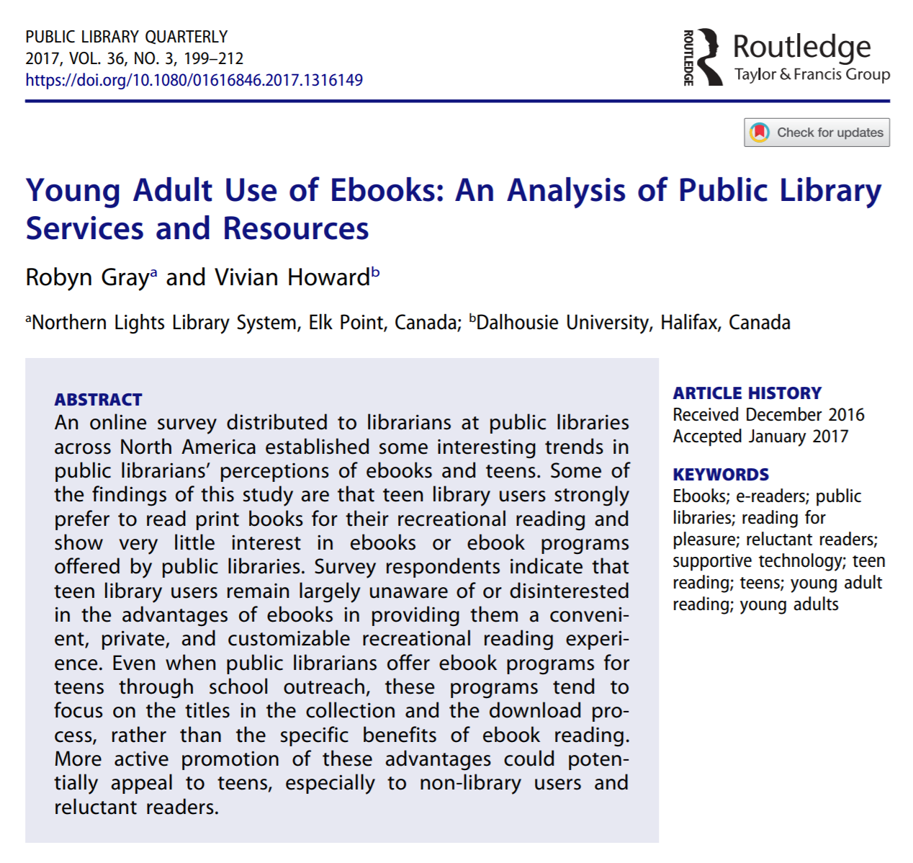
Robyn Gray & Vivian Howard (2017) Young Adult Use of Ebooks: An Analysis of Public Library Services and Resources, Public Library Quarterly, 36:3, 199-212, DOI: 10.1080/01616846.2017.1316149
Notes:
Vivian Howard is an associate professor at Dalhousie University, and was an amazing mentor to me throughout the project. She helped me to come up with a study that was plausible in the one semester I had to conduct a reading project, and at the end of the semester she took my 68-page paper and condensed it into a much more manageable work before submitting it to Public Library Quarterly

Slide 3
Motivation
Reading for pleasure often declines during teenage years (Fasick et al. 2005; Howard 2008; Maynard et al. 2007; National Endowment for the Arts 2007)
Ebooks may increase youth’s interest in recreational reading
E-readers provide opportunity to customize reading experience
Dictionaries, highlighting, audio narration, font size, colour contrast, margin size, translation tools
Notes:
Several studies show that reading for pleasure declines during teenage years. But with the development of e-resources, there are theories that ebooks may result in a more positive attitude toward reading for reluctant and struggling teen readers. While teens are potentially discouraged by reading books written for a lower reading level, ebooks provide a private reading experience with no risk of social stigma. Furthermore, tools included with ebooks, such as dictionaries, highlighting, and audio narration, are helpful for those with reading difficulties. With ebooks, readers can customize the font size, page orientation, or margin size, and potentially use text-to-speech and translation tools.

Slide 4
Increasing Use of Young Adult Ebooks
57% of nine to seventeen year olds were interested in reading ebooks, and one-third “would read more books for fun if they had access to digital titles on electronic devices” (as cited in Springen, 2011, para. 9)
Many schools providing students with e-readers, and this access increases rates of pleasure reading (Larson 2015; Springen 2011)
Many teens have access to a range of ebooks through school; almost all teens have access to ebooks through their local public library
Notes:
In 2011, Scholastic and Harrison Group found 57% of nine to seventeen year olds were interested in reading ebooks, and one-third “would read more books for fun if they had access to digital titles on electronic devices”. Many schools are providing students with e-reading devices, and this access increases rates of pleasure reading (Larson 2015; Springen 2011)
While many teens have access to a range of ebooks through school, almost all teens have access to ebooks through their local public library

Slide 5
Methodology
Created a survey for youth services librarians at public libraries
Distributed survey online through library listservs and social media
Almost all multiple-choice questions, accompanied by free-text space
152 librarians from across Canada and the United States participated
Survey was open from January 28th to March 22nd, 2016
Notes:
This study was conducted through an online survey which combined quantitative and qualitative data, and was to be completed by youth services librarians at public libraries. Almost all of the survey questions were multiple-choice, accompanied by a free-text space. The survey was circulated widely across North America through email listservs and social media. A total of 152 completed surveys were received from youth services librarians in Canada and the United States, although not every respondent answered every question. The survey itself was open for two months, from January 28 to March 22, 2016.

Slide 6
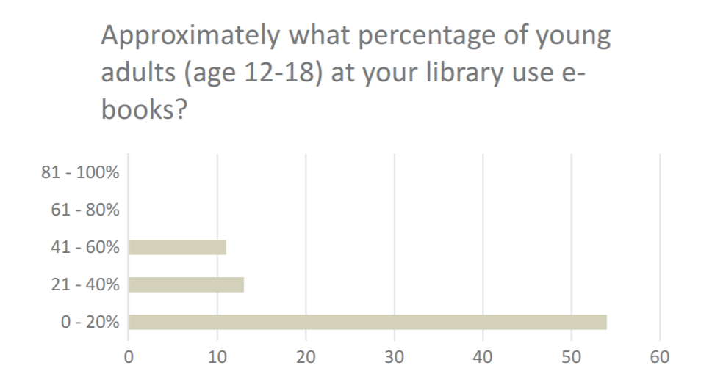
Notes:
69% of respondents estimated that relatively few young adults borrow ebooks. However, many participants indicated that while their system tracks the overall number of ebook downloads, there is no way to know for sure whether teens are borrowing ebooks. One respondent said that “the teens I do know at the library prefer to have a physical book to an ebook and don’t use our OverDrive service”. However, some respondents are confident young adults ARE borrowing ebooks, as shown in the response that “teens using ebooks don’t need to interact with staff since they just do it on their own. However, I’ve done some class visits and know of nearby schools that require teens to read ebooks so I know some of them are borrowing ebooks, for sure”

Slide 7
73% said young adults borrow more physical books than ebooks:
“When a teen is looking for a book and the physical copy is out but the ebook is available, they tend to prefer requesting the physical book [and waiting for it] over getting the ebook [immediately]”

Slide 8
Promotion/Outreach
“We have done a fair amount of outreach in regard to our ebook services to this population so they are certainly aware the service exists”
“I promote the service whenever I am given the opportunity…school visits, for example”
I have been asked to visit classrooms and discuss getting library cards and ebook access”
Notes:
Several respondents indicated that their libraries are actively promoting the ebook collection to teens. One librarian noted that “We have done a fair amount of outreach in regard to our ebook services to this population so they are certainly aware the service exists”. Other respondents observed that class visits are particularly helpful and they promote e-resources through this outreach, saying that they have been asked to visit classrooms and discuss getting library cards and ebook access”

Slide 9
Hardly any young adults ask questions about ebooks
Possible reasons:
Young adults prefer to look up person online instead of asking in-person
Young adults already know how to download ebooks and don’t need help
Young adults aren’t using the ebook collection

Slide 10
Ebook Program Offerings
54% of respondents said they offer programs to help all patrons access ebooks (not specifically young adults)
Programs on ebook usage are offered through school outreach:
“We offer a demonstration class for new users to learn how to read ebooks on tablets, e-readers, and other devices. We also offer one-on-one training … two years ago, I went to a junior high school, visited all the classes, and did a 15-minute demo of our ebook collection”

Slide 11
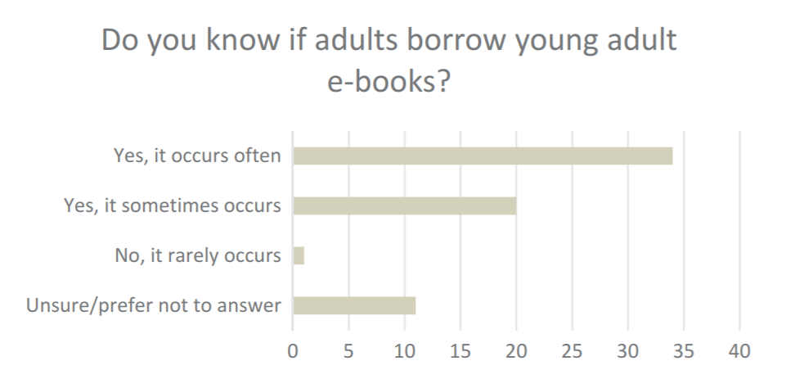
Notes:
82% of respondents felt that some adults are definitely downloading young adult ebooks. Several respondents observed that adults are the majority borrowers of the young adult ebook collection. One respondent stated that “I get more YA ebook suggestions from adults than from teens”. One conclusion that can be drawn from this is that some adults who enjoy reading young adult material feel uncomfortable going to the young adult section of the library, and therefore prefer borrowing these materials online

Slide 12
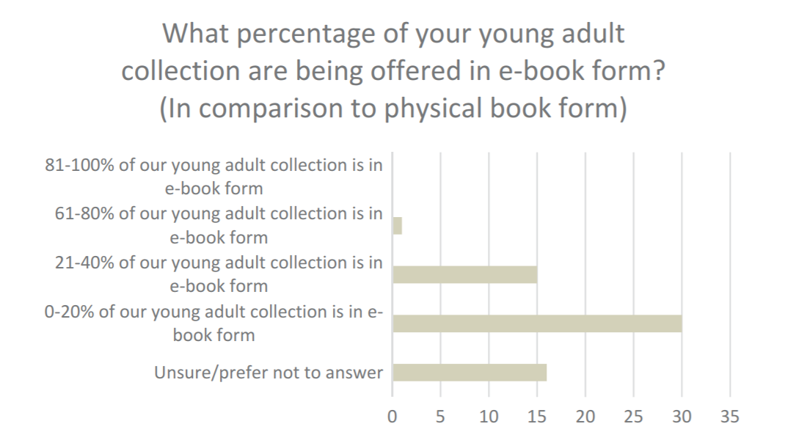
Notes:
When asked the percentage of the library’s young adult pleasure reading collection that is available in ebook form, half of all respondents stated that it was very low. “[The young adult ebook collection] is increasing but feedback from teens is that they want physical books.” Popularity was the main determinant of whether a title would be purchased in ebook format. Respondents noted that only the most popular and high demand titles were purchased as ebooks.
When asked about the main disadvantages of ebooks for young adults, several respondents talked about problems in managing the collection of ebooks. One librarian said it is difficult “having to duplicate the collection in print versus ebook, having multiple vendors, and having the entry point to the collection be through an app. Expiration of the collection is an issue, and cost.”

Slide 13
Other Disadvantages to Ebooks?
The Digital Divide:
“My library serves young adults who often don’t have much technology at home. They have no interest in e-readers because they have no reason to spend money on something that they’d have to come to the library to load up (since most don’t have Internet access at home). I’d like to start moving from encouraging the use of e-readers to focusing on how ebooks and downloadable audiobooks can be used on smartphones, which most of my youth have. I think that patrons associate ebooks with e-readers, which doesn’t have to be the case.”

Slide 14
Possible Solutions…
Tell young adults that e-books can be used on smartphones
Perhaps public libraries could loan out e-readers
Ebooks can offer financial incentive
No late fees for books since ebooks automatically check themselves in
No damage fees for a digital book
No fear of “scolding” for late/damage fines

Slide 15
The Importance of Virtual Space
Young adults may be too embarrassed to ask for help -
“Sometimes young adults prefer print if there’s even a tiny learning curve to download materials”
Potential Solution:
Connect with teens through school outreach visits
Make information about ebooks available online
Social media
Library website
Online tutorials
Notes:
One disadvantage may be that if teens are in need of help, they are too embarrassed to ask. People often assume that teenagers are tech-savvy, so when they do have trouble with technology they don’t always feel comfortable asking for help face-to-face

Slide 16
Advantages of Ebooks for Young Adults
Convenience: “Since a lot of YA’s tend to stay away from a library, using these devices still makes them want to read and have access to reading”
Download ebooks when they go on vacation
“In the current reading culture, there is quite a varied preference for formats. Having the ebook collection offers another format that is appealing to some readers”
Accessible for people who have physical or intellectual challenges
More privacy than physical books
Notes:
Overall, the majority of respondents were very enthusiastic about the potential advantages of the ebook format for young adult readers

Slide 17
Prominent theme: young adults prefer to borrow physical books
However: most teenagers coming into the library enjoy reading
The teenagers who do not read are potentially the ones not going to the library

Slide 18
Supportive Technologies and E-Reading
28% survey respondents said they explicitly discussed e-reader features with young adults
If young adults see ebooks as a digital equivalent to a physical book, not much appeal
If they understand that they can enhance their reading experience through customizing font sizes, using dictionary features, or collaborating through virtual book clubs...might be more eager!
Provide an overview of additional features of ebooks during young adult programs both in-house and during school outreach

Slide 19
Further Questions
Is it advisable for public libraries to invest future time and budget in developing young adult ebook services, given the apparent disinterest?
If young adults were aware that ebooks can offer an enhanced reading experience, would they be more interested in using them?

Slide 20
Conclusion
Ebooks are an important medium for public libraries to offer
Advantages to ebooks that could be promoted:
Ability to customize reading experience
Dictionary, highlighting, audio narration
Convenience of access
Borrowing ebooks is risk-free, no damage or overdue fines
Notes:
Overall, although survey respondents generally felt that ebooks were not very popular with teens, they acknowledged that ebooks are still an important medium for public libraries to offer. While ebooks will not replace physical books anytime soon, they are an important way of increasing the library’s services and outreach.
While ebooks do not currently seem to be a popular format that young adults choose for recreational reading, public libraries have an opportunity to focus on increased awareness and understanding of the full range of ebook technologies to encourage more teens to consider borrowing ebooks

Slide 21
Thank you!

Slide 22
References
Bishop, C., and M. Visser. 2013. Ebooks? So what’s the big deal? Young Adult Library Services 11 (3):4–8.
Braun, L. W. 2011. Now is the time: Ebooks, teens, and libraries. Young Adult Library Services 9 (4):27–30.
Cahill, M., and A. McGill-Franzen. 2013. Selecting ‘app’ealing and ‘app’ropriate book apps for beginning readers. Reading Teacher 67 (1):30–39. doi:10.1002/TRTR.1190.
Fasick, A., A. Gagnon, L. Howarth, and K. Setterington. 2005. Opening Doors to children: Reading, Media and Public Library Use by Children in Six Canadian Cities. Regina, Canada: Regina Public Library.
Gullo, D. F. 2013. Improving instructional practices, policies, and student outcomes for early childhood language and literacy through data-driven decision making. Early Childhood Education Journal 41 (6, March 2):413–21. doi:10.1007/s10643-013-0581-x.
Howard, V. 2008. Peer group influences on avid teen readers. New Review of Children’s Literature and Librarianship 14 (2):103–20. doi:10.1080/13614540902794086.
Howard, V. 2009. “Most of the books I’ve read I’ve found on the floor”: Teens and pleasure reading. VOYA (Voice of Youth Advocates) 23 (4):298–301.
Howard, V. 2011. The importance of pleasure reading in the lives of young teens: Selfidentification, self-construction and self-awareness. Journal of Librarianship and Information Science 43 (1):46–55. doi:10.1177/0961000610390992.

Slide 23
References (continued)
Lamb, A., and L. Johnson. 2011. Nurturing a new breed of reader. Teacher Librarian 39 (1):56–63.
Larson, L. 2015. The learning potential of ebooks. Educational Leadership 72 (8):42–46.
Library Journal/School Library Journal. 2014. Survey of ebook usage in U.S. school (K-12) libraries. http://www.slj.com/wp-content/uploads/2014/11/LJSLJ_EbookUsage_ SchoolLibraries_2014.pdf.
Maughan, S. 2015. Going digital: How schools buy and use ebooks. Publishers Weekly 262 (35):18–33.
Maynard, S., S. Mackay, F. Smyth, and K. Reynolds. 2007. Young People’s Reading in 2005: The Second Study of Young People’s Reading Habits. London, UK: Roehampton University.
National Endowment for the Arts. 2007. To Read or Not to Read: A Question of National Consequence. Research Report No. 47. Washington, DC: National Endowment for the Arts. http://www.nea.gov/news/news07/TRNR.html.
OECD. 2000. Reading for change: Performance and engagement across countries. Programme for International Student Assessment Executive Summary. http://www.oecd. org/education/school/programmeforinternationalstudentassessmentpisa/33690986.pdf.
Springen, K. 2011. Reaching the e-teen. Publishers Weekly 258 (8), February 21.
Springen, K. 2012. Are teens embracing ebooks? Publishers Weekly 259 (8). February, 20.
Tveit, A. K., and A. Mangen. 2014. A joker in the class: Teenage readers’ attitudes and preferences to reading on different devices. Library & Information Science Research 36 (3– 4):179–84. doi:10.1016/j.lisr.2014.08.001.

