Slide 1
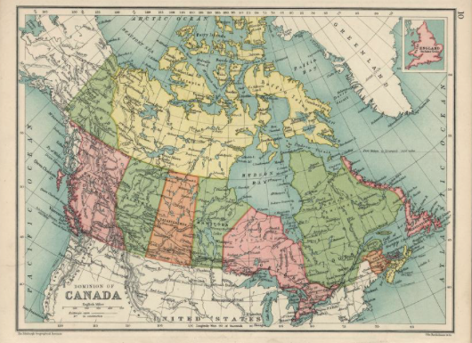
Building a digital library: A case of successful collaborations across library employee groups
The Historical Textbooks Digital Library Team at UVic Libraries​
Session: 4D Time: 2:25pm – 3:10pm​
Vancouver Island Library Staff Conference, UVic ​
April 26, 2019​
Notes:
History of the collection and project

Slide 2
The Historical Textbooks Digital Library Team at UVic Libraries’
Notes:
Librarian, in the Faculty Association. Pia Russell is UVic’s librarian for Education, Indigenous Studies, and Gender Studies.
CUPE 951. Shelley Coulombe is UVic Libraries’ Gifts Coordinator. She has been instrumental in taming the chaos of the physical collection of historical textbooks
CUPE 951. Kathy Mercer is the Supervisor of UVic Libraries Digitization Centre. She loves working in the unit “where the magic happens” and enjoys working with faculty, staff & students on their unique digitization projects.
CUPE 951. Marilyn Wilson began working in the University of Victoria Libraries in 1989, after 12 years at the Greater Victoria Public Library. She has been a cataloguer for the McPherson Library since early 2003.
Co-op Student. Sachi deTreaux is a Humanities Co-op Student and studies Linguistics and Spanish.

Slide 3
An example textbook

Slide 4
Workflow
Planning
Selection​
Inventorying ​
Digitization
Cataloguing ​
Exhibition

Slide 5
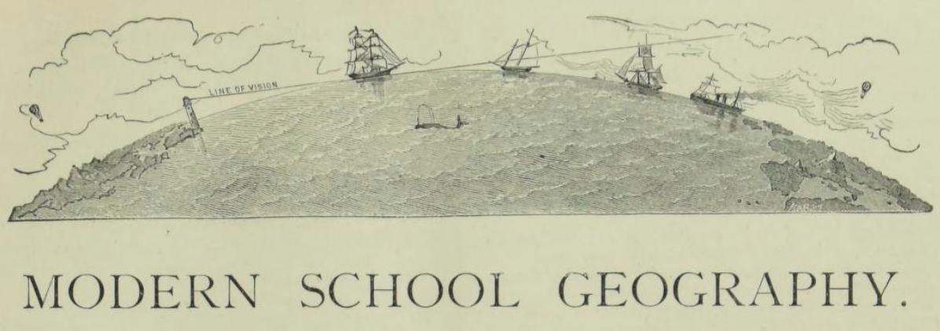
Workflow stage: Project management & title selection—Pia
Project role
Project management
Selection
Grant writing

Slide 6
Workflow stage: Project management & title selection—Pia
Key elements to a successful collaboration
Ask for support, you might be surprised!
Take time for high quality processes and products
Flexibility, trust, empowerment, expertise

Slide 7
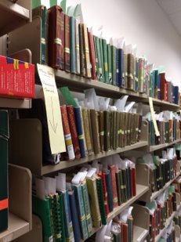
Workflow stage: Acquisition & processing—Shelley
Project role
Incorporate the donated material into the collection by looking at condition, editions, publishers, printings. Maintain an inventory.
Two donation collections of historical textbook were accepted in 2017
Historical Texts Collection moved from Curriculum Library to McPherson Library in 2018

Slide 8
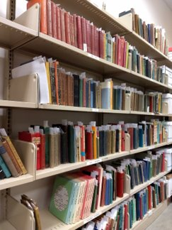
Workflow stage: Acquisition & processing—Shelley
Key elements to a successful collaboration
Stay focused but be open to going off on tangents
Monthly check-ins
Support from our Unit Heads
Enthusiasm
Recognize and respect each person’s expertise

Slide 9
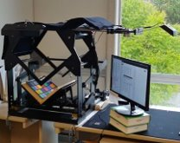
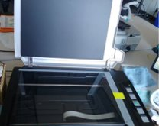
Workflow stage: Scanning & Uploading—Kathy
Project role
Supervising digitization process
Scanning
Uploading to Internet Archive
Notes:
Scanning
The Historical Texts material is primarily scanned using the Internet Archive TTScribe and is operated by one staff member and during the university term, a WorkStudy student has been hired to operate it for 4 hours a week. It’s fairly easy to learn and operate although we did have to make a few modifications to allow operators to either sit or stand. A little ingenuity, at very little cost and we think we have a very good set up.
Internet Archive TT Scribe
Colour control and metadata are added at the beginning of the process and metadata may be edited during the scan process, or after, via a web interface.
Once the metadata is complete, the scanner operation begins.
There are two cameras above the scanner, one capturing the page on the left, the other capturing the page on the right. It is operated by a foot pedal, a numeric pad. Basic operation is push the pedal to raise the book to the glass, click Enter on the numeric pad, to trigger the cameras, lower the book, turn the page, repeat.
The camera on the far right is for large format images (newspapers, maps, foldout pages).
Adding to the Internet Archive without the TTScribe
There are times when material is too large or too thick to fit into the Scribe and in those cases, a flatbed book scanner is used for the scanning.
These items are scanned, images are converted to pdf format and loaded to the Internet Archive via the web interface.

Slide 10
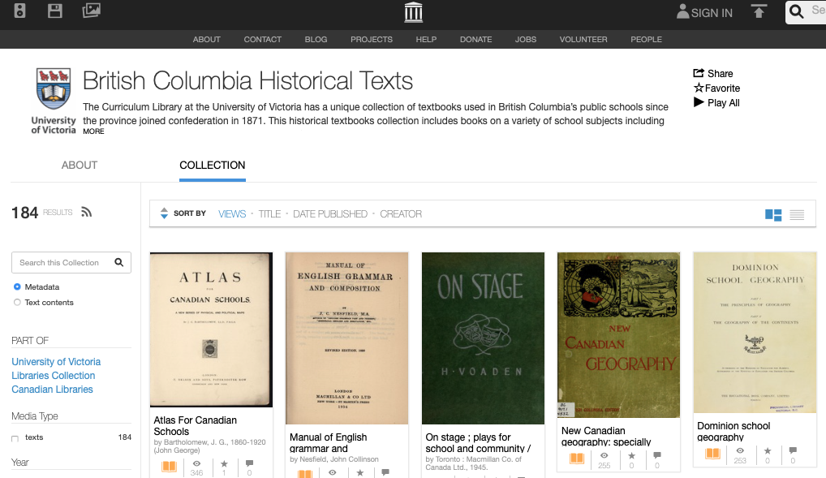
Internet Archive British Columbia Historical Textbooks
Notes:
Once scanning is complete, the images are then loaded to the Internet Archive via the Scribe software and within a few days, they appear on the Internet Archive, with ocr (optical character recognition), in various formats, Daisy, EPUB, full text, Kindle, as well as pdf.

Slide 11
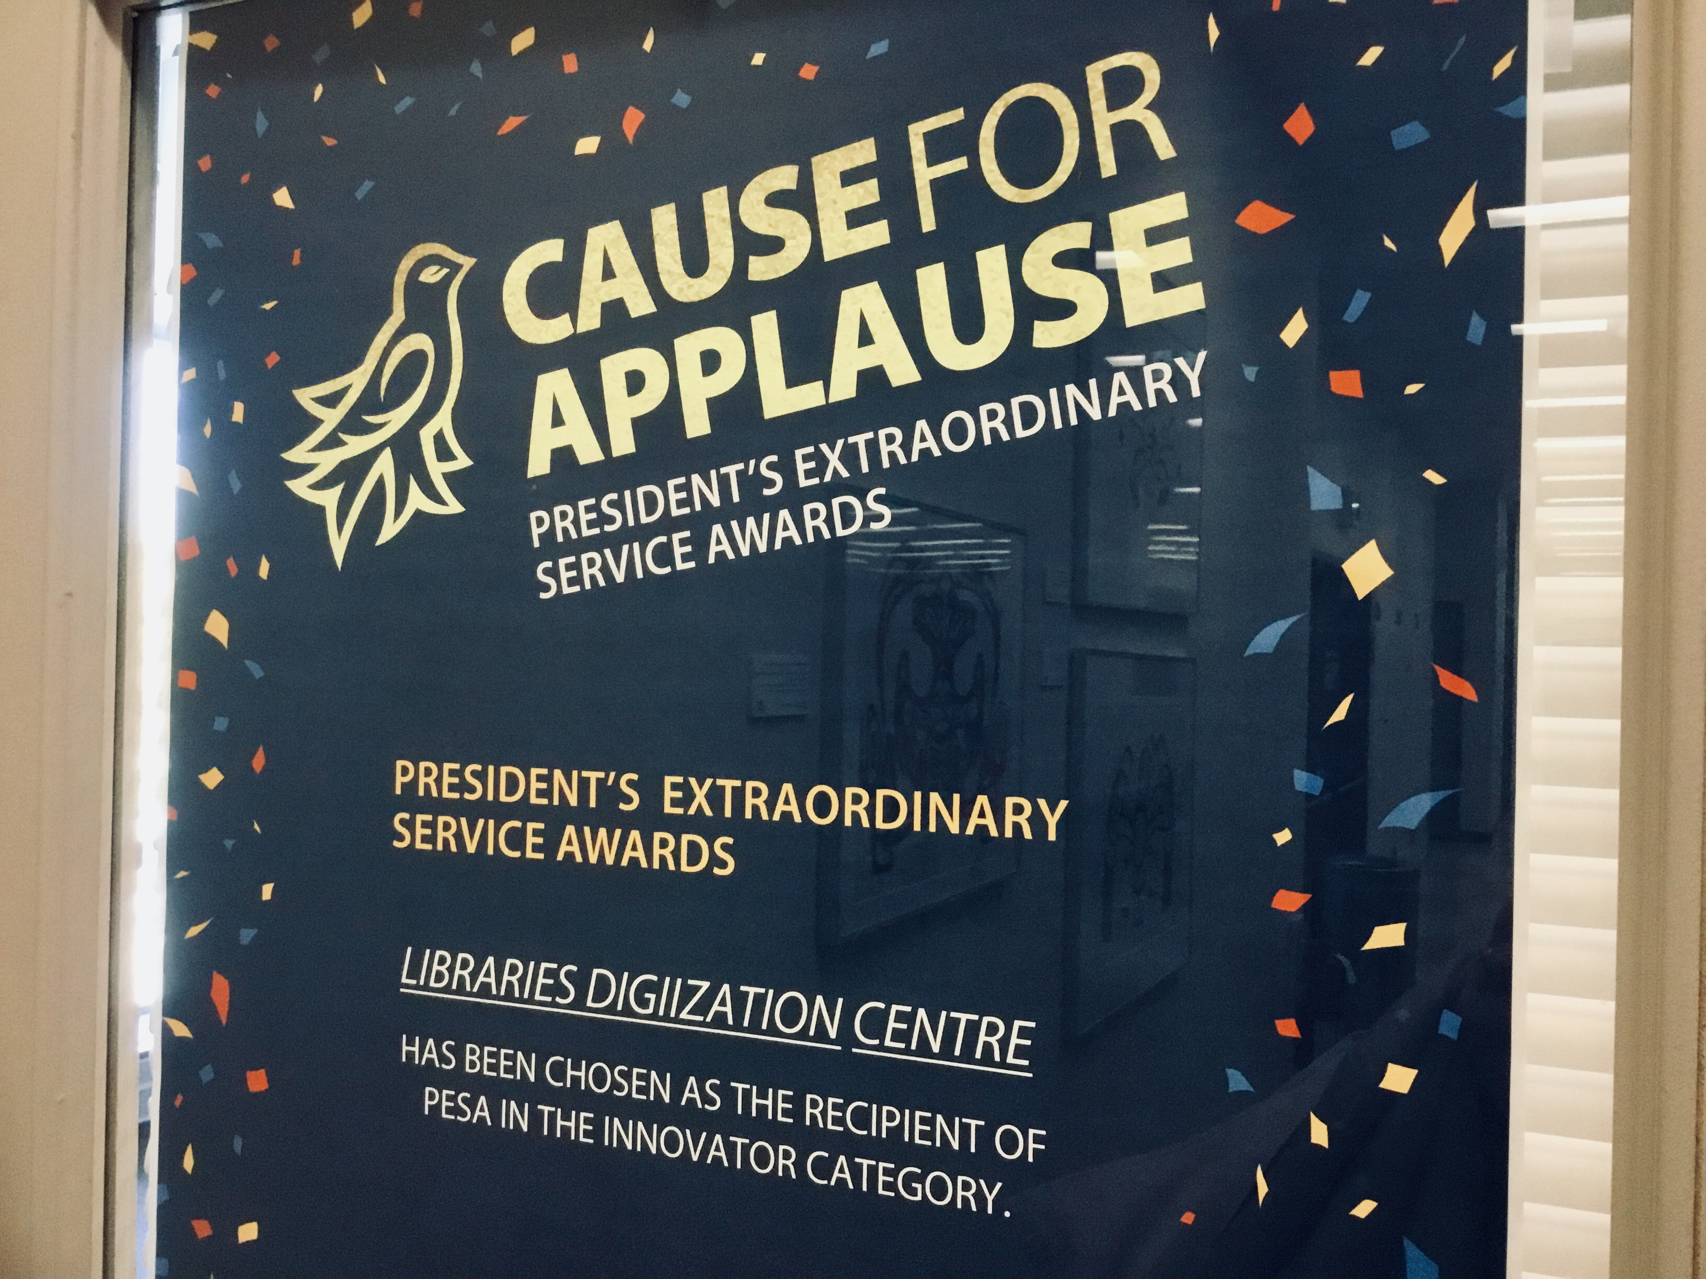
Workflow stage: Scanning & Uploading—Kathy
Key elements to a successful collaboration
Be adaptable
Keep talking together
Take time for high quality

Slide 12
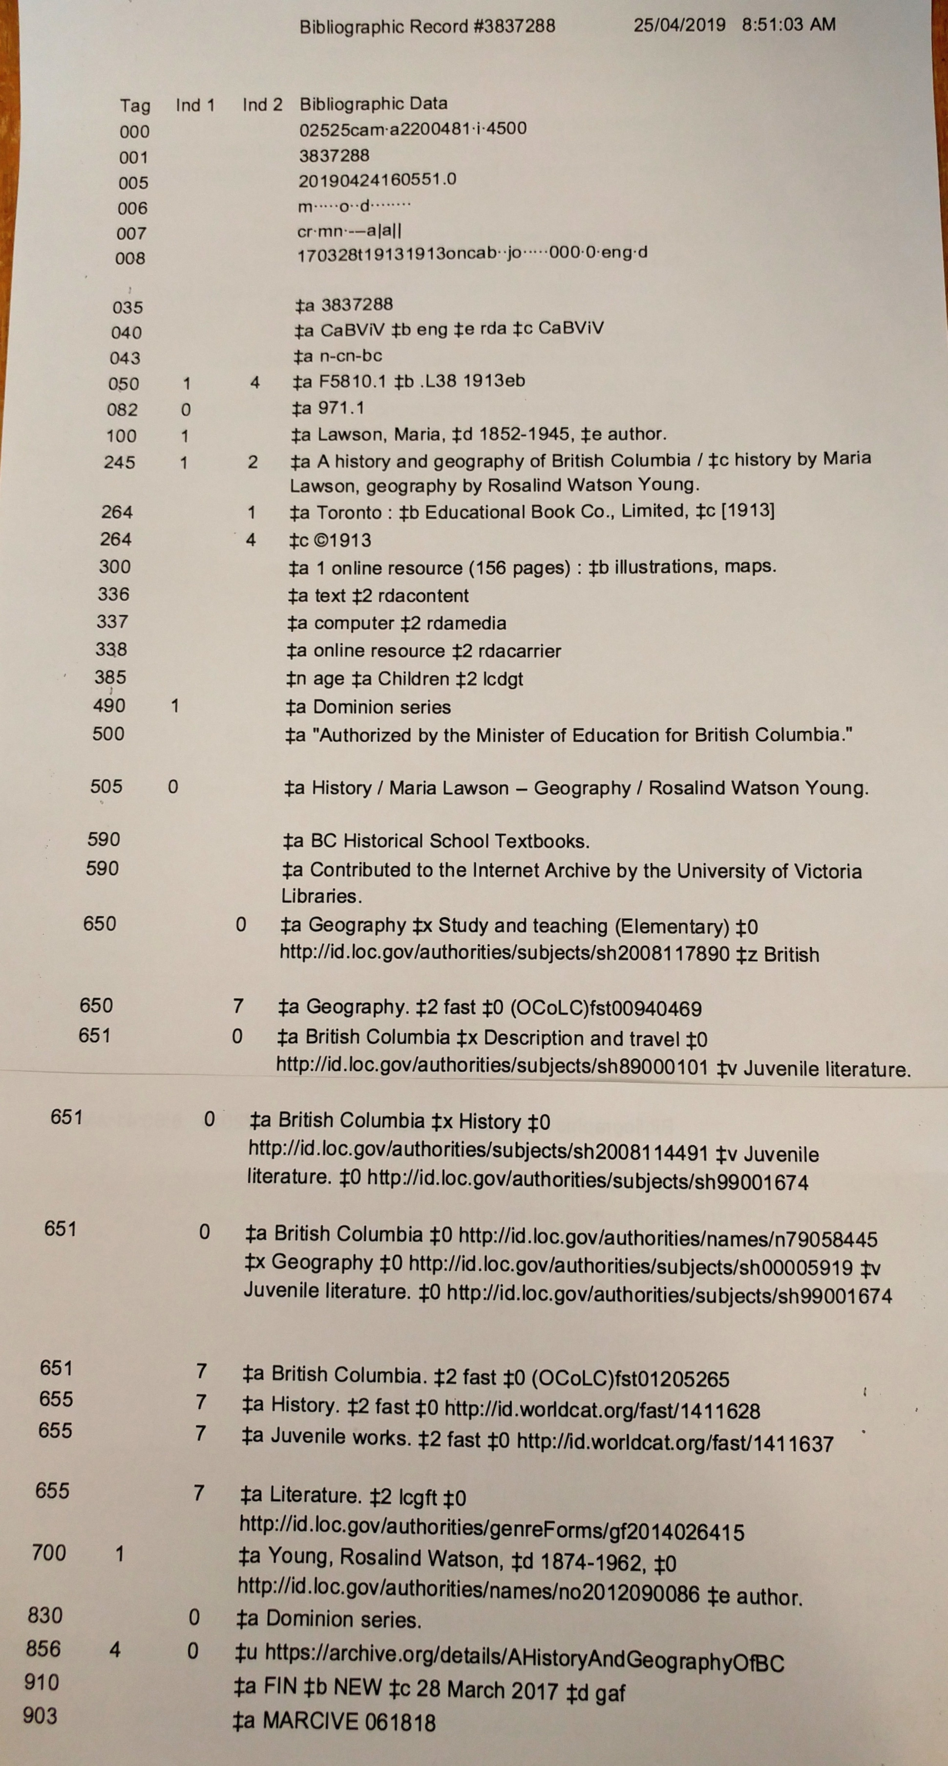
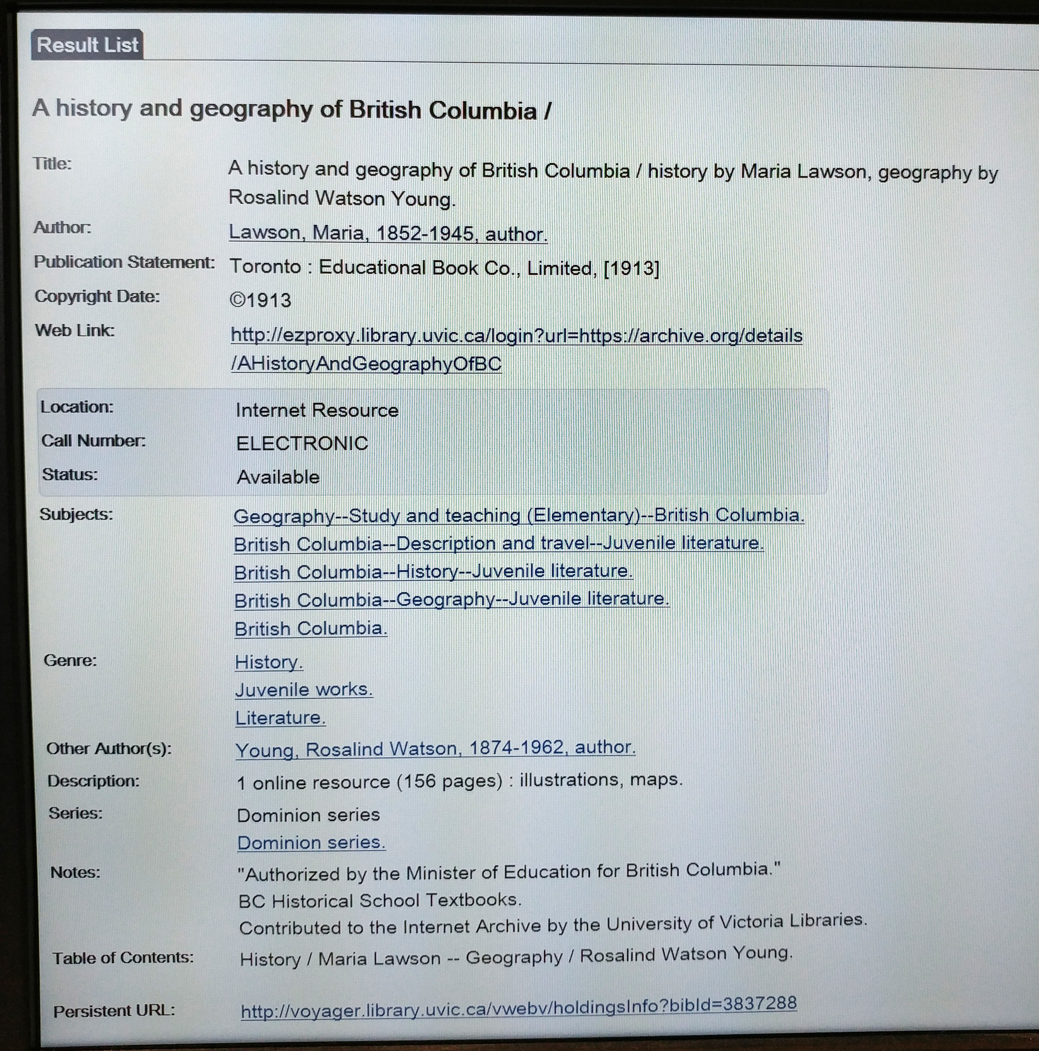
Workflow stage: Cataloguing—Marilyn
Project role
Original cataloguing
Metadata
Description
Notes:
- After the Digitization Unit has scanned the books, they magically appear on my book truck, where they are catalogued by me.
- In short:
- The first thing I do is open the Excel spreadsheet.
- find the book I’m working on
- check the link to be sure it is ‘live’
- I then check for a bibliographic record in Voyager.
- If we already have a record in our database, I work on a copy of that record.
- If not, I check in OCLC Worldcat to find a record there.
- I pull it in to our database, if one exists.
- If not, I create an original.
- I catalogue the monograph, editing and adding appropriate notes as needed
590 – BC Historical School Textbooks
- add note if there is a bookplate
- I create the holdings record and write the call number on an acid-free slip of paper, and attach the barcode to this slip of paper. This stays with the book.
- I scan the barcode number to the spreadsheet.
- Then I construct the second bibliographic record for the digital e-book.
- I make a copy of the bib record I just worked on for the monograph version
- I edit this record to indicate an e-resource, changing some fields and adding others
- I add the note “Contributed to the Internet Archive by the University of Victoria Libraries”
- Add the URL from the spreadsheet to the bib record in the 856 field
- test link
- construct holdings record
- Then I send the books back to Shelley.

Slide 13
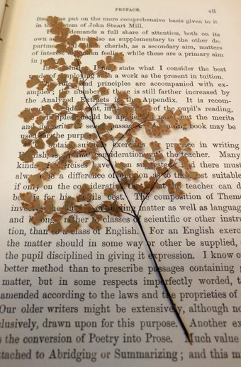
Workflow stage: Cataloguing—Marilyn
Key elements to a successful collaboration
Ask lots of questions
Trust your own expertise
Clear communication is key

Slide 14
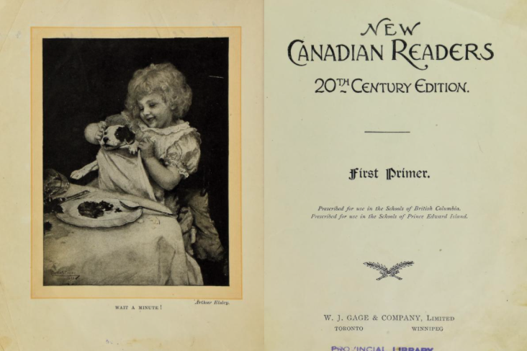
Workflow stage: Digital exhibit development—Sachi
Project role
Assisting with inventorying
Cross referencing titles
Developing digital exhibit content

Slide 15
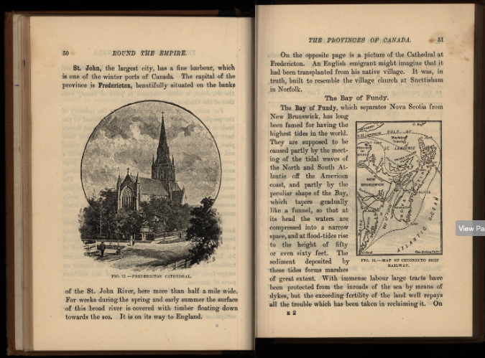
Workflow stage: Digital exhibit development—Sachi
Key elements to a successful collaboration
Ask lots of questions
Space to develop discipline-specific knowledge
Be creative
Make it meaningful to yourself and others

Slide 16
Next steps
More grant applications
Consultation with experts
Text encoding
Digital exhibit development
Learning components

Slide 17
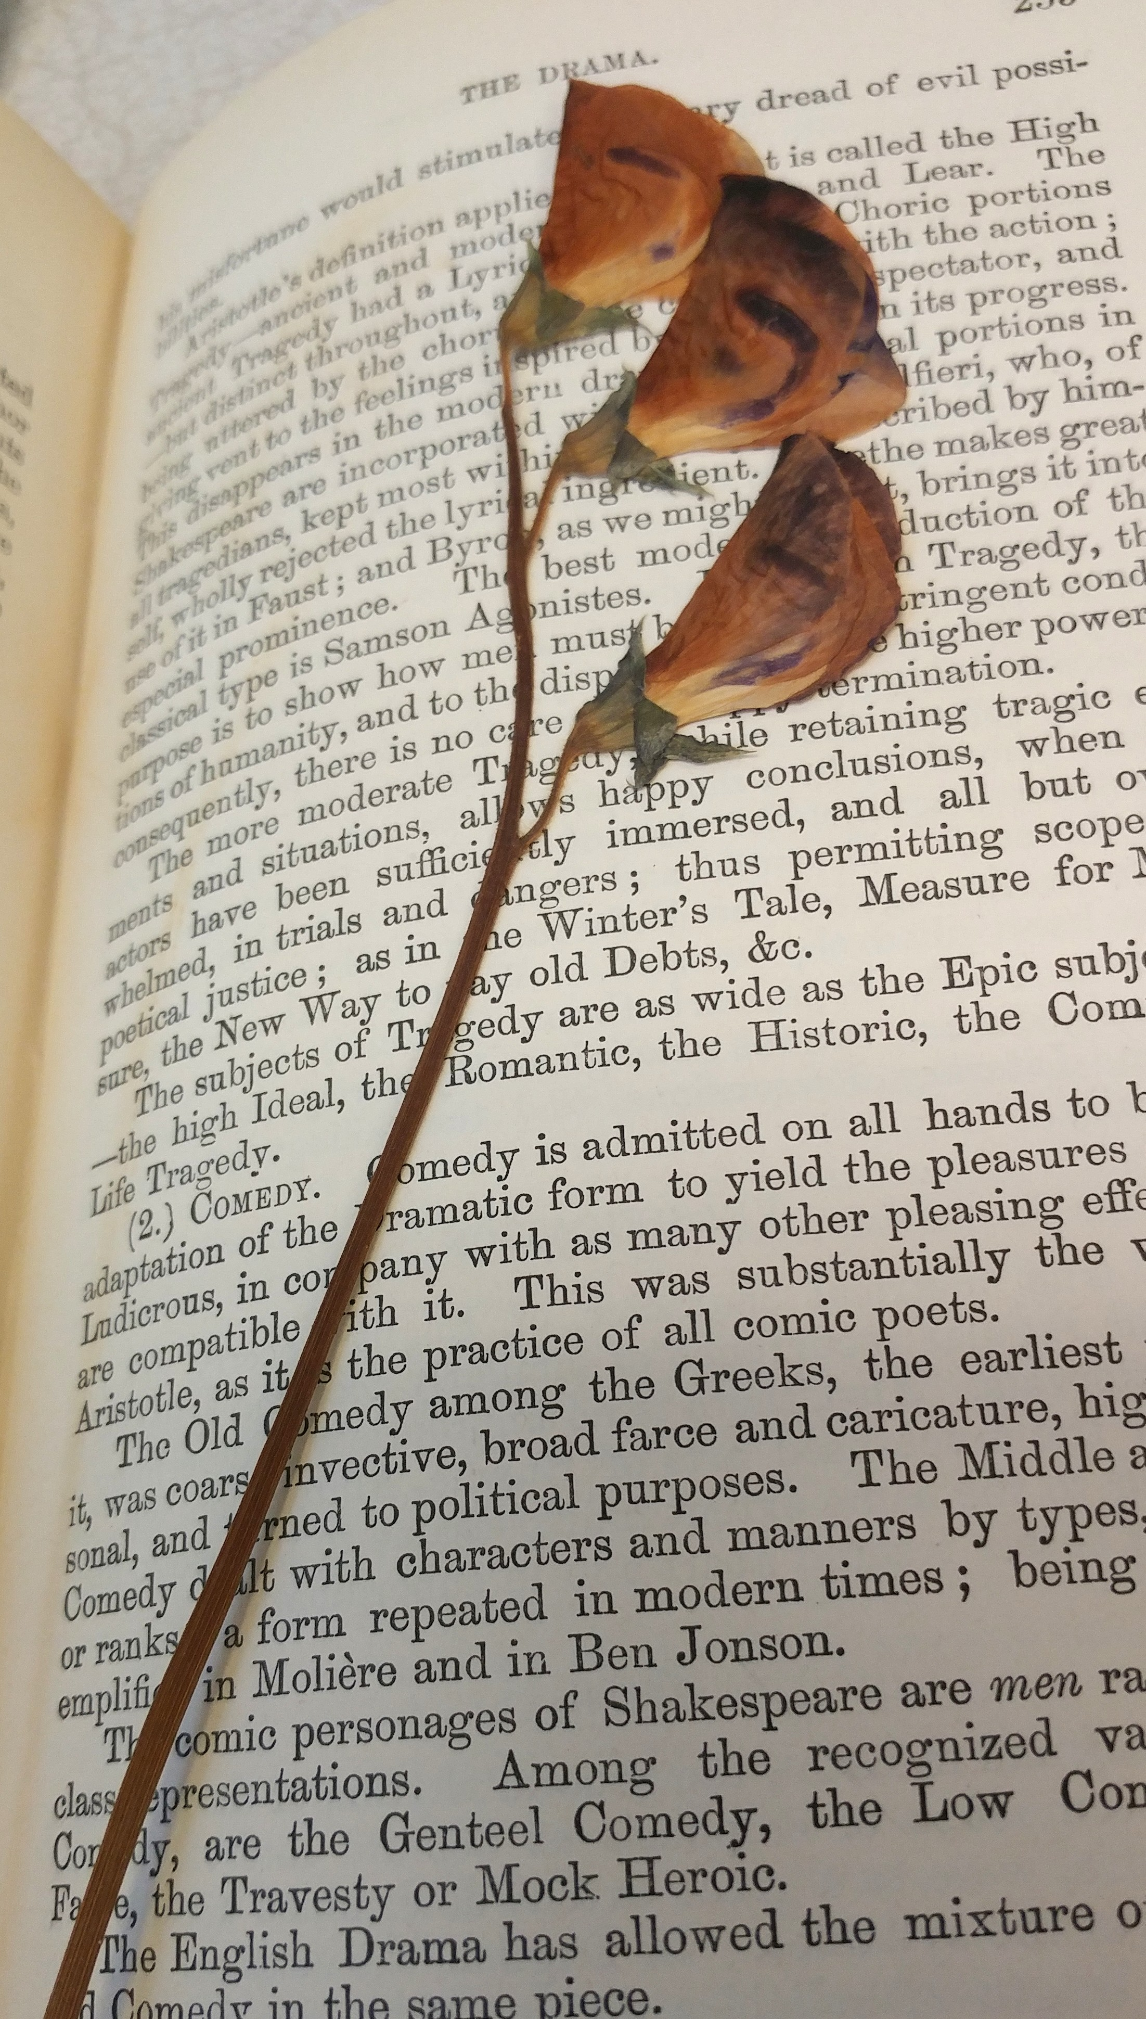
Questions
HÍ,SW̱ḴE SIÁM

Slide 18
