Slide 1
From Blasting to Bridging: Building Electronic Resource Management (ERM) Infrastructure
Patricia Pang, Electronic Resources Assistant & MLIS candidate
Sue Bengtson, Collections Analyst & Business Librarian
Notes:
Sue

Slide 2
Our task
explore CORAL as an potential ERM for UVic Libraries
if suitable, develop recommendations and best practices for maintaining the information with workflow documentation
WHY?
“Having data to make informed decisions related to acquisitions, budget allocation and collection strategies will benefit all areas of the libraries.” AUL Learning & Research Resources
Notes:
Sue

Slide 3
Our ERM needs
Central location of information
Usage statistics
License agreements
Vendor relationships
Renewal information
Consistency of format
Elimination of duplication
Transparency – readily accessible shared location
Notes:
Sue

Slide 4
Our current situation
Multiple locations for stored information
Not easily accessible, especially comparisons across platforms
Admin account holders “gatekeep” access usage statistics
Multiple systems & multiple logins requires management of passwords
Historical knowledge and notes on licenses kept in personal emails and experience
Different Excel spreadsheets for different types of information
Notes:
P

Slide 5
Three guiding principles:
Open
Engaged
Enduring

Slide 6
Communication, in particular intra-unit communications, was identified as an obstacle to achieving UVic Libraries’ Strategic Directions
Photo Credit: Negative Space from Pexels
Notes:
Photo by Negative Space from Pexels

Slide 7
Options to consider
Intota | CORAL ERM | LibInsight
Proquest – part of a bundled subscription to Summon, 360 Link, etc | Open source software first released in 2010 Initially developed by University of Notre Dame’s Hesburgh Libraries. | Springshare – a neutral third-party vendor
Reports (COUNTER, Library, 360 Usage, Ulrichsweb Usage) | Resources – data related to resources Licensing - licenses Organizations – contact & account details for vendors, publishers etc Usage Statistics Management – document management of policies, workflow, procedures etc | Datasets (e.g. Circulation, COUNTER 5, Acquisitions, ILL etc.) Dashboards, Analyze
Notes:
Patricia

Slide 8
Experience with LibAnswers as a workflow solution
Centralized spot for problem reports
Transparency for training purposes
Keep statistics
Track status of inquiry
Ability to claim tickets prevents duplication of responses
Notes:
Patricia

Slide 9
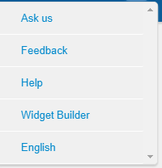
Summon 2.0 Reports
This is found on the Summon Search page.
Feedback is sent to the personal email of 4 librarians on the Discovery & Linking Technologies Committee
Notes:
Patricia

Slide 10
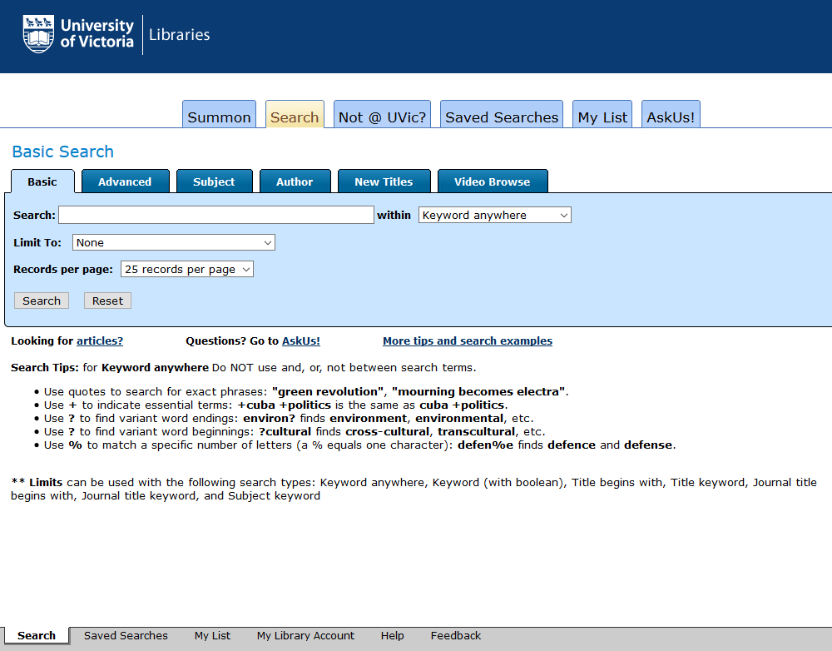
Voyager Feedback
This is found on our catalogue page.
Sent to 4 personal emails (Systems Librarian, librarian working on website redesign, and 2 unit supervisors) and the Serials unit email
Notes:
Patricia

Slide 11
360 Link Problem Report
Sent to askref@uvic.ca, esource@uvic.ca, and Discovery & Linking Technologies Committee chair
Notes:
Patricia

Slide 12
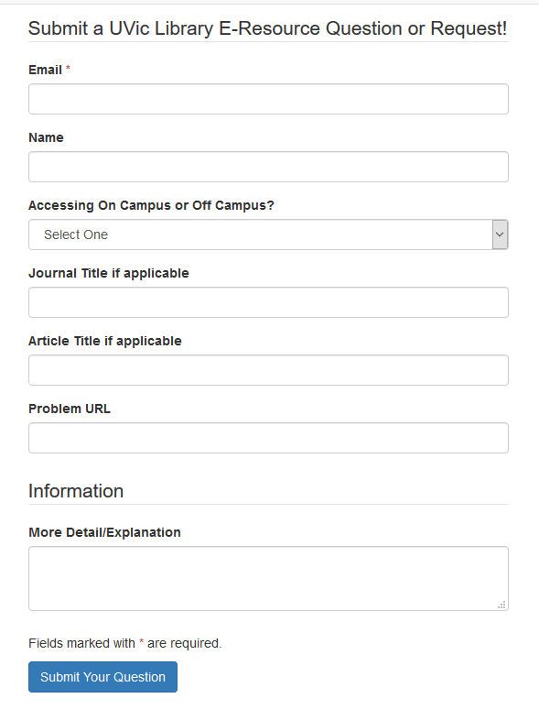
LibAnswers
So…yet another form BUT it starts a ticket
Notes:
Patricia

Slide 13
Notes:
Patricia

Slide 14
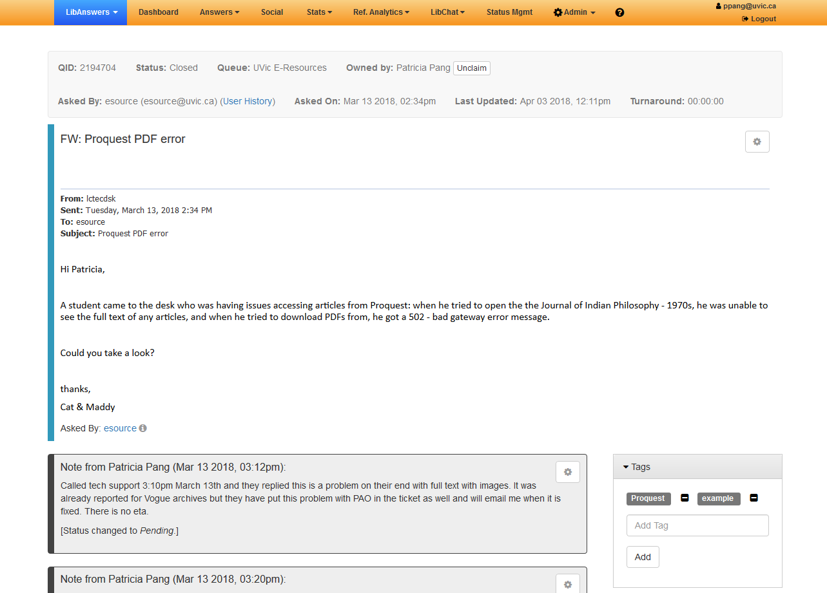
Notes:
Patricia

Slide 15
Springshare Suite
LibGuides
LibInsight
LibAnswers
LibWizard
LibCal
Libstaffer
Libguides CMS
Bundled subscription is more cost effective than individual subscriptions
Springshare subscriptions desired
Current Springshare subscriptions
Notes:
Sue
LibGuides CMS (Platinum Version) – provides more
LibStaffer – create schedules and
LRIG-what it means
LibCal as a libraries wide calendar implies a more holistic approach

Slide 16
Constraints of moving to a new system
Cost
Training
Organizational buy-in
Time available for trialing and implementation
Requires consultation with stakeholders across organization
Infrastructure support and maintenance
Notes:
Sue

Slide 17
No matter what system we use, it has to be…
Collaborative
Provide transparent access
Easy for librarians and staff to log in and use
Able to start small, scale up
Embrace its potential
We also have to…
Notes:
P

Slide 18
Next steps
Wide ranging consultation
Presentation scheduled for next month’s Libraries Council
How do we know we’ve consulted with the “right” people
Identify stakeholders across the organization for draft working groups
Consider innovative applications
Notes:
Patricia

Slide 19
Questions?
Patricia Pang – ppang@uvic.ca
Sue Bengtson - suebeng@uvic.ca

