Slide 1
Growing faculty relationships through proactive communication
Caitlin Keenan (she/her/hers) Librarian, user experience, outreach, and assessment Royal Roads University
VILSC, May 5, 2023
Photo by Akil Mazumder

Slide 2
I humbly acknowledge my status as an uninvited visitor on the traditional, unceded lands of the Xwsepsum, Lkwungen, Songhees, Esquimalt, and W̱SÁNEĆ ancestors and their families.

Slide 3
Agenda
Why a newsletter?
Preliminary considerations
Our launch experience
Lessons learned
Does the return on investment of publishing a newsletter justify the costs?

Slide 4
Why a newsletter?
Faculty interviews revealed:
General feeling of “missing out”
No time to seek out support
Interest in push communications
Notes:
Why we chose to launch a newsletter
Core faculty interviews -- sense that they're missing out on relevant services and resources but don't have the time to seek out support
Interest expressed in receiving push information from the Library -- "I might or might not read it, but I'll be glad to receive it and then I can choose that level of engagement for myself" -- "wouldn't be a bother"

Slide 5
Why a newsletter?
Quick poll! Does your library currently have a newsletter?
Gaps in current outreach model
Sporadic group emails
Reliance on one-on-one connections
Problem of scale
Notes:
Currently (previously) our outreach was sporadic -- emails to groups about new resources, one-on-one connections sharing interesting links. Speak to lack of a liaison model and no way to individually support core + associate faculty

Slide 6
Goals
Increase engagement with Library and awareness of relevant services and resources.
Raise the overall profile of the Library within the University community.
Foster a sense of belonging among faculty and encourage collegial interactions.
Notes:
We wanted a platform for highlighting new and underused resources, increasing familiarity with services and expertise, and announce timely things like events, displays, research activities.
We also hoped it would foster a sense of belonging among faculty and encourage more open dialogue, faculty reaching out with questions, etc.

Slide 7
Scope considerations
Distribution list
50 recipients? 500? 5000?
Frequency
Biweekly? Monthly? Sporadic?
Contents
Regular sections? What’s interesting? What’s sustainable?
Notes:
Audience -- core faculty as a key focus, with assoc faculty and exec as secondary audiences.
For us, this meant a distribution list of around 600. Size of audience becomes a consideration point when thinking about platforms, as many have a limit of 500 subscribers on a free account (size also matters on pay-per-email accounts).
Frequency -- a point of some contention. We needed to make it sustainable but frequent enough to be part of faculty's expected interaction.
Contrasting opinions -- biweekly vs monthly.
Wound up announcing it as "once or twice a month", aiming for biweekly without promising that, and figured we'd identify a good period based on the first few issues.
Contents -- a couple of standard sections, plus some based on need/rotation. Aiming to keep it to a handful of sections so it's never overwhelming.
Featured product or service
New books
Rosie's Reads
ScholComm corner
Search tips -- when there isn't an announcement
Announcements -- as needed

Slide 8
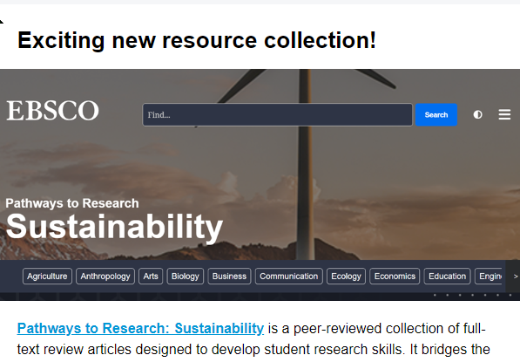
Sections
Featured product or service
New books
“Rosie’s Reads”
Scholarly Communications corner
Search tip
Announcement
Notes:
Audience -- core faculty as a key focus, with assoc faculty and exec as secondary audiences.
For us, this meant a distribution list of around 600. Size of audience becomes a consideration point when thinking about platforms, as many have a limit of 500 subscribers on a free account (size also matters on pay-per-email accounts).
Frequency -- a point of some contention. We needed to make it sustainable but frequent enough to be part of faculty's expected interaction.
Contrasting opinions -- biweekly vs monthly.
Wound up announcing it as "once or twice a month", aiming for biweekly without promising that, and figured we'd identify a good period based on the first few issues.
Contents -- a couple of standard sections, plus some based on need/rotation. Aiming to keep it to a handful of sections so it's never overwhelming.
Featured product or service
New books
Rosie's Reads
ScholComm corner
Search tips -- when there isn't an announcement
Announcements -- as needed

Slide 9
Platform considerations
Factors to consider:
Cost
Privacy
Audience cap
Statistics module
Notes:
Platform -- Campaign Monitor (supported by institutional subscription)
We needed it to be cost-neutral
SpringShare has a cool module but we don't subscribe and didn't have the budget to add it (maybe eventually)
A lot of free platforms have audience caps and/or privacy concerns (information stored on US servers)
Looked at PDF by email or a Google newsletter, but poor options for statistics
Campaign Monitor is free to us and the institution has already done the vetting. It also offers solid analysis tools.

Slide 10
Launched: January 12, 2023

Slide 11
Initial engagement
This is a such a great idea and a great production. I really enjoyed perusing all of this.
Such a wonderful initiative. Many thanks. I love it.
This is awesome and I found it very helpful in research for materials for my courses. Well done and keep up the good work!
Wow! Thanks a lot to you wonderful Librarians!!

Slide 12
Ongoing experience
6 issues so far
Stabilization in engagement
Open rate: 23.5%
Click rate: 4.65%
Open rates underreported
Ongoing positive anecdotal feedback
Uptick in faculty engagement??
Notes:
Wow! Thanks a lot to you wonderful Librarians~!
Ongoing engagement
Immediate dip and stabilization
Note of caution around open rates: opens are only recorded if recipient choses to display images -- a feature which is automatically turned off in our email server. So the actual open rates are likely much higher
Open & click rates are approx industry standard for educational sector
We've received positive anecdotal feedback on every issue so far
Have we noticed an uptick in the quantity or quality of faculty interactions with the library as a result?
Each newsletter has generated at least a couple of outreach encounters with faculty -- folks have responded to the newsletter to ask for help with sourcing course materials, troubleshooting their own technical issues, and schol comm support.

Slide 13
Now we know…
Frequency
Collaboration
Time commitment
Notes:
What have we learned about best practices in terms of timing, content, and design?
Frequency: biweekly was too much, and we noticed a drop-off in engagement and increased unsubscribing. (We don't want to be annoying or overwhelming). We also decided probably nobody but us was actually keeping track of the period, so it didn't need to be rigid necessarily. Now we're nominally on a 3-week schedule, but we shift it as needed based on optimal timing for announcements, vacation times, etc.
How much effort is it to maintain a publishing schedule post-launch, and what are some techniques for mitigating that effort?
The two-week schedule was hard to maintain, but 3-4 weeks is working well.
Collaboration -- different people responsible for different elements (Rosie's Reads, ScholComm corner.)
Maintain a brainstorming document for anybody to drop in ideas for each of the main sections.

Slide 14
So: does the return on investment of publishing a faculty newsletter justify the costs?

Slide 15
Thank you
Caitlin.Keenan@royalroads.ca

