Slide 1
Oasis in the Courthouse
Heather Reid
Library Technician
Vancouver Island Library Staff Conference
May 2023

Slide 2
Welcoming everyone back to our library
Courthouse Libraries BC serves legal professionals and members of the public who are seeking information to help them deal with legal matters ranging from divorce to probating wills, and from evictions to personal injury
In April 2022 we flung our doors wide open to the public after two years of remote and appointment-only legal research services
People often come to our space at stressful time in their lives and we want to make everyone feel welcome

Slide 3
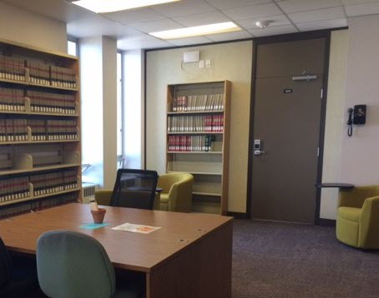
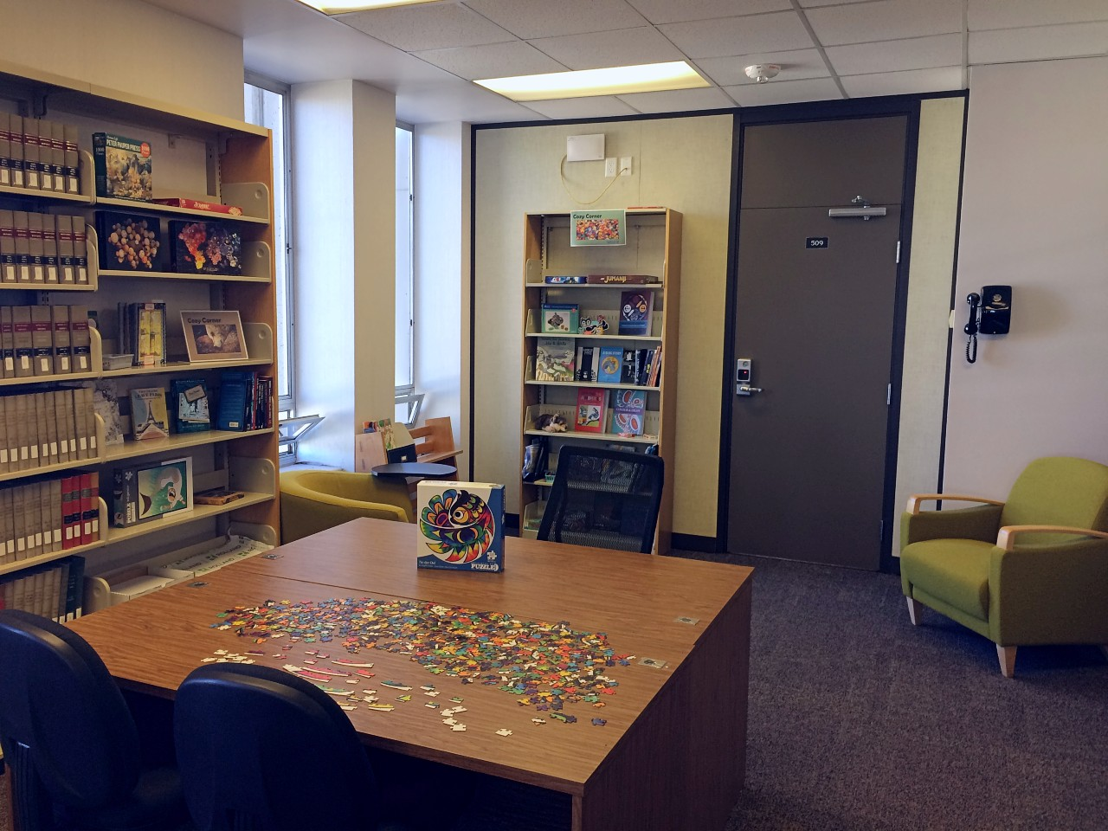
Creating the Cozy Corner
With a small budget in hand, we decided to create a leisure area in a quiet corner of the law library where people can take breaks from the difficult or stressful work they’ve come to do

Slide 4
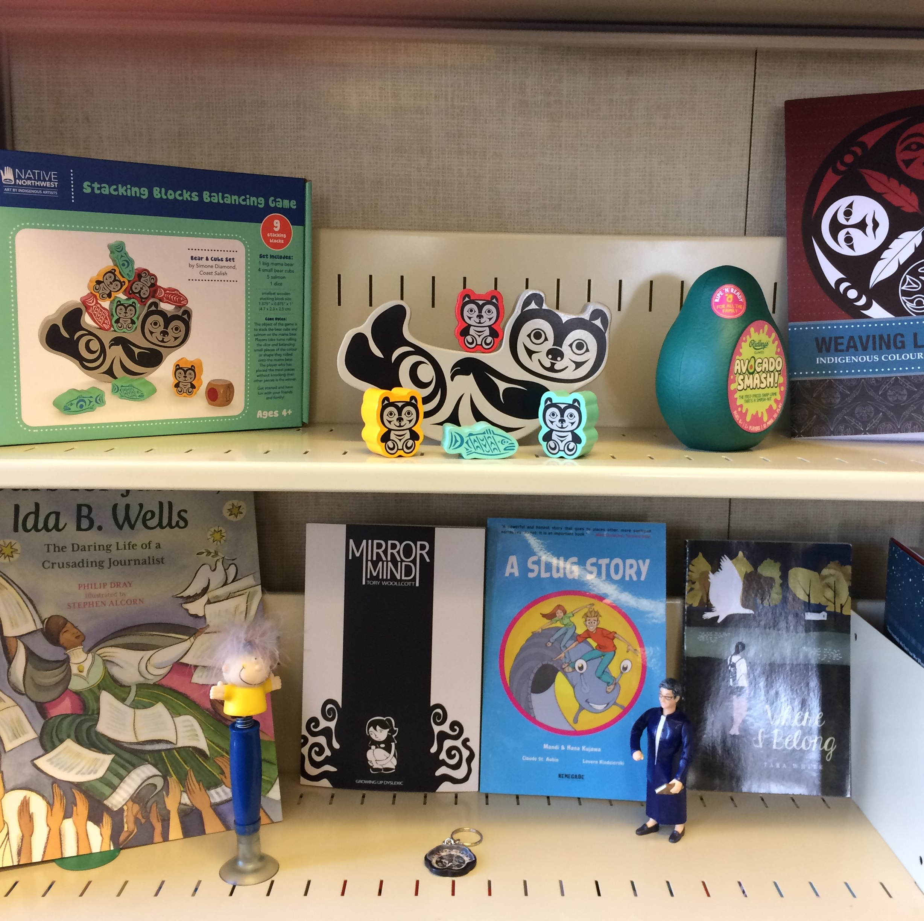
Encouraging the hesitant
We thought about the many people who hesitate before entering our space, unsure of whether they belong, or will be welcomed. With that in mind we particularly wanted to let parents and Indigenous visitors know that this is a space for them, just as much as it is for the legal professionals who use the library

Slide 5
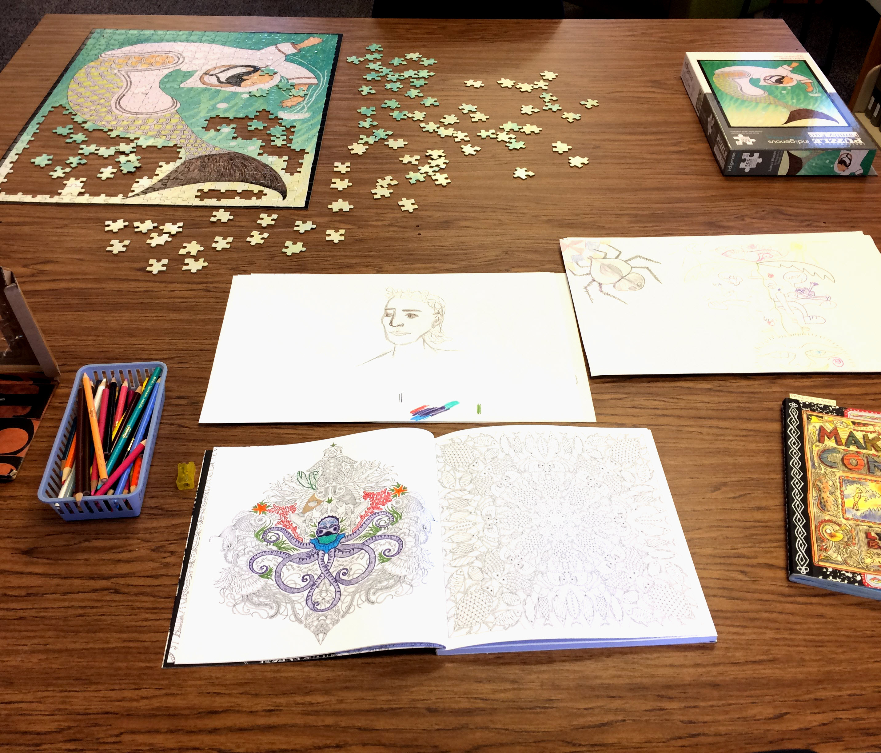
Read, play, have fun or decompress
Because the courthouse can be an intimidating place, we wanted to provide a variety of ways for people to rest or even have some fun
We are glad to find new artworks and completed puzzles that sometimes get done after hours – a very unusual thing about our libraries!

Slide 6
What we’ve observed
Lawyers like doing jigsaw puzzles just as much as we do
Parents trying to fill out forms on a computer appreciate the toys and books for their kids
Courthouse employees enjoy taking their lunches in easy chairs looking out at a beautiful view
Clients share more about themselves in this informal recreation area

Slide 7
Keep in touch!
We welcome your referrals for legal information
Or visit one of our 30 locations across BC!
www.courthouselibrary.ca
@THECLBC
COURTHOUSE LIBRARIES BC

