Slide 1
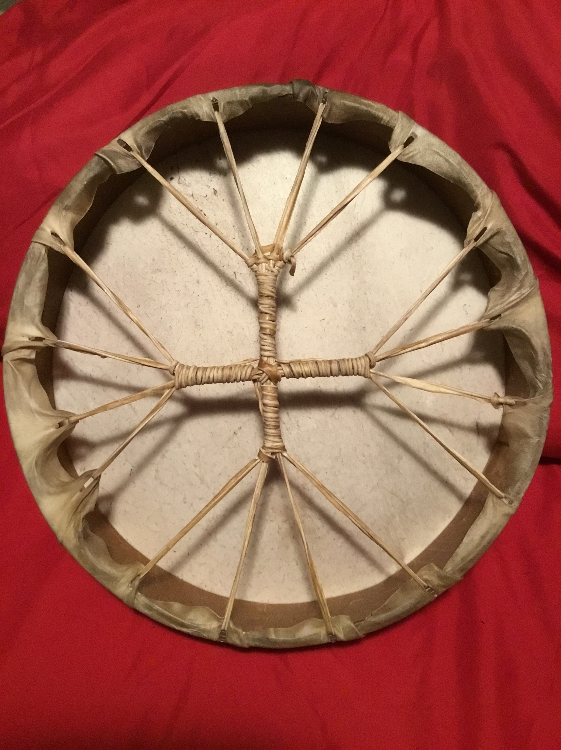
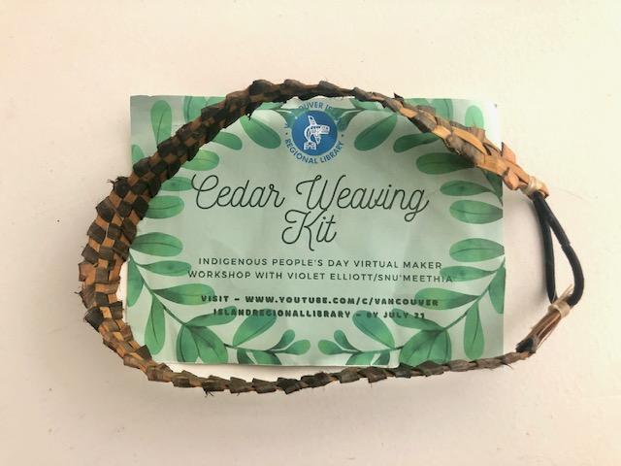
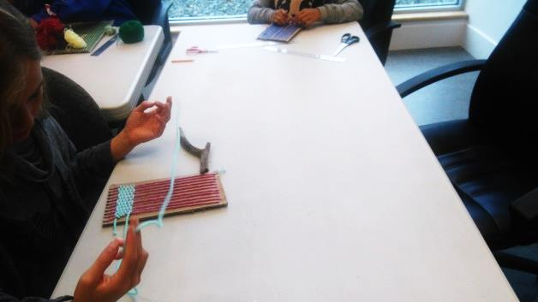
Traditional Knowledge in the Makerspace: Incorporating Indigenous-led Programs for STEAM Success
Vancouver Island Staff Conference 2022
Dalia Levy, Customer Services Librarian, MLIS

Slide 2
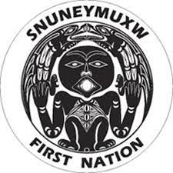
Introduction
Terms of Reference
STEAM promotes the development of multiple literacies beyond reading and writing
Indigenous is a general term that refers to Inuit, Metis and First Nations peoples
Indigenous-led means following guidance and teachings of Indigenous-identifying peoples
EDI stands for equity, diversity and inclusion
Speaking from my personal field experience
Trigger warning: This presentation mentions the effects of residential schools and colonization

Slide 3
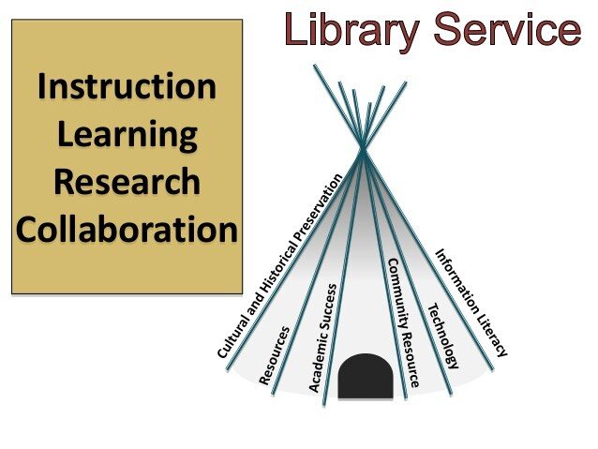
Overview
Barriers of access and library service delivery
Creativity Commons case study for building Indigenous traditions into hands-on makerspace programming for all ages
How do we incorporate STEAM literacies?
Decolonizing Community-led engagement
Best practices and resources for successful program delivery and engagement

Slide 4
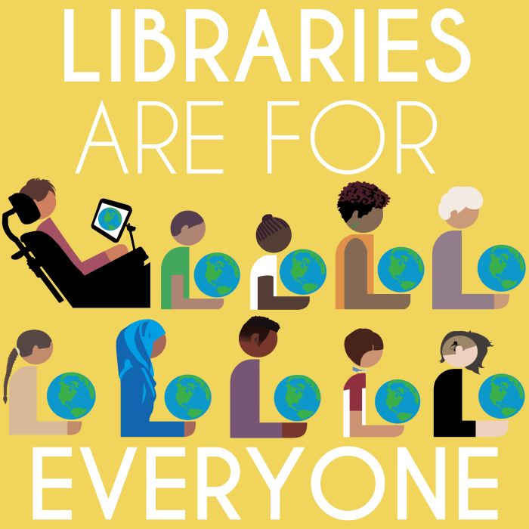
Libraries are for Everyone?
Indigenous peoples in Canada continue to face social and racial barriers as a direct result of colonization and residential schools in Canada –even at the library
Many view gov’t institutions as colonial spaces
Libraries play a crucial role in building welcoming public space and 21st century learning for all – we need to go the extra mile to make this a reality
TRC commenced in 2008 and gathered testimony from four thousand residential school survivors
The final report referred to a “cultural genocide”
TRC Calls to Action includes publicly-funded cultural spaces like libraries
Look to Truth and Reconciliation Committee of CFLA for guidance

Slide 5
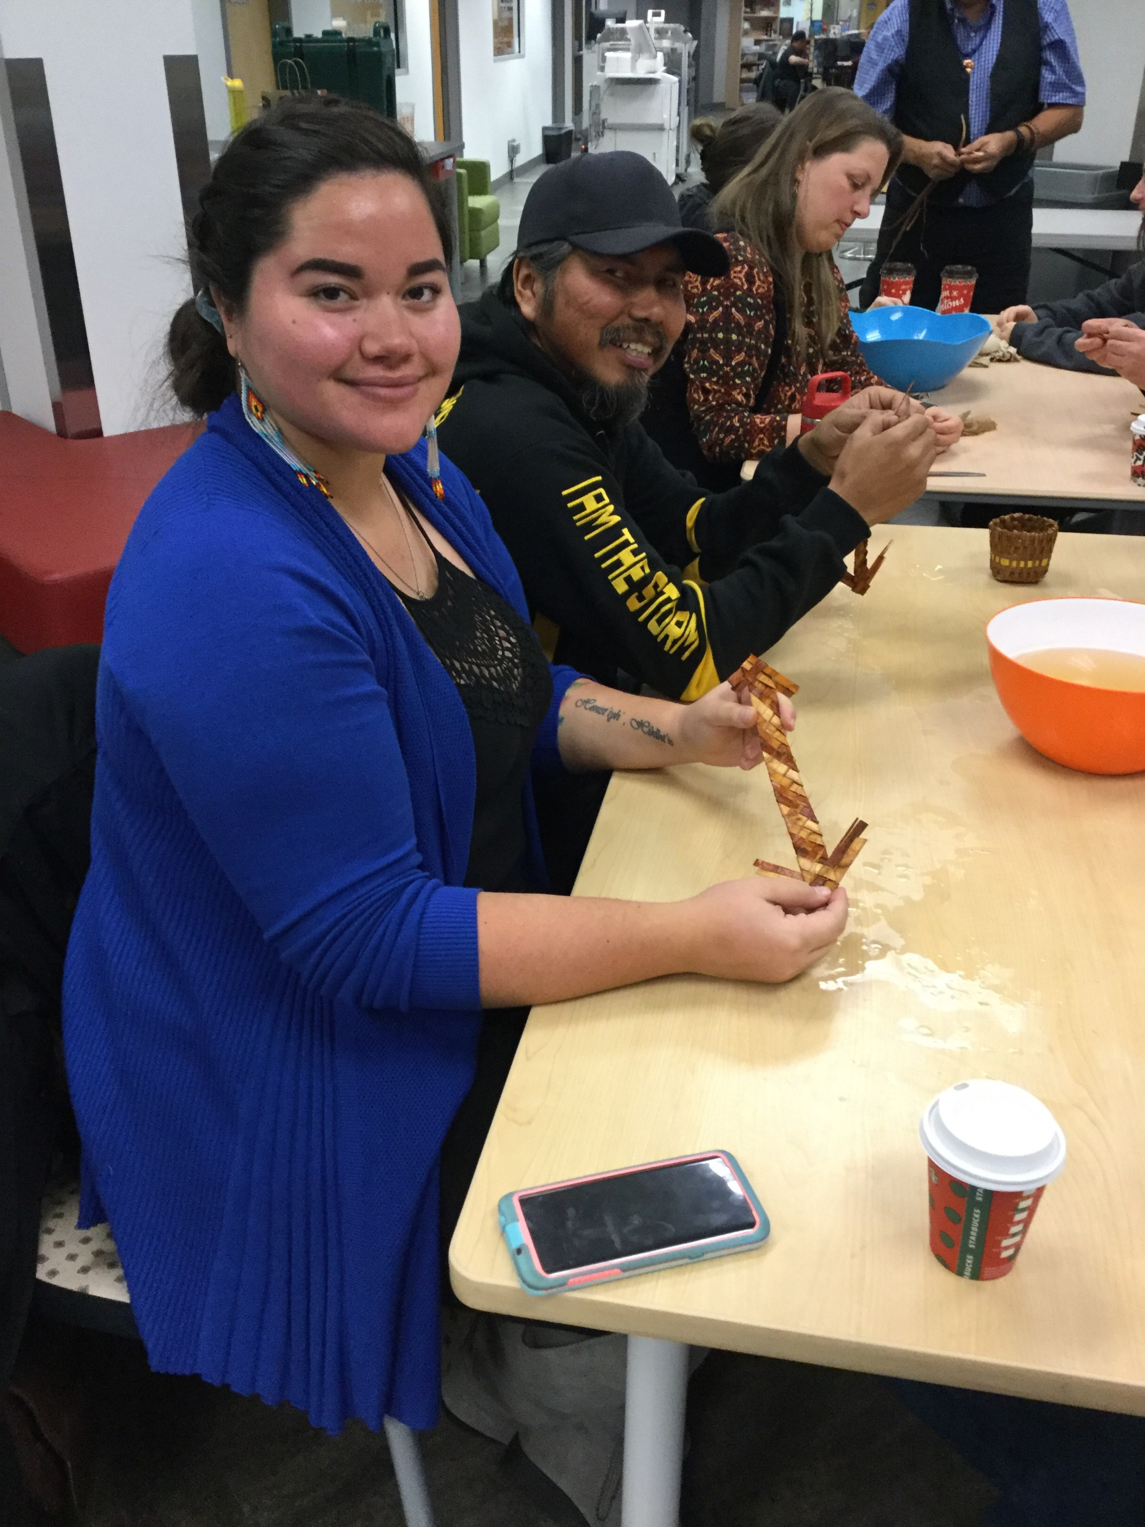
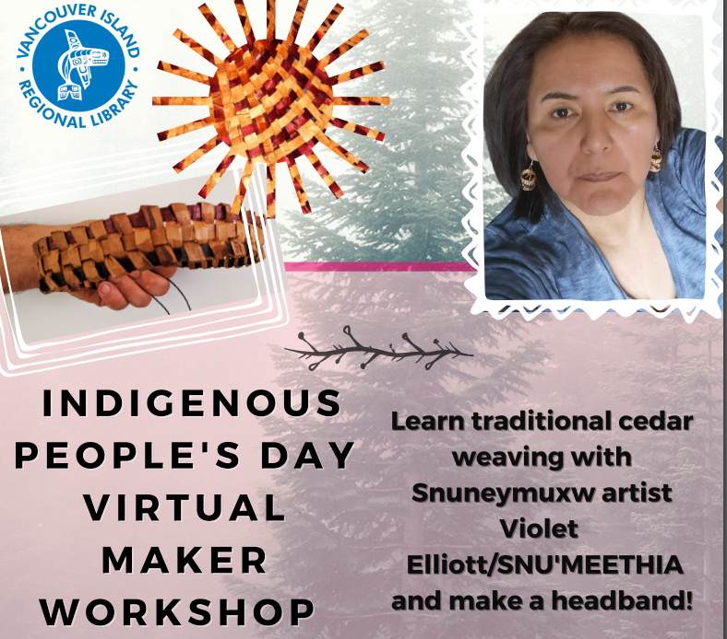
Creativity Commons Case Study
In 2019, the library makerspace launched and I joined VIRL
I took initiative to build relationships with local stakeholders such as Indigenous artists, Elders and Indigenous orgs interested in sharing traditional knowledge through workshops
So far we have hosted Indigenous-led workshops both in-person and online such as traditional drum-making, cedar weaving, loom weaving and sound art.
Youth and families have been very interested and eager to participate
Last year’s Indigenous People’s Day Virtual Maker workshop saw close to 400 views on YouTube
Kits take away barriers to access traditional materials and rewards Elders for gathering materials, partaking in authentic cultural practices, and transmitting knowledge
We gave out over 100 cedar weaving kits which is what was feasible for Elder. We could have given away triple that amount!
Got permission to recommend use of ribbon so more people could participate

Slide 6
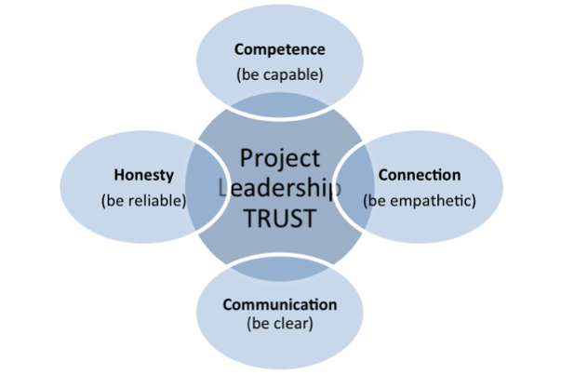
Community-Led Engagement
Assessing community need through outreach → active listening
Requires patience, hard and sometimes painful work and long term commitment to reconciliation
Get training → Trauma-informed practice, cultural awareness, effects of colonization
Follow cultural protocols/traditions
Come from a place of openness and repair
Doing work in community means letting go of expectations and building trust
“Half of life is showing up”
Keep at it!

Slide 7
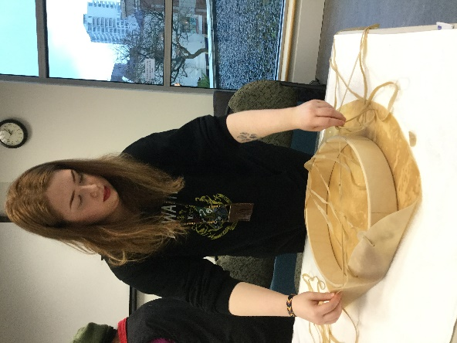
STEAM Learning Applications & Outcomes
All ages programming → family-friendly
Incorporate many literacies through the transmission of cultural knowledge & reviving of craft traditions
Applications: scientific exploration, art, math and physics in textile arts, science of sound, A/V tech, applying plant knowledge as tech+ so many more!
Introducing Indigenous Knowledge-keepers into library programs = gateway to long term connections → comprehensive cross-promotion of resources and services
Provide multi-cultural literacy development
Inclusive and welcoming space for 21st century discovery

Slide 8
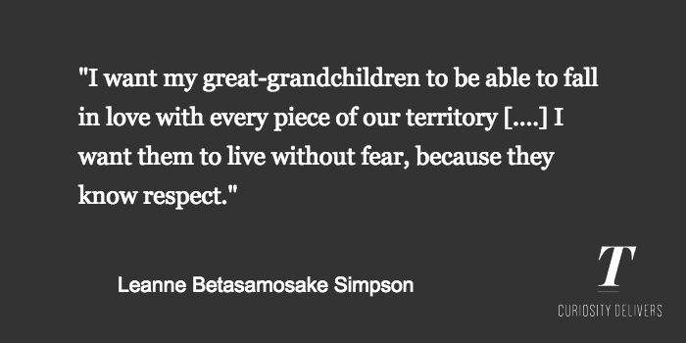
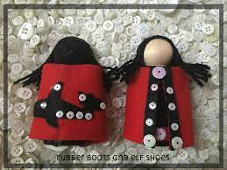
Best Practices
Do’s and Don’ts for working with Indigenous communities
Participate in community-led engagement and outreach
Get training → Trauma-informed practice, cultural awareness, effects of colonization
Localize and represent Metis and Inuit community members
Diversify mediums & STEAM literacy foci
Communicate reminders and follow-up with presenter
Build relationships as opposed to partnerships
Acknowledge Indigenous traditions through monetary rewards for time and supplies
Clearly state deliverables and keep your promises
Market workshops to Indigenous-run orgs
Prioritize registration space for Indigenous youth
Follow the wishes and instructions of your presenter
Give constructive feedback and opportunities to try again
Facilitate from the sidelines as a supportive coordinator
Don’t discount existing non-Indigenous partners’ ability to help with cross-promotion and sponsorship
From Islands of Decolonial Love: Stories and Songs. Leanne is a member of the Mississauga of the Nishnaabeg.

Slide 9
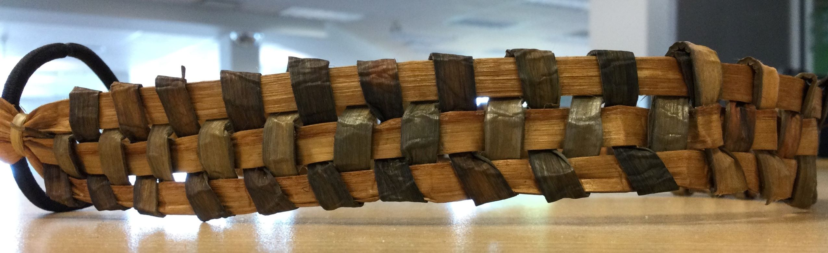
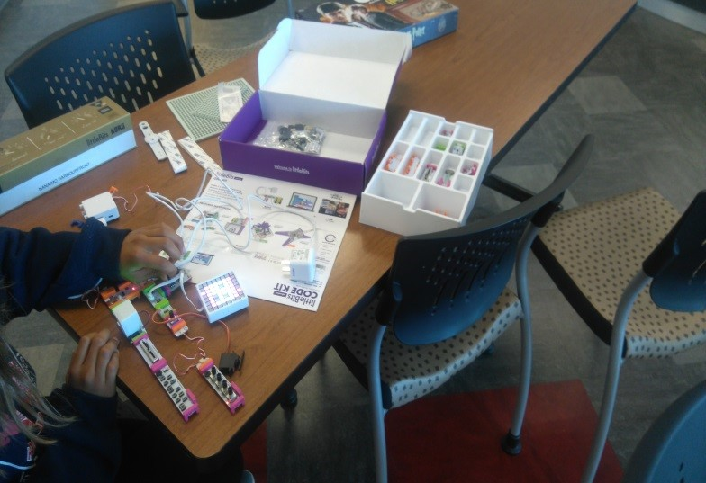
Conclusion
Diversify your STEAM programming by incorporating hands-on traditional knowledge that’s Indigenous-led
Building relationships take time and is part of the larger reconciliation process –It’s not always easy but think of future generations
Provide non-Eurocentric literacy and life skill development
Don’t underestimate the power of community
Thank you to my colleagues and local Indigenous communities
Thank you for attending!

Slide 10
References & Resources
All Staff Training: Effects of Colonization and Residential Schools by Brad Marsden - bradmarsden7@gmail.com
CFLA-FCAB Committee on Indigenous Matters: https://cfla-fcab.ca/en/indigenous
Indigenous Canada MOOC by U of Alberta
Joseph, B. (2019). 23 Tips on What Not to Say or Do When Working Effectively with Aboriginal Peoples. [Web]
Jospeh, B. (2012). Working Effectively with Aboriginal People. Indigenous Corporate Training.
Joseph, G., & Lawson, K. (2003). First Nations and British Columbia Public Libraries. Feliciter, 5, 245-247.
Reconciliationeducation.ca online courses and films in line with TRC 94 calls to action
YALSA STEAM Programming Toolkit

Slide 11
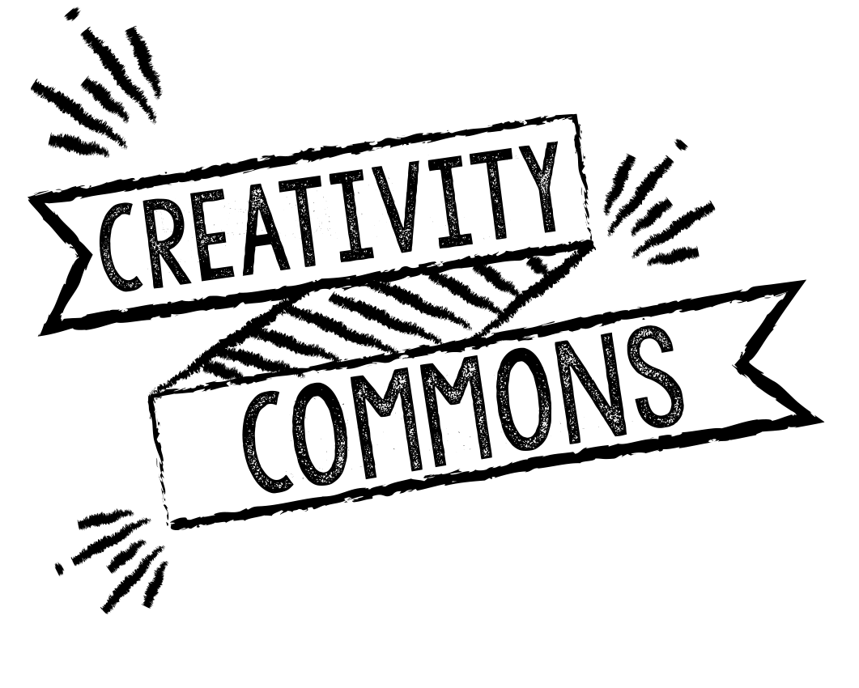
Contact Info
Please reach out!
Dalia Levy, MLIS
Customer Services Librarian, Creativity Commons
→ Email: dlevy@virl.bc.ca
→ Website: https://virl.bc.ca/learn/skills/creativity-commons
→ Visit us on the 2nd floor: 90 Commercial St. in downtown Nanaimo, BC
Indian Residential School Survivors Support Line
1-800-721-0066 - 24/7

Slide 12
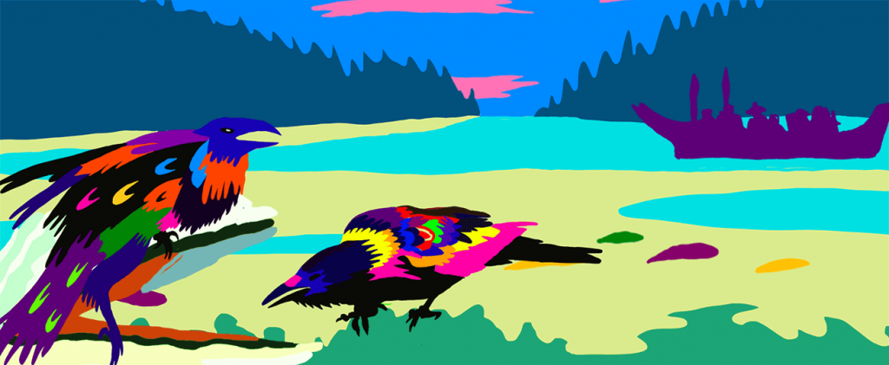
Questions?
Ask away!
Artwork by Jean Paul Langlois © 2021 Commissioned by VIRL for Indigenous History Month Challenge

