Slide 1
Student Belonging in Academia:
Developing an Academic Integrity Course​
Presented by: Margie Clarke and Patsy Scott
Camosun College is located in beautiful Victoria, British Columbia with campuses on the Traditional Territories of the Lekwungen and WSÁNEĆ peoples. We acknowledge their welcome and graciousness to the students who seek knowledge here.

Slide 2
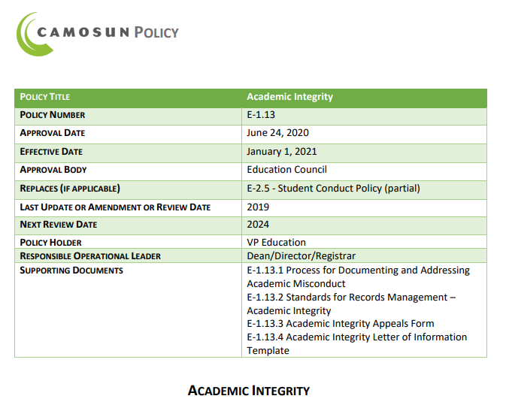
Background…
History of faculty concerns about cheating, plagiarism, and proper citation​
Growing concern with online environment during COVID​
Issues with homework sharing websites​
A course in BETA in our LMS since 2014
New Camosun Academic Integrity Policy in 2021

Slide 3
Student Belonging…
A Role for Librarians:
To create a course with an emphasis on what academic integrity looks like and how it's relevant to a student’s role as a member of the college community​
Address student’s rights and responsibilities
Notes:
As librarians, AI dovetails nicely with our IL standards of how information is produced and valued, the use of information in creating new knowledge and participating ethically in communities of learning.
We also felt strongly about being part of a proactive approach to academic misconduct. Our library guides on plagiarism, citation styles, academic integrity are heavily used – students are seeking out information and trying to do the right thing.
We see a lot of students asking citations questions both in person & online across all disciplines so this gives us a College wide perspective/exposure

Slide 4
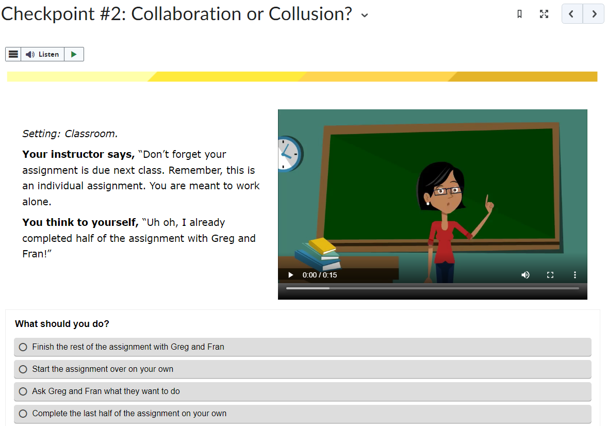
Course Structure…
45 minutes to complete
Self-registration for students through our LMS
Includes interactive videos and self-assessment scenarios
Shared content from Waterloo University
Must achieve 100% on final quiz with multiple attempts permitted
Students earn a digital badge visible to all instructors
Badge remains for two years
Notes:
Several faculty and staff gave feedback during the creation stage, then we conducted pilot sessions with students in 4 or 5 classes before the official launch

Slide 5
Course Content…
Includes course learning outcomes
Cultural differences in understandings of academic integrity
Camosun College expectations
Especially relevant for International Students new to Camosun
Examples of misconduct and expected behaviours
Supports: Writing Centre, Librarians, Ombudsperson, etc.

Slide 6
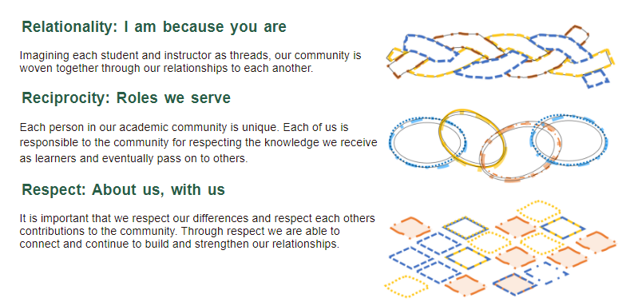
Indigenous Academic Integrity…
Includes Indigenous ways of knowing and learning
Demonstrates alignment of Camosun’s academic integrity policy values with Indigenous values
Relationality, Reciprocity, Respect
Emphasis on relationships with other students and instructors
Notes:
This Creative Commons content is based on the work of Keeta Gladue from the U of Calgary's Taylor Institute; also reached out to our Indigenization Curriculum Developer.

Slide 7
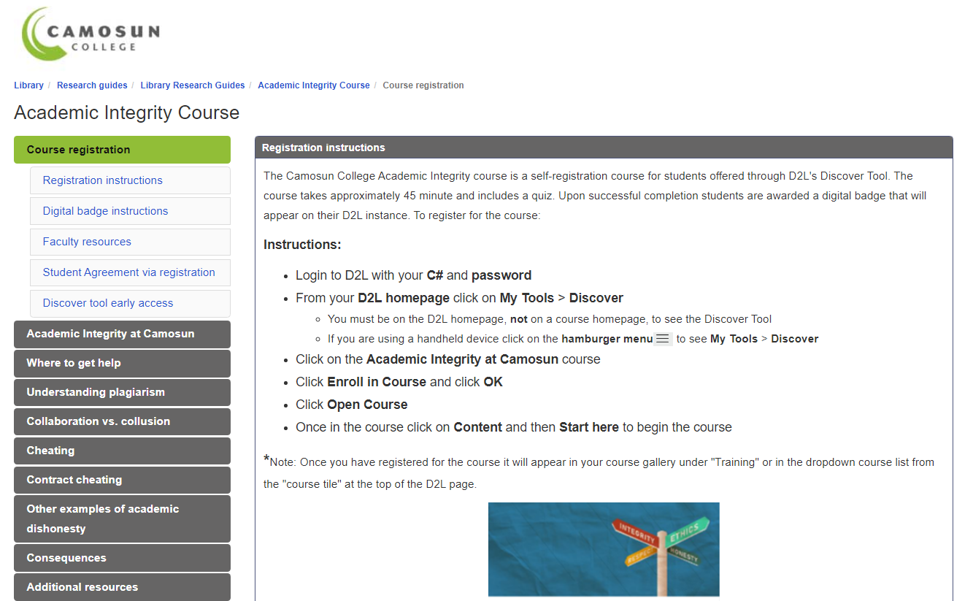
Promotion and faculty buy-in…
Course is standalone self-registration
Can be self-directed activity or requirement assigned by instructor
No classroom time or workload required by faculty
Available to all Camosun students
Faculty information sessions offered during AI week and start of semester
Research guide with registration instructions linked from library homepage
Digital badge provides proof of successful completion
Notes:
Students who are registered in at least one course (i.e. not waitlisted) will have access to D2L 30 days prior to their start date.
Course and the initial Student AI Agreement that students sign upon registering are supported by Patsy and Margie via a specific email account integrity@Camosun.ca

Slide 8
Digital Badge benefits…
Easy way to demonstrate successful course completion
Shareable with instructors and others via link
Students enjoy symbol of accomplishment
First official badge of the College
Demonstrates course completion for 2 years
Notes:
The system allows for a badge to be revoked but we would only do that under very specific conditions i.e. that we have a conversation with a Dean about a serious infraction – hasn't happened yet!

Slide 9
Status of AI course & next steps…
Over 1,000 registrations since the launch
About 90% of students who have taken the course have received the badge
More departments to make earning AI badge a course requirement in Fall 2023
Developing a companion self-registration course on APA Citation Style
Questions? Comments?
Notes:
Initially allowed three attempts to earn the badge but had to increase that to five
The major complications have been related to discovery not course content
Instructions for self-registration (PDF in the D2L student guide) and in a LibGuide
Update the course to include specifics about G-AI e.g. ChatGPT

