Slide 1
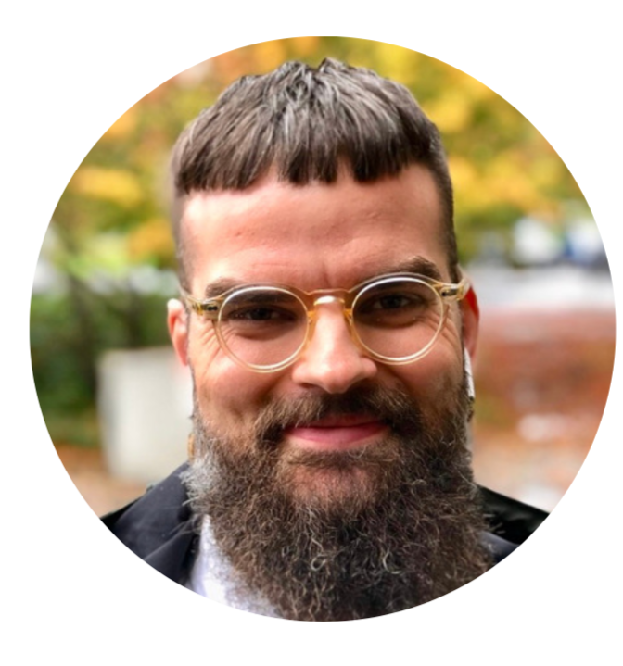
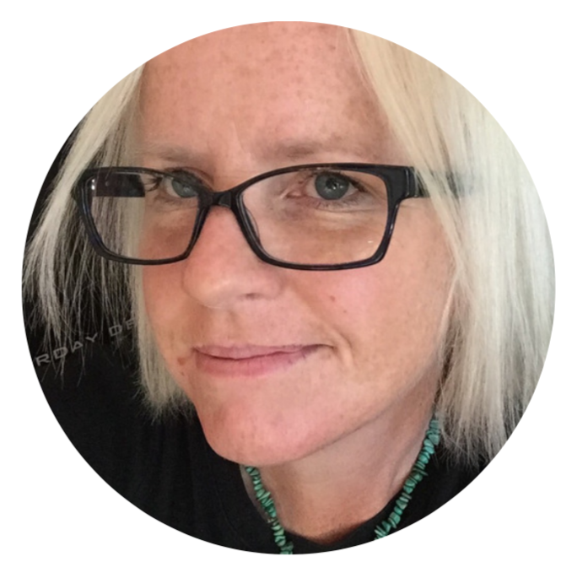
THE TRANSGENDER ARCHIVES
Past, Present, & Future
……………….…………...
Michael Radmacher, MA, MLIS
Office of the Chair in Transgender Studies,
The Transgender Archives, UVic
Lara Wilson, MA, MAS
Director of Special Collections
& University Archivist, UVic Libraries
Notes:
Michael & Lara

Slide 2
What we are doing today?
We acknowledge with respect the Lekwungen-speaking peoples on whose traditional territory the university stands and the Songhees, Esquimalt and WSÁNEĆ peoples whose historical relationships with the land continue to this day.
Notes:
Michael

Slide 3
Who is in the room?
Go to: menti.com
Notes:
Michael

Slide 4
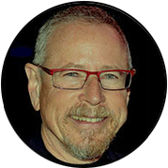
Who are we?
……………….…………...
Dr. Aaron Devor
Chair in Transgender Studies, Founder &
Academic Director, Transgender Archives
Lara Wilson, MA, MAS
Director of Special Collections
& University Archivist, UVic Libraries
Michael Radmacher, MA, MLIS
Office of the Chair in Transgender Studies,
The Transgender Archives, UVic
The Transgender Archives is proudly supported by many dedicated UVic Libraries staff members, including Jaqui, Lawrence, John and members from Technical Services. Thank you also to Hepzibeth Lee from the Chair in Transgender Studies.
We could not operate without your support. Thank you!
Notes:
Michael

Slide 5
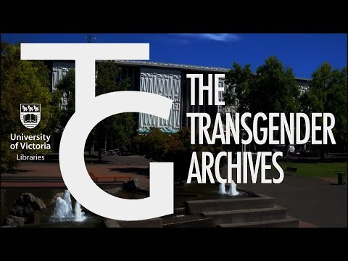
Notes:
Michael

Slide 6
Why is the TGA at UVic Libraries?
Special Collections & University Archives acquires:
documents of persons and organizations associated with the university
university records
archives related to established and emerging fields of study
related rare print materials
Established holdings in women’s history (Victoria Women’s Movement Archives, including activist lesbian material )
2007 Dr. Aaron Devor, Dean of Graduate Studies
2007 - present University Librarians support: Marnie Swanson & Jonathan Bengtson
Rikki Swin Foundation records and research collection; Reed Erickson archives
Formal launch as acquisition initiative 2011
Notes:
Lara
Acquisitions are sometimes undertaken with advise from faculty members and/or other subject matter experts
Rikki Swinn donation was over 200+ small to medium moving boxes; Erickson 50+ boxes plus artworks (both 2008)

Slide 7
Acquisition policy
research records
court case records
audio recordings
movies and video recordings
photographs and slides
original art works
ephemera and memorabilia
Archives:
documents relating to the history of pioneering activists, community leaders, and researchers who have contributed to the betterment of trans, non-binary, and Two-Spirit people
Archival & published material types:
books and book masters
periodicals
pamphlets
newspaper clipping files
erotic fiction
organizational records
personal papers and correspondence
conference records
Notes:
Lara

Slide 8
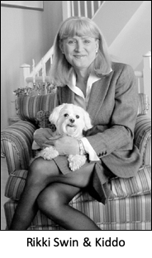
Founding collection
Rikki Swin Collection
Extensive newsletters and other periodicals
Large collection of books
Fantasia Fair documents 1974-2001
Ari Kane Collection
International Foundation for Gender Education (IFGE) organizational records
Virginia Prince Collection
Photos, audio & video tapes
Notes:
Lara

Slide 9
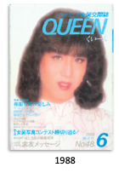
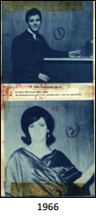
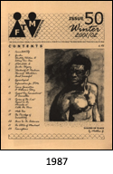
Rikki Swin collection
482 different newsletters & periodicals
Educational TV Channel Newsletter, San Francisco, USA
Hose & Heels, Los Angeles, USA
Hawaii Transgender Outreach (HTGO) Newsletter
Gendys Journal, London, UK
Belfast Butterfly Club, Northern Ireland
The Seahorse Society, New South Wales, Australia
FTM, Tokyo, Japan
Kuin (Queen), Japan
Hundreds of books
Original photos & negatives for Harry Benjamin’s Transsexual Phenomenon (1966)
Notes:
Lara
FTMInternationalnewsletter 1987- present. Complete run of all of them that were issued in print
Issue # 50, Winter 2001/02. “Shades of Black” drawing by Matthew G

Slide 10
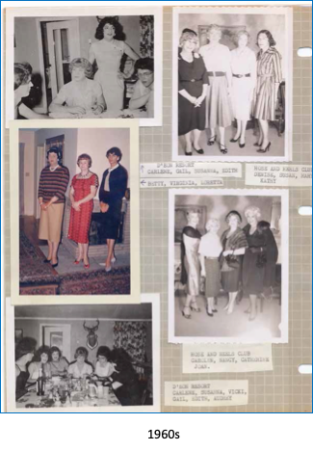
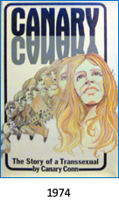
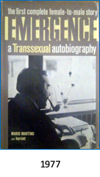
Rikki Swin collection
Audio & video tapes
Pre-publication versions of books (e.g.)
Photo albums
Records of the RSI
Notes:
Lara
Photo Album Page: From VirginiaPrince
Right half: Hose & Heels Club members
Lefthalf: @ Casa Susanna. Labeled as D’EonResort
Top:Susanna standing
Middle:Virginia Prince in red dress

Slide 11
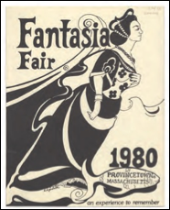
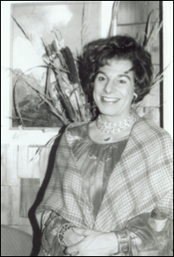
Fantasia Fair & Ariadne Kane
Fantasia Fair
Week-long Trans event each October in Provincetown, MA
The oldest and longest-running event of its kind
Started in 1974 by Ariadne Kane and Betty Ann Lind
Records of the Fair 1974-2001
Ariadne Kane (1936 - )
Extensive public speaking and educational work on behalf of crossdressers and transsexuals
Founder Human Outreach Institute, 1975
One of the founders of Fantasia Fair, 1974
Continued as a leader until 1998 (24 yrs)
Founder Theseus Counselling Services
Founder Journal of Gender Studies
Notes:
Lara

Slide 12
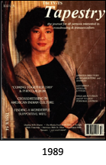
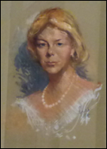
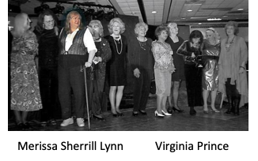
International Foundation For Gender Education
Founded by Merissa Sherrill Lynn (1942-2017 )
Sponsored large Trans conventions 1987-2010
Published 115 issues of Tapestry magazine, 1979-2009
Betty Ann Lind (1931-1998)
Original board member of IFGE Served through the early 1990‘s
Board member for Fantasia Fair and Fair Coordinator 1987-1991
Notes:
Lara
Tapestrywas called TV-TS Tapestry 1979-1995.
Then called Transgender Tapestry1995-2009.
IFGE Conventions were called “Coming Together”

Slide 13
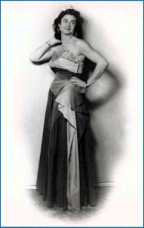
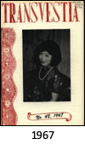
Virginia Prince (1913-2009)
A founder of modern transgender activism
Accidentally became public face of crossdressing in the US
1961. convicted of sending obscene material through the mail. On probation, Prince was liable to be imprisoned if caught cross-dressed. Given permission for public cross-dressing for educational purposes.
Coined the term “transgenderist”
1960 started Transvestia.
111 issues 1960-1986
Notes:
Lara
All Transvestia issues soon to be available online via UVic Libraries digital collections

Slide 14
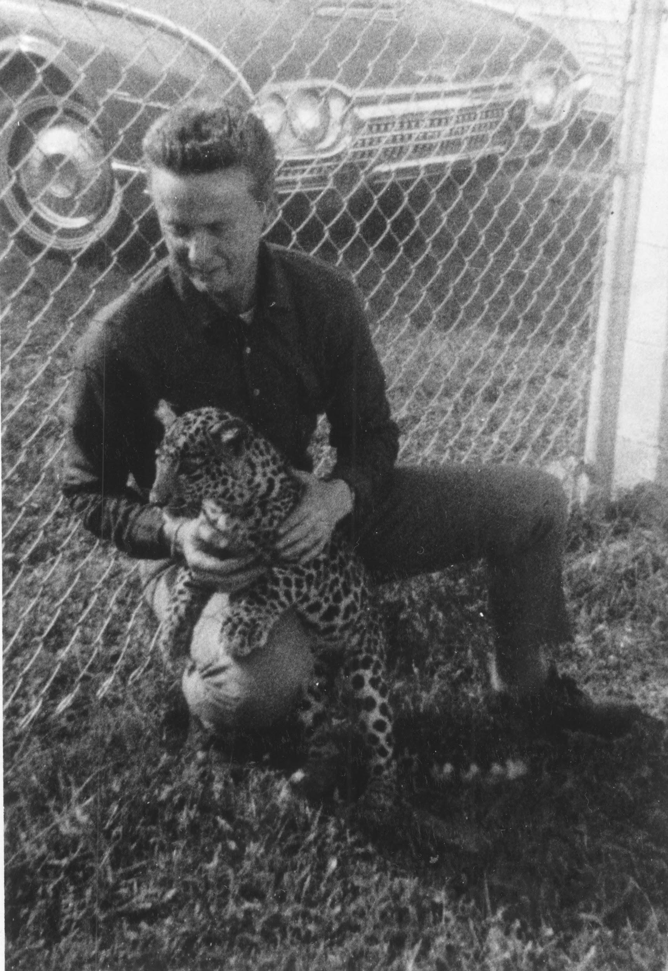
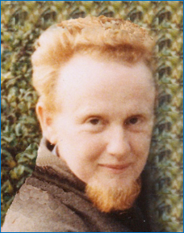
Other major collections
Reed Erickson (1917-1992)
Erickson Education Foundation. 1964-1984
Founded & funded by Erickson
Homophile organization ONE Inc.
Transsexualism
INTL conferences became WPATH
Research funding
Publications, films, TV, radio, speakers
New Age movements
Dolphin communication
Dream research
1st edition of A Course in Miracles (1976)
Erickson and Henry
Notes:
Michael

Slide 15
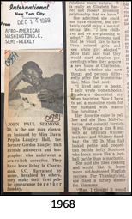
Reed Erickson
Scrapbooks: newspaper clipping services
Newsletters 1967-1976, 1983
Pamphlets 1969-1974
An Outline of Medical Management of the Transexual (1971)
Information for the Family of the Transexual and Children with Gender Identity Disturbances (1971)
Religious Aspects of Transexualism (1971)
Legal Aspects of Transexualism (1971)
Information on Transexualism for Law Enforcement Officers (1973)
Counseling the Transexual: Five Conversations with Professionals in Transsexual Therapy (1973)
Guidelines for Transexuals (1974)
Correspondence, Funding applications and records, Court records, Personal papers, Photos, Ephemera
Notes:
Michael

Slide 16
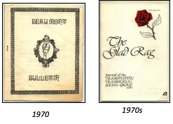
University of Ulster Trans-Gender Archive (1986-2013)
Huge collection
Collected & donated by Richard Ekins
Started collecting in the late 1970s
1986. Joined his collection with SHAFT (Self Help Association for Transsexuals)
350 periodicals from US, UK, EU, et al. …& more
Notes:
Michael

Slide 17
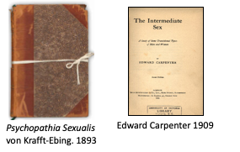
University of Ulster Trans-Gender Archive (1986-2013)
100 linear feet / 30 m
120+ yrs of books
30+ years of UK & EU trans history
Newspaper clippings files 1920s-1990s
Pamphlets …& more
Notes:
Michael

Slide 18
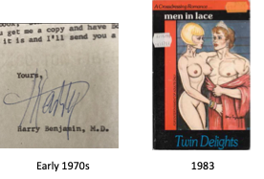
University of Ulster Trans-Gender Archive (1986-2013)
Correspondence & personal papers
Pulp fiction
Photographs
Ephemera … & more
Notes:
Michael

Slide 19
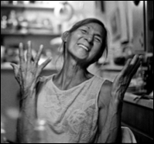
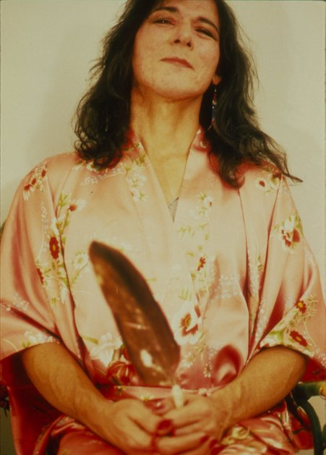
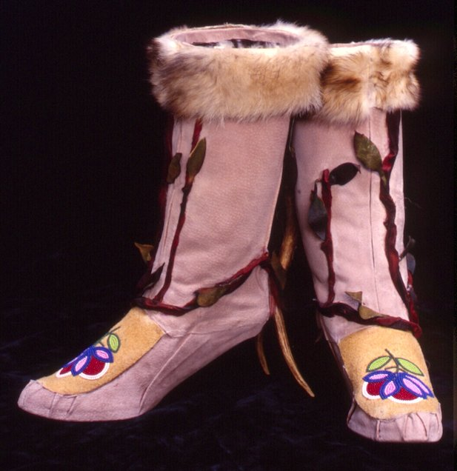
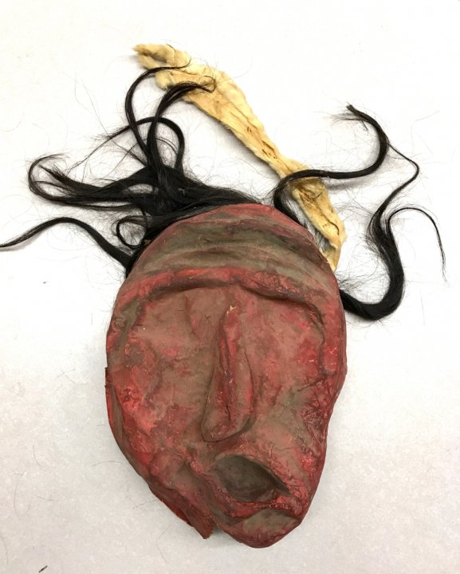
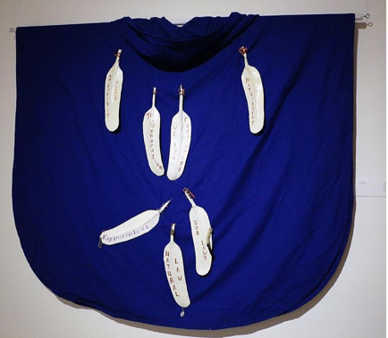
Aiyyana Maracle (1950-2016)
Two-Spirit woman from Six Nations of Grand River (Ontario)
Maker and keeper of culture, multi-disciplinary artist, scholar, educator, story-crafter and storyteller
1st Indigenous person to be awarded the Canadian John Hirsch Prize (1997) for theatre direction
Notes:
Michael

Slide 20
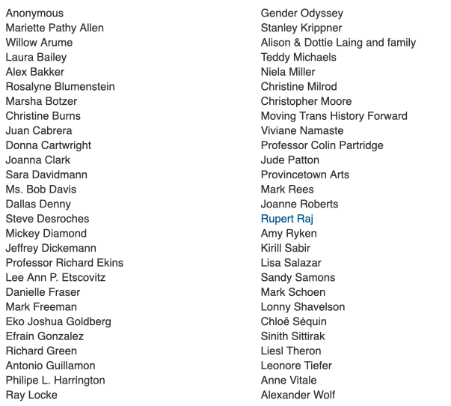
Smaller
collections
Notes:
Michael

Slide 21
Projects (Current & Future)
“Mapping Transgender History”
Started in 2017 and worked on by international interns (Mitacs) and community researchers
Goal = to create an interactive global digital map of trans history
Example: Ian McTaggart Cowan: Champion of Canadian Ecology
Indexing 4 levels of metadata
Title: 92 identified
Issue: 312 collected
Article: 3323 collected
Event: 953 collected
Collecting names, dates, places, subjects, themes, keywords, item descriptions, etc.
Notes:
Michael

Slide 22
Support
An active acquisition initiative that requires resources:
Salaries - professional and technical staff
Wages - work study students, partial grant-funded students
Supplies - archival and rare publications re-housing
Space - collections storage, reading room
Time - supervision of student workers, consultations with community researchers, filmmakers and other intensive collections users, outreach events
Special projects - LIBR publication and Spotlight exhibit, MTHF in-kind contributions
Opportunities to provide short term employment and experience for undergraduate and graduate students - promotion of archives / libraries as career path - creation of enhanced resources
Opportunities to use more progressive subject headings (Yale LGBTQI, Homosaurus)
University Librarian
Chair in Transgender Studies
Notes:
Lara
Cataloguers
Digitization Centre technicians
Special Collections and University Archives assistants
Digital Scholarship professional and technical folks

Slide 23
Momentum
Increased awareness of and activism for transgender history and rights in North America and around the world
Other institutions with collections historically built on lesbian and gay holdings are directing more attention to transgender and breadth of holdings (LGBTQ2+)
Examples:
ONE Archives at UCLA https://one.usc.edu/ (complete title ‘One National Gay and
Lesbian Archives’)
Kinsey Institute at Bloomington Indiana (https://www.kinseyinstitute.org) (transgender
among major research topics)
Canadian Lesbian and Gay Archives ; in March 2019 renamed The ArQuvies : Canada's LGBTQ2+ Archives
Other trends: gender studies departments (from women’s studies) ; TSQ journal
Notes:
Lara
Reed Erickson Foundation provided financial support to ONE Inc in 1964 and subsequently helped established elped ONE create a tax exempt charitable division called the
Institute for the Study of Human Resources (ISHR)
Dr. Alfred Kinsey and his research team incorporated as the Institute for Sex Research. ISR had two primary goals in 1947: to continue the team's research on human sexual behavior; and to administer research resources, including research materials, a library, case histories, and other related materials.
Changing the name gave us an opportunity to show LGBTQ2+ communities that we are actively trying to make our space and collections more inclusive
IBC G and Lesbian archives to City of Vancouver Archives (formerly held privately)

Slide 24
Programming & outreach
“As the world’s only Chair in Transgender Studies, we are committed to generating solid reliable information about the real world to drive social change and improve the well-being of trans, non-binary, and Two-Spirit people; and we support and build healthy communities by facilitating activities of interest.”
Dr. Aaron Devor
Chair in Transgender Studies, Founder &
Academic Director, Transgender Archives
Michael Radmacher, MA, MLIS
Office of the Chair in Transgender Studies,
The Transgender Archives, UVic
Notes:
Michael

Slide 25
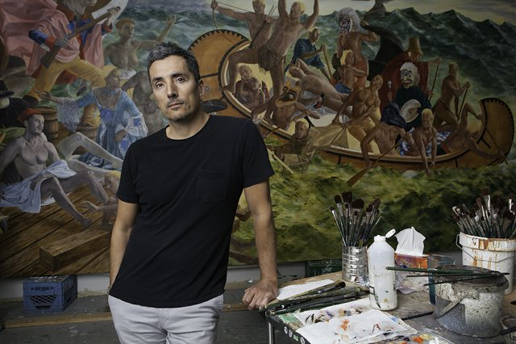
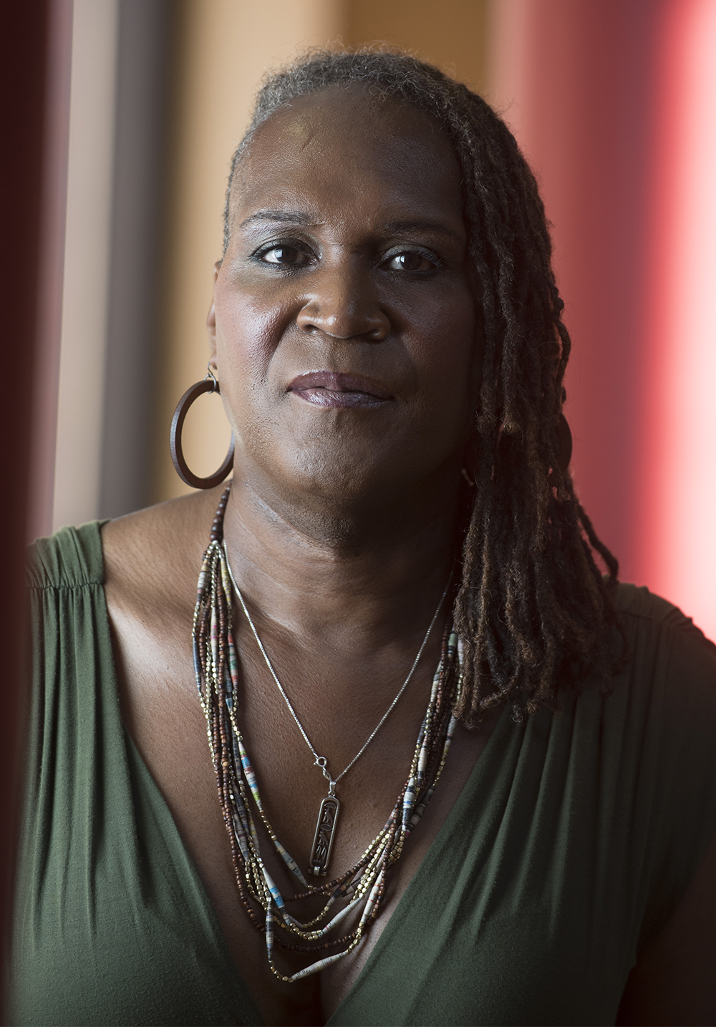
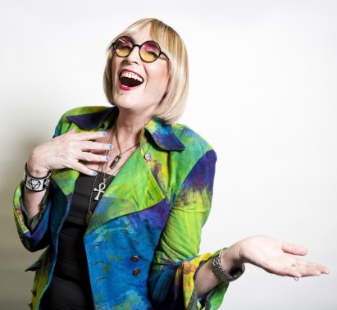
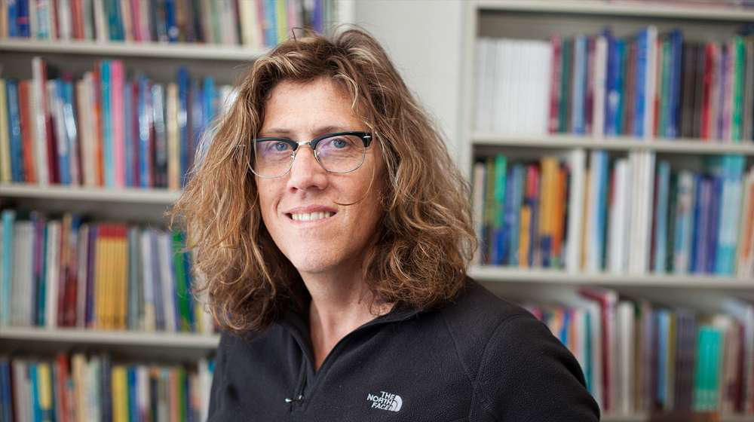
Programming & outreach
Kent Monkman
Moving Trans History Forward Conferences
2014: 75 attendees
2016: 150 attendees
2018: 300 attendees
2020: Expecting 500 attendees
Elders/Youth Panels
Speakers
Social Events (Nachos Night)
Scholars in Residence
Luxembourg, Thailand, Japan, China
Andrea Jenkins
Kate Bornstein
Susan Stryker
Notes:
Michael

Slide 26
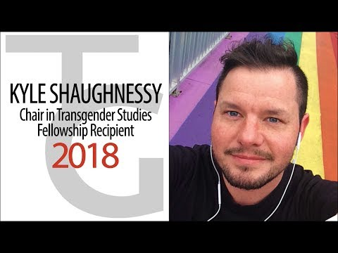
Programming & outreach
Art Events
“Trans Hirstory in 99 Objects brings together art and archival material material from UVic's world-renowned Transgender Archives to narrate an expansive and critical history of transgender communities.”
Over 2,000 visitors from Canada, U.S., Japan, Colombia, Iran & England.
Academic & community presentations
Pride, local religious centers, Royal BC Museum, OUTstages, int’l conferences (ALMS)
Student Scholarships & Community Fellowships
Notes:
Michael

Slide 27
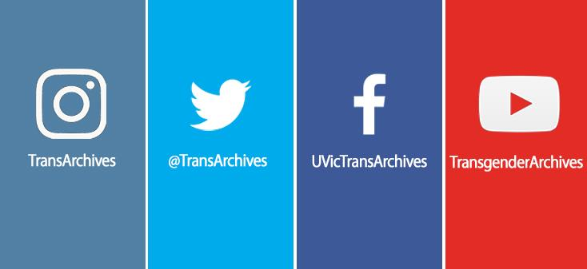
Connect with us!
transarc@uvic.ca
transgenderarchives.ca
Sign-up for our newsletter!
Notes:
Michael

Slide 28
THE TRANSGENDER ARCHIVES
Past, Present, & Future
……………….…………...
mikerad@uvic.ca
@mradmacher
ljwilson@uvic.ca
@UVicDirSCUA
Questions & Discussion
Notes:
Michael & Lara

