Slide 1
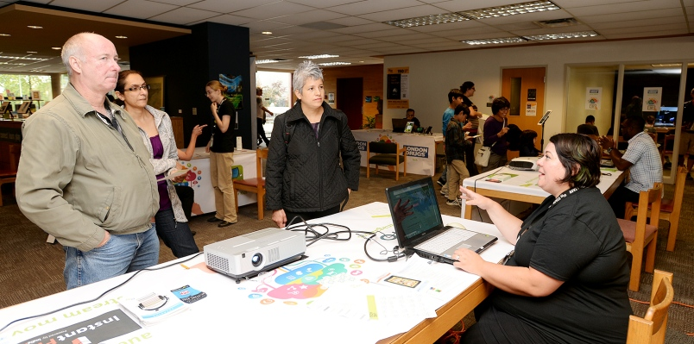
Using the Capability Approach in Digital Inclusion
Photo courtesy New Westminster Record

Slide 3
https://www.flickr.com/photos/surreal_badger/8573233746

Slide 4
The “roaming autodidact”
http://www.freeimages.com/photo/sitting-on-grass-1309209
- Tressie McMillan Cottom, “Democratizing Ideologies and Inequality Regimes in Digital Domains” (online talk)

Slide 6
Martha Nussbaum’s Central Capabilities
“What does a life worthy of human dignity require?”
Creating Capabilities (2011) Martha C. Nussbaum
Central capabilities aim to be universal and neutral: individuals decide what the good life is for themselves
She sees this list as open to revision

Slide 7
The Central Capabilities
Bodily health
Being able to have good health, including
reproductive health; to be adequately nourished; to have adequate shelter

Slide 8
The Central Capabilities
Senses, Imagination, and Thought Being able to use the senses, to imagine, think, and reason—and to do these things in a "truly human" way, a way informed and cultivated by an adequate education, including, but by no means limited to, literacy and basic mathematical and scientific training

Slide 9
The Central Capabilities
Affiliation
A. Being able to live with and toward others, to recognize and show concern for other humans, to engage in various forms of social interaction
B. Having the social bases of self-respect and non-humiliation; being able to be treated as a dignified being whose worth is equal to that of others

Slide 10
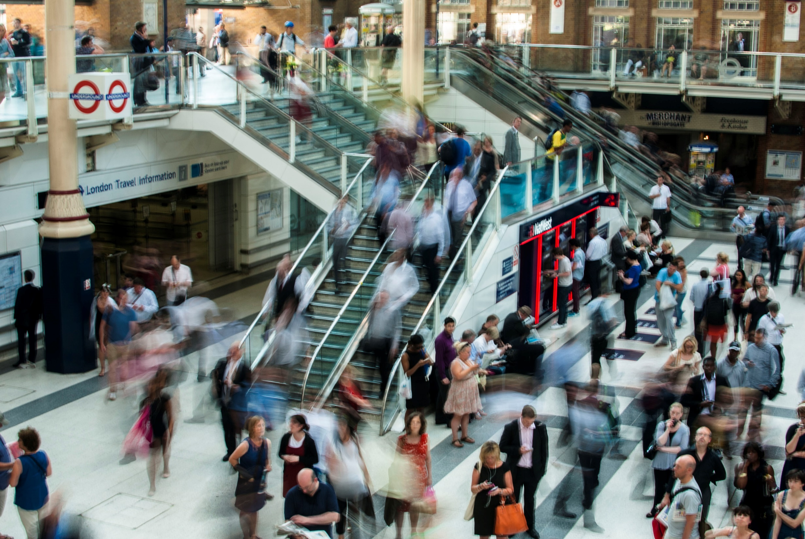
Implications for library work
https://static.pexels.com/photos/1719/city-people-walking-blur.jpg

Slide 13
“just run the mouse up the screen” still from the film I, Daniel Blake

Slide 14
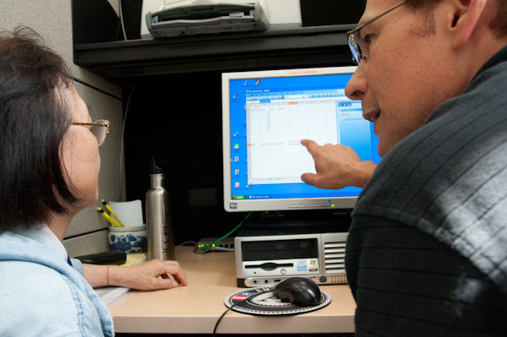
One on One Computer tutorials
https://www.flickr.com/photos/sanjoselibrary/6053765827

Slide 15
Seniors’ Technology Classes
www.xkcd.com/1817/

Slide 16
Summary: The Capability Approach in Library work
Who is disadvantaged? How do we contribute to their effective freedoms?
What arrangements are acceptable? Which are not?
This is a practical model
Works together with other theories of liberation and social justice

Slide 17
hdr.undp.org/sites/default/fils/2016_human_development_report.pdf

Slide 18
Possibilities for Action
Collaborations in and outside library profession
Human Development and Capability Association

Slide 19
Conclusion: The Capability Approach
Supports the dignity of the individual
Central to the institution of the public library

Slide 20
Share Your Thoughts
Blue Wall, by Brooke MacDonald, courtesy NWPL

