Slide 1
Stand up for Inclusion
Alberta Library Conference 2018
Shereen Samuels, Board Trustee, Calgary Public Library
Heather Robertson,
Director, Service Design, Calgary Public Library

Slide 2
Overview
Inclusion Statements: What are they and Why do they matter?
Sharing our Story: The Calgary Public Library’s experience in developing an inclusion statement
The process and discussions
What we learned along the way
The impact the process had on our team(s)
The impact we hope the statement will have on our organization
Learning your Story: Opportunities to reflect and share

Slide 3
Our Community Assumptions
We all have a voice and experience that has value, and we have the choice to share our voice and experience
The presenters of this session are not experts in this topic, and we don’t have “right” answers or solutions for how this work is done
We are all here because we are wanting and willing to learn about this topic
All of us can take responsibility for working to create inclusive environments
We will work to learn together, accepting that we may do so imperfectly

Slide 4
Chapter 1:
What is an Inclusion Statement and Why does it Matter?

Slide 5
The Changing World We Live In
1980s
1986: Employment Equity Act designates four disadvantaged groups – women, Aboriginal peoples, people with disabilities, members of visible minorities – and focused on removing structural barriers in organizational policies, practices and cultures
1988: Multiculturalism Act described a Canadian vision of a diverse society as a mosaic
With these two acts, provincial governments began to develop diversity management initiatives; this work started expanding significantly on the four disadvantaged groups, to include sexual and gender identity, and religious background, creating one of the challenges around the concept of diversity – who is the word referring to?

Slide 6
Continued …
2010s
There is growing pressure across human service fields to move away from a diversity management model towards one of equity, inclusion, universal design and social justice
2010 – Canadian Urban Libraries Council Social Inclusion Audit completed
2016 / 2017 –
Truth and Reconciliation Commission’s Final Report provides 94 recommendations;
Canadian Federation of Libraries releases Truth and Reconciliation Report and Recommendations
Urban Library Council (ULC) develops statement on Race and Social Equity; the statement is endorsed by both ULC and the Canadian Urban Libraries Council

Slide 7
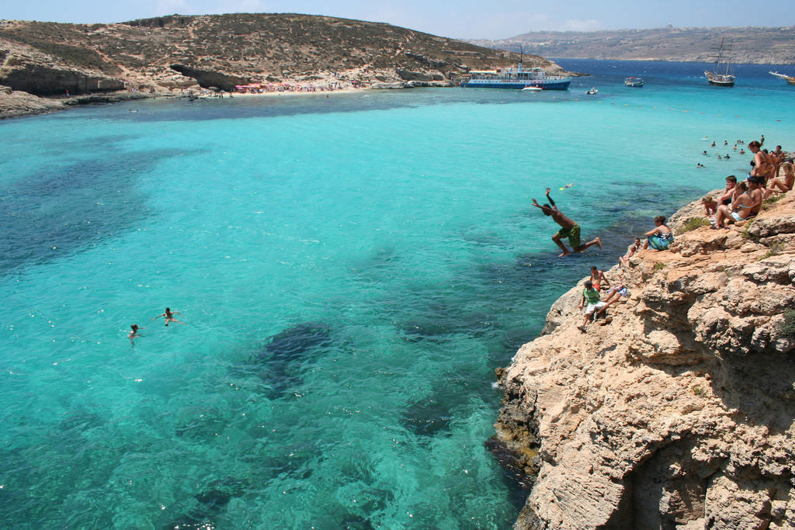
Diving into the Deep End…
Photo by Jon Rawlinson

Slide 8
Our First Attempt:
INCLUSION:
It takes people with different ideas, strengths, interests and cultural backgrounds to make the Library thrive.
Honouring and supporting the diversity of our communities, our members, and our colleagues.

Slide 9
Chapter 2:
Developing a Deeper Understanding

Slide 10
Defining the Terms:
Diversity
“Diversity” is a quality of being different, understood as “different from the norm” (assumes a “norm”)
Historically, the norm in the workforce has been a white, straight, able-bodied male with a full-time unpaid work partner at home; “diversity” is code for the problematic group of others outside of that description, who require a special or extra understanding, effort or response
Open Access
Most often used in the context of online publishing the term is also used more generally to describe access to information, resources and services that is free of all restrictions and available to all.
Use of this term can promote the assumption that “open doors” are enough to ensure people feel welcome and have a sense belonging

Slide 11
Defining the Terms Continued …
Inclusion
Stems from social inclusion theory (poverty-related) and universal design theory (ability-related) which creates a focus on identifying and lowering systemic and structural barriers, instead of dwelling on perceived individual lacks
Rather than sitting at a “normal” centre, struggling to include diverse individuals on a case-by-case basis, meaningful inclusion refocuses organizations on their own structures, searching for environmental barriers and strategizing how to lower or dismantle them

Slide 12
Examples of Inclusion Statements
Cornell University Cooperative Extensions University: Commitment to equitable treatment and elimination of discrimination in all its forms at all organizational levels and throughout all programs.
CFLA/FCAB champions values that include access to information, privacy, democracy, equity, diversity and inclusion, intellectual freedom, and social responsibility. Libraries are safe and inclusive spaces that build social capital and support discovery and creation.
National Committee for Responsive Philanthropy is an independent nonprofit that works to strengthen the nonprofit sector and improve its ability to represent and serve individuals politically, economically, or socially disadvantaged, by promoting greater philanthropic openness and accountability.
The Chinook Fund is committed to the transformation of society into one that promotes social justice and freedom from oppression, including but not limited to, racism, sexism, classism, heterosexism, ageism, and ableism.
Halifax Public Libraries recognizes and energetically affirms the dignity of those it serves, regardless of heritage, education, beliefs, race, income, religion, gender, age, sexual orientation, gender identity, physical or mental capabilities. Halifax Public Libraries understands that an acceptance of differences can place individual and collective values in conflict. The Library is committed to fostering an environment of understanding and respect. Halifax Public Libraries acts to ensure that people can enjoy services free from any attempt by others to impose values, customs or beliefs.

Slide 13
Key Elements of Inclusion Statements
1.
Acknowledgement of systemic inequity and / or structural barriers
2.
A commitment to do something specific about it.

Slide 14
Moving Towards Meaningful Inclusion
SOCIAL BELONGING
Formal inclusion
Social/informal inclusion
Structural principles
PERSONAL
OPPORTUNITY
Intent and culture
Impact of hierarchy on inclusion
Openness to change
Perceived ability to impact the organization
ORGANIZATIONAL CITIZENSHIP
Inclusion Matrix, from Beyond Diversity Management:
A Pluralist Matrix for Increasing Meaningful Workplace
Inclusion, 2013, Samuels, S.

Slide 15
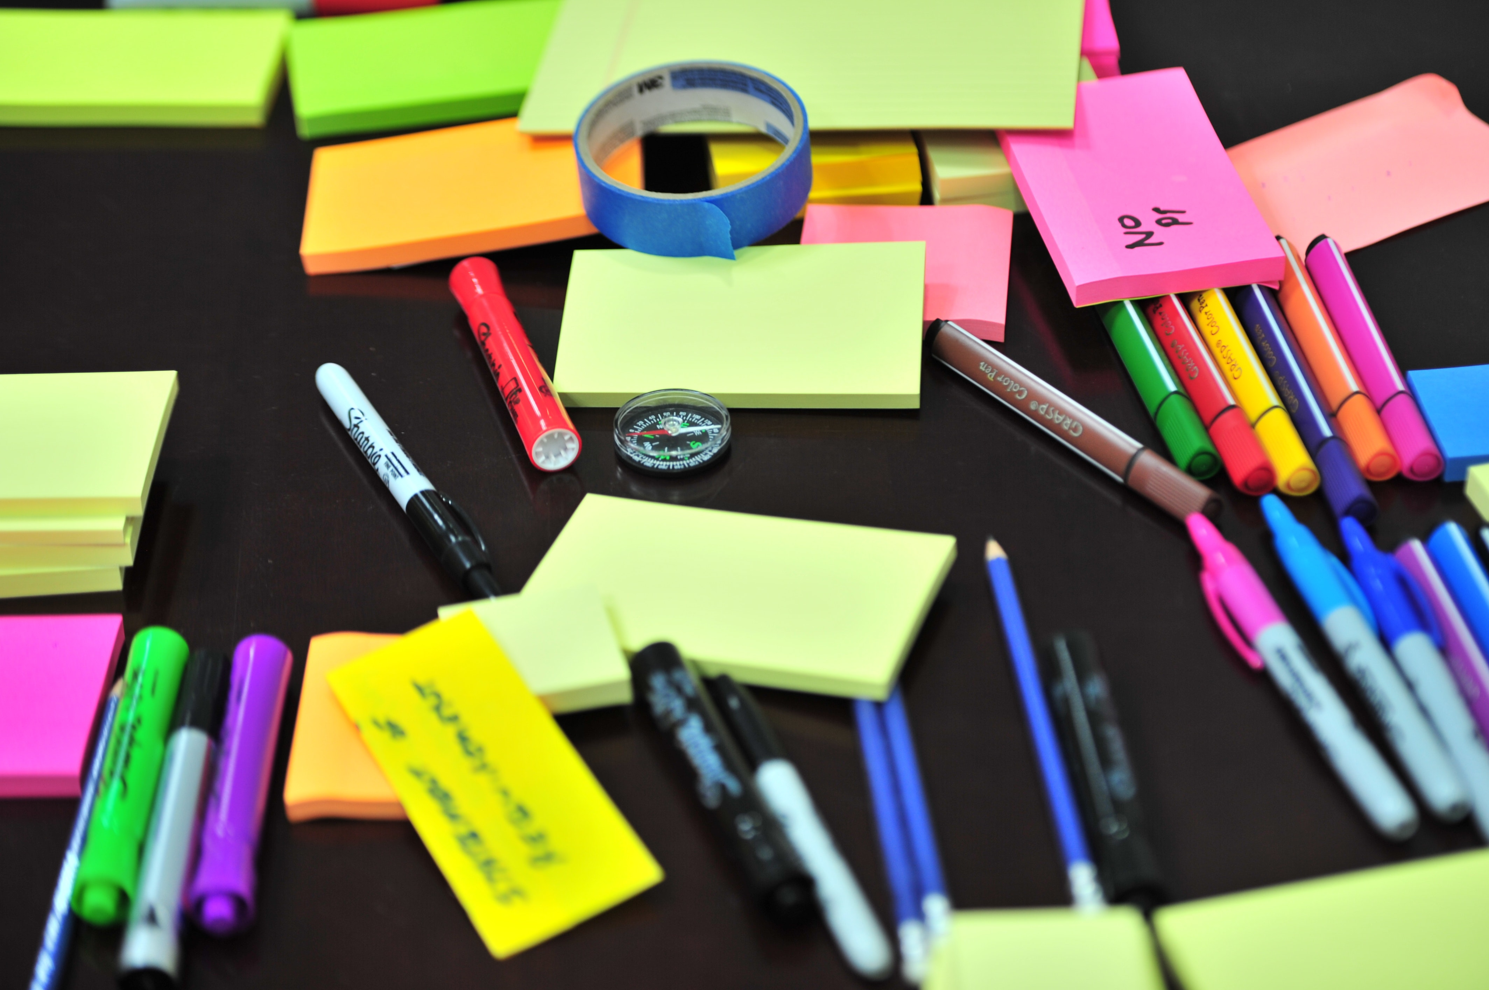
Building a Common Understanding
Photo by Frans Van Heerden

Slide 16
Addressing Barriers to Progress
Photo by Jan Mallander

Slide 17
Taking Another Step Forward:
INCLUSION:
It takes people with different ideas, strengths, interests and cultural backgrounds to make the Library thrive.
Honouring and supporting the diversity of our communities, our members, our colleagues.
INCLUSION:
It takes people with different perspectives and experiences to make the Library thrive.
The Library recognizes, respects and supports the diversity of our communities, our members, and our colleagues by actively engaging in dialogue, deepening our knowledge and gaining a greater understanding of each other.
INCLUSION:
"The Library upholds the principles of respect, dignity, fairness, and equity for our members, staff and volunteers. We are committed to engaging in dialogue and deepening our knowledge in working to create an environment that is inclusive of all.“

Slide 18
Chapter 3:
Creating A Statement We Could Stand Up For

Slide 19
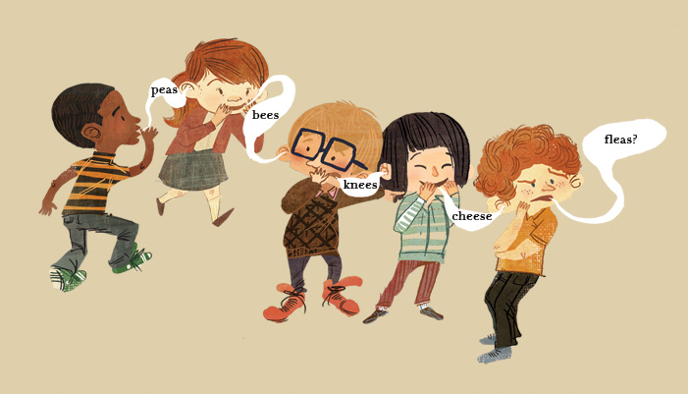
Understanding The Importance of Dialogue
Art by Joseph Tyler

Slide 20
A Statement to Stand Up For
INCLUSION:
It takes people with different ideas, strengths, interests and cultural backgrounds to make the Library thrive.
Honouring and supporting the diversity of our communities, our members, our colleagues.
INCLUSION:
It takes people with different perspectives and experiences to make the Library thrive.
The Library recognizes, respects and supports the diversity of our communities, our members, and our colleagues by actively engaging in dialogue, deepening our knowledge and gaining a greater understanding of each other.
INCLUSION:
The Library upholds the principles of a just society, chief among them respect, dignity, and equity.
We will engage in open, meaningful dialogue and deepen our understanding to inform Library practice and create an environment that is inclusive of all.

Slide 21
Our Learnings Along the Way…
You can’t wait for the perfect time to do this work; there is no perfect time. There has to be a willingness to learn
Be brave and speak-up: It can just take one voice, one person to stand up for inclusion and get the ball rolling
Importance of being comfortable with the uncomfortable
Make space and time to learn as a group; to reflect and grow together
Role of the External Facilitator is important, but it changes throughout
This work does not suggest the work that is currently being done is wrong, it’s an opportunity to apply a different lens and enrich the work we do
There is no right or wrong pathway. There is also no end point

Slide 22
What Does This Mean for Our Library?
Art by Mark Hess

Slide 23
What Does This Mean for Your Library?
Art by Palto on CanStock Photo

Slide 24
THANK YOU! Shereen Samuels shereen.samuels@gmail.com Heather Robertson heather.robertson@calgarylibrary.ca

