Slide 1
Stand Up! Access to Justice at Your Local Library
Megan Siu
Centre for Public Legal Education Alberta (CPLEA)

Slide 2
What is CPLEA?
The Centre for Public Legal Education Alberta (CPLEA): a not-for-profit organization that provides plain language legal education and information to help Albertans understand their rights and responsibilities
*formerly the Legal Resource Centre of Alberta (rebranded in 2012)
Notes:
Nearly every province and territory in Canada has at least one non-governmental organization dedicated to PLE – for Alberta, that is CPLEA.
The Northwest Territories is currently the only region in Canada without a law library and without a non-governmental PLE organization.

Slide 3
What is Public Legal Education?
Public Legal Education (PLE): programming that empowers people to address their own legal issues by knowing their rights and responsibilities under the law

Slide 4
Legal Information vs. Legal Advice
CPLEA provides legal information, but not legal advice
Legal information: explains the law and legal system in general terms, but isn’t tailored to a particular situation
Legal advice: applies the law to a particular situation and provides recommendations about the best course of action based on facts

Slide 5
Self-Represented Litigants: The DIY Lawyer
People want to solve their own legal problems
Fake News! Alternative Facts!
Facebook! Twitter! Instagram!
Librarians to the rescue!

Slide 6
Why Does PLE Matter?
Law impacts EVERYONE
Most people don’t qualify for Legal Aid and can’t afford a lawyer
A lot of court cases don’t need to happen
Many self-reps don’t know where to start or how to filter and verify information

Slide 7
CPLEA’s Resource Development Process
Who is the resource for?
What goes into it?
How is it verified?
Who pays for this?

Slide 8
Case Study: Human Rights Resources for Immigrant and Refugee Seniors
Project to educate immigrant and refugee seniors and their caregivers about their rights when trying to access and maintain housing
The Alberta Human Rights Act

Slide 9
Case Study: Human Rights Resources for Immigrant and Refugee Seniors
Who is the resource for?
Seniors
Immigrants
Refugees
Seniors centres
Government ministries
Settlement agencies
Caregivers

Slide 10
Case Study: Human Rights Resources for Immigrant and Refugee Seniors
What goes into it?
“Seniors prefer having someone to come and talk to them”
“Newcomers accept information from community leaders they trust”
“Many experience discrimination, but may not follow through because they’re afraid”

Slide 11
Case Study: Human Rights Resources for Immigrant and Refugee Seniors
How is it verified?
CPLEA’s staff lawyers
Feedback from project advisors or focus groups

Slide 12
Case Study: Human Rights Resources for Immigrant and Refugee Seniors
Who pays for this?
Not you!
Funding from provincial and federal government
Funding from foundations
Funding from personal donations

Slide 13
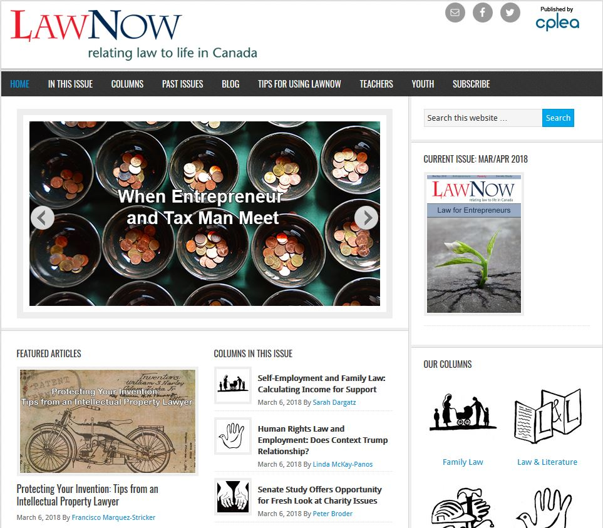
www.lawnow.org
Notes:
LawNow
Free digital magazine that addresses Canadian legal issues
Published bi-monthly every year
Contributors are experts including lawyers, judges, Senators
Each issue has a theme and special report:
March/April → Entrepreneurship (theme), Poverty and Homelessness (special report)
May/June → Ghosts in the Legal Machine (theme), International Treaties (special report)
Sign up for our mailing list by contacting info@cplea.ca or lawnow@cplea.ca

Slide 14
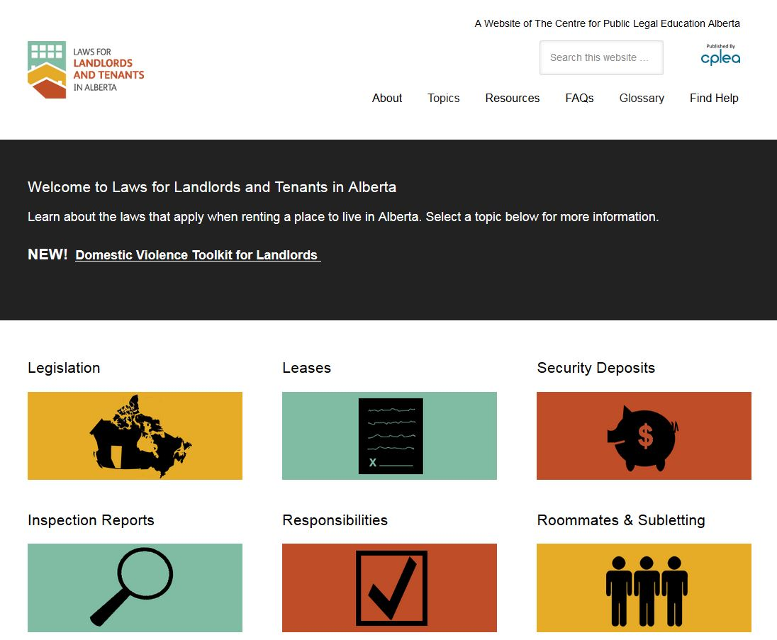
www.landlordandtenant.org
Notes:
Landlordandtenant.org
#1 website for Alberta landlord and tenant law
NEW! Domestic Violence Toolkit for Landlords for landlords, property managers, and anyone else with access to a residential unit

Slide 15
Notes:
Making a Will
Most downloaded publication (followed by Grandparents’ Rights, then by Renting with a Pet)

Slide 16
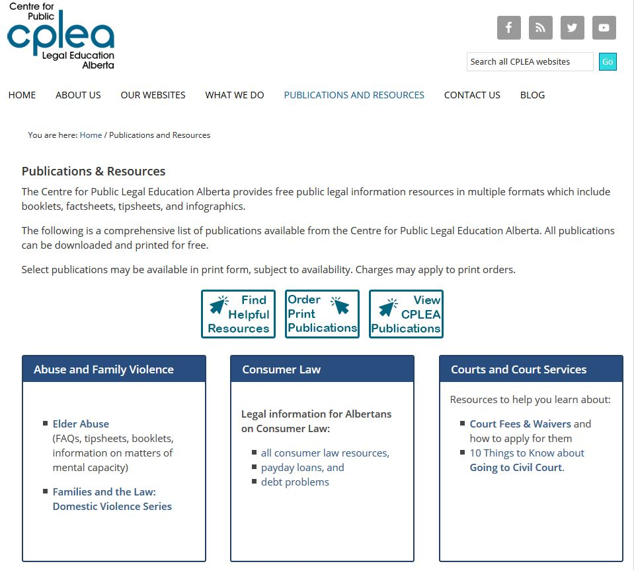
Notes:
CPLEA’s online “store”
Order free print copies of our publications, shipping is usually free
You will be asked to set up an account to record your shipping information

Slide 17
Yeah, but…
Let us help you help your patrons!
Leave our brochures at your reference desk
Bookmark our websites on library computers
Invite us to come and present
Every person’s legal issue is very different.
Legal advice, bad. Legal information, good.

Slide 18
What Can Libraries Do?
When library users approach your library for help with a legal issue, you should not:
Give people legal advice (i.e. apply the law to their situation or tell them your opinion on their case)
Tell people what might happen if they go to court or if they see a lawyer
Tell people they need to go to court
Help people fill out legal documents
Notes:
Don’t give out legal advice. It is a huge liability issue for yourself, your fellow staff, your library, and your board and trustees.

Slide 19
What Can Libraries Do?
When library users approach your library for help with a legal issue, you can…
Help them find reliable legal information
Make legal information easily accessible
Refer them to a PLE organization or a local community legal clinic
Spread the word about public legal education
Notes:
Libraries are trusted sources of information. Help us normalize public legal education – it should be normal to know what your legal rights are.

Slide 20
Questions?
Centre for Public Legal Education Alberta
(780) 451-8764
info@cplea.ca
Twitter: @CPLEAlberta
Facebook: www.facebook.com/CPLEAlberta

