Slide 1
Social Media: Tips and Tricks from a Library System Perspective
Robyn Gray
@RobynG8
Notes:
Hello Everyone! Within this short presentation, I wanted to provide some tips and tricks based on my experience working with numerous forms of social media. Hopefully I can provide you with a few new ideas, but if not, then at least you only have to put up with me for the next 15 minutes!

Slide 2
www.brsd.ab.ca
www.nlls.ab.ca
Notes:
So while I currently work at the Battle River School Divison in Camrose, I worked at the Northern Lights Library System for one and a half years. I have always been an avid user of social media, and when I worked at Northern Lights I jumped at the chance to manage the social media accounts. While Northern Lights already had a facebook page, I added a Twitter page, Instagram account, and pinterest page. Before I continue though, I would like to note that nothing I say today is supposed to “represent Northern Lights” – there are a lot of my examples that are based on my working there, but I do not mean to speak on behalf of them or anything.

Slide 3
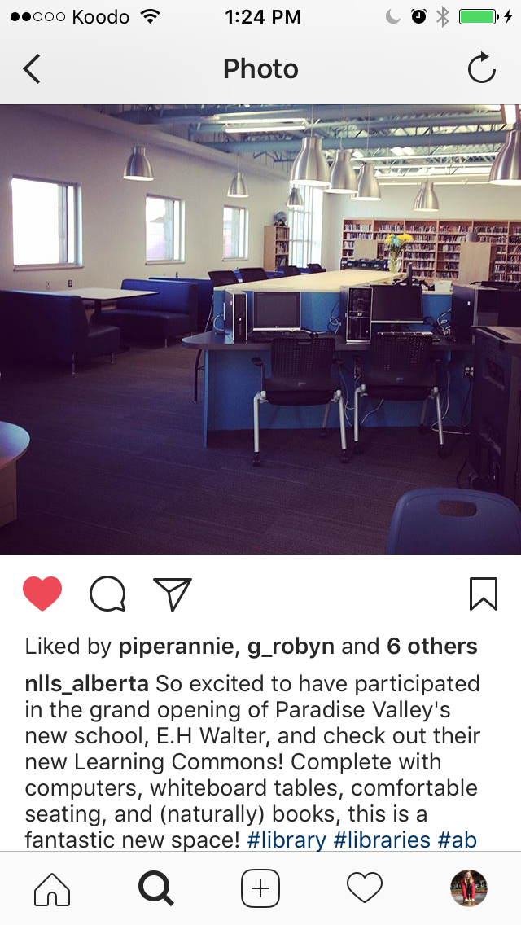
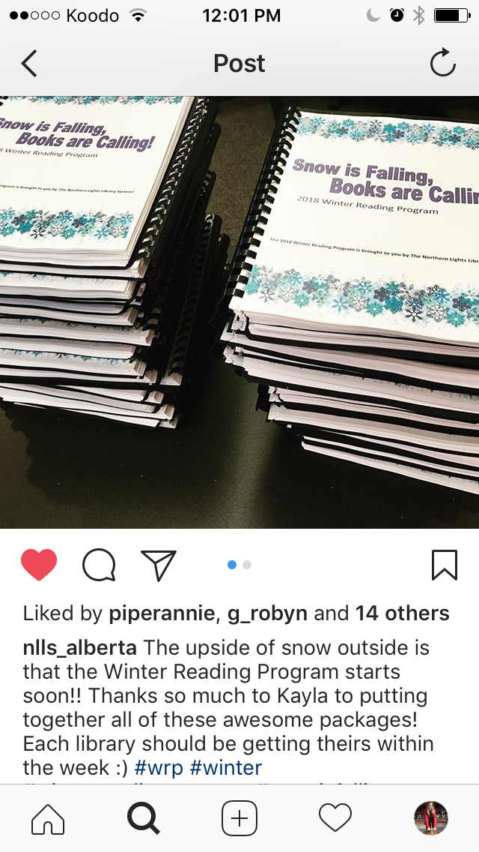
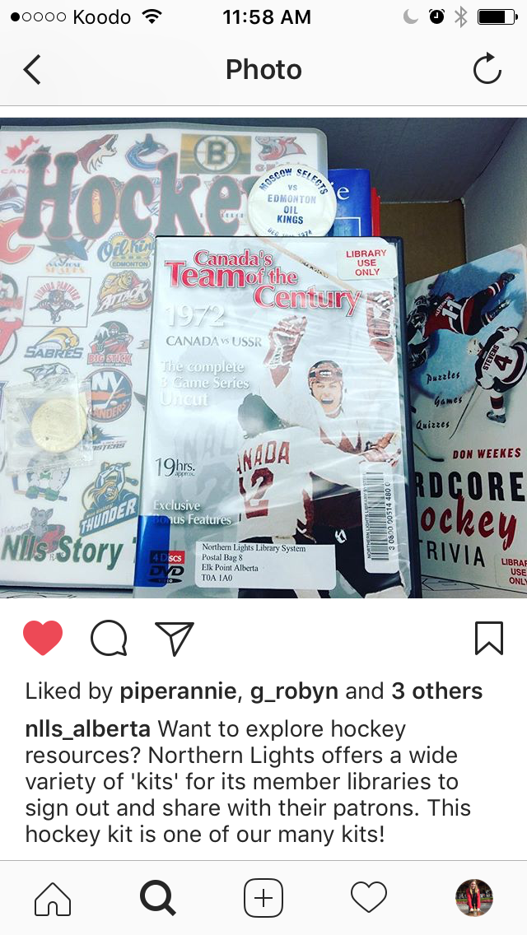
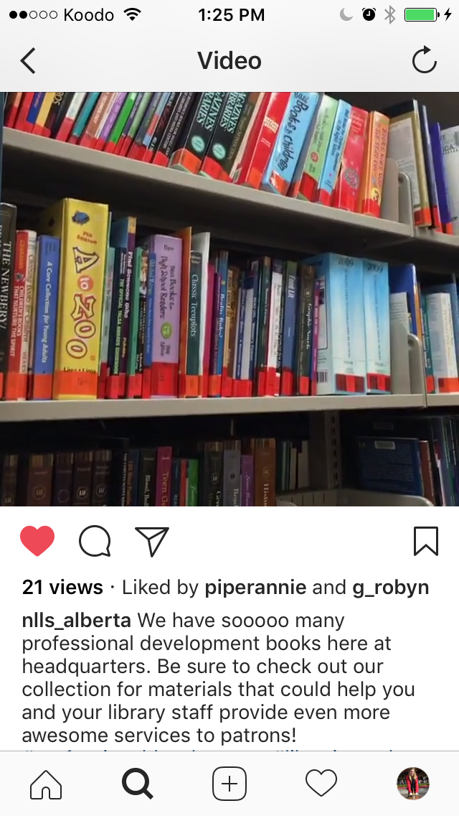
Notes:
My perspective on the topic of social media is a bit unique, because Northern Lights was a “library system” or “head office” serving member libraries, as opposed to a public space where patrons would come in. While this meant that we couldn’t provide photos of programs or displays featuring the public, there was still lots of material to use for social media. Even in this slide alone, there are events such as a member library’s grand opening, a sample of the collections offered at headquarters, and a sneak peak of last year’s winter reading program materials before they were distributed

Slide 4
Notes:
We were able to spend a lot of time highlighting our e-resource offerings, such as language learning tools and ebook providers through social media

Slide 5
Notes:
One of our e-resources, Niche Academy, was a service that provided tutorials for several of our e-resources. Whenever a new Niche Academy video was released, I would use this as an opportunity to promote both the resource itself (in this case, Ancestry), and Niche Academy on our social media

Slide 6
Facebook
Most popular both with member libraries and with patrons
Easy to share other organizations’ posts
Potential “features” based on how many followers you have
Notes:
For getting into specific sources of social media, I’ll start off with Facebook. In my experience, it is the most popular, in terms of libraries that participate and have their own Facebok pages, as well as the amount of patrons that follow libraries
With Facebook, it is fairly easy to follow other organizations that will be of interest to your community, and spontaneously share their posts onto your page. In the case of Northern Lights, it would be easy to share member library’s posts onto our own page so that each post reaches a wider audience

Slide 7
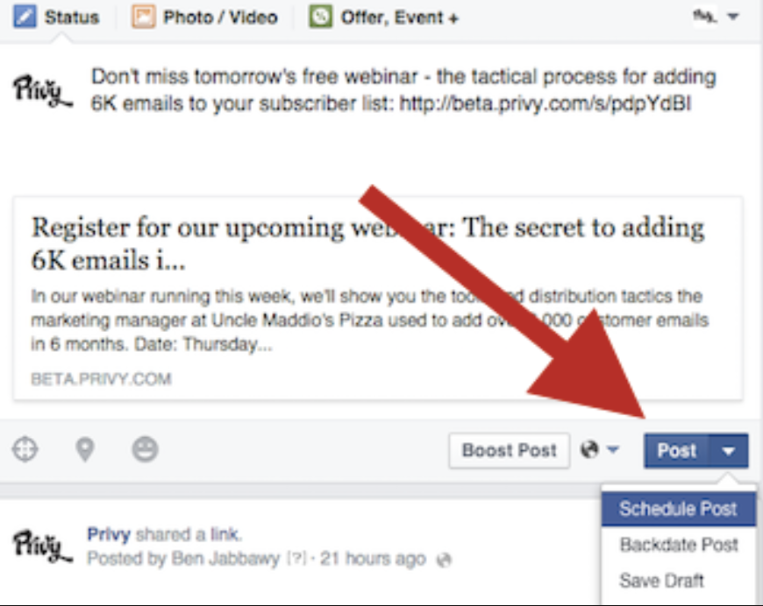
Scheduling Facebook Posts
SCREENSHOTS
https://blog.privy.com/blog/secret-facebook-feature
Notes:
As for “features”, I noticed that when I was on the Facebook administration for Northern Lights’ page, I was able to pre-schedule facebook posts. I don’t know if this feature only kicked in after we hit a certain amount of likes or if it was there all along, but I was happy to discover it none the less. It gave me the opportunity to set aside an afternoon and schedule posts for the entire next month. To find out if your organization has access to this option, create a post and see if a down arrow appears beside the word “post” which then leads to the option to “Schedule post”

Slide 8
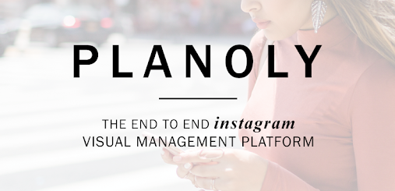
hootsuite.com
buffer.com
tweetdeck.twitter.com (for Twitter only)
planoly.com (for Instagram only)
Notes:
I would like to mention here that pre-planning for multiple forms of social media is an option. I’ll admit that I haven’t thoroughly explored any of them, although I believe that you would have to pay for hootsuite, and both TweetDeck and Planoly are specific to only one form of social media whereas hootsuite and buffer can apply to posting across multiple platforms.

Slide 9
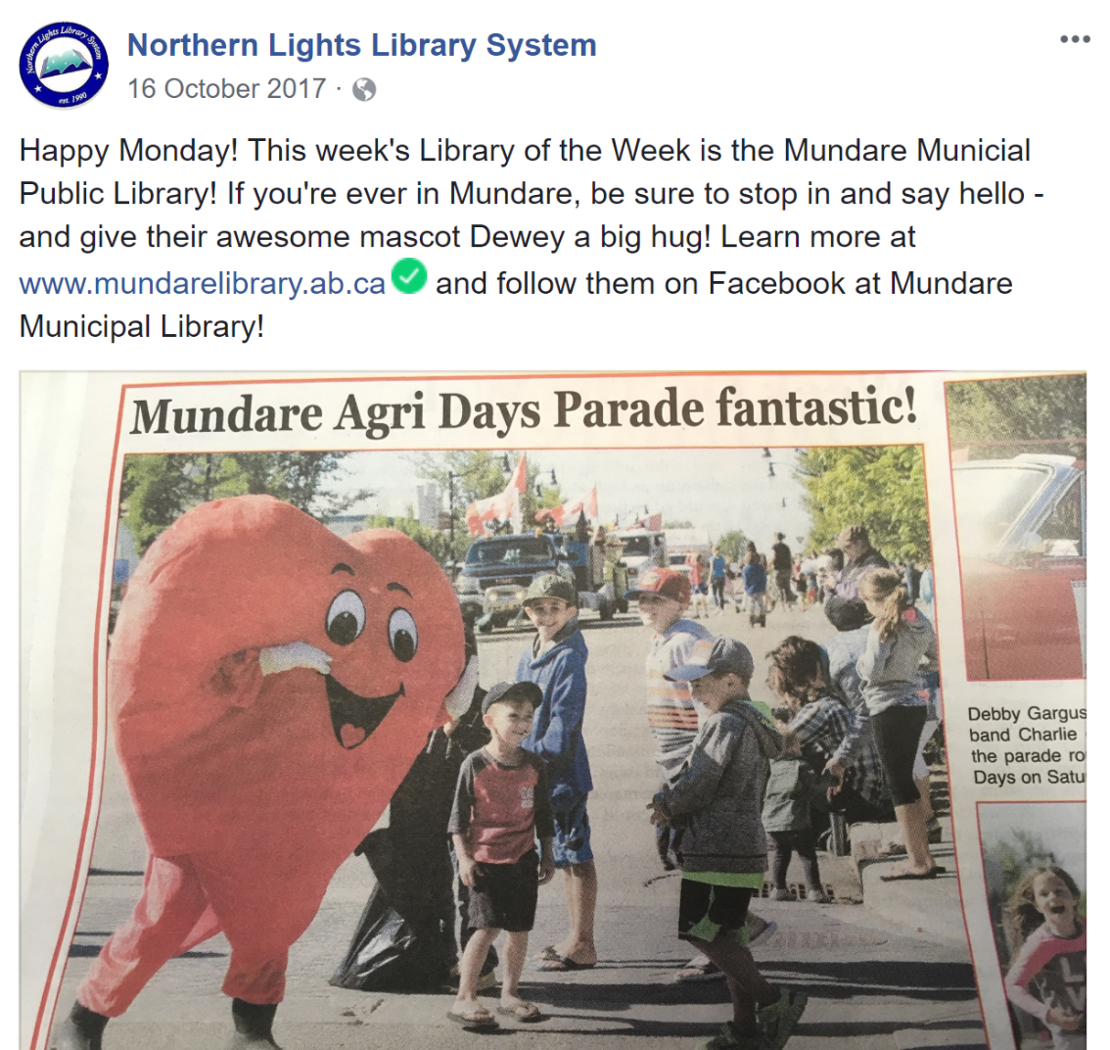
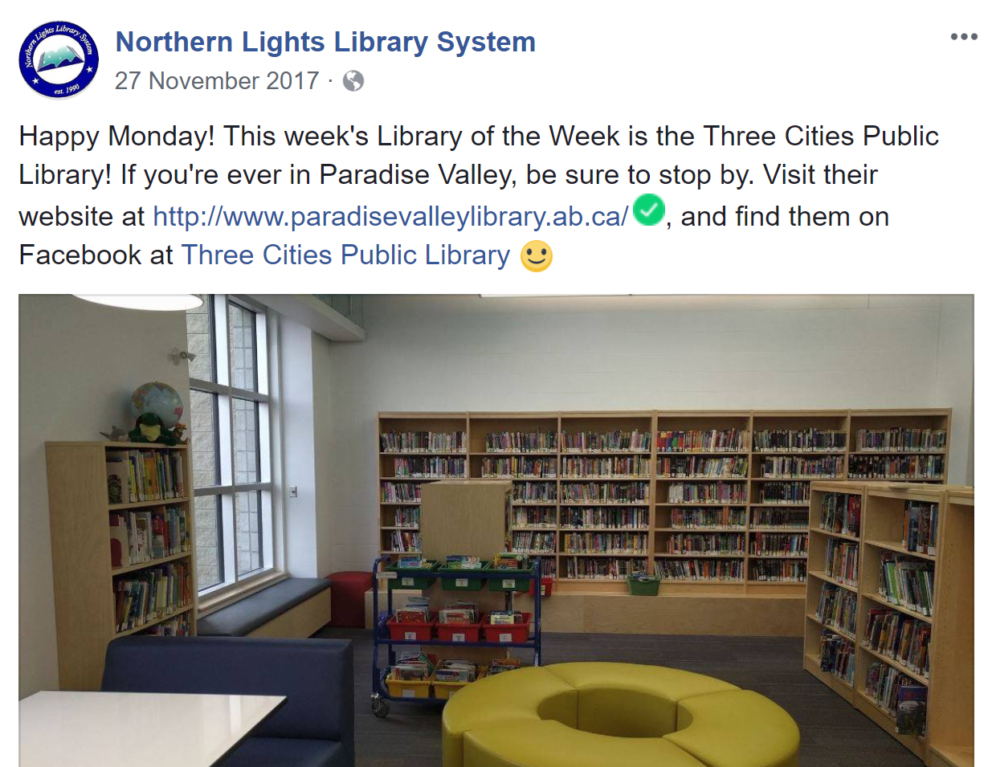
Mondays: Library of the Week
Notes:
But back to Facebook! My favourite method was to start off social media planning by creating a schedule for certain days of the week. I would have weekly regulars, which consisted of member “library of the week” on Mondays, a sample of which are pictured here…

Slide 10
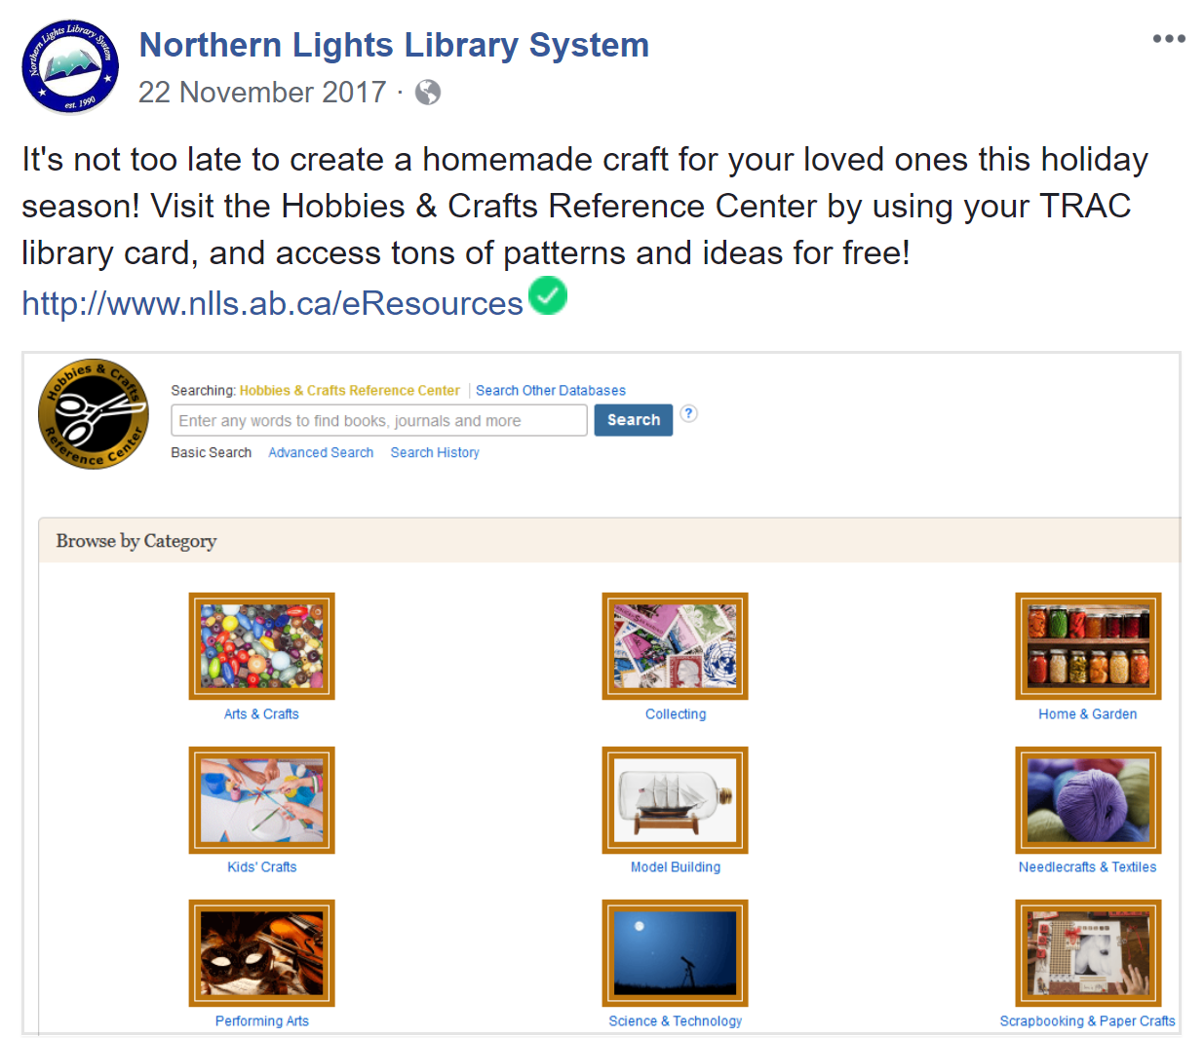
Thursdays: E-Resource Features
Notes:
And on Thursdays I would promote one of our eresources, and try to make each post relevant with current events and seasons. In addition to the photo in this slide, another example could be “taking a trip somewhere new this summer? Learn the local language with Mango Languages, free with your TRAC library card!”

Slide 11
Other “Feature” Ideas: Follow them and repost their exciting news to your page
Public Libraries:
Local Businesses
Daycares
Sports Centres
Municipalities
Farmer’s Markets
Academic Libraries:
Other University Departments
University bookstore
Nearby Museums
Art Centres
Local Events
Notes:
If you are an independent library as opposed to a system (and therefore don’t have “member libraries”) perhaps you could feature a local business of the week or something to that effect. In addition to regular posts, you can spontaneously share their posts as we mentioned before

Slide 12
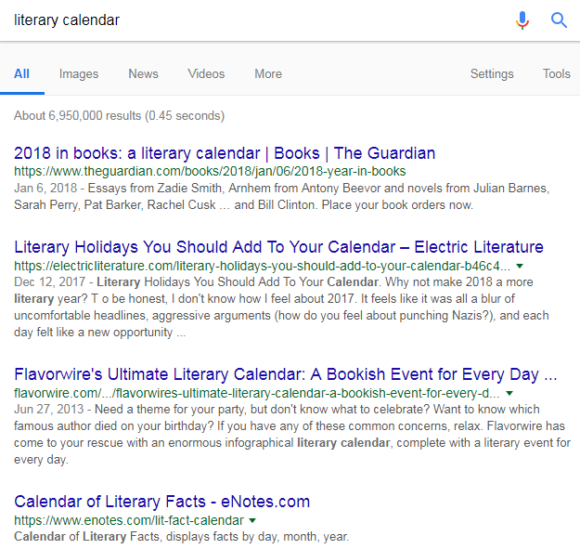
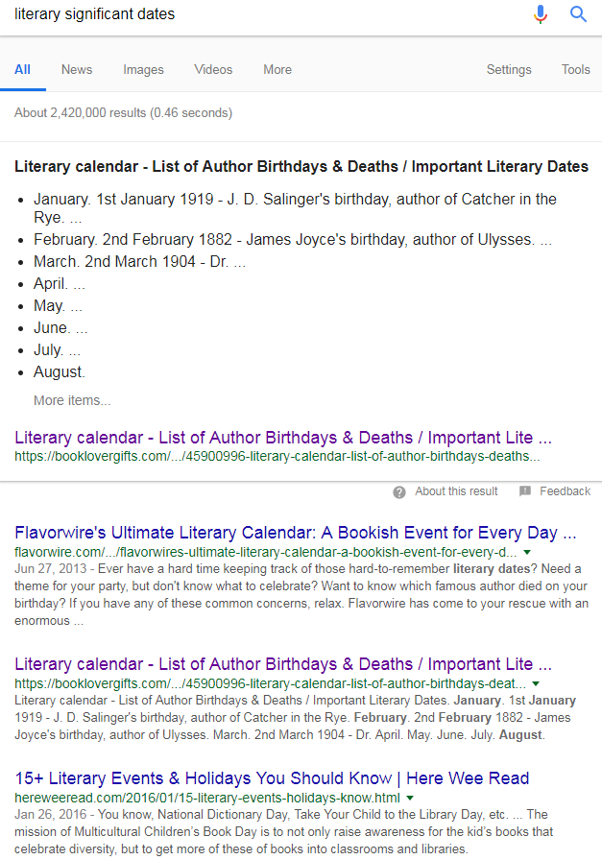
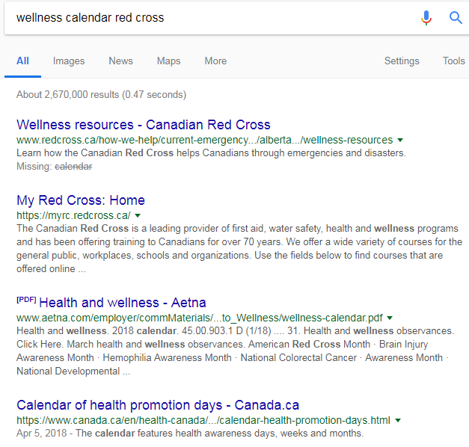
Literary Calendar
Can come from library significant dates, school literary dates, health/wellness days
Notes:
Some of the other posts I could plan out within that weekly schedule were literary dates. At Northern lights, I tracked down several lists on Google that showed any dates and events that could be used by libraries on social media. This includes literary calendars, school lesson plan dates, and wellness dates.

Slide 13
Created One “Master List” for our system
http://www.nlls.ab.ca/Public-Services
Notes:
I then took several of these lists and created one that our libraries could use, and posted it on the website – here is just a sample

Slide 14
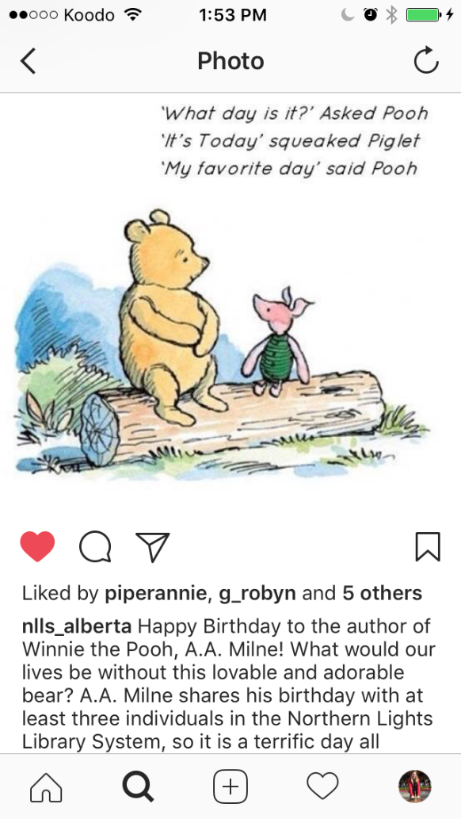
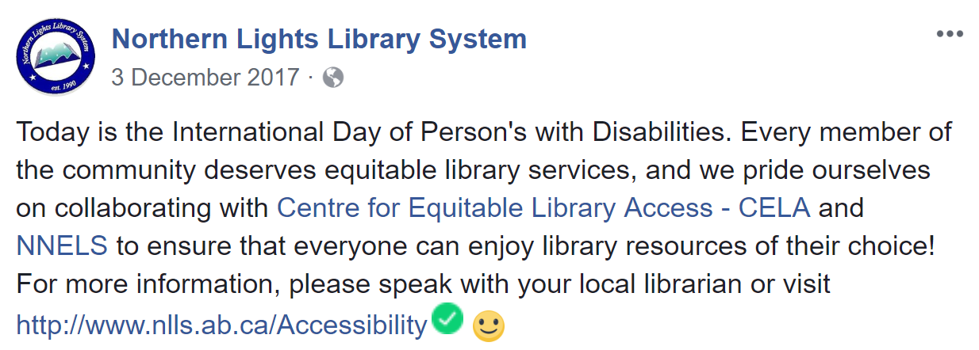
A.A. Milne (Winnie the Pooh)’s Birthday
Harry Potter Publication Anniversary
National Dyslexia Day
Promote how E-Resources offer ebooks with Dyslexic Font
International Day of Persons with Disabilities

Slide 15
Book Recommendations make great posts!
Including sources of multiple lists, like Goodreads.com and Blog.overdrive.com
And one-time lists, like “The 42 Best Books to Read Before You Die” by www.independent.co.uk
Top summer-reads lists, “books being made into movies in 2018” lists

Slide 16
Twitter
A bit less “member libraries”
A bit more “library organizations” – PLSB, LAA
More municipalities & counties – “Town of Smoky Lake”, “Smoky Lake County” (draw attention to these accounts in tweets about libraries)
Notes:
In my experience, the followers of each form of social media were very different. Our tweets at Northern Lights would get
a lot more attention from broader groups such as the Public Library Services Branch of the
Government of Alberta, LAA, and town municipalities such as the “Town of Smoky Lake” or “Smoky
Lake County” as opposed to lots of our local member libraries and patrons. I tried to keep up with the
same “library of the week” the way that I did on Facebook, but I would often tag the municipality where
the library was located, instead of the library itself if that library didn’t have Twitter. Twitter is a great
place to “retweet” tidbits of information from bigger parties such as LAA or PLSB, as well as posts from
e-resource providers.

Slide 17
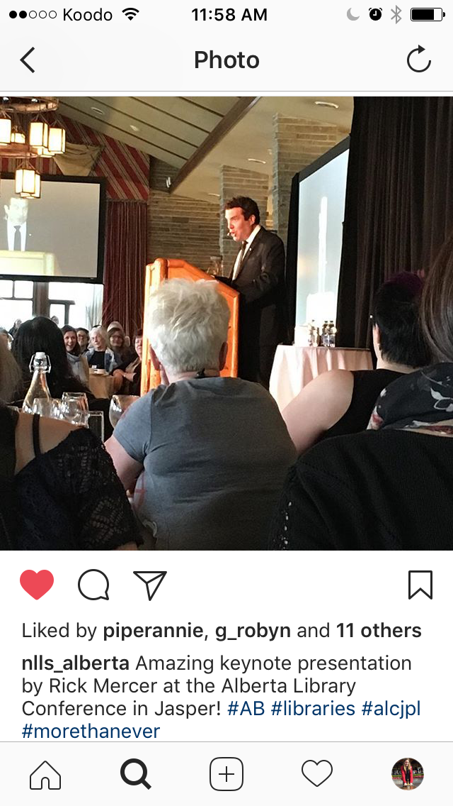
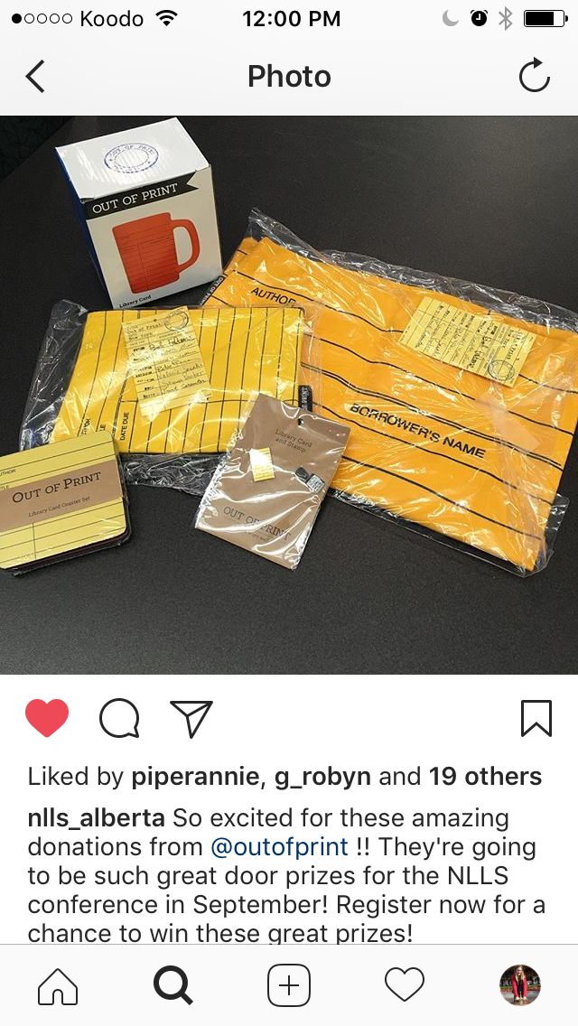
Tweet current and relevant info, like hours of operation or updates on events
Retweet tidbits of information from LAA or PLSB
Tweet at Library Conferences on behalf of the organization (only occasionally)
Retweet info from e-resources
Tweet pictures of donations from e-resource providers/library vendors
Notes:
Twitter is a great way to post current and relevant information about your library, such as hours of
operation or quick updates on events.
Sometimes when I was attending a conference on behalf of Northern Lights, I would include a tweet or two from the event that would be popular amongst these broader organizations (although I would make sure not to post too many, and potentially switch to my personal twitter for future tweets). In addition, when we were gathering donations for our annual Northern Lights Conference, I made a conscious effort to tweet pictures of donations from vendors, in the hopes that
they would see our appreciation and be willing to donate materials in future years.

Slide 18
Twitter Handle: @RobynG8 (that’s me!)
Hashtag: #alcjpl, #libraries – specific topics you can follow along with
Same system for Instagram
Notes:
Just as a side note: a twitter “handle” is someone, or something’s, specific account. So if you want to talk to me, you would use my twitter handle, @RobynG8, in your tweet. When you use a “hashtag” (so starting with the number sign), you are discussing a topic. At this conference, attendees can use the handle @alcjpl to address the conference’s twitter account directly. Because the conference theme for this year is “We Stand Up”, this particular hashtag is used to show the topic of discussion. If you click on that hashtag you can see who else is posting similar things

Slide 19
Limited Number of Characters
Use capital letters to differentiate words, instead of using underscores
bitly.com – can shorten external links
Notes:
Of course, one of the unique aspects of Twitter is that there are a limited number of characters you can
use within any one post. It can be difficult to keep hashtags short and within the “character” limits. One
recommendation, if you’re using more than one word in a hashtag, is to capitalize the beginning of
each word and use no spaces, as opposed to using underscores to separate words, because that
takes up more “characters”. Also, while I have not done it myself, I know you can potentially use
services like “Bitly” to shorten links when you’re attaching them to tweets. This means the link will take
up less of those characters too.

Slide 20
Instagram
Can’t easily share posts from other accounts
However, highly used amongst youth
Notes:
Instagram is my personal favourite! But one of its biggest barriers is that it can be more difficult to share an Instagram post versus other forms of social media. I think that it is possible, but you have to download another app to share someone else’s Instagram picture to your Instagram, so I never got very far with this. However, there was enough content that could be posted for Northern Lights as it was. Instagram is quite popular amongst youth, so it was worth it to create this account

Slide 21
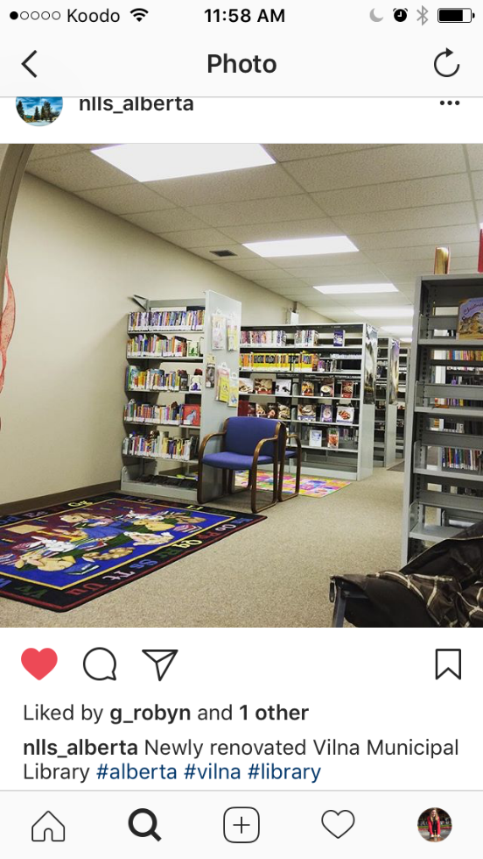
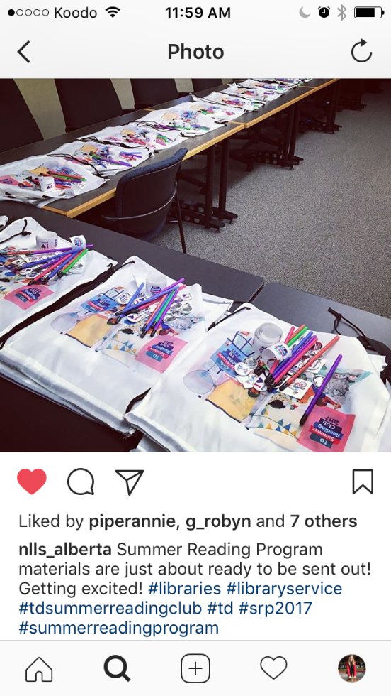
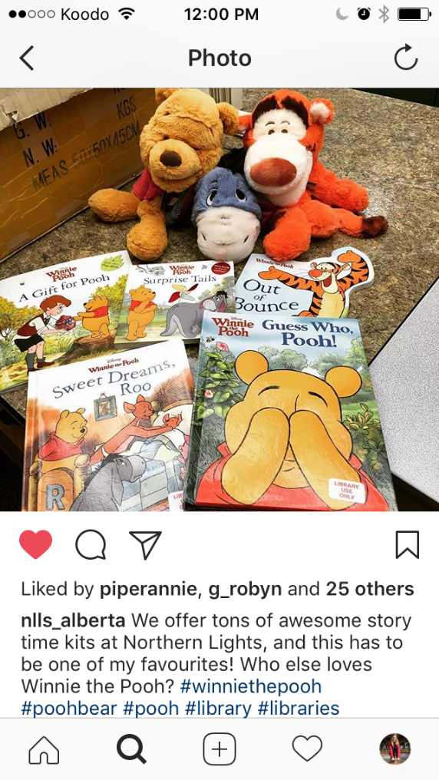
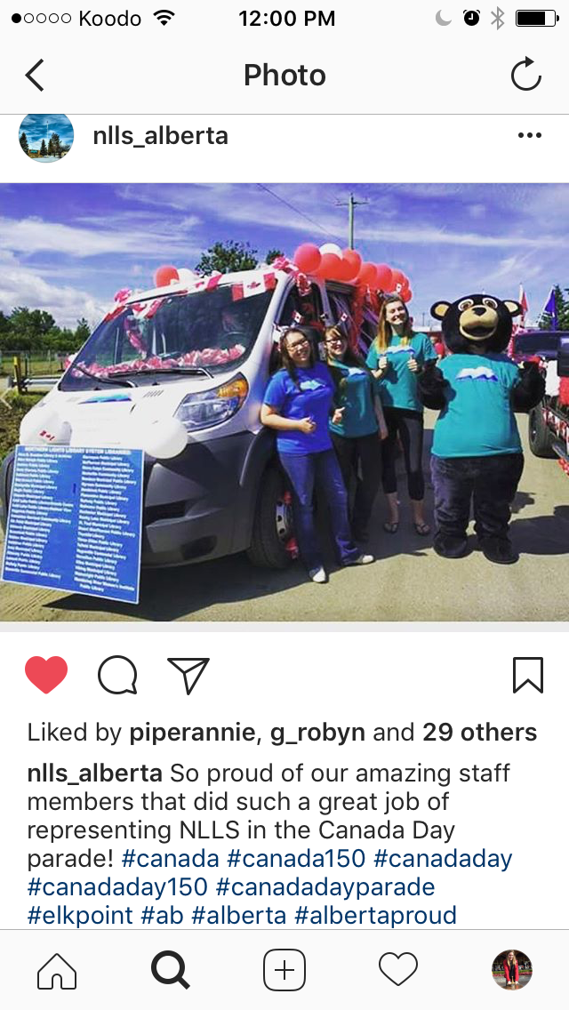
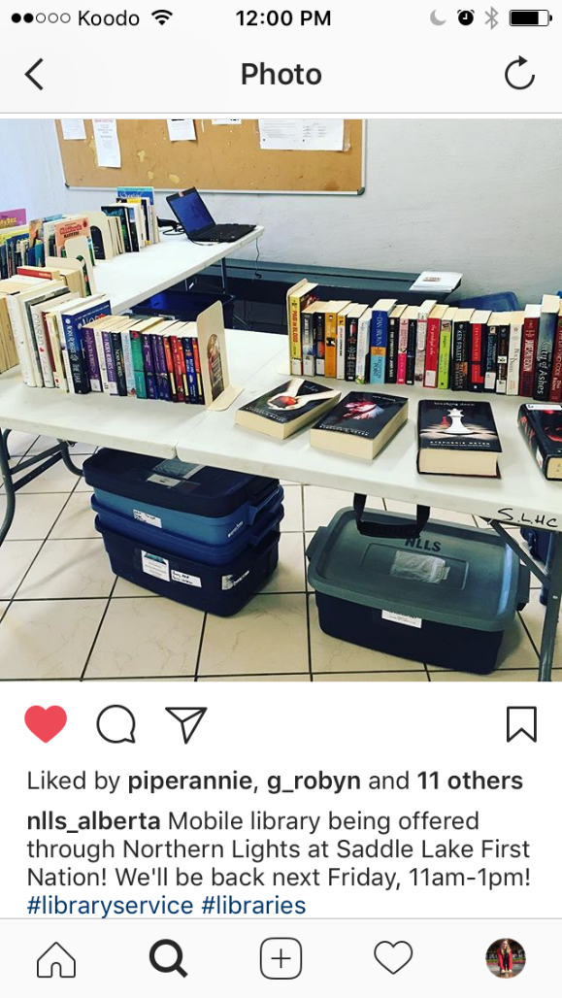
Great for programs, book displays, new furniture, renovations, & special events
Notes:
As for Northern Lights as a system, I was able to post openings of new library spaces, or pictures of items within the “division office collection”, and even post “sneak peeks” when new materials arrive. Our headquarters was also able to post events such as when we had our van in the Canada Day Parade, photos from delivering pop-up library services at Saddle Lake First Nation, and another popular post was when we showed all of our materials for the summer reading program lined up and ready to be distributed to libraries.

Slide 22
Pinterest
“Timeless” and can be done at any time
Often, posts created in Pinterest will be pinned by someone else months or years later
Notes:
Another form of social media I’ll mention is Pinterest. My favourite thing about pinterest is that a lot of it
propels itself forward. Unlike other forms of social media, where you create a post and people like it
but then they move on, often the posts you create in Pinterest will be “pinned” by someone else
months or years later.

Slide 23
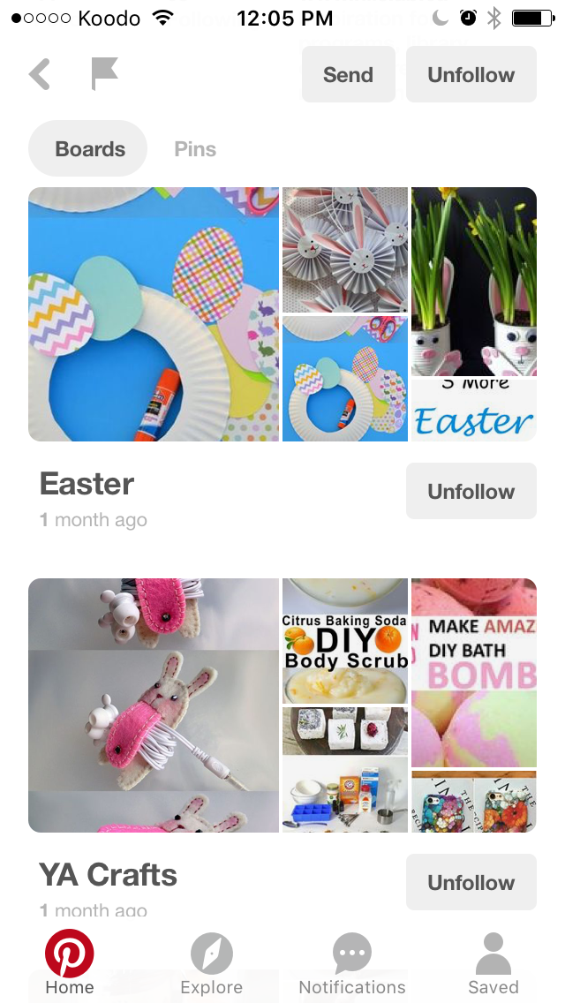
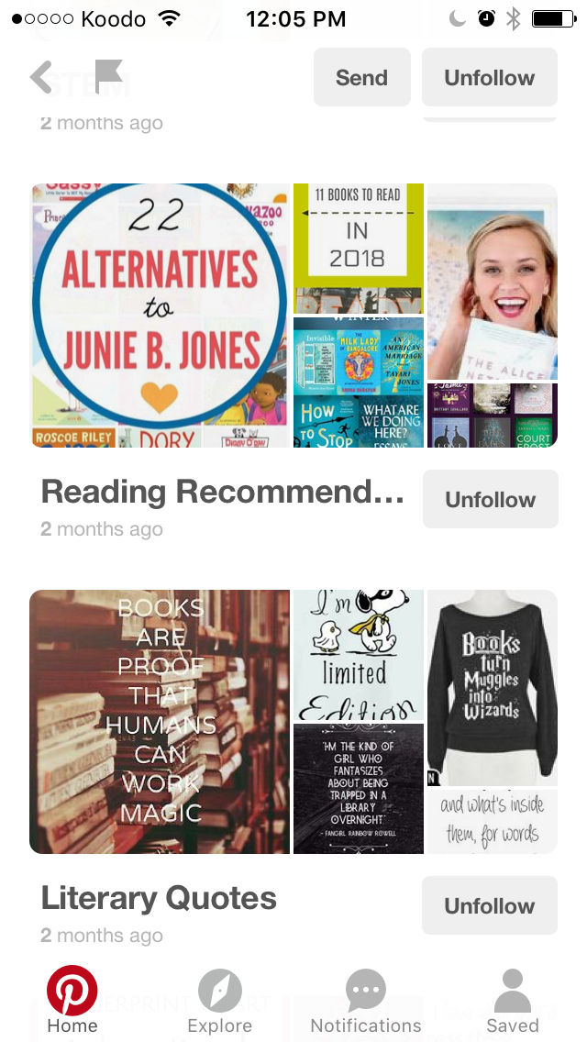
Possible accounts to follow if you’re a public library:
Classrooms, Crafts and DIY, seasonal activities, other libraries
Possible Boards you could create:
Reading Lists, Summer Reading Club Craft Ideas, Library Displays
Possible accounts to follow if you’re an academic
library:
Academic libraries and universities, museums,
travel pages, budget tips
Possible Boards you could create
Stress relief for students, photos of libraries
around the world, book quotes
Notes:
Pinterest consists of different “boards” that you can “pin” articles and other
pieces of information to. When starting out on pinterest, if you come from a public library, I recommend
following lots of other pinterest accounts that relate to school, education, kids, and naturally, libraries.
Some of the boards that libraries can use are reading lists, Summer Reading Club
Craft Ideas, and library displays. Perhaps if you’re an academic library, some resources such as
“Stress relief activities for students”, photos of academic libraries around the world, or book quotes
would be good topics to explore. It is so easy to follow lots of different accounts and then “pin” ideas
onto your own boards.

Slide 24
SnapChat
Very popular amongst youth
Great for “In the Moment”
Photos only appear temporarily
Have to be dedicated to capturing pictures as an event is happening
Notes:
One other type of social media that I never really explored for NLLS as a “Work account” was SnapChat. This is a service
where you can create “stories” that are posted to your profile for a limited amount of time, or else you
can send people pictures directly, which they can see for an allotted amount of seconds. Typically,
once the person closes the picture, they are unable to open it again. This app is extremely popular
amongst youth, but the main reason I never explored it was that it really depends on reacting
immediately in the moment as an event is happening. It would be great for capturing the hype of a
library event. But you can’t plan out posts in advance, since you take the picture then send it
immediately.

Slide 25
Social Media Timing and Tracking
Ideal times of day to post on social media, and lots of Google sources
Creating a post for a particular audience? Theorize when that audience is online
Spread out posts at different times of day, instead of all at once
Notes:
There are ideal times of day to post on social media to get the most attention, and lots of google
sources that list these ideal times. However, when you’re creating a post for a particular audience,
keep in mind what times of day those individuals might be on social media. If you are creating a post
about storytimes or programming for babies, then maybe post between 2 and 3pm when babies are
napping and their parents are potentially online.
I recommend trying to spread out your posts at different times of the day instead of publishing several
posts in a row in a quick period of time. Part of this is coming from my own frame of reference: for
Instagram in particular, if my feed is constantly photos from one account, I will probably unfollow them.

Slide 26
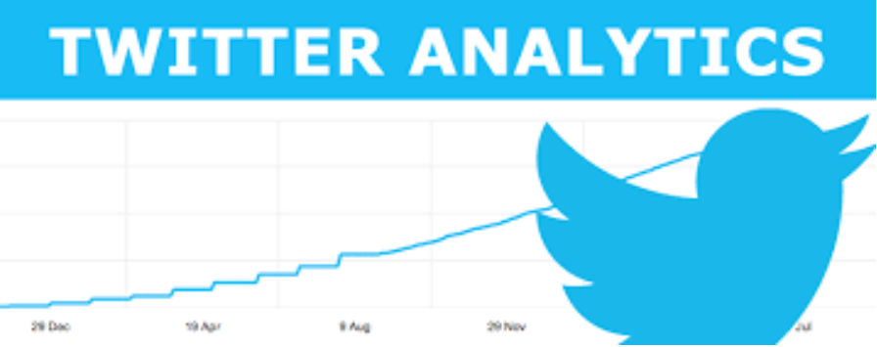
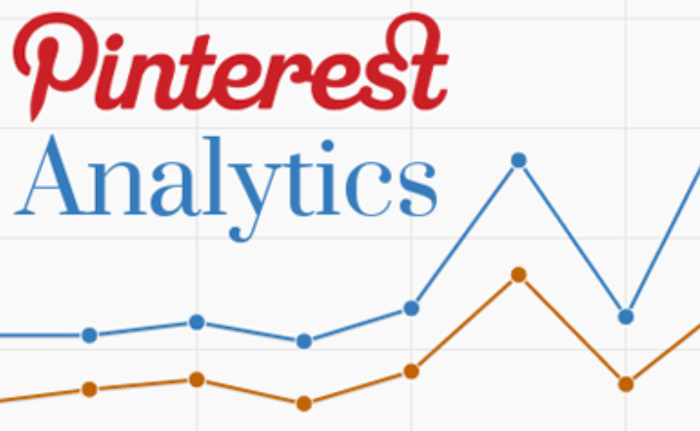
Statistics and Tracking
Track the amount of attention and “likes” your posts get, and adjust accordingly
Statistics:
Facebook Insights (analytics.facebook.com)
Twitter Analytics (analytics.twitter.com)
Instagram Gabstats (www.gabstats.com)
Pinterest Analytics
Notes:
Don’t forget to track the amount of success that each of your posts attains – if some posts are more
popular than others, then maybe shift your approach on what content you provide. Each form of social
media offers statistics if you want to examine trends more closely, in the form of Facebook Insights,
Twitter Analytics, Instagram Gabstats, and Pinterest Analytics

Slide 27
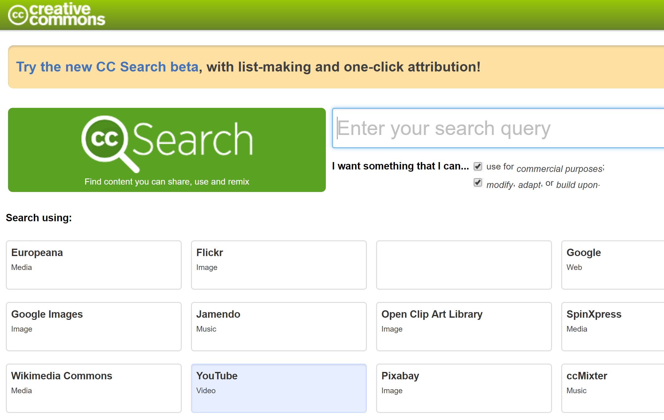
Copyright for Pictures
creativecommons.org
Notes:
Three reminders to “cover yourself” when it comes to social media: one is to be sure you keep
copyright in mind. When you are sharing a photo that you didn’t take, be sure to attribute the work to
whoever took that photo. If you want to use a general photo to go along with a caption, like Spring
Scenery with the caption “happy spring!” then I recommend visiting Creative Commons, where you can
browse photos that are open to anyone using them.

Slide 28
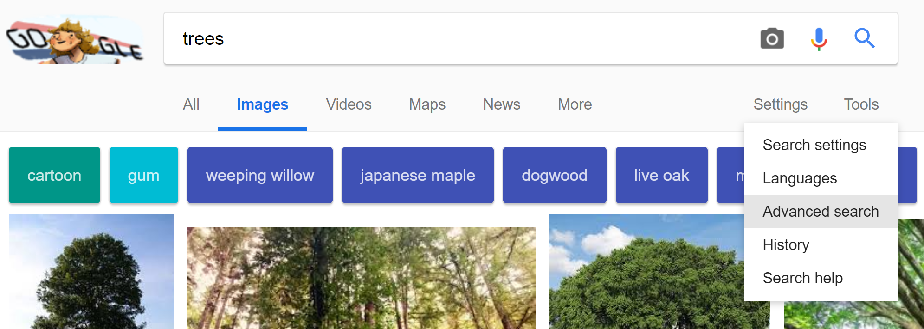
Copyright on Google
Notes:
Alternatively, when you Google Search for Images
to potentially use, filter your results to only see ones that you could possibly repost. To do this, go to
“Tools” and then select “Usage Rights”, and choose whichever option means that you can use the
photo for your own posts.

Slide 29
Privacy (FOIP)
Post signs at events that state photos will be taken
(http://lacombe.ca/doing-business/council-meetings-agendas/freedom-of-information-and-privacy)
Notes:
The second reminder is to always maintain privacy rights. If you plan on taking pictures at an event
and using these pictures on social media, then post signs at the event saying that photos will be taken,
and if anyone does not want their photo taken then they must talk to the photographer or library staff.

Slide 30
Create a Social Media Policy
Establish who will be in charge of creating posts
What is acceptable to post?
How would your organization react to negative posts?
Notes:
The third reminder is to create a social media policy for your workplace. Establish a select staff
member or two who will be in charge of creating posts, and ensure that they understand the persona of
your social media page. Social media posted to your library’s account is a representation of your
library, and you want to make sure that those in charge of social media respect that. Your library’s
social media policy will provide guidelines on what is acceptable to post versus what is not. This policy
should also contain guidelines on how to react if anyone ever posts negative reactions to your social
media account through comments or messages. Where would you draw the line between addressing,
say, a patron’s concerns, and deleting a comment because it is unacceptable? I like to think that this is
an issue that would not come up, and I have never experienced it personally, but it’s good to have a
policy in place just in case it ever happens.

Slide 31
Thank you, and happy posting!
Notes:
And that concludes my lightning talk. Thank you so much for listening – hopefully I was able to share a
new idea or two with you! Happy posting, and enjoy the rest of your conference!

