Slide 2
Here’s what we’re talking about
Why we did this
The long and winding road
The governance framework
Stuff we stepped in
Who’s at the table
What are we, anyway?
Difference between Bylaws and policies
Discussion drivers
Wrap-up

Slide 3
Why we did this
Bylaws last reviewed in 2010
Ad hoc approach to policy creation and revision
As part of a holistic review of the Board’s governance practices
To correct, update and improve the Bylaws and policies
3 parliamentary sources
No provision for “modern” meetings
Dense, long, redundant

Slide 4
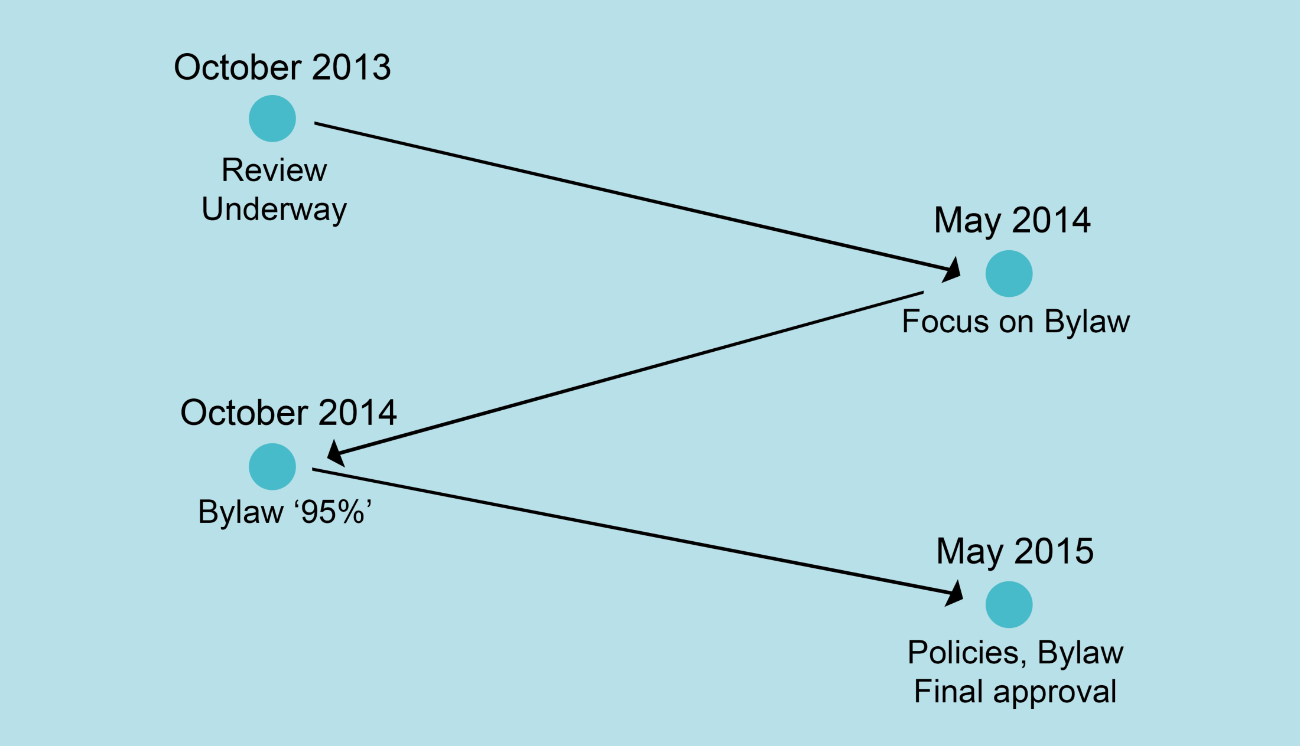
The Long and Winding Road I

Slide 5
Governance Framework: The starting point
Legislation
Libraries Act (Alberta), RSA 2000, c. L-11
Libraries Regulation, Alta Reg 141/1998
City of Calgary Bylaw Number 38M2006
Board Governance Documents
Use of the Library Bylaw
Board Procedure Bylaw
Board Policies
Administration Documents
Administrative Policies & Procedures

Slide 6
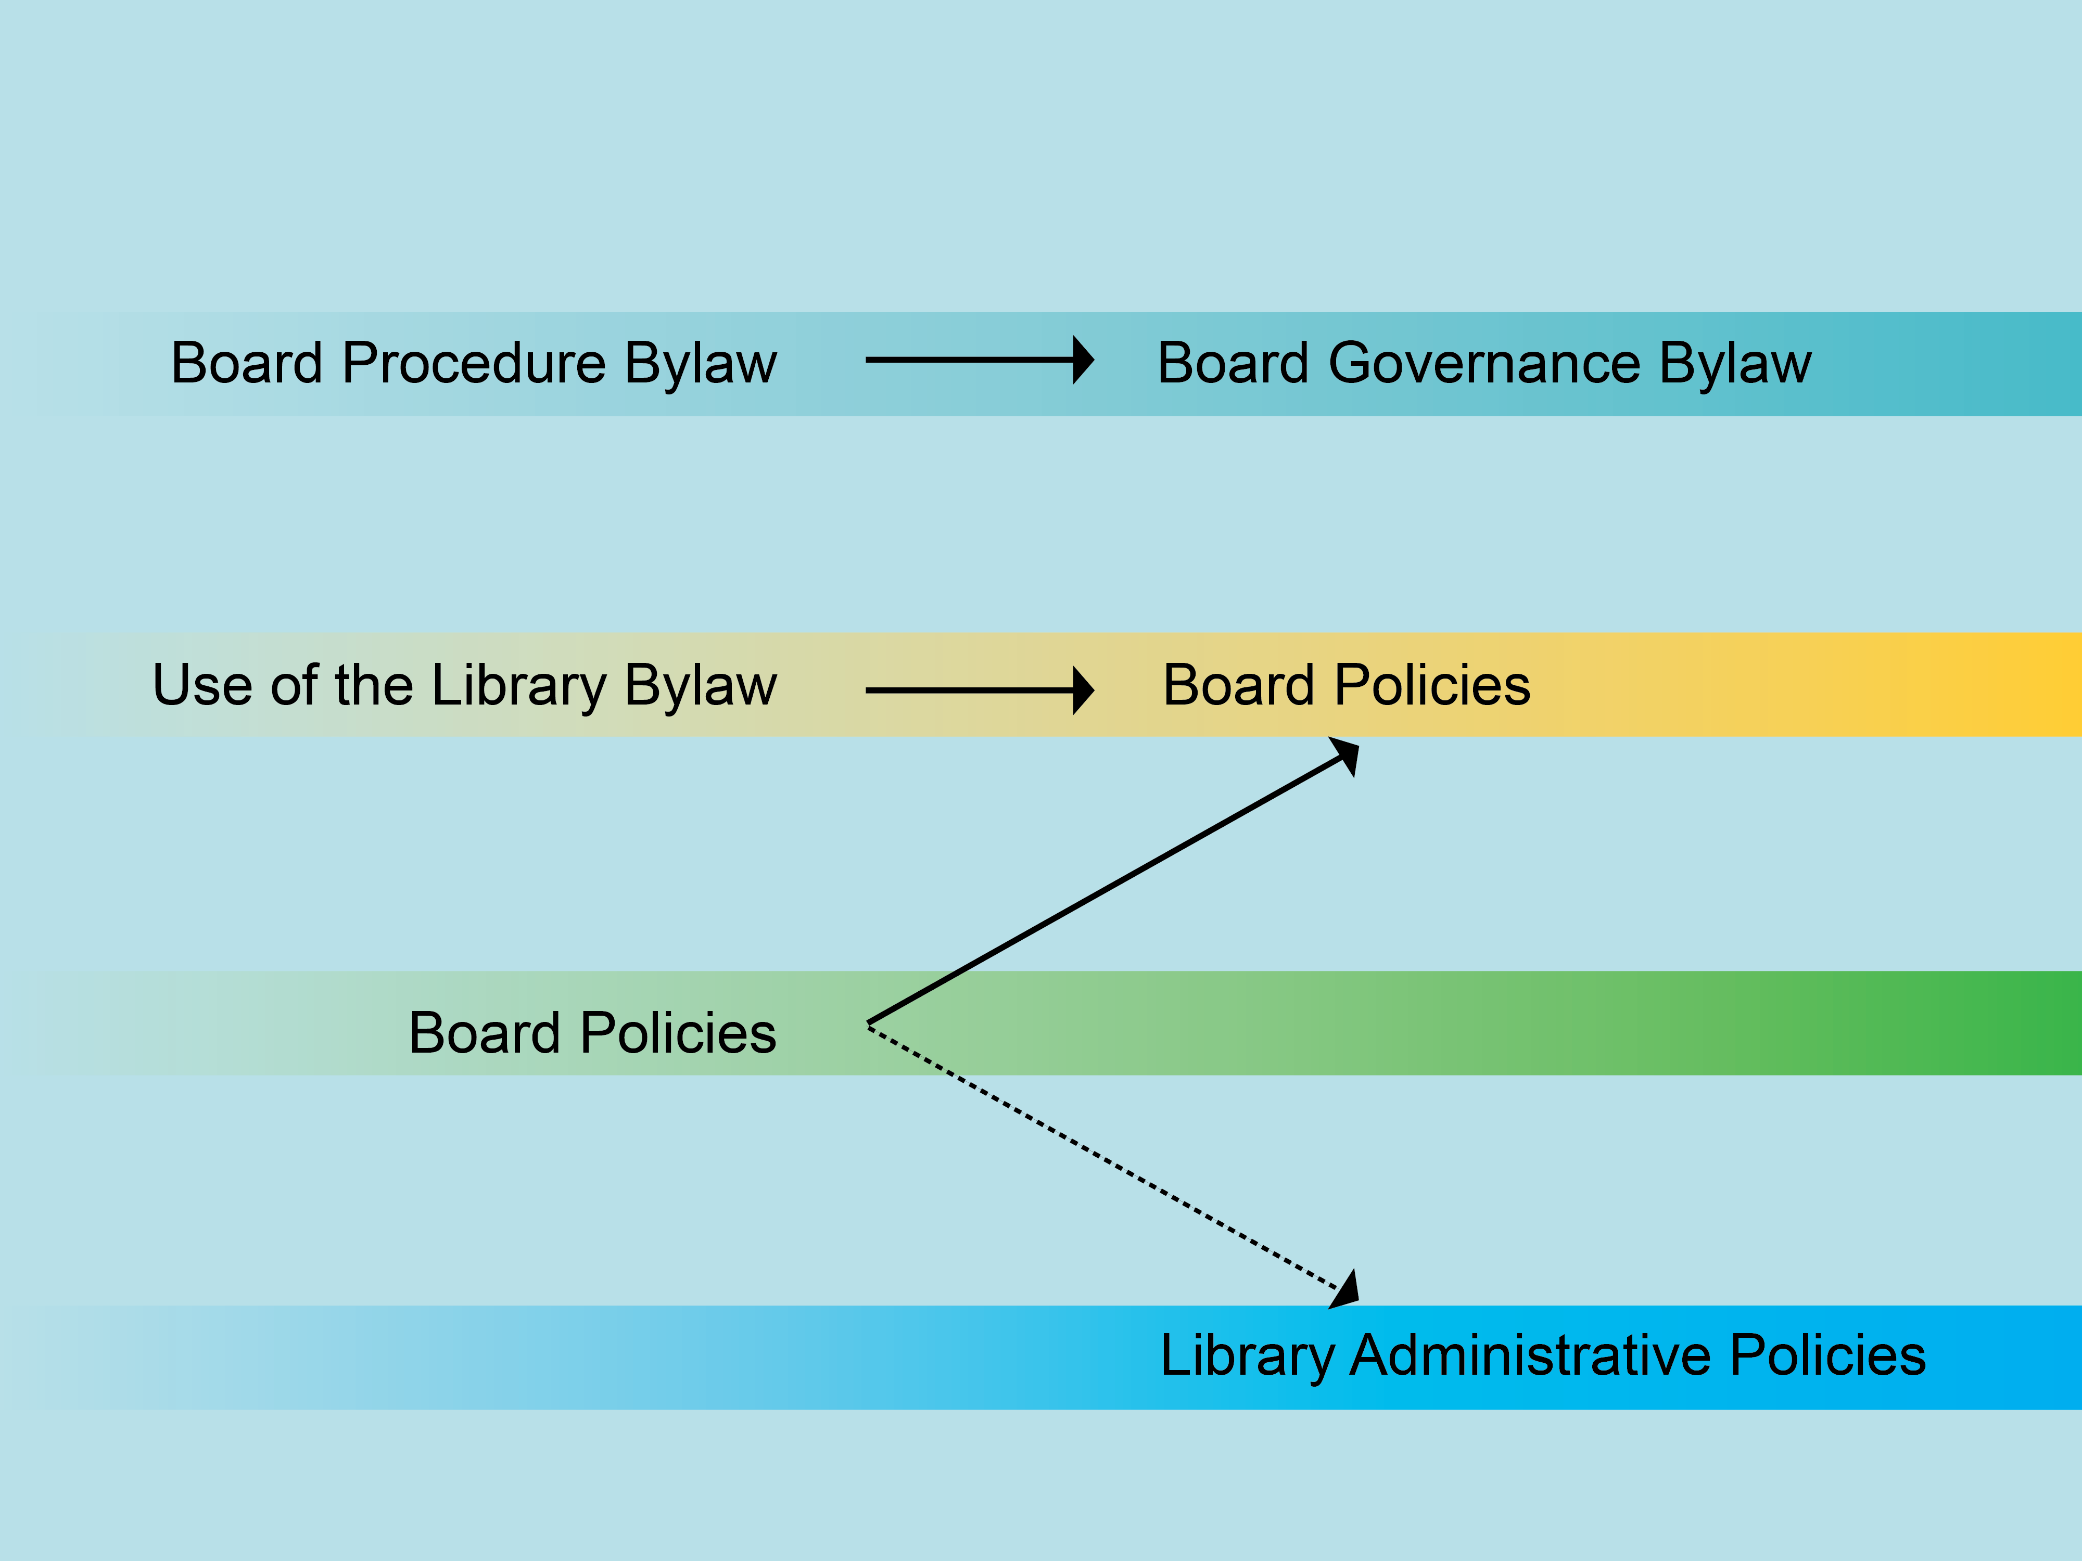
Governance Framework: Evolution
(63% fewer words)
(8 fewer policies)

Slide 7
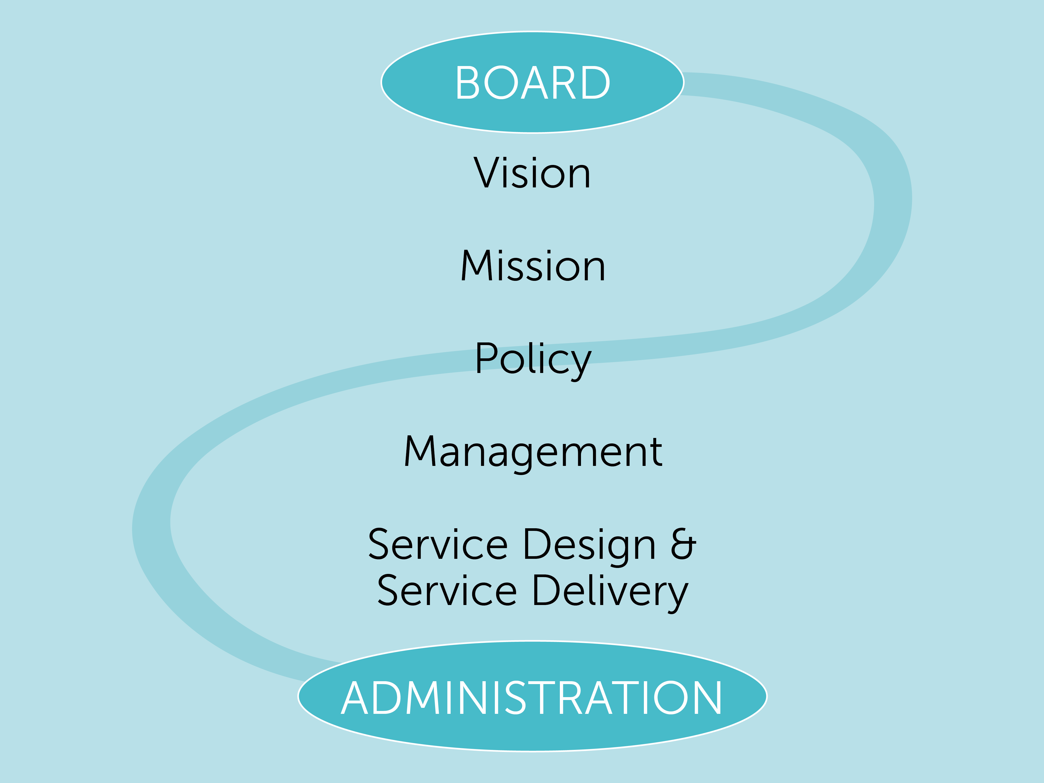
Governance Framework: The philosophy

Slide 8
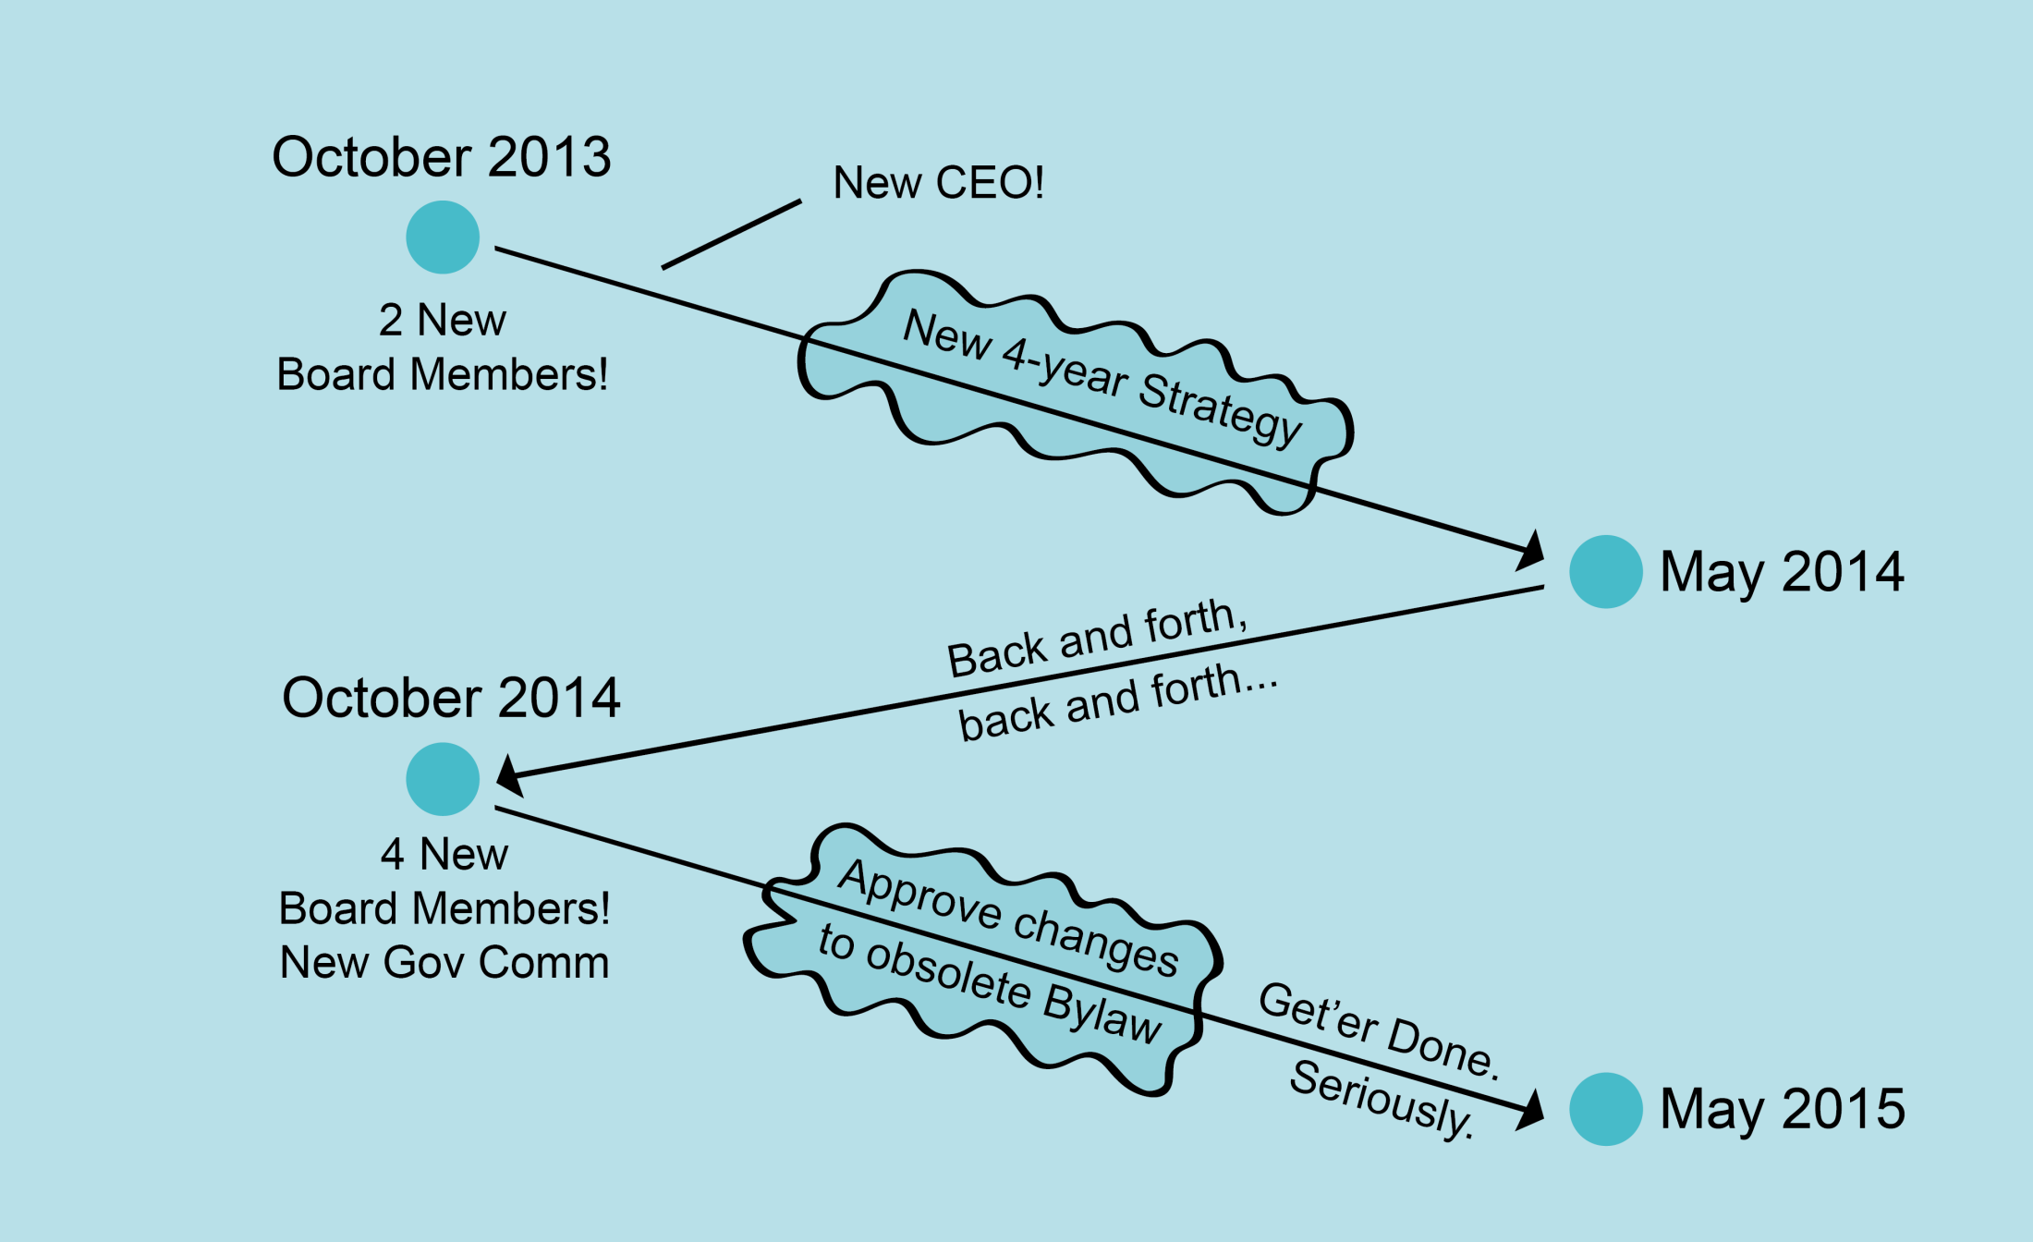
The Long and Winding Road II

Slide 9
Stuff we stepped in early on
Corporate approach of Board members with varied experience
No knowledge of relevant legislation
Trying to review bylaws and policies at the same time doesn’t work
Too many bartenders = an undrinkable cocktail

Slide 11
Who’s at the table
Board
Has ultimate responsibility
Owns the results
Opportunity for engagement
Library Administration and staff
Have right and need to participate
Bring knowledge and experience
“Bear the brunt”
Legal counsel
Brings expertise and objectivity
Provides assurance and empowerment
Spent about 30 hours of work

Slide 12
Speaking of legal counsel…
What is a public library?
Charitable organization
Not-for-profit organization
Local public body
…And why does this matter?

Slide 13
Charitable Organization
An organization formed for a charitable purpose, that is any purpose that is:
philanthropic
benevolent
educational
health-oriented
humane
recreational
religious
cultural
artistic
Charities in Canada are regulated under the Canadian Income Tax Act.

Slide 14
Not-for-profit Organization
A not-for-profit organization is formed to promote art, science, religion, charity or other similar endeavours, or it may be formed solely for the purpose of promoting recreation for its members. A not-for-profit organization is governed under the Companies Act and may be private or public.

Slide 15
Local Public Body
Section 1(p) of the Freedom of Information and Protection of Privacy Act (the FOIP Act) lists the following public bodies:
Government of Alberta
Municipalities
Metis settlements
Drainage districts
Irrigation districts
Housing management bodies
School jurisdictions
Post-secondary institutions
Public libraries
Police services
Police commissions
Health care bodies

Slide 16
What’s the difference?
Bylaws
Policies
Usually address matters that relate to the functioning of a Board and its relationship to members.
May be required by legislation
Usually cannot be adopted or changed by a simple majority
Are few in number
Articulate and define important objectives, principles or values
Limit or prescribe actions in specific situations
Define responsibilites and authority
Are subject to change by the Board at any time

Slide 17
Discussion Drivers
Bylaw
Term of the Chair
Pros and cons of a longer term
Voting by email
“Urgent motions” – strict conditions and procedures
Remote attendance
Allowed, “in compliance with Board policy”
Chair must be physically present

Slide 18
Discussion Drivers
Policies
Board honorarium
Dropped in favour of policy on expenses
Naming
Strict, simple rules
Can’t name a library building to recognize a gift from a commercial enterprise
CEO approves naming to recognize gifts up to $1M
Board approves naming over $1M
Clear guidelines for suitability, including:
Reputation, integrity, history, compatibility

Slide 19
Characteristics of good Bylaws and Policies
Used / referenced
Items can be found relatively quickly
Language is succinct and unambiguous
Bylaws should:
Be built to last
Avoid repetition and redundancy
Policies should:
Be logically arranged
Reflect the Board’s governance philosophy
Capture the spirit and intent

Slide 20
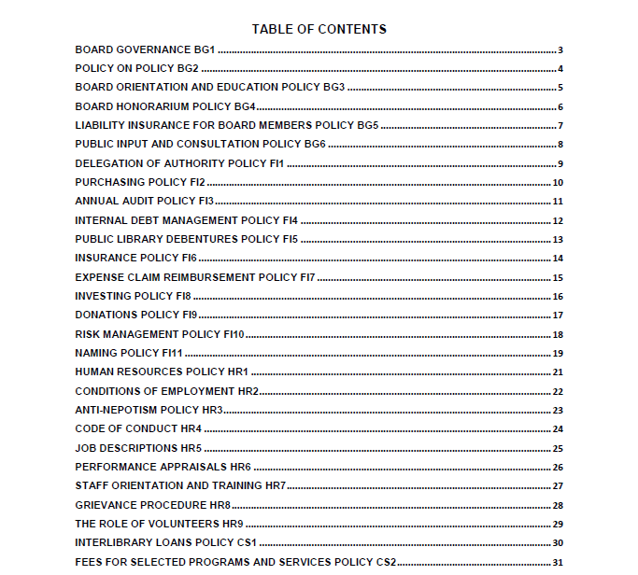
Previous contents

Slide 21
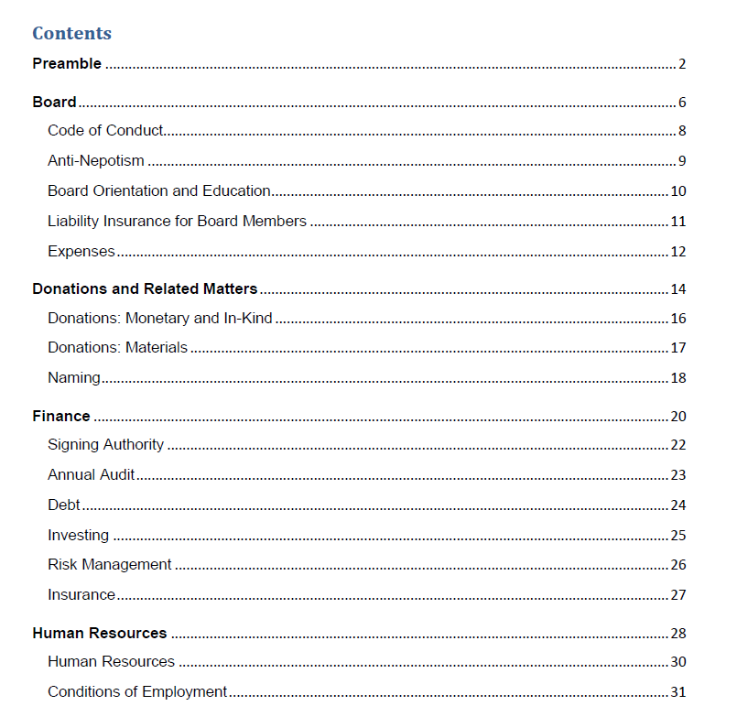
Revised contents

Slide 22
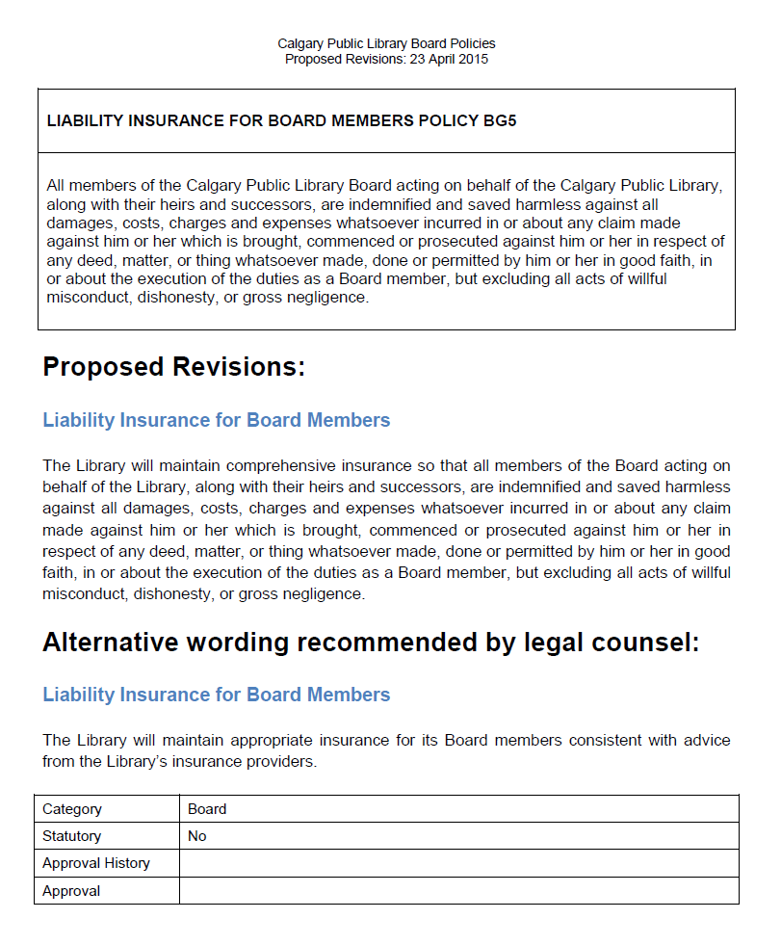

Slide 23
Stuff we learned
(The Columbus approach)
Assemble a qualified team
Appoint the head bartender
Include the whole Board in discussions of governance philosophy
Undertake the review in manageable phases with appropriate help and clear deadlines
Make time for editing for consistency and clarity

Slide 24
There may be other ways…
The KonMari approach
Gather all your Bylaws and policies together in one room. Pick up each one and ask, “Does this give me joy?” Ruthlessly discard those that don’t. Thank remaining ones for their service, then place them in a closed container.

Slide 25
Questions & Answers

