Slide 1
Toward Reconciliation: Update on CFLA-FCAB’s Indigenous Matters Committee
Joëlle Samson
Library Manager, Vancouver Island Regional Library
&
BCLA Representative, Canadian Federation of Library Associations’-Fédération Canadienne des Associations de Bibliothèques (CFLA-FCAB)
Indigenous Matters Committee (formerly Truth & Reconciliation)
Presentation adapted from Camille Callison’s Honouring our Path toward Reconciliation: Addressing the Information Needs of Indigenous Peoples & Building Relationships

Slide 2
We acknowledge with respect the Lkwungen-speaking peoples on whose traditional territory the university stands and the Songhees, Esquimalt and WSÁNEĆ peoples whose historical relationships with the land continue to this day.
I’d like to also acknowledge that I work and live on the unceded traditional territory of the Laichwiltach peoples

Slide 3
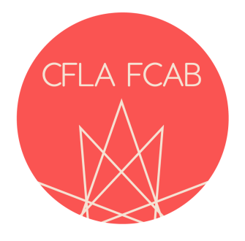
Canadian Federation of Library Associations/ Fédération canadienne des associations de bibliothèques
Update and
Truth & Reconciliation Committee Report

Slide 4
Canadian Council of Archives
Nunavut Library Association
Yukon Library Association

Slide 5
Truth and Reconciliation Committee

Slide 6
Elder Norman Meade was given tobacco and consulted traditionally in regard to process being undertaken.

Slide 7
Truth and Reconciliation Committee Members
Sarah Andrews, Martha Attridge Bufton, Greg Bak, Betty Braaksma, Marc Bragdon, Donna Bourne-Tyson, Patti Bryant, Cynthia Bretell, Anne Carr-Wiggin, Michael Ciccone, Carol Cooley, Diana Davidson, Monique Désormeaux, Michael Dudley, Pierre Gamache, Stan Gardner, Linda Garvin, Ben Gosling, Rosemary Griebel, Helen Halbert, Karen Hoffmann, Katherine Kasirer, Patricia Knockwood, Thom Knutson, Megan Langley, Jessie Loyer, Feather Maracle Luke, John Mutford, Maggie Neilson, Trina O’Brien Leggott, John Pateman, Colette Poitras, Trudy Russo, Pam Ryan, Joëlle Samson, Sonia Smith, Trecia Schell, Paul Takala, Suzanne van den Hoogen, Jenna Walsh, Natalie Wing and Monique Woroniak

Slide 8
Truth & Reconciliation Committee Charter
Truth & Reconciliation Committee Charter http://cfla-fcab.ca/wp-content/uploads/2016/08/Committee-Charter-Truth-and-Reconciliation-Committee-Approved.pdf
COMITÉ DE VÉRITÉ ET RÉCONCILIATION Charte du Comité http://cfla-fcab.ca/wp-content/uploads/2016/08/Committee-Charter-Truth-and-Reconciliation-Committee-002-2_FR_fr.pdf
Mandate
The Truth and Reconciliation Committee exists to promote initiatives in all types of libraries to advance reconciliation by supporting the Truth and Reconciliation Commission Calls to Action (http://www.trc.ca/websites/trcinstitution/File/2015/Findings/Calls_to_Action_English2.pdf) (http://www.trc.ca/websites/trcinstitution/File/2015/Findings/Calls_to_Action_French.pdf) and to promote collaboration in these issues across the Canadian library communities.

Slide 9
Responsibilities
The responsibilities of the Truth and Reconciliation Committee include:
Engaging with existing committees and/or working groups within CFLA-FCAB members to highlight best practices in this area already in place across Canada, help to disseminate those best practices, and foster greater co-operation at the federal level.
Engaging with the working group that is in the process of forming the National Aboriginal Library Association (NALA), with the intention of supporting the successful formation of NALA and engaging them in a leadership role on Indigenous issues at CFLA-FCAB.
Review existing guidelines and best practices regarding Indigenous (First Nations, Metis and Inuit) peoples of Canada as they pertain to library services.
Recommend a long-term structure and direction to the CFLA-FCAB Board to pursue and to address Indigenous issues related to libraries, including the formation of a permanent committee and programs, following the inaugural CFLA-FCAB AGM in February 2017.

Slide 10
Truth and Reconciliation Committee Report & Recommendations

Slide 11
Truth and Reconciliation Committee Report & Recommendations
Methodology
The Truth & Reconciliation Committee was divided into four teams with the following responsibilities.
The Black Team compiled Best Practices already in existence in regard to Indigenous peoples of Canada.
The White team provided a gap analysis on the TRC Calls to Action and has recommended a report card be developed to better evaluate how this is moving forward.
The Yellow team looked at existing relationships and has developed a contact database.
The Red Team envisioned the future by reviewing the existing body of knowledge related to the decolonization of space, access and classification, Indigenous knowledge protection, outreach and service.

Slide 12
Truth and Reconciliation Committee Report & Recommendations

Slide 13
Truth and Reconciliation Committee Report & Recommendations
Recommendations
The following ten (10) overarching recommendations have been agreed upon by the T&R Committee with specific, granular recommendations being addressed by each of the four team chapters of the report
This report is a snapshot and by no means purports to be comprehensive but rather it is a beginning. The numerous “living databases” that were created will continue to be updated as more information becomes available.

Slide 14
Truth and Reconciliation Committee Recommendations
1. As CFLA-FCAB is the national voice with the ability to influence national and international policy regarding issues of importance, we request the CFLA-FCAB create a permanent Standing Committee on Indigenous Matters utilizing the medicine wheel structure developed by the Truth & Reconciliation Committee;

Slide 15
Truth and Reconciliation Committee Recommendations
2. The T&R Committee supports and endorses the CFLA-FCAB Position Statement on Library and Literacy Services for Indigenous (First Nations, Metis and Inuit) Peoples of Canada;

Slide 16
Truth and Reconciliation Committee Recommendations
3. Encourage libraries, archives and cultural memory institutions to implement the Truth and Reconciliation Commission of Canada 94 Calls to Action, several of which have been identified as having a direct impact on libraries and archives and are prioritized in this report, and to implement a status report on a yearly basis to monitor their implementation;

Slide 17
Truth and Reconciliation Committee Recommendations
4. Ensure accessibility moving forward by continually reminding stakeholders that material produced and programming planned in the future should be accessible to all Canadians. CELA (the Center for Equitable Library Access) and NNELS (the National Network for Equitable Library Service) are positioned to support these efforts.

Slide 18
Truth and Reconciliation Committee Recommendations
5. Decolonize Access and Classification by addressing the structural biases in existing schemes of knowledge organization and information retrieval arising from colonialism by committing to integrating Indigenous epistemologies into cataloguing praxis and knowledge management;

Slide 19
Truth and Reconciliation Committee Recommendations
6. Decolonizing Libraries and Space by recognizing and supporting Indigenous cultures, languages and knowledges through culturally appropriate space planning, interior design, signage, art installations, territorial acknowledgements of geographic-specific traditional territories and public programming in collaboration with local Indigenous stakeholders;

Slide 20
Truth and Reconciliation Committee Recommendations
7. Enhancing opportunities for Indigenous library, archival and information professionals as well as the inclusion of Indigenous epistemologies in the Canadian library and archives profession through culturally appropriate pedagogy, recruitment practices, professional and continuing education and cross-cultural training in collaboration with local Indigenous stakeholders and partners;

Slide 21
Truth and Reconciliation Committee Recommendations
8. Recommend the implementation of Indigenous Knowledge Protection protocols and agreements with local and other Indigenous groups who have holdings in libraries, archives and/or cultural memory institutions to respect the Indigenous cultural concept of copyright with regard to Indigenous history or heritage, which is often located in but not limited to oral traditions, songs, dance, storytelling, anecdotes, place names, hereditary names and other forms of Indigenous knowledges; recommend that CFLA-FCAB actively participate in reforming the Canadian Copyright Act to include protection of Indigenous knowledges and languages while advocating for changes to include traditional knowledge as outlined and recommended by the World Intellectual Property Organization (WIPO) – Intergovernmental Committee on Intellectual Property and Genetic Resources, Traditional Knowledge and Folklore (http://www.wipo.int/tk/en/igc/). We join the Truth and Reconciliation Commission (TRC) to call upon Library and Archives Canada to implement the Truth and Reconciliation Commission Calls to Action #69 (Appendix D) by fully implementing the United Nations Declaration on the Rights of Indigenous Peoples (UNDRIP) http://www.un.org/esa/socdev/unpfii/documents/DRIPS_en.pdf and the Updated Set of Principles for the Protection and Promotion of Human Rights through Action to Combat Impunity (2005), more commonly known as the Joinet/Orentlicher Principles http://www.derechos.org/nizkor/impu/principles.html;

Slide 22
Quick facts on Indigenous Knowledge
Includes but is not limited to tangible and intangible expressions including oral traditions, songs, dance, storytelling, anecdotes, place names, and hereditary names.
Is dynamic and has been sustained, transformed, and continues to remain dynamic producing “new” knowledge in new media such as modern forms of music, theatre and dance interpretations, film, poetry, literary expression, language applications, blogs, facebook, digital collections, etc..
Who holds "legal" copyright to that knowledge or cultural expression under current Copyright legislations is contrary to Indigenous notions of copyright although parallel to Western legislations, Indigenous peoples regarded unauthorized use of their cultural expressions as theft.
Only in the proper cultural context with owner from the originating people can the true expression of that cultural expression be found.
Part of the Indigenous notions of copyright and patent is that understanding and preservation of ways of knowing can only truly be upheld with the ultimate aim to transfer the knowledges to the next generation in the proper cultural context.

Slide 23
Truth and Reconciliation Committee Recommendations
9. Establish an online database of “living documents” to highlight existing Best Practices of Indigenous Services in libraries, archives, and cultural memory institutions that will serve as a foundation to help disseminate those best practices and for this “living document” to be updated preferably on a quarterly basis but minimally semi-annually;

Slide 24
Truth and Reconciliation Committee Recommendations
10. Maintain a database of Indigenous organizations or groups committed to preserving cultural memory primarily, but not limited to, libraries, archives, language preservation, cultural history/museums to build relationships; to support the development of an Indigenous association of library, archives and cultural memory institutions; and to support in principle the National Aboriginal Library Association (NALA) regarding their stated intent of developing First Nations public libraries on reserves.

Slide 25
Truth and Reconciliation Committee Recommendations
Disclaimers
1. The CFLA-FCAB Truth and Reconciliation Committee Report & Recommendations is meant to be a foundation to be built upon and due to the timeframe is unlikely to be considered comprehensive;
2. Due to the time limits, there was no consultation with Indigenous communities, although there were Indigenous professionals in leadership positions;
3. The lack of input from the Canadian archival community is due to the limited membership of archives in CFLA-FCAB, at the time of the formation of the Truth & Reconciliation Committee. In November 2016, the Canadian Council of Archives (CCA) joined the CFLA-FCAB; and the Canadian archival community had, by that time, already established its own task force to address the TRC’s Calls to Action. In June 2016, the Steering Committee on Canada’s Archives (a collaboration undertaken by the Canadian Council of Archives, the Association of Canadian Archivists, Association des archivists du Québec, Library and Archives Canada, and the Council of Provincial and Territorial Archivists) established the “Response to the Report of the Truth and Reconciliation Commission Task Force” with a two-year mandate to address the TRC Call to Action #70 which speaks directly to the Canadian archival community. The CFLA-FCAB Truth & Reconciliation Committee supports their process and looks forward to working in partnership as we all move forward on this journey towards reconciliation.

Slide 26
Best practises
A vision of best practices includes obligations to:
Protect and preserve Indigenous knowledge(s) in a variety of mediums for use by current and future generations in a respectful and sensitive manner;
Provide a welcoming environment and assistance for First Nations, Metis, non-status and Inuit people to access this knowledge;
Seek direction from communities on proper protocols regarding access and care of their culturally sensitive records;

Slide 27
Best practises cont.
Respect the First Nations, Metis and Inuit cultural concept of copyright with regard to Aboriginal history or heritage, which is often located in but not limited to oral traditions, songs, dance, storytelling, anecdotes, place names, hereditary names and other forms of indigenous knowledges;
Provide opportunities and access to training and employment for First Nations, Metis, Inuit and non-status people.

Slide 28
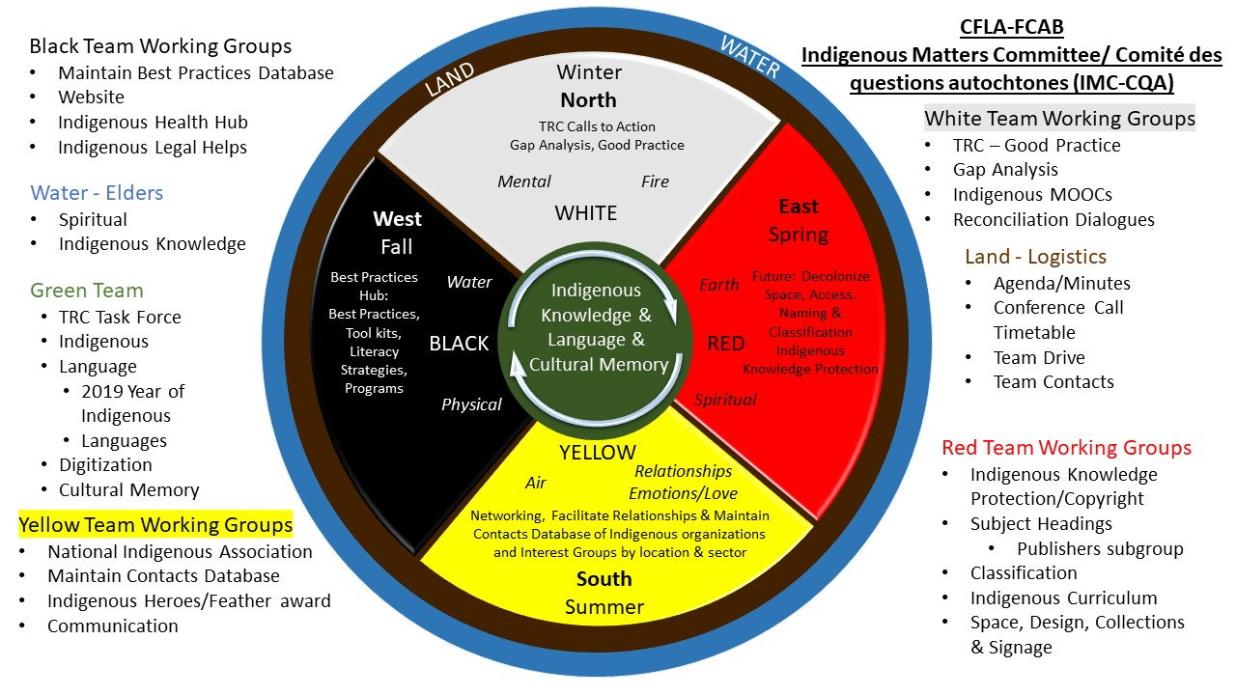
CFLA-FCAB Indigenous Matters Committee

Slide 29
Comité des questions autochtones

Slide 30
CFLA-FCAB Indigenous Resources Hub
CFLA-FCAB Indigenous Resource Hub
Resources and Databases
Indigenous MOOC
“Let’s talk about Reconciliation” Dialogues
A series of dialogues associated with the screening of a film made by an Indigenous artist, and organized by public libraries across Canada. This three-year project (2018-2021)
CFLA-FCAB Indigenous Matters, Libraries & Archives Canada, National Film Board, NCTR and Canadian Council for UNESCO
CFLA-FCAB T&R Report

