Slide 2
Cookies or kooky?
Hoping to bake your day a little better
Sue Bengtson
Lisa Abram
Lisa Petrachenko

Slide 3
Events discussed
Date | Events | Partners
April 2019 | Pop-up Relaxation Stations (aka Cookies & Milk) during exam week | UVic Food Services Adam Matthew Digital
October 2019 | De-Stress Fest during exam week i. Instagram contest ii. Snack pack giveaways | UVic Food Services
January 2020 & 2021 | Series of events for UVic Student Wellness Week, 2020 & 2021 | Led by Office of Student Life in partnership with UVSS and partners across campus

Slide 4
Cookies event: Why?
Support student wellness during exam time
We had some sponsorship funding remaining
We also had a newly renovated space
the reserves area had been renovated to a lovely, open and airy student lounge
The event was pulled together in short order - 17 days
Partnered with UVic Food Services

Slide 5
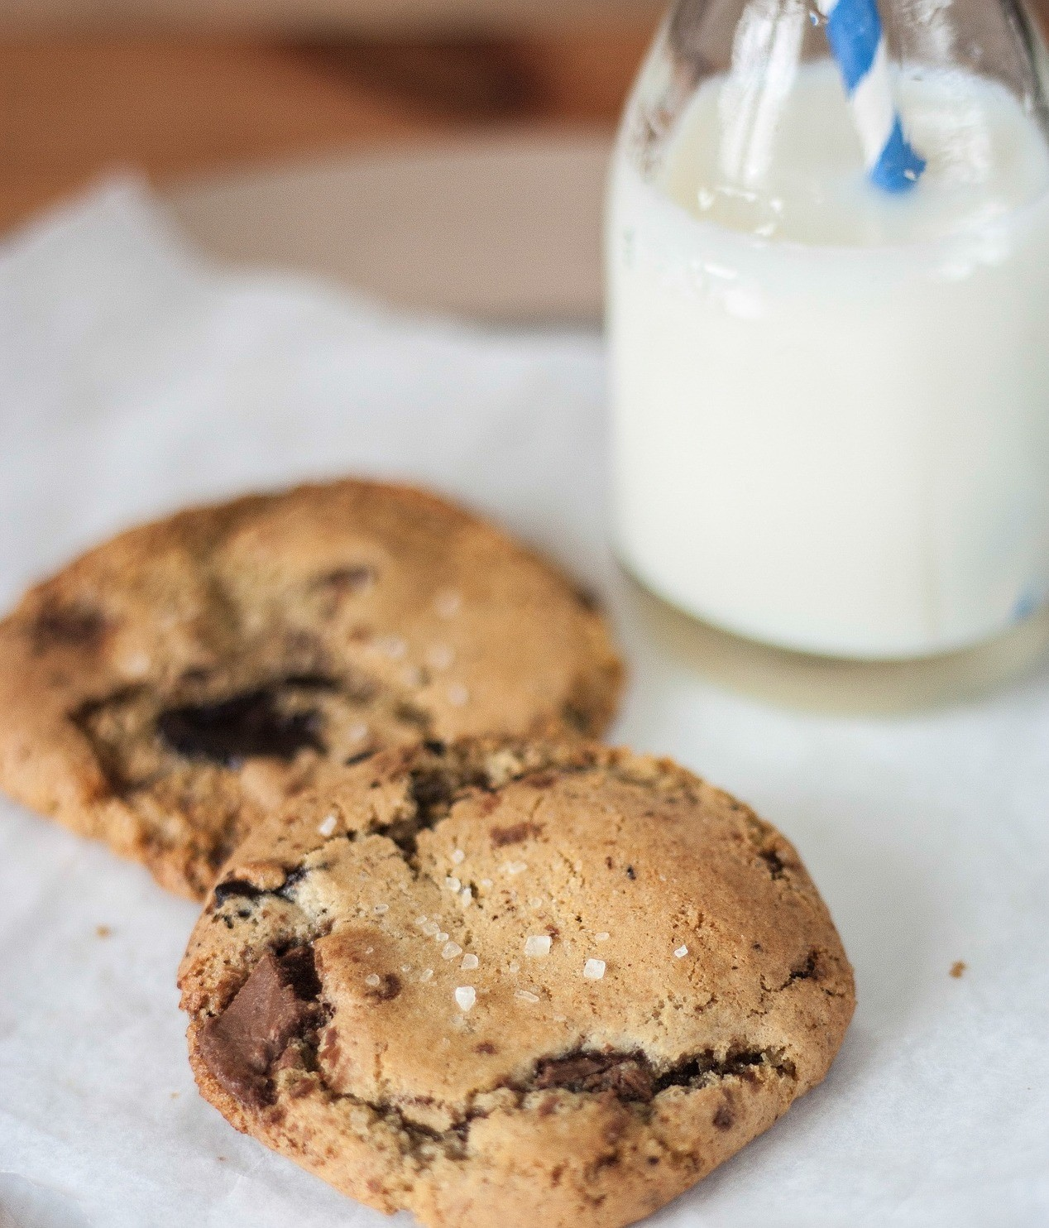
Pop-up
Relaxation Station
April 16 & 17, 2019
7 pm - 10 pm
Main Floor, Mearns Centre for Learning - McPherson Library
Some days deserve cookies.*
Take a break from your exam studies and join us for:
Colouring
Puzzles
Music Listening Station
Button-maker
Leisure reading ideas – graphic novels, fiction and more
*Cookies available on the main floor from 7pm until they are gone*
Brought to you by UVic Libraries and UVic Food Services, and with generous sponsorship by Adam Matthew Digital
Credit: Photo by Snapwire via Pexels
Notes:
Decided on hosting the event over 2 nights from 7pm until the cookies ran out.

Slide 6
The event
Over 800 cookies were handed out over 2 nights
Planned activities available:
Jigsaw puzzles
Music listening station
Button maker
Colouring sheets - special collections, some students brought their own
Delivery service to 3rd floor silent study space

Slide 7
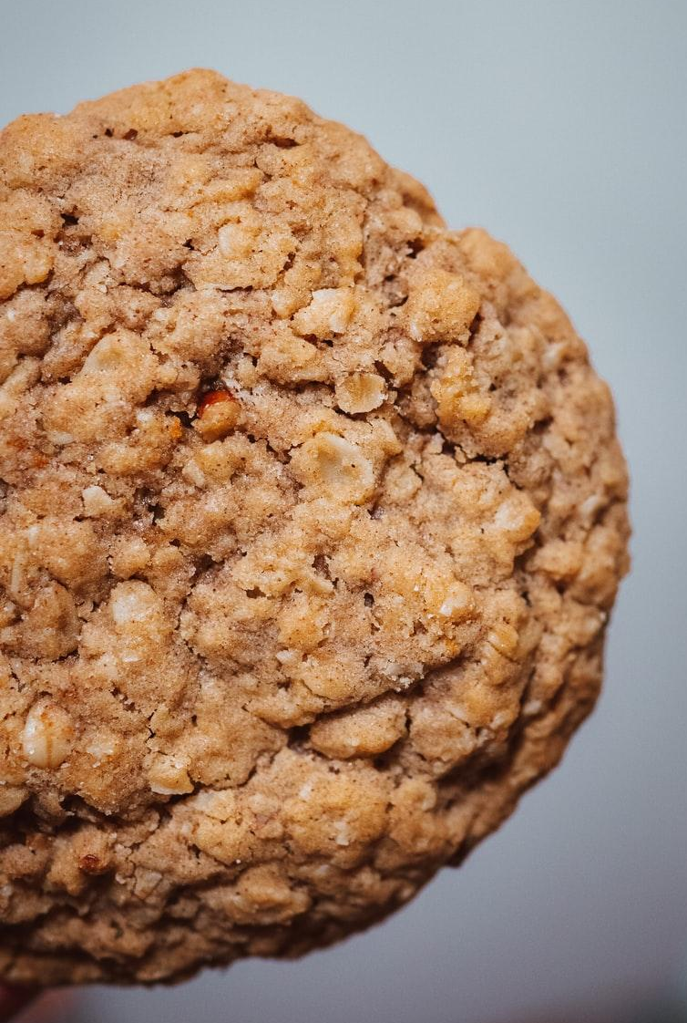
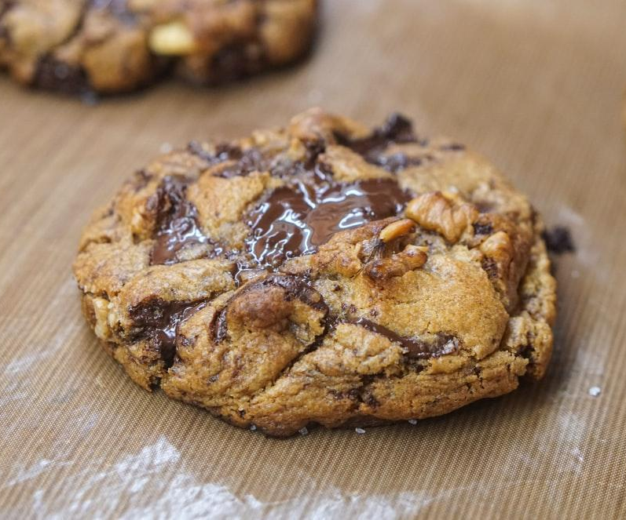
What does your cookie choice say about you?
Oatmeal
Chocolate
Vs
Notes:
Totally unscientific but interesting observation that the cookies of choice were chocolate on the ground floor lounge but on the 3rd floor which is a designated silent space oatmeal & raisin were the most popular

Slide 8
POLL: Cookie of choice?
Chocolate chip cookie
Double chocolate chip
White chocolate & macadamia nut
Oatmeal & raisin

Slide 9
Lessons & reflections
Students were beyond grateful and it was a feel-good event all round
Helped dispel student perception of traditional library - questions from students around eating in library etc
Milking it – too much milk
Desire more sustainable cup options for beverages

Slide 10
More lessons & reflections
More time to plan would allow for more collaboration across campus:
Yoga, international office, student life, Vikes, massage chair
Planned event for March 2020 was cancelled due to Covid-19
Food is such a great connector - what will future events look like?

Slide 11
STRATEGIES AND TIPS FOR SOCIAL MEDIA CONTESTING AND PROMOTION OF
WELLNESS ACTIVITIES

Slide 13
DE-STRESS FEST WITH UVIC FOOD SERVICES
Mid-term DeStress Packs
Promote healthy eating and increase # of student followers on Instagram
Instagram contest: October 15, 2019 (two day promotion)
Contest idea: Show us your study snacks
Prizes: UVic hoodie, library bag, yoga mat, mug, food (value: $100+)
Increased followers from 936 to 971 (35)
Total entries: 16
Notes:
UVic Food Services - 2,200 followers (as of Jan 21, 2021)
Compared to October 2018 contest: Show us your study space
Hoodie, library bag, yoga mat, mug, food, study supplies (value: $100)
53 likes
18 entries total
Increased followers from 615 to 690 (75)
https://www.instagram.com/p/Bo9jzndAHeb/

Slide 15
DE-STRESS FEST WITH UVIC FOOD SERVICES
Mid-term DeStress Packs
Instagram promotion: October 16, 2019
Contest idea: Giveaways at the library, 110 mini-packs handed out
Prizes: KitKat chocolate bars, stickers, ear plug, and a “Studying: Do Not Disturb” table top sign
Total likes: 66
Costs: $322 split in half ($161 each)
Notes:
Compared to October 2018: Giveaways at the library
300 mini packs handed out
12 oz coffee coupon, an Awake caffeinated chocolate square, earplugs, a sticker, and a “Studying: Do Not Disturb” sign.
46 likes
https://www.instagram.com/p/Bo__wTjDXzK/

Slide 16
BACKGROUND TO WELLNESS WEEK
Wellness Week - 7th consecutive year
Organized by Office of Student Life
January, post holiday blues, students feeling under the weather
New start to the term – school work stresses begin
Libraries first participated in 2020, proactive approach
Partners: student residence, office of student life, student union
Notes:
Strategies for a successful wellness week partnership:
•We approached library colleagues to lead events specific to their area of expertise (i.e. bookbinding, movies).
•We asked library staff (19) to volunteer at the events. Plus work study student.
•Some events were date/time specific, others were drop-in events like the Gratitude Wall.
•We approached campus and community partners (UVic movie theatre, student union, health services – student affairs, local public library, massage school).
•We introduced ourselves to a PhD student with a unique Instagram account.
•We received budget approval from University Librarian – spent $460 (sharpies, sticky notes, popcorn, drinks, popcorn bags, stickers created).

Slide 17
Notes:
Promotion: sticky notes, poster, digital slide

Slide 18
2020 WELLNESS WEEK
There’s a Place for you Here - tag line
January 13-17, 2020
Six library events: https://www.uvic.ca/library/home/home/news/current/wellness-week-2020.php
Gratitude Wall with UVic Students’ Society Peer Support Centre
Book display curated by librarians
Create your own wellness journal
Movie Night: The Princess Bride
Pop-up display with Greater Victoria Public Library
Massage chairs with West Coast School of Massage
Notes:
Quick stats from the event:
• over 287 notes of gratitude
• 31 students benefited from a massage (we could have had this run for the entire day – it was over subscribed)
• 55 Wellness journals made
• 20 students attended Princess Bride Movie night (not bad for the night of the snow fall, they enjoyed popcorn and said they would love to see this as a regular event in the library)
• GVPL event had to be cancelled due to the weather but we hope to have them return during reading break or in the very near future

Slide 19
Notes:
Gratitude Wall

Slide 20
Make your own wellness journal
Notes:
Make your own wellness journal

Slide 21
Notes:
Broodyanon Instagram account

Slide 22
Notes:
Library Instagram posts

Slide 23
2020 WELLNESS WEEK – LESSONS LEARNED
You can’t control Mother Nature – 2 events cancelled due to snowstorm
Movie Night not well attended due to snowstorm - could do more targeted promotions to students living on residence even though Office of Student Life did outreach.
Students like to engage with volunteer library staff, and appreciated onsite events like the gratitude wall and bookbinding.
Students were not aware of the wide-ranging resources that we offer (i.e., 3D printers, respite room, silent piano, multimedia equipment).
We need to continually promote: We are here to help!

Slide 24
STAYING CONNECTED

Slide 25
COLLABORATIVE VIRTUAL EVENTS
2021 UVic Wellness Week
Theme: Pathways to Wellness
Wellness Circle
Partnership pathways – Just Ask!
Notes:
Wellness week is in it’s 7th year and a partnership between The Office of Student Life and part and UVSS – grown over the years and now includes 15 campus partners.
Wellness Week initial meetings summer 2020 with the knowledge they would need to all be online events.
Given many experiencing isolation and disconnected from a sense of community this year’s theme was Pathways to Wellness.

Slide 26
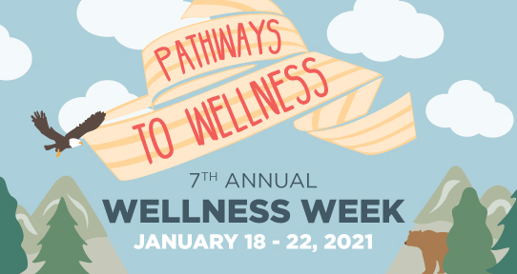

Slide 27
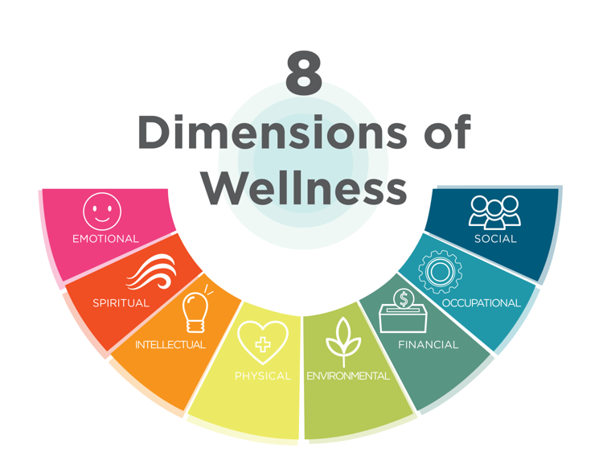
Notes:
Online collaboration to narrow down and focused the 5 of the 8 areas of the wellness wheel
Community
Emotional
Spiritual
Physical
Academic
good brainstorming sessions using Google Jam Board and breakout rooms in Zoom.
From this each partner area developed and hosted either a workshop, activity, event or discussion.

Slide 28
Notes:
https://www.uvic.ca/services/studentlife/initiatives/mental-health/wellness-week/index.php
For a list of event from this year’s Wellness Week
UVic Libraries opened the week with an online discussion
Indigenous Approaches to Holistic Wellness – a conversation hosted by our AUL Reconciliation Ry Moran speaking with Elder Dr. Barney Williams, Elder Yvonne Rigsby Jones, and Brenda Reynolds
https://www.uvic.ca/library/home/home/news/current/wellness-week-2021.php
Great opportunity to reach many and start the week off with positive messages around self care and the power of positivity
Libraries curated a list of resources to support the event
Promoted other resources and community partners such as the VNFC
Good turnout – over 200 in attendance

Slide 29
OBSERVATIONS
Hosting virtual events
Creativity – use tools and technology – experiment
Interactive collaborative tools used
Google Jam Board
Padlet
Mentimeter
Others?
Meet regularly
Wellness in online environment
Assessment – what do students want
Notes:
Creativity and brainstorming tools
Regular meetings but shorter in length
Interactive tools important
Breakout rooms
Wellness events typically involve a physical or tactile aspect. Probably the most difficult to replicate unless it’s a follow along type video.
Not everything replicates well in an online platform
Example Food events that usually are popular
Community of care

Slide 30
WINNIPEG COMMISH
3 eggs
1 cup sugar
1 cup vegetable oil
1 teaspoon vanilla
Beat above together in mixmaster
Add 1 cup all-purpose flour into mixmaster and blend
By hand, add:
2-2.5 cups additional flour
2 teaspoon baking powder
1 teaspoon salt (optional)
2 teaspoon cinnamon
1-1.5 cups Hershey’s milk chocolate chips
Make 3 rolls and shape and put on cookie sheet
Brush with oil
Bake at 375, 20-23 minutes
Remove and slice
Turn off oven and put back in to dry about 30-45 mins.
Notes:
Recipe provided by Lisa Abram
Photo by: Lisa Abram

Slide 31
OATMEAL COOKIES
3 cups flour 2.5 cups brown sugar 3 cups rolled oats 2 cups coconut 1 cup butter 1 tsp soda 1 tsp salt 1 tsp salt 1 tsp baking powder 2 beaten eggs
Cream sugar, butter, eggs, sift dry ingredients add the creamed butter mixture. Add oats, coconut, mix well.
Drop from tsp and bake at 350 for 12-14 minutes
Notes:
Recipe provided by Lisa Petrachenko – sent to her by her Grandmother Lilian Oliver as part of a recipe exchange.
Photo credit Photo by Dex Ezekiel on Unsplash

Slide 32
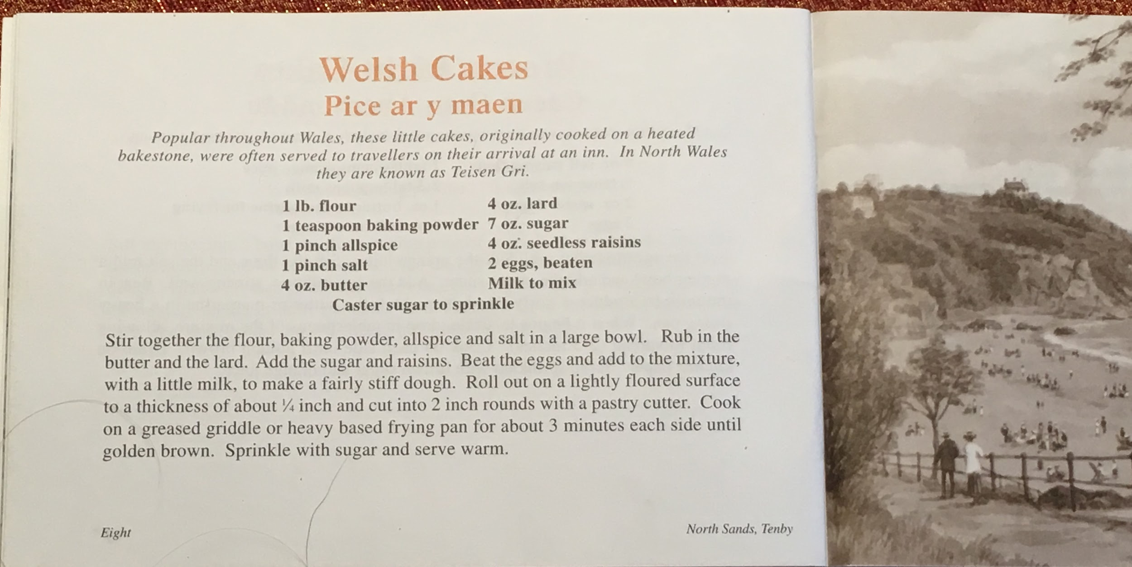
Notes:
Not quite a cookie but delicious nonetheless. I use all butter rather than half butter and lard.

Slide 33
QUESTIONS?

