Slide 1
Digital badges pilot project
Information literacy skills within a Marketing course
Presenters for VILSC 2021:
Margie Clarke, Librarian
Marina Jaffey, Instructor, School of Business
Camosun College

Slide 2
Territorial acknowledgement
Notes:
We acknowledge with respect the Lkwungen peoples on whose traditional territory the University of Victoria stands, and the Songhees, Esquimalt and WSANEC peoples whose historical relationships with the land continue to this day. Your presenters are also coming to you from the same territories as our host though we also acknowledge the territories of our audience.

Slide 3
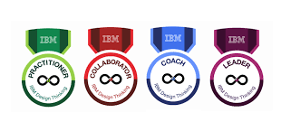
What is a digital badge?
a visual representation of a competency or skill learned that can be displayed, accessed, and verified online
badges include meta-data to communicate details of the badge to verify the achievement it signifies
digital badges are just one part of the larger credentialing ecosystem
IBM Digital Badges
Information Literacy Badges at Penn State
Notes:
Will sometimes be referred to as a micro-credential though that is somewhat different
Together the meta-data should provide all the information needed to understand what the badge signifies: Who received the badge? Who issued the badge? What was the criteria for issuing the badge? Does it expire?
IBM has over 1500 badges with 4 distinct types Certification, Experience, Learning, Validation; Penn State has multiple layers to achieve the Uber Badge status

Slide 4
Digital badges survey
Have you ever earned a digital badge? Yes, no, not sure (single choice answer)
If yes, where do you display it? Facebook, LinkedIn Learning, Personal resume, Instagram, Twitter (multiple choice answer)
Does your institution offer a digital badge? Yes, no, not sure (single choice answer)

Slide 5
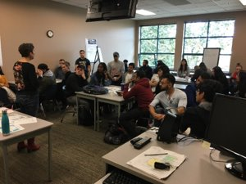
Why digital badges?
Industry has embraced digital badges – IBM (2015)
Help our grads / students stand out
4th Year Leadership course – Sales Management
Notes:
Open Badges standard was established in 2012.
Mission was: create a way to package information about accomplishments and embed it into portable image files as digital badges.
Classroom image with students’ written permission MARK 435 fall 2019.

Slide 6
How? Our first steps
Conducted a literature review
Internal and external consultations with individuals and organizations
Discovered there are existing College courses that award students a digital badge, however these are granted via external associations or private sector firms (e.g. Salesforce.com)
The intention of our pilot was to explore granting a Camosun College digital badge
Notes:
Speaking notes:
Attended a webinar "Teaching with digital badges"; vendor presentation on a publisher's use of digital badges; IBM rep presented to students
Reputation for quality assessment and distribution is an important element in the credibility of micro-credentials.

Slide 7
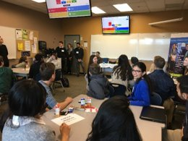
When? Pilot project overview
4th Year Leadership course – Sales Management
Applied Project – motivation
Partner with – Dee Bee’s Organics and Level Ground Trading
Learn about sales force – issues and challenges
Recommendations
Notes:
Presenter notes:
Marina to describe the course, level, etc., client projects
Classroom image with students’ written permission MARK 435 fall 2019.

Slide 8
Activities: Research topic of Sales Motivation
Week 1: Evaluating resources
Watch a video: Evaluating resources
Complete quiz to assess understanding
Conduct research, locate a relevant article
Complete a Resource evaluation worksheet
Submit via the LMS
Week 2: Annotated bibliography
Complete a tutorial: Annotated bibliography (no quiz, but there are checkpoints to assess understanding)
Complete an Article annotation worksheet for their first of four article annotations
Submit via the LMS
Week 3: Write an essay on Sales Force Motivation
Notes:
Presenter notes:

Slide 9
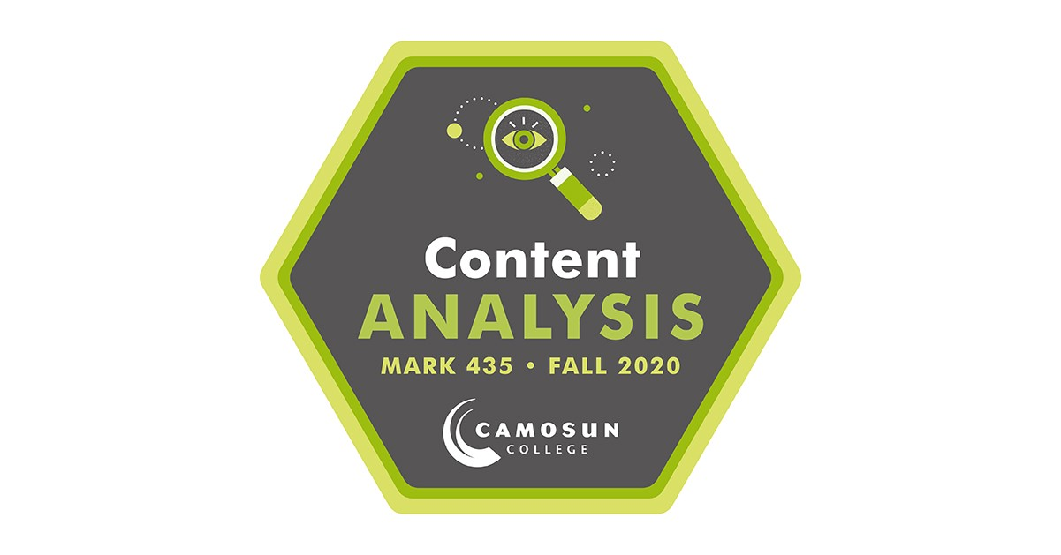
Our digital badges
To be awarded the badges, students must achieve a minimum of 80% in each of the three components
2019: 29 out of 37 students received badges
2020: 31 out of 36 students received badges
Notes:
Designed by Camosun's graphics department

Slide 10
Result? Class feedback
95 % either strongly agreed or agreed that the ability to earn the two digital badges increased their engagement or interest in the course
90 % either strongly agreed or agreed that being able to earn digital badges motivated them to learn the material in the course
95 % either strongly agreed or agreed that they would like to see more opportunities to earn digital badges in future courses
Notes:
These student comments are from an internal survey within the MARK 435 LMS course

Slide 11
Class comments
When your work is rewarded in form of digital badges it is one of the best feelings in the world
The learning activity was very fun and engaging. The part which I liked the most was the thought of getting rewarded because of my hard work
The concept of earning digital
badges was something really motivating

Slide 12
Student survey results
Almost 81% of students were interested in earning digital badges. Female respondents aged between 18-24 showed a high interest in gaining digital badges
78% of respondents would like to display their digital badges on their LinkedIn profile and most want to share it with employers
When it comes to recognition of skill, communication skill was the top choice for students followed by leadership, critical thinking and management skills
Notes:
Presenter notes:
Students in a MARK 210 Research methods class helped us out by developing a survey instrument as part of their term project. It was distributed to all students and faculty in the School of Business and the Centre for Sport & Exercise Excellence
78% of respondents would like to display their digital badges on their LinkedIn profile and most want to share it with employers – this has implications beyond any internal badging system

Slide 13
Faculty survey results
10% of faculty surveyed had been awarded a digital badge
63.16% agreed that "digital badges would be a useful way to acknowledge the skills my students learn in class"
However, only 47.37% were likely to consider adding a digital badge to one or more of their courses

Slide 14
Next steps
Education/working group needed to promote the use of badges and how easily the assessment instruments can integrate with current course content
The current digital badge has no metadata (criteria, evidence, etc.) attached to it; if the College adopts the concept of using digital badges, then an external badging provider or IT need to be involved to ensure quality and security of delivery and linking to learning outcomes/achievements

Slide 15
Resources to explore: Badging systems
https://openbadges.org/
https://credly.com/
https://www.accredible.com/
https://www.badgelist.com/
https://info.badgr.com/ - integrated with Microsoft Teams
Your own institutional LMS – e.g. D2L Brightspace has an internal badging system

Slide 16
Resources to explore: Selected readings
Duklas, J. (2020, November). Micro-credentials: Trends in credit transfer and credentialing. BCCAT. https://www.bccat.ca/pubs/Reports/MicroCredentials2020.pdf
Guan, L. (2019, March 27). The 10 top tech trends in education this year. CIO.
Kalil, K. (2015, July 29). Open Badges UBC – Pioneering badge-based learning pathways. Dialogues, 3(4). https://ctlt.ubc.ca/2015/07/29/open-badges-ubc-pioneering-badge-based-learning-pathways/
Lewington, J. (2019). Badge of honour. Maclean’s, 132(6), 89–90.
Penn State. (n.d.). Information literacy badges at Penn State. https://sites.psu.edu/informationliteracybadges/
7 Things you should know about...digital badges. (2019, June). Educause Learning Initiative. https://library.educause.edu/-/media/files/library/2019/7/eli7168.pdf
SUNY online teaching: Badges and certificates. (n.d.). https://commons.suny.edu/cotehub/online-competency-development/badges-and-certificates/

