Slide 1
Government Librarians Roundtable
Adrienne Canty, J.T. Fyles Natural Resources Library
Bronwyn Guiton, Attorney General Law Library
Antje Helmuth, Health and Human Services Library

Slide 2
J.T. Fyles Natural Resources Library
Adrienne Canty, Head, Knowledge Resources

Slide 3
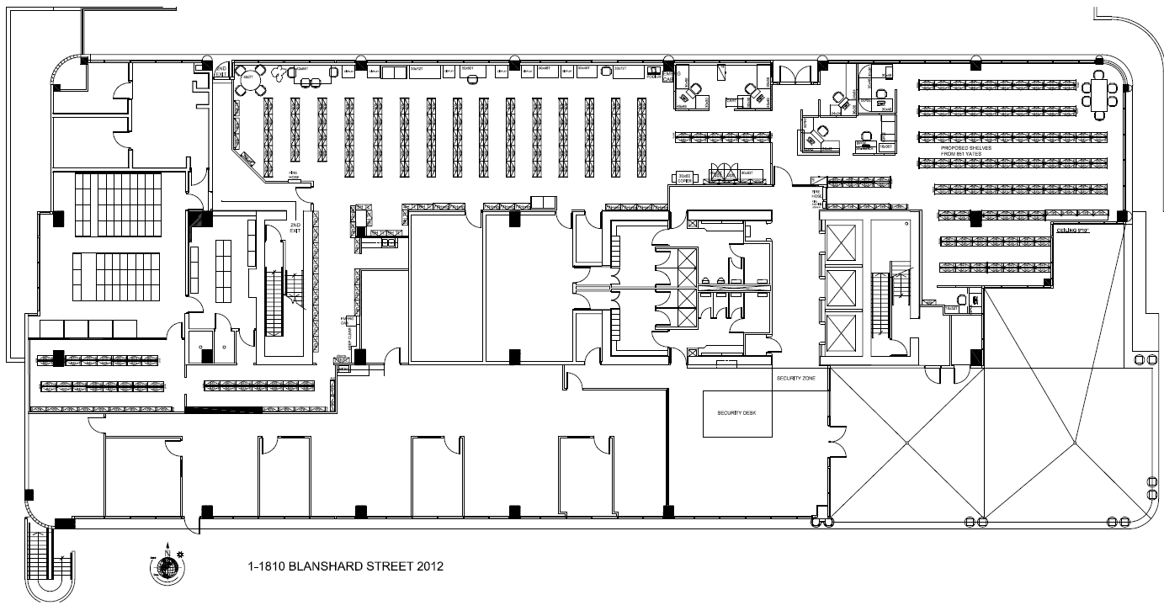

Slide 4
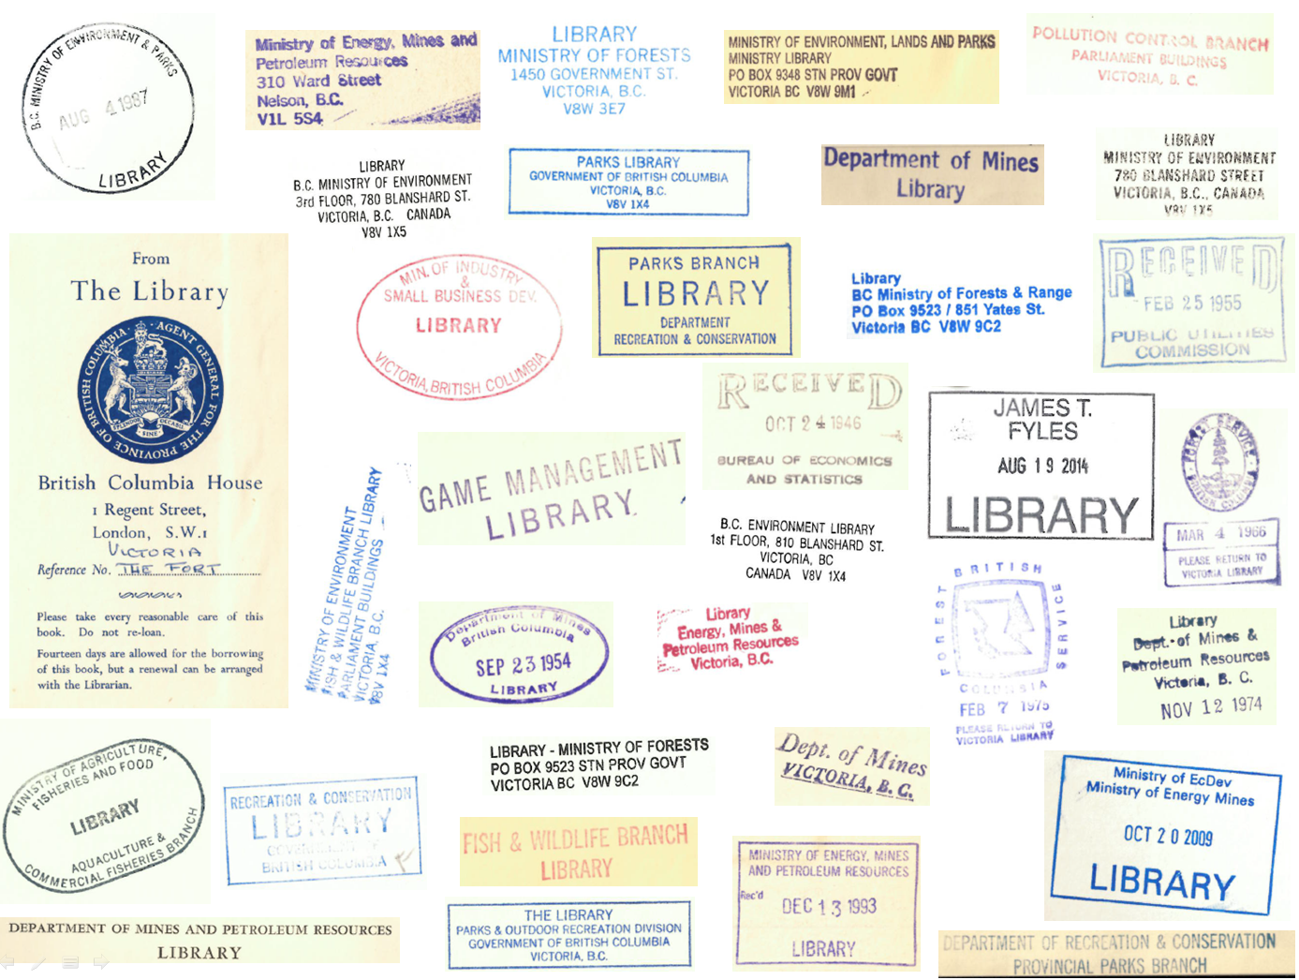

Slide 5
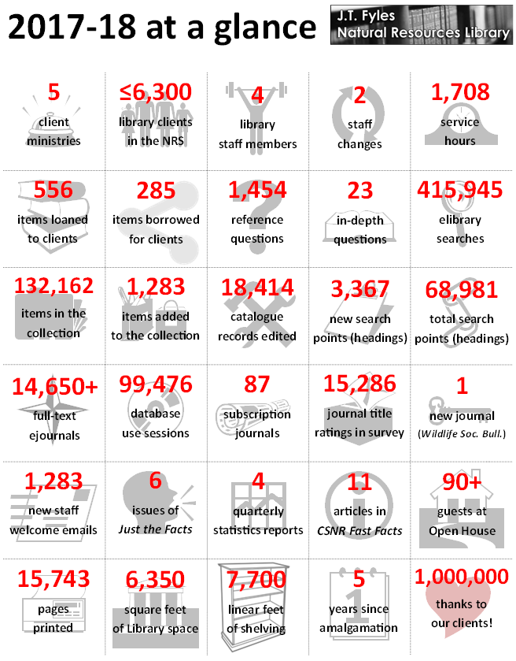

Slide 6
Attorney General Law Library
Bronwyn Guiton, Senior Librarian

Slide 7
Attorney General Law Library
Primarily serve the Legal Services Branch, within the Ministry of Attorney General (MAG)
Our team:
1 Director
2 Senior Librarians
1 Criminal Justice Librarian
1 part-time Library technician
To a much lesser extent, our library is also available to other Branches within MAG
Occasionally respond to inquiries from other BC Government employees
No services or access to the public

Slide 8
Service Model
A physical main library with a substantial print collection
Multiple small satellite print collections located where our clients are working
Multiple legal research databases and e-book offerings
Receive questions via email, phone, instant message, and walk-ins
Increasingly moving towards embedding within lawyer-client teams, rather than working only for our lawyers

Slide 9
Antje Helmuth, Library Manager

Slide 10
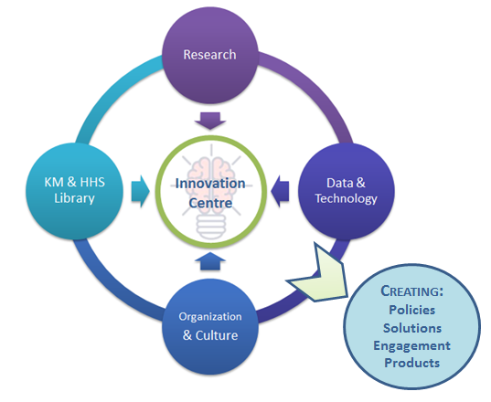

Slide 11
Our Past (6 months ago)

Slide 12
Our Current State

Slide 13
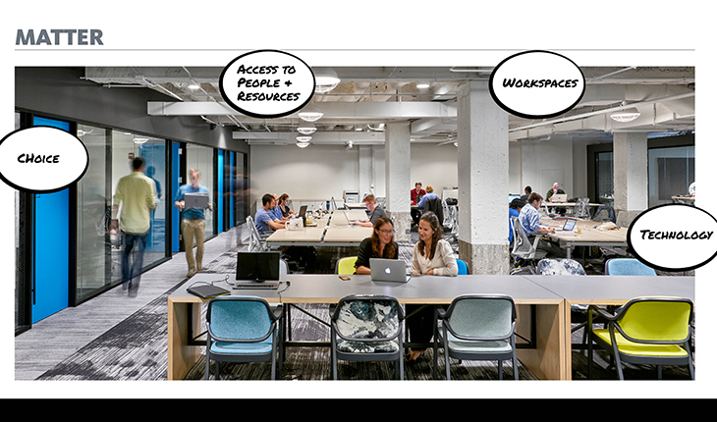
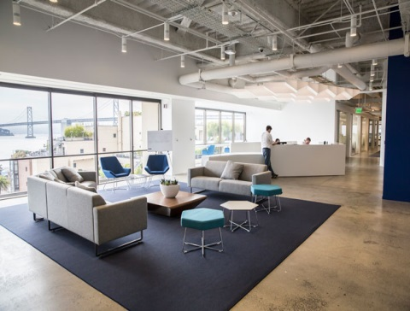
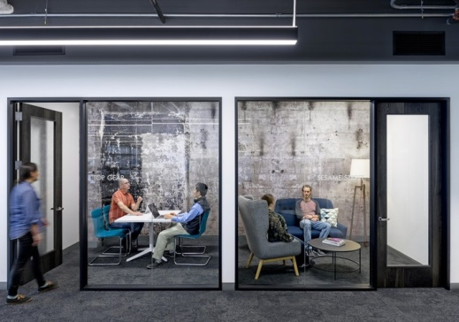
Concept of our Future (6 months from now)

Slide 14
Thank-you

