Slide 1
Intersections with Open Knowledge:
Wikidata at UVic Libraries

Slide 2
Territorial Acknowledgement

Slide 3
What is Wikidata? What is Linked Data?
A crash course in 4 minutes

Slide 4
Wikidata is a free and open knowledge base that can be read and edited by both humans and machines.
Wikidata acts as central storage for the structured data of its Wikimedia sister projects including Wikipedia, Wikimedia Commons, Wikivoyage, Wikisource, and others.

Slide 5
What is ?
Wikidata is a free and open knowledge base that can be read and edited by both humans and machines.
Wikidata acts as central storage for the structured data of its Wikimedia sister projects including Wikipedia, Wikimedia Commons, Wikivoyage, Wikisource, and others.
Multilingual/Multiscript
Open to anyone in the world
A Linked Data System
As of January 18, 2021: 1.17 Billion Statements (Triples)
https://tools.wmflabs.org/wikidata-todo/stats.php

Slide 6
What Is Linked Data Again?
A way of structuring information as data
Take any assertion ...
David Sedaris is the author of Calypso.
Linked data chops this up into component parts
David Sedaris
Is the author of
Calypso
Subject
Predicate
Object
This creates a statement or, in linked data terms, a “triple”
“Good Linked Data” Takes Each of These Parts and Represents Them With Globally Unique Identifiers that are machine actionable (instead of text)
http://id.loc.gov/authorities/names/n94015692
http://purl.org/dc/terms/creator
http:////www.worldcat.org//oclc//1090454755
Notes:
Linked Data, although technically resource intensive, is easy to understand for English speakers because it reflects the structure of the language. Subject, Predicate, Object. A TRIPLE!

Slide 7
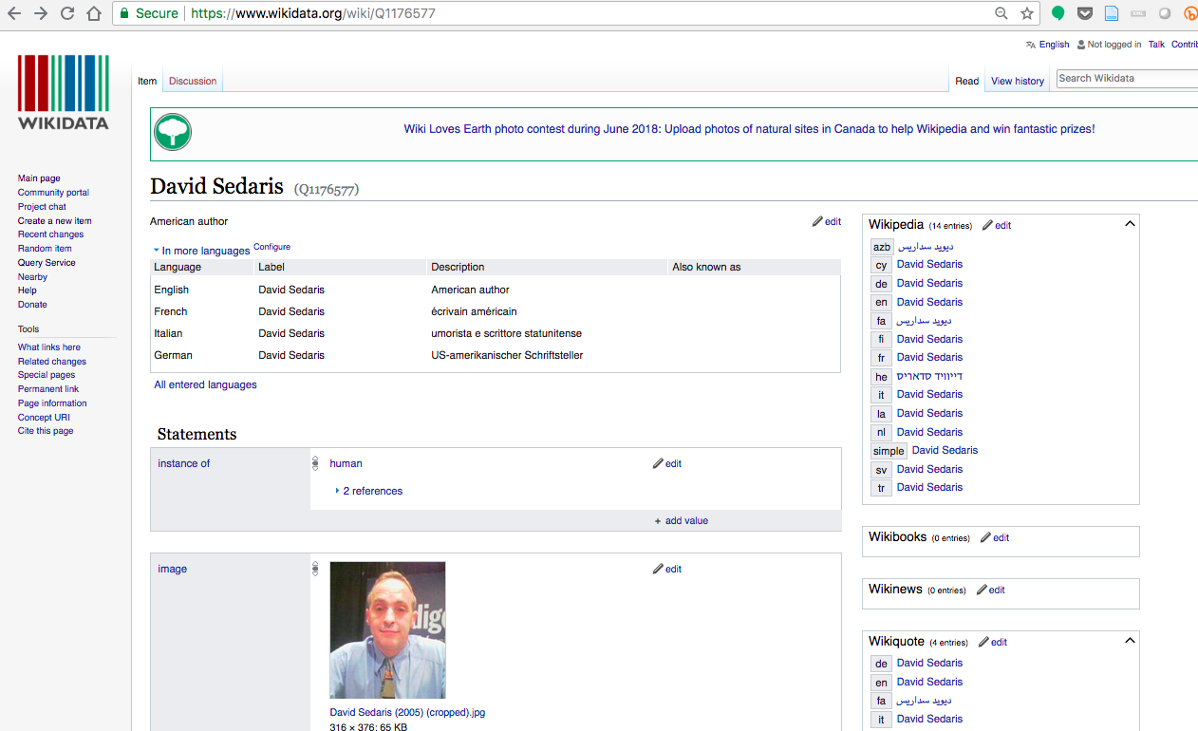
Wikidata Structure
Item
Property
Value

Slide 8
The Structure of Wikidata
Item
Property
Value
Q #
P #
Often a Q#

Slide 9
What Does Linked Data Look Like In Wikidata?
Item
Property
Value
Q #
P #
Q #
Subject
Predicate
Object

Slide 10
Remember “Good” Linked Data?
Item
Property
Value
Subject
Predicate
Object
URIs

Slide 11
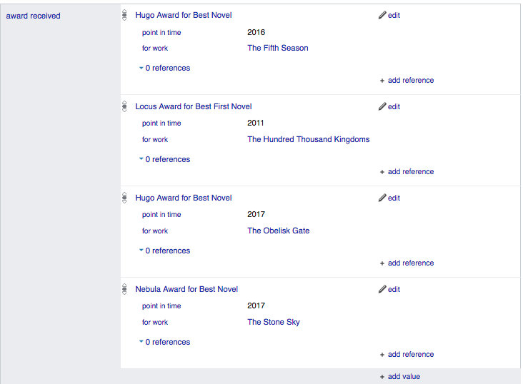
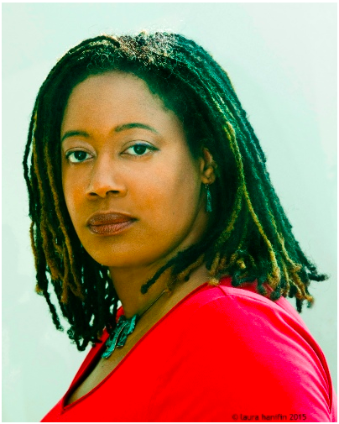
Qualifiers
Notes:
What if a statement is only true for a certain period of time? Or in relation to a particular constraint?
Wikidata uses Qualifiers so that we can actually be more specific and clear about our statements.

Slide 12
How Do I Know If Anything is True?
You don’t but you can use References to Verify your statement
Verifiability NOT Truth
Notes:
In Wikidata, as in life, you don’t REALLY know if a particular statement is actually true. So we include References to back up or provide evidence for our statements.
In other words it relies on VERIFIABILITY not TRUTH

Slide 13
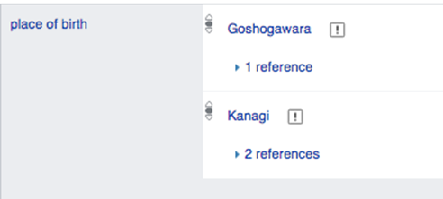
The reliance on Verifiability instead of Truth allows Wikidata to deal with competing claims
Notes:
This also allows for messy data : competing claims are inevitable and this is one way of handling it.
In this case there are two competing claims related to the place of birth for Japanese Author Osamu Dazai. Each statement, however, is backed up by References to act as proof.

Slide 14
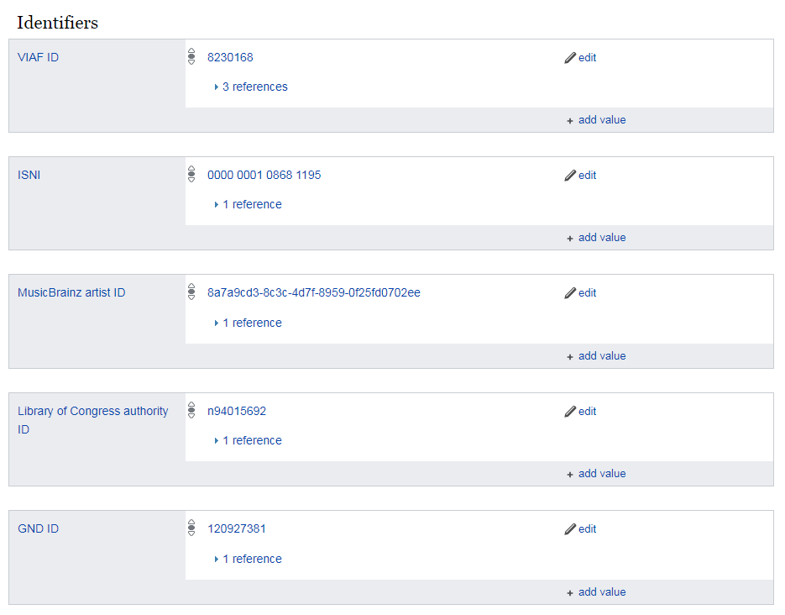
Wikidata also acts as a “secondary database” : a hub to equate identifiers in different databases
Notes:
Wikidata also acts as a hub for various identifiers used for Items in various systems and databases around the world.

Slide 15
How do you query linked data?
SPARQL
SPARQL Protocol and RDF Query Language
An RDF query language (a semantic query language for databases) able to retrieve and manipulate data stored in Resource Description Framework (RDF) format.
Notes:
How do we query these triples? Through Sparql

Slide 16
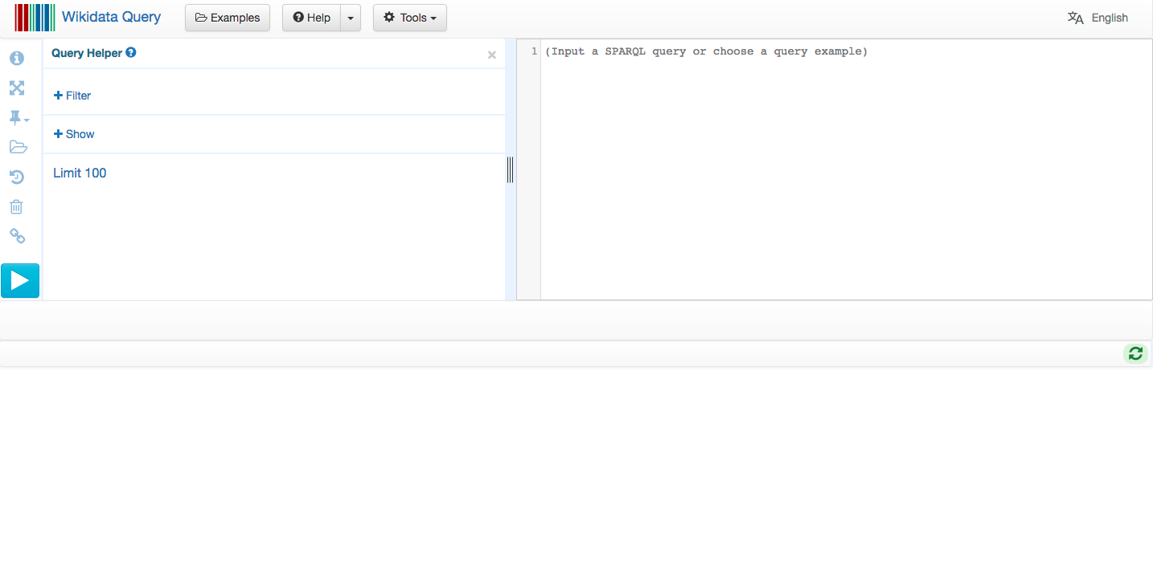
Querying with The Wikidata Query Service
Intuitive interface to build SPARQL queries

Slide 17
Wikidata Case Studies within Libraries & Archives
Authority Data
Scholarly Communication
Diversity, Equity, and Inclusion
Wikibase as an Infrastructure for Linked Open Data

Slide 18
Authority Data
Wikidata includes IDs from: Virtual International Authority File (VIAF), German GND database, International Standard Name Identifier (ISNI), Library of Congress Name Authorities, Social Networks and Archival Context (SNAC)
Europeana
BibCard University of Wisconsin–Madison Libraries

Slide 19
Scholarly Communication
WikiCite
Scholia
CopyClear

Slide 20
Diversity, Equity and Inclusion
Work of Stacy Allison-Cassin (York University)
American Women’s History Initiative (Smithsonian)
Science Stories (Yale University)
Canadian Archive of Women in STEM (Indiana University-Purdue University Indianapolis University Library and the University of Ottawa Library)

Slide 21
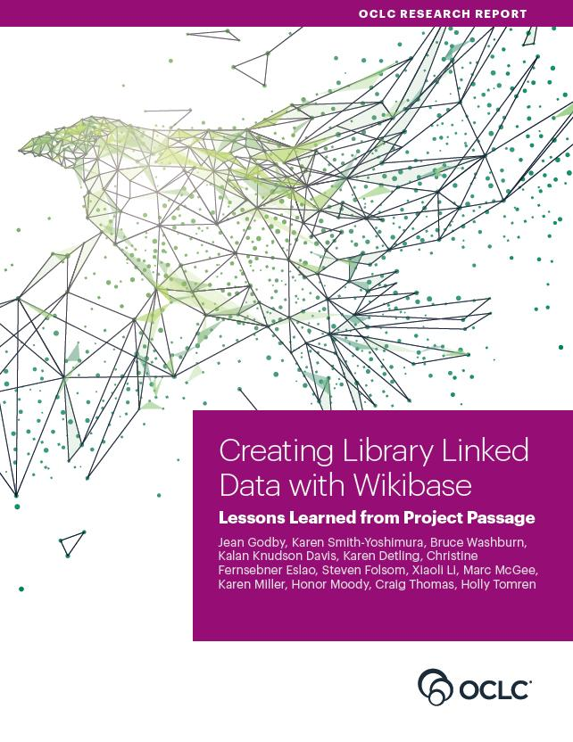
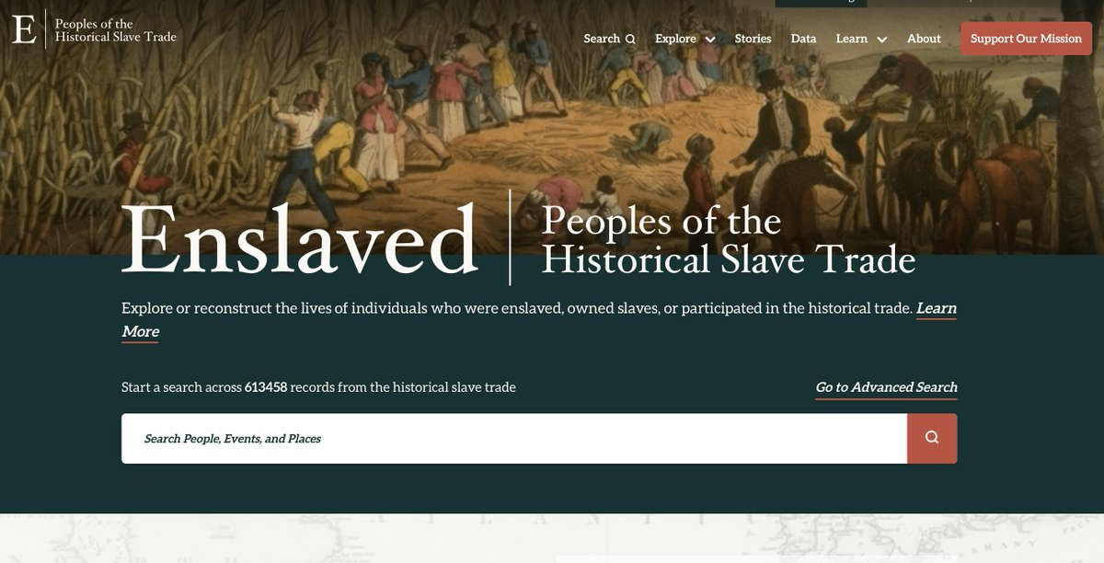
Wikibase
OCLC Linked Data Wikibase Prototype
Enslaved.org
Rhizome’s Archive of Born-Digital Art & Digital Preservation

Slide 22
What to Add and How to Add to Wikidata
Wikidata Community
WikiProject Archival Description
WikiProject Archives Linked Data Interest Group
What to Add
Fonds/Collections
Creators (individuals and corporate bodies)
Archival repositories
How to Add
Manual edits
Batch edits (Quick Statements & OpenRefine)
Cradles

Slide 23
Archives at

Slide 24
How We’re Using Wikidata at UVic Libraries [placeholder slide]

Slide 25
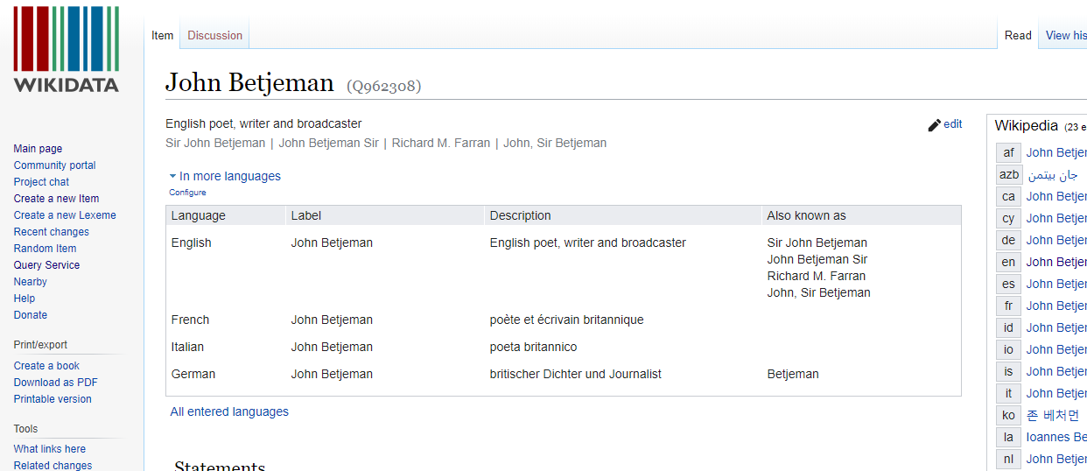
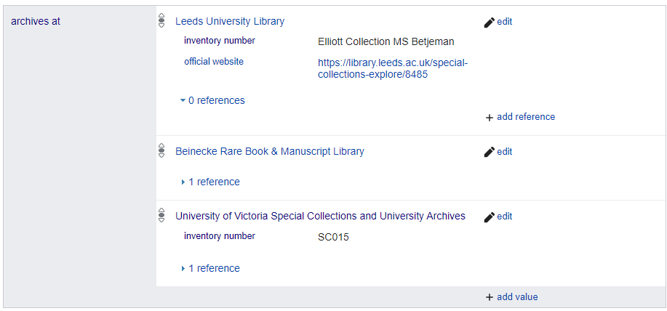
Creating a Hook
Creating a Hook into Wikidata via Archives At (property P485)

Slide 26
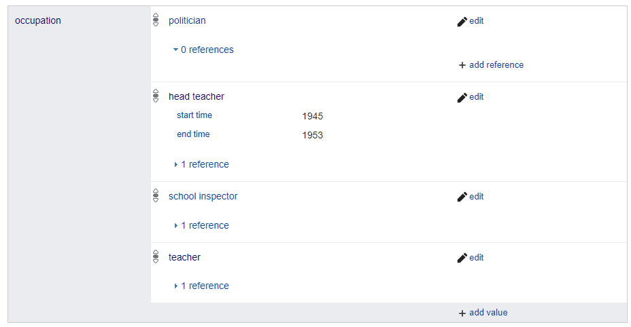
Otherwise - ENTITY DRIVEN so far
Focus on Adding Entity Information to Wikidata (people and organizations)

Slide 27
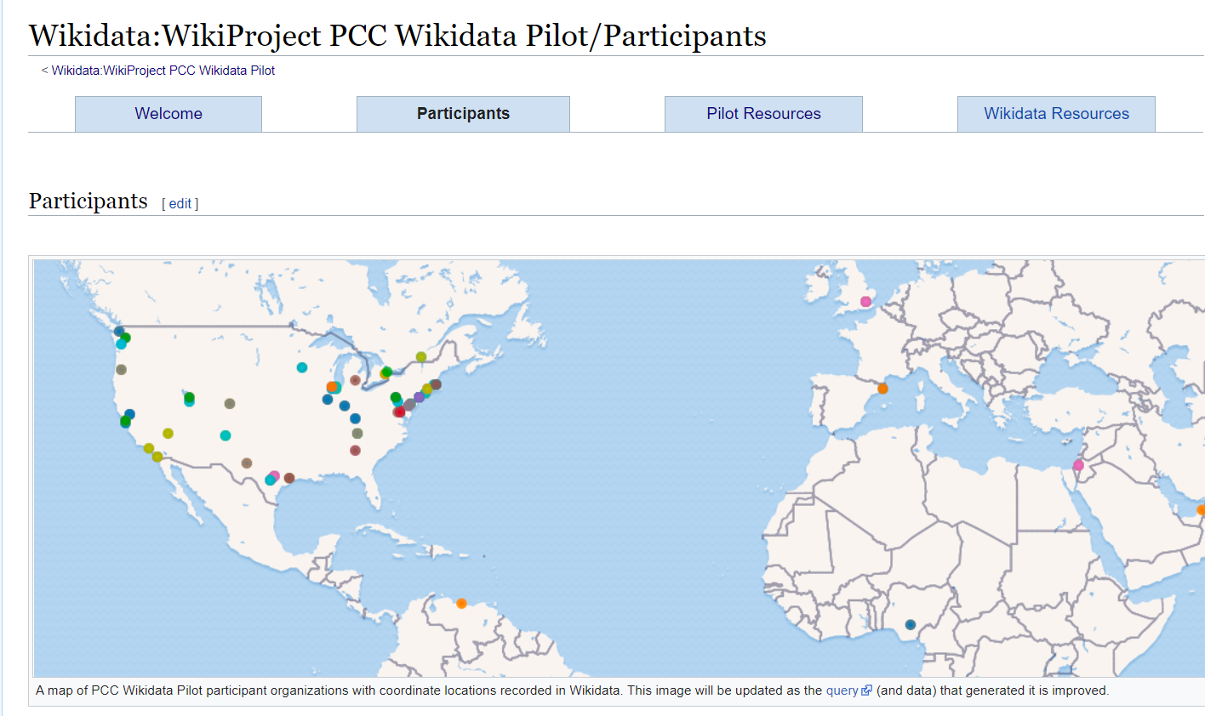
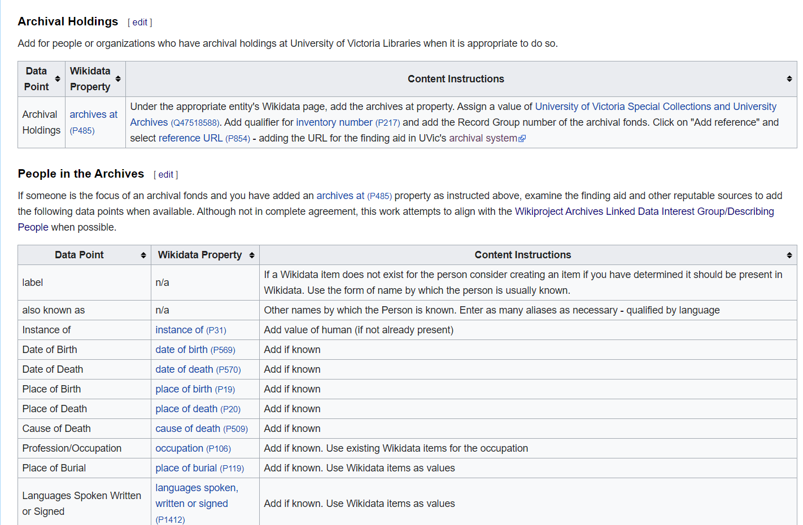
WikiProject PCC Wikidata Pilot and Wikiproject Page

Slide 28
Overall Entity Approach [slide needs developing]
AtoM
Wikidata
LC Authorities
FAST

Slide 29
What does Wikidata Give Us?
Knowledge is created by many: better reflects user terminology
Many perspectives in conversation
Knowledge is iterative, fluid and expansive
Knowledge is nuanced and uncertain
A space for knowledge that goes uncaptured during regular metadata process

Slide 30
Wikidata Allows Us To Ask More Interesting Questions
Does my collection have anything by people who have received both an Academy Award and Nobel Prize?
Does my collection have anything by George Bernard Shaw?
Wikidata
Local Collections

Slide 31
How Much Data We Create vs. How Much the World Has Created
We have (as an organization) created 10 Date of Birth data statements in Wikidata.
Yet our Query (at present) of people in our archives gives us 326 dates of birth for people associated with our archives.
Leverage massive global knowledge of Wikidata to query locally.

Slide 32
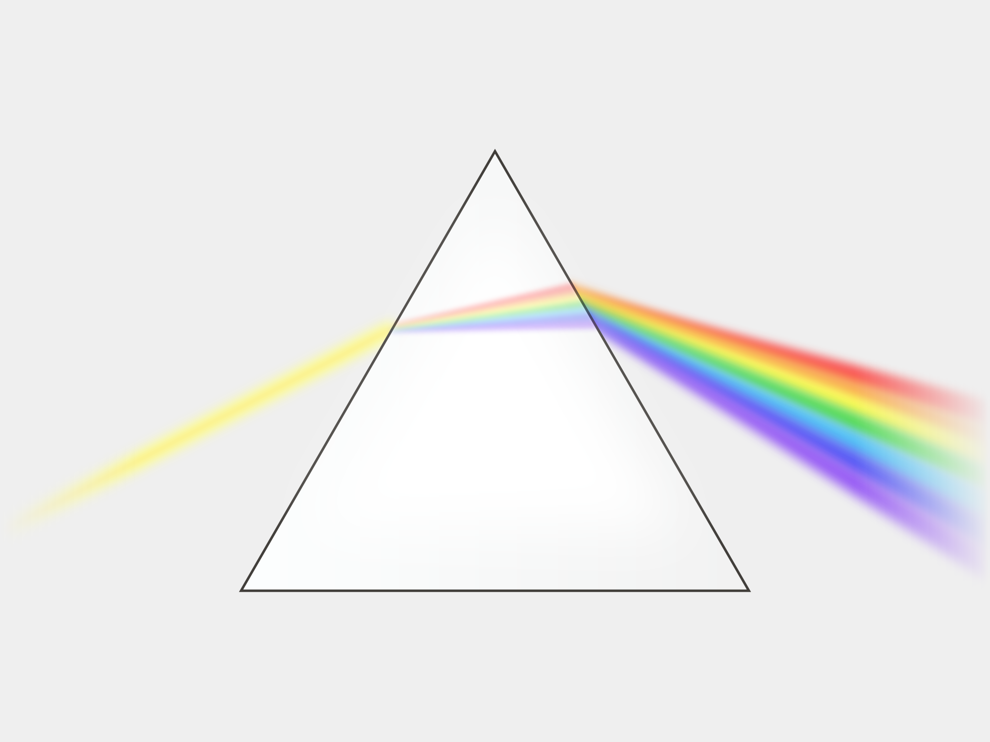
Prismatic Effect on Value Of Routine Metadata Production
Value of This Knowledge Increases Exponentially
Routine Metadata Labour
Addition to Wikidata
2nd order knowledge
1st order knowledge
Image: https://commons.wikimedia.org/wiki/File:Prism-rainbow.svg

Slide 33
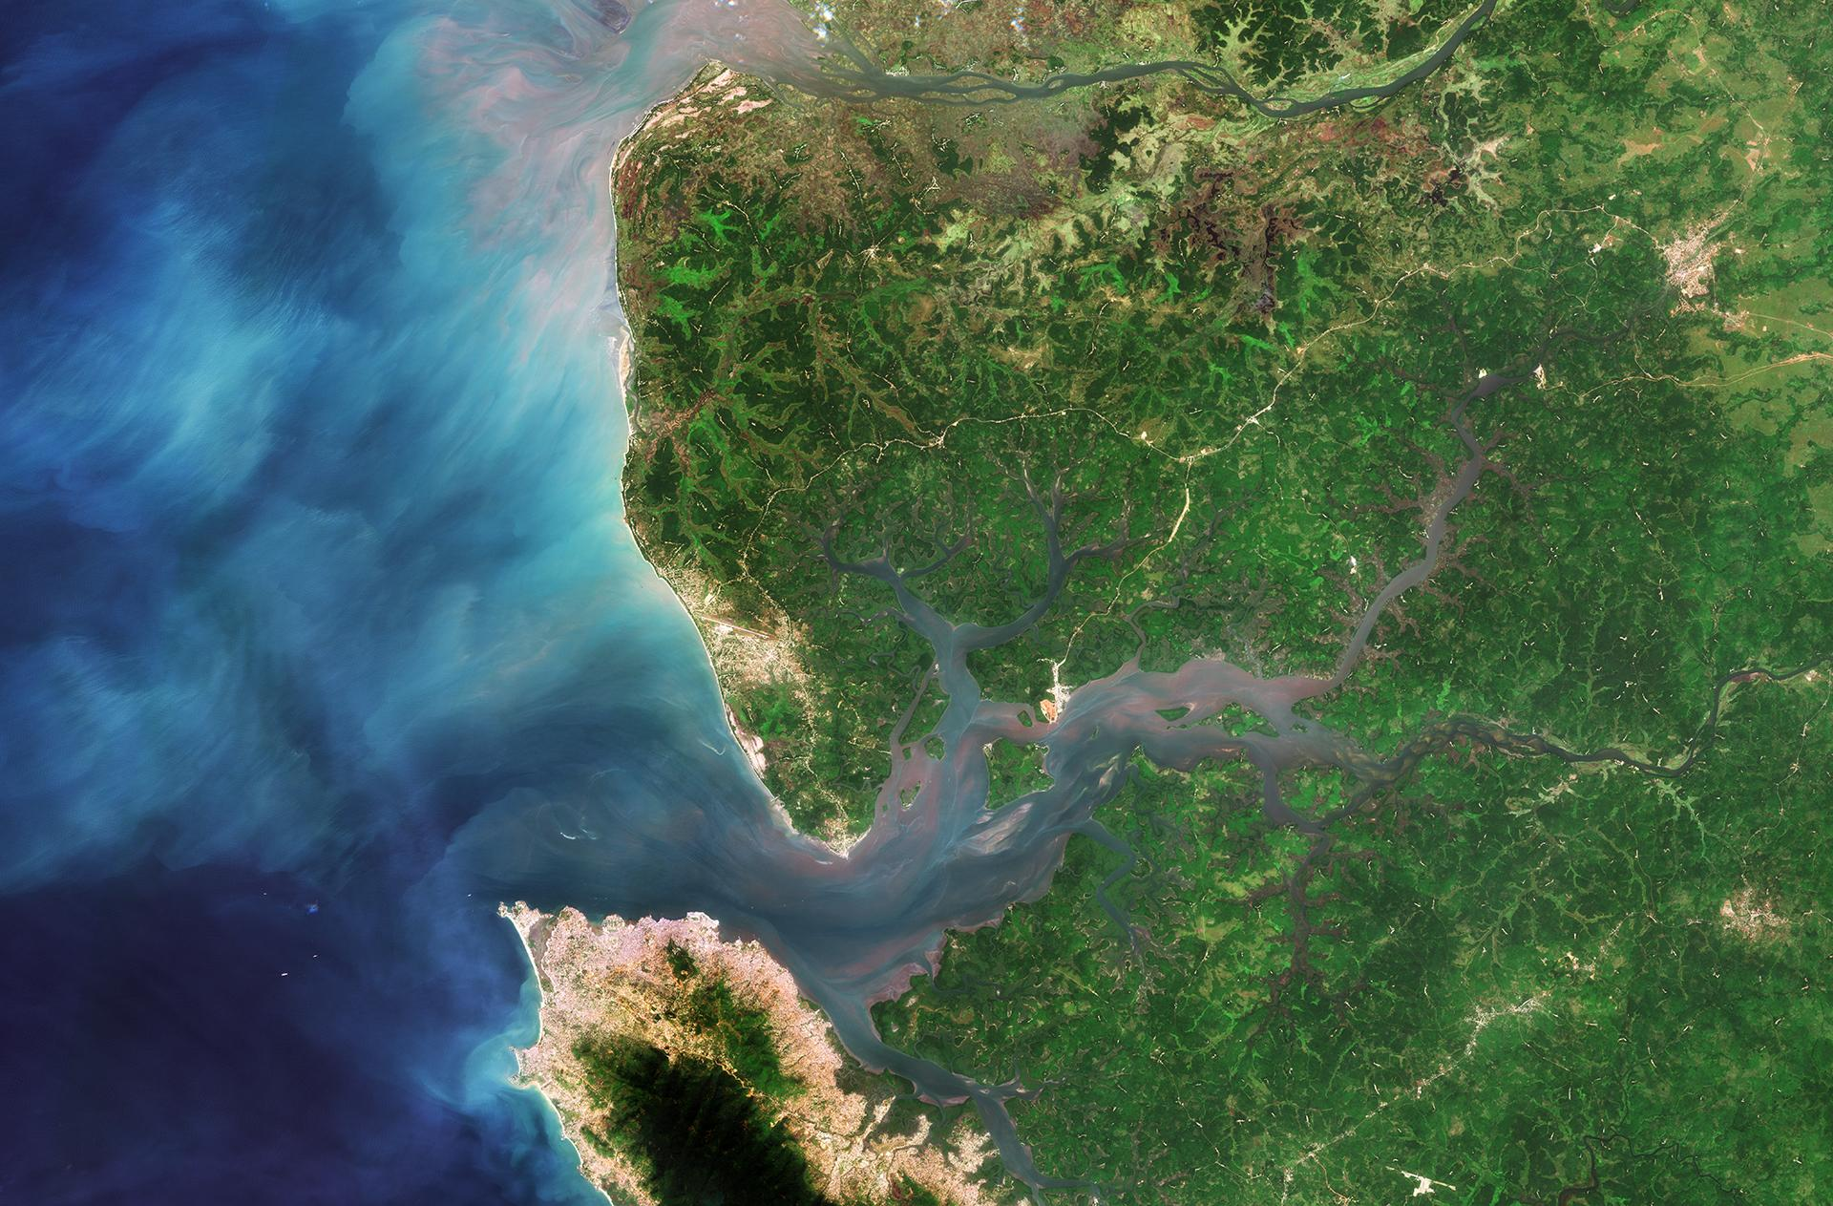
Wikidata as Estuarial Space
Cultural Heritage Organization Knowledge
Global Knowledge
New Connections
New Relationships
New Knowledge
New Narrative
“Edge of Chaos” - McElroy
https://commons.wikimedia.org/wiki/File:Sierra_Leone_River_Estuary_ESA353596.jpg

Slide 34
Experimenting with Queries & Visualizations
Two tasks:
Experiment with writing queries in order to create visualizations of the archival holdings at UVic
Experiment with how UVic might use Wikidata to highlight relationships between archival creators and their correspondents

Slide 35
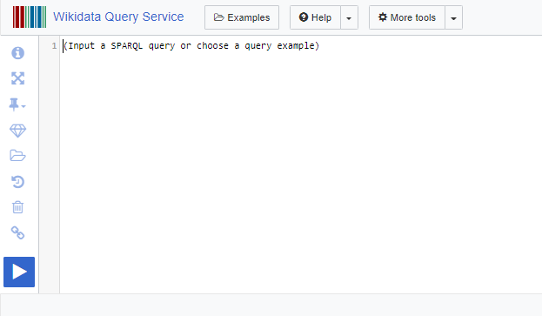
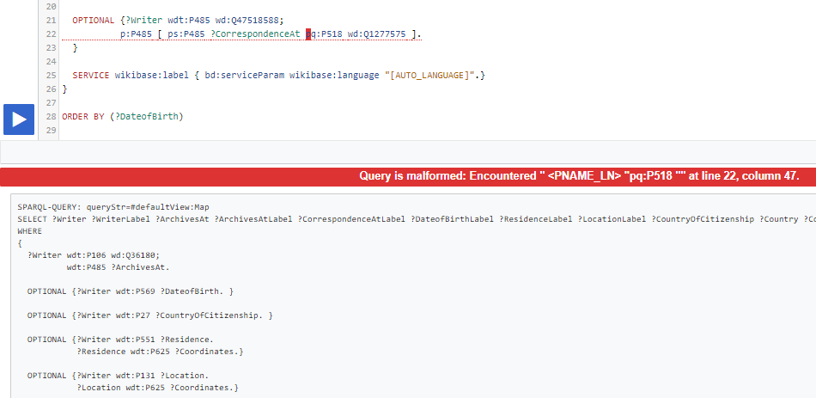
Task 1: Querying and visualizing the “archives at” UVic
A lot of trial-and-error...

Slide 36
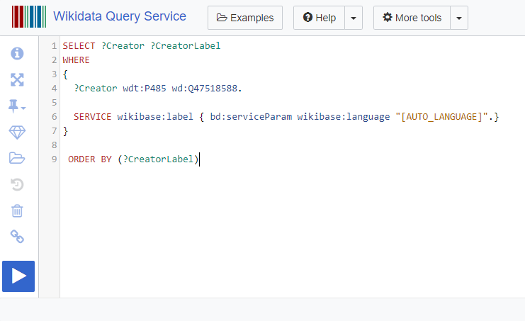
Task 1: Querying and visualizing the “archives at” UVic
Who has...
“archives at”
“University of Victoria Special Collections and University Archives”
Resulting table currently lists 321 people and organizations (creators) who have archives at UVic:
...?

Slide 37
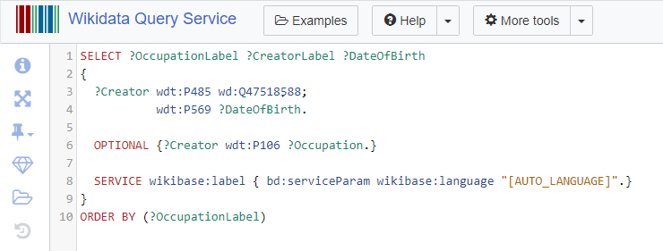
Refining the query:
Who has “archives at” the “University of Victoria Special Collections and University Archives”?
What is their “date of birth”?
What is their “occupation”?

Slide 38
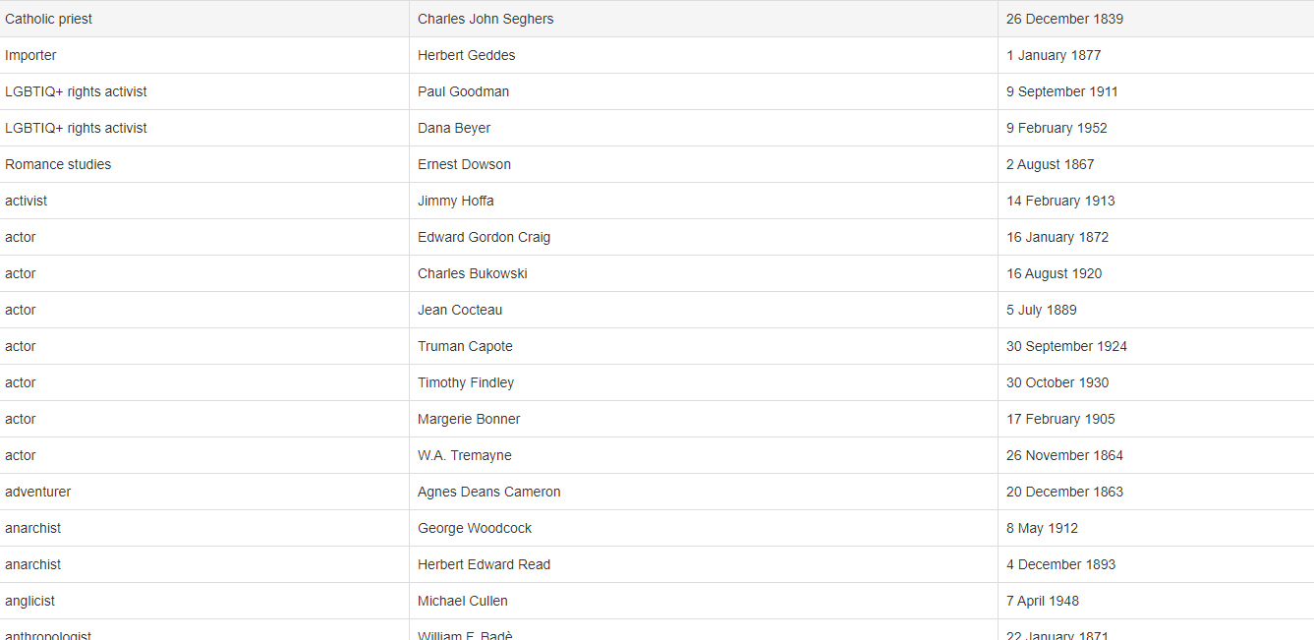
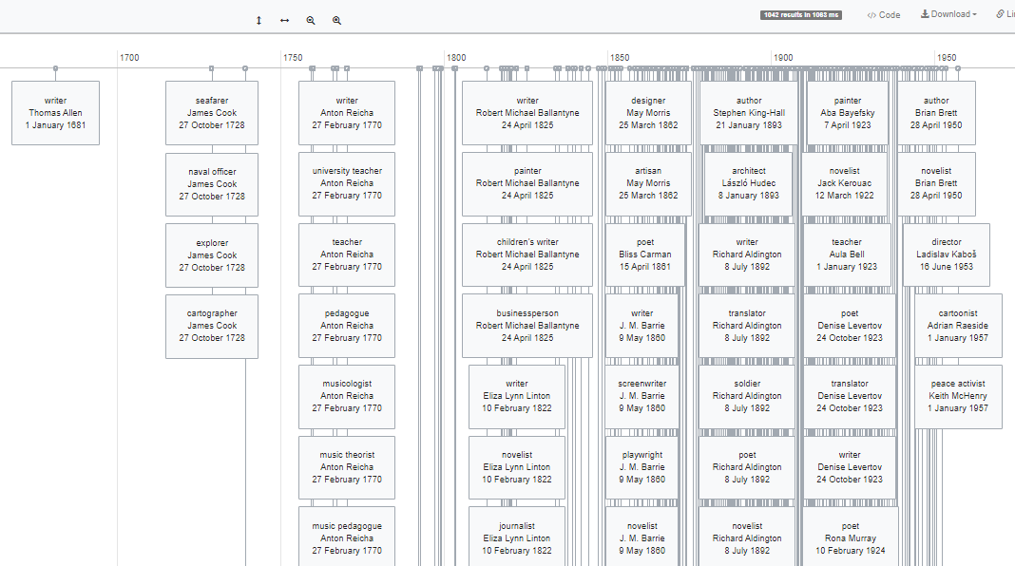

Slide 39
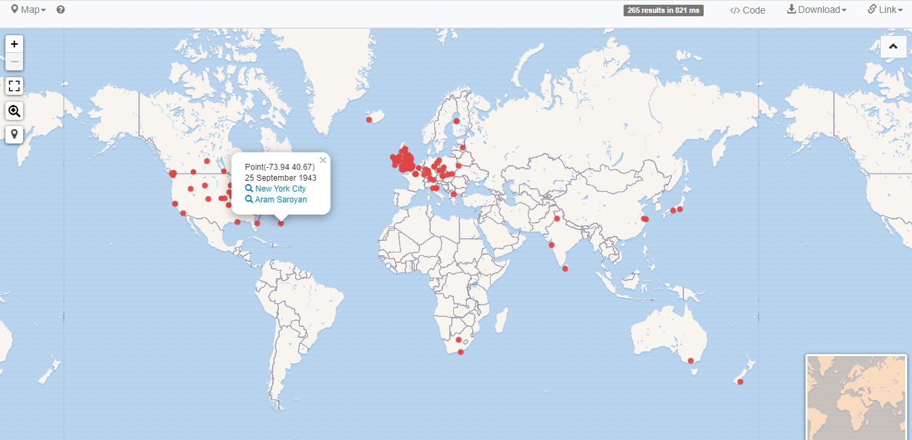

Slide 40
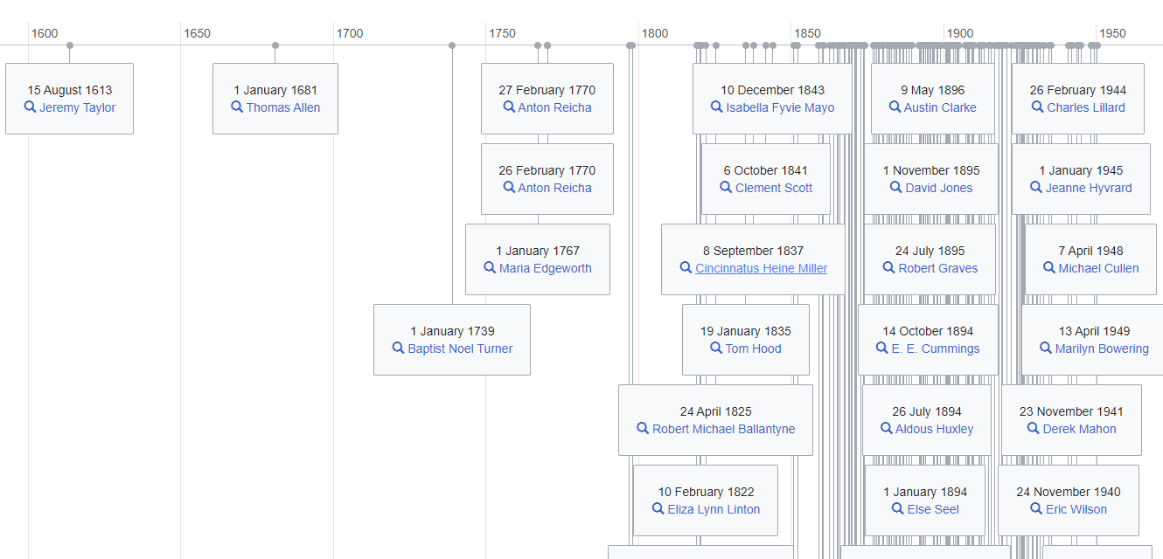
Benefit: Broad overview of UVic’s archival collections and creators
Bubble chart showing occupations of UVic archival creators
Timeline of writers who have archival holdings at UVic

Slide 41
Limitation: Focus on archival creators rather than materials, subjects
Pictured above: “archives at” statement from Else Seel’s Wikidata page
Pictured to the right: Visualization resulting from Else Seel’s “archives at” statement

Slide 42
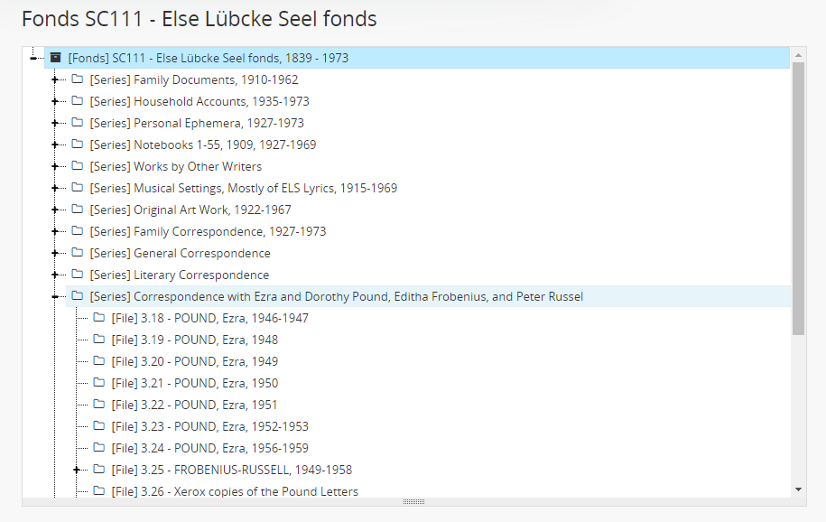
What materials are actually in the Else Lübcke Seel fonds?
Example: Over a decade of letters received from Ezra Pound, Dorothy Shakespear, and Mary de Rachewiltz
Screenshot of the Else Lübcke Seel fonds AtoM finding aid

Slide 43
Task 2: Highlighting correspondence within an archival fonds
Initial idea: create a “correspondent of” Wikidata property
Would allow you to add Wikidata statements such as: Ezra Pound is a “correspondent of” Else Seel
Property proposal rejected by Wikidata community

Slide 44
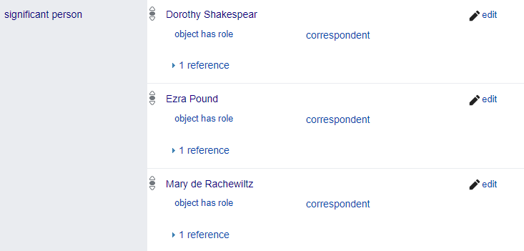
Task 2: Highlighting correspondence within an archival fonds
Work-around statement proposed by Wikidata community:
Else Seel has “significant person” Dorothy Shakespear → “object has role” of correspondent
Resulting challenge: Much more difficult to write useful queries that connect this information with UVic’s “archives at” statements

Slide 45
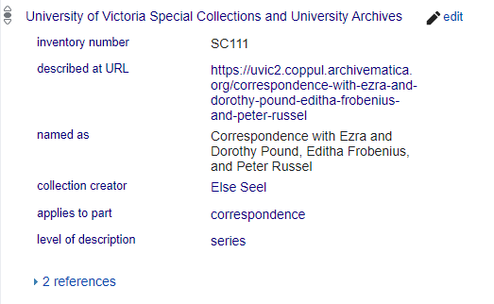
Alternative: Experiment with creating “archives at” statements for lower levels of description (in this case, series-level)
*fonds-level is usual focus
Pictured above: Screenshot of the Else Lübcke Seel fonds AtoM finding aid
Pictured to the right: Series-level “archives at” statement now included on Ezra Pound’s Wikidata page

Slide 46
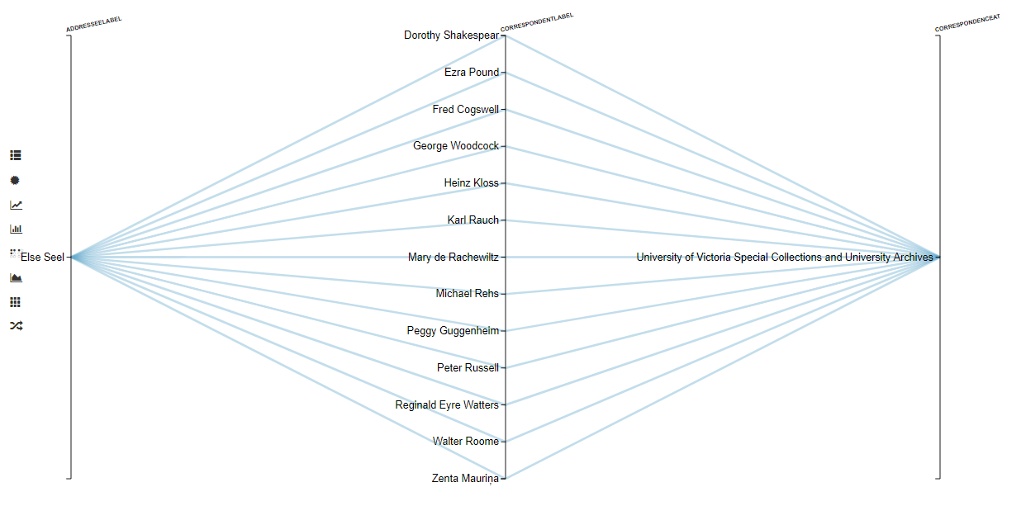
Experimentation results:
In addition to querying for creators who have entire fonds at UVic, you can now query for people who specifically have correspondence at UVic (current results would be limited to Else Seel’s correspondents)
Now able to create a visualization that links Else Seel to the materials held within her fonds:

Slide 47
Resulting question: How much detail is too much detail?
Adding “archives at” statements for every fonds or collection is already a huge amount of work; adding “archives at” statements for each series of correspondence would increase this work exponentially
However, as archivists are dealing with unique aggregations of unique items, detailed descriptive data can make a big difference when promoting access
No straightforward answer; clear that linked open data provides many opportunities for enhancing archival description efforts

Slide 48
Resources

