Slide 1
HOW DO YOU IMPLEMENT TRUTH AND RECONCILIATION AS A LIBRARIAN
KAREN HUDSON, CHIEF LIBRARIAN, SALT SPRING ISLAND PUBLIC LIBRARY
MELANIE REAVELEY, EXECUTIVE DIRECTOR, KOOTENAY LIBRARY FEDERATION
PIA RUSSELL, EDUCATION LIBRARIAN, UVIC LIBRARIES
RINA HADZIEV, COLLECTIONS AND TECHNICAL SERVICES COORDINATOR, GVPL
2018 Vancouver Island Library Staff Conference

Slide 2
TRUTH AND RECONCILIATION (TRC)
From 1876 (Canada’s Indian Act) -1996, 150,000 First Nation, Métis, and Inuit students attended 139 residential schools.
Children were separated from families and forced to abandon their culture, religion, and language. Neglect and abuse were rampant, and parental visits were heavily restricted. An estimated 6,000 students died while in residential schools.
The system has been linked to a very challenging legacy for survivors and intergenerational trauma for their families.
The TRC spent seven years assembling documentation from survivors and working to build awareness of these abuses, ultimately issuing a series of Calls to Action at the end of 2015.
Libraries and Librarians are a part of the national reconciliation movement.

Slide 3
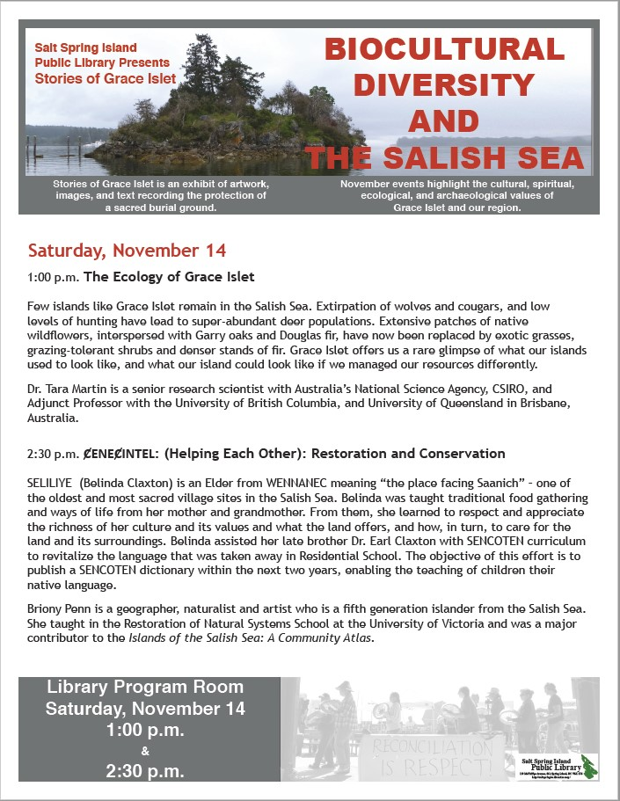
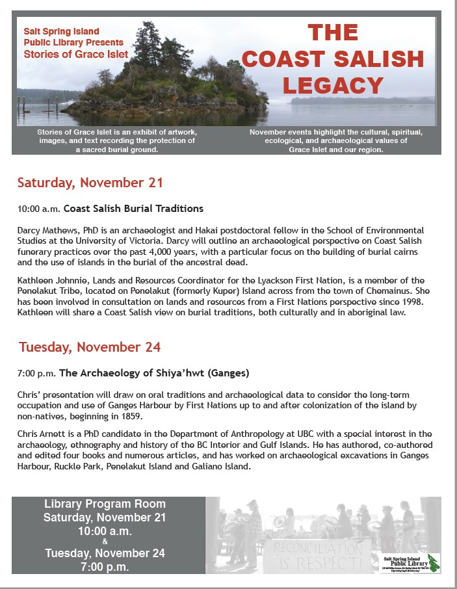
Stories of Grace Islet Series (2015)

Slide 4
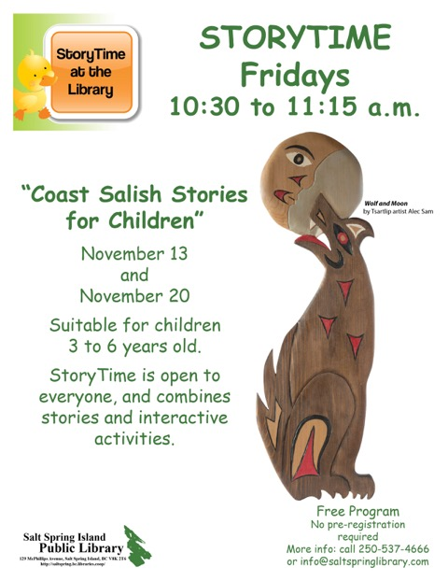

Slide 5
Collection
Development

Slide 6
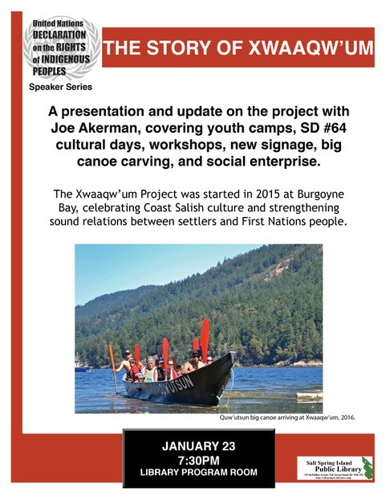
UNDRIP Series (2018)

Slide 7
First Nations Elders (UNDRIP 2018)

Slide 8
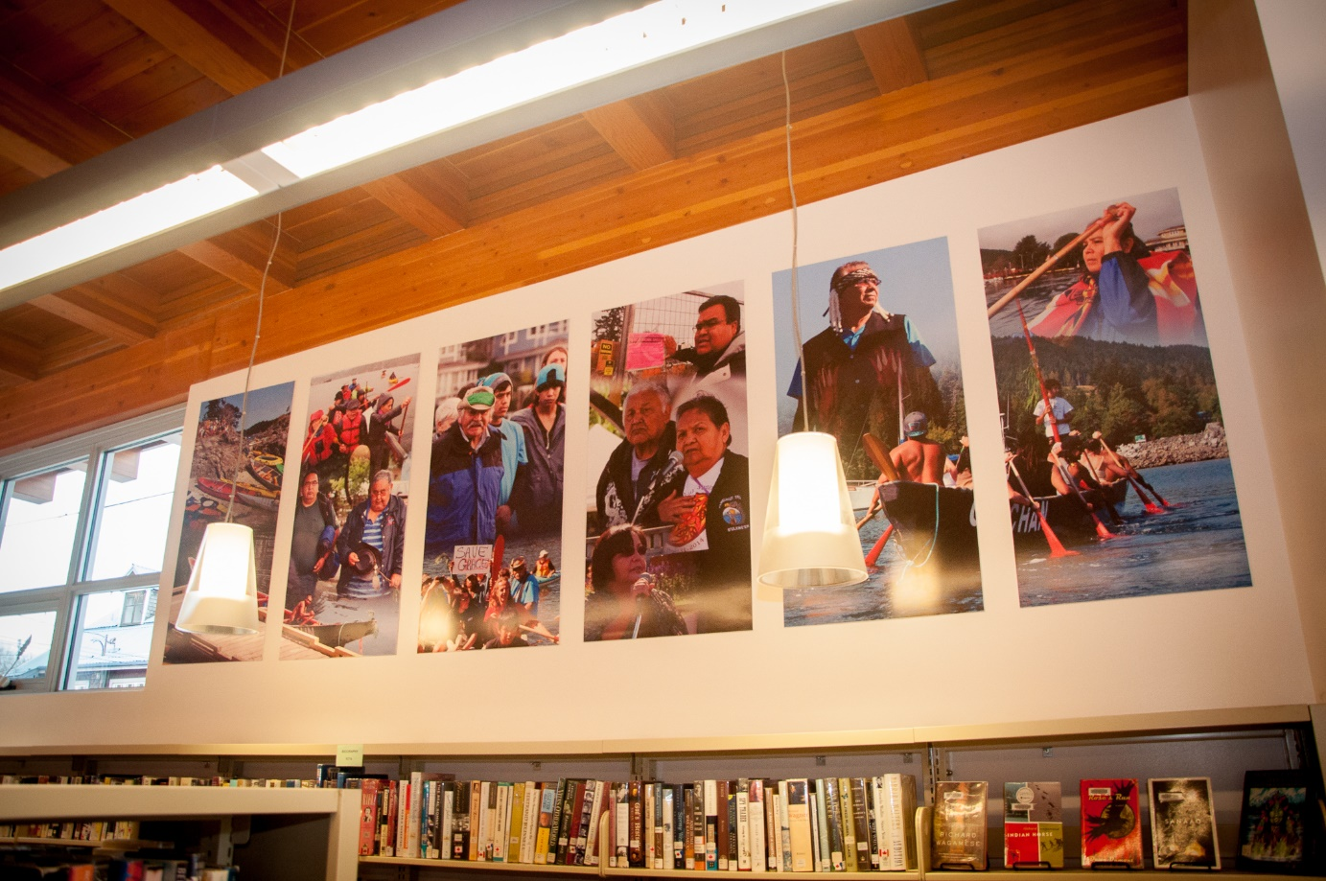
Art Installations

Slide 10
MELANIE REAVELEY EXECUTIVE DIRECTOR KOOTENAY LIBRARY FEDERATION

Slide 11
PIA RUSSELL EDUCATION LIBRARIAN UVIC LIBRARIES

Slide 12
RINA HADZIEV COLLECTIONS AND TECHNICAL SERVICES COORDINATOR GREATER VICTORIA PUBLIC LIBRARY

Slide 13
Questions?

