Slide 1
Scoop on OA Monograph “Double Dipping”
David Boudinot, E-Resources Librarian & Head of Acquisitions Inba Kehoe, Copyright & Scholarly Communication Librarian Vancouver Island Library Staff Conference April 26, 2019

Slide 2
Outcomes
What is double dipping?
Why this story?
The evidence
Acquisitions ordering platforms
Discussions with publishers/vendors
Author publication agreement
Ebook publishing models
Solutions for Acquisitions

Slide 3
What is double dipping?
Notes:
Before digging into the investigation, we thought it would be best to review the definition of double-dipping and specifically in open access ebook publishing.

Slide 4
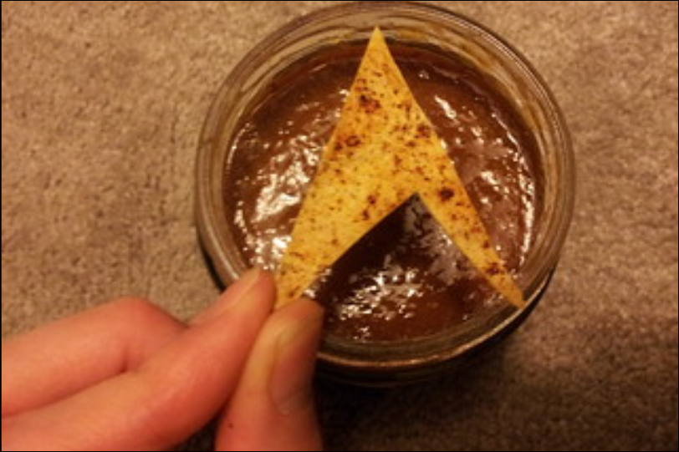
Urban Legend
John Fisher, flickr, CC BY-NC-ND
Notes:
Double dipping is a generally frowned upon act where a person at a party with snacks dips a chip they have already taken a bite out of into the dip a second time. (Urban Dictionary)

Slide 5
Double dipping in monograph publishing?

Slide 6
Hybrid Book Publishing Model
Typically happens in journal publishing -- publishers receive revenue from subscriptions, while also charging authors to make the article “open access”
Publisher sells services to author (Book Publishing Charge)
Publisher sells end product to libraries (subscription)
Publishers are paid twice -- hence the term “double dipping.’
Martin Paul Eve, https://eve.gd/2015/01/31/on-open-access-books-and-double-dipping/
Notes:
In this scenario - publisher does not lower the cost of subscriptions to the journal for libraries
According to Elsevier - “there is no connection between subscriptions and APCs … they are decoupled.” The “money coming in through a journal subscription is used to pay for a particular number of articles, and that open-access articles in hybrid journals are additional to that. https://adamesmith.files.wordpress.com/2014/11/nov-2014-the-empire-strikes-back-alicia-wise-elsevier-profile.pdf
The “risk” for the publisher is non existent as the service is sold up front. Publishers don’t have to predict how many volumes will sell and attempt to spread the risk across their title lists.
Hybrid Book Publishing Model
Authors are guaranteed all parts of the publishing process - editorial to production, marketing, dissemination and supporting discoverability. Palgrave Open charges about $17,500 for BPCs. They generally charge for selling the print copy. The cost of each print copy is based on sale of 200-250 copies. Which amounts to what they make on the cost of the BPC. “So, publishers have offloaded the cost of the print sales onto the author”

Slide 7
Our Definition
Double dipping for Open Access eBook Publishing occurs when
Authors or funders pay to make the ebook Open Access
and
Publishers charge for access to the ebook
Notes:
The general concept is - see what is on slide
QUESTION - How far do you think publishers should go with this model of publishing. NOTE - we are referring to sale of ebooks through acquisitions platforms while the ebook is also free on the publisher’s website.
Some people think it is a good thing; others not.
https://scholarlykitchen.sspnet.org/2013/01/29/in-praise-of-double-dipping-fairness-affordability-vitality-and-sustainability/

Slide 8
Why this story?
Ebook order
Request for ebook made on GOBI
Acquisitions staff searched for title on Google
Open access ebook available from publisher
Many open access ebooks available for sale by EBSCO and ProQuest - Double Dipping!
Question - Why pay for an ebook that is open access?

Slide 9
An Investigation
IOS press and other publishers
Publishing Models
GOBI / Serials Solutions
EBSCOHost
ProQuest
Notes:
Don’t forget DRM information

Slide 10
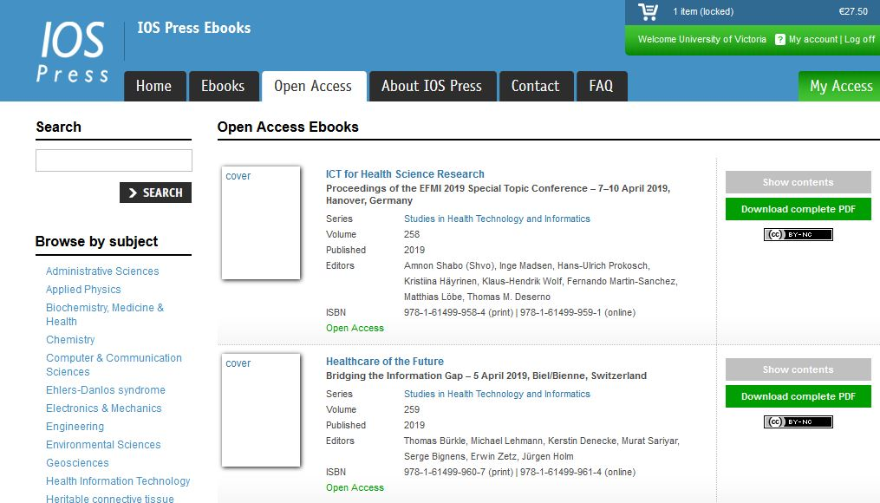
IOS Press
Hundreds of titles are available for free download on IOS Press Ebooks site
CC BY-NC
PDF download
text

Slide 11
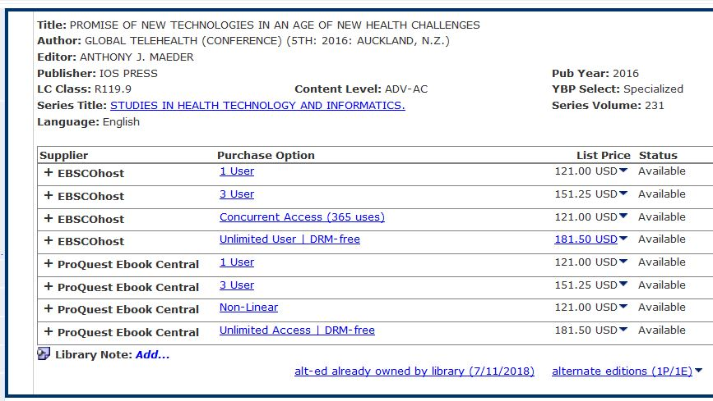
GOBI
From IOS Press website
No indication ebook is OA
EBSCOhost and ProQuest Ebook Central platforms full of DRM
Price varies
From GOBI website

Slide 12
EBSCO
IOS Press ebooks: $150--$225/title
DRM free
Unlimited access

Slide 13
ProQuest
Many publishers are employing a “hybrid OA”—they release the title with a price, and once they cover costs, they change it to OA.
Unfortunately, they don’t update the new price.
Other publishers offer free downloads on their website for individuals, but feel that broader library access justifies charging a price.
Many of the big NGO’s like World Bank, and National Academies work under this policy.
Notes:
Comments from Vendor rep

Slide 14
Can publishers sell OA eBooks with BPCs?
.... Let’s look at the publication agreement

Slide 15
IOS Press Publication Agreement
BPC
2. The Publisher shall … publish the work with Open Access under the Creative Commons BY-NC license ...
4. … copyright for the work will be taken out in the name of the Authors and IOS Press. The Publisher shall have the right to sell the work in printed form ...
7. … an Open Access publication on its e-book platform and charge EURO 1810 per published page, EURO 7240 in total for 400 pages …
10. The Editor shall not during the continuance of this Agreement publish any abridgement of the said work …. Shall not write or publish … any other book on the same subject ...

Slide 16
IOS Press
11. The duration of the Agreement is in principle unlimited … right to terminate … after the publication of every (new) edition.
What about royalties … authors, editors do not receive any royalties
from the sale of the print/ebook copies

Slide 17
What about other publishers?

Slide 18
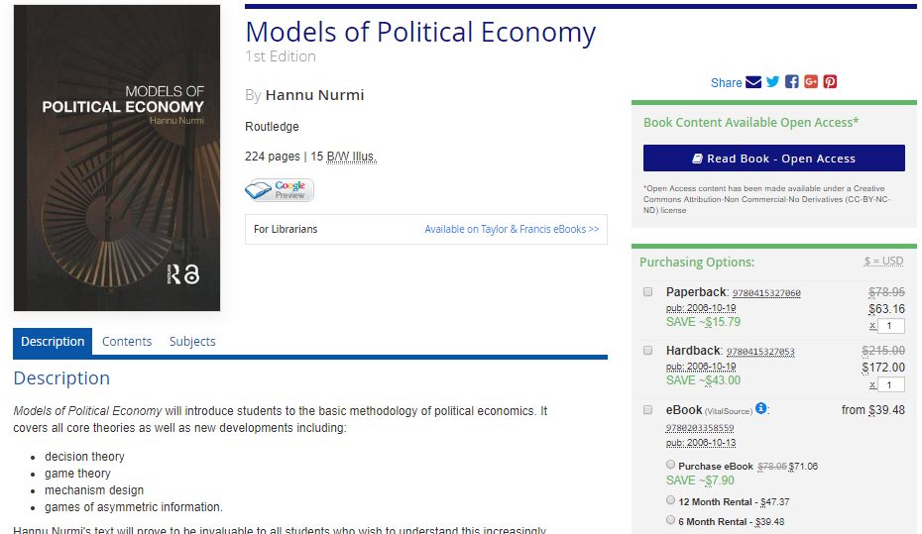
Routledge
BPC: $13,000/book; $1,625/chapter
DRM free pdf
CC BY-NC-ND
Included in subscriptions, customers not charged
Research books
Author owned
Royalties on print
https://www.routledge.com/collections/13042
Notes:
Here’s another example from Routledge
What about author royalties?
We will continue to pay royalties on any print sales. As we no longer charge for the eBook there will no longer be royalties from this.
License is a preference from authors in HUM/SS in corroboration with OAPEN-UK HSS Researcher Survey Results
Publication fee - when final manuscript is submitted
Charge based of revenue they would receive to cover the typical cost involved in the publishing process - see slide

Slide 19
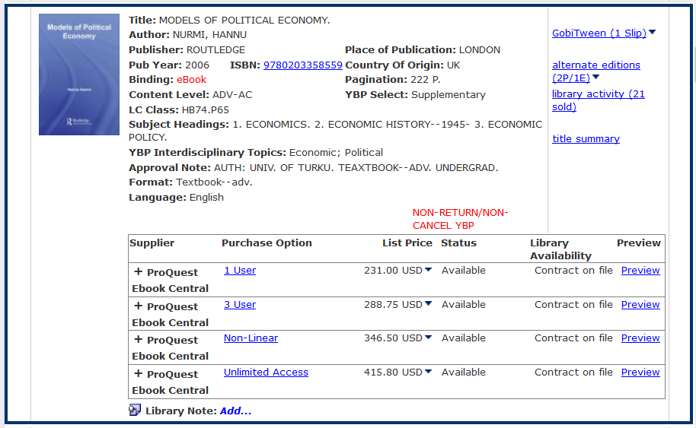
Routledge: in GOBI

Slide 20
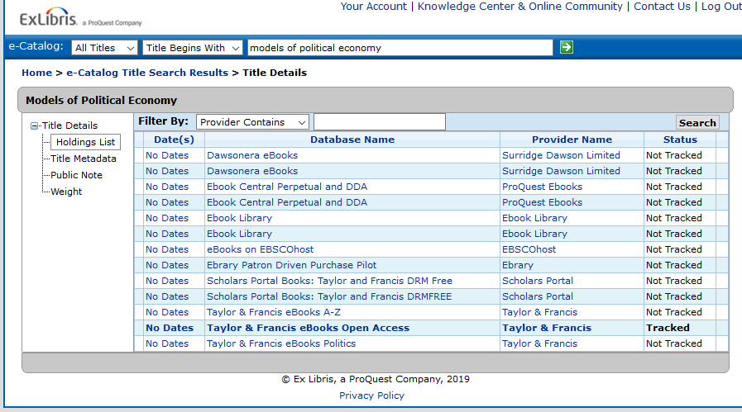
Routledge: in Serial Solutions
Included in an Open Access collection
Tracking in Serials Solutions

Slide 21
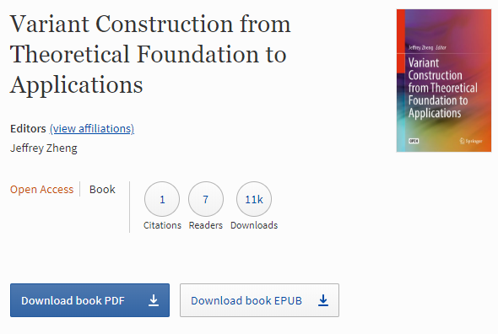
Springer
Free Download
DRM free
CC BY
Author retains copyright
Archive final pub. Version
DOAB deposit
No subscription fee for OA books?
https://link.springer.com/search/page/3?facet-content-type=%22Book%22&package=openaccess
Notes:
SPRINGER - no charges on website - only a download button and purchase print copy

Slide 22
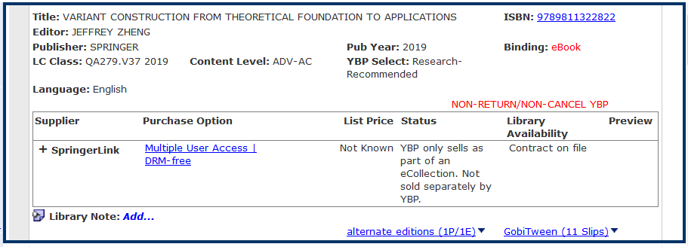
Springer: in GOBI

Slide 23
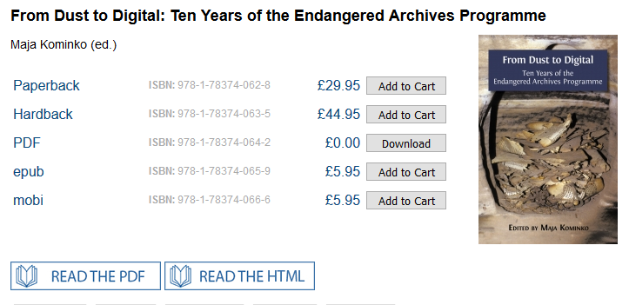
Open Book Publishers
Your work, your copyright
no BPC for the authors
CC BY license.
Free online editions: PDF, HTML and XML formats
BOOK PUBLISHING MODEL
sales of modestly-priced paperback, hardback and digital editions; grants; donations; and Library Membership Scheme
https://www.openbookpublishers.com/section/14/1
https://www.openbookpublishers.com/section/44/1
Notes:
Library Membership Scheme in which libraries pay an annual sum for institutional access to all OBP’s digital editions and discounts on physical copies.”

Slide 24
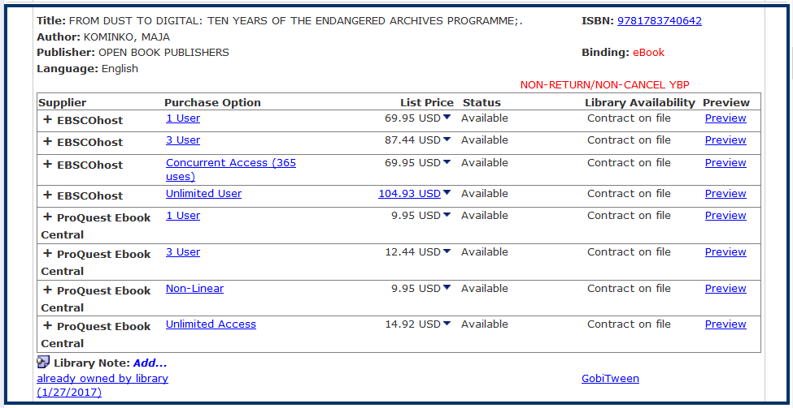
Open Book Publishers: GOBI

Slide 25
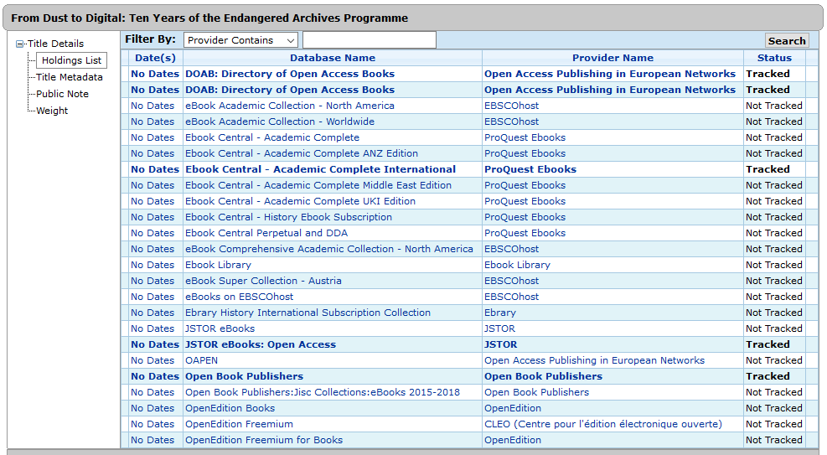
Open Book Publisher: Serials Solutions

Slide 26
Solutions for Acquisitions

Slide 27
Keep an eye on
Metadata standard
ONIX (ONline Information eXchange) standard for publishers
Field in ONIX for Open Access
Block titles and/or certain publishers from approval plans
FUTURE Possibilities
Ebook collections from aggregators

Slide 28
Takeaways
Identify publishers of open access ebooks (Directory of Open Access Books - DOAB)
Track open access titles (e.g. Serials Solutions)
Block open access titles on your approval plans
Do you want print when open access ebook is available?
Start a discussion with publishers and aggregators about double dipping
Ask why should we pay for a title that our authors paid to make open access?

Slide 30
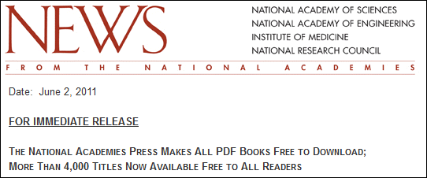
National Academies Press
2011
Free pdf download from publisher website
GOBI

