Slide 1
Customer Privacy and Digital Collections and Services

Slide 2
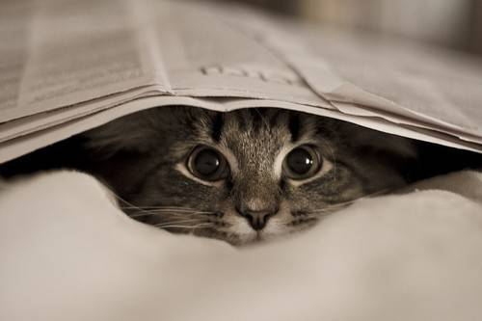
Customer Privacy
♪ Sometimes it feels like,
Somebody’s watching me ♪
Notes:
Libraries engage vendors to offer content to their customers/patrons
Libraries have little to no control over vendor sites
Customer data is/can be collected and retained by vendors (google analytics, borrowing habits etc…) I’ve seen this research study mentioned in a few library articles about Privacy.
Not inherently a bad thing – offers service and customization to our customers like reading recommendations
To libraries/librarians protecting privacy seems pretty key. Public libraries have an ethical obligation to preserve our customers’ privacy and right to privacy and I think we all know that the digital landscape has definitely complicated this ideal for us.

Slide 3
Privacy at Your Library
What guidelines, laws, and policies does your institution follow?
FOIP – Freedom of Information and Protection of Privacy Act
CLA Statement on Intellectual Freedom
EPL policy “Privacy & Confidentiality of Customer Information”
Notes:
Before you embark on any journey of discovery through your institution’s privacy practices it’s recommended that you start by understanding what documentation your organization has already written, and what it’s legally obligated to follow.
Alberta’s FOIP act.
EPL Intellectual Fredom policy follows the CLA’s statement on Intellectual Freedom
EPL specific policy called “Privacy & Confidentiality of Customer Information”

Slide 4
Privacy at Your Library
Who at your institution is invested in Customer Privacy and your library’s digital resources?
IT
ILS admins
Web Services
Collections Management & Access
FOIP Coordinator
Notes:
really obvious that there were many people and departments that were all tied up in customer privacy and our digital resources.

Slide 5
Customer Privacy & Digital Collections:
Guidelines
♪ I just can’t get
you out of my head ♪

Slide 6
Library Associations and Privacy
CLA Statement on Access to Information and Communication Technology:
In all situations, there should be a written statement outlining the purpose for which personal data is collected.
The collection of personal information should be limited to that which is necessary for the purposes identified by the organization
This data should not be traded or sold without the express written permission of the individual affected. Information about privacy policies and mechanisms should be easily accessible and all changes to these should be made on an opt-in basis
New CLA Intellectual Freedom Statement :
“Libraries have a core responsibility to safeguard and defend privacy in the individual’s pursuit of expressive content. To this end, libraries protect the identities and activities of library users except when required by the courts to cede them”(CLA IF Statement).
Notes:
In 2012, the CLA amended their Statement on Access to Information and Communication Technology.
STATEMENT ABOUT TERMS OF USE - 5.2: I all situations, there should be a written statement outlining the purpose for which personal data is collected. The collection of personal information should be limited to that which is necessary for the purposes identified by the organization. Consent should be required for the collection of personal information and the subsequent use or disclosure of this information
STATEMENT ABOUR INFO COLLECTION – 5.3 This data should not be traded or sold without the express written permission of the individual affected. Information about privacy policies and mechanisms should be easily accessible and all changes to these should be made on an opt-in basis
-5.4 Individuals should have the right to examine their own personal information collected by government, public bodies and corporations and to have mistakes corrected, both without charge

Slide 7
Library Associations and Privacy
ALA:
New ALA Privacy Guidelines for E-books Lending and Digital Content Vendors
The ALA guidelines urge libraries to work together with vendors to “ensure that the contracts and licenses governing the provision and use of digital information reflect library ethics, policies, and legal obligations concerning user privacy and confidentiality” (ALA, Library Privacy Guidelines).
NISO:
“Consensus principles to address privacy of user data in library, content-provider, and software-supplier systems”
Notes:
In June 2015, the American Library Association published a list of Privacy Guidelines for E-book Lending and Digital Content Vendors.
The ALA guidelines urged libraries to work together with vendors to “ensure that the contracts and licenses governing the provision and use of digital information reflect library ethics, policies, and legal obligations concerning user privacy and confidentiality” (ALA, Library Privacy Guidelines).
We then saw NISO publishing its “Consensus principles to address privacy of user data in library, content-provider, and software-supplier systems” in late 2015.
We continue to see new and relevant publications out of organizations like LITA (Library Information Technology Association) or Marshall Breeding’s Library Technology Reports.

Slide 8
ALA & NISO
SECURITY
Transmission
Encryption at-rest and in-motion
Policies for access control of sensitive data
DATA SHARING
DATA COLLECTION AND USE
Balancing benefit to user and software provider against user’s right to privacy
Opt-In provisions
Disclosure of the use of personal data
TRANSPARENCY AND AWARENESS
Availability of statements of use
Availability of policies
Notes:
What jumped out from these guidelines

Slide 9
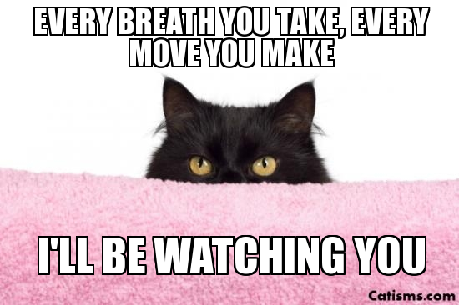
Encryption

Slide 10
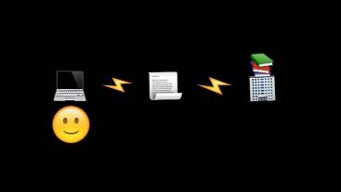
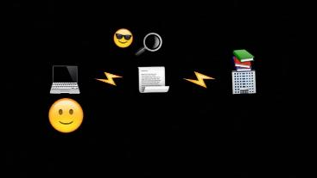
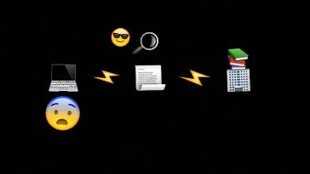
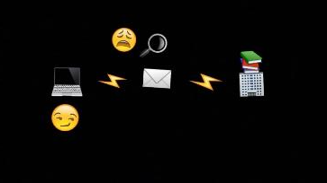
HTTPS
Notes:
Https is one way that libraries can provide online security for the transmission of our customers’ data. It’
HTTPS: is a secured standard for communicating information that encrypts that information as it is being transferred between computers, preventing customer information from being intercepted, stolen, or modified while it is being transmitted online. Essentially, protecting the customer while the customer is using a webpage.

Slide 11
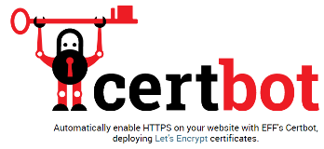
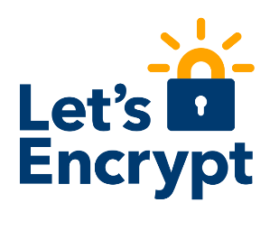
HTTPS

Slide 12
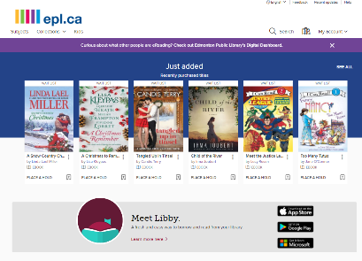
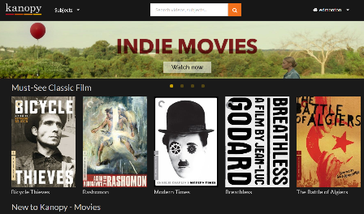
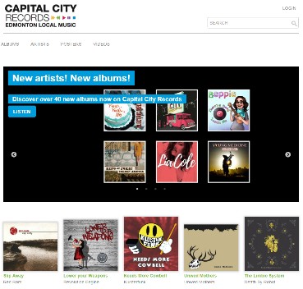
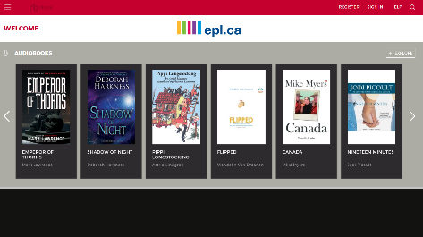
HTTPS for Collections
Notes:
Almost all of these resources come with a vendor-specific website. Each site is a location on the internet that we send our customers out to search and login using account information.
On each of these sites, customers could unwittingly have their information and information seeking behaviours monitored if the site is unencrypted

Slide 13
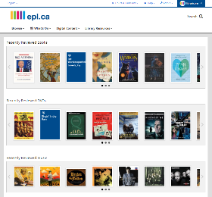
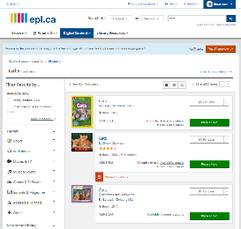
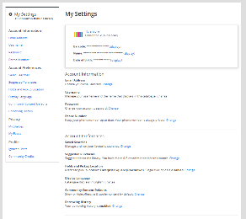
HTTPS for Catalogue
No encryption exposes:
Account Information
Search behaviour
Borrowing history

Slide 14
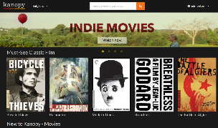
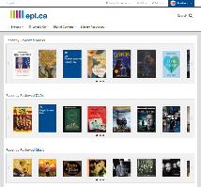
HTTPS and Vendor Sites
Most sites owned by vendors
Notes:
Be mindful of vendor sites and sites owned/operated by your institution

Slide 15
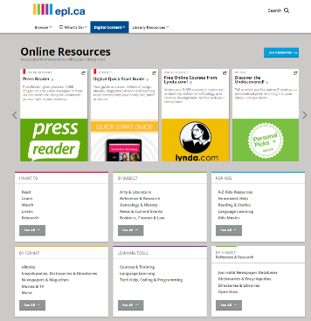
HTTPS Website Updates
Vendor Compliance
In 2016, 60 sites were without https
Notes:
Update you’re the resource links on your homepage

Slide 16
HTTPS for EZproxy
Image from OCLC.org EZproxy Overview
Notes:
If you use EZproxy for authentication get an SSL certificate and update your links!

Slide 17
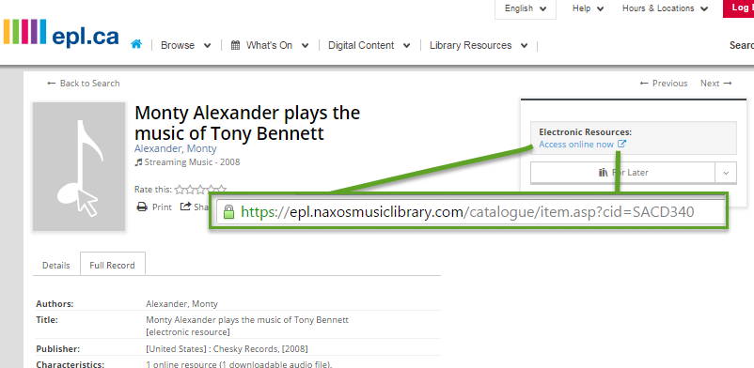
HTTPS and MARC records
Catalogue records to send customers to https sites
Notes:
Dohn’t forget about your catalogue and all those URLs in the 856s

Slide 18
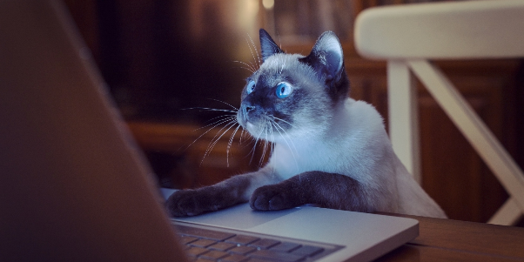
Authentication
♪ Private eyes are watching you,
They see your every move ♪
Notes:
We are constantly communicating customer information to our digital collection vendors when a customer logs into a website and this authentication occurs through a communication with our ILS.

Slide 19
SIP2 63/64
Barcode Pattern Matching
EZproxy
SIP2
Notes:
For us, authentication largely occurs in 3 ways.

Slide 20
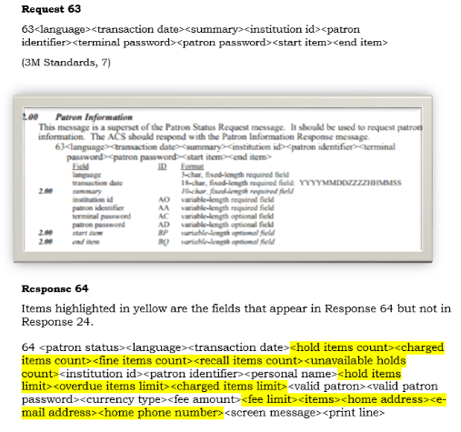
SIP2
SIP2 63/64 requires the transmission of information to the vendor during authentication (ie. home address, email address, phone number, etc)
Notes:
Several of our most popular vendor products are using SIP2 to authenticate, specifically SIP2 call/response 63/64. This communicates a surprising amount of information to the vendor. Some of it is expected like customer barcode, card expiration date, card status, and user profile that tell the vendor our customer is a local resident. But most of it is unexpected like the customer’s address, phone number, birthdate, gender, and email address.

Slide 21
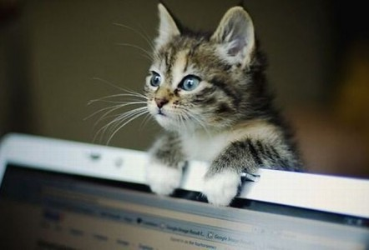
Third Party Vendors
♪ I’m gonna find ya
I’m gonna getcha, getcha, getcha, getcha ♪
Notes:
When you’re dealing with our ILS and the customer information within it you’re dealing with FOIP. But when customers leave our spaces and navigate onto these individual vendor sites they are dealing with new sets of privacy legislation which could potentially change for each vendor depending on where the vendor’s headquarters are and the state, provincial, federal legislation that guides them.

Slide 22
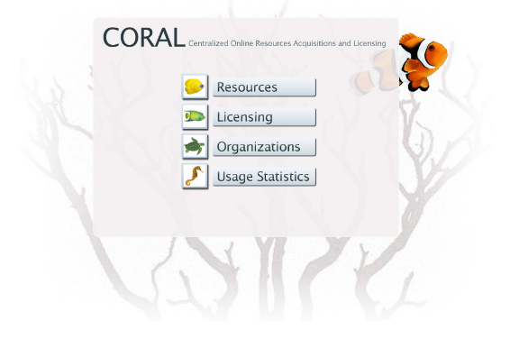
Summer 2016 Project
Electronic Resource Management with open source CORAL Licensing Module

Slide 23
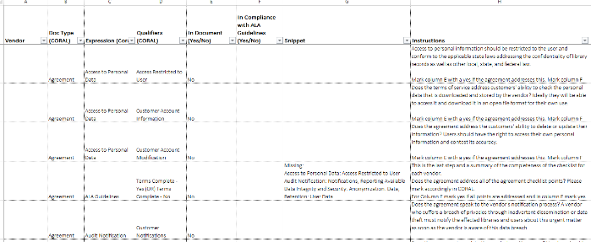
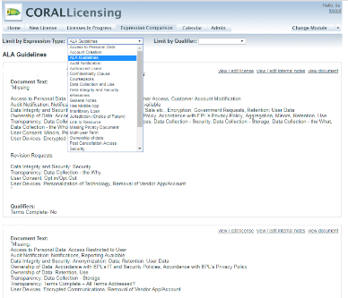
CORALLicensing – Setting up Expressions and Qualifiers

Slide 24
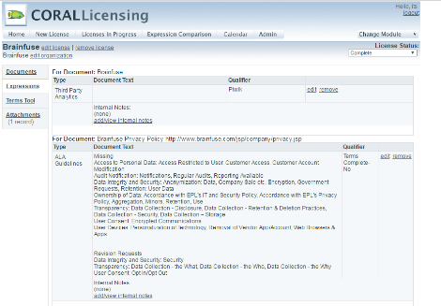
CORALLicensing
CORAL Licensing Module
Uploaded electronic copy of most up-to-date vendor agreement
Tagged contracts for missing or non-ideal compliance to the ALA eBook Vendor Guidelines/NISO
Flagged related snippets of agreements for compliance or lack of compliance to ALA guidelines
Created central access to vendor information for EPL

Slide 25
Contract Renewal & Negotiations
CMA Creating Checklist
Check out the ALA Privacy Checklists
What are other libraries asking for?
What is the most important to your institution?
Does the vendor’s website enforce secure connections (https or better)?
Does your website include a Terms of Use page? Can customers access it before logging in?
Does your website include a Privacy Policy page? Can customers access it before logging in?
Do you share our customers’ personally identifiable information with any third party?
If you collect personal data is the storage encrypted?
Does your tracking software associate IP addresses with individual user behavior?

Slide 26
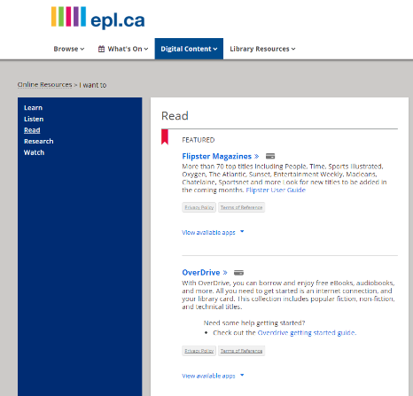
Terms of Service and Privacy Policy Buttons
Notes:
Customer/patron Education is key. They need to determine what they are willing to trade for access and also be aware of the difference between our site and vendor sites

Slide 27
Customer Education
♪ You can change your telephone number
♪ And you can change your address too
Next Steps
But you can’t stop me from loving you ♪

Slide 28
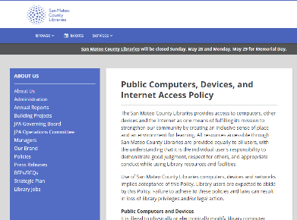
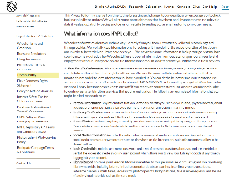
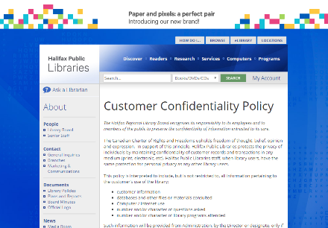
Survey of Library Websites
Notes:
Summer student started by reviewing 50 linrary websites to see what other libraries were doing for digital privacy education/awareness
Out of the 50 libraries, 25 had some digital privacy content readily accessible for their customers, but only 5 had detailed digital privacy content

Slide 29
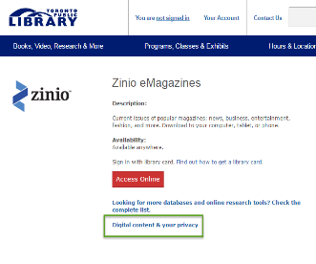
Website Guidance
Notes:
Toronto Public Library and New York Public Library provided good examples of how public libraries can facilitate better customer understanding of their privacy and the library’s online resources.

Slide 30
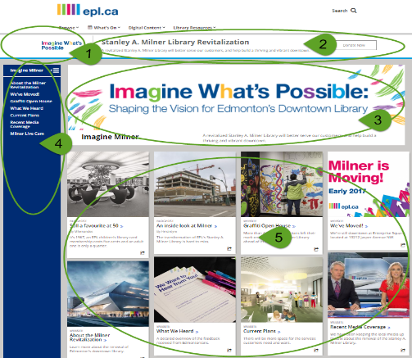
Digital Privacy Page
Example of Program Page in BiblioWeb
1. Logo
2. Program Banner: appears at the top of all related pages and provides link
3. Program Block: a large image, descriptive text, and up to five option buttons on landing page
4. Page Navigation
5. Content Cards: Each card can feature an image, header, and brief content statement. Each card can be created to link to a content page.
Notes:
Our website is a BiblioCommons product called BiblioWeb. As such we have templates for building different spaces for the website. The Web Services librarian worked with summer student and determined that we should use the BiblioCommons Program page to create our Digital Privacy space. Not published yet

Slide 31
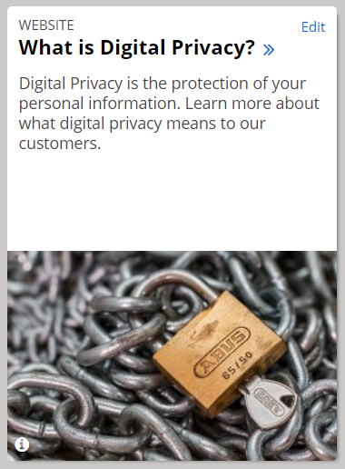
Digital Privacy Page
What is Digital Privacy?
PII: Personal Identifiable Information
EPL and Digital Privacy
Notes:
Content for upcoming web pages

Slide 32
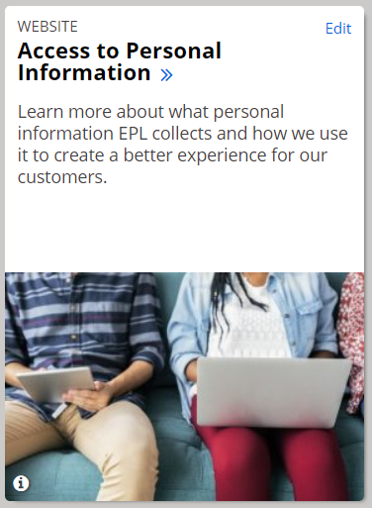
Digital Privacy Page
Access to Personal
Information
What EPL Collects
Library Card Registration
My Account Registration
Borrowing History
Electronic Communication
Notes:
Content for upcoming web pages

Slide 33
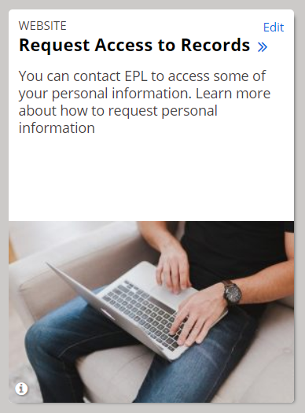
Digital Privacy Page
Request Access
to Records
Notes:
Content for upcoming web pages

Slide 34
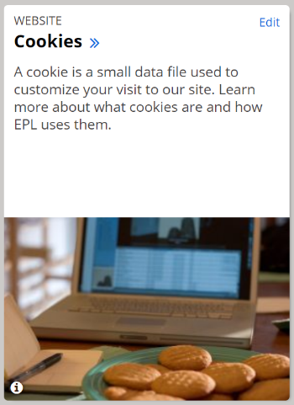
Digital Privacy Page
Cookies
What Are Cookies?
What Cookies Do
Different Types of Cookies
EPL and Cookies
Third-Party Cookies
How to Clear or Reject Cookies
Notes:
Content for upcoming web pages

Slide 35
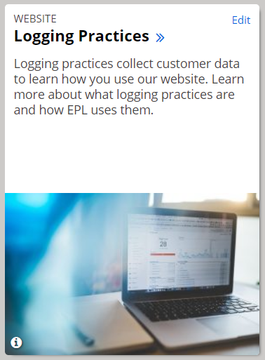
Digital Privacy Page
Logging Practices
EPL and Logging Practices
EPL Website
Google Analytics
Crazy Egg
EPL Apps
Notes:
Content for upcoming web pages

Slide 36
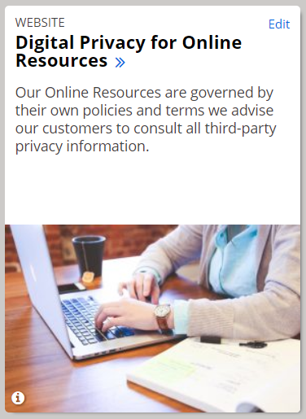
Digital Privacy Page
Digital Privacy for
Online Resources
Your Information and Online Resources
Information Shared
Creation of Secondary Accounts
Mandatory
Optional
A-Z Online Resources
Notes:
Content for upcoming web pages

Slide 37
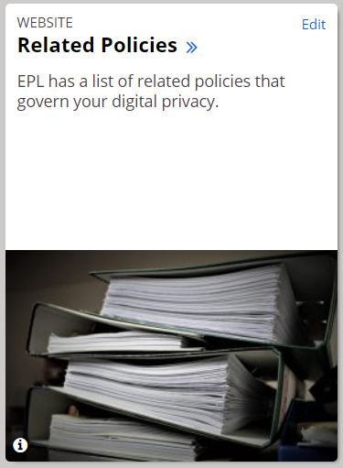
Digital Privacy Page
Related Policies
Privacy and Confidentiality
of Customer Information
Public Internet Access
Social Media Community Policy
Personal Information Banks
Policies
A-Z Online Resources
Notes:
Content for upcoming web pages

Slide 38
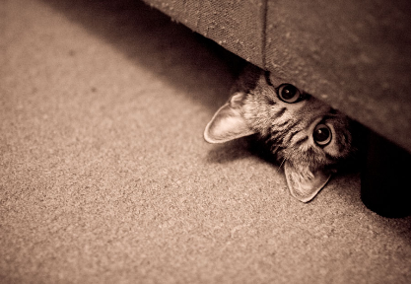
Questions?
Rachael Collins
rcollins@epl.ca

Slide 39
Resources
Webinars
Protecting Patron Privacy in Public Libraries – Tech Soup March 2016
The Why and How of HTTPS – LITA March 2016
ALA Guidelines & Checklists
Library Privacy Guidelines for E-book Lending and Digital Content Vendors
Library Privacy Checklist for E-Book Lending and Digital Content Vendors
NISO Principles
NISO Consensus Principles on Users’ Digital Privacy in Library, publisher, and Software-Provider Systems
Articles and Chapters
Breeding, Marshall. Privacy and Security for Library Systems. Library Technology Reports. May/June 2016.

