Slide 1
How Hip is the Partnership?
Robin Bergart, University of Guelph
Leanne Olson, Western University
Nathalie Soini, Queen’s University

Slide 2
Take the Poll
Go to
www.govote.at
and use code 61 36 34

Slide 3
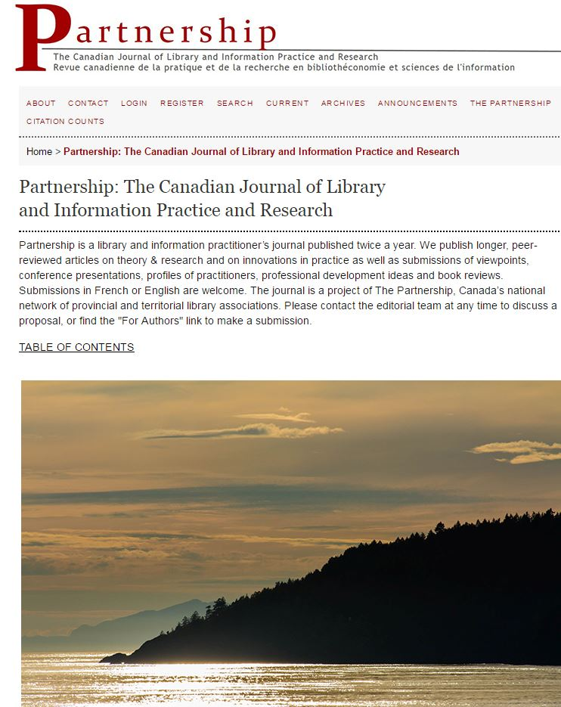

Slide 4
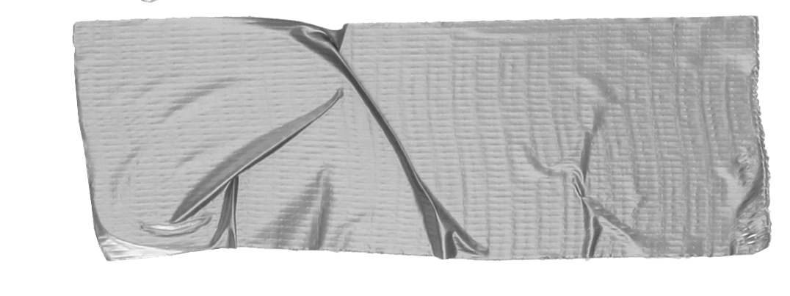
Overview
Literature Review Readership Studies Bibliometric Studies Scholarly Communications Studies
Research Methods Expert Interviews Survey Reader data
Early Insights
Future Directions

Slide 5
Literature Review
Readership Studies
Who are our readers?
What do our readers want and expect?

Slide 6
Literature Review
Bibliometric Studies
Who contributes to the journal literature?
Which topics and research methods are trending?
Where are articles cited?

Slide 7
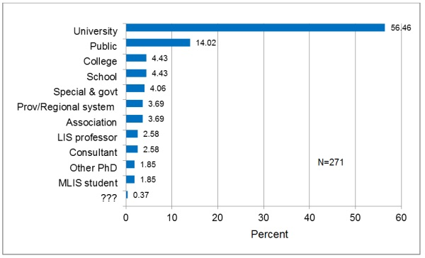
Notes:
Authorship in P journal 2006-2103

Slide 8
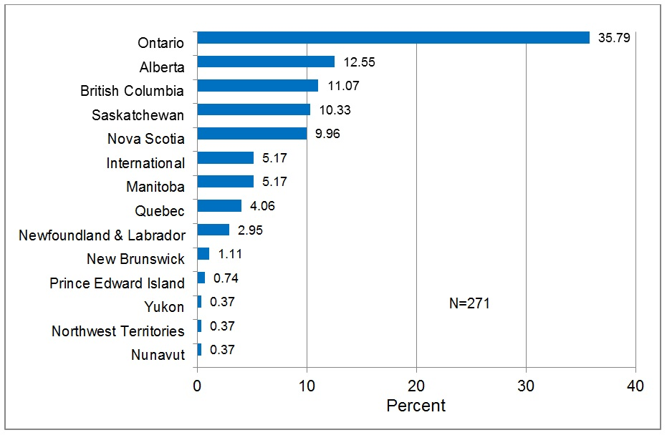
Notes:
Authorship in P journal 2006-2103

Slide 9
Literature Review
Scholarly Communications Studies
What are the reading & publishing habits of library workers?
How do libraries support research by library staff?
Are LIS practitioners and academics talking to each other?

Slide 10
Research methods
19 Expert Interviews
National survey
Reader data
Notes:
Examples of people interviewed: executive directors of provincial associations, academic and public librarians, students, francophone librarians
Interviews inform survey preparation--what’s important, what did we not think of, what should we continue to ask? - which questions did we feel were no longer necessary after the interviews?

Slide 11
Early insights
How do you keep up with LIS literature?
Is Canadian content important to you?
What are the strengths and drawbacks of a generalist library journal?
What matters to you when you are choosing where to publish your work?
What metrics matter to you as an author?

Slide 12
Early insights
What words or images come to your mind when you think of the journal?
What is your sense of the journal’s reputation?
Would advertising negatively affect your perception of the journal?
How important is it to include French language articles?

Slide 13
Future Directions
Survey analysis & data mining
More questions

Slide 14
Contact us
Nathalie
soinin@queensu.ca
Robin
rbergart@uoguelph.ca
@PartnershipJ

