Slide 1
Not on campus, no problem: Distance librarians round table
Moderator: Carol Gordon, UVic
Serena Ableson, College of Law USask; Camosun College
Will Meredith, RRU
Jessica Mussell, UVic

Slide 2
Provide a brief history of how your library got involved in distance education
By Twitter, CC BY 4.0, https://commons.wikimedia.org/w/index.php?curid=59972852

Slide 3
What is the typical online student?

Slide 4
How do you support students and programs? What services are you currently offering?
By Twitter, CC BY 4.0, https://commons.wikimedia.org/w/index.php?curid=59973868 By Twitter, CC BY 4.0, https://commons.wikimedia.org/w/index.php?curid=59974718

Slide 5
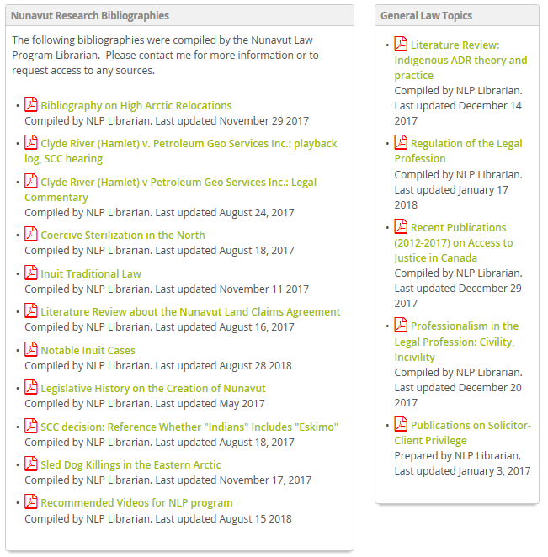
Library services for the Nunavut Law Program
Completed many research projects for Law Faculty: Inuit traditional law, Nunavut court cases, and northern history topics

Slide 6
How do you engage, market, or communicate your services to clients?

Slide 7
Do you have any stories or “lessons learned” around serving this population?
By Twitter, CC BY 4.0, https://commons.wikimedia.org/w/index.php?curid=59972094

Slide 8
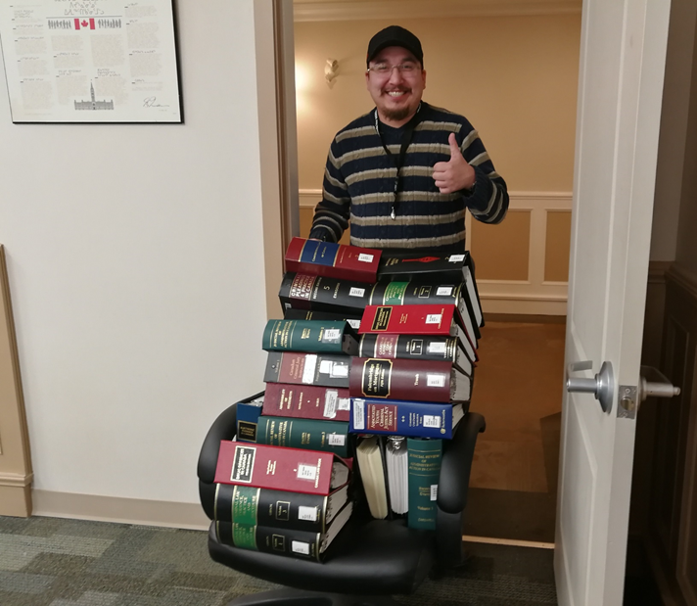
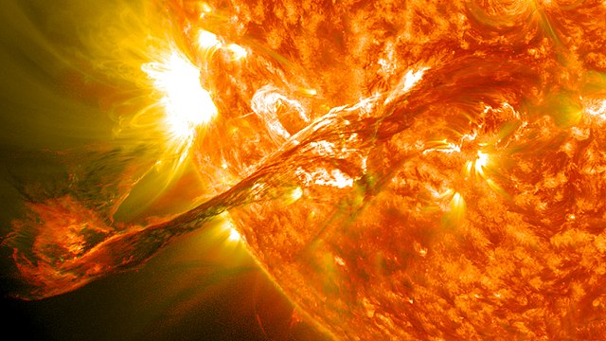
Sometimes you need to get creative….
By Wikipedia, Goddard Space Flight Center, CC BY 2.0, https://en.wikipedia.org/wiki/Solar_flare#/media/File:Magnificent_CME_Erupts_on_the_Sun_-_August_31.jpg
Photo credit: Serena Ableson

Slide 9
Thank-you!
Moderator: Carol Gordon, UVic: cjgordon@uvic.ca
Panel:
Serena Ableson, College of Law USask; Camosun College serena.ableson@usask.ca
Will Meredith, RRU: will.meredith@royalroads.ca
Jessica Mussell, UVic: jmussell@uvic.ca
Resources:
Journal of Library & Information Services in Distance Learning (Taylor & Francis)
Conference: Distance Library Services Conference (biennial, recently cancelled)
CLA, Guidelines for Library Support of Distance and Distributed Learning in Canada: http://cla.ca/cla-at-work/position-statements (Revised November 2000)
ACRL Standards for Distance Learning Library Services: http://www.ala.org/acrl/standards/guidelinesdistancelearning (Revised June 2016)
By Twitter, CC BY 4.0, https://commons.wikimedia.org/w/index.php?curid=59973758

