Slide 1
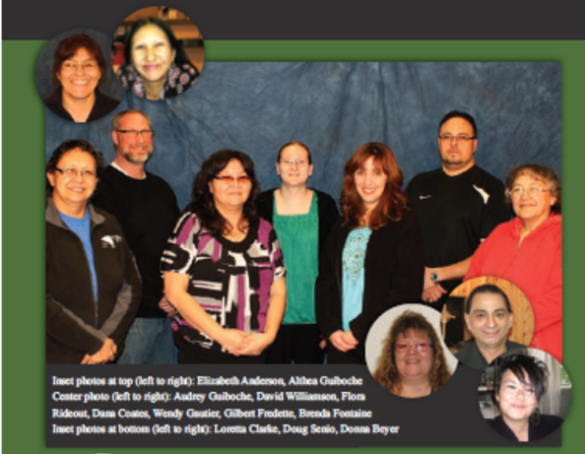
Northern Writers and Community Libraries

Slide 2
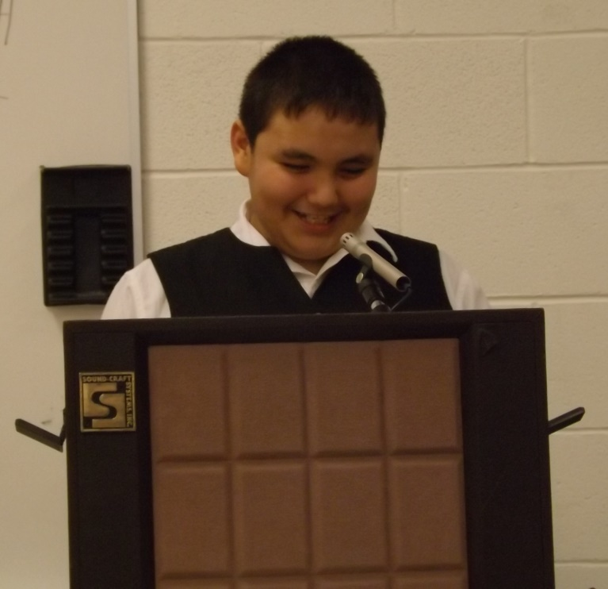
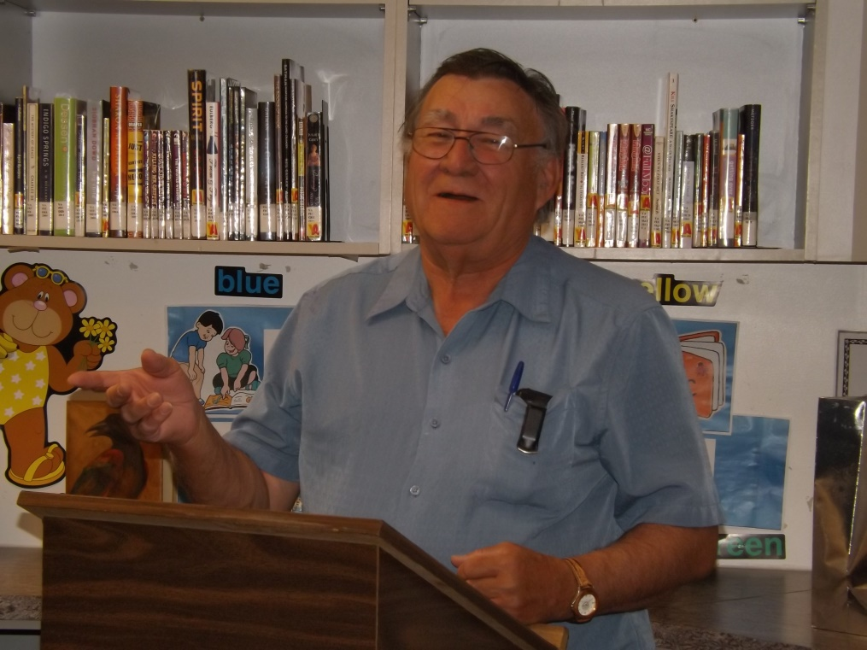
Everyone has a voice
from the youngest...
to the oldest.

Slide 3
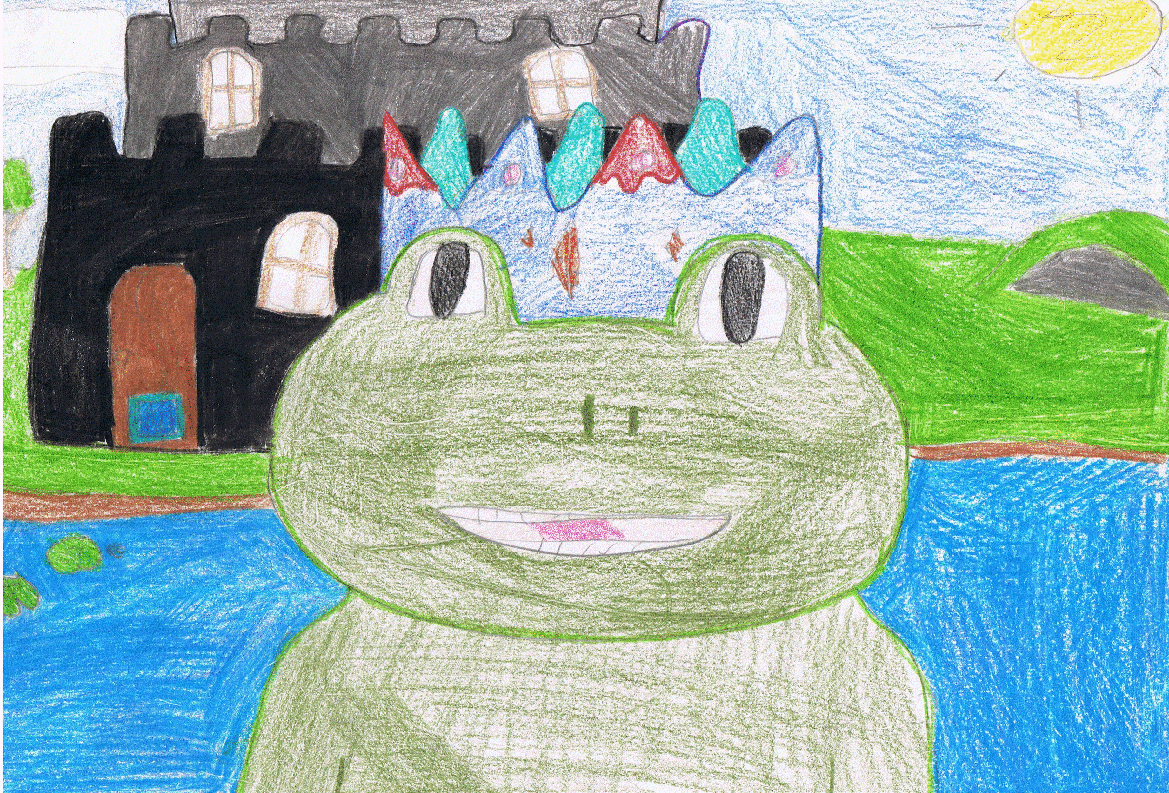
Everyone has a story to tell
Whether it is simple…
Once upon a time, there was a frog named Matt...
Excerpt from story by Michelle Colon from Squirrel Tales and Rabbit Trails.

Slide 4
- Ray Dawn Balfour from Isle of Mirage
Or complex…
As the sun rounds the earth
I sit awake thinking about
How to tell you the news
You come to check if mommy is home
And as you enter the room
You see that I am crying
You see that I am not crying for you or me
But for mommy and her lost soul

Slide 5
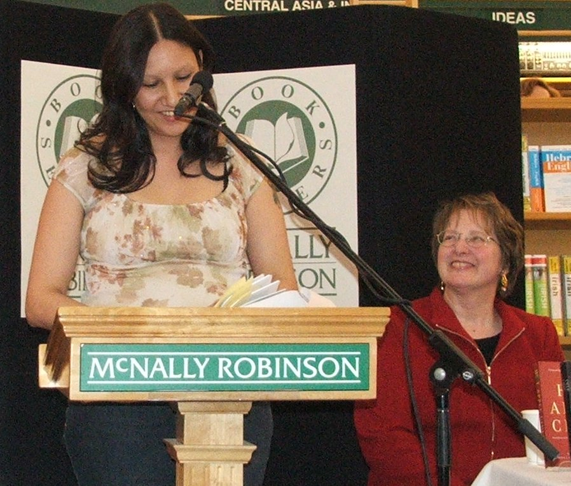
Every story we listen to…
Enriches our lives
Builds bridges of understanding
Expands our horizons

Slide 6
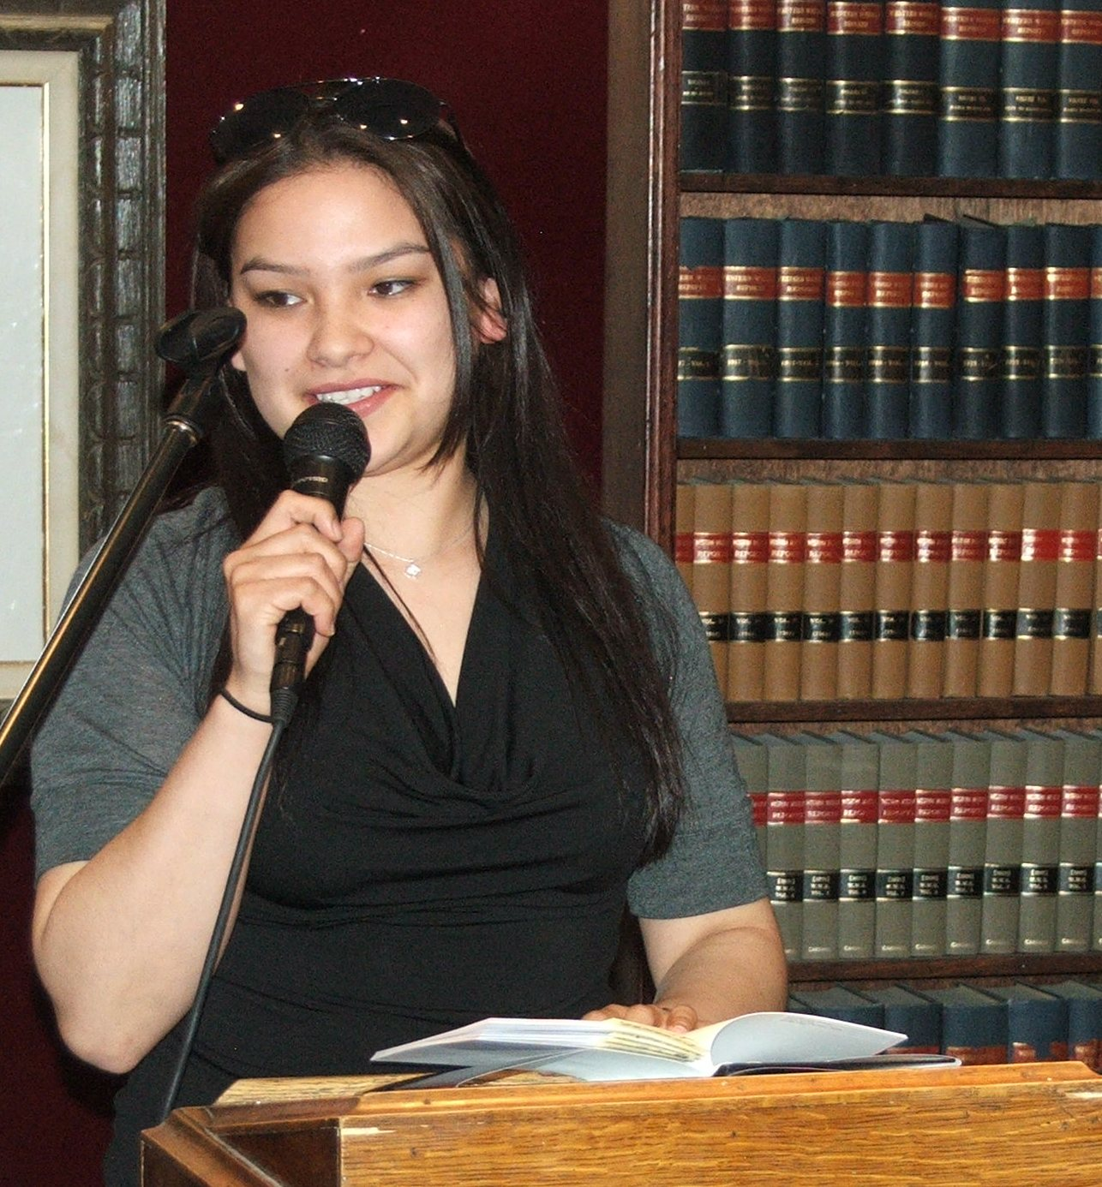
Every story we hear…
Helps someone to feel less alone
Builds self-esteem
Encourages the author to share their story with others

Slide 7
Many voices are not heard. Many stories are never told.

Slide 8
Because of geographic isolation…
Norway House
(850 km north of Winnipeg)
It is much harder for writers to develop their skills when they live far away from other writers, publishers, editors, writing classes, writing conferences, book launches, readings, etc.

Slide 9
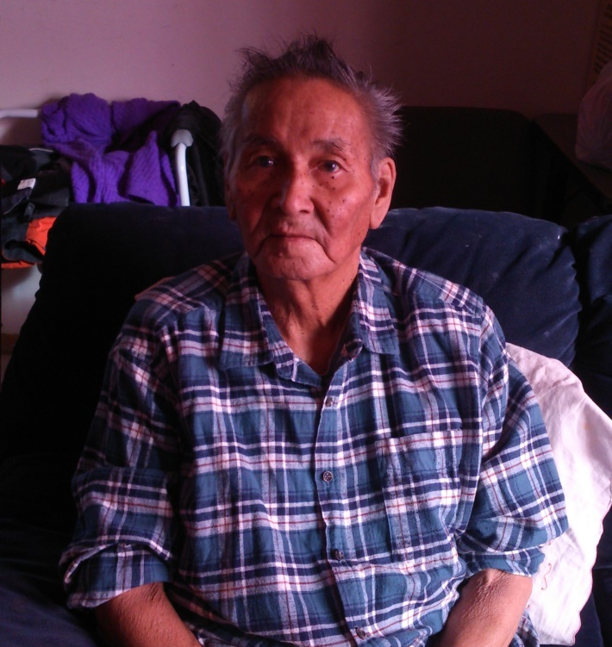
Because of language differences…
ᑲᓇᒋ ᐃᓯᐢᒋᑫᐃᐟᐣ ᒥᓂᐢᑎᐠ
ᑕᑊᐁ ᐅᒪ ᐊᒋᒧᐃᐧᐣ ᑲᐃᐧ ᐃᐧᐦᑕᒪᑕᐣ, ᓂᑐᑌᒪᐦᐠ, ᑲᑭ ᐃᐢᐸᓂᑯᔭᐣ ᑲᔭᐣ᙮
ᐁᑯᐢᐱ ᒪᑯᓭᑭᓯᑲᐃᐧ ᐱᓯᒼ, ᐃᐢᑭ 1959 ᒣᐠᐊᐧᐨ ᓂᐢᑕᓇ ᓂᓱᓴᑊ ᐁᐩᑕᐊᐧᓂᔭᐣ᙮
It is much harder for writers to become published when they speak and/or write in a language that is not very often published by most major publishing companies.

Slide 10
Because of cultural differences…
Sometimes it is difficult for a writer to become published when they are from a minority group. There are words associated with a culture that might not be understood to a majority of readers, and the historical and cultural implications may need to be explained.
“We went to school by boat in the summer or by bombardier in the winter.”
* A mode of transportation used in the north before there were roads. It was developed by Joseph Armand-Bombardier. It had skis like a snowmobile but was enclosed and could hold several passengers at a time.
- Sylvia Richard from “Kissipanok” from First Nations Christian Writers, volume 1

Slide 11
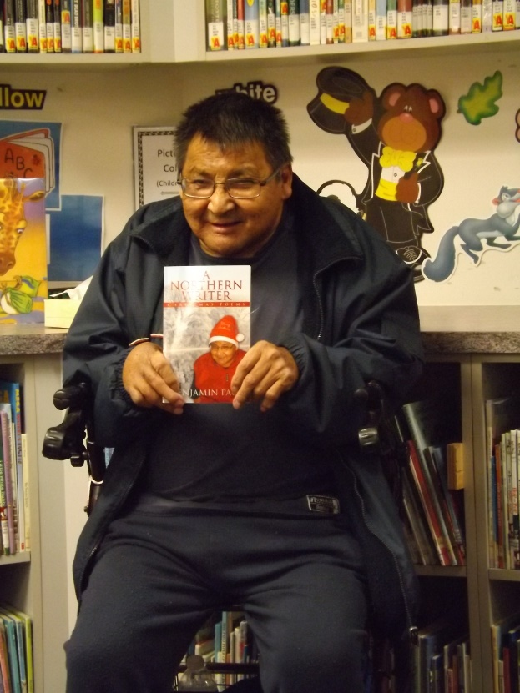
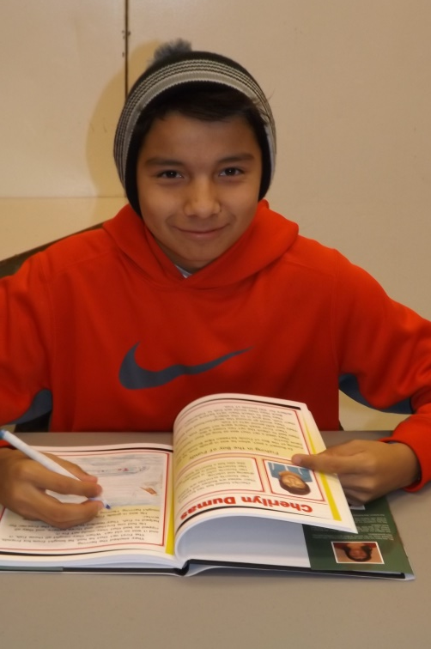
Because of age differences…
It is harder for writers to become published when they are very young – or when they are elderly – as they may not have access to the Internet and all the resources available there. Also there is sometimes a bit of disregard for the writings of children or of the elderly.
Benjamin
Paul with his book of poems.
Tyrone Scott-Poker signing his copy of Grade 6 anthology.

Slide 12
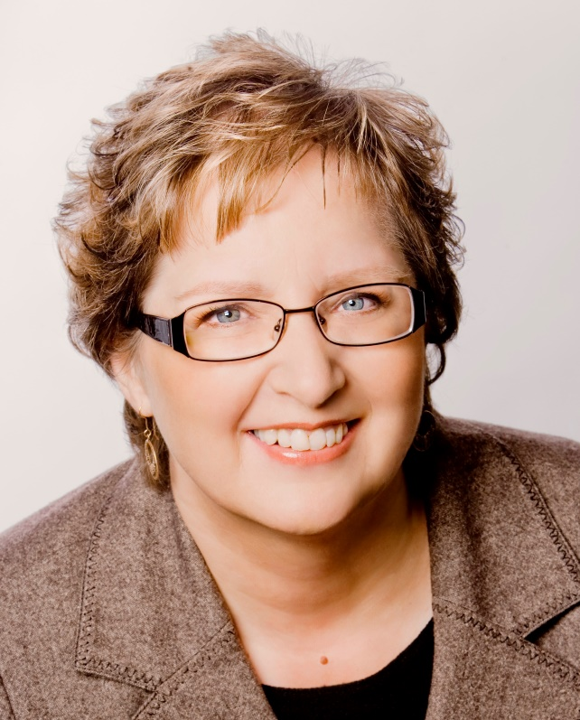
Goldrock Press www.goldrockpress.com
Dorene Meyer is the owner and publisher at Goldrock Press.
She began teaching writing classes in Ontario and continued to do so after moving to Winnipeg. When Dorene moved to Norway House in 2005, she began to teach writing classes there as well.

Slide 13
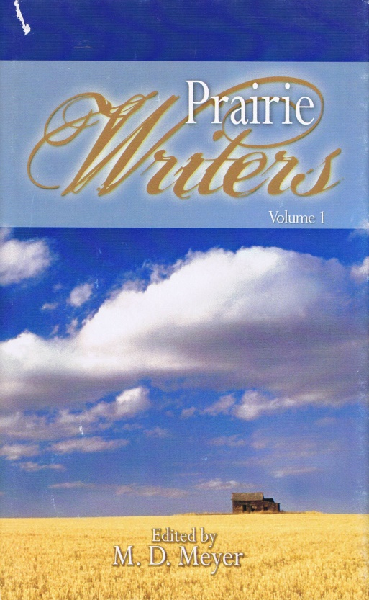
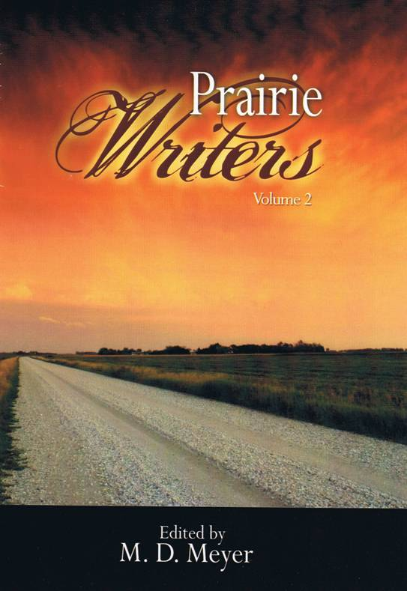
To help her writing class students to better understand writing from the first edit all the way through to book launch, Dorene developed the Prairie Writers anthology series. Some of her students went on to write their own books and anthologies.
Prairie Writers Series

Slide 14
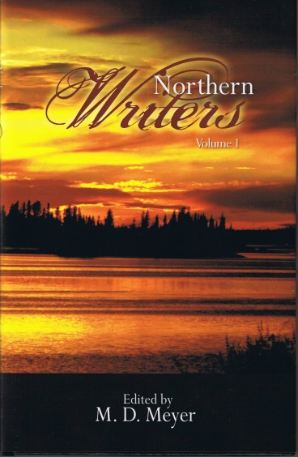
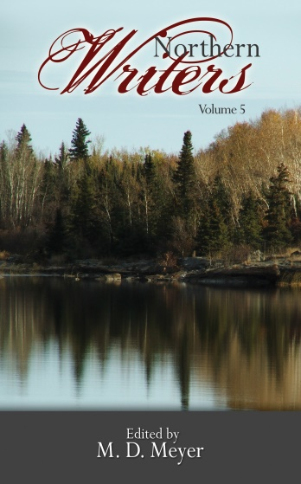
When Dorene moved to Norway House in 2007, she continued her writing classes and began the Northern Writers series.
Northern Writers Series

Slide 15
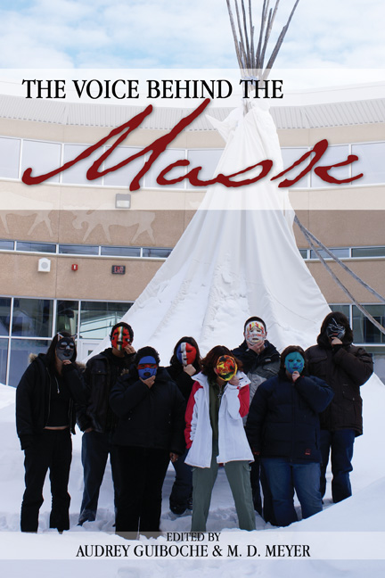
Dorene Meyer also began to work with students at the high school level, mentoring and publishing anthologies with teens. The students went to Winnipeg to launch the books and to meet members of the Aboriginal Writers Collective.
High School Series
Notes:
Voice Behind the Mask – 2008, Isle of Mirage – 2009 and Remember Me – 2010.

Slide 16
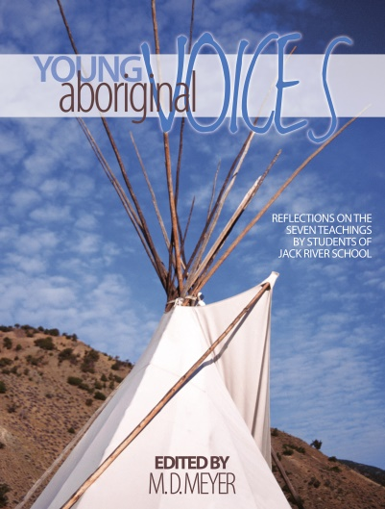
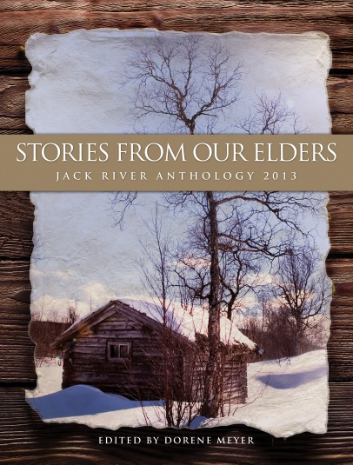
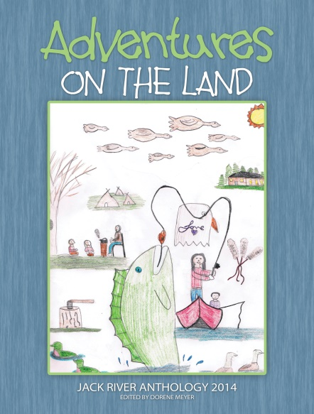
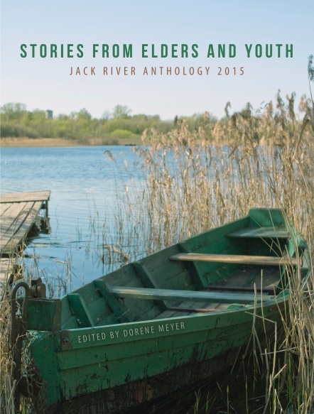
Children’s anthologies have also been published: seven of them so far…

Slide 17
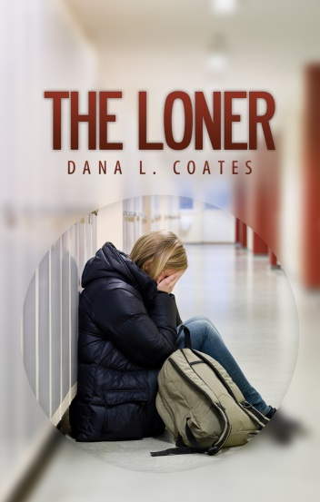
Books by northern writers…
As the writing classes continued, and the students progressed through several of courses, they began to write their own books which were published by Goldrock Press.
Others in the class had books published by Pemmican, and had articles published in various magazines and newspapers.

Slide 18
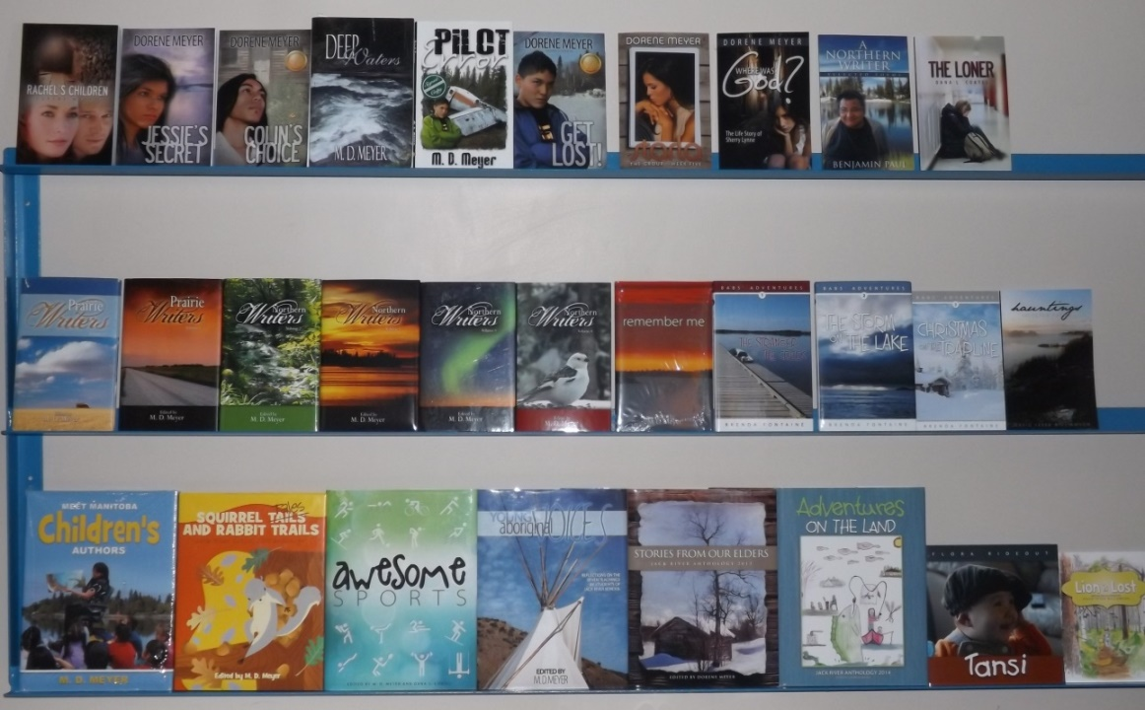
Books published by Goldrock Press include 18 anthologies, 7 novels, 5 children’s chapter books, 6 children’s pictures books, 3 books of poetry, 3 life stories and 1 resource book. Two books are in Cree, one is in Cree and English, and one book is in Cree, English and syllabics.

Slide 19
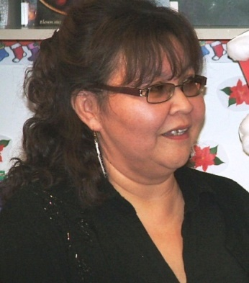
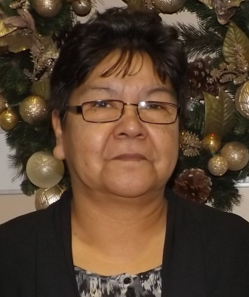
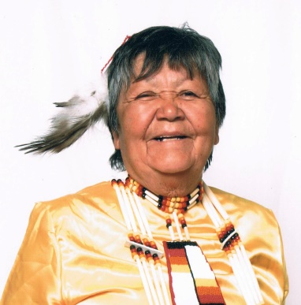
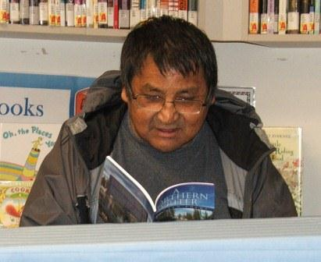
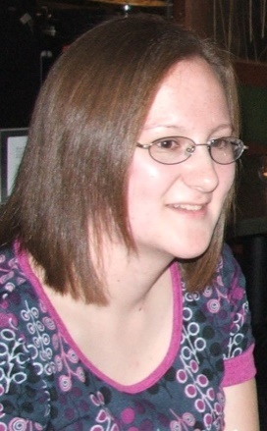
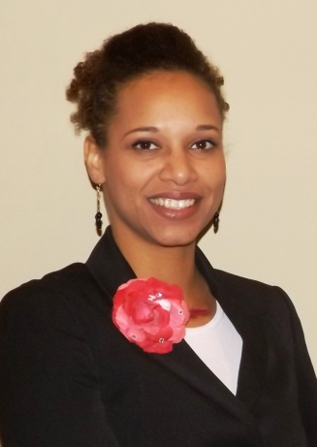
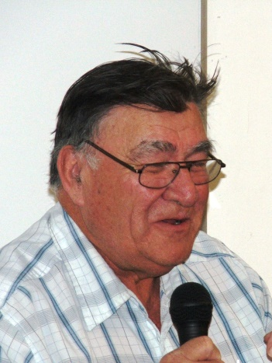
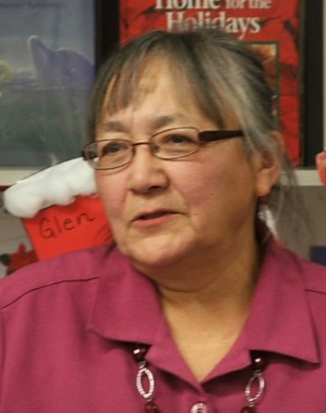
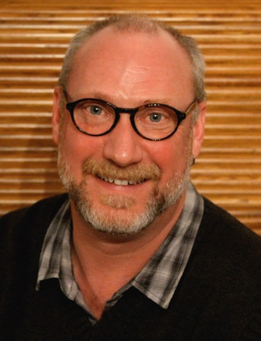
Authors of their own books include: Flora Rideout, Dana L. Coates, Shamin Brown, Brenda Fontaine, Irene Young, David Yerex Williamson, Sam Parmar, Clarence Thordarson, Benjamin Paul, Pauline Poker, Byron Apetagon, and Bernard Mason.

Slide 20
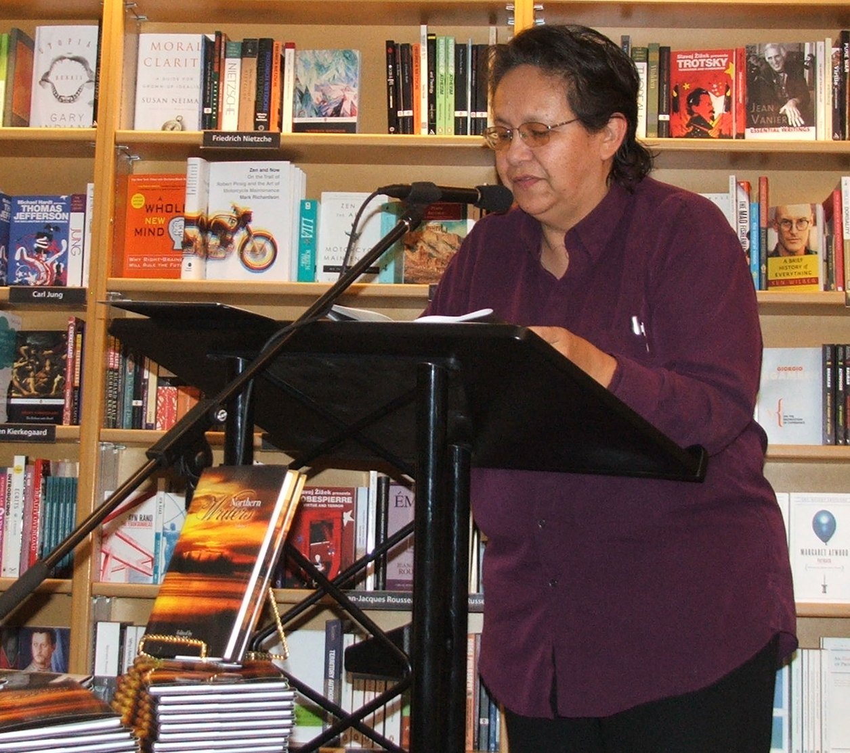
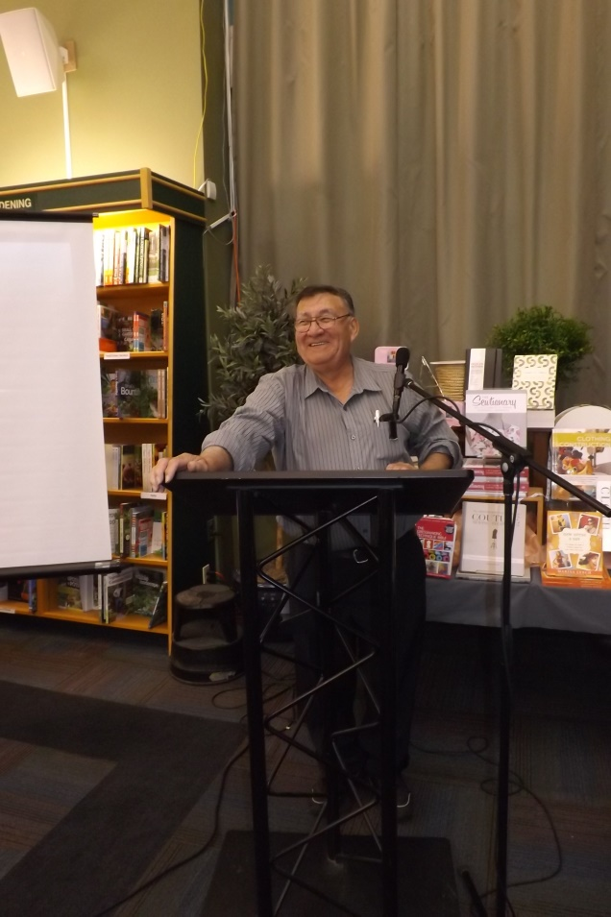
Goldrock Press has had several book launches in Winnipeg at Aqua Books, McNally Robinson, and Neechi Commons.
Clarence Thordarson at his launch of This ‘n’ That
Audrey Guiboche reading from Northern Writers volume 1

Slide 21
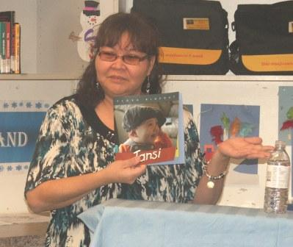
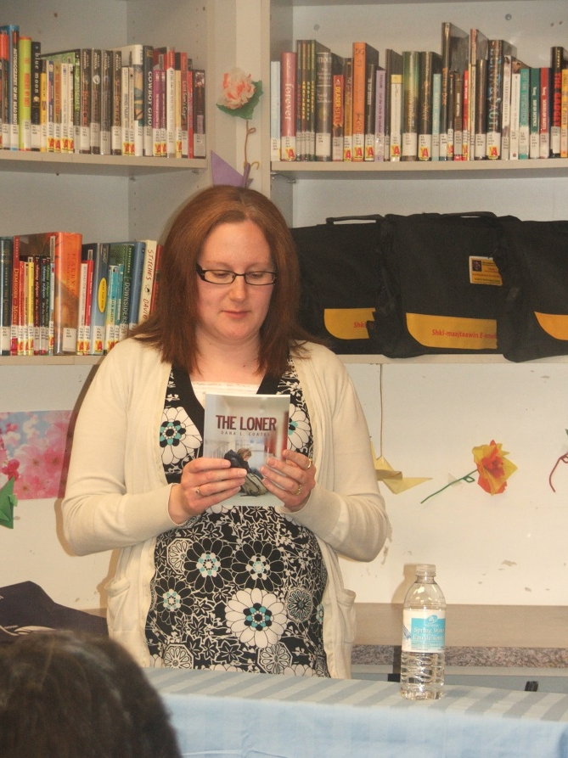
When we needed a place locally to launch our books, the UCN/Norway House Cree Nation public library was there to help. The library not only provided a space but offered refreshments, and the staff helped to set up for the event!
Flora Rideout, author of Tansi
Dana L. Coates, author of The Loner

Slide 22
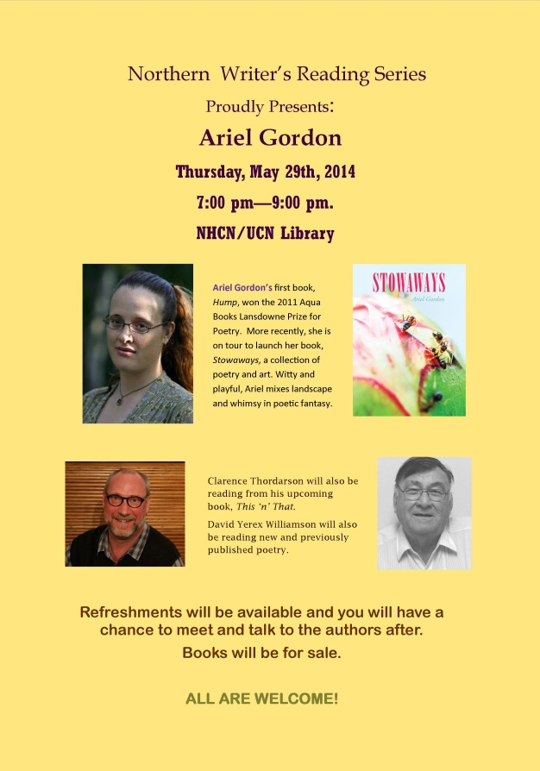
The UCN/Norway House Cree Nation public library are very supportive of the Northern Writers Reading Series and local authors. When there is an event, they make up posters and advertise the event on the local radio.

Slide 23
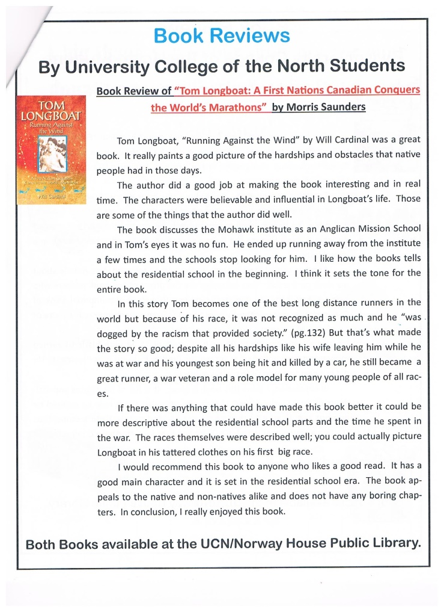
The UCN/Norway House Cree Nation public library also publishes a newsletter every month (and a calendar), and book reviews are included. Also upcoming Northern Writers Reading Series events and writing classes..

Slide 24
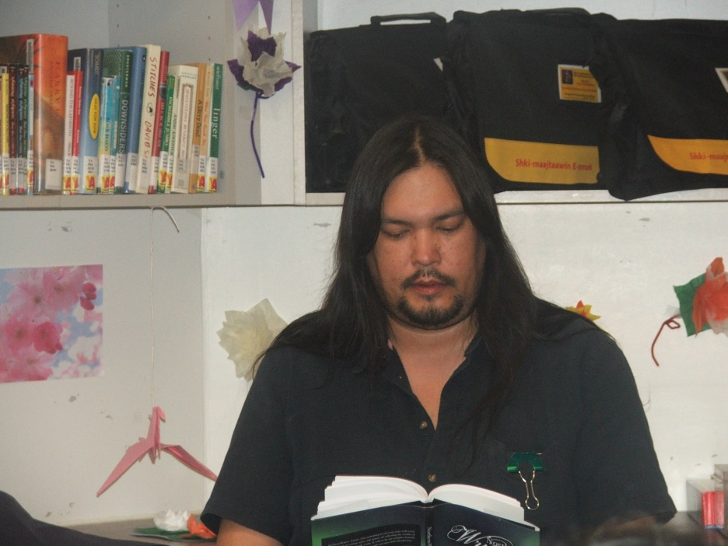
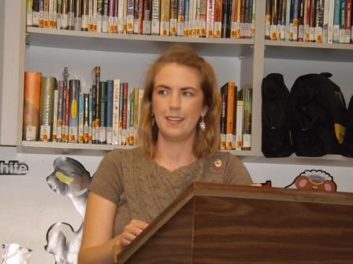
Not every writer publishes a book. But through the Northern Writers Reading Series, everyone gets a chance to read their work. Typically, we will have one book author who is releasing a new book and one or two other writers who would like to read their latest work.
Northern Writers Reading Series at UCN/Norway House Cree Nation Public Library

Slide 25
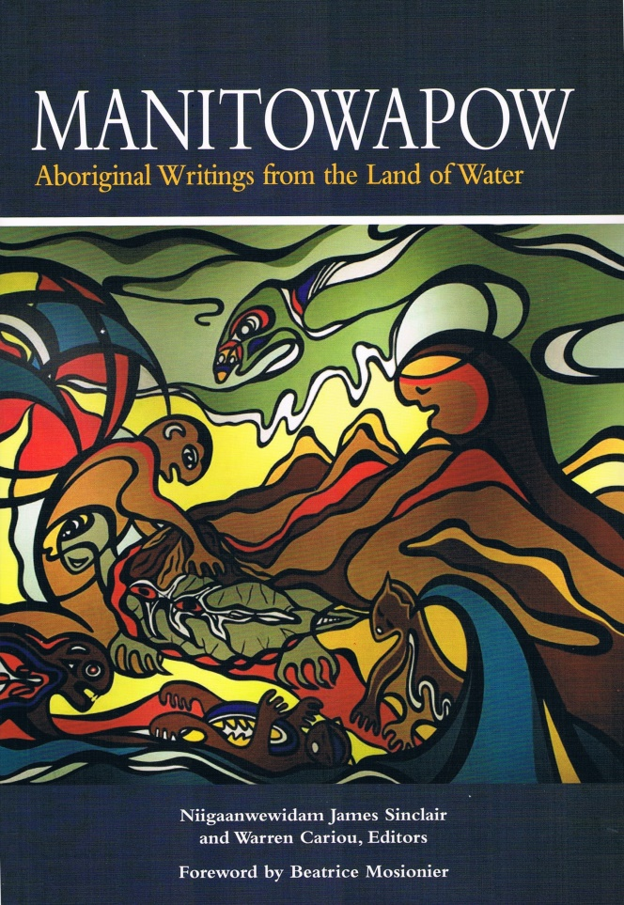
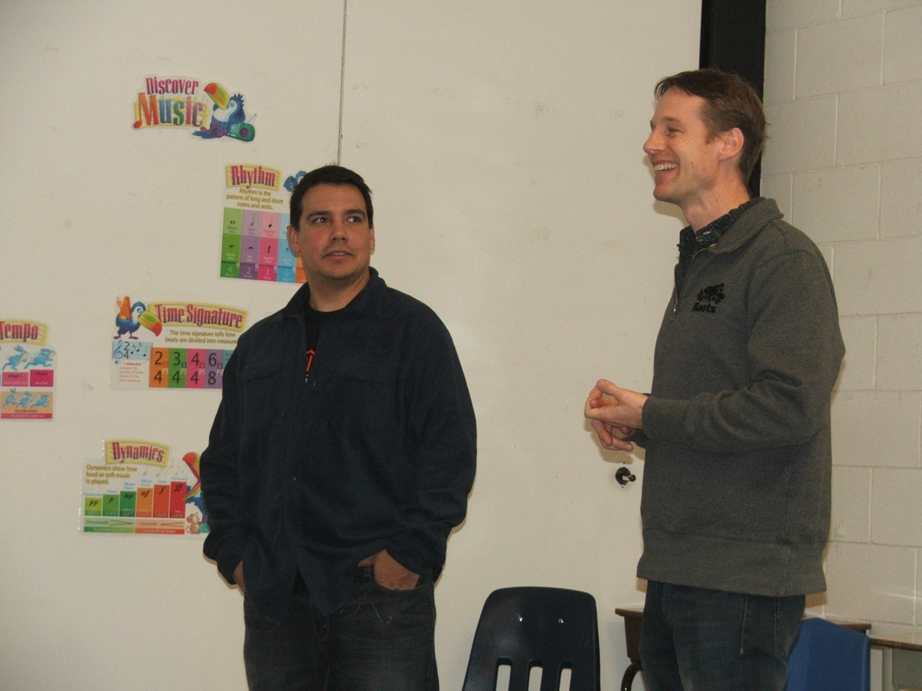
We have also had special guests who have joined our authors for readings from time to time.
Niigan James Sinclair and Warren Cariou visiting Norway House with Manitowapow.

Slide 26
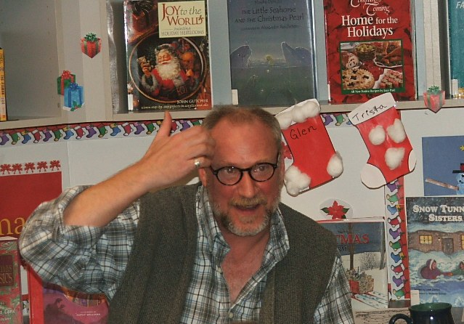
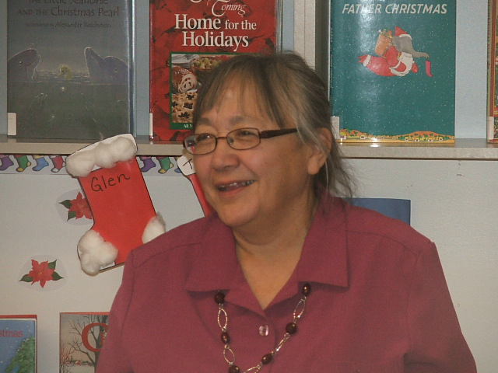
Recently, we have added a new opportunity for our writers. In addition to the Northern Writers Reading Series, we now also have a Northern Writers Sharing Circle where writers can share their current work with others to get feedback and encouragement. This is also held in the library.

Slide 27
For more information…
www.goldrockpress.com
info@goldrockpress.com

Slide 28
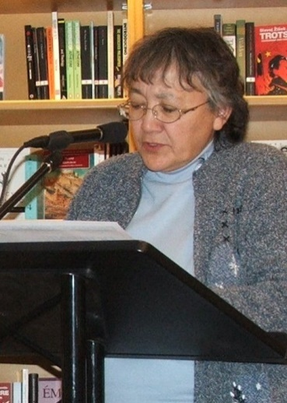
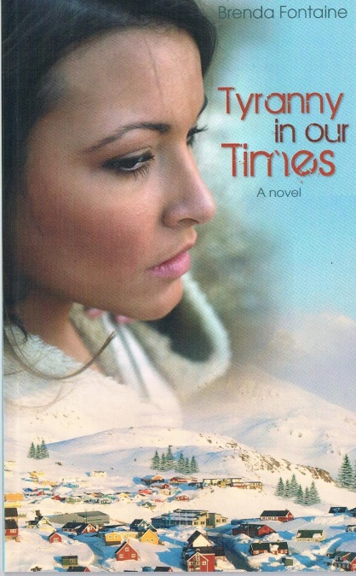
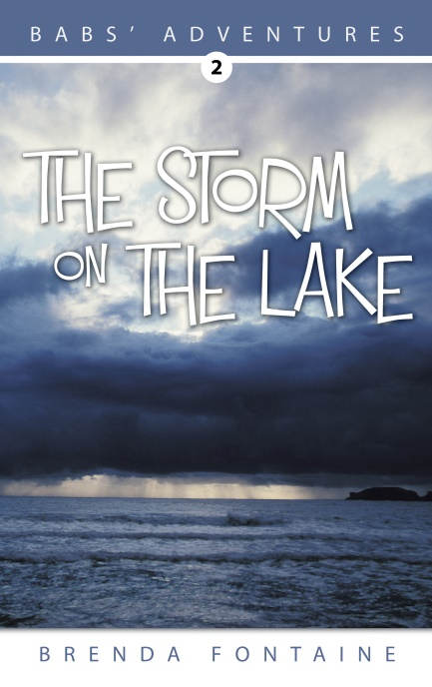
Brenda Fontaine
Brenda is a prolific author with articles published in North Roots magazine, First Nations Voice, Urban NDN and Maranatha News, and also in the Northern Writers anthology series and First Nations Christian Writers volume 1.
Brenda has written three children’s books in her Babs’ Adventures series, books which tell the story of a young girl growing up in a Cree community in the 1950’s.
And she has just recently published a contemporary novel titled Tyranny in our Times.
Notes:
And now I would like to introduce you to Brenda Fontaine who will say a few words about her personal experience with the Northern Writers Reading Series and the UCN/Norway House Cree Nation Public Library.

