Slide 1
Never Call a Meeting a Pow Wow and Other Steps in Creating a Successful Indigenous Event
Tanya Ball, Sheila Laroque, Anne Carr-Wiggin,
Sharon Farnel, Kayla Lar-Son, and Gabrielle Lamontagne
Alberta Library Conference, Jasper, April 2018

Slide 2
Territory Acknowledgement
Welcome to Jasper and the Alberta Library Conference. We are gathered today on Indigenous lands.
We wish to acknowledge the unceded land, the treaties in the nearby area, Treaties 6 and 8, and also the homeland of the Métis people. Jasper is a traditional meeting ground, gathering place, travelling route and home for many Indigenous peoples.

Slide 3
Presentation Outline
Introduction
Territory Acknowledgement
Writing Stick Background
Making Meaning Background
NCTR MOU Background
Participant Takeaways
Organizer Takeaways
Guidance for Non-Indigenous People
Next Steps…
Questions
Credit: Andy Grabia

Slide 4
Who is allowed to plan an Indigenous event?

Slide 5
EVERYONE!
The key is...
Be responsible!
You have a responsibility to represent Indigenous Peoples respectfully and appropriately
Don’t know how to do this?
Ask! Involve the community in your decision making

Slide 6
The Basics
Relationships with community members
Make sure that these are reciprocal
They should be ongoing (a relationship doesn’t end after your event)
Politics
This is where relationships can help you
Compensation
In a timely manner
May need to be flexible with process (e.g. cash payments)
Protocol and ceremonial items
Different from community to community
Some Nêhiyaw examples: flags, sage, sweetgrass, smudging
Protocol gifts
Blankets, etc.
FOOD! (and related protocol)
Timing
Assessment

Slide 7
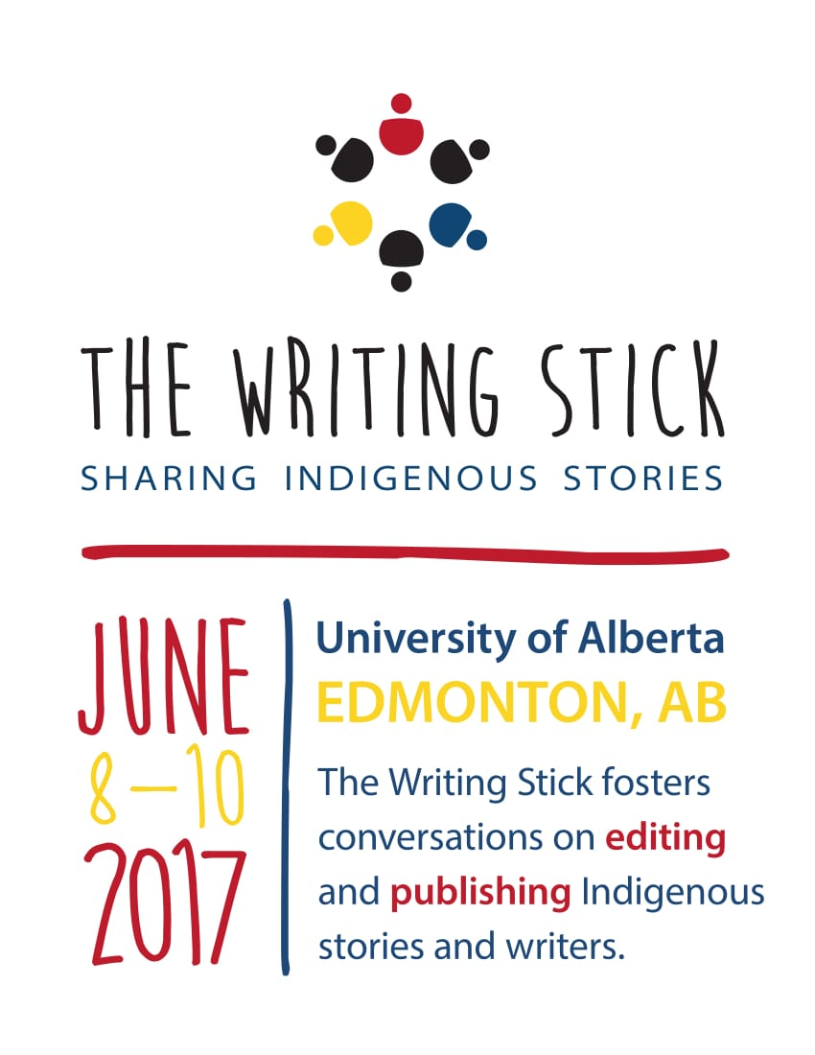
The Writing Stick
June 8 to 10, 2017
Through conversation, participants will look for wisdom and insight while exploring principles and guidelines for publishing and editing materials by Indigenous writers and about Indigenous peoples
Topics addressed: editing Indigenous works, cultural protocol, appropriate use of terminology, names and images, issues of appropriation, stereotyping, etc.

Slide 8
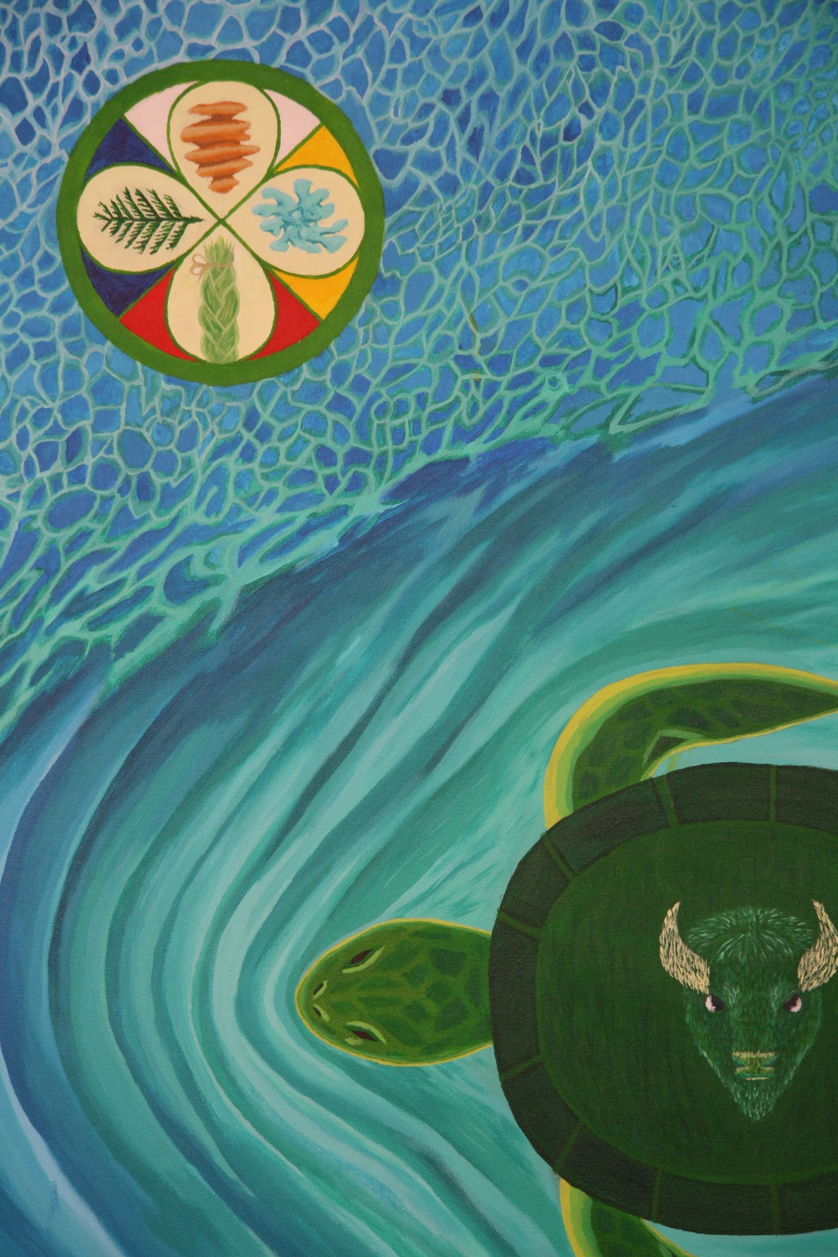
Making Meaning Symposium
February 8 & 9, 2018
Marked the first in a series of steps to gain an understanding of how our stakeholders would like to see the Decolonizing Descriptions Project proceed
Knowing which words would be preferred over what is being used in our current systems. This can only come through an ongoing relationship building process
Artist: Alex Auger, aauger@ualberta.ca

Slide 9
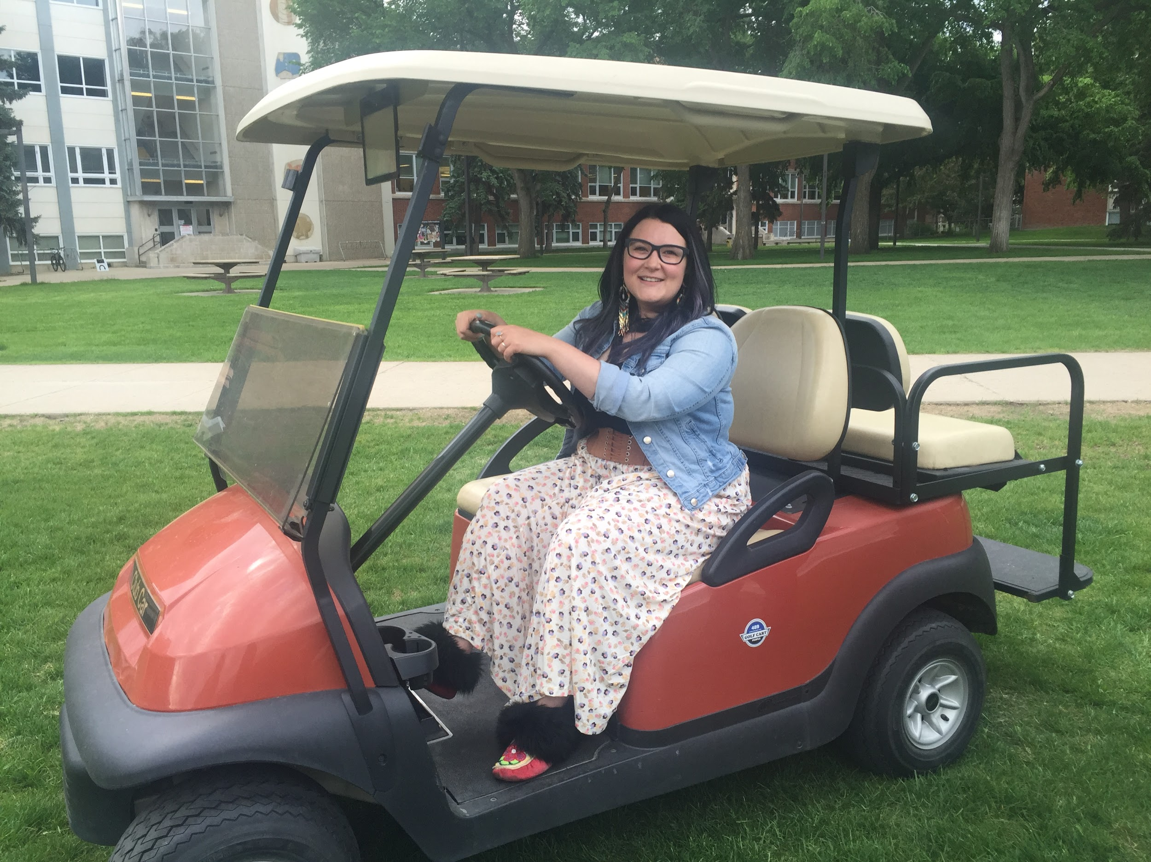
Partnership Agreement with NCTR Ceremony
High level partnership agreement (MOU) between the University of Alberta and National Centre for Truth and Reconciliation: Working in two worlds
Elders and community - and University dignitaries
Ceremony (pipe ceremony, feast, signing)
Large-scale organizing for deep community work requires a respected community member.
Kayla’s Elder Taxi at the NCTR event.
Credit:: Anne Carr-Wiggin
Notes:
The National Centre for Truth and Reconciliation; The University Provost’s and President’s offices. Indigenous leaders and organizations.
Multiple Elders were involved. This takes planning. It includes considering logistics. Elder helpers - Kayla and the Elder Taxi, Gabrielle and Lorisia at the MMS. Food. Ceremony. Ceremonial protocol. The tent entrance facing East, what makes a feast a feast? Pipe ceremony, order of seating for men and women, clothing, ribbon skirts.

Slide 10
What did we learn as organizers?

Slide 11
Major Takeaways
TIMING!
Community Involvement
Compensation
Budgeting Items
Team Organization
Indigenous and Non-Indigenous Folks
Communication with Organizing Team
Venue
Elder involvement and logistics
Protocol
Catering
Incorporating Indigenous Pedagogies
Transportation for Elders
Cultural elements
Student Involvement
Language
Naming of event/panels
Networking
Emotional Labour
Be mindful of where your money is going
Elder helpers
Politics
Venue
Community Involvement
Organizing Team
Indigenous and Non-Indigenous
Video Recording/Storing

Slide 12
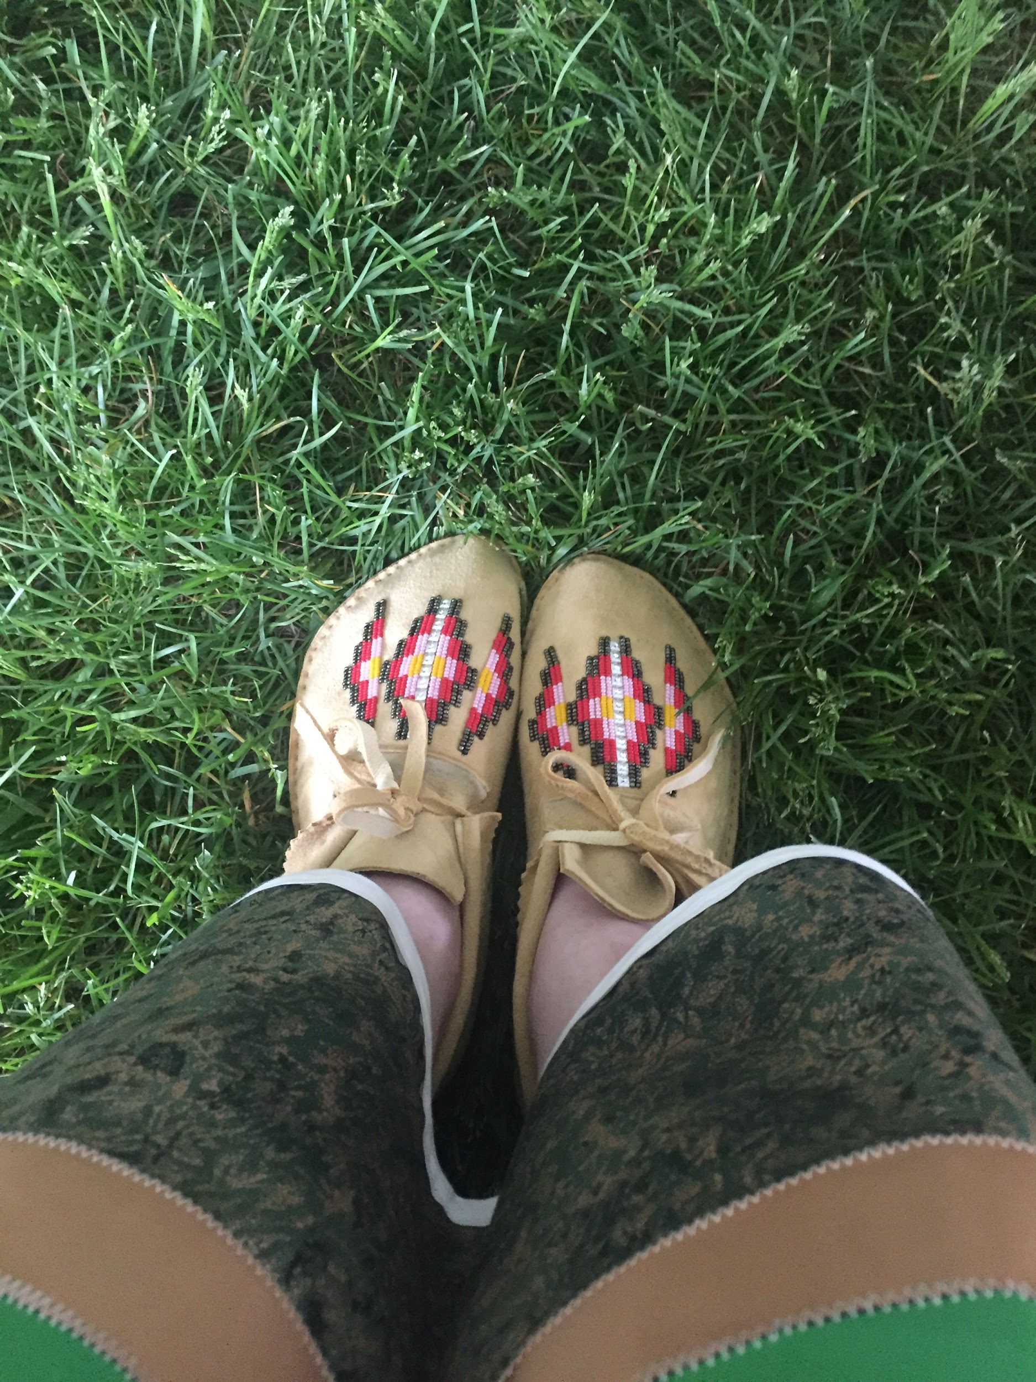
Guidance For Non-Indigenous People
Know your place. (Know where you come from. Know when to step back. Let the community take the lead.)
Have a Guide to be your touchstone. (A knowledgeable community member can centre your knowledge in a particular culture.)
You have a relationship with the people you have touched; you have no automatic “in.” (Indigenous people: it’s about who they are. Non-Indigenous people: it’s about what we do. We Are All Related, but we have to show it.)
Be there. Always. Take time. Build trust. Drink tea. Listen. Hug.
Respect: protocol for women: long skirts, moontime; ceremony: use of tobacco, abstaining from alcohol; terminology; culture/religion/secular society.
Just take it. (Take the heat even if you don’t deserve it. You may experience the kind of micro-aggressions Indigenous people experience constantly. Some Indigenous people do not feel benevolent to Europeans or people of other newcomer cultures.)
Credit:: Anne Carr-Wiggin
Notes:
Knowing your place can mean a lot of things.
It can mean knowing where you’re from. Non-Indigenous people also have a relationship with community and the land. Know what yours is. It may be far from here, or your ancestors may have been settlers. What relationship have you and your ancestors had with Indigenous people?
It can mean knowing when to step back, to listen, to not speak FOR Indigenous people but to speak WITH them, to let the community take the lead. But cherish and celebrate your learning.
Your guide is someone you can ask questions of. Your guide can help centre your knowledge in a particular Indigenous culture, which you can use to communicate with people in other cultures. For example, using my guidance on protocol to present to an Elder outside the culture where I’ve done my primary learning, I could say “I was taught to do this, is this appropriate for you, and how would you like this to happen?” without feeling. Your guide can be an Elder, but can also be someone with cultural connections who isn’t an Elder.
Being a non-Indigenous person in this world can have a lot of benefits. It’s beneficial to have a non-Indigenous person working and learning in an Indigenous culture. That bridge works in a different way from if it’s an Indigenous person reporting back to the mainstream organization.
Also know that sometimes you have to take the heat even if you don’t “deserve” it. You may experience the kind of microaggressions that Indigenous people experience all the time. Some Indigenous people do not feel benevolent towards non-Indigenous people, whether European or from other cultures.

Slide 13
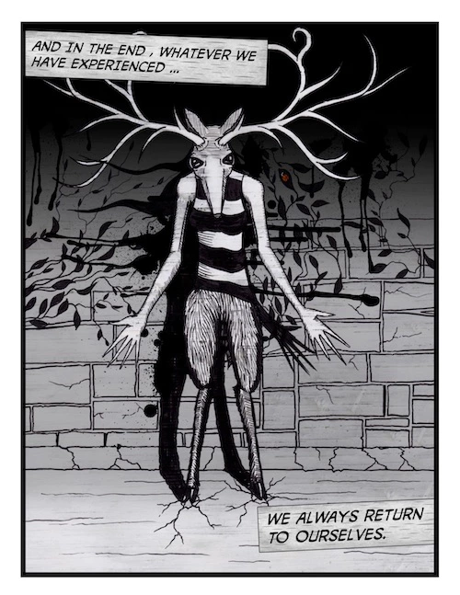
Next Steps...
Why is it important to promote culturally appropriate events?
For example:
What is happening at large institutions? Universities? Public libraries?

Slide 14
Questions?
Tanya Ball tcball@ualberta.ca
Sheila Laroque laroque@ualberta.ca
Anne Carr-Wiggin anne.carr-wiggin@ualberta.ca
Sharon Farnel sharon.farnel@ualberta.ca
Kayla Lar-Son verbicky@ualberta.ca
Gabrielle Lamontagne glamonta@ualberta.ca

Slide 15
Further Resources
CFLA Indigenous Matters Committee - http://cfla-fcab.ca/en/about/committees/indigenous_matters_committee/ and
CFLA Truth and Reconciliation Committee Report http://cfla-fcab.ca/en/indigenous/trc_report/
DDWG Final Report - http://bit.ly/2wvArQh
Elder Protocol and Guidelines. (2012). University of Alberta - https://cloudfront.ualberta.ca/-/media/ualberta/office-of-the-provost-and-vice-president/indigenous-files/elderprotocol.pdf
Blackfoot and FNMI Protocol Handbook (2013). University of Lethbridge https://www.uleth.ca/sites/default/files/2018/01/protocol_document_blackfoot_and_fnmi_approved_oct_7_2013_1.pdf
University of Calgary Cultural Protocol Guidelines (2016). http://www.ucalgary.ca/nativecentre/files/nativecentre/cultural-protocol-guideline-november-2016.pdf
Tuck, E. and Yang, K. (2012). Decolonization is not a metaphor. Decolonization: Indigeneity, Education & Society. 1(1) 1-40.
Vowel, C. Indigenous writes: a guide to First Nations, Métis & Inuit issues in Canada.

