Slide 1
Taking Away the Homework Help Challenge with ORC Curriculum Maps
Bethany Arsenault, ORC Coordinator
2017/2018

Slide 2
Q: What is the ORC?
A $1.4 million collection of curricular aligned authoritative digital resources licensed on behalf of all Alberta:
K-12 students and their parents
School Staff
Pre-Service teachers
Public Library Staff *
Funded by a yearly Grant-In-Aid from Alberta Education to The Alberta Library (TAL)
*for the purposes of supporting K-12 patrons

Slide 3
Q: Why These Resources?
Provides authoritative, age appropriate, curricular aligned content
Google and Wikipedia are the tip of the searching and information literacy iceberg
Allow students to become familiar and comfortable with the kind of resources and searching practices that are integral to 21st century learning
Are time savers once users become familiar with them
Include embedded supports for diverse learners like listen, text translation, citation tools, vetted websites, copyright friendly pictures and videos

Slide 4
Q: What’s in it for Library Staff?
Direct curricular correlations and the ability to search curricular outcomes
Curriculum mapping for:
Elementary Science and Social Studies (Published in 2016/2017)
Secondary Science and Social Studies (Will be completed in 2017/2018)
Support for diverse patrons
Access to journals like Walrus, National Geographic, School Library Journal, Men’s Health, and Maclean’s (RSS feeds can be set up)
Consistent and explicit update schedules
Access to vetted content including website to supplement print collections
Ability to create permalinks that can be posted on a website/moodle/blog or sent in an email blast

Slide 5
Q: How do I access the ORC?
Go the LearnAlberta.ca
Select English or French
Click “Online Reference Centre” in the tab along the top of the screen
In school automatic authentication should occur
Outside of school access requires a district username and password
LA___________ (username) ______________ (password)
Share your district username and password using low tech methods - do not post on an open website
Email ORC@thealbertalibrary.ab.ca for your remote username/password

Slide 6
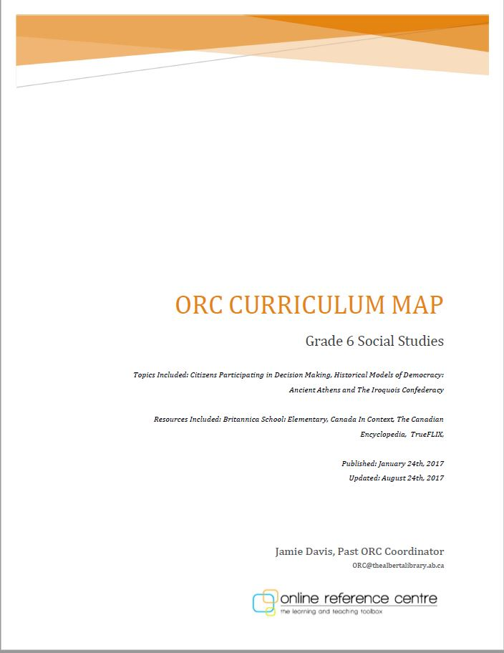
How to use an ORC curriculum map
Map ORC resources to the Alberta Social Studies and Science curricula
Once the Science and Social Studies curricula is mapped, English and Language Arts curriculum will be mapped
Each subject is colour-coded
Each map identifies the grade, subject, topics included, and resources included
Each map identifies when it was originally published and when it was last updated
Each map identifies the author of that particular map
Takes between 75-100 hours to create each map

Slide 7
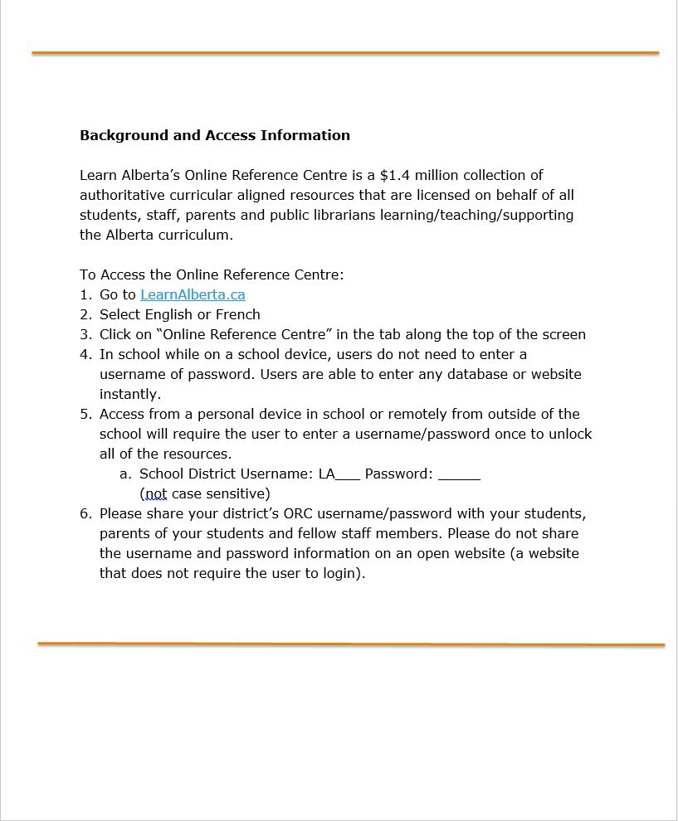

Slide 8
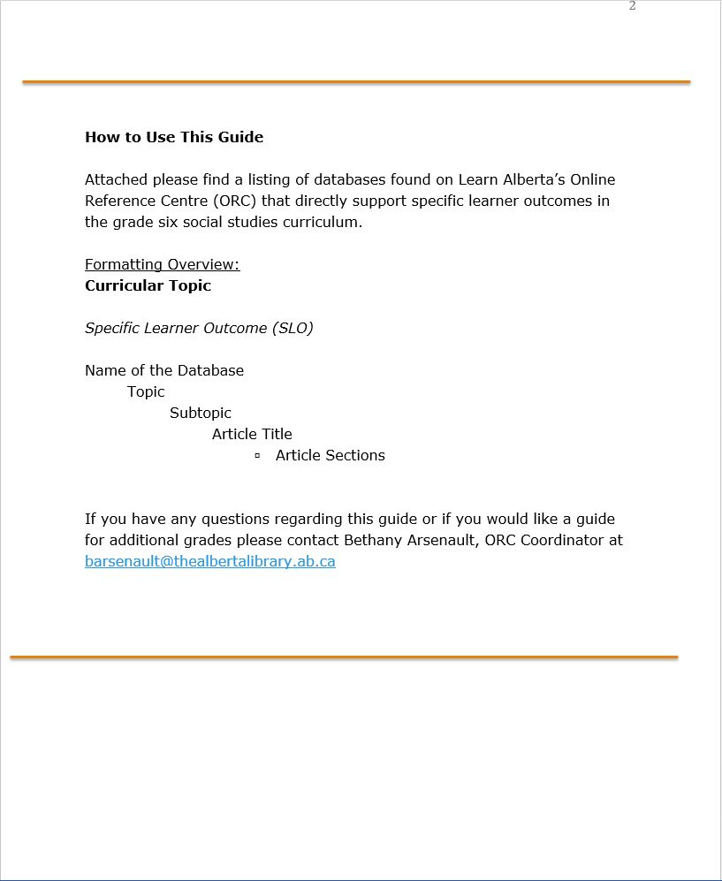

Slide 9
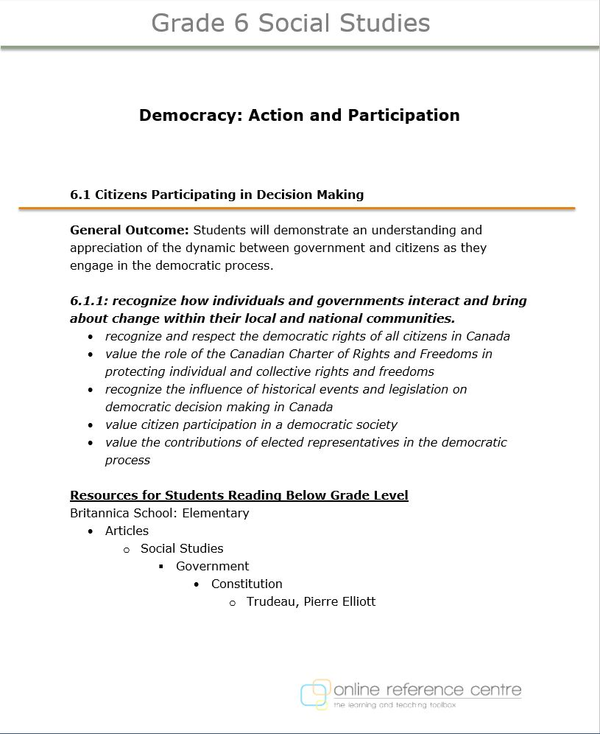

Slide 10
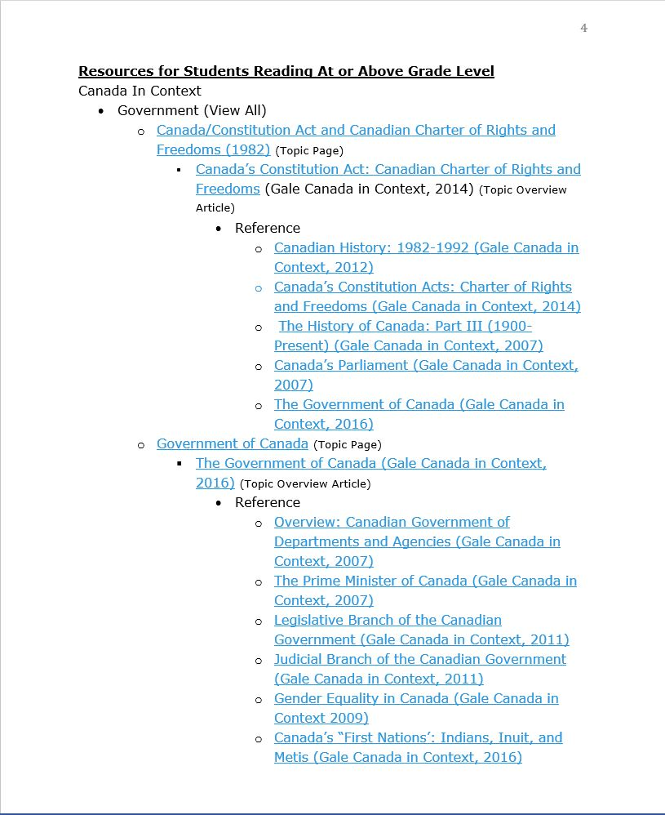

Slide 11
Literacy Development and English Language Arts
Early World of Learning
BookFLIX
TeachingBooks.net
Literature Resource Center
Academic OneFile

Slide 12
Early World of Learning
Found in Kinder Social Studies Curriculum Map
Recently added to the ORC Collection
Designed for very young learners with human voice read aloud embedded throughout
Stories, pictures, videos, songs and activities build literacy skills
Related content to Science and Social Studies curricula
Fun and interactive, works well on iPad or tablet
URL at the top of the screen acts as a permalink **only for this resource
Notes:
Early World of Learning
Top Right-Hand side of the screen
Read:
Trek’s Travels - stories about what Trek learns on his adventures. Each story includes human voice read aloud, auto play or user controlled play, related game, videos and pictures
Welcome to Reading - Additional Trek Books that are levelled from A -D. Books include all additional features (game, videos, etc.)
Know It- Explore Animals Homes, Animal Safari, Creepy Crawlies, Sea Animals, Me, Myself and I, People at Work, Plants, Rainforest Animals, Dinos, Vroom Vroom, and Weather. Each section include related pictures and videos
Play:
Put the Story in Order (ordering the story - first, second, third, and fourth events)
Concentration (digital concentration game, flip the cards to find matches)
Multiple Choice (Fill in the missing word in the sentence)
Sorting (long vowels, short vowels, middle sounds, final sounds, etc.)
Watch:
Sports and Hobbies (yoga, step aerobics, juggling, etc.)
People (police officers, teacher, firefighters, garbage truck)
Animals (numerous animal videos to choose from)
Getting Around (cars, busses, planes, etc)
Machines (backhoes, snowblowers, Tractors, etc.)
Big Ideas (shapes, colors, sizes, sounds, etc.)
Plants (plants growing, starting a garden, etc.)
Health (doctors, vaccines, senses, etc.)
Earth (seasons, weather, etc.)
Print and Do:
Blackline Masters available to print. Include colour the number activities.
Topics include: colors, numbers, letters, locations, matching, sets, shapes, sizes and time
Bottom Right-hand side of the Screen
Click on the Frog with the fly to access additional resources
Story Corner - Variety of classic stories read aloud
Nursery Rhymes - Variety of Classic nursery rhymes
Songs - Classics like Baa, Baa and Eensy, Weensy Spider

Slide 13
BookFLIX
Found in Grades 1- 3 Science and Kinder - Grade 1 Social Studies Curriculum Maps
Recommended for K-3 students
120 fiction and nonfiction book pairs (250 books total) organized into themes
Pairing fiction with related nonfiction increases student comprehension when reading both formats
Search titles by guided reading level (Fountas and Pinnell), author, grade level, theme, etc.
Lesson plans provided for each pair
Real voice audio support embedded throughout resources to allow emergent readers to navigate the resource independently
Between 1-3 follow up “puzzlers” for each pair

Slide 14
TeachingBooks.net
Not currently found in Curriculum Maps for Science and Social Studies, but will be used in the English & Language Arts Curriculum Maps
A wealth of support materials to teach and promote books in your school (book trailers, author interviews and read ins, author audio name pronunciation, QR flyers, embedded citations, book guides and lesson plans)
Share/permalink any page using the Email/Text/QR Flyer/Bookmark or Permalink features
Access Alberta specific booklists:
Pacific Northwest Library Association Young Readers Choice Award (YRCA)
ELA Authorized Novel and Nonfiction Reading List for grades 4-12
Meet-the-Author book readings in English and French
Canadian Book Award Winners/Canadian Book and Author Resources
Create and/or request a personalized booklist
Notes:
Advanced Search allows you to search:
French and Spanish resources by selection “Foreign Languages” and then French/Spanish
Specific grade ranges
Book Apps available
Features:
1) Hover over any book cover to see a listing of the resources available for that book
2) Link for requesting a personalized booklist along the right-hand side of a booklist
Alberta Specific Lists at the bottom of the homepage:
YRCA
ELA Approved
Rocky Mountain
Also at the bottom of the homepage find:
Curriculum uses
What’s New
Featured Content
New Material
Canadian Authors:
Large listing, always changing
Authors include Melanie Watt, Sigmund Brouwer, Eric Walters, Cory Doctorow, Marty Chan
Marie-Louise Gay – Canadian author
Video recording from her home, available in French or English
Can use to learn about the writing process to include in your own writing curriculum
Name pronunciation
Access her materials two ways
Bottom of the page links – share this page or email this page
Help and Training Available:
Video demonstrations that can be shared
Self-guided professional development
Contact:
Make author/illustrator suggestions
Suggest links to be included in TeachingBooks

Slide 15
Literature Resource Center
Not currently found in Curriculum Maps for Science and Social Studies, but will be used in the English & Language Arts Curriculum Maps
Gale resource that supports the grades 7-12 English and Language Arts curriculum
Read aloud feature in the top left-hand corner of every article
Text Translation to 13 languages
Highlight and take notes within the article, save to a folder without an account
Embedded citation tools (MLA 8th Edition, APA 6th Edition, Chicago 16th Edition)
Links to “Related Subjects” to support shallow searchers
Share/permalink any page using the “Bookmark” tab right side of the search bar at the top
Advanced search allows for Boolean
Save to Google Classroom, Google, or Microsoft
Notes:
Literature Resource Center
Literature Resource Center is a Gale resource. It supports the grades 7-12 English and Language Arts curriculum, as well as supporting interdisciplinary approaches, information literacy, and the development of critical thinking skills. Literature Resource Center was newly added to the 2017/2018 ORC Collection. As a Gale resource, it uses the same interface as Gale’s “In Context” databases. If users are familiar with the “In Context” databases, they can easily navigate Literature Resource Center as it shares some of the same features and functionality.
Features
Teaser “Featured Author” and “Feature Work” along the top of the homepage – vivid pictures that provide a little bit of information necessitating the students click to read more
-Featured Author – Full biography
Click-Friendly interface to help student locate information
Research shows that students are click driven in their searching – they like to click around, see visual cues to find what they are looking for
---Search for additional works
---Find criticism
---“View All” to find other featured authors
-Featured Work – Overview of work
---Look for literature criticism
---Delineated content type on right-hand side
---Provides search limiters (subjects, person – about, name of work, etc.)
---“View All” to find all featured work
Search bar at the top of the homepage allows a “Basic Search” by keyword, person, or name of work
-Not able to search by basic, intermediate, or advanced levels like the other Gale resources
“Gale Literary Index”
-Takes you to a master index of the major literature products published by Gale, providing quick and easy access to author and title listings from over 130 literature products from Gale
-Use this as a starting point to locate authors and titles
“Encyclopedia of Literature”
-Provides dictionary entry for any word entered in search box
“Person Search”
-Takes you to advanced search screen with “Person Search” selected
-Male/Female, Nationality, Ethnicity, Occupation, Literary Movement, Genre, Place of Birth
“Works Search”
-Takes you to advanced search screen with “Works Search” selected
---Male/Female, Nationality, Ethnicity, Occupation, Literary Movement, Genre, Place of Birth
“Bookmark” along the top right-hand side of the screen creates a permalink for the page
Google Classroom and Microsoft capable
Language translation on homepage (beside Google Classroom)
Within the Article
Read aloud feature in the top left-hand corner of every article
To customize the speed and colour of highlighting click on the cog image that appears when the slide out menu appears after play is pressed
Text translation in every article found on the right-hand side of the screen in the “Tools”
“Related Subjects” provided for every article
Research shows that students are very “shallow” searchers – they locate one article and think they are done
Providing related content within the article helps students move forward to find other information and also teaches additional search terms
Tools include downloadable citations, email, PDF download of article, print, highlight and notes, download MP3, and share option

Slide 16
Academic OneFile
Found in Grades 10-12 Science and Social Studies Curriculum Maps
Multidisciplinary Gale resource that supports students enrolled in an IB, AP or -30 program
Customizable read-aloud feature, articles available to download to MP3
Text Translation to 13 languages
Highlight and take notes within the article, save to a folder without an account
Embedded citation tools (MLA 8th Edition, APA 6th Edition, Chicago 16th Edition)
Links to “Related Subjects” to support shallow searchers
Share/permalink any page using the “Bookmark” tab right side of the search bar at the top
Homepage lists “Top Searches” at the bottom (right-hand side) that you can click on and see articles related to that search term
Homepage also has “Topic Finder” to help users discover the context of their search term and find connections to other terms
Notes:
Academic One File
Academic One File is a multidisciplinary Gale resource that supports students enrolled in an IB, AP or -30 program. It was newly added to the 2017/2018 ORC Collection. As a Gale resource, it uses the same interface as Gale’s “In Context” databases. If users are familiar with the “In Context” databases, they can easily navigate Literature Resource Center as it shares some of the same features and functionality.
Features
“Browse by Discipline” feature on the homepage allows browsing by:
Biology, Chemistry, Criminal Justice, Economics, Environmental Studies, History, Marketing, Political Science, and Psychology
-Clicking on each topic takes you to a further detailed list of keywords related to that topic that you can click on
-Clicking on these keywords takes you to a list of articles regarding that keyword
-On the right-hand side, you can choose view these articles by “Content Types” – Academic Journals, Magazines, News, etc.
-Can also “Search within results,” view articles based on publication date, document type, and publication title
Click-Friendly interface to help student locate information
Research shows that students are click driven in their searching – they like to click around, see visual cues to find what they are looking for
Search bar at the top of the homepage allows a “Basic Search” by subject, publication, and entire document
-You can choose the “Subject Guide Search” button or “Publication Search” button under the search bar to be taken to an advanced search page for these methods of searching
-Not able to search by basic, intermediate, or advanced levels like the other Gale resources
“Advanced Search” along the top right-hand of the homepage includes search by Peer Reviewed Journals, Publication Dates, Document Type, and Lexile reading level or Lexile score
“Bookmark” along the top right-hand side of the screen creates a permalink for the page
Google Classroom and Microsoft capable
Language translation on homepage (beside Google Classroom)
Within the Article
Read aloud feature in the top right-hand corner of every article
To customize the speed and colour of highlighting click on the cog image that appears when the slide out menu appears after play is pressed
Text translation in every article found on the right-hand side of the screen in the “Tools”
“Related Subjects” provided for every article
Research shows that students are very “shallow” searchers – they locate one article and think they are done
Providing related content within the article helps students move forward to find other information and also teaches additional search terms
Tools include downloadable citations, email, PDF download of article, print, highlight and notes, download MP3, and share option
Tips for Ease of Use
Homepage lists “Top Searches” at the bottom (right-hand side) that you can click on and see articles related to that search term
Homepage also has “Topic Finder” to help users discover the context of their search term and find connections to other terms

Slide 17
Supplementing Nonfiction Science & Health Content
Amazing Animals of the World
PebbleGO Animals
PowerKnowledge Suite
National Geographic Kids Virtual Library
Science In Context
ScienceFLIX
Teen Health and Wellness

Slide 18
Amazing Animals of the World
Found in Grades 1-3 Science Curriculum Maps
Click-friendly navigation to support young learners
Lists animals classes, orders and species
Read aloud available
Provides quick access to the “animal stats” at the top of the brief article
Links to information about animal habitat and order
Vetted weblinks that open within the database
This resource is included in the Curriculum Mapping available on the ORC Support Site

Slide 19
PebbleGO Animals & Science
Found in Grades 1 & 3 Science Curriculum Maps (Animals) and Grades 3-6 Science Curriculum Maps (Science)
Recommended for students in K-3
Easy navigation, levelled text, visual searching all designed for beginning researchers
Human voice read aloud with text highlighting, photos, videos, audio clips to enhance learning and engage learners
Articles segmented into brief sections with tab navigation at the top of the screen
One or two videos that align with the article to help activate/develop background knowledge of the topic

Slide 20
PowerKnowledge Suite
Recommended for grades 1-6
Content divided into 3 databases: Earth & Space, Life Science, and Physical Science
Includes a customizable read-aloud feature
Short, segmented articles with introductory videos to build background knowledge
Embedded science experiments, projects, and educational games related to the content of the database
Aligns with 95% of the grade 3-6 science curriculum and 87% of the grade 1-6 science curriculum

Slide 21
National Geographic Kids
Virtual Library
Found in Grade 3 Science Curriculum Map and Kinder, Grade 1, and Grade 4 Social Studies Curriculum Maps
Authoritative nonfiction content
Award-winning maps and photos
200 National Geographic Kids Books
500 Kid-friendly downloadable images
National Geographic Kids Magazines (2009-Present, 3 month embargo)
Includes listen feature

Slide 22
Science In Context
Found in Grades 5 – 12 Science Curriculum Maps and Grade 4 Social Studies Curriculum Map
Featured videos, news, and stories on homepage
Customizable read-aloud feature, articles available to download to MP3
Text Translation to 13 languages
Highlight and take notes within the article, save to a folder without an account
Embedded citation tools (MLA 8th Edition, APA 6th Edition, Chicago 16th Edition)
Links to “Related Subjects” to support shallow searchers
Share/permalink any page using the “Bookmark” tab right side of the search bar at the top
Advanced search allows for Boolean, and content selection (Advanced/Intermediate/Basic)
Search specific learner outcomes in “Curriculum Standards” for the Alberta Science curriculum - embedded links to the article included

Slide 23
Teen Health and Wellness
Currently not found in any of the Science or Social Studies Curriculum Maps, but does support Grades 7-12 Health Curriculum
Straightforward discussion of all teen health and wellness topics with links to the Alberta science, foods, health and CALM curricula
Customizable listen feature and text translation
Sectioned articles with links to related articles for shallow searchers
Embedded citations (MLA 8th Edition, APA 6th Edition, Chicago 16th Edition)
Many interactive features that allow students to interact and contribute:
Student polls on current topics
Share personal stories and read stories from other teens
Create and submit videos on various health and wellness topics
Submit questions to Dr. Jan and receive answers back
Alberta/Canada specific hotlines

Slide 24
Supplementing Nonfiction Humanties Content
Canada In Context
Global Issues In Context
World History In Context
Culturegrams
The Canadian Encyclopedia

Slide 25
Canada In Context
Found in the Grades 10 – 12 Science Curriculum Maps and Grades 4 – 12 Social Studies Curriculum Maps
Canadian content not only for Social Studies but also Science (i.e. Alberta Oil Sands)
Featured videos, news, and stories on homepage
Customizable read-aloud feature, articles available to download to MP3
Text Translation to 13 languages
Highlight and take notes within the article, save to a folder without an account
Embedded citation tools (MLA 8th Edition, APA 6th Edition, Chicago 16th Edition)
Links to “Related Subjects” to support shallow searchers
Share/permalink any page using the “Bookmark” tab right side of the search bar at the top
Advanced search allows for Boolean, and content selection (Advanced/Intermediate/Basic)
Search specific learner outcomes in “Curriculum Standards” for the Alberta Social Studies, ELA and Science curricula - embedded links to the article included
Notes:
1. In the "Advanced Search" directly under the search bar, you can perform Boolean searches, select content type, limit by dates and document types. However, you can also select the level of content - basic, intermediate or advanced. This can be very helpful when you are searching for the same content for different reading abilities. 2. You can search for specific learners outcomes from the Alberta curriculum in the "Curriculum Standards" tab along the top grey links bar? Curriculum alignments are available for grades 6-12. 3. You can access short tutorials for uses these resources in the "Resources" link beside the "Curriculum Standards" along the top grey links bar.
4. There are many features within every article to support diverse learners. To access these features start with the toolbar along the right-hand side of the screen. The "Bookmark" feature provide a permalink to the article. When you share this link via email or on your website it allows visitors to open the link without authenticating.
All articles can be downloaded to HTML or PDF
You can share all articles using 284 services including, but not limited to Twitter, Delicious, Google, and LinkedIn.
The citation tools provide MLA 7th Edition or APA citations that can be exported directly into 3rd party software like Endnote, ProCite, Reference Manager or RefWorks. However, your school does not have to subscribe to citation software to benefit from the citation tools. You can simple download the citation and copy/paste it into your works cited page.
Emailing and printing options are also available for every article.
The dictionary option allows you to search the dictionary. Users can hear the definition read to them since there is a read-aloud feature included in the dictionary.
Lastly, all articles can be translated into 13 different languages including, but not limited to French, Arabic, Spanish, and German.
5. The other feature in every article that is often overlooked is the "Listen" feature. The listen feature is customizable, and clicking on the image of the cog allows users to select text highlighting options, word colour, sentence colour, rate of reading speed, etc. These databases also allow users to download the articles to an MP3 format by clicking on the down arrow beside the cog.

Slide 26
Global Issues In Context
Found in Grades 10 – 12 Science and Social Studies Curriculum Maps
Excellent support for the Grade 10-12 Social Studies Curriculum
Featured videos, news, and stories on homepage
Customizable read-aloud feature, articles available to download to MP3
Text Translation to 13 languages
Highlight and take notes within the article, save to a folder without an account
Embedded citation tools (MLA 8th Edition, APA 6th Edition, Chicago 16th Edition)
Links to “Related Subjects” to support shallow searchers
Share/permalink any page using the “Bookmark” tab right side of the search bar at the top
Advanced search allows for Boolean, and content selection (Advanced/Intermediate/Basic)
Search specific learner outcomes in “Curriculum Standards” for the Alberta Social Studies and Science curricula - embedded links to the article included
Notes:
Homepage:
Featured video and World News links on the right-hand side
Browse topics – provides a few key topics with a few articles within each
“Browse Topics” in the link bar at the top of the screen:
Provides links to all of the different topics organized alphabetically
Clearly identifies which topics have been recently updated or are newly added
Topic Page:
1)Information organized into Features, Reference, News, Statistics, etc.
2) Quick links for the topics can be found on the top right-hand side of the screen
3) Customize listen feature with highlighting and speed options (Click on listen and click on the cog)
4) Download to MP3 in the listen box – somewhat hidden
World Map:
Allows you to search the world map for a variety of predetermined topics
Enter your own search criteria and have results displayed on the World Map
Click on the pin in the location to access the related articles
Global Issues Blog:
Links to lessons plans, ideas for student collaboration
Most frequently blogged about countries are larger font along the right hand side like an embedded wordle
Access the blog archives along the right hand side
Sign up for an RSS feed to this blog
Research Tools:
Links to search tips, homework helpers and guides for getting started with research, etc.
Educator Resources:
Includes search tips, curriculum standards, lesson plan builder, research guides, etc.

Slide 27
World History In Context
Found in Grades 10 – 12 Science Curriculum Maps and Grades 7 - 12 Social Studies Curriculum Maps
Excellent support for the grade 8 social studies curriculum
Featured videos, news, and stories on homepage
Customizable read-aloud feature, articles available to download to MP3
Text Translation to 13 languages
Highlight and take notes within the article, save to a folder without an account
Embedded citation tools (MLA 8th Edition, APA 6th Edition, Chicago 16th Edition)
Links to “Related Subjects” to support shallow searchers
Share/permalink any page using the “Bookmark” tab right side of the search bar at the top
Advanced search allows for Boolean, and content selection (Advanced/Intermediate/Basic)
Search specific learner outcomes in “Curriculum Standards” for the Alberta Social Studies curriculum - embedded links to the article included

Slide 28
Culturegrams
Found in Grades 2 – 5 and 10 – 12 Social Studies Curriculum Maps
Kids Edition - excellent support for gr. 3 & 5 Social Studies
Provinces Edition - supports gr. 2 & 4 5 Social Studies
World Edition - supports gr. 10-12 Social Studies
Updated every 6 months and written/reviewed by in-country consultants
Features included: customizable read-aloud, photo gallery, slideshows, videos, famous people, and cultural recipes
Tools included: build-your-own graphs and tables, pre-generated graphs and tables, distance calculator, and currency converter

Slide 29
The Canadian Encyclopedia
Found in Grades 10 – 12 Science Curriculum Maps and Grades 2 – 12 Social Studies Curriculum Maps
Free website provided by Government of Canada
Change from English to French at the top right-hand corner of every page
New updated interface - much more aesthetic and functional
Multiple pathways to finding content
View personal accounts from veterans, view videos, articles, image and digital exhibits
Articles include information about the author, publication date, editor, and edit date
Embedded citations (MLA 7th Edition, APA 6th Edition, Chicago 16th Edition, Turabian)
Wealth of Canadian content to support Social Studies grades 9-12
Historica link at top left-hand side includes Citizen Challenge, immigration stories, etc. for grade 9
Notes:
Left-Hand Side of Homepage When you click on the Historica Canada icon in the top left-hand corner of the homepage a menu of options will drop down. Here you will find: -“Historica Canada" search programs, videos (Heritage Minutes, Parodies, Radio Minutes, and Memory Project Archives), polls, media and education resources on this page.
-“Aboriginal Arts and Stories" is the largest art and creative writing competition in Canada for Aboriginal Youth. Explore past winners artwork and writing, or create your our submission. This competition is currently open.
-“Citizenship Challenge" Although this competition is expired it remains a wonderful idea for a class project.
-“Encounters with Canada" Canada's largest youth forum.
-“Got a Minute" Access heritage minutes about a variety of Canadian historical events. The most recent one is about Sir John A. Macdonald and Confederation.
-“My Park Pass" Designed for grade 8 students, classes create and submit videos that highlight the national park system in their area. Once submitted, visitors to the website can vote on their favorite video. Voting has commenced and will remain open until March 24, 2014. The winning class receives a trip to British Columbia.
-“Passages Canada" is a storytelling initiative that compiles the personal accounts of cultural identity and heritage from volunteers around Canada. Stories are organized into themes like Adjusting to Life in Canada, Human Rights & Social Justice, Multiculturalism & Diversity, etc. -“The Memory Project" shares stories of service and sacrifice. Access images of artifacts and personal stories from Korea, WWI, and WWII, in addition to peacekeeping missions. In the middle of this page, you can click on the Image Gallery which includes a searchable image gallery. Along the top of the Image Gallery homepage you will see a link for Inside the Classroom. Access a variety of lesson plans including, but not limited to Putting a Face on Remembrance, Passchendaele, Women and the War, Dieppe, and more.
-“Toronto in Time" offers tales of the city told in words and image. This may not necessarily be all that applicable for us in Alberta, but it is available nonetheless. -“War of 1812" provides a wealth of content for teaching the War of 1812. This page includes an interactive Timeline, Classroom Resources (themed activities, guide downloads, guide supplements, external resources), and Heritage Minutes related to the War of 1812.
Right-Hand Side of Homepage
Click on the Learning Centre to access study guides and a searchable timeline. You can also change the language from English to French and French to English by clicking on EN/FR on the very right-hand side of the screen at the top.
Centre of Homepage
The centre of the homepage allows for a traditional search, but also provides content organized into 4 themes
-Events - Holidays, Political, Weather Phenomena, Historical, etc.
-People - Explorers, French Canadians, Politicians, Women, Scientist & Technologists, etc. -Places - Cities, Provinces & Territories, Parks & National Historic Sites, Geography, etc.
-Things - Agriculture, Innovations & Technology, Environment, Politics, Sports, etc.
Just under the search bar you will find quick access to the Exhibit (a digital themed exhibit like Black Freedom Fighters, Human Rights, The Korean War, etc), Your Canada (an interactive map that allows you to read and share your Canadian story), as well as a searchable Today in Canadian History timeline.
Bottom of Homepage
At the very bottom of The Canadian Encyclopedia homepage you will find three columns with links to Popular (WWII, Confederation and Fur Trade), Recommended (Urban Music, Quebec Values Charter and Natural Regions) and Latest (Norval Morrisseau, Queen Mother and Martin Picard) content.
Within the Article
When you open an article you will immediately notice how clean the text is. Even though there is not an embedded listen feature, for those students who are not able to read it or who prefer to have it read aloud the clean text should make it very readable for a program like Naturalreader. You will also notice that words within articles are red. These words link to additional information - a great way to stretch and deepen learning! In addition, you will notice a box at the top right-hand side of the article that provides information on who wrote and revised the article, when it was published and last edited. Just below that information users will find a searchable table of contents, suggested reading, related articles and links. And if that was not enough, there is also citation information available for every article. Located between the share and save icons at the very bottom of the table of contents is the open quotation mark which provides citations in 4 different styles.

Slide 30
Multidisciplinary Resources: A Jumping Off Point to Research
Britannica School: Elementary
Britannica School: Middle
Britannica School: High

Slide 31
Britannica School: Elementary, Middle, High
Found in Grades 3 – 6 Science Curriculum Maps and Grades 4 – 7 Social Studies Curriculum Maps
Recommended for students in grades K-6 (Elementary), students in 6-8 (Middle), and has content to prepare students for college-level research (High)
Britannica Learning Zone designed for grades PreK-2
Offers play-based activities for learning colours, geography, numbers, shapes, how to tell time, and vocabulary
Canada In Focus section devoted to articles about significant Canadian people, places, and history
3 reading levels allow users to change level while maintaining age appropriate interface
Embedded read-aloud feature and font adjustment
Text translation for 100 languages
Seamless access on tablet, smartphone, laptop or desktop
Educator tools including lesson plan builder

Slide 32
Support for Using the ORC
ORC Support Site
ORC Listserv
Links
Contact

Slide 33
ORC Support Site
www.onlinereferencecentre.ca
Resource training materials - podcasts, videos, archived webinars, TwitterChats, and guides
Information about upcoming free ORC PD opportunities
Information about province-wide resource trials and surveys
Online booking system for ORC sessions
Calendar of ORC Events
Links to ORC Twitter, YouTube, and Facebook accounts

Slide 34
ORC Listserv
Weekly email updates powered by MailChimp and organized by grade level:
New resources and features
Province-wide trials
Surveys
Free PD opportunities
No emails during school breaks
Email ORC@thealbertalibrary.ab.ca or visit the ORC Support Site to join today

Slide 35
Links to Check Out
ORC Support Site
www.onlinereferencecentre.ca
ORC Listserv
http://eepurl.com/cgred5
ORC Facebook
www.facebook.com/OnlineReferenceCentre ORC Twitter
https://twitter.com/ORC_AB
ORC YouTube
https://www.youtube.com/channel/UC0KNbdjEt6OwuTsXvfhUnFg

Slide 36
Contact
For more information or to schedule a school/library presentation contact
Bethany Arsenault, ORC Coordinator
Call 780-414-0805 Ext. 236
OR
Email barsenault@thealbertalibrary.ab.ca

Slide 37
Questions?

