Slide 1
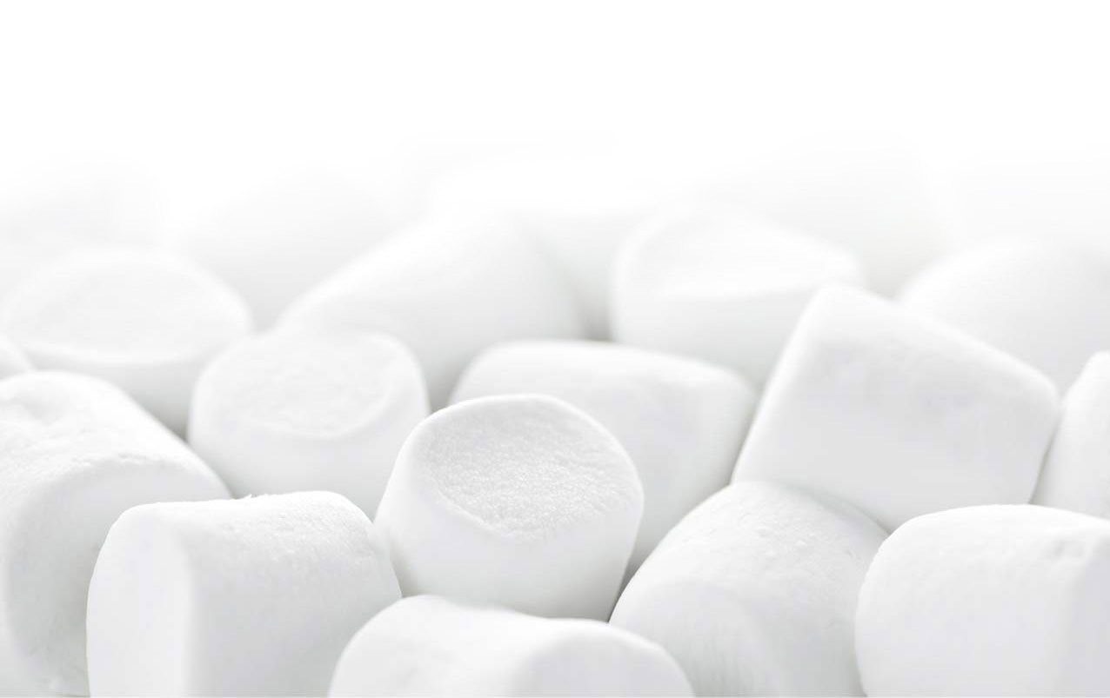
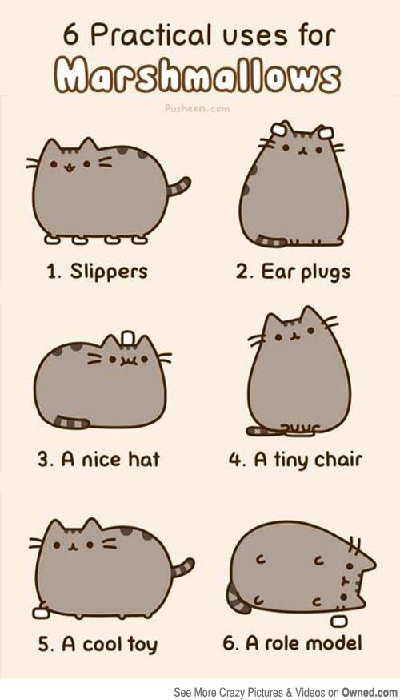
Spaghetti, Marshmallows, and Teamwork!
Hannah Loewen & Kerby Salberg

Slide 2
Ten Things…
Find 10 things you have in common with every other person in your group
Avoid the obvious! (eg “we all have a nose”)
Have one person record your group’s list
Let’s compare!
Notes:
Kerby

Slide 3
Goal
Build the tallest freestanding structure using the follow supplies:
Notes:
Kerby

Slide 4
Rules
You have 18 minutes to complete the challenge
The structure cannot be suspended
The entire marshmallow must be on top
Use as much or as little of the kit as you want
You can break up the spaghetti, string or tape
Notes:
Hannah:
Build the Tallest Freestanding Structure
The winning team is the one that has the tallest structure measured from the table top surface to the top of the marshmallow. That means the structure cannot be suspended from a higher structure, like a chair, ceiling or chandelier.
The Entire Marshmallow Must be on Top of the structure. Cutting or eating part of the marshmallow disqualifies the team.
You may use as much or as little of the kit as you want. You do not have to use up all the supplies. The team cannot use the paper bag as part of their structure.
Teams are free to break the spaghetti, cut up the tape and string to create new structures.
The Challenge Lasts 18 minutes
Teams cannot hold on to the structure when the time runs out. Those touching or supporting the structure at the end of the exercise will be disqualified.
Ensure Everyone Understands the Rules
Don’t worry about repeating the rules too many times. Repeat them at least three times. Ask if anyone has any questions before starting.

Slide 5
Ready… Set… Go!
Notes:
Start the countdown clock and the music with the start of the challenge.
Walk around the Room
It’s amazing to see the development of the structures as well as notice the patterns of innovation most teams follow.
Remind the Teams of the Time
Countdown the time: Call 12 minutes, minutes (half-way through), 7 minutes, 5 minutes, 3 minutes, 2 minutes, 1 minute, 30 seconds and a ten-second count down.
Call Out How the Teams are Doing
Let the entire group know how teams are progressing. Call out each time a team builds a standing structure. Build a friendly rivalry. Encourage people to look around. Don’t be afraid to raise the energy and the stakes.
Remind the Teams that Holders will be Disqualified:
Several teams will have the powerful desire to hold on to their structure at the end. Usually because the marshmallow, which they just placed onto their structure moments before, causing the structure to buckle. The winning structure needs to be stable.
After the clock runs out, ask everyone in the room to sit down so everyone can see the structures. Likely, just over half the teams will have standing structures.
Measure the Structures
From the shortest standing structure to the tallest, measure and call out the heights. If you’re documenting the challenge, have someone record the heights (eg. Flipchart).

Slide 6
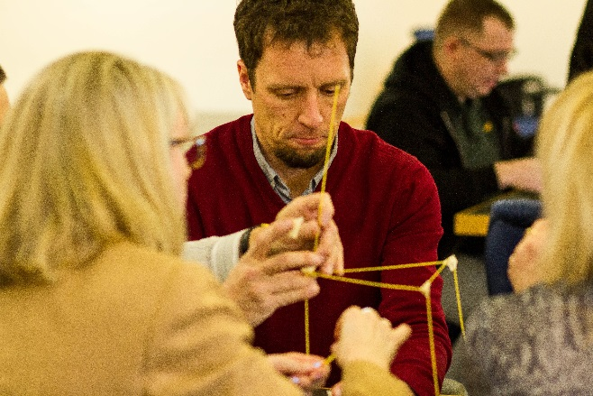
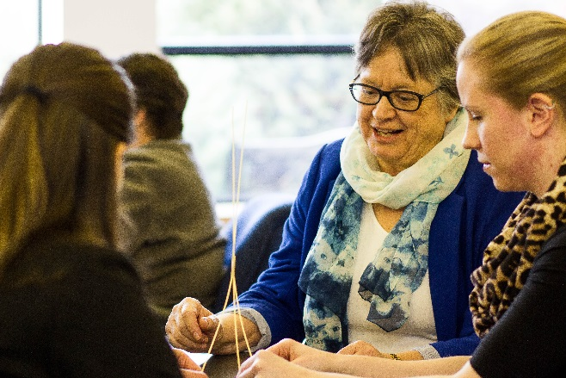
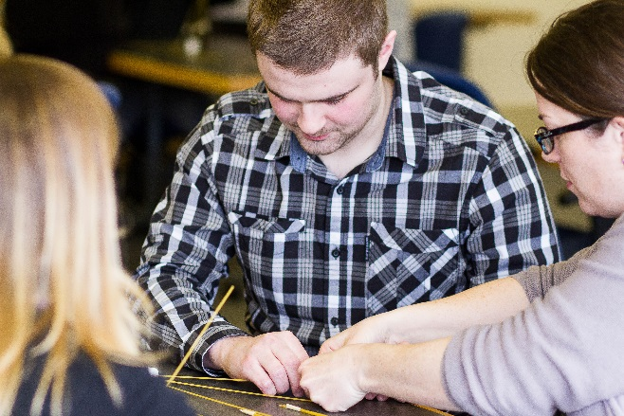
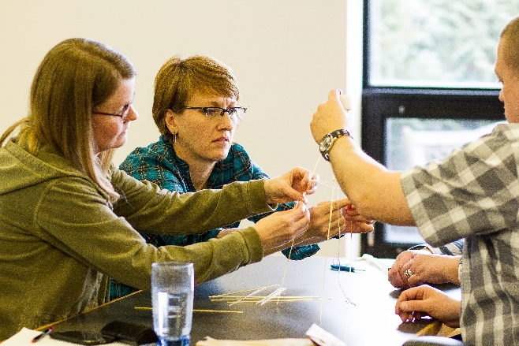
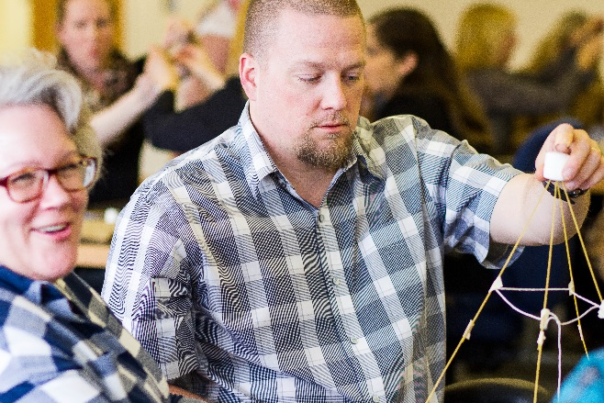
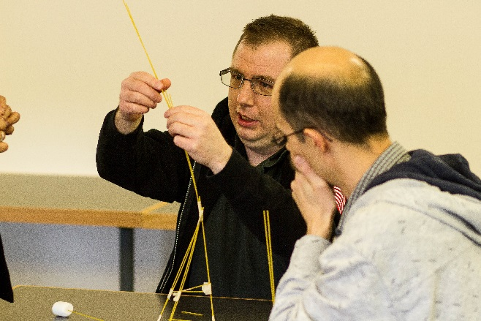
Ta-Da!
Notes:
After the clock runs out, ask everyone in the room to sit down so everyone can see the structures. Likely, just over half the teams will have standing structures.
Measure the Structures (Hannah)
From the shortest standing structure to the tallest, measure and call out the heights. If you’re documenting the challenge, have someone record the heights (Kerby) (eg. Flipchart).

Slide 7
And the winner is…
Notes:
Kerby:
Identify the Winning Team
Ensure they get a standing ovation and a prize (if you’ve offered one).

Slide 8
What do you think?
Did it go as you expected?
Did anyone take charge?
Did anyone disagree with your plans/procedures?
How did you resolve conflict?
How soon did you start building?

Slide 9
The TED Talk
Tom Wujec: Build a tower, build a team

Slide 10
Final Thoughts…
Did you have fun?
Did you make any new friends? (hopefully no enemies!)
What insights can you take home following this exercise?
How will this impact your approach to working with your colleagues or interacting with your peers?

