Slide 1
physical Literacy
linking literacy
Mitzi Fortin – community librarian – lumby branch - ORL

Slide 2
How it came to be
There was a gap in programming for the kids who were not ready for preschool so I was
Approached by the facilities supervisor and asked if there was something the library could
do with programming for this group

Slide 3
This had to be something more than we were offering
these kiddos are not prepared to sit and listen to directives. Parents did not attend the regular story times as they believed their children would not sit through them. They wanted an active program.
There had to be a creative way to bridge the gap

Slide 4
I was a school trustee for 4 terms, I KNEW ABOUT AND had worked with the edi - early developmental instrument.
I did some research using the edi
Found 25% of the students entering kindergarten in our AREA schools were not meeting the average standard in physical, emotional, social, language and communication,

Slide 5
i thought if I could combine participation stories and gym time that could be the key
AROUND THAT same time, The preschool teachers were going to A FUNDAMENTAL MOVEMENT SKILLS WORKSHOP and asked if I wanted to come too. THAT was THE KEY I needed to set the direction for the new program.

Slide 6
I WAS already DOING THE STORY TIME PORTION
ALL I NEEDED WAS TO FIGURE OUT HOW TO LINK STORY TIME LITERACY TO THE PHYSICAL COMPONENTS.
WE DO USE RHYMES AND SONGS SO THAT PART WAS AN EASY WORK IN and a start for physical activity

Slide 7
So how do we define physical literacy?
Active for life states that “it is when kids have developed the skills, confidence, and love of movement to be physically active for life.

Slide 8
THe WORKSHOP WAS UNDER THE COACHING ASSOCIATION OF CANADA AND confirmed gaps existed
It was confirmed at THE workshop, that children who are not exposed to the basics of sports do not participate.

Slide 9
We want to create healthy active kids
By using a combination of structured and unstructured play we can help children learn to move to the best of their ability. This will help to instill in children:
confidence
skill development
fun, team play and cooperation
respect
inclusiveness

Slide 10
If you can’t…

Slide 11
Linking literacy was born
I felt we could make a difference and make it fun for the kids
I brought together some ideas for programming AND TALKED TO THE BUILDING AND PROGRAMS MANAGER
The name was actually coined by the building supervisor

Slide 12
Ensuring confidence for all
By modifying games and activities so that they are appropriate for each child’s ability level, they ensure the child has fun and achieves success which builds confidence.

Slide 13
Inclusive for all
Inclusiveness is learned by children when we bring children of all abilities and backgrounds together to engage in the same activities.

Slide 14
Cooperation, team work and fun
These qualities develop when each child contributes in the activity, has success and feels valued by the group, by playing games that require a group effort and cooperation. This naturally leads to fun.

Slide 15
the village as well as the regional district partnered with the library.
They supply the hall next to the library for the physical portion for free.

Slide 16
With the hall came some sports equipment
Unfortunately the equipment was well used, not enough for all the children who attended my program and much of it broken.

Slide 17
In a village you know many people and the ladies at the post office put a flyer about a grant in my post office box, thinking the library could use the funding
It was for the Canada post community foundation grant

Slide 18
My Public services director was receptive to the idea
I wrote the grant and sent it for her approval and input.

Slide 19
We received notification that we were successful

Slide 20
We now have the equipment we need to run the program for over 20 children
We have balls, bean bags, spot markers, cones, hoops and a versatile obstacle course.

Slide 21
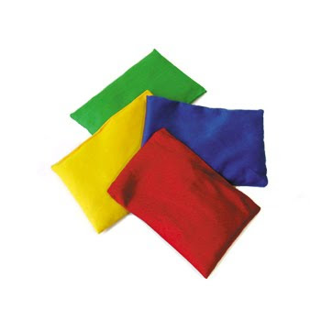
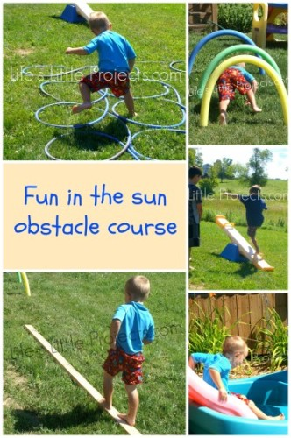
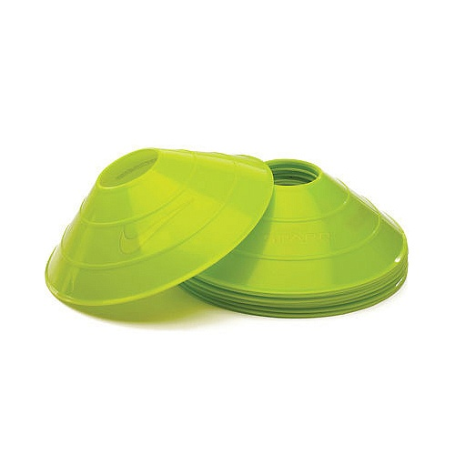
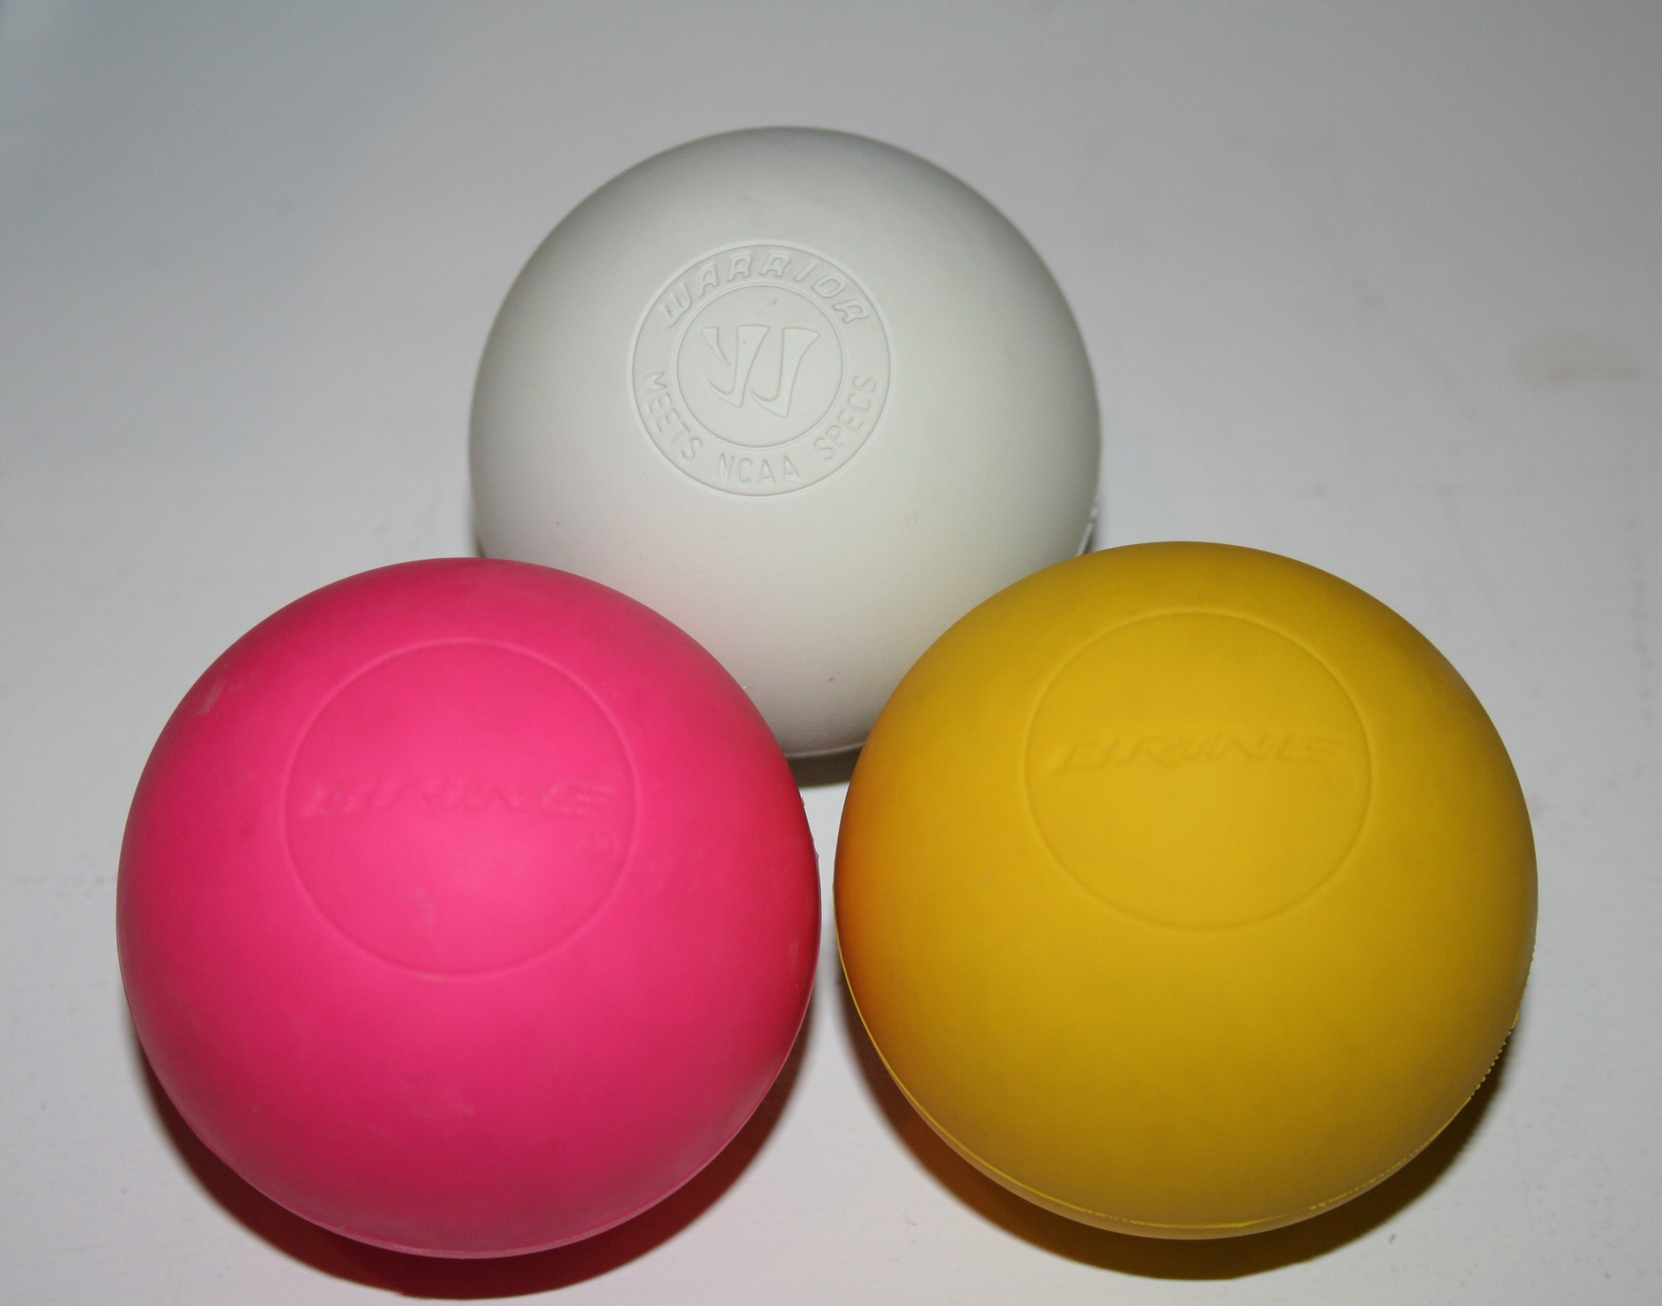
Similar to these:

Slide 22
The program offers early learners the opportunity to learn pre reading skills as well as physical literacy skills
Through the use of stories and sports resources, children will be learning the concepts of direction, color, balance, pre reading, taking turns, patience, sport readiness and socialization.

Slide 23
My programs consist of:
25 minutes of participation stories, rhymes and songs

Slide 24
Lots of movement
And repetition, Not only in the songs, rhymes and actions as I soon found out

Slide 25
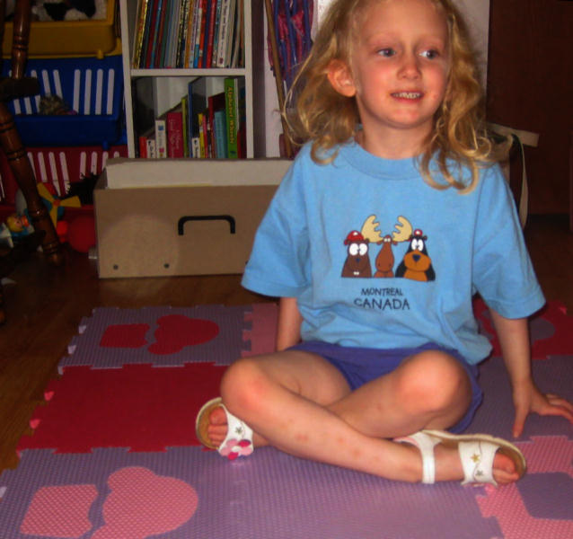
We always start like this
Criss cross applesauce
This is the way the preschool and kinder-
Garten classes would like the kiddos to sit

Slide 26
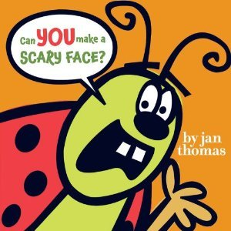
Use Stories such as:
This book begins with “hey you. Yes I’m talking to you. Stand up!”
How can we not participate?

Slide 27
That is exactly what we are looking for in a story; One that gets our kiddos listening and waiting for direction.
The children do exactly as the book suggests…and so do I. This part is important as well!

Slide 28
If there is a number in the book
I ask can you show me the number with your fingers? Remember this needs to be an action packed program. we count showing it with our fingers. Modelling what I ask shows those who may not know. It also shows that we all participate.

Slide 29
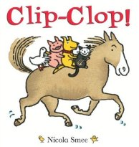
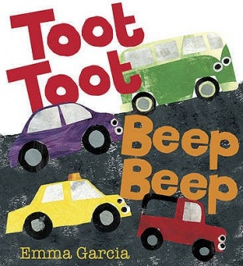
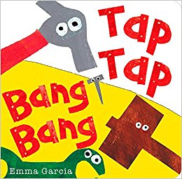
We love stories like

Slide 30
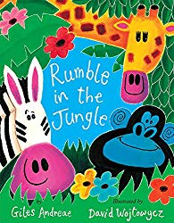
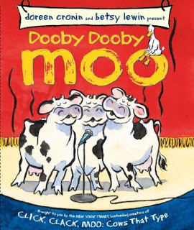
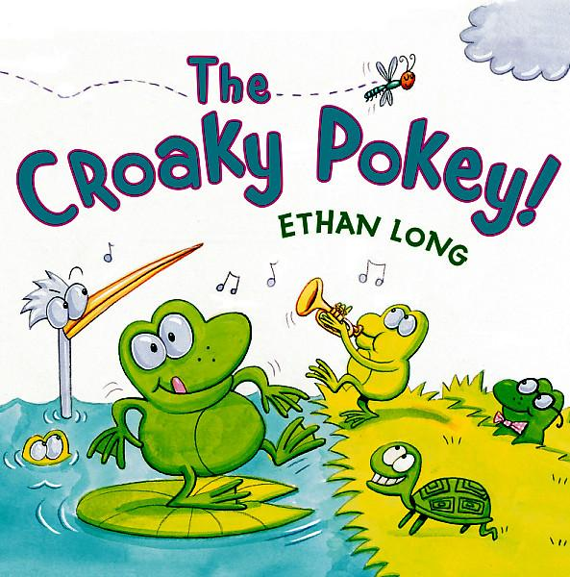
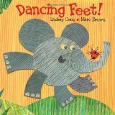
And these:
This Photo by Unknown Author is licensed under CC BY-NC-ND
This Photo by Unknown Author is licensed under CC BY-ND
This Photo by Unknown Author is licensed under CC BY-NC
This Photo by Unknown Author is licensed under CC BY-SA-NC
This Photo by Unknown Author is licensed under CC BY-SA

Slide 31
Actions, Rhymes and songs between might be
I incorporate the spot markers into story time:
This is a circle, a circle, a circle
This is a circle and it is ………….(children say the colour)
I might do this with 3 different colours and then repeat it once more during the story time portion.

Slide 32
Others may be:
Climb up on my rocket ship
We’re going to take a little trip.
Are you ready for the count down?
3, 2, 1 ……….blast off.
Here is a bunny with ears so funny
And here is a hole in the ground.
When a noise he hears, he picks up his ears
And jumps in the hole in the ground
(this can be done with fingers or sitting on the floor using our arms and legs)

Slide 33
Rhymes and songs get us up and moving too
Head and shoulders

Slide 34
The hokey pokey is a favorite
We are fortunate that our book spinners are all on rollers to accommodate our space needs.

Slide 35
So that covers the story portion! participation stories, combined with action rhymes AND/or songs with a bit of number, colour and alphabet learning thrown in.

Slide 36
Gym time is the physical literacy
I set up the hall so that we have stations to go to. It keeps the children and myself more organized.
I am fortunate to have story boards with stands to designate stations
It also gives me the cues I might need as reminders.

Slide 37
This is what the gym looks like

Slide 38
And a couple of stations:
Starting station is always:
This is the fruit salad

Slide 39
Roll a ball station

Slide 40
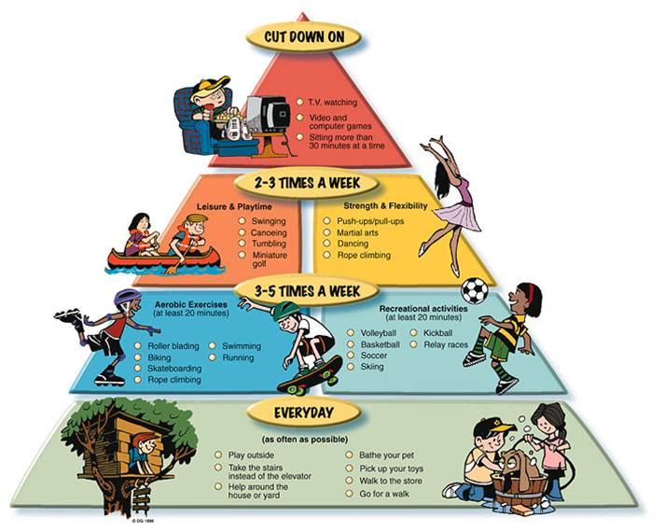
Active for life programs
There are so many great resources available
To help us get up and get moving.

Slide 41
Activeforlife.com
I was able to utilize the 3 – 5 year old programs from this site and fill in with my own as
Needed.

Slide 42
A session on balance might look like this:
Introduction (2 – 3 minutes)
Take the children to the hall and begin at the criss cross applesauce station
I start with them sitting along a wall so that they can all see me.
In about 30 seconds I explain that we will be learning and practicing balance.

Slide 43
I might ask. Does anyone know what balance is?
Usually someone wants to demonstrate. So I just say thank you. That is correct…it is when you don’t fall over. If you stand on one foot you balance so you stay up and not fall down.

Slide 44
Remember to keep everything simple
Always be positive and sometimes funny i.e. wobbling when you are showing balance

Slide 45
We are going to play a game called traffic light
Give yourself 5 to 8 minutes to explain and do this station
Hold up the green spot marker and ask what colour is this? Repeat yes it is green (for the benefit of the little ones who are just learning the colours.)
Every moment is a teaching and learning moment
Hold up the red spot marker and ask the same, repeating again
And finally hold up the yellow spot marker and go through the same process

Slide 46
Green means walk red means stop and stand on one foot yellow means hopping on the spot
we are following in a line around the hall, like a train.
I hold the spot markers high so all can see and also I do the actions.
I might choose a leader that we all follow after everyone has the hang of what we are doing and I call out the colour they hold up because my voice is louder

Slide 47
The red spot marker is the balance portion
Standing on one foot and count to 2
You can expand on this to count to 5
And if the kids are really keen count to 10

Slide 48
Next station…frOGGY HOP
This station will take 5 to 8 minutes

Slide 49
This is done to a song and actions
I get the group to sit along the wall
I explain that they are to copy the actions I do
Each child is given a bean bag
These are the frogs
The frogs want to hop…they can hardly wait to hop

Slide 50
Song and action for this balance station
Froggy is hopping
Froggy is hopping on my toes, on my toes, on my toes. (place the bean bag on our toes)
Froggy is hopping on my toes…..ribbit
Froggy jumped to my knee!
Froggy is hopping on my knee, on my knee, on my knee.
Froggy is hopping on my knee…..ribbit
Repeat on to tummy, shoulder and head.
Then the frog hops to the ground and hops away.

Slide 51
We may do this twice so that children experience the success of balancing the bean bag
I will remind them to keep still once they balance their frog.
Use positives such as great job everyone.
Look at those frogs sitting so still

Slide 52
Next station…circus
I place masking tape on the floor in a straight line – it is our tight rope
I explain that we are in a circus.
Our rope goes from the roof of one building to the roof of another building
Look at all the people who came to see us

Slide 53
I then ask them to watch me
Watching with your eyes and not following
I first hold my bean bag in my hand, arms out to your sides and show them balancing as I walk across the tight rope
Remind them to Keep you arms out for balance
One foot in front of the other
Now let us watch the other tight rope walkers
Each take turns just walking across and we clap

Slide 54
Next we add the balanced bean bag
I place the bean bag on my head and ask the group to copy me.
Let’s take a practice walk across the room with the bean bag balanced on our heads
Then we each take a turn walking the tight rope with the beanbag on our heads
Positive encouragement
Help those having difficulty

Slide 55
Balance a bean bag on your head and walk to the other wall

Slide 56
Once we have touched on balance and the children get the hang of that
We can introduce catching the beanbag

Slide 57
Next station might be fruit salad
I place 4 hoops around the activity space
The colours are the colours of my beanbags – red, blue, yellow and green
I hand out the bean bags
I show them how to toss and catch the beanbag
I explain we do not throw it way up, we want it to be more like popcorn so it hits our hands and we toss it up a little way

Slide 58
I have to explain about the fruit next
I tell the children that if you have a red beanbag I want you to come over to the red hoop – this is the fruit bowl and you are red cherries
I tell the children that if you have a blue beanbag I want you to come over to the blue hoop – this is the fruit bowl and you are the blue berries
I tell the children that if you have a green beanbag I want you to come over to the green hoop - you are green apples
I then tell remaining children with the yellow beanbags to come to the yellow hoop, which is the fruit bowl - you are the bananas

Slide 59
Everyone will toss and catch their beanbags until I call your fruit. If I do not call your fruit…you continue to toss your beanbag
When I call your fruit, you toss your beanbag into your fruit bowl and run to me in the center of the room
The group that has run over to me, has to complete a task and then run back to their fruit bowl, pick up their beanbag and continue tossing your beanbag.
If I call our fruit salad, everyone tosses their beanbag in their fruit bowl and runs to me – remember your space bubbles. You complete the task and then run back to your fruit bowl, retrieve your beanbag and toss – up and down, up and down.

Slide 60
We have had to play this in a few of our sessions
The children do like it and it helps with their coordination, colour concepts as well as running and skills development.

Slide 61
Always communicate with the group

Slide 62
Wrap up back at the first station
We sit criss cross applesauce and ask if everyone understands about balancing.
They usually tell me what their favourite part was.
We head back to the library for checking out books, getting coats and a stamp
I then clean up the hall, sweep it and put our equipment away.

Slide 63
So that is what a session might look like
But there is so much more and many ways to build new programs

Slide 64
The concept of over
Jack be nimble, jack be quick

Slide 65
We have our cones
I have a cone for each child and they place them on the ground and we say the rhyme and jump over the “candle stick.”

Slide 66
incorporate balls into the sessions
Roll a ball is the first task to introduce with balls
This works with the children paired up
I ask them to sit across from one another
We need goal markers so that is your legs
Let’s stretch our legs apart so that we can roll the ball to each other
We are going to roll the ball…not bounce it and our partner will catch it with both hands

Slide 67
If it seems too easy for the children
Well we just move back a bit further and try it

Slide 68
While we have the balls in a session
I can then introduce what an underhand roll looks like

Slide 69
I model this and explain
We will swing our arm like an elephant’s trunk
Look where you want to roll the ball
Step forward with the opposite foot – not the one on the same side as your arm with the ball in it
Swing that arm forward and let go of the ball
Help those who need it and always encourage them

Slide 70
I begin with simple tasks
We work our way up to actually learning games

Slide 71
Catching can begin with a scrap of material in a scarf size
It floats to the ground slower allowing for better success among our group

Slide 72
Over, under and through concepts
I have the obstacle course but it could be as simple as over this hat, under the table and through the door.
We are limited only by our imaginations

Slide 73
I teach them to hold and control sports gear
Such as a hockey stick or ball before we learn anything about playing a game
We have the resources for learning this on our shelves

Slide 74
Each time I see improvements
I see improvements in participation
I see improvements in physical components such as balance, knowing the difference between over, under and through.
I see the children and parents excited about each day we meet
I feel that the library is making a difference and hope it will be reflected in our edi.

Slide 75
IT IS A PROGRAM THAT I HAVE BECOME VERY PASSIONATE ABOUT
HOW CAN WE NOT FEEL PASSIONATE ABOUT LEARNING?
I FEEL IT IS OUR JOB TO INTRODUCE LITERACY OF ALL TYPES TO OUR COMMUNITY
WE POSSESS THE KEYS
OUR LIBRARIES HAVE THE RESOURCES
WE ARE THE INFORMATION STATIONS IN OUR COMMUNITIES
ALL WE NEED IS THE DESIRE

Slide 76
So why physical literacy?
If that was a lot to take in, think of it this way. Physical literacy boils down to this, it improves everyone’s overall well-being, emotionally, physically and mentally. everyone, of every age and ability, deserves health and well-being and the best way to achieve this is to play whenever you can.

Slide 77
I hope that you see the benefits of this idea and find some small way to incorporate physical literacy into your programs
Thank you for your time

