Slide 1
Learn-Plan-Do: A Service Planning Model for Alberta Public Libraries
Notes:
DISCUSSION noted in the notes field
Activities indicated by picture of Overlook on slide
SUPPLIES and / or HANDOUTS noted in in notes field

Slide 2
Hello!
Your name
Your community and your library role
Your expectations
Notes:
Group introductions and housekeeping (time of finishing, breaks, fire exits, etc.
Our expectation / hope – this will be a fun and educational day
Participation is important – we have built discussions and exercises into day, need people to participate

Slide 3
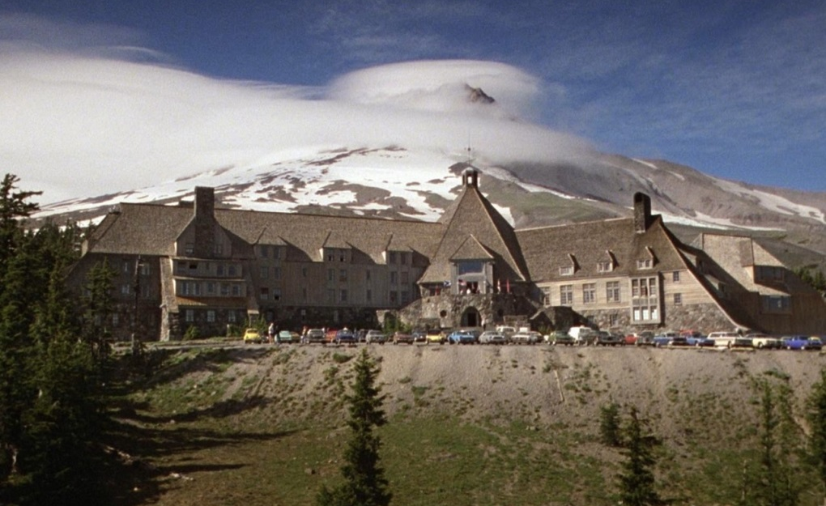
Today’s Agenda
WHAT is a plan of service
WHY a plan of service
HOW to do a plan
“Lodge, AB”
Notes:
Agenda for the day
Exercises are built around a fictitious mountain resort town (FIRST EXERCISE HANDOUT, introducing Lodge)

Slide 4
What’s a Plan of Service? Why do one?
Notes:
Three reasons: provincially required; practical ; powerful
Legislation – good way for board and management to coordinate activities of library – good way to connect with the community, demonstrate value

Slide 5
How to do a Plan of Service
Notes:
Don’t talk much on this slide – click through to next (sort of a clumsy animation)

Slide 6
LEARN
PLAN
DO
about your community and explain what libraries do.
what services the library will deliver in response to community needs.
what is called for in your plan, evaluate results, and spread the good news.
Have a conversation with your community about the local situation.
Inform them a little about what libraries do, and look for local needs that the library can help meet.
There are many techniques you can use to engage your community:
Public meetings
Surveys
Social media campaigns
Statistics
Other community plans
Conversations
You can’t go wrong if you talk about the community and how the library can help.
Analyze what you learned about your community and what the library should do.
Describe the library services you will deliver in response to community needs. (SP4R Service Response or other)
Write a plan that includes goals (what benefit the community will receive), objectives (what specifically the library will do to achieve a goal), and a mission statement (a one sentence summary of what the library does.)
Remember to mention how you did your community needs assessment!
Review your plan periodically.
Gather statistics and information to help determine if you’ve met your goals.
Update your plan as your situation changes.
Keep the public informed of your progress. Explain the benefits that the community has received from the library
Continue learning about the local situation, having a learning conversation with your community, and thinking about your next plan- well before it is due!
And repeat!
Notes:
Explain Learn – Plan – Do: a “choose your own adventure” model, “menu” model – pick your own way of doing each step
LEARN about your community (also libraries)
PLAN what services to offer in response to local needs – pick what local needs the library can help with, define the services you will deliver in response to those needs, write a plan with goals, objectives and a mission statement
DO what is called for in the plan, review and update the plan, evaluate results, keep the public informed
AND repeat!
SP4R is more prescriptive, doesn’t include much “do” (click to start animation)
Set menu vs. you pick your own appetizer, entrée and dessert

Slide 7
LEARN
Community needs assessment
Community engagement
Environmental scan
Self assessment
Notes:
Step one – learn
Learn about what? (DISCUSSION) The community and what it needs; libraries; and the world in general (planning, architecture, social trends, etc); also, have the community learn a little about you
Four activities will lead to learning:
Community needs assessment, learning about what is going on in the local community and what the local community needs.
Community engagement, having a back and forth conversation with community, will lead to deeper insights about the community AND will teach them something about the library
Environmental scan – term that means looking at your whole world, seeing what the trends are
Self assessment – looking at the organization itself, thinking about its characteristics

Slide 8
“Passive” needs assessment and environmental scan
Census
ECMap.ca
Municipal Sustainability Plan, other strategic plans in your community
Library trade publications
Web
Notes:
Passive needs assessment = looking at existing data
Environmental scan – looking at existing data about the wider environment the library is in (not just the community – also the industry, the world, etc.)

Slide 9
“Active” needs assessment and community engagement
Surveys
Public meetings
Open houses
Social media campaigns
One on one interviews
Casual conversations

Slide 10
Principles of active community needs assessment
Start with the community, what it is like, what is going on, what is needed
Teach a little about libraries and what they can do
Ask what needs the library should help meet, and what services would help do that
Leave process open to other input
(Document the process)
Notes:
You can do community needs assessment in all those different ways. However you do it, here are some principles which will ensure you do a good job.

Slide 11
Questions
“Our town”
What is our community like today?
What would we like it to be like in the future?
What is needed to get us where we want to go?
What is our biggest strength?
What is our biggest weakness?
If you could change one thing, what would it be?

Slide 12
Community engagement is a two way conversation
What do you have to say to your community?
Notes:
DISCUSSION: What are libraries for? What do they do? What role do they play? How do you explain them to people, quickly and simply?

Slide 13
Library services
“The Heart of the Community”
“Community Hub”
“Community Living Room”
“The People’s University”
Learning
Entertainment
Making
Sharing
Place

Slide 14
Library services: “Service Responses”
“Create Young Readers: Early Literacy”
“Children from birth to age 5 will have programs and services designed to ensure they will enter school ready to learn to read, write and listen.”

Slide 15
Community is abstract
People are real
Notes:
It is fine to study the community, and to uncover community needs, but we need to remember, that the community is made up of individuals, and all the needs and hopes and dreams etc live inside those individuals, and are experienced individually.

Slide 16
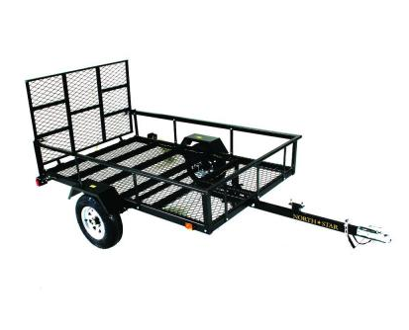
Design thinking
Notes:
Surfing industry value: 7.29 billion / year

Slide 17
What’s it like for you at ALC?
What do you hope for?
What do you learn about?
What’s hardest?
What’s best?

Slide 18
PLAN
Process information
Determine what’s important
Pick / define services that meet local needs
Describe services in ways that are relevant to customers and also relevant to library staff

Slide 19
Fun fun facts about Lodge
Notes:
EXERCISE – give them the data dump about Lodge and have them report back their impressions about it (table by table)

Slide 20
How to analyze data
Just read it – all of it
Initial impressions
Categorize – quantify – crunch
Secondary impressions
Pick the most important things
Tertiary impressions
Come to conclusions
Write the story
OBSERVE
REFLECT
INTERPRET
DECIDE

Slide 21
How to analyze data (some more)
Find themes, give them descriptive names
“I’m having a little trouble using the eresources”
Use charts
Look for connections

Slide 22
Figuring out Lodge
Notes:
Distribute barcharts, ask if that makes the data any more clear.
Go through some of the data: Patterns? Name any themes? Any cross-connections? ORID?
What can the library do for Lodge?

Slide 23
Goals and objectives
Goals keep you focused on outcomes that matter to your customers
Objectives give specific, measurable instructions to your staff
Notes:
EXERCISE: Write goals and objectives for Lodge

Slide 24
Goals and objectives for Lodge Library
Notes:
Each table comes up with goals and objectives for Lodge Library

Slide 25
Mission statements

Slide 26
DO
Five easy steps to implement your plan:
Manage change
Do an inventory
Execute
Evaluate
Communicate
Notes:
So you have your goals and objectives and your plan. NOW WHAT?
The completion of the written plan signal the end of the planning process and is the launch of the implementation, or DO, phase.
DOING, or implementing, is SHIFTING from GOALS AND OBJECTIVES to STRATEGIES
OVERVIEW of the 5 EASY STEPS to implement your plan:
MANAGE CHANGE – prepare for the implementation process by having a change friendly environment
DO AN INVENTORY – what is it you’re doing now? Do your activities support your plan? What can be streamlined or eliminated?
EXECUTE – Choose new activities or streamline existing ones. Assign responsibility and deadlines. Make sure your budget reflects your new strategic priorities.
EVALUATE – Review the plan at every board meeting, gather stats and feedback. Note progress made and be flexible in case you have to make adjustments.
COMMUNICATE – As soon as the plan is finished, share it. When you meet a goal, tell everyone.

Slide 27
Managing Change
Notes:
QUESTIONS:
ASK: HOW DO YOU PREPARE FOR CHANGE? WHAT CHANGES WOULD YOU LIKE TO MAKE AT YOUR LIBRARY?

Slide 28
Managing Change
The library is great and we love and support it
AND
The library needs to change to continue to meet our needs
Board and staff must commit to change
Prepare for the implementation process by creating a change friendly environment
Notes:
It’s not unusual to think that your library is already doing a fantastic job and perhaps only a few cosmetic changes are needed. It is very likely that people will validate the work the library is currently doing, however, it’s unrealistic to think that in today’s changing environments (particularly in regard to technology) that patron’s needs and wants have remained unchanged. Meeting these new patron demands means new services and programs to support new priorities.
It is gratifying to hear that the board and staff are doing a great job and people are happy to hear the first part of the message. IT IS A REFLECTION OF THE LIBRARY’S PAST PERFORMANCE. However, that the library needs to change part PROVIDES DIRECTION FOR THE LIBRARY’S FUTURE.
You can and should acknowledge the value of services offered in the past, but you should not feel compelled to continue those services if they are no longer effective or relevant.
Commit to change – acknowledge and accept it
How do you prepare for the implementation process? By having a change friendly environment. How do you make a change friendly environment?
COMMUNICATE- staff should be strongly encouraged to participate in the planning process and listen to their suggestions and opinions.
LISTEN – You cannot expect people to listen to you if you do not listen to them.
ASK: DOES ANYONE HAVE ANY STORIES ABOUT CHANGE MANAGEMENT? TIMES WENT IT WENT WELL, TIMES WHEN IT DIDN’T AND LESSONS LEARNED?

Slide 29
Do an inventory
Notes:
People are now ready and open to change. Now what?
Doing an inventory means looking at everything you’re already doing and asking yourself some questions: (NEXT SLIDE)

Slide 30
Do an Inventory
What are you already doing?
Are they essential or core library services?
Are they effective?
Do not be afraid to eliminate or streamline
Based on the above, you will be able to identify potential new or modified activities
Notes:
What is it the library is already doing? What services and programs are offered?
Are the services and programs essential or core library services? – ASK: WHAT IS A CORE LIBRARY SERVICE??
Are these activities meeting a service priority? E.g. you’ve identified by early literacy/comfy place but you’re investing a lot of time and money into ESL.
Are the services and programs being offered EFFECTIVE?
Evaluate what you’re doing. If the activities are not effective, should you continue doing them?
Practices that have been immune from scrutiny or criticism, often for no good reason, are called SACRED COWS. Many library sacred cows have been firmly entrenched for decades, although new ones are added regularly. These practices continue because no one has asked “why?”. There is a SACRED COW example worksheet in your workbook (from IMPLEMENTING FOR RESULTS by Sandra Nelson).
Basically what it comes down to is you have to know what you’re already doing (and what’s working) in order to move forward to add or modify activities. Also, you likely can’t just keep adding activities without taking something away, or at least making modifications. That streamlining allows you to redirect funding and support to activities to support your new strategic direction.

Slide 31
Lodge Municipal Library: Current activities
Notes:
Now, let’s look at WORKFORM A in your workbook. As a group, list some existing activities that Lodge Municipal Library might already be doing. Do THEIR inventory. Think about what are core and essential services, what might have been offered to support their previous strategic plan, and perhaps a few ‘sacred cows’.
You have 10 minutes.

Slide 32
Execute Do what you said you would do
Notes:
Okay so now you know what the library is doing. And you have an idea of what is effective or not, and where things might be eliminated or streamlined and redirected.
NOW IT’S TIME TO DO WHAT YOU SAID YOU ARE GOING TO DO IN YOUR STRATEGIC PLAN. It’s time to figure out ways to meet those goals and objectives.
HOW do you do that?

Slide 33
Execute
Choose new activities or streamline existing ones to meet the goals and objectives in your plan
Assign responsibilities and deadline
Make sure your budget reflects and supports your new strategic priorities
Notes:
Now that you know what the library is doing, you need to decide what you are going to continue doing and what new activities you’re going to add. Work with staff to identify potential activities that could support the strategic goals. Potential activities include both new activities and significant modifications of current activities. Encourage all staff to suggest new activities and to recommend changes in the way current activities are delivered.
ASK: WHAT ARE SOME WAYS YOU CAN IDENTIFY NEW POTENTIAL ACTIVITIES?
See what other libraries are doing, brainstorm, read, system support, the Internet, Pinterest, Facebook, etc.
What activities can be eliminated or streamlined? There is very likely not enough time and money for staff to continue to do everything they have always done in the way they’ve always done it AND implement the new activities need to support the plan of service. With all the change that have affected public libraries in the past decade or more, it would be unreasonable to assume that every activity that has been a part of the library’s services for the past 5, 10 or 15 years is still as relevant as it once was.
Eliminating and/or streamlining should free up time and/or funding to support new strategic activities.
Once you’ve decided what the new and/or modified activities are, you need to assign responsibility and deadlines. Things rarely get done unless someone is assigned to do it – and surprisingly little gets done if there is no deadline for completion. It can be as simple as creating an internal spreadsheet and/or adding it as an appendix in the plan of service.
List each task/activity with a target date for completion and show who is responsible for it. Have a “Completed” Colum so it can be checked off when it’s achieved.
Another important component of execution is making sure your budget reflects and supports your new plan of service.
You will have to balance the resources required for new activities with the resources that can be made through reallocation. You can support new or expanded activities by reallocating existing resources/funds that are currently being used to perform ineffective, inefficient or non-priority activities.
Align the library’s resources to the plan. Budget implications of activities name in the plan are important considerations in developing future budgets. HOWEVER, do not have the entire plan be reliant on receiving new funding. There has to be a willingness to realign and reallocate current resources so that the initiatives named in the plan can proceed. At the same time, it is important to keep in mind that the plan only addresses new activities and the library board must also continue to fund core library programs and services.

Slide 34
Lodge Municipal Library: Task list and budget
Notes:
Now it’s time for another group activity.
There are three workforms: WORKFORM B (planning to eliminate or streamline) and WORKFORM C (IMPLEMENTING NEW OR EXPANDED ACTIVITIES). There is also the BUDGET form for Lodge Municipal Library on yellow paper.
I’d like you to take 20 minutes to work through them. Start with WORKFORM B: WHAT ACTIVITIES OFFERED BY LODGE LIBRARY COULD BE ELIMINATED OR STREAMLINED? Look back to workform A where you identified and evaluated existing activities. Then move to WORKFORM C: What new or expanded activities could be implemented? BE SURE TO ASSIGN REPONSIBILITY AND TIMELINES. Then look at the Budget on yellow paper. What or how would you reallocate funds to support the new activities??

Slide 35
Evaluate
Notes:
It’s been a month, two months, 6 months since the board approved and implemented the new plan….Does the plan then get put on a shelf and is never looked at again? I hope not! Evaluation is a keep step in implementing a plan of service.

Slide 36
Evaluate
Review the plan
Gather statistics and feedback
Monitor progress
Gather data
How well is it working?
Be flexible
Notes:
ASK: HOW DO YOU CURRENTLY EVALUATE YOUR PLANS? HOW OFTEN DO YOU REVIEW IT? HAVE YOU EVER HAD TO ADJUST YOUR PLAN? IF SO, WHY?
The regular monitoring and reporting of progress and success is an important aspect of implementation. Even though the Libraries Regulation 13(b)) says the plan of service should be reviewed annually, library boards should receive an update on planning activities on a monthly or quarterly basis. If you wait until the end of the year to check your progress and find that there are problems, it will be too late to make any needed adjustments. It is a local decision, keeping in mind that regular reporting provides valuable information about progress and the reasons for lack of progress. Such information facilitates further action, as needed, and/or a revision of the plan.
Gather statistics and information to help determine if you’ve met your goals. However, remember to look beyond the purely quantitative measures to include important qualitative anecdotes and impact statements that speak to the experience of a positive change. Remember, also, to celebrate and publicize success – large and small.
Keep track of what’s been accomplished and then re-focus the attention of staff to goals left unfinished. Some library boards really do accomplish all the goals in their plan and should begin the planning steps again. It’s much more common, though, for a plan to be revised and expanded as time goes on in response to accomplishments.
Be flexible. In some cases, the plan provides clear direction to emerging trends and issues, even those unanticipated when the plan was written. In other cases, it happens that emerging realities require a revisiting and revising of some pieces of the plan. Almost always, the revisions happen at the level of objectives or tasks. Libraries rarely confront a change that challenges purpose or vision, at least in spirit. Likewise, revisions to the strategic directions are infrequent, as they are usually broad in nature and sufficiently rooted in the vision.
The time frame to review plans can change in response to significant events that have an impact on the library or the community. For example, if the library receives a large bequest or gift collection, it would make sense to look at what might change in the plan. An increase in minority population, as another example, would also suggest a plan update.

Slide 37
Input, Output, Outcome, Impact
Notes:
Ways to measure and evaluate results
INPUTS are what you put into your service. Example – coffee beans. Library example – books.
OUTPUTS are the things you do with those inputs. Example – brewed coffee. Library example – circulation rates.
OUTCOMES are the results in the person who consumes or receives the outputs. Example – caffeinated energy. Library example – literacy.
IMPACTS are the meaningful effects that outcomes have on people or society. Example – no one must die if I have my coffee. Library example – literate people get better jobs.

Slide 38
Communicate
Notes:
I’ll end on communication but it’s actually important in every step we’ve talked about today.
Communication is a tool and builds good will. There’s communication on so many levels - between board members, board and staff, staff members, board and council, board and the community.

Slide 39
Communicate
Communication is important in all steps of implementation
As soon as the plan is finished, work to get it out into the community:
Trustees
Staff & volunteers
Municipal council
Public
Publicize your success
Notes:
As soon as the plan is available in a published document work here to get it out into the community:
Start with the municipal council – get yourself invited to as many meetings as possible and present the library’s plan. Be flexible and creative about tying the library’s plans to the concerns of other community groups and agencies. Discovering a shared agenda can be a powerful incentive in altering people’s views of the library’s role and the important in the community.
Do everything you can to make the plan a news story that catches the interest and support of the local media. Develop key message arising from the contents of the plan and use those messages to raise the profile of the library in the community.
Put the plan up on the website, share on social media. Have copies available in the library.
Keep the public informed of your progress. Explain the benefits that the community has received from the library.
When you achieve your goals and objectives, publicize your success. Broadcast the news on your social media accounts and website. Forward the information to your municipal council.
Share it with staff and volunteers.
A practice of making the plan mandatory reading for any new trustees and staff (at all levels) serves to make them familiar with what the library is striving to achieve. It also gives them an opportunity to ask questions, leading to further conversation about the contents of the plan.
ASK: HOW DO YOU COMMUNICATE WITH DIFFERENT GROUPS ABOUT YOUR PLAN OF SERVICE?

Slide 40
Lodge Municipal Library: Communication plan
Notes:
WORKFORM D and WORKFORM E are two sample communication plans. SPEND 10 Minutes experimenting with them for Lodge Municipal Library. They have different focuses – which one do you prefer or find more helpful?

Slide 41
Summary
What’s the best thing you’ve heard today?
What are you the most concerned about?

Slide 42
Contact Us
Ken Feser ken.feser@gov.ab.ca
Jen Anderson jen.anderson@gov.ab.ca

