Slide 1
When to Hold On and When to Let Go: "Last Copy" Shared Print Archiving and Book Deselection VILSC, April 27 2018
Jean Blackburn, Collections Librarian, Vancouver Island University
Lisa Petrachenko, Associate University Librarian, Learning & Research Resources, UVic
Tina Bebbington, Learning & Research Librarian – English & History, UVic
Sue Bengtson, Collections Analyst & Business Librarian, UVic

Slide 2
COPPUL SPAN (Shared Print Archive Network)
Council of Prairie and Pacific Libraries' Shared Print Archive Network (SPAN) is a distributed retrospective print repository program.
SPAN's main goals are to:
Provide access to shared print archives
Preserve the print record for members in a cost-effective way
Create opportunities for the reallocation of library space

Slide 3
COPPUL SPAN (shared print archive network)
series of projects in phases
Phase 1
2012-13
Phase 2
2013-14
Phase 3
2014-16
Phase 4
2016-18
High risk journals
Low use, low & medium risk journals
Gov Docs
Gov Docs
Monographs
Notes:
Phase 1 and Phase 2:
Focus on low use, low and medium risk journals
Archive Holders/Supporters
Holdings notes to include retention commitment
Example: 583 1#$a Committed to retain$c20120810$d20221231$fCOPPUL SPAN$5BVAU
Approximately 3000 journals across COPPUL members
Mandate for Phase 1 and 2: Preservation and Shelf space reclamation
Phase 3: High Risk Journals/preceding and continuation titles
Phase 3 & 4: Government Documents (first phase Stats Can)
Phase 4: Monographs

Slide 4
COPPUL SPAN Monograph: overview
Analyzing 7.3 million records across 10 participating academic libraries
First priority is retention and preservation mandate (15 years)
Space reclamation - local decisions

Slide 5
Key goals
Assess collection - usage, duplication, dispersion of holdings
Identify and preserve rare material
Facilitate deselection of low use, widely held materials
Evolve a regional strategy for print book collections

Slide 6
Guiding principles
OCLC’s Sustainable Collection Services (SCS) provides collection analysis
Retention commitments defined by the group
Create a book safety net
Weeding decisions voluntary, and decided locally
Retention decisions will include circulation and storage discussion

Slide 7
Group Retention Models
Rarely held model
Retain if:
UofA/UBC holdings equal 0 (same edition)
Other COPPUL holdings less than 3 (same edition)
CARL Libraries less than 5 (same edition) *non-COPPUL CARL libraries
Not COPPUL Canadiana
Combined with:
COPPUL Canadiana Model
Retain 3 if not held by UofA/UBC
Retain 2 if held by UofA/UBC
*Combined models average 16% retention rate across participating libraries

Slide 8
Sampling methodology: Libraries provided with retention commitment lists
Reviewed and rejection criteria established
Titles already weeded
Outdated textbooks, medical, legal, technical material
Damaged/missing
Travel guidebooks
Serials inadvertently included
Anthologies, study guides, workbooks, newsletters
Any rejected titles would be removed from the retention commitment lists rather than reallocated

Slide 9
Shelf level verification process
Risk Management
Group felt this was important part of the process
Random sample of 6000 records was supplied
Verified
No obligation to replace missing items – local decision
Circulating versus preservation copies
All retained titles to remain circulating

Slide 10
Project scope
What is included?
What is excluded?
Circulating print monographs
Juvenile material
Government documents classed in LC or DDC
Music scores
Serials
Special Collections
Government Documents (not LC or DDC)
Reference books or non circulating items
Ebooks
Microforms/Microfiche
Audio visual media
Lost/withdrawn items
Theses and dissertations
Maps

Slide 11
Notes:
What is GreenGlass? It’s a web-based data browser, visualization, modeling and reporting tool developed by a company called Sustainable Collections Services (SCS). OCLC acquired SCS in 2015.

Slide 12
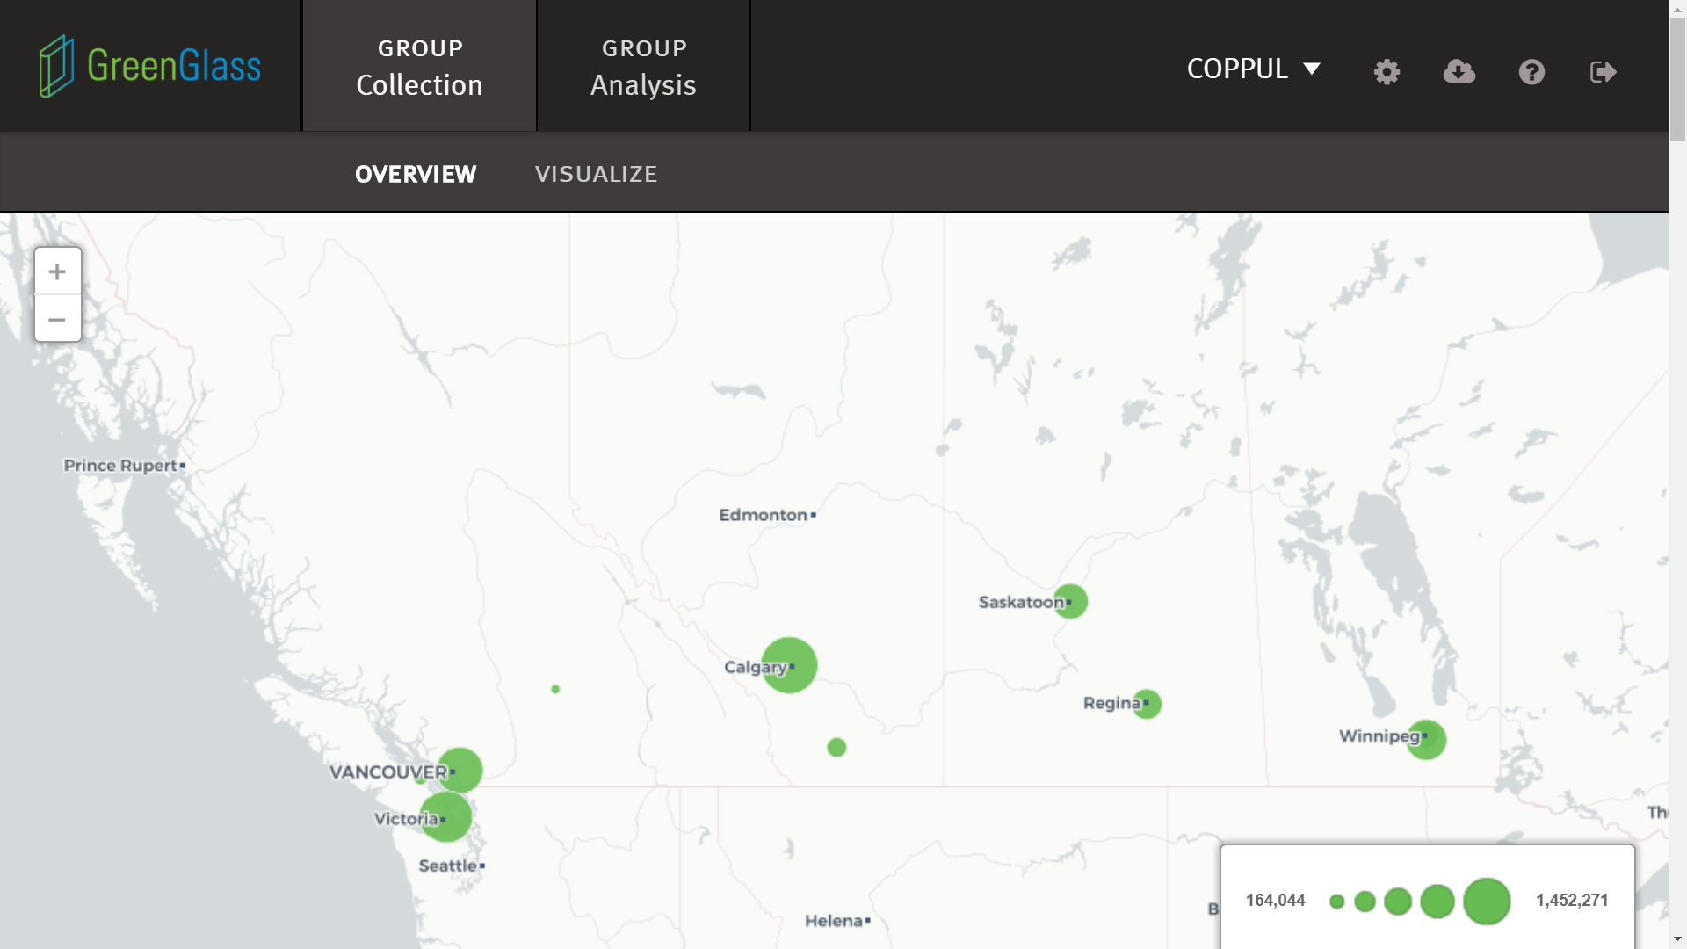
Notes:
The GreenGlass interface toggles between the group collection view (COPPUL in this case) and individual library collections. In GreenGlass’s group view, a quick visualization of the SPAN Monograph Project participant collections.

Slide 13
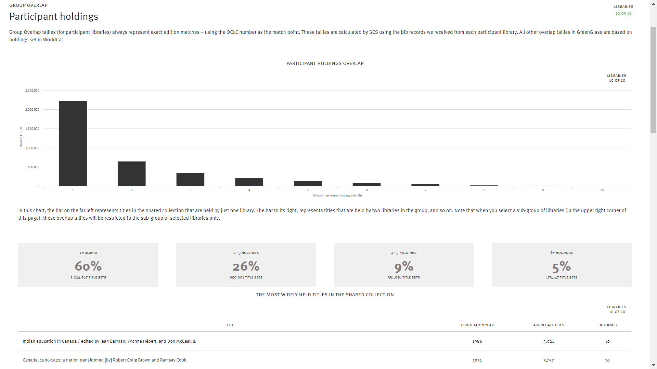
Notes:
GreenGlass has several data visualizations available. Here we can seen the distribution of holdings overlap among the SPAN Monograph Project participants. The bulk of our combined holdings (60%) are unique to our respective libraries, i.e. held in only one participating library. GreenGlass also shows a list of the 10 most widely held titles in the group.

Slide 14
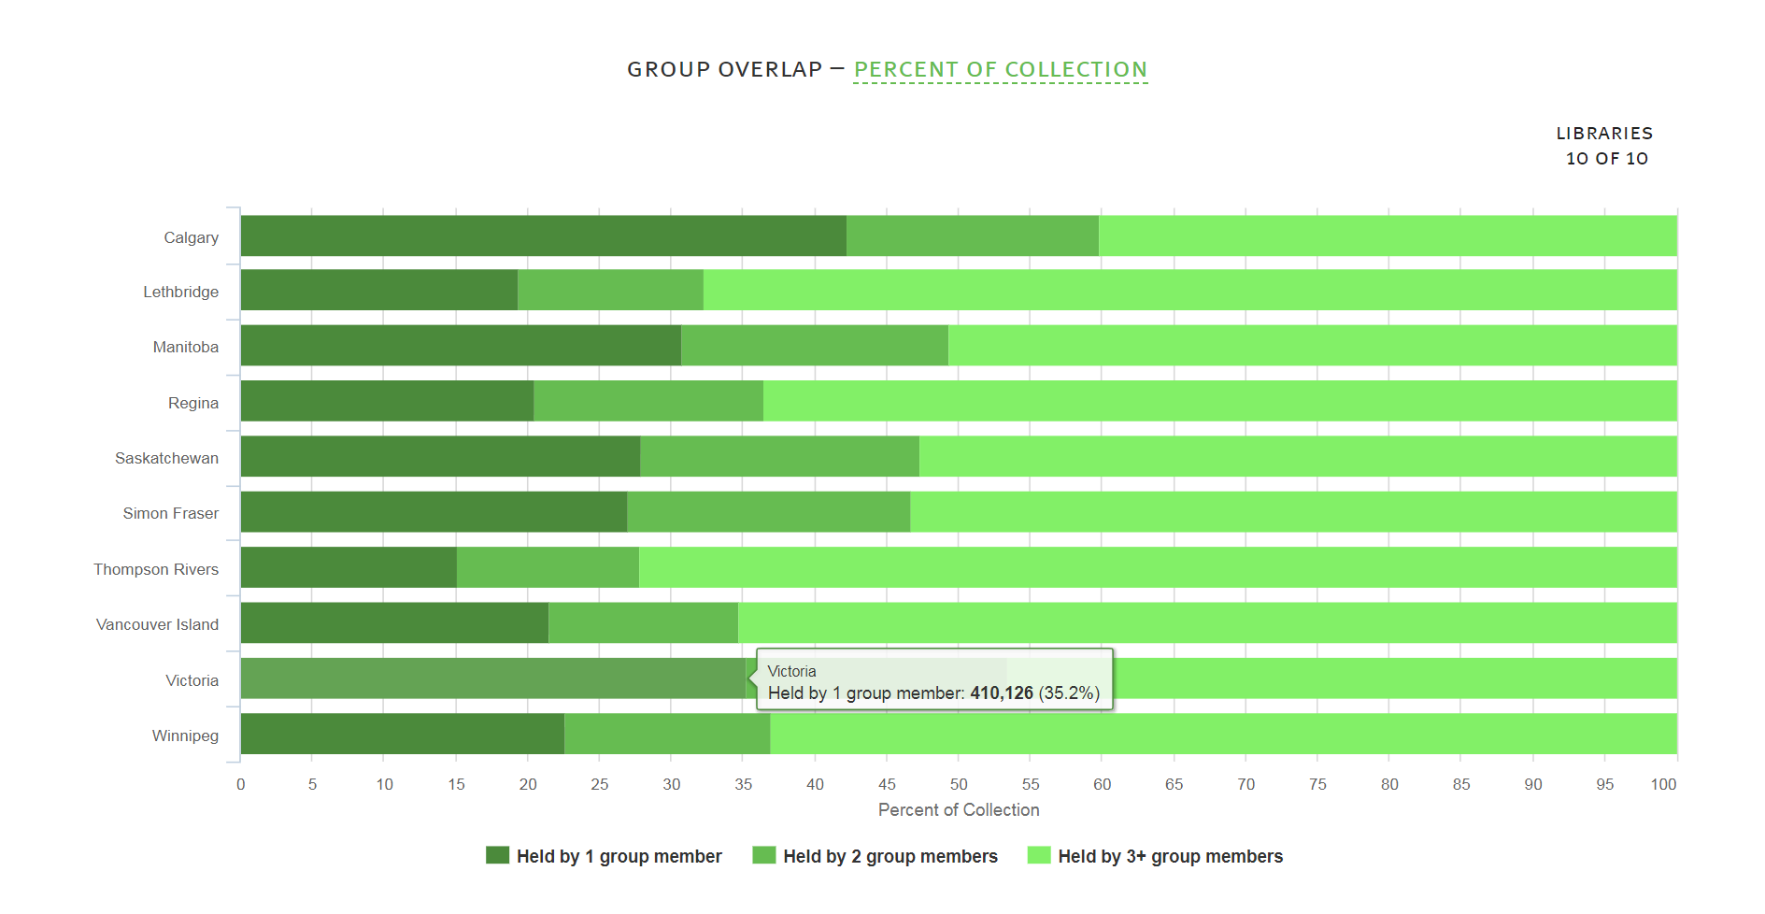
Notes:
Another GreenGlass visualization showing the breakdown of unique vs widely held holdings in each participating library collection. More details appear in pop-up balloons when you mouse over the coloured bars. Here we can see that over a third of Uvic’s collection is unique among SPAN Monograph participants, compared to VIU’s unique holdings which make up about 21% of the collection – not surprising since UVic is a much larger library with a stronger research focus and “library of record” mandate.

Slide 15
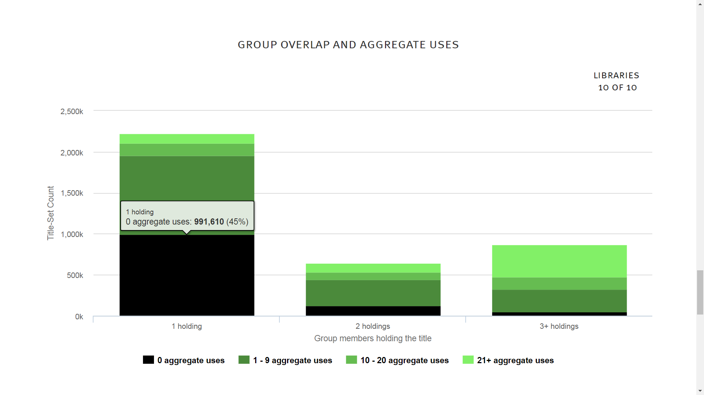
Notes:
This visualization is interesting in that it correlates uniqueness within the SPAN Monograph group with usage aggregated across the group. The holdings that are unique have a much higher percentage of zero-use titles – not really surprising, but since the SPAN Monograph Project is focusing on preserving rare materials, it also means that participants are committing to retain many items which have had very low use (i.e. items which may have been good candidates for weeding if not for the SPAN Monograph project!)

Slide 16
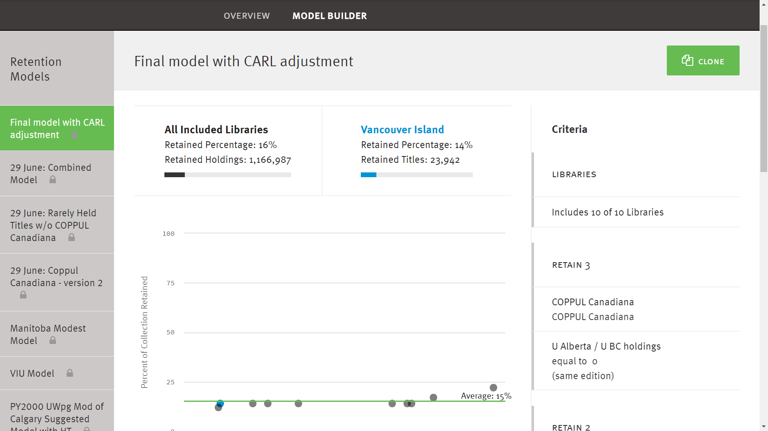
Notes:
The GreenGlass Model Builder allows you to build various retention models across the group holdings. On the left you can see several of the models we developed as part of our process, with the final model we decided on at the top.

Slide 17
SPAN Monograph Project Retention Model
Notes:
Criteria details for the SPAN Monograph retention model.

Slide 18
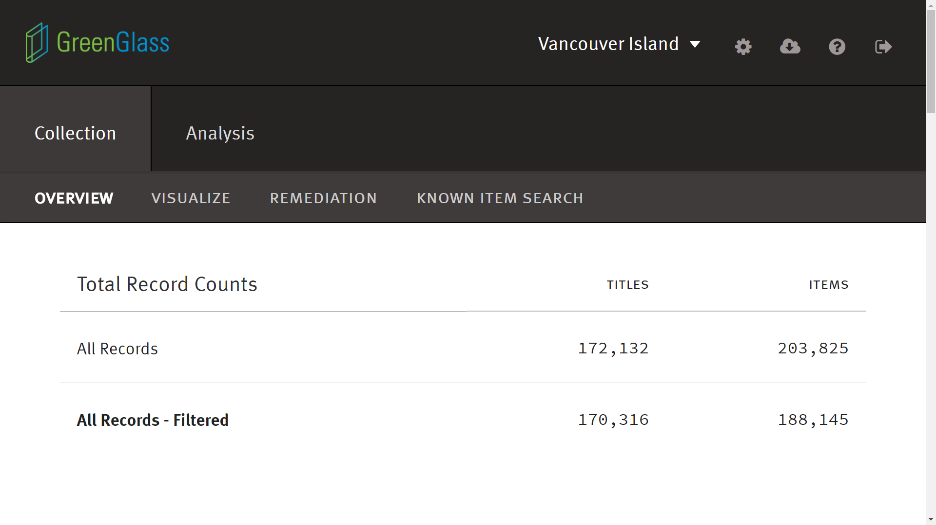
Notes:
In GreenGlass you can toggle out of the group collection view to view and analyze your own library’s collection data (in this case, Vancouver Island University’s).

Slide 19
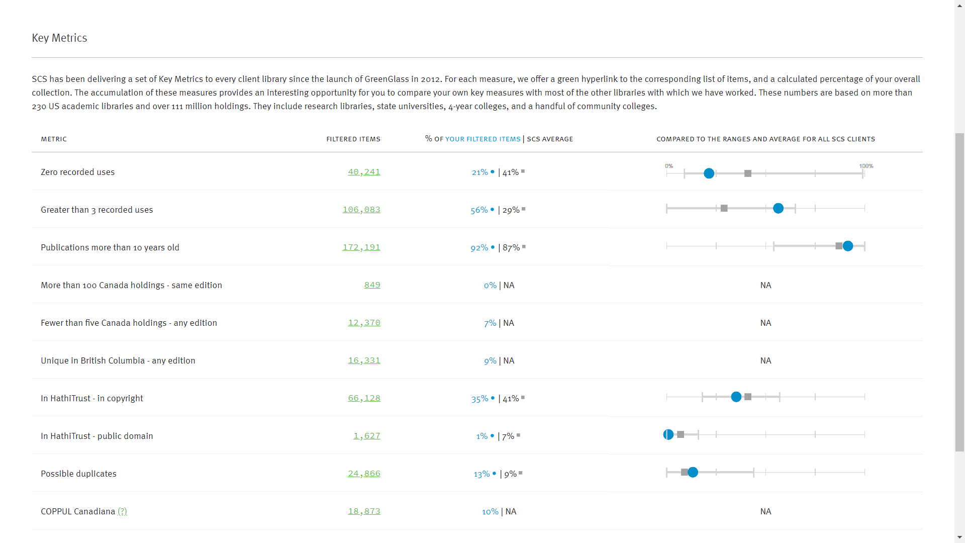
Notes:
There are several built-in queries in GreenGlass that are very useful – e.g. zero recorded use items, items published more than 10 years ago, etc. VIU was interested to see that our print collection is better used than average, with a zero-use rate of 21% vs. 41% among other Sustainable Collections Services clients! You can click on the “Filtered Items” numbers to see a list of the items, filter the list further, and export the list to Excel…

Slide 20
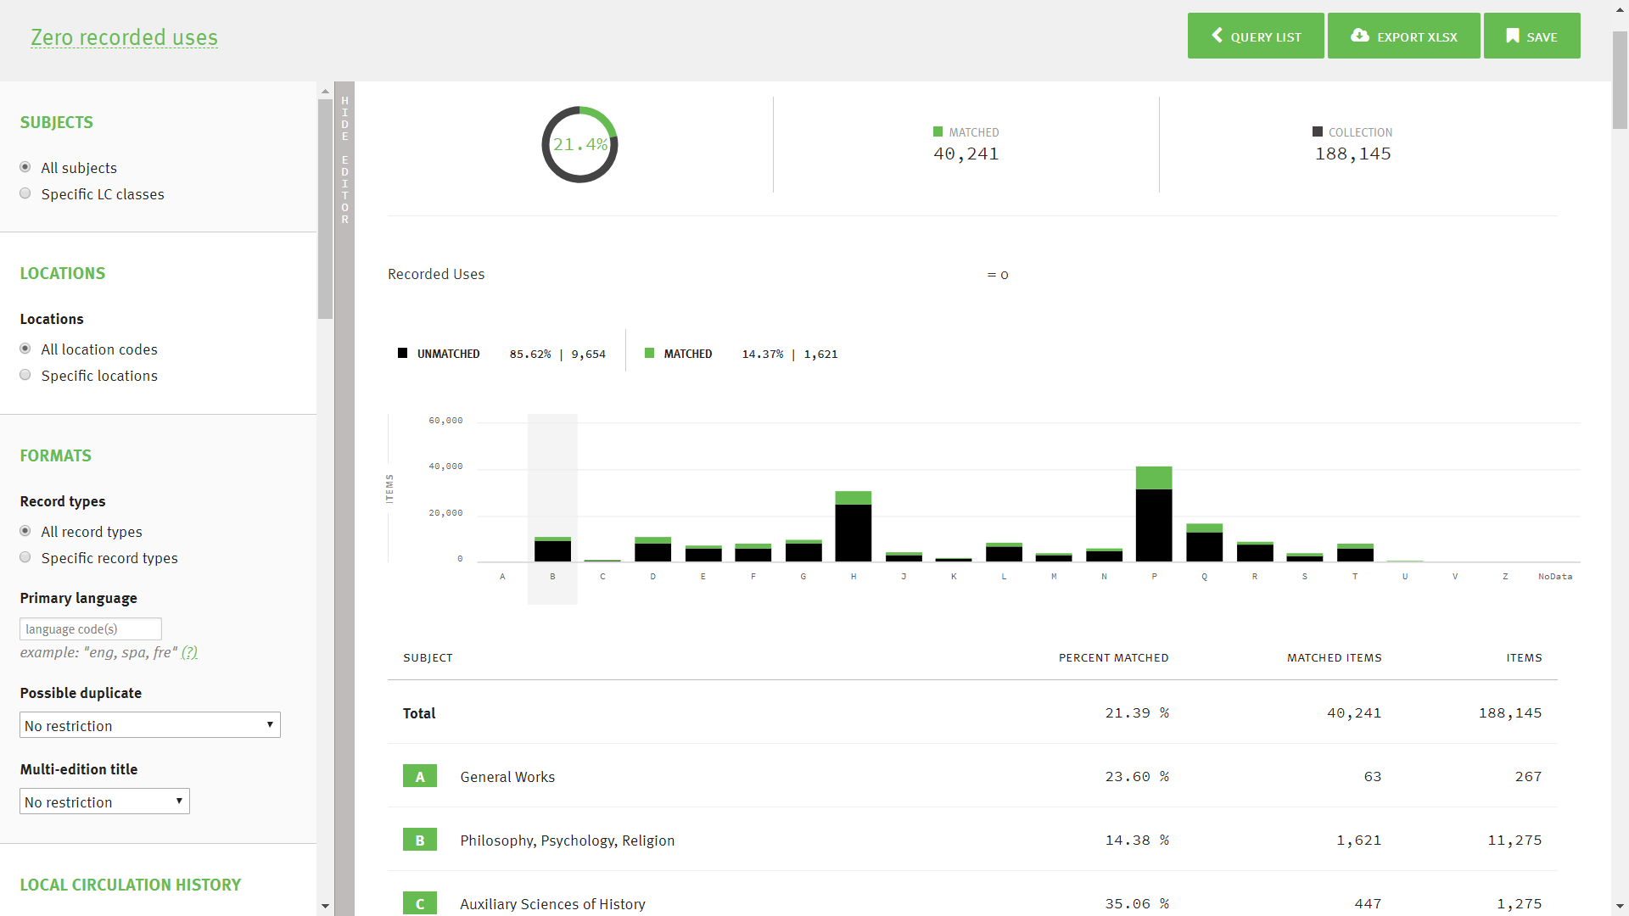
Notes:
Here is the default “Zero recorded uses” query for VIU’s collection in GreenGlass. We can see that 21.45% of VIU’s overall collection has zero usage, but when we mouse over the B bar in the LC class distribution chart, the zero-use percentage is lower (14.37%). You can use the facets down the left to filter the list further (e.g. by library location, date added to collection, LC subject class or sub-class, etc., and then export your filtered list to Excel.

Slide 21
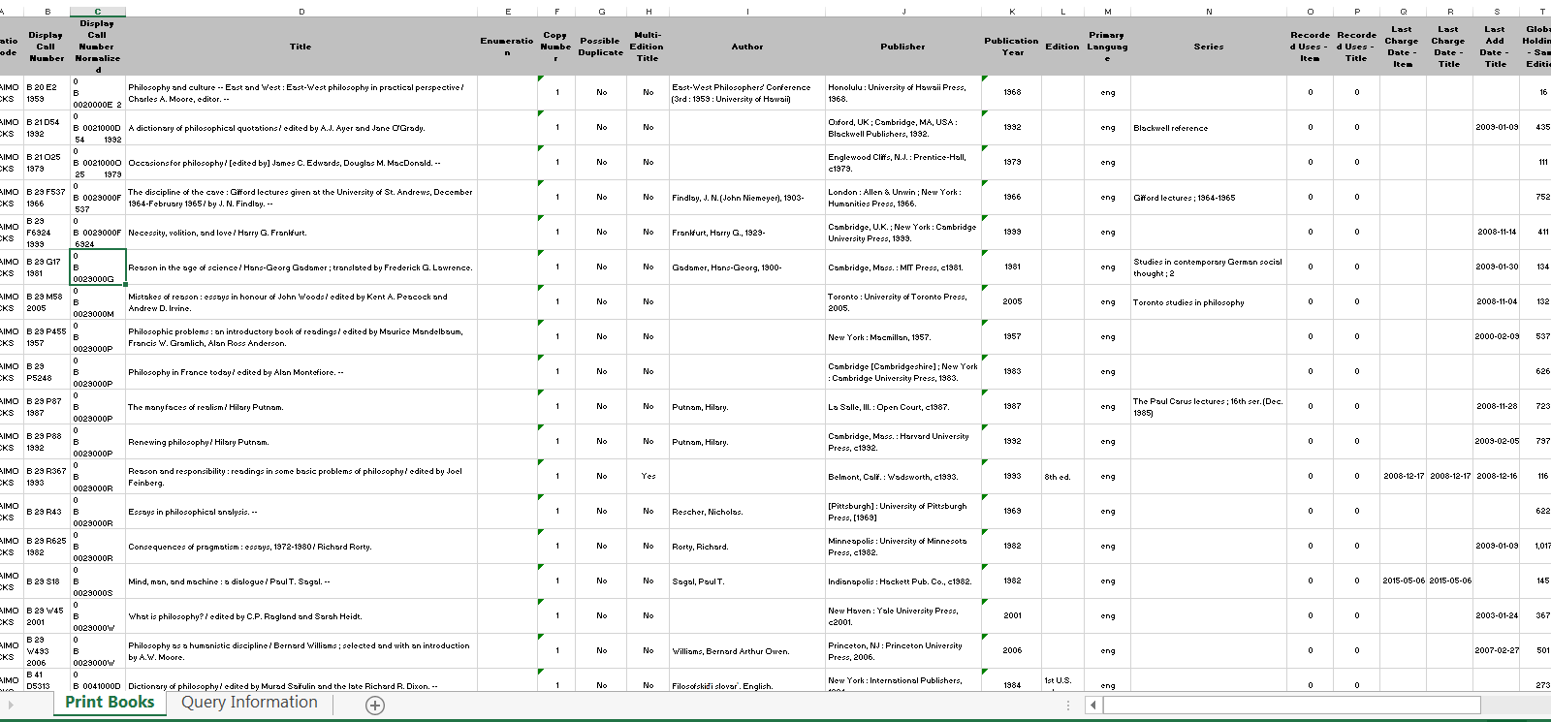
Notes:
Here are VIU’s zero-use B class titles, exported as an Excel spreadsheet. GreenGlass exports all available data points including bibliographic data, duplicate copy status, total recorded uses, last recorded use, date added to collection, overlap with comparator library holdings, etc. It’s very useful to have all these variables collected in one spreadsheet for collection management decision-making.

Slide 22
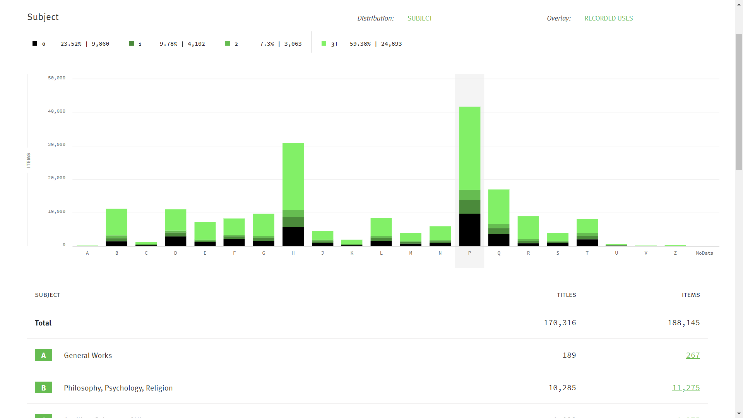
Notes:
GreenGlass visualization tools allow you to overlay variables. Here we see a subject class distribution for VIU library, overlaid with recorded uses. You can mouse over each bar in the distribution to get the breakdown for each LC class. It’s interesting how most of the bars seem to show items falling into the extremes at either end of the distribution – i.e. most items get used either heavily (relatively) or not at all.

Slide 23
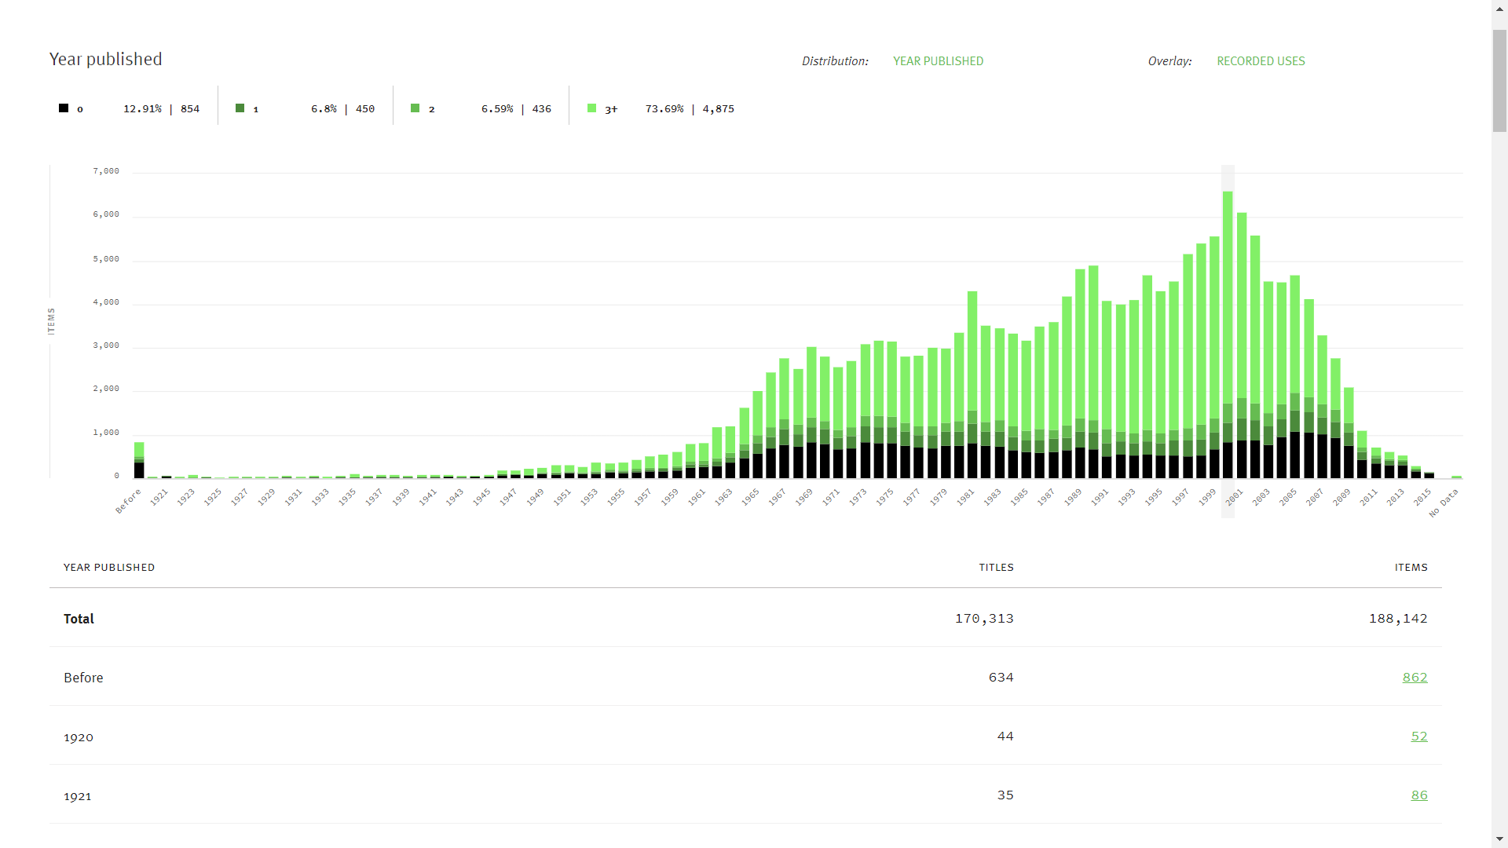
Notes:
This visualization shows publication year overlaid with recorded uses. We can see here that unsurprisingly, at VIU our print collection reflects the fact that we became a college offering academic programming in 1969, and that our print collection development peaked in the early 2000’s and declined along with usage after that point.

Slide 24
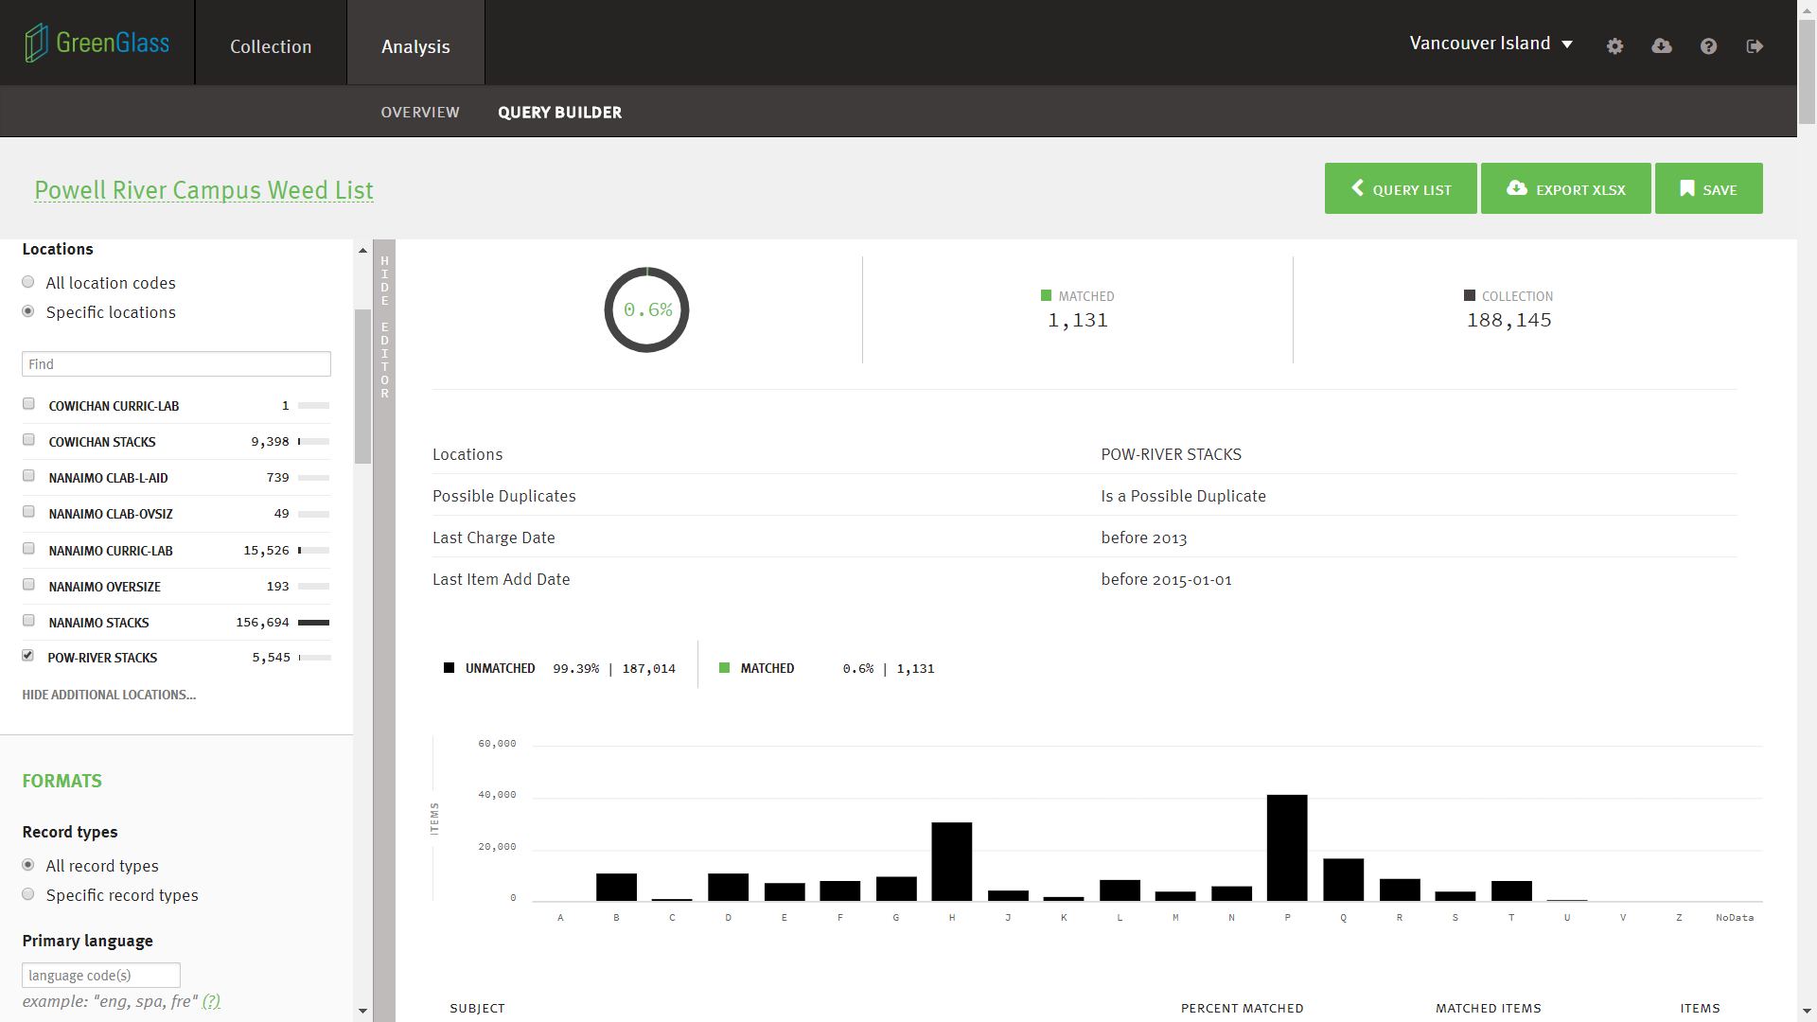
Notes:
The GreenGlass “Query Builder” is useful for collection management at the local level. Here is a hypothetical model for potential weed candidates at one of our regional campuses. The campus collection (5545 items) has been filtered to those added to the collection before 2015 and with no usage after 2012, with possible duplicate copies elsewhere in the VIU Library collection.

Slide 25
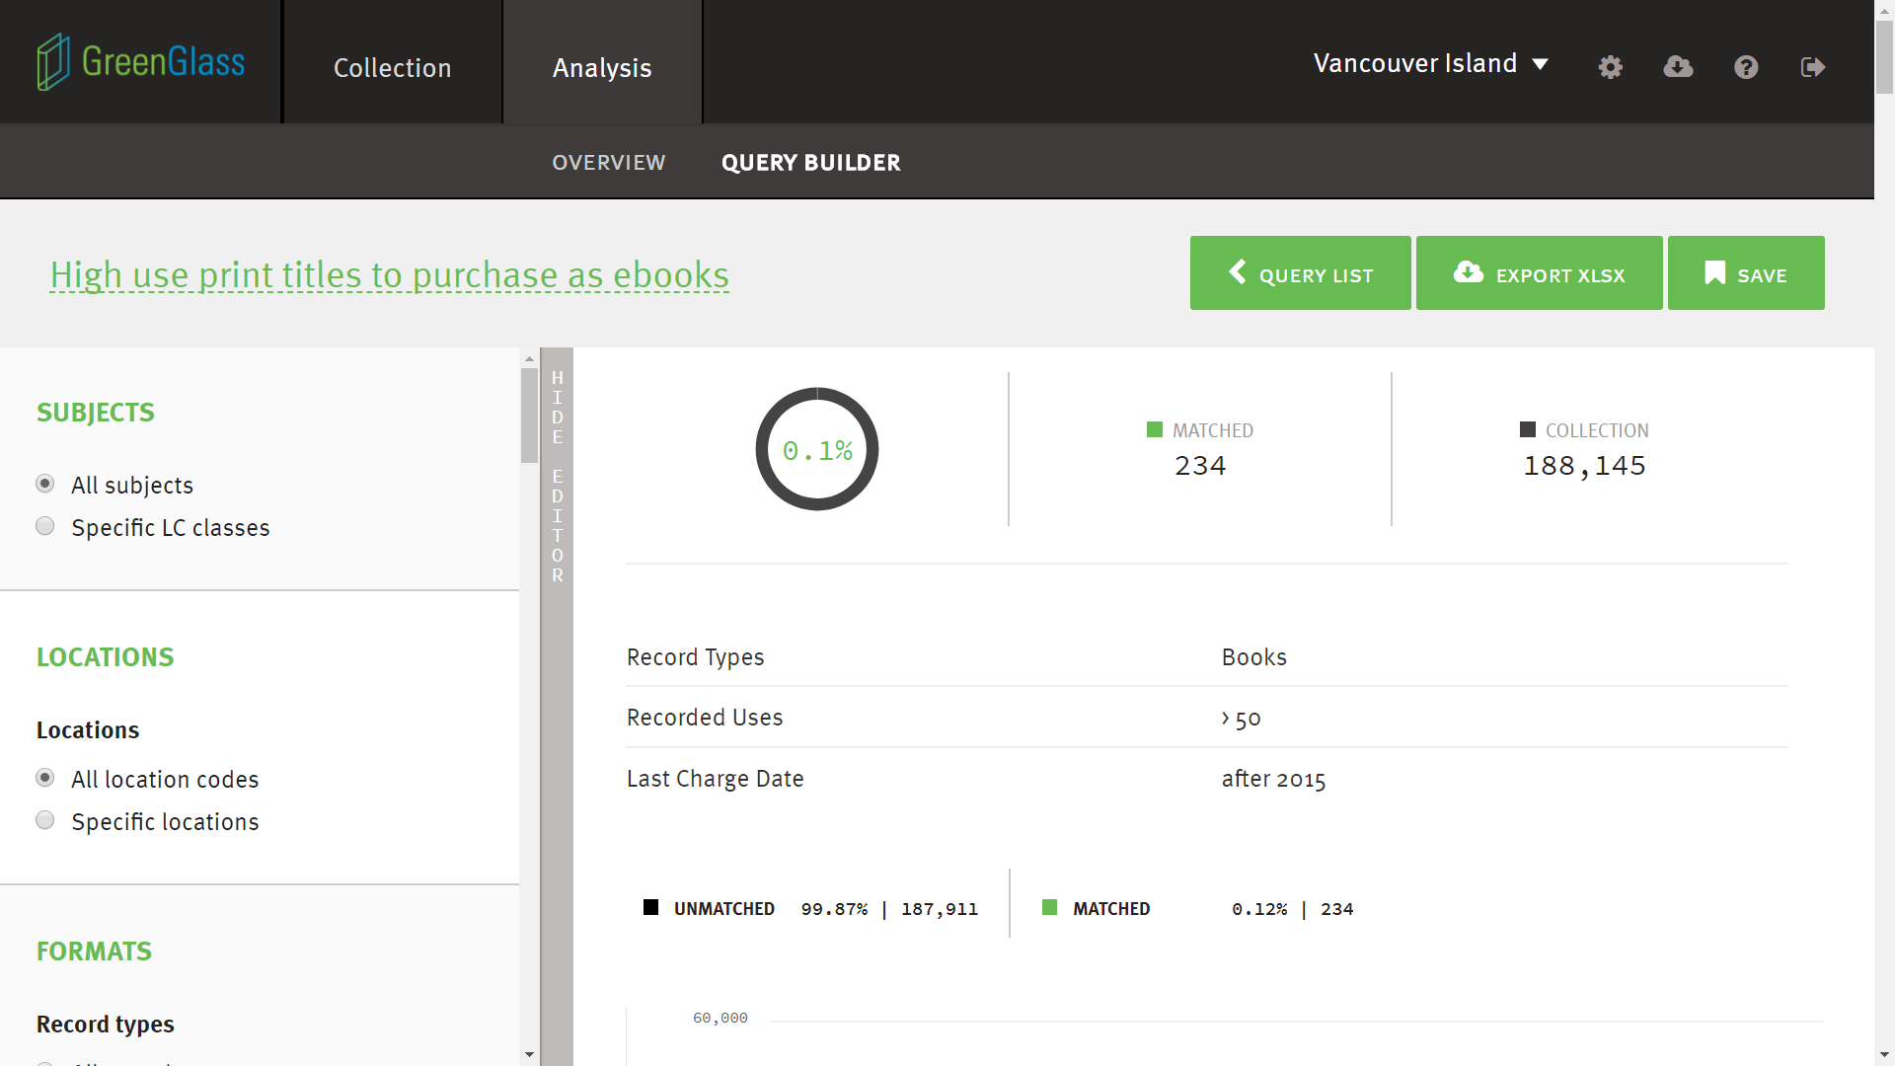
Notes:
And of course you can use the query builder for other uses besides weeding! Here we have modeled a list of very highly and recently used titles to use in a project to replace our highest use print books with electronic equivalents.

Slide 26
SPAN Monograph project @ UVic

Slide 27
The project so far…
Created collections analysis dataset (snapshot from April 2016)
Identified retention guidelines
Completed shelf verification project for 6000 sample items
Developed local criteria for candidates for weeding

Slide 28
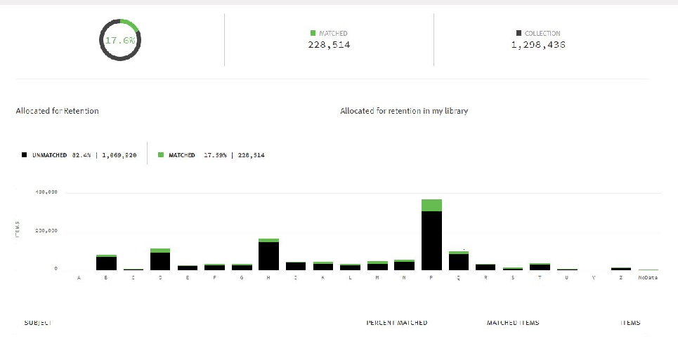
UVic Libraries’ Retention Allocation

Slide 29
SPAN Monograph retention notes added
The following retention notes have been added to the 228,514 items that UVic is committed to retain until 2032:
Bibliographic Records:
583 1/ $aCommitted to retain$c20170101$d20321231$fCOPPUL SPAN Monograph$5BVIV
Item Records (Free text field):
DO NOT DISCARD. UVIC COMMITTED TO RETAIN UNTIL 2032 AS PART OF COPPUL SPAN Monograph

Slide 30
Identification criteria:
The criteria to identify items as follows:
Recorded uses <2 (either 0 or 1 circ since 1999)
Age (accession date before 01.01.2008)
Not allocated for retention

Slide 31
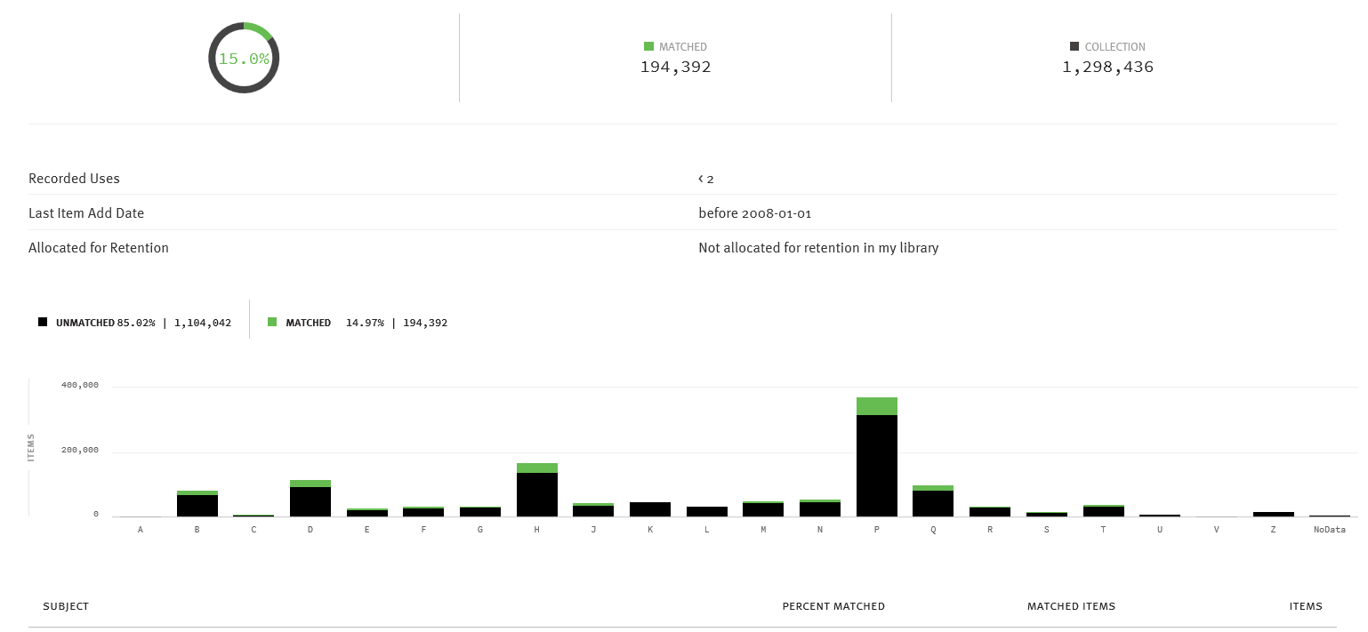
Items that meet the criteria

Slide 32
LC Call # & Subject |  | Total # items | Total # items allocated for retention | % collection allocated for retention | Total # items match query criteria (NAfR) | % items match query criteria (NAfR)
Total |  | 1,298,436 | 228,514 | 17.60% | 194,392 | 14.97%
A | General Works | 3,729 | 941 | 25.23% | 1,050 | 28.16%
B | Philosophy, Psychology, Religion | 82,412 | 11,335 | 13.75% | 14,772 | 17.92%
C | Auxiliary Sciences of History | 7,725 | 1,341 | 17.36% | 1,872 | 24.23%
D | World History | 115,968 | 20,933 | 18.05% | 23,146 | 19.96%
E | History of the Americas | 28,666 | 2,802 | 9.77% | 6,736 | 23.50%
F | History of the Americas | 33,614 | 5,673 | 16.88% | 5,510 | 16.39%
G | Geography, Anthropology, Recreation | 32,477 | 5,163 | 15.90% | 1,205 | 3.71%
H | Social Sciences | 169,416 | 21,614 | 12.76% | 30,958 | 18.27%
J | Political Science | 44,923 | 4,803 | 10.69% | 8,675 | 19.31%
K | Law | 46,129 | 9,772 | 21.18% | 568 | 1.23%
L | Education | 33,369 | 5,103 | 15.29% | 665 | 1.99%
M | Music | 49,733 | 17,593 | 35.37% | 5,565 | 11.19%
N | Fine Arts | 54,289 | 11,529 | 21.24% | 6,751 | 12.44%
P | Language and Literature | 373,373 | 64,412 | 17.25% | 57,322 | 15.35%
Q | Science | 99,724 | 14,597 | 14.64% | 18,189 | 18.24%
R | Medicine | 33,234 | 4,097 | 12.33% | 2,259 | 6.80%
S | Agriculture | 16,531 | 6,962 | 42.11% | 1,805 | 10.92%
T | Technology | 38,356 | 8,991 | 23.44% | 5,000 | 13.04%
U | Military Science | 8,146 | 1,601 | 19.65% | 285 | 3.50%
V | Naval Science | 2,080 | 589 | 28.32% | 79 | 3.80%
Z | Bibliography, Library Science | 17,839 | 3,228 | 18.10% | 1,972 | 11.05%
 | No Data | 6,701 | 5,435 | 81.11% | 8 | 0.12%
Notes:
Overview of the UVic collection, items allocated for retention & items that meet query criteria & are NAfR

Slide 33
UVic: Process overview
Selectors review individual LC lists & save retention decisions on spreadsheets
Selectors save completed lists to shared folder.
Metadata & Stack Maintenance will withdraw marked items
Disposal options for discards are being explored
Lists of items identified as discard or SC will be sent to Metadata & Stack Maintenance

Slide 34
Current status
228 spreadsheets by LC subclass have been downloaded from GreenGlass
Not allocated for retention (NAfR) Spreadsheets have been shared with individual selectors to make retention decisions
Discard? – Yes, No, Special Collections review
Developing workflow with Metadata and Stack Maintenance
Exploring deselection and removal options

Slide 35
Benefits
Development of healthy culture of continuous collection assessment
Data driven collection management
Familiarity with collection
Preservation and access across a network
Future planning for collection management

Slide 36
Questions?

