Slide 1
Labs for Libraries:
Social innovation for designing our future
BC Library Conference
May 10, 2018
Lindsay Cole, Lisa Gibson, Heidi Schiller
Presented by the BCLA Public Libraries Interest Group

Slide 2
Introductions
Your fullest name & its roots
What territory you live on
How do you identify yourself (i.e. beyond your job title)?
What brings you joy?

Slide 3
What is Social Innovation?
Any initiative (product, process, program, projects or platform) that challenges and, overtime, contributes to changing the defining routines, resource and authority flows or beliefs of the broader social system in which it is introduced. Successful social innovations have durability, scale and transformative impact
– Frances Westley
To think about systems means we pay attention to wholes, to interrelationships, patterns, and dynamics as well as to parts.

Slide 4
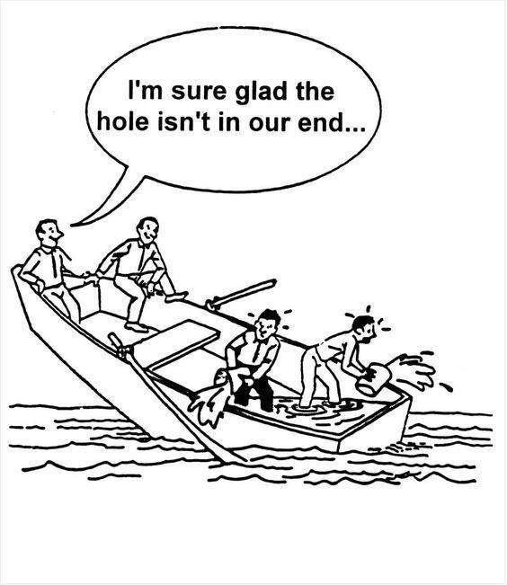

Slide 5
Social Innovation is at the Intersection of Many Approaches…
DEMOCRATIC
PARTICIPATION
MULTI-SECTOR
COLLABORATION
SOCIAL-ENVIRO
MOVEMENTS
WHOLE SYSTEMS
THINKING & COMPLEXITY
DESIGN
THINKING
ORGANIZATIONAL
LEADERSHIP
& CHANGE
SUSTAINABILITY
POLICY
DEVELOPMENT &
SERVICE DESIGN
Positive Social Change
COMMUNITY
DEVELOPMENT
ACTION RESEARCH
& LEARNING
SOCIAL
ENTERPRISE/
ENTREPRENEURSHIP
INNOVATION LABS
SOCIAL
TECH
SOCIAL
FINANCE/
IMPACT INVESTING
CORPORATE
SOCIAL
RESPONSIBILITY

Slide 6



What kind of problem are we trying to solve?
SIMPLE | COMPLICATED | COMPLEX
Baking a cake | Sending a rocket to the moon | Raising a child
Right recipe essential Same result each time | Formulas needed, specific paths + policies Can be repeated with success | No right recipe Context changes problem Experience helps, but doesn’t guarantee success

Slide 7
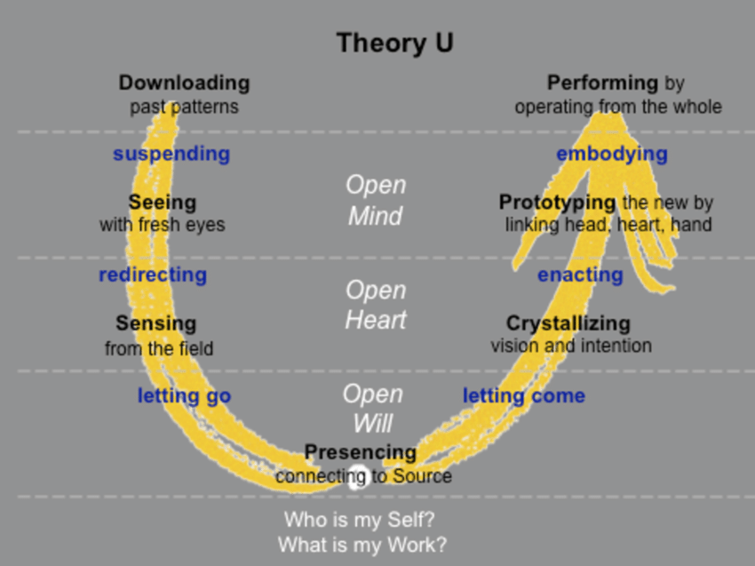
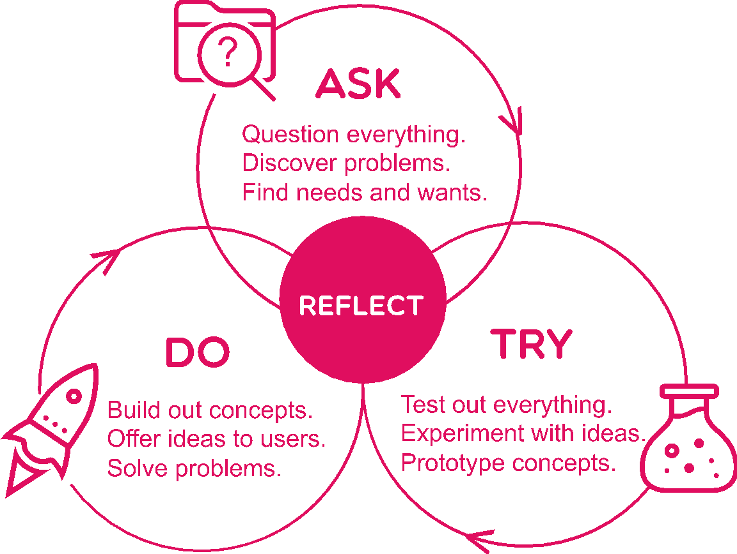
THEORY U: ONE PROCESS, SIX LEADERSHIP
CAPACITIES | SCHARMER © 2009
STRATEGIC DESIGN PROCESS | QUAYLE AND BEAUSOLEIL © 2017

Slide 8
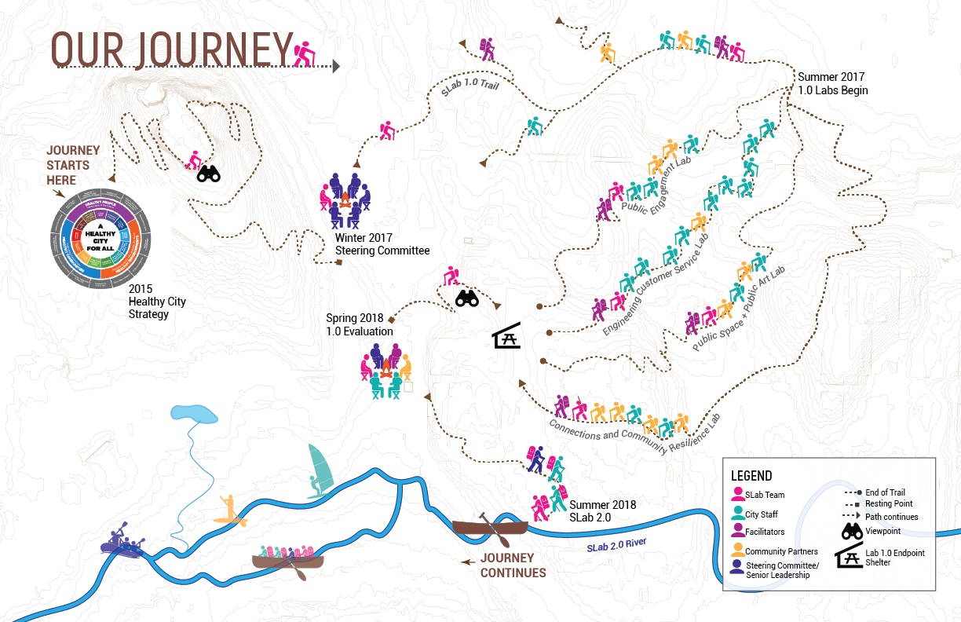
City of Vancouver Solutions Lab

Slide 9
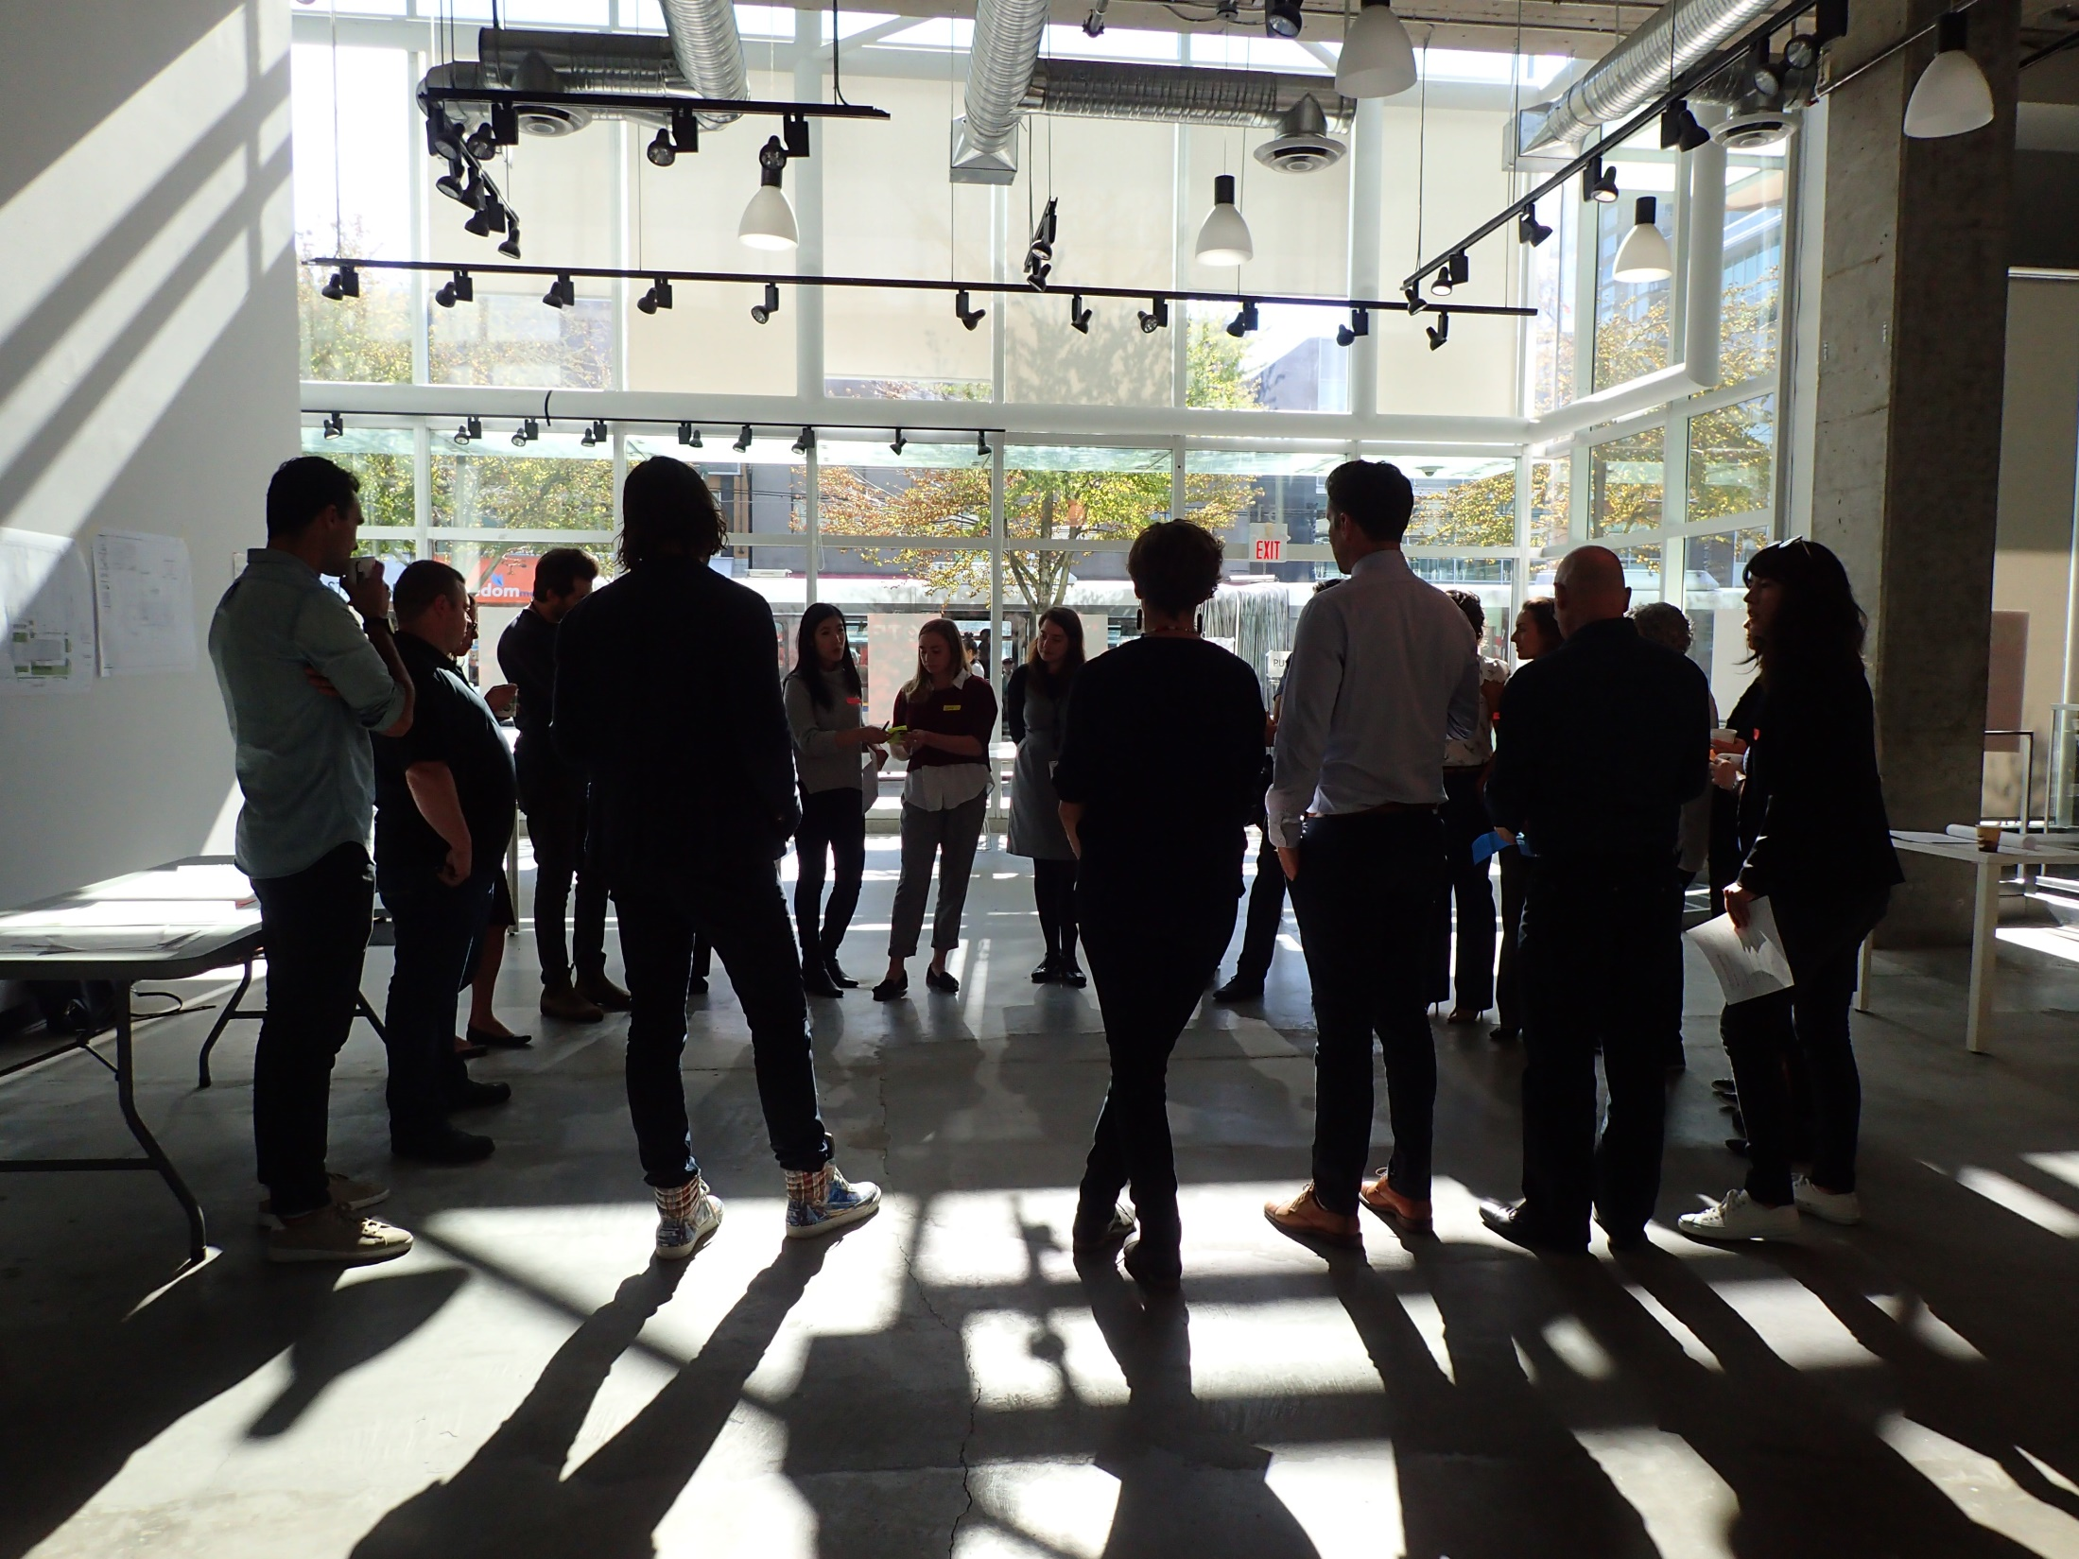

Slide 10
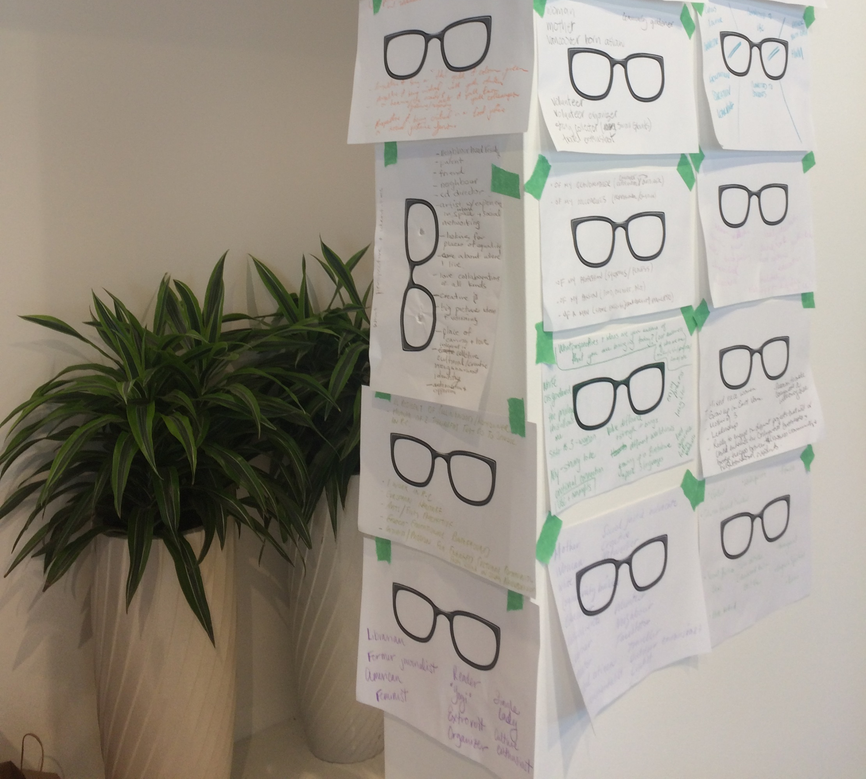

Slide 11
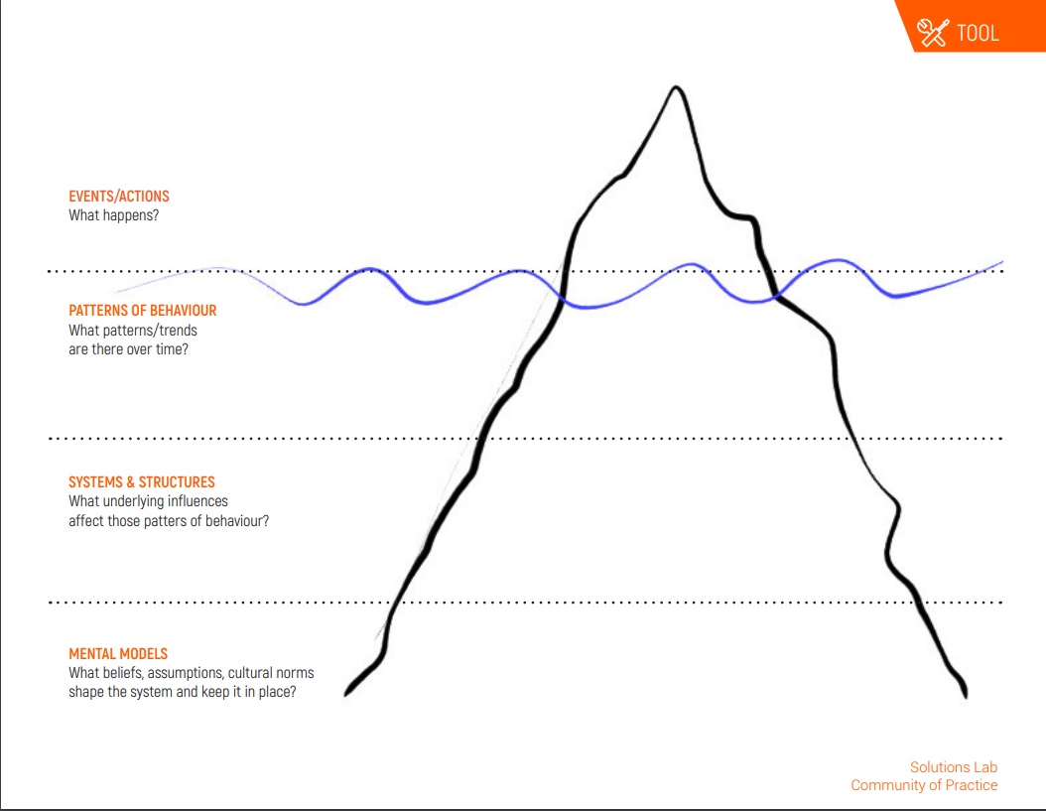
Iceberg Mapping

Slide 12
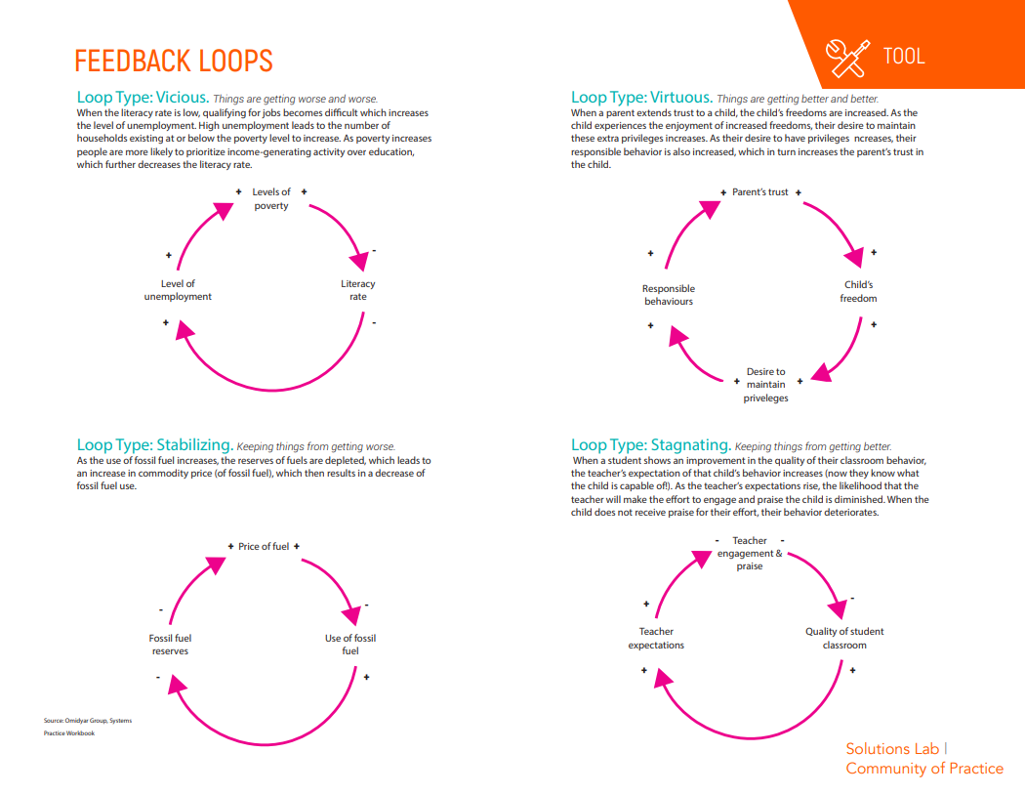

Slide 13
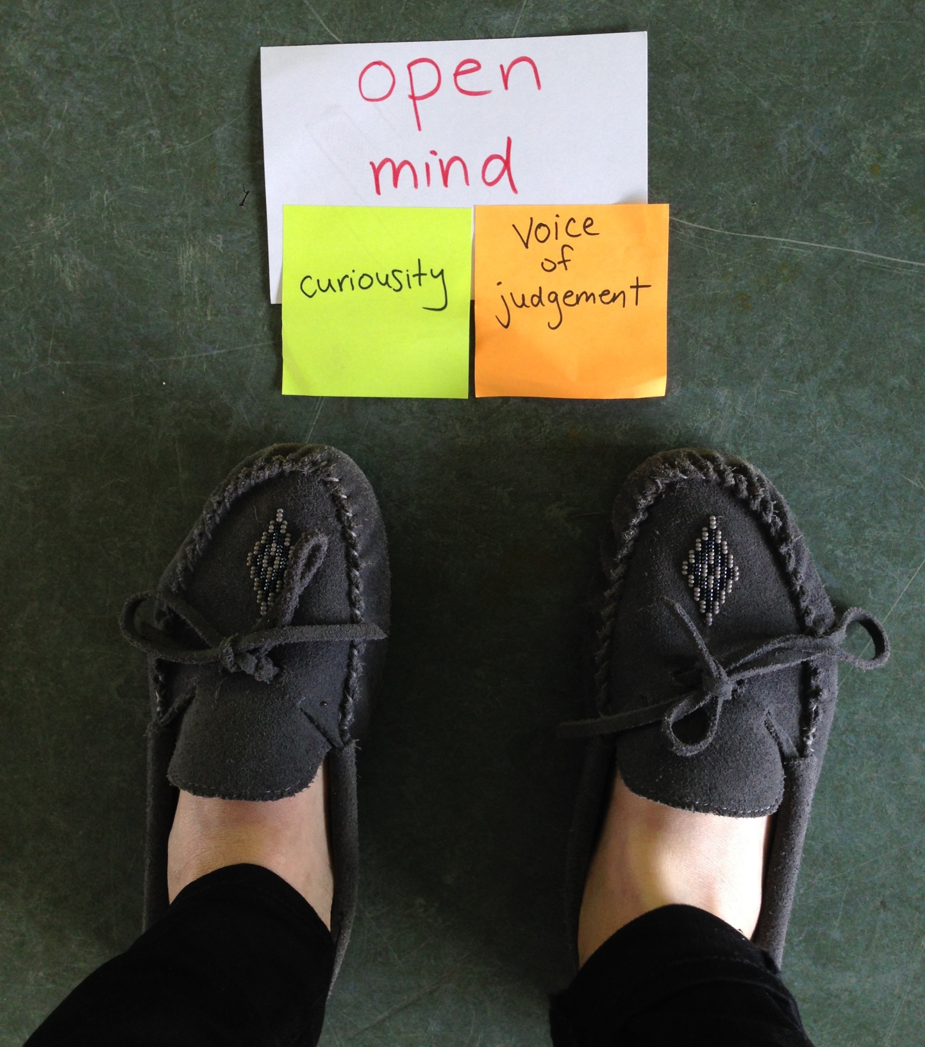

Slide 14
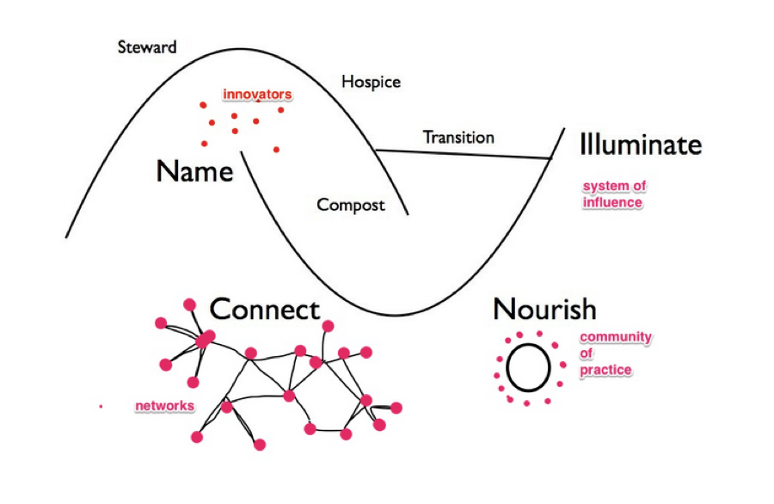
Two Loop Theory of Change
SOURCE: BERKANA INSTITUTE

Slide 15
Resources
Books:
Social Labs Revolution, by Zaid Hassan
Thinking in Systems: A Primer, by Donella Meadows
Design Leadership, by Moura Quayle
Emergent Strategy, by adrienne marie brown
The Surprising Power of Liberating Structures, by Henri Lipmanowicz and Keith McCandless
This is Service Design Doing: Applying service design thinking in the real world, by Marc Stickdorn, et. al.
The Fifth Discipline, by Peter Senge
Online:
Social Innovation Canada: http://www.sicanada.org/
A Primer on Social Innovation– Social Innovation Generation http://www.sigeneration.ca/home/resources/primer/
Leverage Points: Places to Intervene in a System, Donella Meadows http://donellameadows.org/archives/leverage-points-places-to-intervene-in-a-system/
Nesta States of Change: https://states-of-change.org/
Apolitical: https://apolitical.co/
Vancouver’s Solutions Lab: https://vancouver.ca/solutions-lab

Slide 16
Labs for Libraries:
Social innovation for designing our future
Contact:
Lindsay Cole – lindsay.cole@vancouver.ca or @lindsaycole
Heidi Schiller – heidi.schiller@bpl.bc.ca

