Slide 1
Putting the User in the Center
Design Thinking in Digital Literacy Services
Lydia Zvyagintseva, Edmonton Public Library

Slide 2
Context

Slide 3
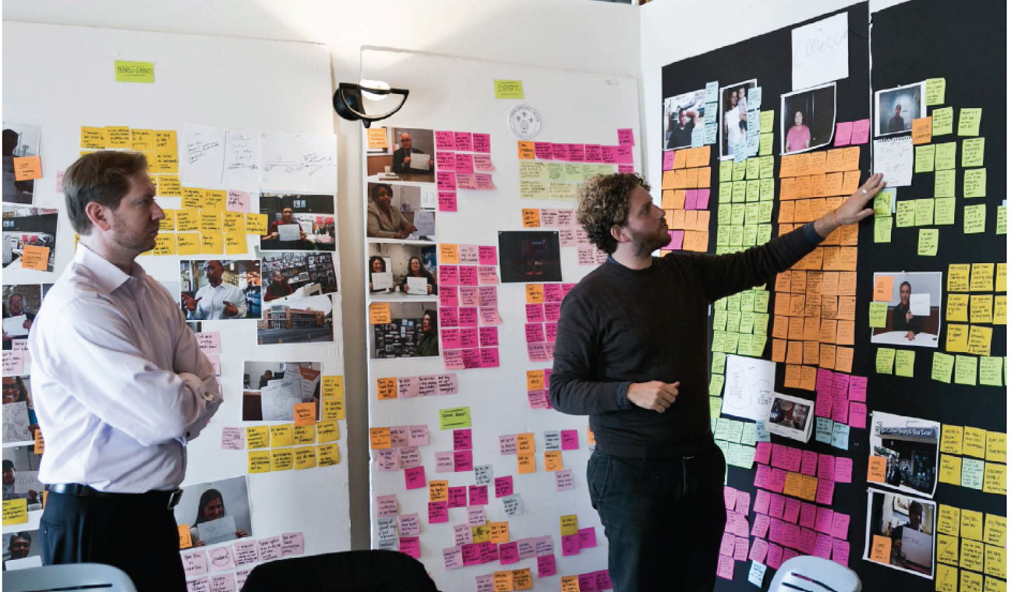

Slide 4
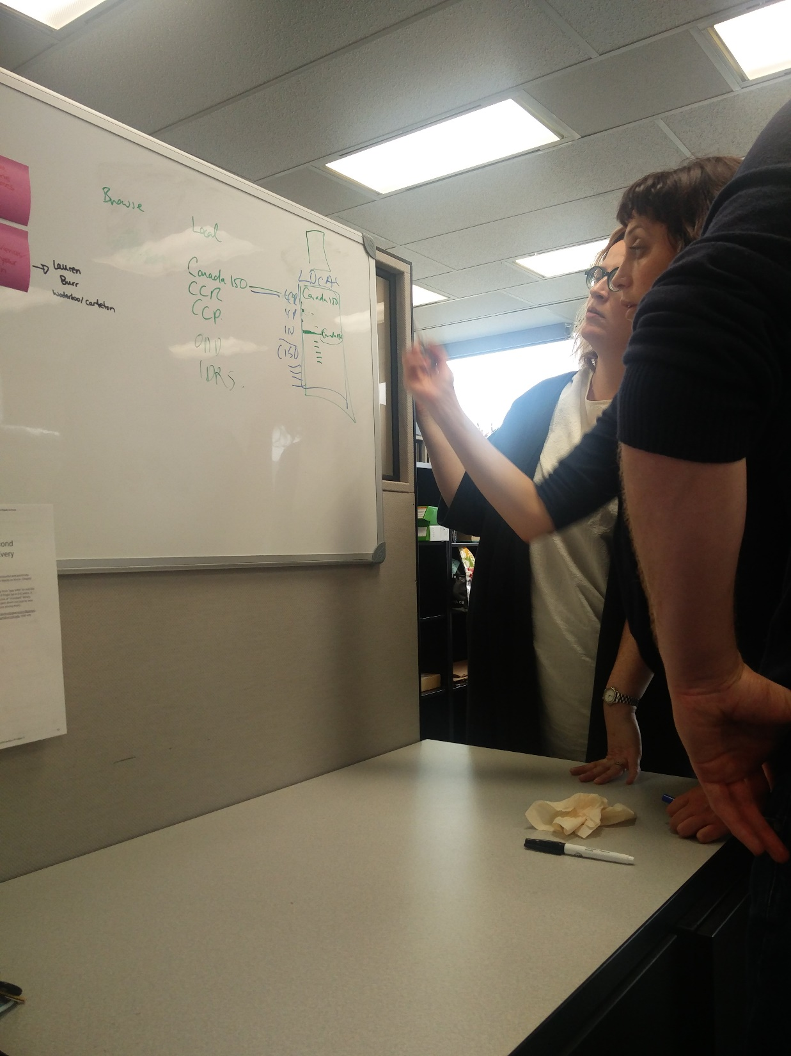
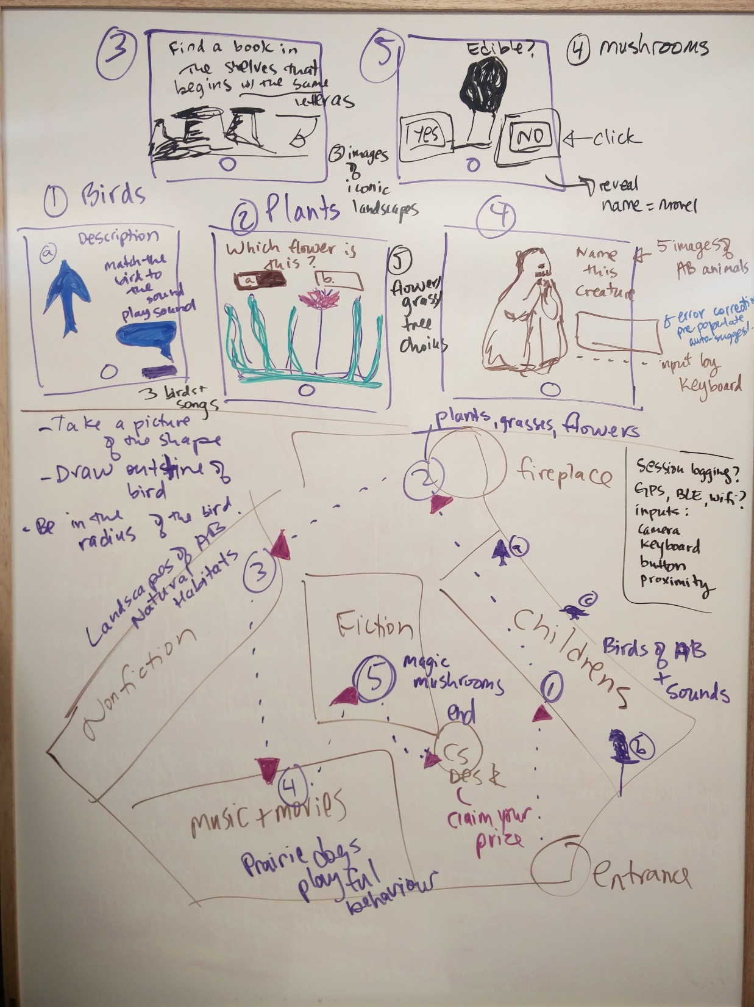
Notes:
White-boarding can be a technique in design thinking, but it is not its extent. For example, on the left, Digital Literacy Initiatives librarians are collaboratively working through information architecture schema for the growing suite of local content at EPL.
On the right, I am planning a scavenger hunt game to be designed in collaboration with Computing Science students at UofA. I knew that my challenge was some sort of mobile location-based experience, but no specifics of what the content, gameplay logic or scope of the project would be.

Slide 5
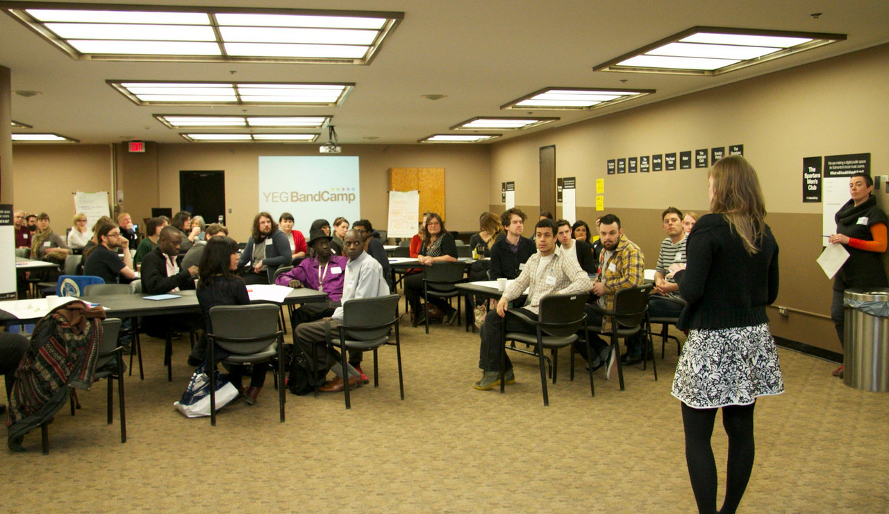
Notes:
Or when our former colleague, Alex Carruthers, ran a community charrette/design session to think through a new service for a digital public space, which became the Capital City Records. She asked community partners a series of structured questions but left it up to the participants to figure out how to answer.
“We’re building a digital public space for Edmonton’s music community – what will/could/should it do?” Among the advice we received was that the site should offer regularly changing multimedia content, should be interactive, and should be curated by members of the community.

Slide 6
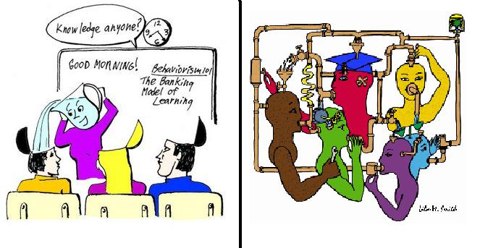
Notes:
Constructivism is a paradigm or worldview which posits that learning is an active, constructive process. The learner is an information constructor. People actively create their own subjective representations of objective reality (the world around them). New information is linked to prior knowledge, thus mental representations are subjective.

Slide 7
Constructivist learning
1. Problems are “good”
Discovery oriented
Multiple paths to solve, multiple solutions
Uncertainty is OK
Ownership / empowerment

Slide 8
Constructivist learning pt. 2
2. Learning is collaborative
Questions help learners construct meaning
Conversations help share, create, and test ideas
Sharing between groups

Slide 9
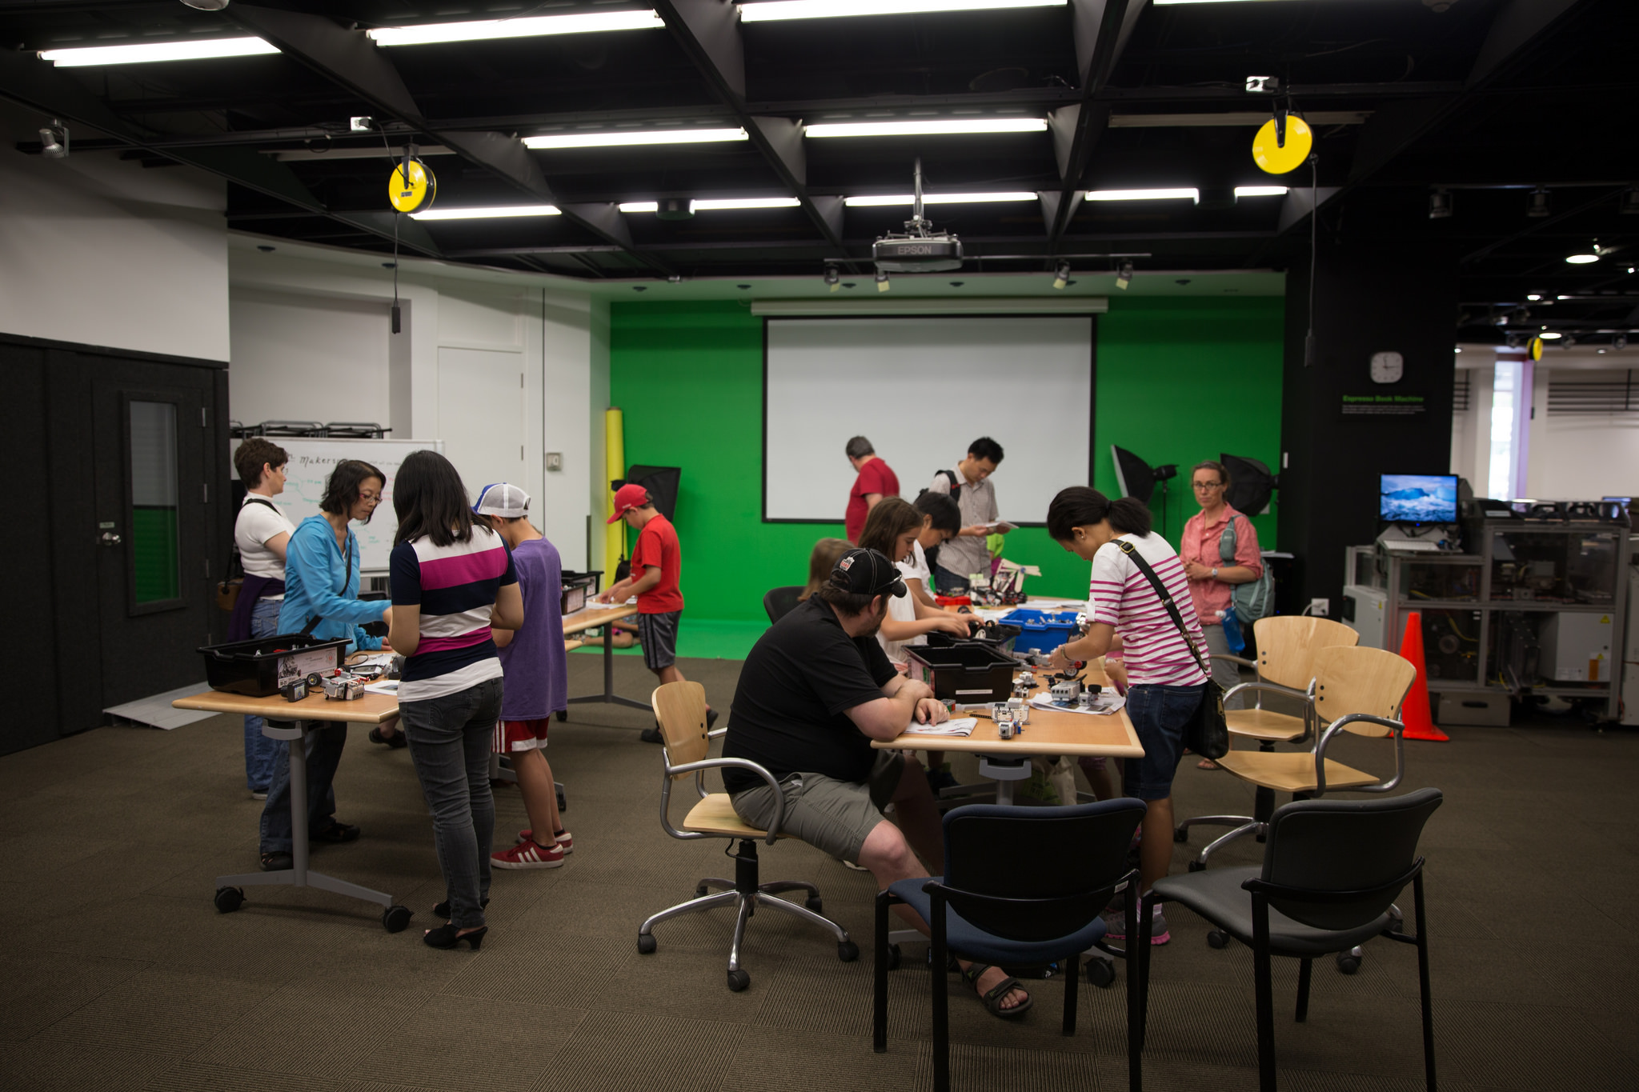
Participatory environments
Notes:
By virtue of putting makerspaces in libraries, we need to consider how users experience those services, and therefore need to think through intentionally creating a participatory environment.

Slide 10
Design thinking activity

Slide 11
The process
Premise: design and prototype a product/service based on specifications
Break into groups 2-4
Design:
Exploration
Making
Pitch
Debrief

Slide 12
Mission:
Design a product/service/space/system, which will be pitched to a major venture capital firm, that also improves life for your intended customers.

Slide 13
Design (15 min):
Exploration
Prototyping
Pitches!
Debrief
Notes:
Debrief:
1. What did you like about this process?
2. What challenges did you have to overcome in making your prototype?

Slide 14
Why and how it fits together

Slide 15
STE(A)M Framework
Welcome
Challenge
Exploration
Making/prototyping
Sharing, celebration, reflection
Notes:
This framework is based on research on participatory learning and to some degree on Family Creative Learning Guide.

Slide 16
STEAM framework is flexible and aligns well with structure to foster collaborative, safe environments for learning.
Notes:
Key elements of the framework include group or team participation.
The “how” is left up to the participants to decide.
There is openness to a creativity in how to solve the problem, though the terms are defined.

Slide 17
Case Studies:
Digital Learning Day
Robotics programs: ie. Maze Dash
Lego Robotics staff training
Tween Services Report
CX Intern Librarians 2017-2018
Digital Exhibits Service

Slide 18
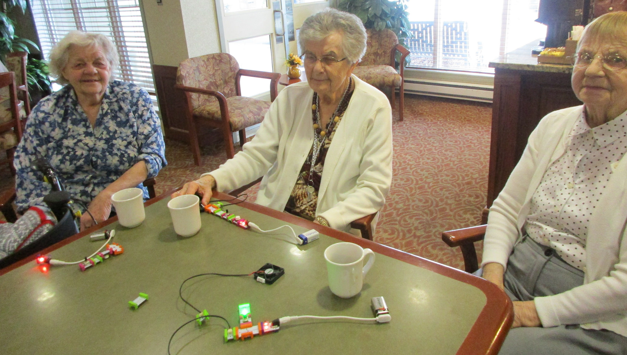
Digital Learning Day Creations

Slide 19
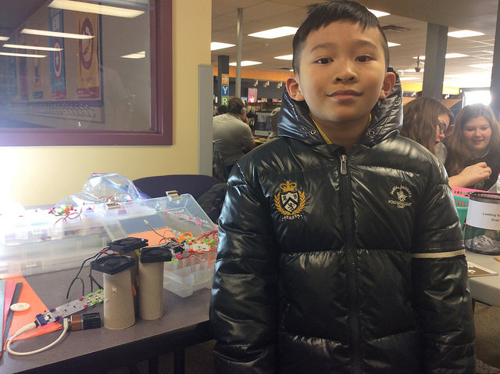
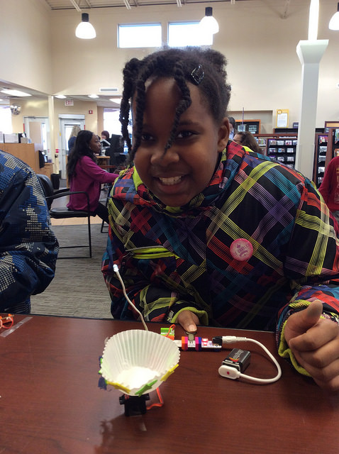
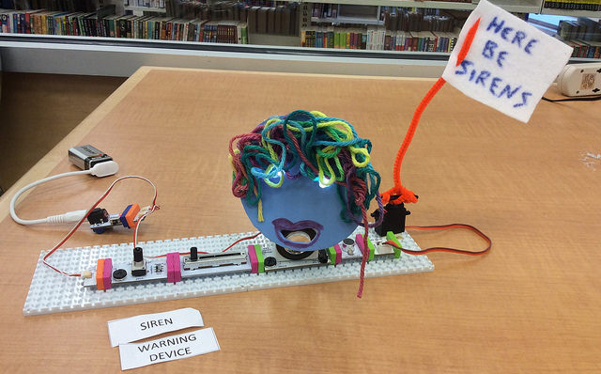

Slide 20
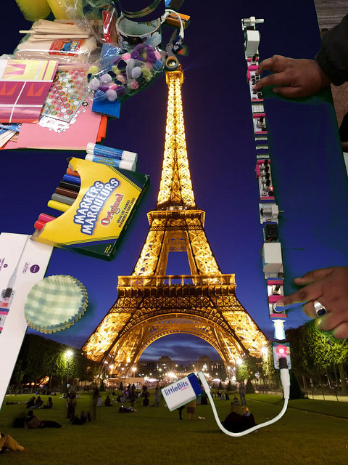
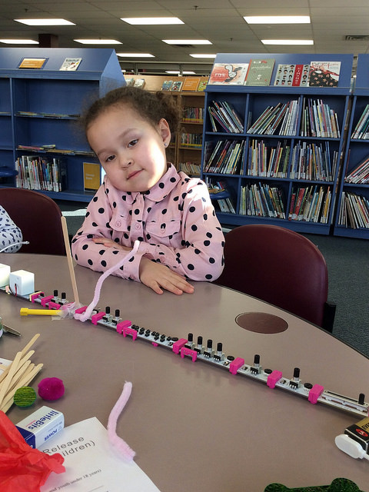

Slide 21
Lego Robotics Training
1. Welcome participants!
2. Introduce yourself, the format being delivered, and any ground rules.
3. Icebreaker game to partner kids up or put them in small groups and have them learn each other’s
names.
4. Break out into small groups.
5. Midbuild
sharing (encourage participants to observe other creations!)
6. End of build challenge or sharing. Have participants celebrate each other’s accomplishments and
think about building possibilities the next time they attend.
Example: “My favourite thing about your robot is…” / “One thing I would change about my robot is…”

Slide 22
Maze Dasher Program
Program Outline:
1. Welcome & Introduction [5 minutes]
Guidelines – Be safe, have fun, go with the flow
Housekeeping – Bathrooms, fire exits, etc.
Introduce yourself (and any helpers you may have)
Ask the children question related to the topic. (The idea is that it helps build community and makes them seem less of strangers to each other, and also maybe more willing to help each other if anyone needs help later on.)
Has anyone ever raced robots before?
What do you know about mazes?
2. Activity #1 [10 minutes]
Break into teams (one team for each Dash)
Brainstorming
Talk about the different potential mazes you can build
Think about how the robot moves—so what obstacles are easy/hard to get by
3. Activity #2 [30 minutes]
Each team builds a section of the obstacle course OR
Each team builds an obstacle course for their opponents
Teams do test runs to make their course as good as possible
5. Celebration & Sharing (STEAM) __________________________ [15 minutes]
Obstacle course races!
Contest to get the best time
Race through all the courses at the same time and see who comes first
Relay races with all team members going back and forth through the courses
Etc.
Reflection:
What worked? What didn’t?

Slide 23
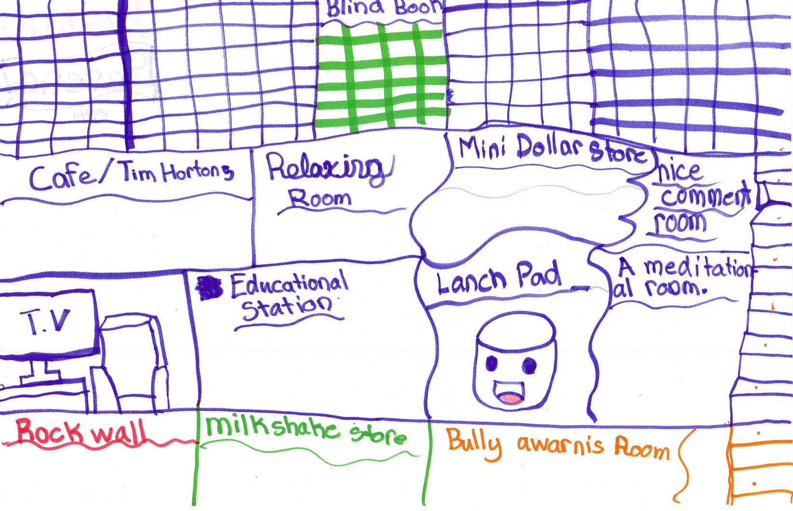
What Tweens Want Report: Ideal Library Activity

Slide 24
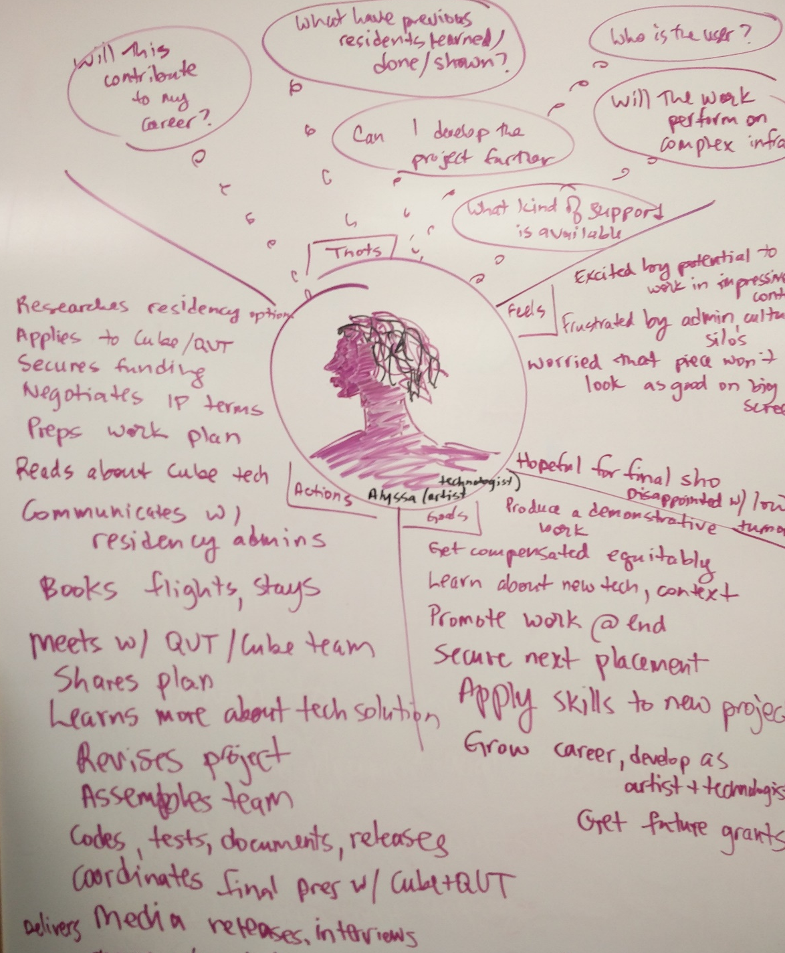
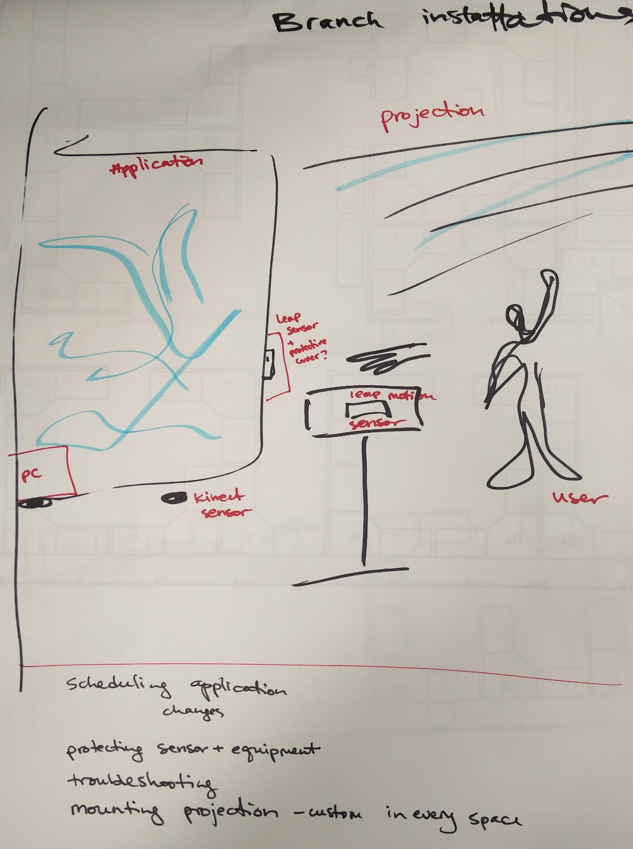
Digital Exhibits Service Planning
Notes:
Why I became interested in this process
Tools applied – human-centered design principles, user journey mapping, ideation, prototyping.

Slide 25
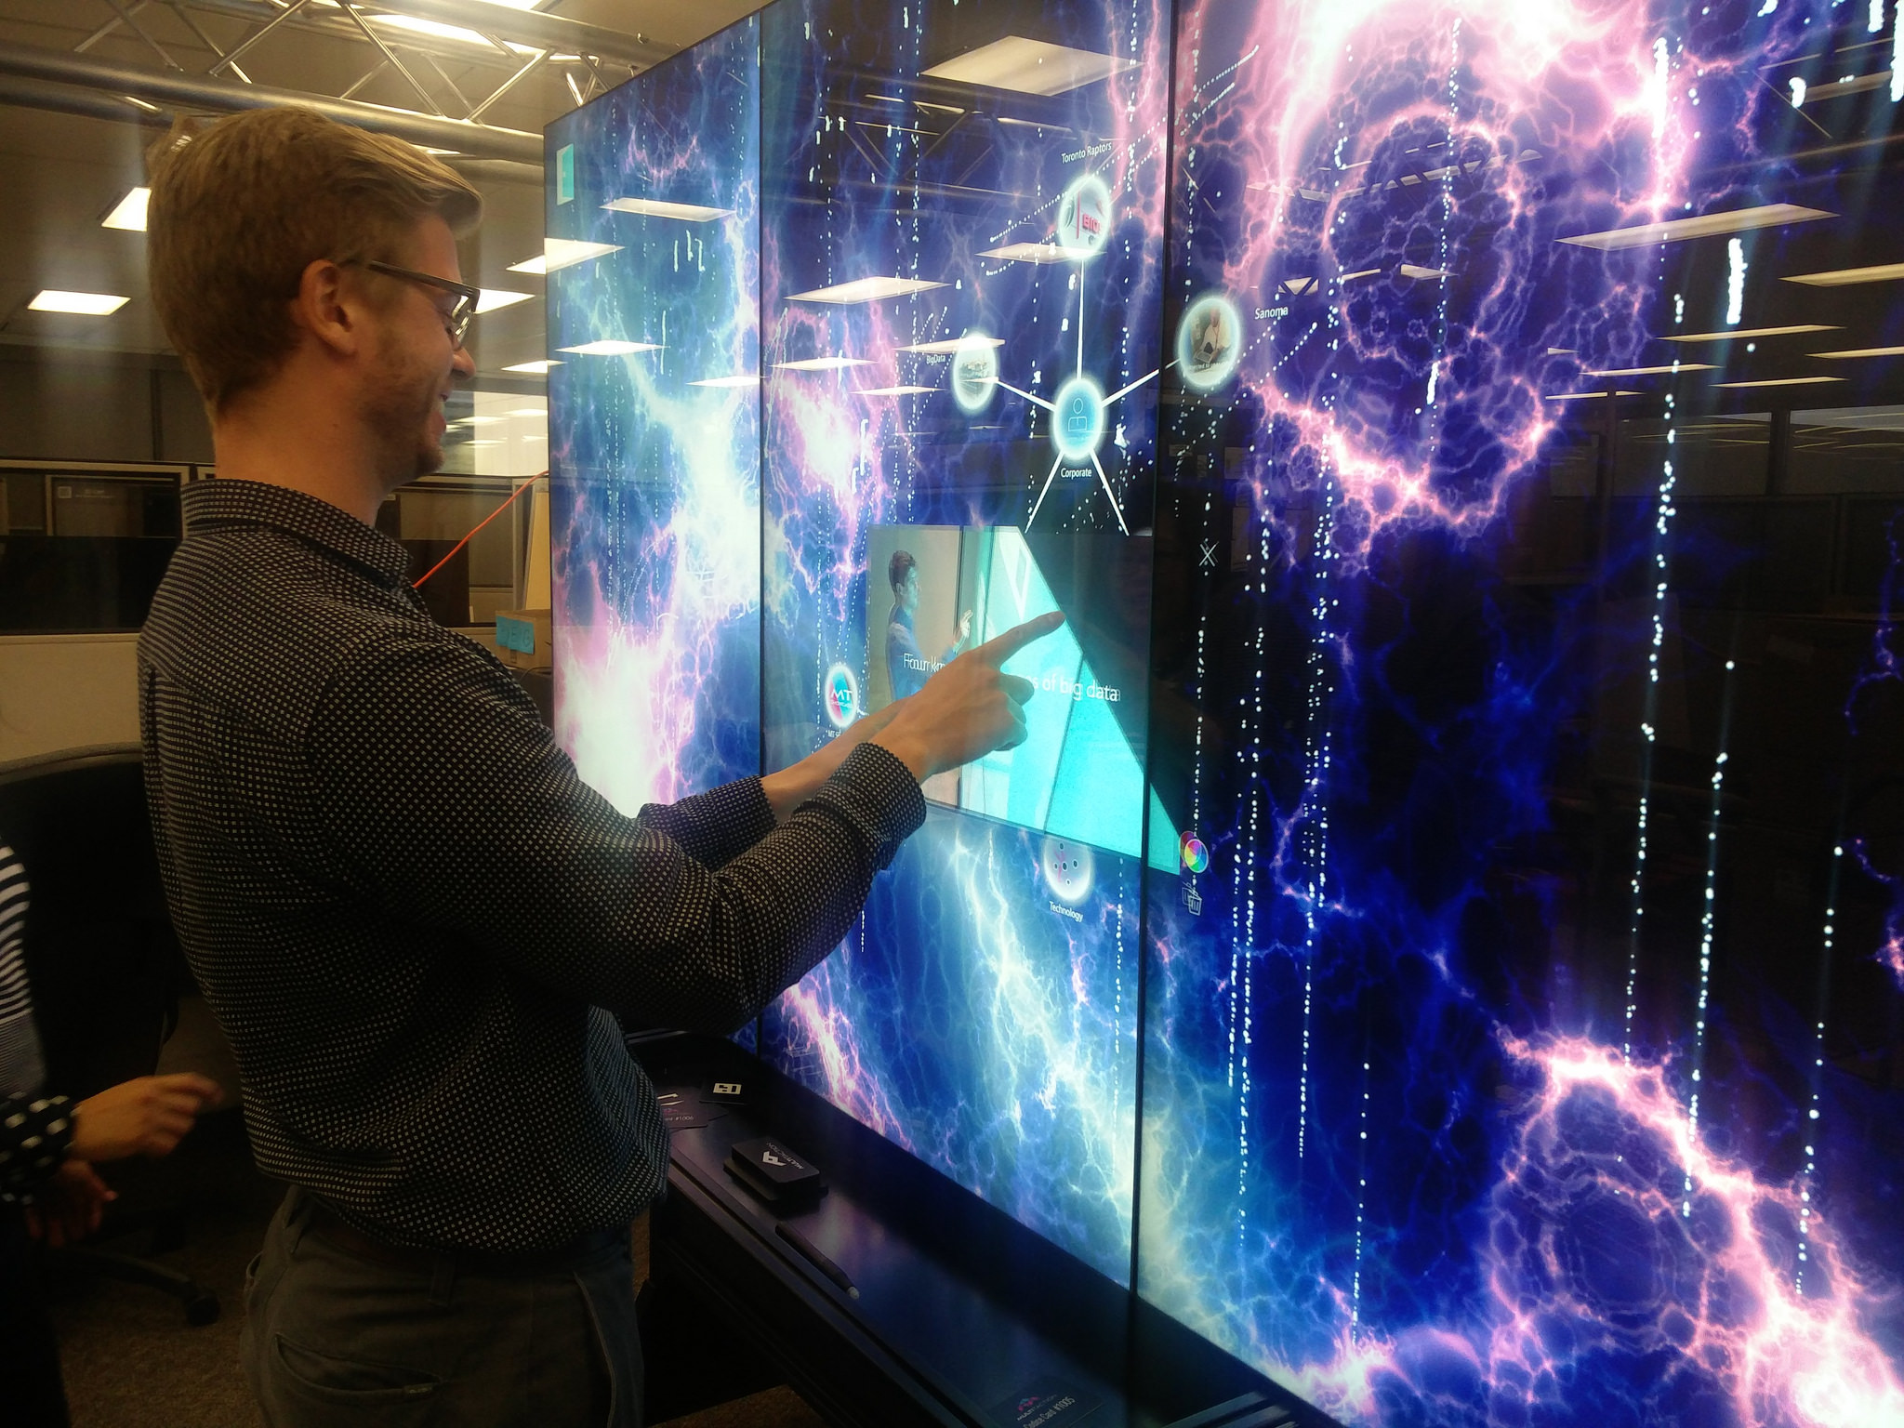

Slide 26
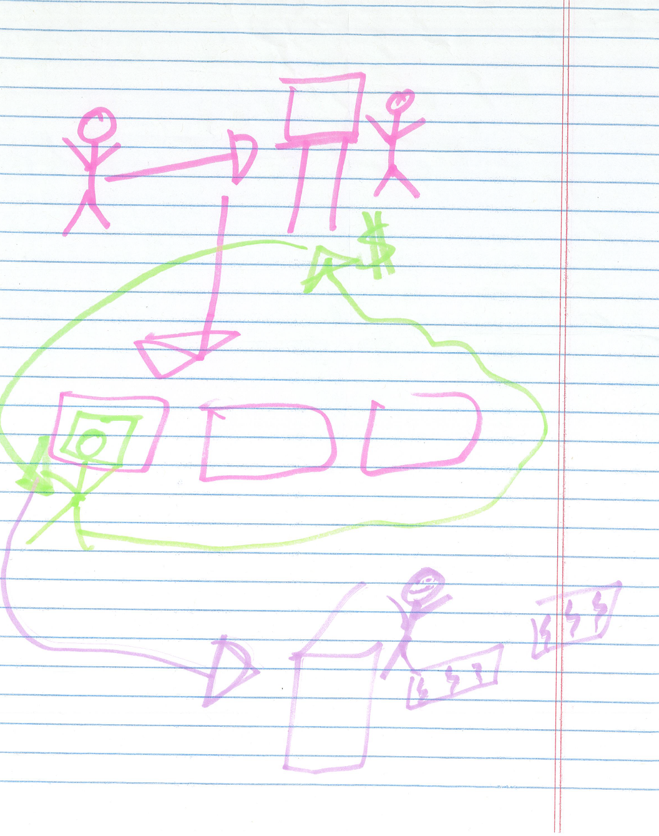
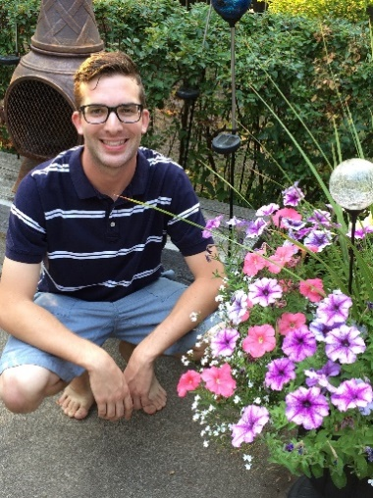
CX Intern Research Project

Slide 27
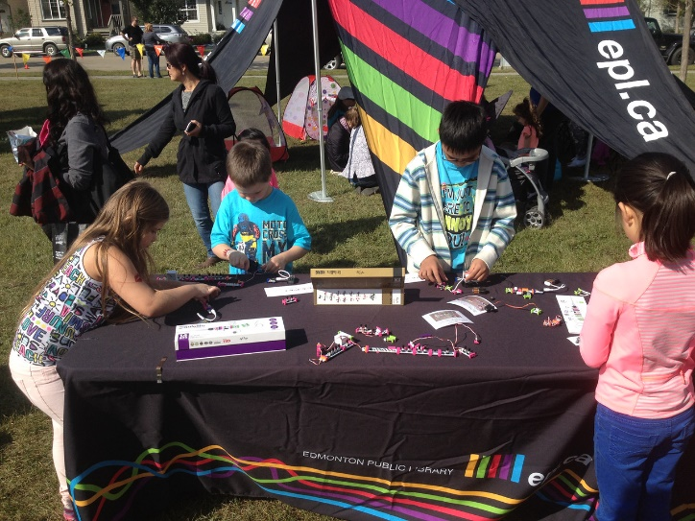
Design Thinking Activity
Instructions
Each team must incorporate the two words provided.
Your team has ___ minutes to design and build a prototype for a product or service that can be pitched to a large technology company.
The product or service should make life better or easier for its intended audience.
At the end of the build/prototyping phase, your team will pitch the design to other teams.
Next Steps
Other challenge ideas?
How could makerspace resources like LEGO, LittleBits, Makey Makey, or 3D printing be incorporated?
More K-12 resources: www.epl.ca/teachers
Activity adapted from dschool.stanford.edu K-12 Lab: https://dschool.stanford.edu/groups/k12/ and IDEO
Design Thinking for Educators Toolkit: www.designthinkingforeducators.com.

Slide 28
Product or Service Name:
Team Members:
Describe / draw the problem(s).
Describe / draw the solution.
Pitch:

Slide 29
THANK YOU!
lzvyagintseva@epl.ca
harnason@epl.ca

