Slide 1
Kicking it Old School
Bringing Historical Textbooks out of the Basement and Into Your Browser
Kim Frail & Debbie Feisst University of Alberta Libraries

Slide 2
Kicking it Old School: Today’s Lesson Plan
Project Vision
Wiedrick’s Legacy
Why This Project?
Progress to Date – Formative Assessment
Digitization – Planning, Prep & People, Please
Project Management & Milestones
Lessons Learned

Slide 3
To provide the UofA community, as well as provincial, national and international researchers and educators, with access to a unique, comprehensive, discoverable digital collection of over 10,000 French and English language historical textbooks that were used in Alberta schools from the late 1800’s to present.
Project Objective

Slide 4
Wiedrick Family Legacy
2011 bequest from Mary Wiedrick, wife of Laurence “Laurie” Wiedrick
Laurie Wiedrick had deep roots in Edmonton’s school library and education communities
University of Alberta's Department of Elementary Education
coordinated the University's Curriculum Laboratory from 1967-81
assisted in the establishment of the University's School of Library Science
Coutts Library Advisory Committee decision to use bequest to continue digitizing the HT Coutts historical curriculum materials

Slide 5
Why This Project – Doing Our Homework
Supports a project that is in alignment with the donor’s history of work at the University of Alberta.
The Coutts Historical Curriculum Collection was established ca. 1964 with Laurie Wiedrick developing the mandate Most comprehensive collection of this nature in the province.
Builds on the aspects of the collection that have already been digitized.
Facilitates unmediated and online access to this “hidden” collection.

Slide 7
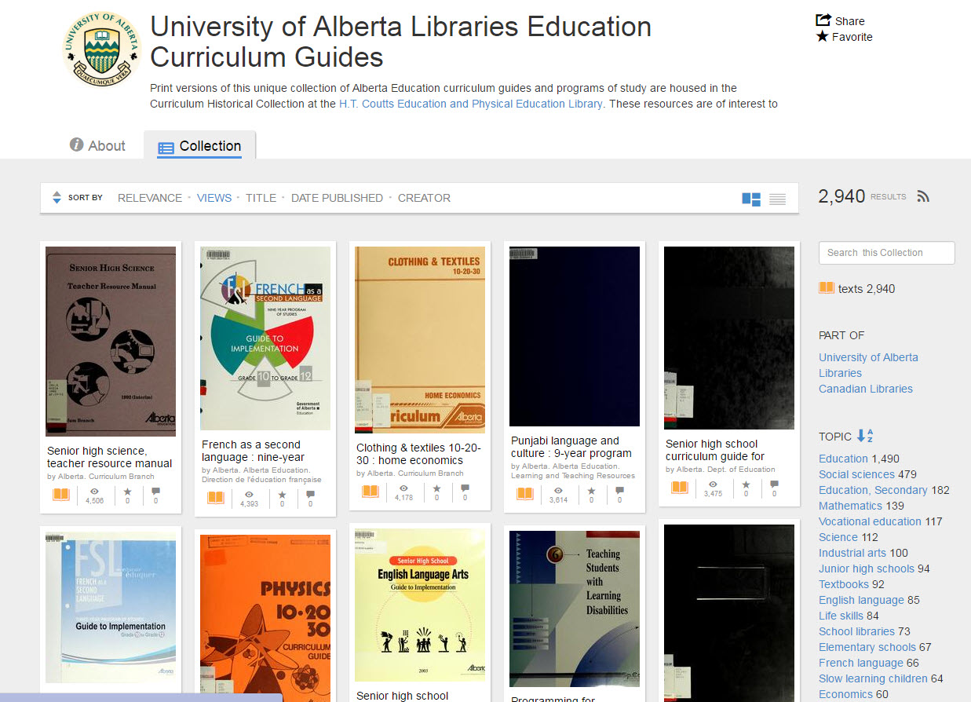
Building on What Our Users Need
In response to requests from faculty and students, a portion of this collection, the curriculum guides, were digitized in 2012.

Slide 8
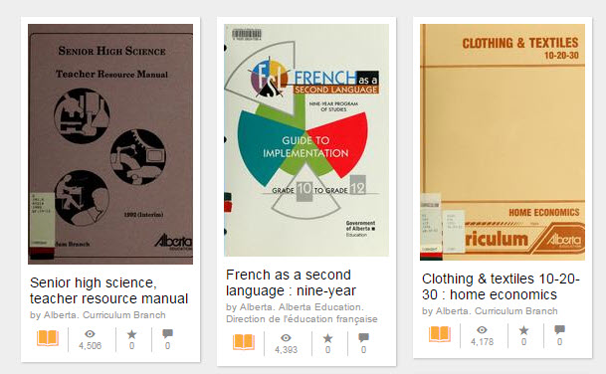
Progress Report
To date, 500 curriculum guides have been digitized and are being used.
Senior High Science has been downloaded over 4500 times!

Slide 9
Digitization
Established relationship with Internet Archive (gov docs, postcards, micro, media, etc) Set scanning fees – known budget Fine-tuning of scanning procedures Documentation required – spreadsheets galore!
Secondment in 2015
Materials prepped for scanning

Slide 10
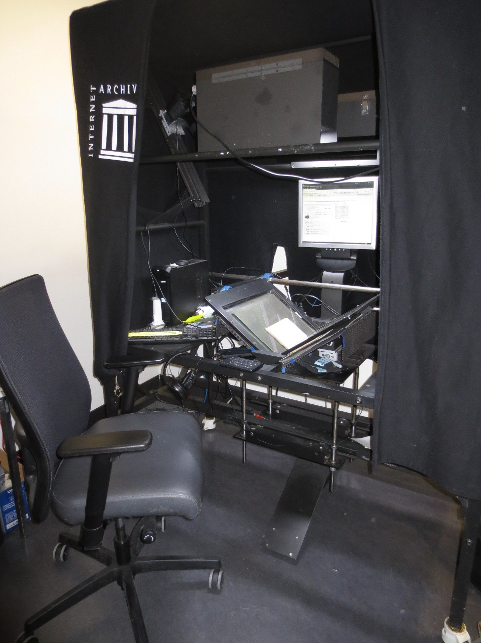
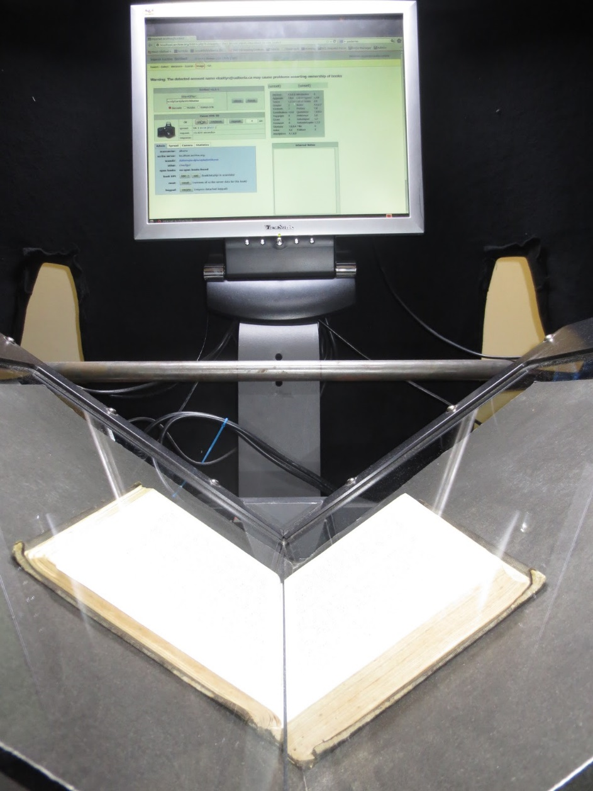
Set up of Internet Archive Scribe monograph scanning station
Full time scanning position
Quick, almost instant access
Notes:
Deb
Here is the set up that we have in Cameron library
It is a cradle scanner with 2 over head cameras - Canon 5D Mark II cameras
Scribe
Fast paced, large output
-Foot pedal -Non-destructive, cushioned glass platen with 'shock absorption' -LED lighting -All images shot in color -Structural metadata(Table of Contents, Chapter Headings, etc.) added while scanning using small keypad -Barcoded Inventory control system that tracks each item

Slide 11
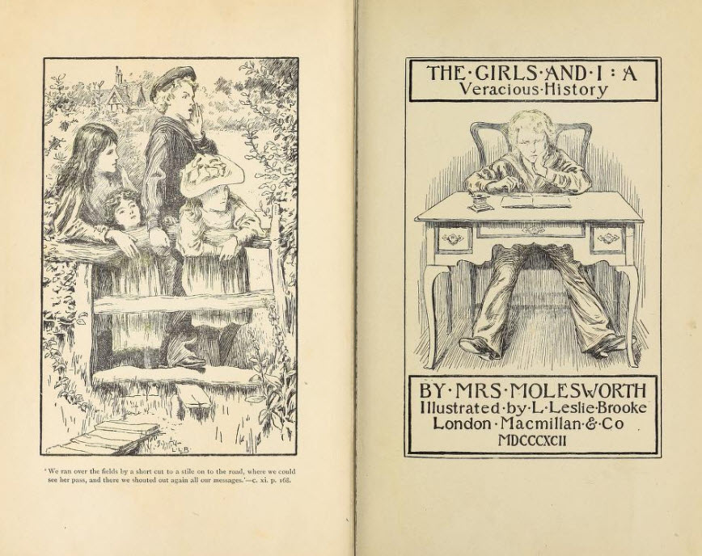
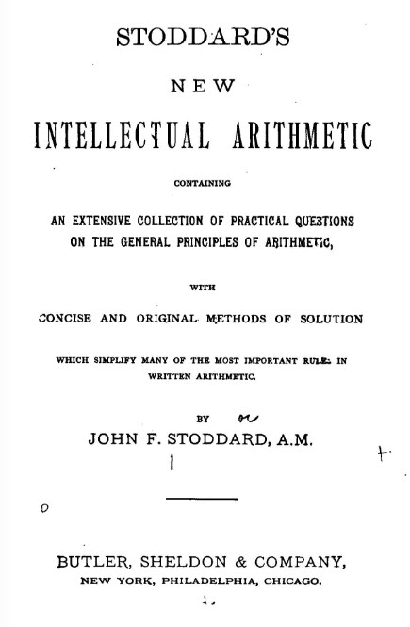
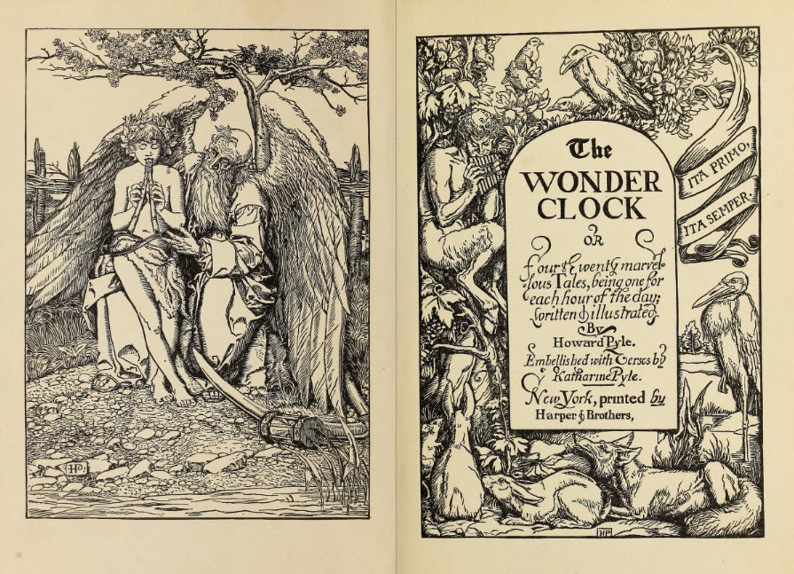
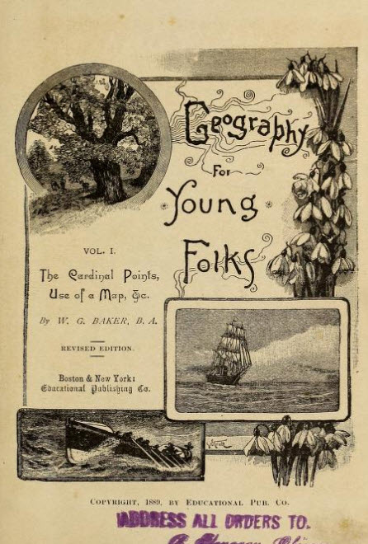
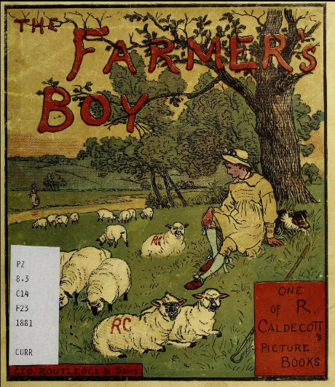
Some Gems from the Collection & Show and Tell

Slide 12
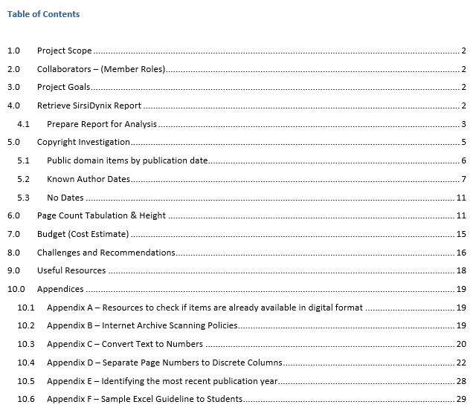
Getting Started – Project Documentation

Slide 13
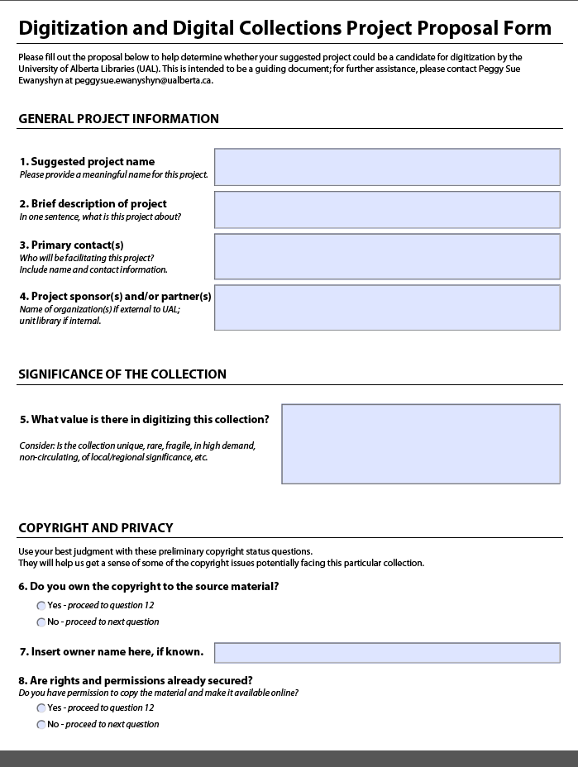
Project Specs
Any Internal/Guidelines or specs?
Internal
UAL Proposal Form
General Project Info
Significance of Collection
Copyright/Privacy
Timelines/Deadlines
Online Access

Slide 14
Project Specs
External - Internet Archive (IA) Specs
Dimensions
Scribe Scanner (IA) 10.5" x 14.5.“
Foldout Scanner (IA) 18.5in x 12in
Metadata
Criteria for exclusion
metal coil bindings (can damage scanning glass)
very tight binding that will not lay flat

Slide 15
Copyright
Publication Date pre-1895 = Public Domain
Personal Author
Author death date known = death date + 51 years
Author death date unknown = assume author lived until 90, then + 51 years
Author birth date unknown = assume author wrote at age 20 and lived until 90, then + 51 years
Corporate Author
Corporate author = Date of publication + 51 years
Notes:
Kim
This image represents how we feel about copyright
Two of the things that were most time consuming in preparing the lists of items to be digitized were:
1. estimating page count and 2. investigating copyright
When we began it was a priority to start with the “low hanging fruit” so to speak or the items already in the public domain
Janice needed to split the initial report we had gotten from the SIRSI into the categories you see on the slide and then start applying the algorithms listed here
Very time consuming as you can imagine
There is a detailed explanation of how she did this in her final report if anyone would like to take a peek after the presentation
Image Source: https://www.pinterest.com/artdecogal/scream-queens/
Not CC! Remove before uploading

Slide 16
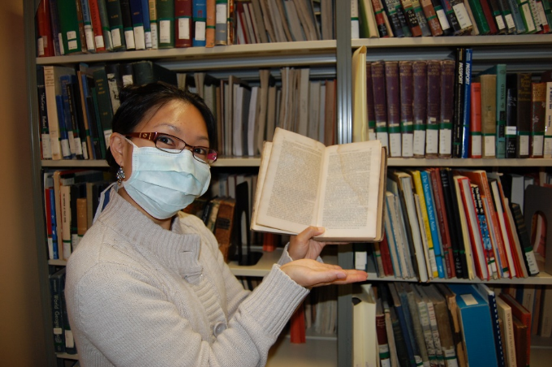
Estimating Page Count
Some data obtained through catalogue records
Manually check monographs
Identify oversized items (measure height)
Record information and tabulate total number of pages for collection

Slide 17
Estimating Page Count

Slide 18
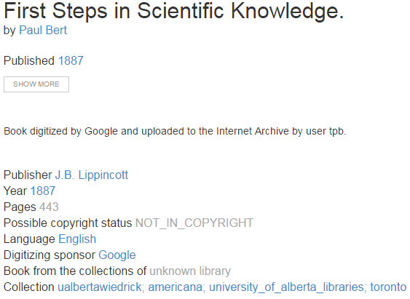
Already Digitized?

Slide 19
Digitization Prep

Slide 20
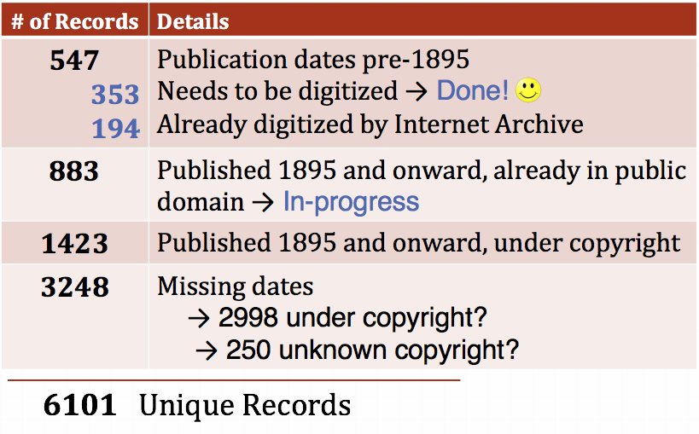
Project Milestones

Slide 21
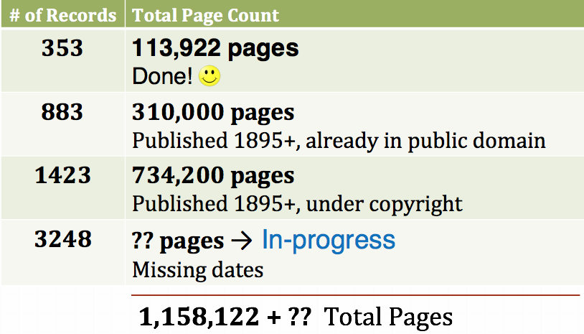
Project Milestones

Slide 22
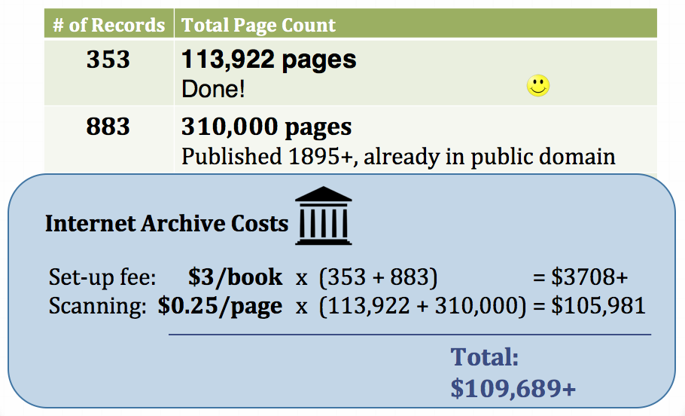
Project Milestones

Slide 23
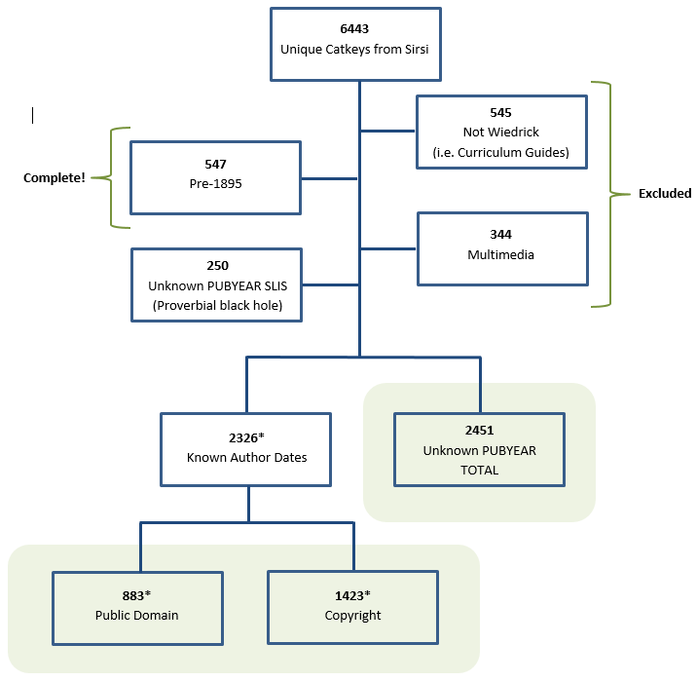
Project Management & Milestones
Documentation & Communication = Essential
Regular Meetings
Meeting Notes & Action Items
Final Reports/Exit Documentation

Slide 24
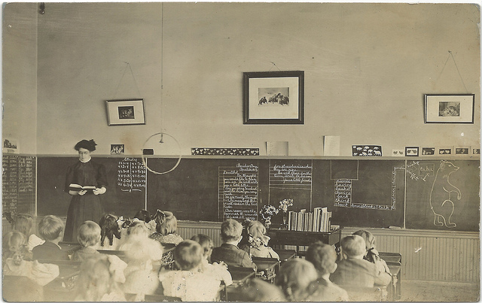
Lessons Learned

Slide 25
Lessons Learned
Version control and naming conventions must be established from the beginning
Provide clear directions to project members
Conduct trial runs
Look really carefully at first report to see what is needed
Use test samples

Slide 26
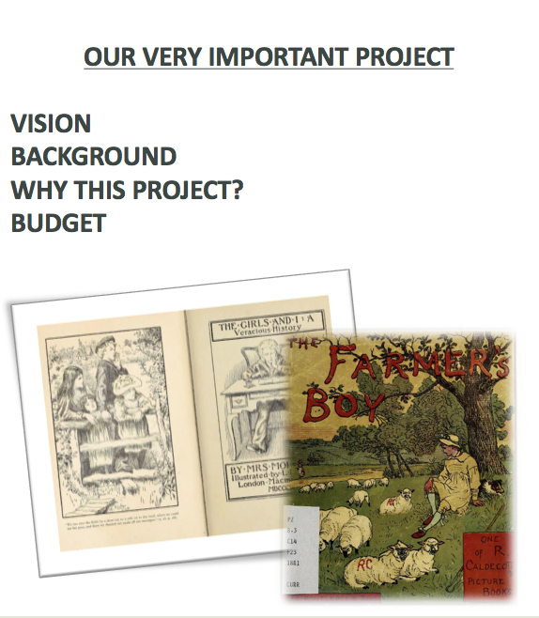
Lessons Learned
One pagers are important
Elevator speech
Buy in from organization
Guidelines for creating – Who? Why?
“Excel-Fu”

Slide 27
Alicia Cappello
Adrian Castillo
Danoosh Davoodi
Sharon Farnel
Viera Hotar
Spencer Holizki
Janice Kung
Denis Laplante
Nicole Loroff
Karen Willsher
A+ ‘Students!’

Slide 28
Thank you! Questions?

Slide 29
Image Credits
Slide 1: Image: https://flic.kr/p/cUB2o7 Dennis Jarvis
Slide 24: Images
https://www.flickr.com/photos/upnorthmemories/6773002151/in/photolist-bjvpza-bjvpt8-58M5yM-7sNdmN-dkuAok-58M6dD-EsECC7-7sJgiZ-7ZwNpj-zGikEg-7sJfUg-cGXSeo-baCBhD-bTWtaX-cKq1xS-qfY9TM-58s3zZ-ioqcmC-dpNLE8-58rZCp-6ohF5c-dpNLK6-cKpyod-cKpyt9-ekhzhz-aGMgQ2-cKqkkJ-cKpcBd-cKqkgQ-ds1Wgf-dc2PUX-dWWAju-cGXS45-8BJg6s-asogpX-qVj1Rn-rBQAgm-bpx2NU-bCrXVk-bPgUwz-dWQWwi-cGXS8m-qfYqhc-dpNVTj-cKpyqC-dWQWi4-rknT2d-5fYV1H-9zKxjT-biorvM
https://creativecommons.org/licenses/by-nc-nd/2.0/
Slide 25:
Images https://pixabay.com/en/apple-education-school-knowledge-256261/
License: https://pixabay.com/en/service/terms/#usage
Slide 29: Phil Roader https://flic.kr/p/dcBoGn

