Slide 1
Promoting your library through photographs
20+ Ideas for photographic posts on a shoestring

Slide 2
Instagram is a visual medium and libraries are visual places with interesting spaces, people, interesting events, interesting items for loan and use inside the library. Add to this that people love libraries, and they love visiting their libraries. All we need to do is connect the two, connect what makes our libraries great, to the people that love those great things about the library
Notes:
In this presentation i will be discussing a range of ideas that libraries can use to promote their library service through social media using photographs. I have focused on Instagram, although the same ideas could be applied to Facebook or twitter

Slide 3
Your library
Notes:
1. Your library; get a shot from the outside. Make this a regular post. Pair the image with a story, e.g, "even though it's snowing today we are open!" "It's almost fall and the leaves are starting to turn red!" Take the picture from the same location or take the picture from a different location each time.

Slide 4
From the archives
Notes:
2. ; photos from the past, how the library used to look, previous staff etc. NYPL posts a picture of an old catalogue card with a reference request every Monday under the hashtag #letmelibrarianthatforyou. You might need a scanner or a way to take a good clear photo of an old photo or note/object.

Slide 5
Book display
Notes:
3. Book display; take a regular shot of what is on display this week, something that you've already put time into looking good. Check out these great examples.

Slide 6
Book highlight
Notes:
4. Book highlight; a special spot to highlight a title/s. Consider setting an area up where you have good lighting and you can use a tripod or something to stabilise the shot for a great image. Add some props. Get on the same level as the books.

Slide 7
Signs
Notes:
5. Signs; do you have a chalkboard or white board that you update with positive and cheerful messages. Again you can set it up with good lighting for steady shot, remember to only post positive messages.

Slide 8
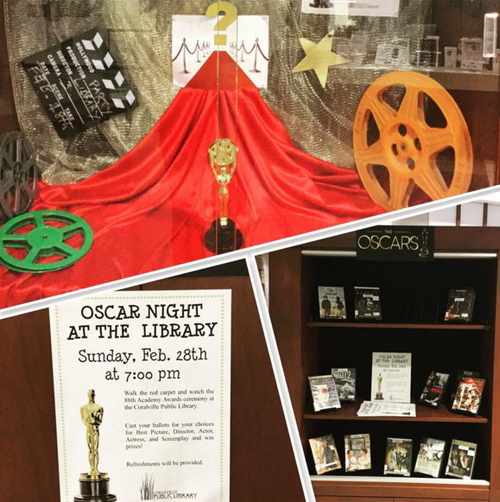
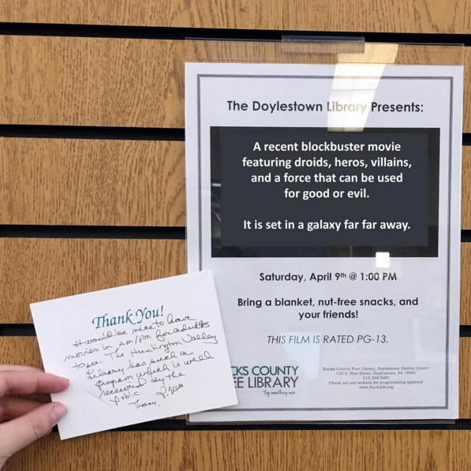
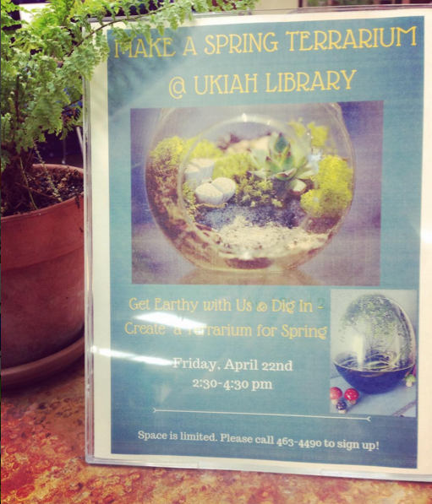
posters
Notes:
Posters; Photographing posters for events can work in some circumstances. Although posters on their own could potentially be a bit dull. Here are some ways you could make it more interesting:
a. Focus on the graphic you have used on the page, with the idea being that people will see the image elsewhere and create the connection. You can put all the event details in the post, remember you have 2200 characters!
b. Photograph the poster in its environment. Make an arty composition which could make it look more attractive. Again use the description field to add extra info. You can always edit it after posting if you want to share it to other platforms like twitter first.

Slide 9
Craft time
Notes:
7. Craft time; pick an example of a craft that was made (or a selection). Kids art can be amazing, take a clear colourful close up!

Slide 10
Events
Notes:
8. Events; take a photo of an event taking place (pending permission), be sure to mention what it was for context and how patrons can learn about future events. This option has so many possibilities, visiting author, adult book club, kids entertainer, knitting circle, teen event etc

Slide 11
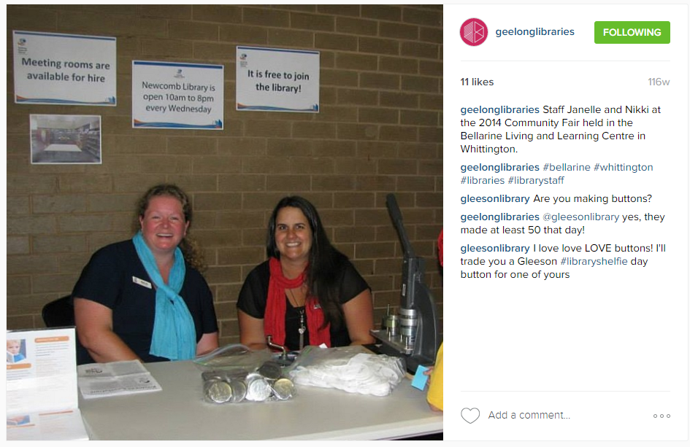
Out and About
Notes:
9. Out and about; are your staff doing an outreach session? A local school, fair or business event. Be sure to tag and geolocate posts for extra reach.

Slide 12
Step out!
Notes:
10. Step out! As before, but more in terms of simply stepping outside the branch, is there an outdoor garden, a tree to read under a cafe next door?

Slide 13
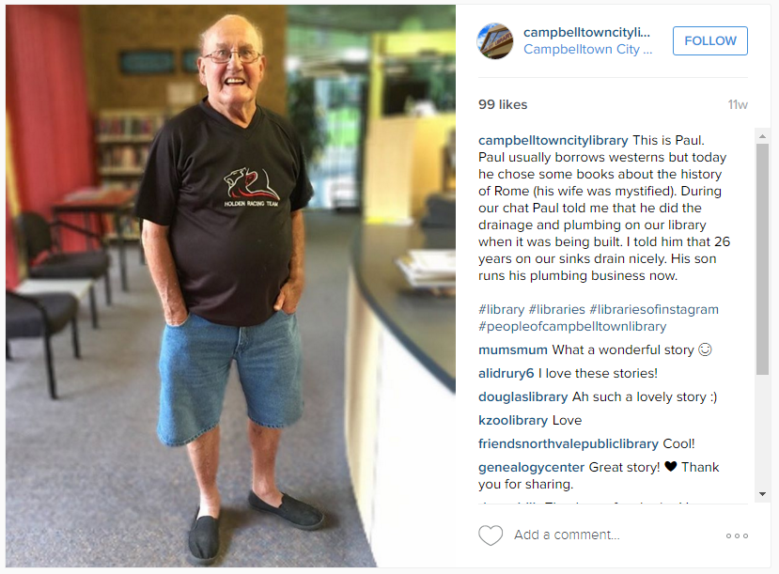
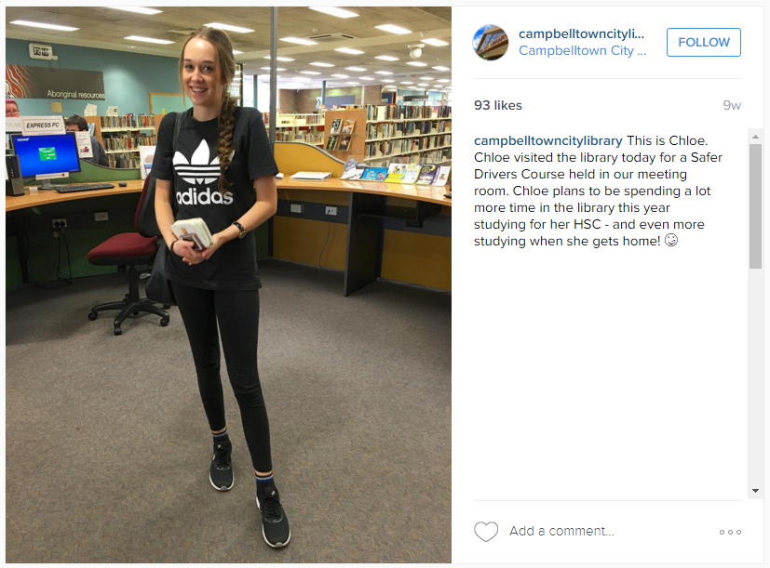
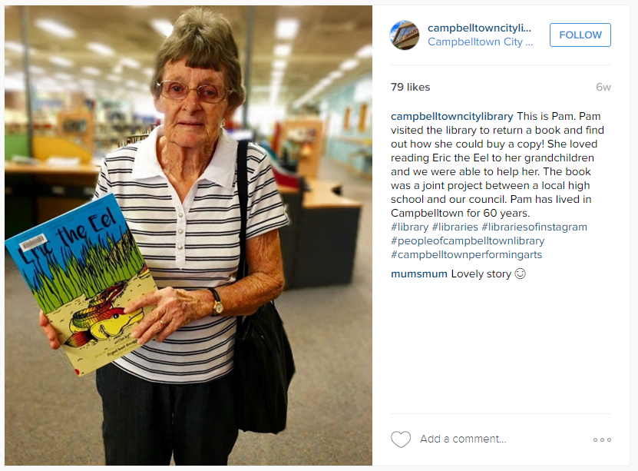
Visitors and patrons
Notes:
11. Visitors and patrons; this can be harder to do as it can be awkward to ask to take someone's photo. But perhaps the delivery person is dropping off some new magazines, a patron is visiting the library with their guide dog. The local mayor is stopping by. Lots of strange and interesting people visit your library that might make for a good story. Think HoNY

Slide 14
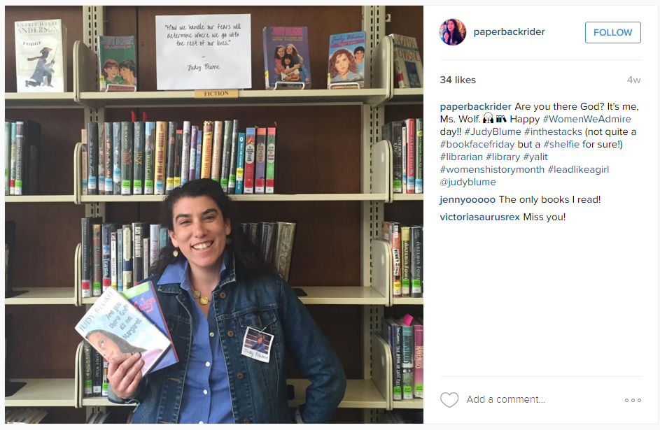
Staff profiles
Notes:
12. Staff profiles; introduce your staff, take a photo of them where they work (be sure they smile), think Humans of New York type posts. Photograph staff helping or serving a patron (again make sure they look friendly and natural). Photograph a staff member with a favourite book, recommended book, book review etc.

Slide 15
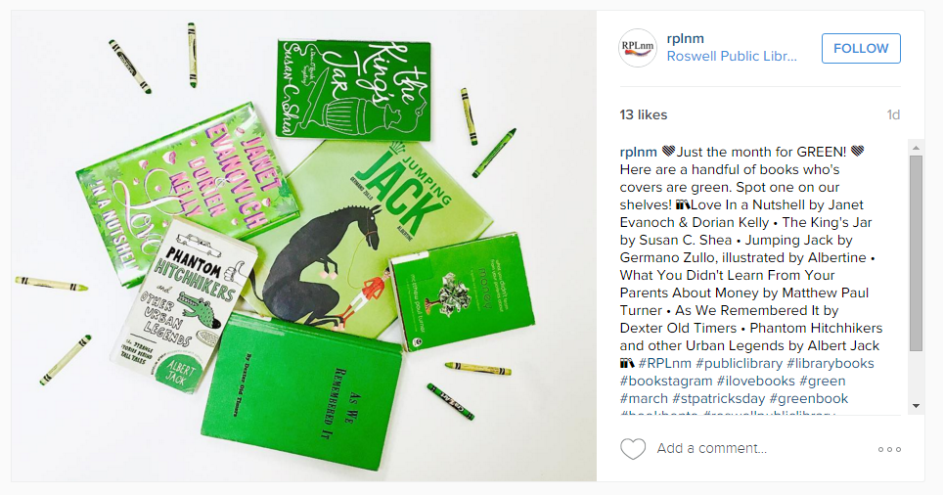
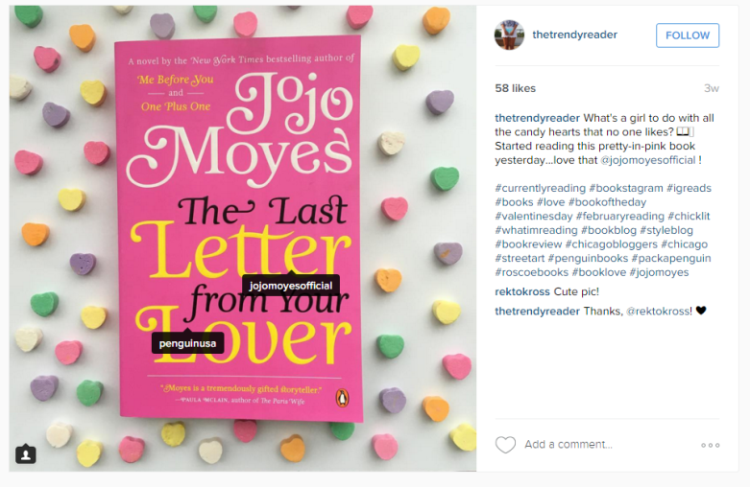
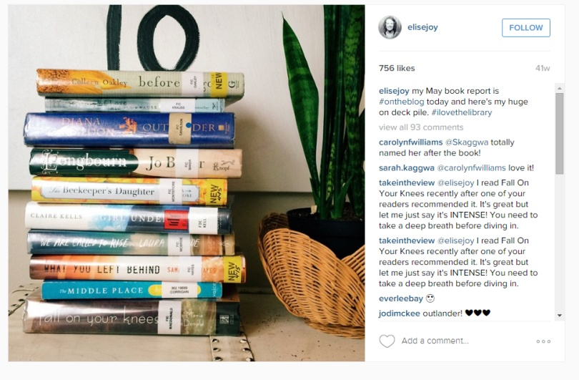
Books!
Notes:
13. BOOKS!
a. Spine poetry (horizontally stack books with interesting titles on each other)
b.
c. Stack of new arrivals
d. Staff holding a favourite book, or one they just read
e. Books with the same colour cover or a similar design, picture theme...
f.

Slide 16
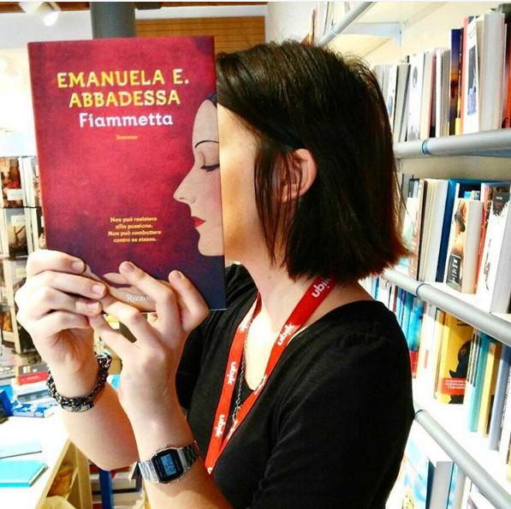
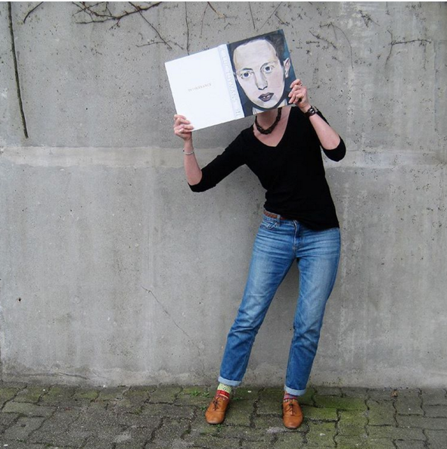
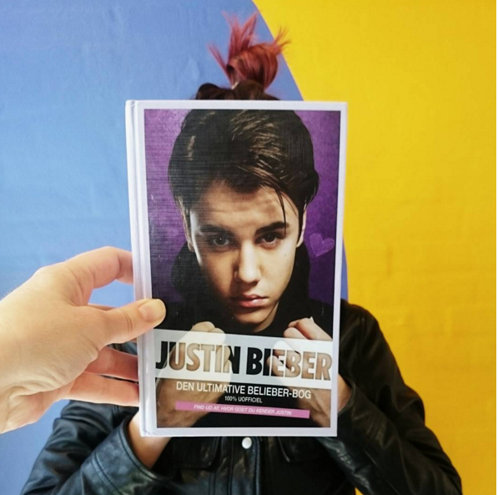
More books!
Notes:
A vertical row of books with interesting spines (encyclopaedias, a series)
Book face; book cover that has a face over a real person

Slide 17
Repeat ideas
Notes:
14. Repeat ideas; is there something that happens on a regular basis, e.g, once per week. Using repeat ideas can make Coming up with posts each week easy. There’s nothing wrong with repeating ideas if done creatively.
a. Thursday’s a school group comes in
b. Every Monday you have a new display
c. Every second Friday you get a special delivery

Slide 18
Make a list
Notes:
15. Make a list; think about all the services your library offers, programs & events, items for loan. Everything is up for grabs and everything is a potential post. Think of it as documenting your library to someone that has never been before or for a future historian that is researching everything you library offers. Create a post that reflects each thing on your list.

Slide 19
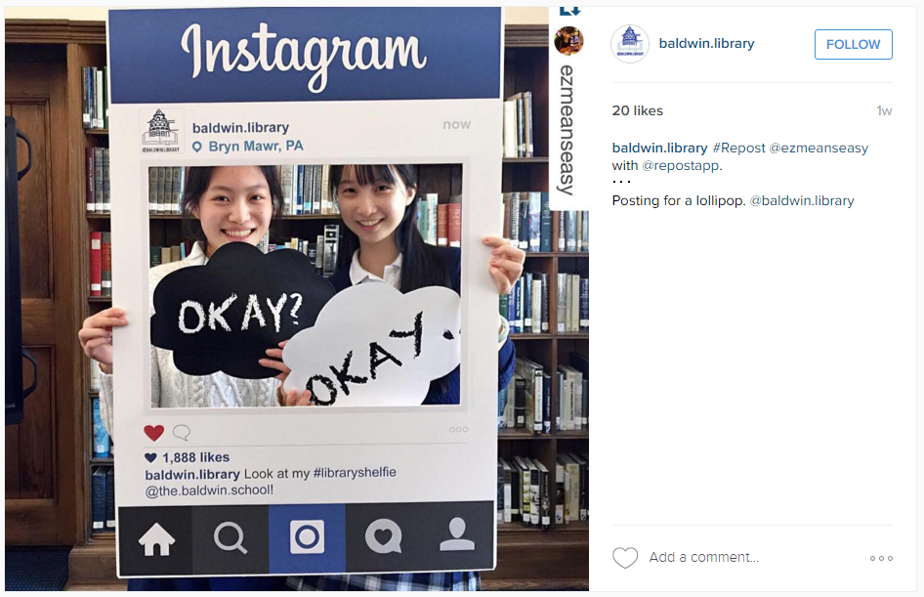
Photo opportunity
Notes:
16. Photo opportunity; create a poster, cardboard cut out or wall decoration that people can take their photo in front of, maybe they can put their face through a hole to become a character in a book. Your patrons could do this or you could photograph them in front of it. Great for a kids section.

Slide 20
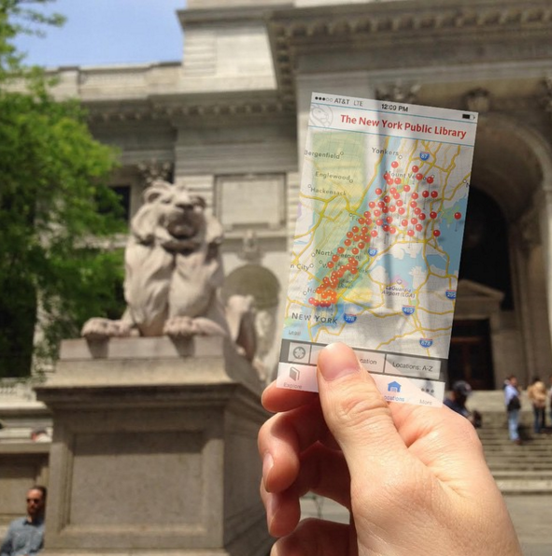
Screenshots
Notes:
17. Screenshots; screenshots of a webpage or within an app (e.g, overdrive) can work if used well, be sure what you screenshot is visually appealing, all the same rules previously discussed apply. Also make sure the screenshot is high enough resolution to post, i.e., don’t post if it is too small and looks pixelated.

Slide 21
Behind the scenes
Notes:
18. Behind the scenes; take the viewer into the back room, the tea room, where all the new books arrive.

Slide 22
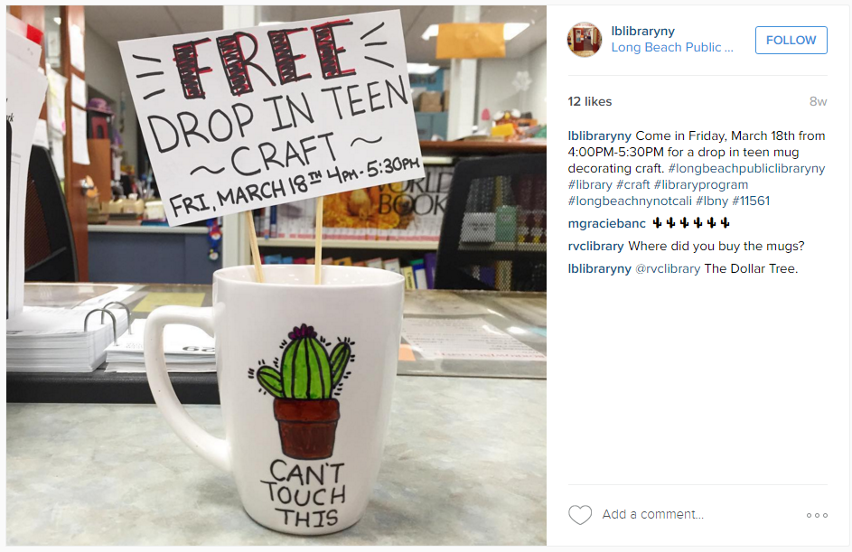
Text
Notes:
19. Text; Check out poetry accounts on IG and see how they use typewriter text and handwritten text to display their poems. Find an old typewriter, write out on paper or print out some text and take a photograph of a good quote related to books or libraries. It is better to use a real well taken photo of text rather than a digital file, which are often too low of a resolution and look pixelated.

Slide 23
Thank you!
For the full document go to
http://librarytoolshed.ca/content/instagram-marketing-public-libraries
Or
http://goo.gl/ppfPI7

