Slide 1

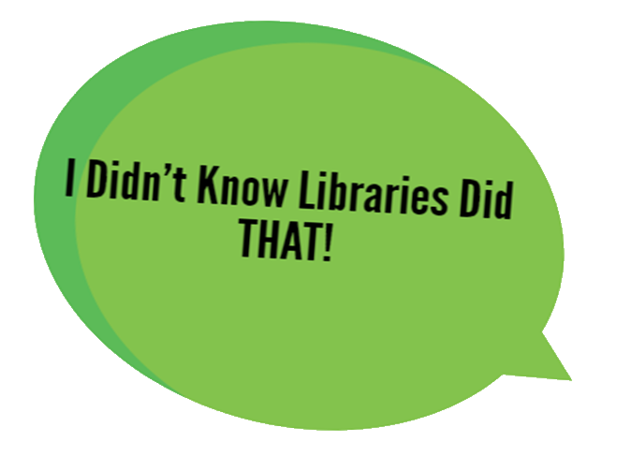
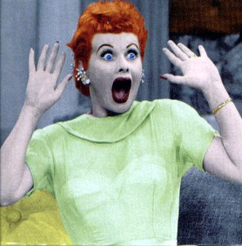

Presented by Allison Stewart
April 30, 2016
Alberta Library Conference
Jasper AB
Notes:
Many libraries in Alberta are already doing “non-traditional” programming but hopefully this presentation will provide a theoretical framework as to how such programming benefits communities and why we should change how we evaluate our programming.

Slide 2

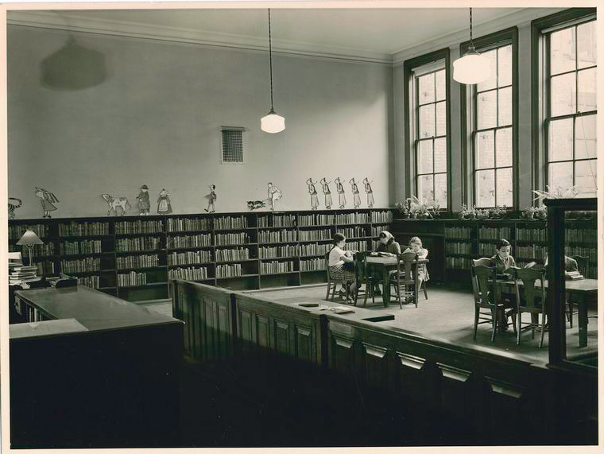
WHY Non-Traditional Programs
Manuscripts and Archives Division, The New York Public Library. Children's Reading Room Retrieved from http://digitalcollections.nypl.org/items/510d47dd-e53e-a3d9-e040-e00a18064a99
Notes:
To begin with I’d like to address the inherent assumption in the title of my presentation. Despite our ongoing work to change how people think of libraries, for some people the vision of the early mid-20th century library persists. Astonishing as this is for those of us immersed in the library world, to many people outside our library universe, this is the picture that is conjured up when you say “Library”. In their minds, we are still temples of silence where people go to sit and read. Oh, we do the occasional story time and run a book club or two but really for many people we are still the shushers of the world.
I didn’t know libraries did THAT infers a narrow range of activities for libraries; a box, if you will, in which some people still expect libraries to exist.

Slide 3
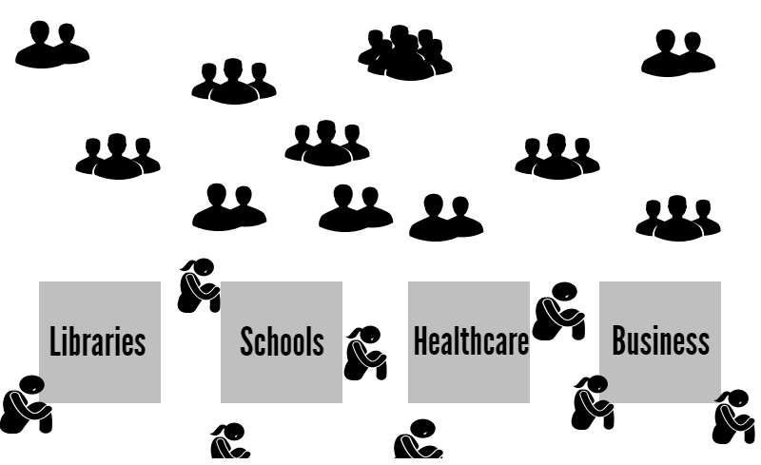
WHY Non-Traditional Programs
Notes:
It’s not just libraries that get put into boxes; for many people there are clearly delineated areas of responsibility for most organizations; libraries do this, schools do that, healthcare does this, business does that and so on. The problem with boxes is they create gaps and inevitably, vulnerable individuals fall into those gaps.
Ideally our libraries’ strategic planning processes are identifying the gaps in our respective communities but sometimes we ask the wrong question; we ask what DO we do that can meet some of those needs, when we could ask instead, what CAN we do to meet some those community needs. I appreciate the distinction is a very subtle one; but the first phrasing keeps us safely inside our library box by focusing on what we do now. The second phrasing allows us to make the box a little bigger, by getting us to think about what we COULD do that we aren’t doing now.
I do also understand that “out of the box” thinking is so old and so far from “shaking things up” that it might almost be approaching it from the opposite direction. However, about a month ago a 14 year old girl committed suicide in Stony Plain. Gaps still exist. Which is a very good reason to at least make the box a little bigger even if we cannot get rid of the box completely. Yet.
Inevitably at this point, what I usually hear is, “We can’t be everything to everybody” and “Watch out for mission creep!”. I generally respond by saying, no one organization can be everything to everyone but should that be a reason NOT to build and expand our capacity to serve our community?

Slide 4
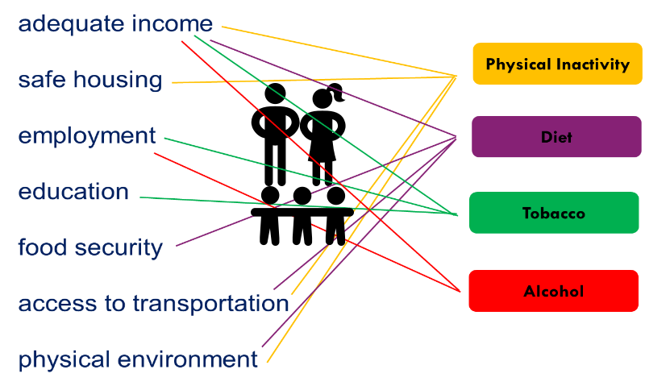
WHY Non-Traditional Programs
Social Factors Affecting Health Risks
Steil, K (2016)
Notes:
This type of “break the box” thinking is becoming prevalent in other sectors. Stony Plain is part of an AHS pilot project that takes as its foundation the reality that health is not attributable to a single isolated factor. This is something we realize as individuals but the SYSTEMS, such as Health and Education and Social Services have a tendency to confine themselves to their box.
This pilot project is seeking to build capacity in the existing community organizations, keeping as its core foundational principle the idea that all elements of a community relate to each other in ways that either promote wellness or promote poor health in a given population. This diagram illustrates the complexity of those relationships.

Slide 5
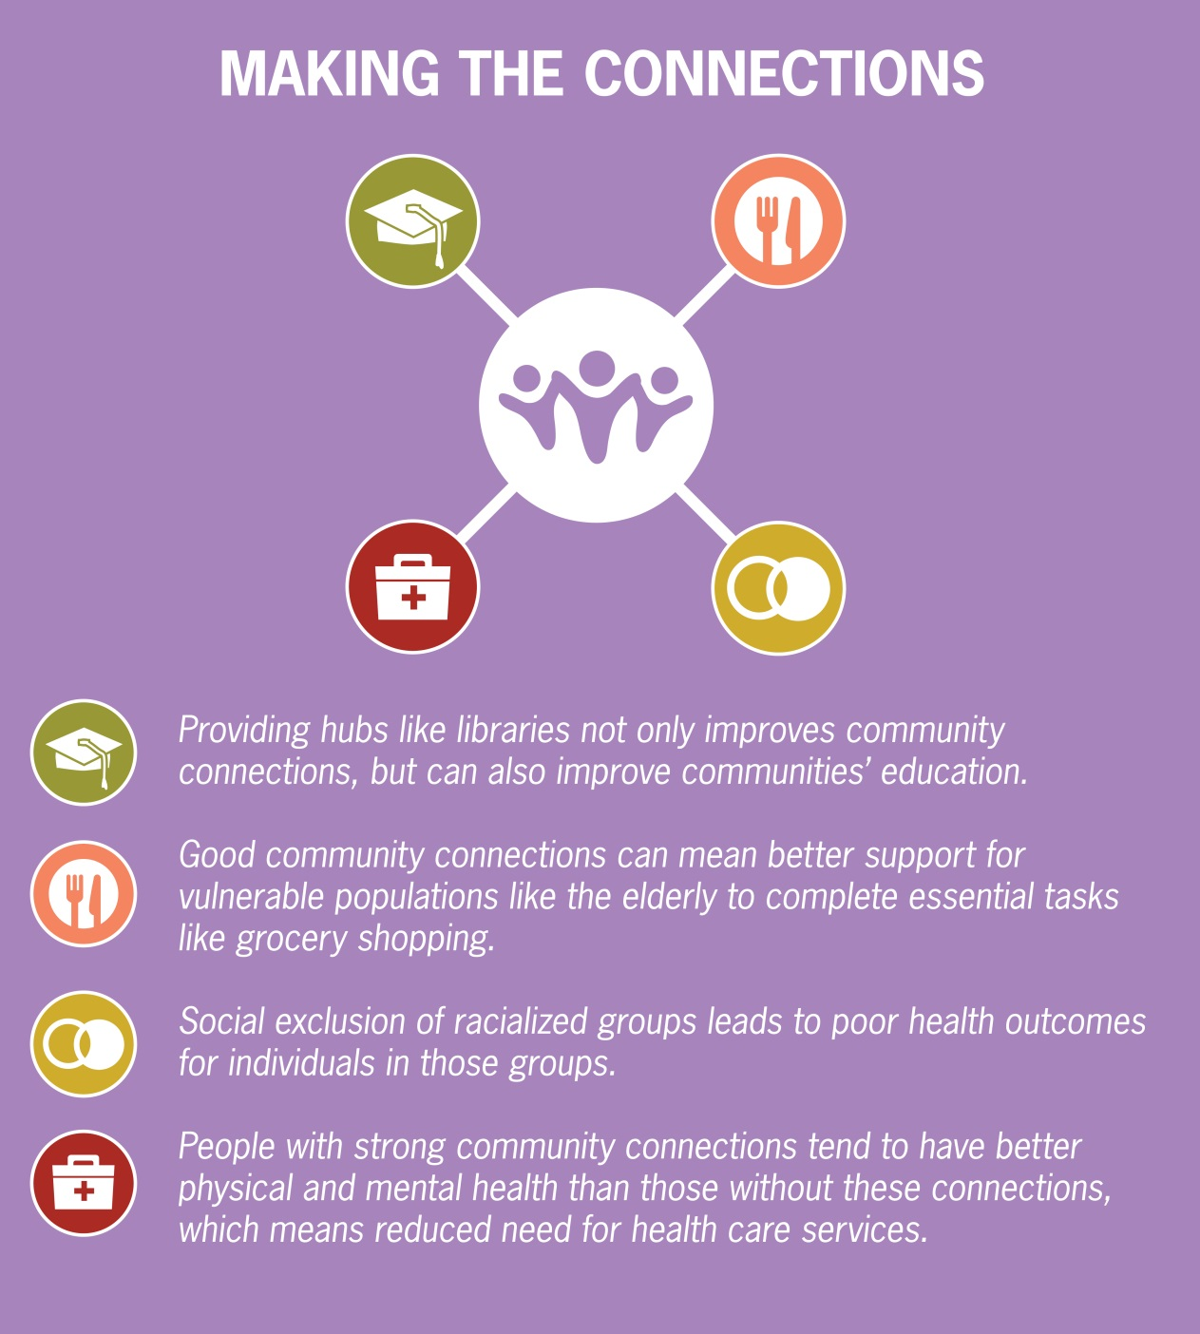
WHY Non-Traditional Programs
Making Connections (2014)
Notes:
This relates to libraries because we are part of that community infrastructure and there has been a lot of conversation in the past several years as to the nature of libraries; libraries are community hubs, we are the community’s “third space”, we are the community’s living room. The common theme running through these concepts of libraries is that libraries create connections. That perception of libraries as community connectors fits in with this way of developing healthy communities because as this image shows; physical and mental well being are inextricably connected to a sense of community belonging.
The key point here is that the well-being of our community is not confined to the health system “box”. Even though health and wellness are not our “traditional” areas of operation, this inclusive model of wellness demonstrates that we the ways in which we interact with our community affects the wellness of our residents.

Slide 6
WHY Non-Traditional Programs
The choices people MAKE
are supported by the choices that they HAVE.
Rehm et al., as cited in Eastern Health, 2012
Steil, K (2016)
Notes:
When we as libraries provide the people in our communities with more choices, we become part of a system that makes it easier for the people in our communities to make better choices. In other words, confining ourselves to our boxes is not in the best interest of our communities.
So when responding to the question WHY should libraries provide non-traditional programming a very good answer is because we help MAKE our communities better when we do.
To be clear, I’m not advocating that libraries should be THE place in a community that provides all solutions under one roof. What I am saying is that if we don’t allow ourselves to be kept inside a box of other people’s thinking, and instead work as part of a larger inter-related community infrastructure we can be even more valuable to our communities than we are already.

Slide 7
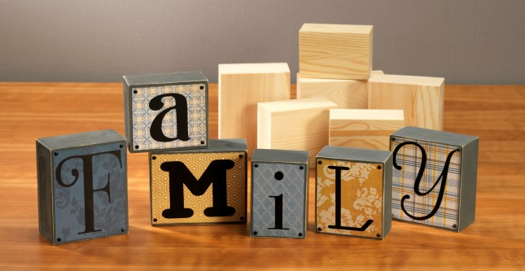
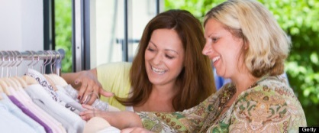



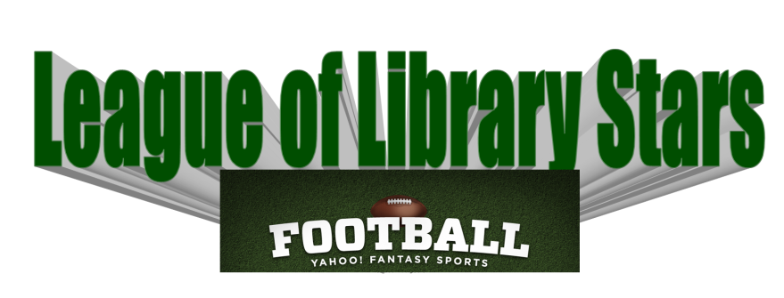



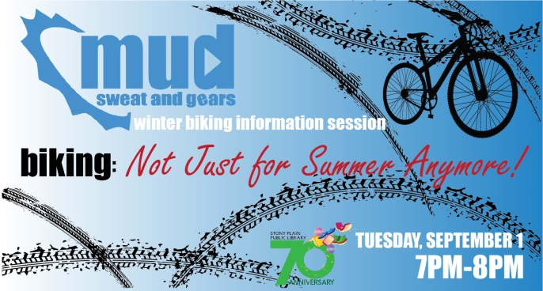


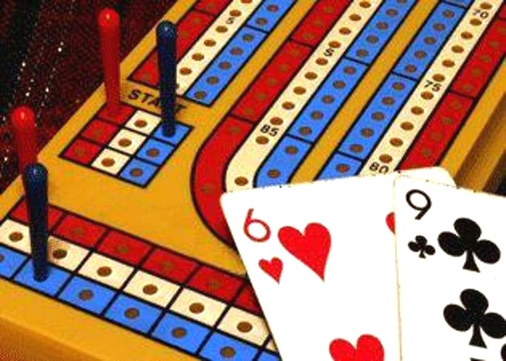

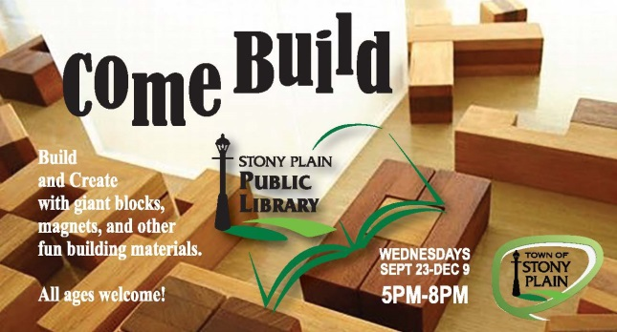
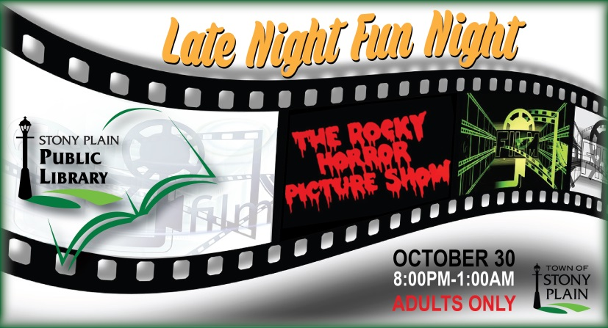
Program Ideas
Notes:
I’m a deep believer in sharing programs. Any program that is borrowed/stolen/gifted from one library to another is going to change based on the stealing library’s community anyway. We rarely implement a program exactly as it was done before because our facilities and communities are all relatively unique.
Now, given that libraries in our province range from tiny to multi-branch, I do understand that not all the ideas here will work in all libraries. I do try and suggest some ideas for small community libraries as well.
Pictured here is a sample of different programs we’ve provided in the last year. If you would like more information about a given program please don’t hesitate to contact me.
In addition to being a shameless stealer of programs I’m also a shameless bandwagon jumper, particularly when it comes to Teen programs. Keep up to date on what’s popular and get the Teens to create programming around those pop culture phenomenon.
Don’t be afraid to connect with businesses in your community. As long as clear ground rules are in place to prevent them from turning the program into a sales pitch, businesses can do great presentations. Have a local martial arts group provide a free sample lesson of Tai Chi with the opportunity for participants to sign up AFTER the class if they want to be contacted by the business. Have a travel company provide an armchair traveller session.

Slide 8
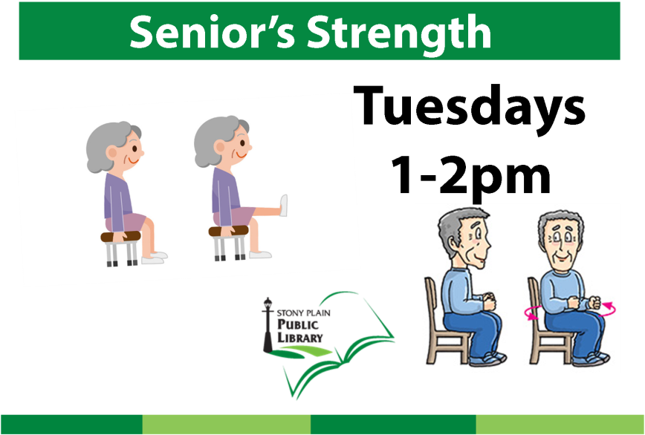
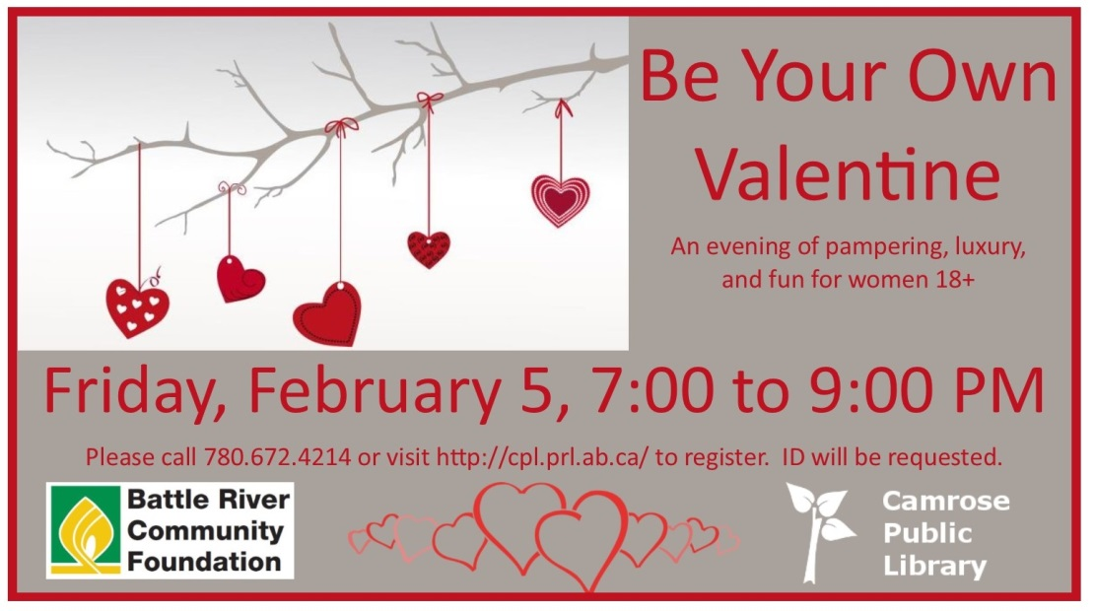

Program Ideas
Notes:
I am by no means suggesting that Stony Plain Library is the only library doing unique and innovative programming. I would like to mention one or two that stand out to me as being non-traditional programming that help make their communities better. Camrose Public Library hosts an annual Be Your Own Valentine evening. Local businesses provide services such massages, mani-pedi’s, and woman in the community get a chance take a break and have some me time. This might seem to be a frivolous program, but isolation and stress are major risk factors for poor mental and physical well-being. Unconventional programs such as this provide people opportunities to connect with other and come together in a leisure moment.
Lethbridge Public Library is doing amazing things with physical literacy learning by partnering with AHS. In Stony Plain, we`ve identified physical literacy as being a 21st Century literacy in our plan of service. One of the reasons we find such classes to be so popular with our seniors (we also offer seniors yoga) is what I call the intimidation factor. Most of the people taking these classes are late 60’s/early 70s and they find the gym or leisure centres to be intimidating spaces. For them, the library is a place where they feel comfortable and are therefore more willing to try something new. Given the choice between staying safely inside the traditional library box or helping community members stay mobile and independent, we’ve decided it’s more important to provide extra benefit to our community. In case you think only libraries in larger communities can do these types of programs, Rimbey Library hosts a Culture Café where they feature a country; have food brought in or we cooked it themselves. So far they have done Mexico, India, Africa, and Korea. They had authentic ethnic music at each one and depending on the country, they have someone talk about the country as well.

Slide 9
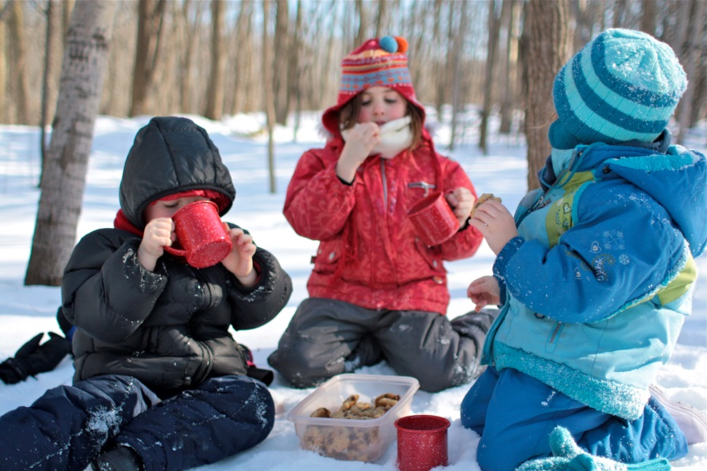

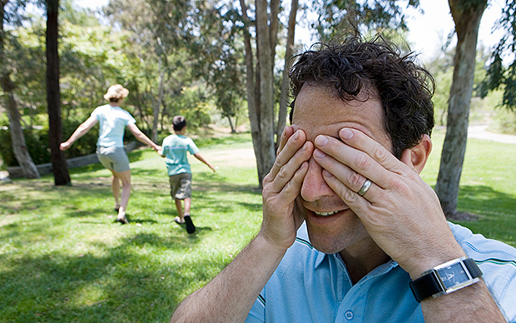

Program Ideas
Notes:
So how do you program in your library if you are too tiny? The best answer is leave the library. IF your community so small your library is too small to accommodate large groups, the chances are everyone will know it’s a library program even if it doesn’t take place inside the library space itself. There are a multitude of options outside that can be combined with learning opportunities. A winter picnic can be combined with Family Day if there aren’t any other Family Day events happening in your community. The library can provide outdoor story-time, organize games, hand out a winter reading list. Be the facilitator for the annual World Wide Photo Walk in October (http://worldwidephotowalk.com/) or just facilitate your communities own photo-walk. Chances are someone in your community is a photo buff who would be thrilled to share their passion with other people. Introduce your community to GeoCaching. There is an entire website and an app to help you implement this program. If your community has an annual event, your library could just facilitate a massive Hide & Seek Game as part of that festival. Now I have to say, that I’m providing suggestions coming from a perspective which is grounded in our library’s mission statement “We connect the people of our community to the knowledge and cultures of the world and to each other” and our plan of service which feeds into that mission. I am by no means suggesting that you develop programs at random which don’t meet the objectives of your plan of service or the needs of your community. One of the core issues facing Stony Plain is the growth we are experiencing is affecting the deep sense of community that residents identify as being of importance to them. With new housing developments that are on the outskirts of the older tight-knit community and many residents who work in Edmonton, which is only 30 minutes away, that “small town feel” might get lost. As such, we have creating connections and reaching under-served residents as objectives, these are just some not-your-usual library ideas that might help get creative ideas going.
And of course, another not so “shake it up” idea is to partner with other organizations in the community.

Slide 10
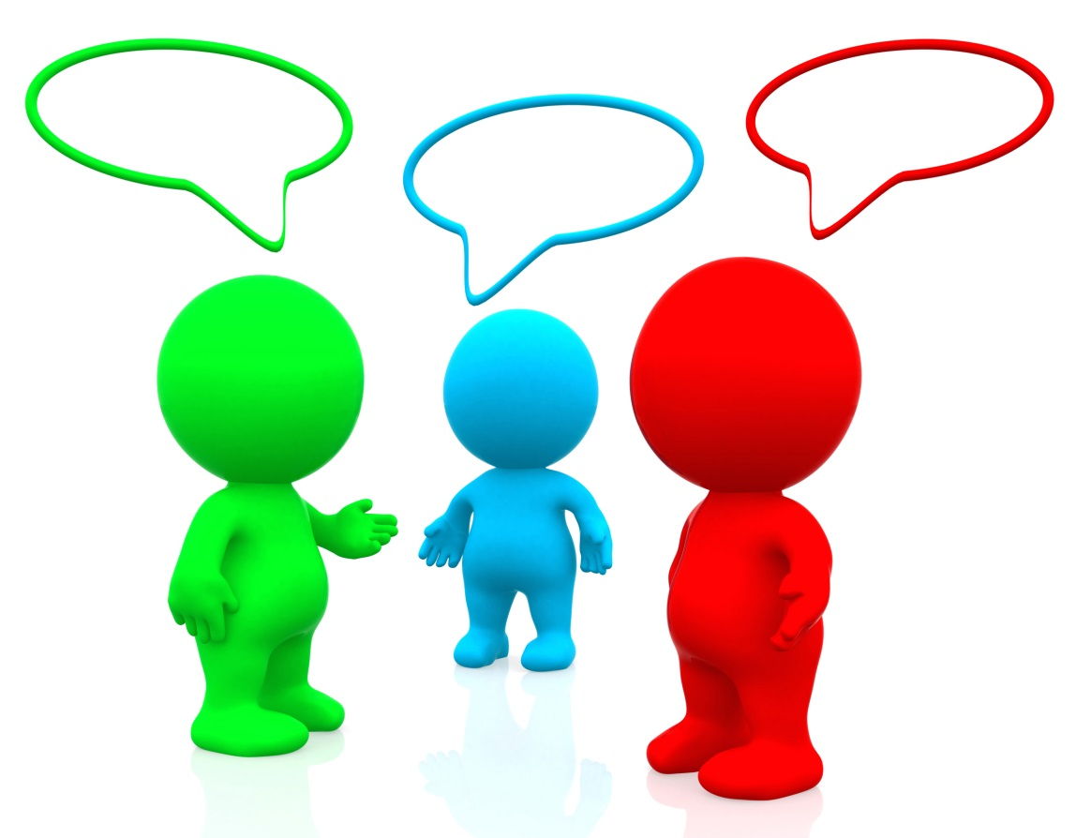
Everyone Has Something To Offer
HOW do you get other people to do your programs for you?
ASK THEM
SAY YES WHEN THEY ASK YOU
Talk to people
Be accessible
Be on the lookout for new opportunities
Remember everyone has something to offer
Notes:
The biggest resource most of these programs take is time. If we are working from the foundational principle that staying inside our library box is not in the best interest of our communities then why not let our volunteers out of the library box as well? How many of you conduct volunteer interviews? How many of you ask what interests they have during the interview? My favorite question is to ask what activity brings them joy. Ask them if they would be interested in providing a library program on that activity in addition to shelving books or laminating or whatever else volunteers do at your library. Our library currently has Photo-Fan Club because an individual who moved here from Barrhead who volunteered in order to meet new people. She just wanted to shelve books but during the interview she responded to my question with how much she had enjoyed the photoclub in Barrhead. Being a shameless opportunist I immediately asked her if she would be interested in helping our library start a club. She has since moved away, but we have a thriving club which is now facilitated by a semi-professional photographer who started coming to our club instead of having to travel all the way to Fort Saskatchewan. We also have Magic the Gathering Club which is facilitated by the parent of a teen who got tired of driving to a games store in St. Albert to play. They meet the 3rd Friday of every month; the library promotes both programs and provides the space but other than that initial outlay of time and conversation, both these clubs are self-run. We just get the credit. These are my favorite programs! Sometimes programs are one-offs, which is fine as well because not all the programs we put on are successful. Which brings us to Failure Happens.

Slide 11
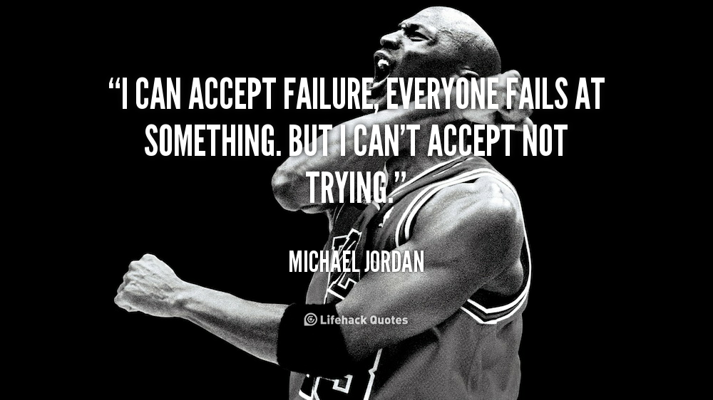
Failure happens. And That’s Okay
Jordan, M (1994).
Notes:
There’s honestly not much to more to say about failing. If you choose to try new things, some of them WON’T WORK despite your having put forth your best efforts. It can be very disheartening especially if you went out on a limb to do something different and the program didn’t go as you planned.
As an example in 2015, we ran a pilot project; Late Night Fun Nights. On the last Friday of every month, except July, August and December we stayed open until 1am to provide the people in Stony Plain who weren’t interested in hanging out at the bar a place to hang out. We offered different activities during different months and we aimed our programs at emerging adults and new residents. We had a board game night, a retro video game evening, hosted a couple of open mic night, screened Rocky Horror Picture Show, played Cards Against Humanity and also provided library services (but no computer access) as well.
The most popular events were the Retro Game Night and the Open Mic nights. But the people who showed up were not the people we were expecting. Until we made the evenings adults only, around March, we were getting teenagers. For the Retro Video Game nights in fact we got mostly 11-14 year olds and they stayed until midnight! In retrospect we should have expected some parents to take advantage of free Friday night babysitting but we were still quite surprised at that turnout.
The other odd thing that stood out was that for the open Mic Nights, we were getting seniors. A LOT of seniors. This was quite frankly a bit of surprise because there is a Seniors Drop-In Centre in Stony Plain, and we had assumed, WRONGLY, they already had place where they could connect with each other.
So while we were trying to reach emerging adults and new residents it seemed as though teens and seniors were more in need of a place to hang out on Friday nights. Since we do a LOT of programming for teens and seniors already, we decided instead to offer a later (around 9/10pm) program for all ages of adults just once a quarter and a late night event for teens once a quarter as well.
Was this pilot project a success? It wasn’t to me because it didn’t achieve our goal of engaging with emerging adults in our community. We did learn a few things but let’s be honest, nothing we couldn’t have figured out with our existing information. However, for a couple of people in our community who don’t feel comfortable in tradtional social settings, Late Night Fun Night was the best thing that ever happened for them. They had a place to go where they felt comfortable and welcome so this program had a fairly large impact for that group.

Slide 12
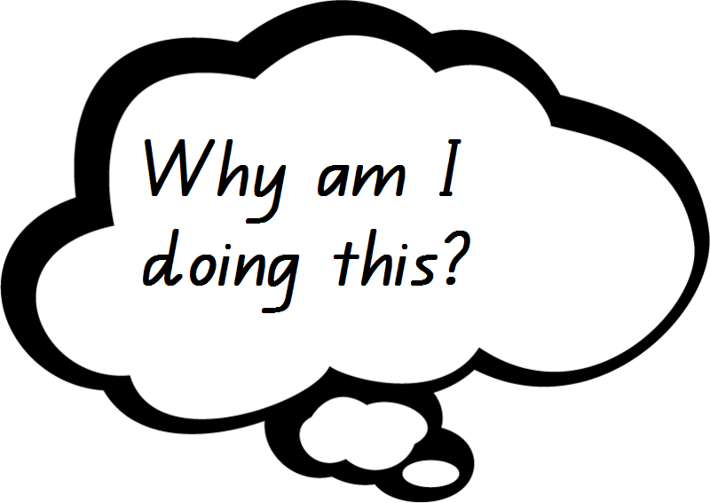

Re-evaluating Evaluations
Notes:
Which brings me to outcome based evaluations. Given that there was an entire CONFERENCE last fall in Vancouver on this subject, CLEARLY I don’t have time or expertise to provide a detailed “how-to” on doing Outcome Based evaluation, in fact, it’s quite probable that some of you here in the audience are more familiar with this topic than I am. All I would like to do is provide those of you who aren’t familiar with this type of evaluation an idea of the foundational concepts . For the record I have already requested LAA to provide a similar conference here in Alberta because this is definitely something public libraries need to consider.

Slide 13

Re-evaluating Evaluations
“Non-profit organizations often use financial metrics of efficiency to evaluate performance when what they really need are measurements of program and organizational impacts…”
Epstein & Yuthas (2014).
Notes:
There is a tendency to focus solely on the numbers when evaluating how well our libraries are doing. How many people came to the program, how many items did we circulate, how many people entered the library, how many members do we have and so on. These numbers serve a purpose but they don’t tell the whole story. In fact, sometimes numbers leave out big chunks of the story. In our growing digital environment, it’s not uncommon for some people to only enter a library to renew a membership. Carol Anthony pointed this out three years ago in her article, New Measures for a New Era. While we can track how many people viewed our website or accessed a mobile platform, it’s less easy to know what activities they are undertaking. All of this adds up to the reality that we can talk quantitatively about what our libraries do, but we can’t adequately discuss the qualitative impact our libraries have on our communities.
For example, we hosted a Home-School Information Fair around the middle of March which entailed a great deal of preparation and organization. We had 9 people show up. The last woman who came was almost tearfully grateful as she detailed how difficult it had been for her to find information and to make sense of all the different terminologies. Was the Fair a success or a failure?

Slide 14
“Social impacts are the societal and environmental changes created by activities and investments.”
Re-evaluating Evaluations
LIBRARIES
“Social purpose organizations are entities that exist solely or partially to create positive social impacts.”
Epstein & Yuthas (2014).
Notes:
If we start considering the social impacts of our libraries activities; we also are able to provide yet another answer to the question, “What is a library?” that is being asked a little more often these days as we start to move out of the library “box”. If we combine this definition with our core function we can articulate a public library as a social purpose organization which exists to create positive social impacts by providing barrier free access to knowledge & information. We can do this, because we have the capacity to effect change in our communities in so many different ways. Having a better understanding of the social impacts of those activities also provides a more comprehensive picture to funders and boards of how we impact the community.

Slide 15
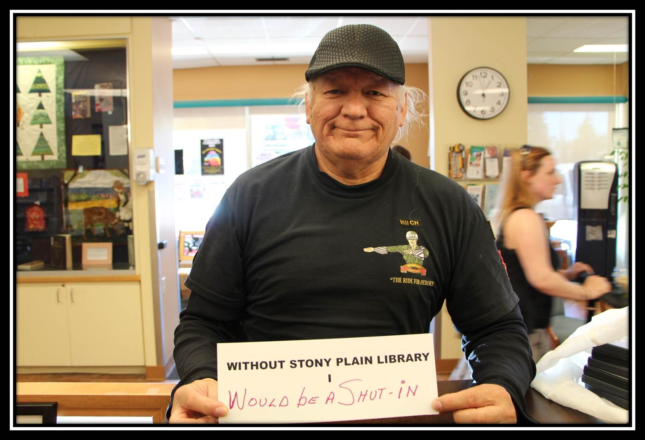
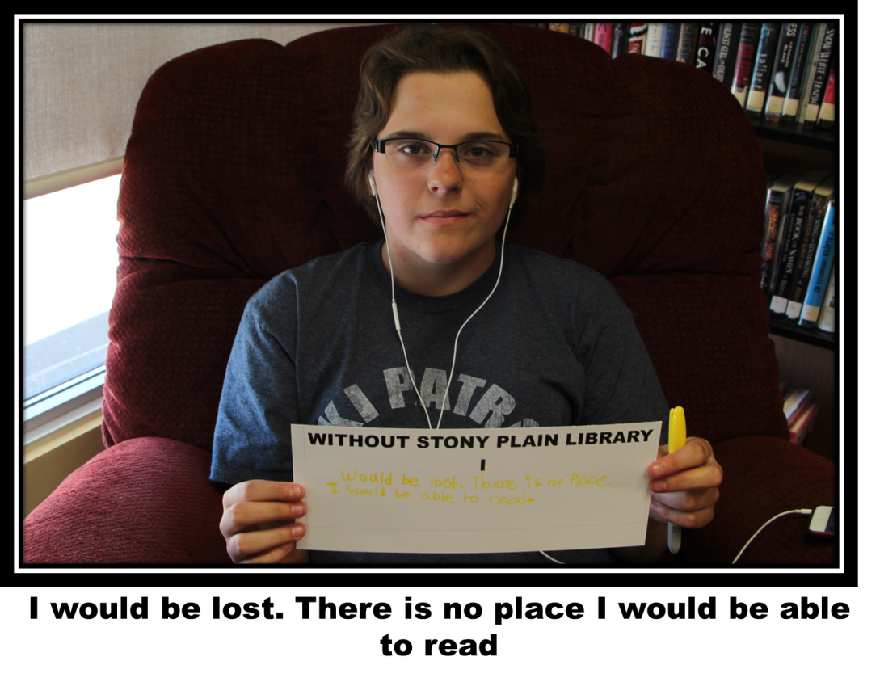
Re-evaluating Evaluations
Notes:
These are two image from our campaign last spring which asked library users to complete the statement Without Stony Plain Library I… We then compiled the images into a slideshow which we used in our presentation to our Town Council. This was one way that we were able to put faces to the numbers that they see every year in our annual report because those numbers cannot capture the impact our library has on the community.

Slide 16
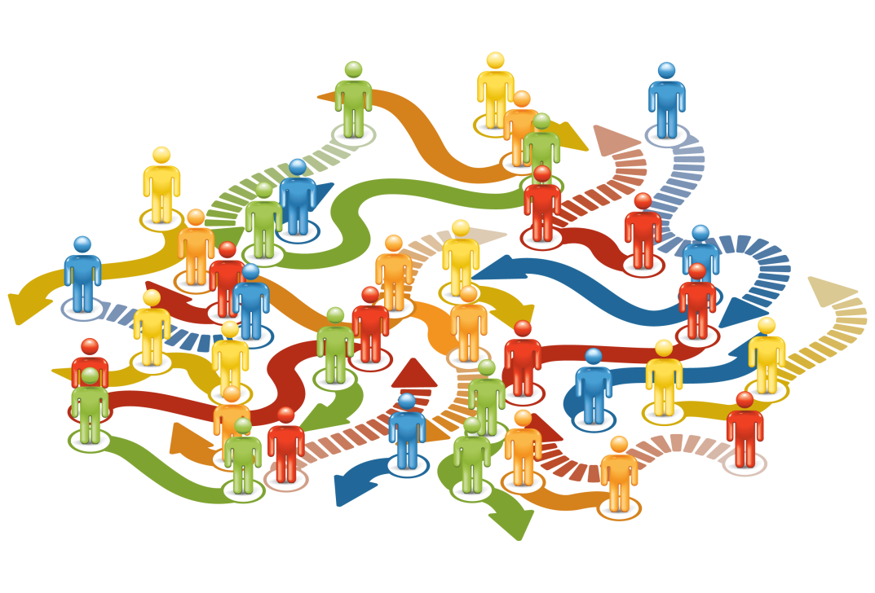
Re-evaluating Evaluations
“We also need to measure the outcome or impact regarding the difference that some of these services make in the lives of individuals and the well-being of the community.”
Anthony, C., 2013
Image retrieved from http://onpurpose.uk.com/my-two-cents-on-social-impact-measurement-part-2/
Notes:
When we start to consider the impact our programs have on the people who attend, the answer to success or failure becomes less clear cut because impacts have ripple effects. Which of course goes right back to the way social factors affect health. Those ripple effects make it very difficult to measure the true extent of how we affect our community. Which of course makes it difficult for us articulate to our boards and our funders, other than anecdotally, how libraries benefit our communities. Having a better understanding of the social impacts of our activities not only provides a more comprehensive picture to funders and boards, as mentioned earlier, but it also provides us with a better idea just how well we are meeting our communities needs. And of course, it also allows us to better explain why our libraries should do THAT.

Slide 17

Questions?

Slide 18
References
Anthony, C. (2013). New Measures for a New Era. Public Libraries Online, August 21, 2013. Retrieved from: http://publiclibrariesonline.org/2013/08/new-measures-for-a-new-era/
Epstein, M. J., & Yuthas, K. (2014). Measuring and improving social impacts: A guide for nonprofits, companies, and impact investors (1st ed.). San Francisco: Berret-Koehler.
Jordan, Michael. I Can't Accept Not Trying : Michael Jordan on the Pursuit of Excellence. San Francisco, CA: HarperSanFrancisco, 1994. p. 129
Making the Connections (2015). Community – Making the Connections [pdf]. Toronto, ON: Wellesley Institute. Retrieved from http://www.wellesleyinstitute.com/topics/healthy-communities/making-the-connections/
Steil, K. (2016). Comprehensive Community Cancer Prevention: the Road to Success [ppt]. Edmonton, AB.
ADDITIONAL RESOURCES
PPT presentations from conference in Vancouver on Outcome Based evaluations: http://www.metricsandlibraries.org/program.html
Project Outcome: Impact based surveys and resources for libraries.
https://www.projectoutcome.org/

