Slide 1
Alberta Library Conference
Adult Books
Spring | Summer

Slide 3
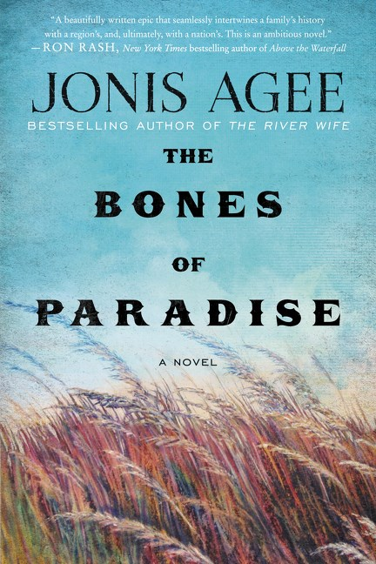
The Bones of Paradise by Jonis Agee
William Morrow | 9780062413475| HC | $31.99 | Fiction/Literary
432 pp. | August 2016
“From the opening image of a ‘windmill slowly clanking in a wobbly circle’ to the sublime final sentence, Jonis Agee’s The Bones of Paradise is a beautifully written epic that seamlessly intertwines a family’s history with a region’s, and, ultimately, with a nation’s. This is an ambitious novel.”—Ron Rash, author of Above the Waterfall
“Set in the implacably unforgiving Nebraska Sand Hills—the kind of place where you can get lost in a heartbeat, and that features a grit so pervasive it seasons your food—in the years following the massacre at Wounded Knee, The Bones of Paradise is about the way those we love can bring us a new language and help us make it ours, and in so doing teach us how to ride in concert with the world.”—Jim Shepard, author of The Book of Aron
“Deadwood has nothing on Nebraska’s Sand Hills. Jonis Agee serves up a gritty, bloody romance set a decade after Wounded Knee. Half murder mystery and half family saga, The Bones of Paradise is a spirited reweaving of history.” — Stewart O'Nan, bestselling author of A Prayer for the Dying

Slide 4
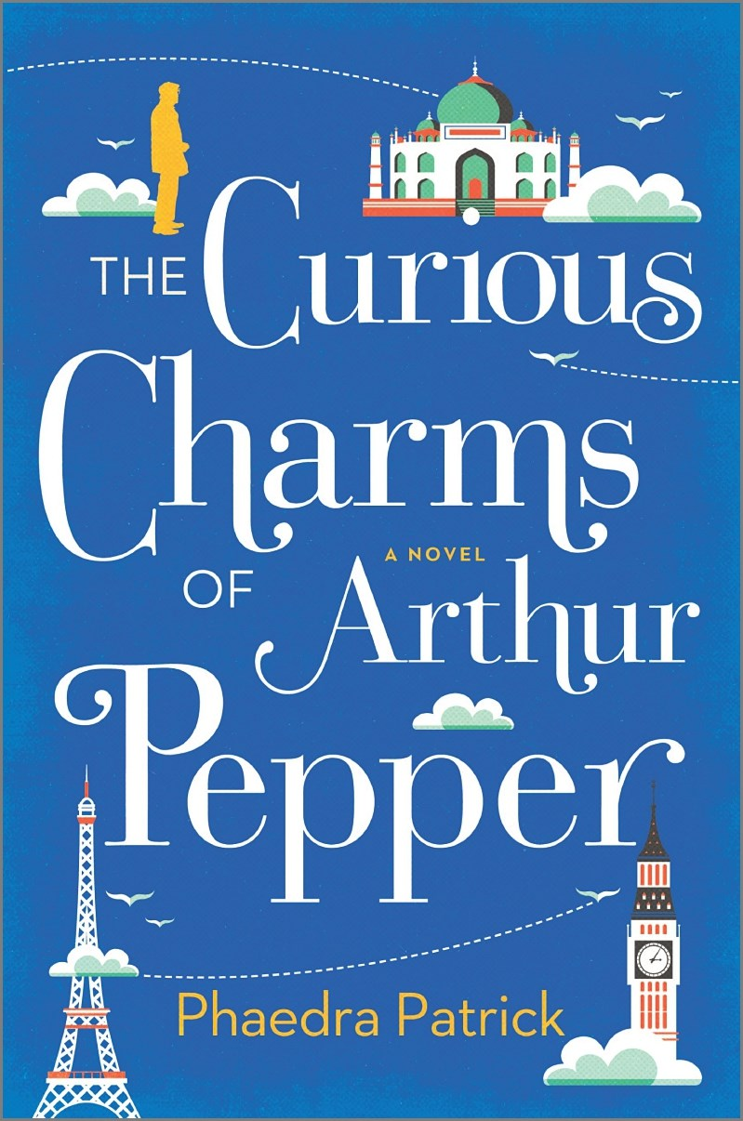

The Curious Charms of Arthur Pepper by Phaedra Patrick
Mira| 9780778319337| HC | $27.99 | Fiction/Literary
366 pp. | May 2016
"Phaedra Patrick understands the soul. Eccentric, charming, and wise, The Curious Charms of Arthur Pepper is about finding courage, generosity, and compassion, even when all seems lost. With clear-eyed prose and a moving story, Patrick reminds us how selfless people can be she reminds us to be brave. The Curious Charms is not just for those who are mourning over love or the past. This book will illuminate your heart." -Nina George, New York Times bestselling author of The Little Paris Bookshop“
‘Tender, insightful, and surprising, this wonderful debut novel is a stunning addition to the popular genre of transformative stories of otherwise uneventful lives. It will instantly capture the hearts of readers who loved Rachel Joyce’s The Unlikely Pilgrimage of Harold Fry, Nina George’s The Little Paris Bookshop, and Antoine Laurain’s
The Red Notebook.’ ‐ Library Journal (Starred)
"As cozy and fortifying as a hot cup of tea on a cold afternoon." – Kirkus Reviews

Slide 5
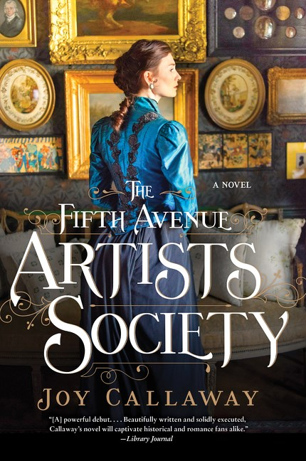

The Fifth Avenue Artists Society by Joy Callaway
Harper Paperbacks| 9780062391612| PB | $19.99 | Fiction/Historical
368 pp. | May 2016
“With the warm glow and heavy drapery of Gilded Age salons as its inviting backdrop, Joy Callaway’s engaging period novel explores the timeless struggles women face in the creative and working world, and the price some are willing to pay to protect all they hold dear.”
—Erika Robuck, author of Hemingway's Girl
With THE FIFTH AVENUE ARTISTS SOCIETY, debut author Joy Callaway paints a marvelously detailed portrait of Gilded Age New York, and in Ginny Loftin, inspired in part by the author’s own ancestor, she has created an affecting and appealing heroine. This is a delightful and memorable book.” — Jennifer Robson, International bestselling author of Moonlight Over Paris
“[A] powerful debut. . . . Callaway paints an all too real portrait of the power of love to both create and destroy.… Readers will never see the twists around every corner. Beautifully written and solidly executed, Callaway’s novel will captivate historical and romance fans alike.”
— Library Journal
“Drawing on her own family history, first-time novelist Callaway melds romance, intrigue, and the pursuit of art together to create this engaging late-nineteenth-century story. Readers will enjoy cameos by Edith Wharton and Oscar Wilde, two writers who influenced her dramatization of the dangers of social climbing.” — Booklist

Slide 6
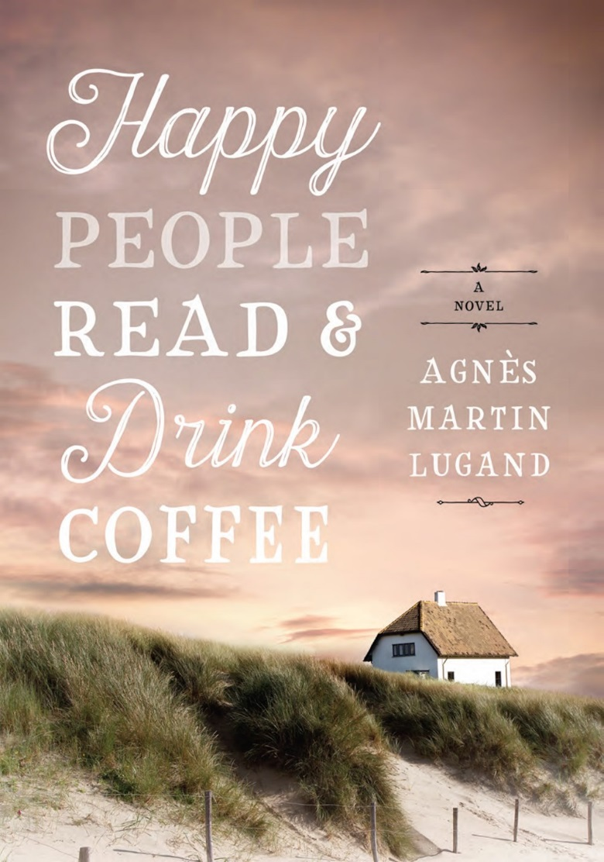
Happy People Read and Drink Coffee by Agnes Martin-Lugand
HarperAvenue | 9781443451000|PB| $19.99 | Fiction
240 pp. | May 2016
“Profoundly moving and expertly told, Happy People confronts life’s most nightmarish tragedy with an unblinking examination. Diane’s journey to find meaning again is at once charming and heartbreaking, and I found myself pulling for her to seek out her next experience of love. The wisdom and magic in these pages will linger long after the book is closed.”—bestselling author Susan Wiggs
“Martin-Lugand’s sparse but emotionally forceful style, aided by Smith’s translation from the original French, catches the sweeter moments between two people embittered by loss.” — Kirkus
“A heartbreaking story of love and loss that will twist readers up in knots. . . Essential for any foreign literature or women's fiction collection.” —Library Journal

Slide 7
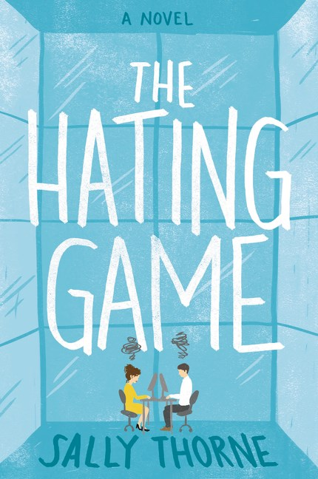
The Hating Game by Sally Thorne
William Morrow Paperbacks | 9780062439598 | PB | $18.50
Fiction / Contemporary Women | 384 pp. | August 2016
“A brilliant, biting, hilarious new voice. THE HATING GAME will take the rom-com world by storm. One of the best I’ve read, ever.” — Kristan Higgins, bestselling author

Slide 8
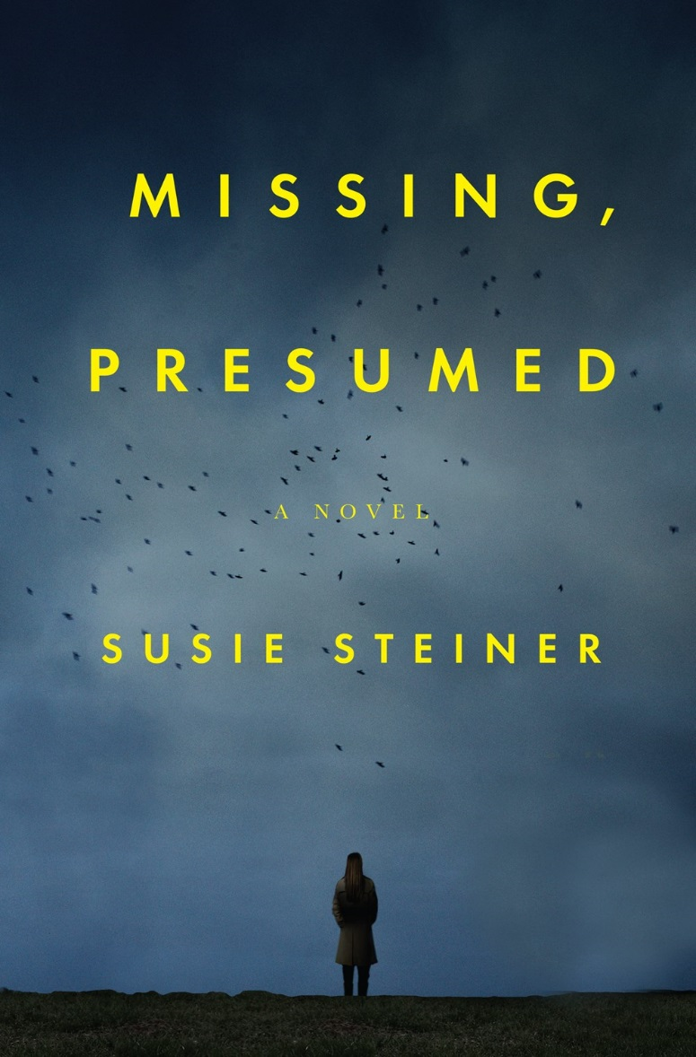
Missing, Presumed by Susie Steiner
HarperCollins Canada | 9781443450508 | PB | $22.99 | Fiction/Thriller
416 pp. | July 2016
"Gripping, authentic, funny and moving, MISSING, PRESUMED hits the sweet spot between literary and crime fiction. The plot is gripping, with a twist that knocked me sideways…. More than that, the characters became dear friends over the course of the book. I'm already looking forward to the next one."
—Erin Kelly, author of THE POISON TREE
"Within a chapter, DS Manon Bradshaw announces herself as a detective to follow through books and books to come. A treat in store for those who love their crime fiction rich in psychology, beautifully written and laced with dark humour. Dive in."
—Lucie Whitehouse, author of BEFORE WE MET

Slide 9
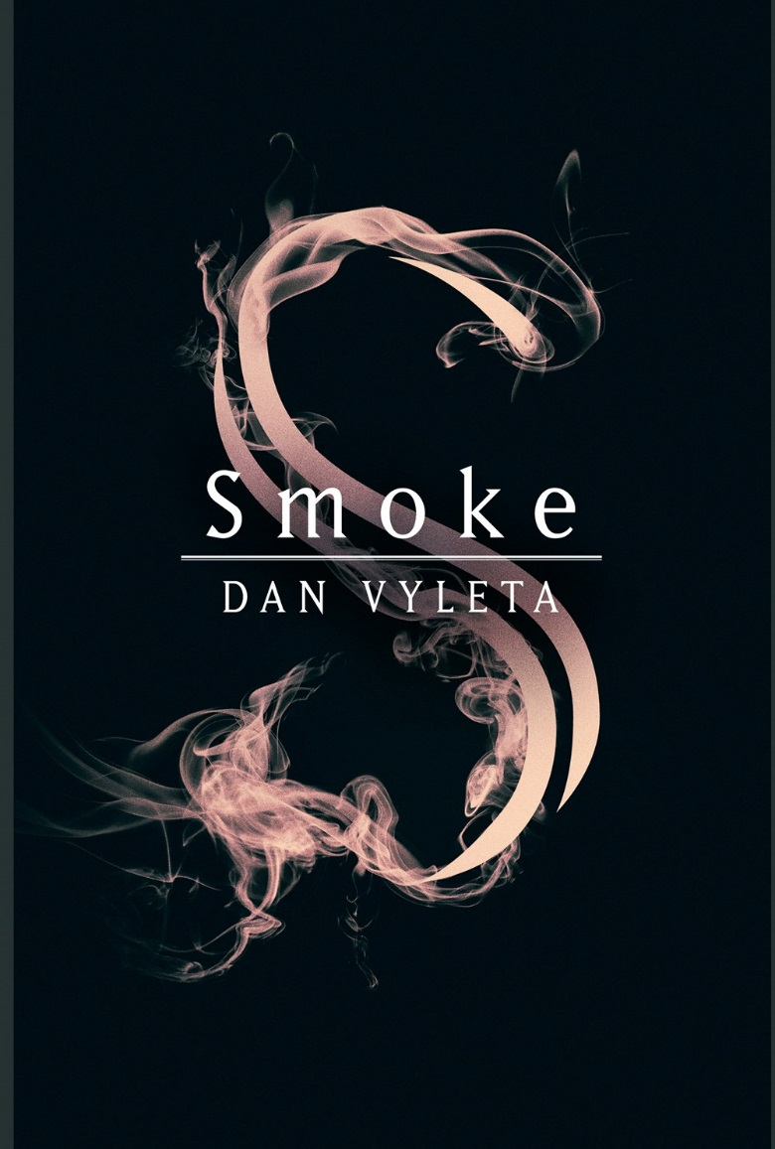

Smoke by Dan Vyleta
HarperCollins Canada | 9781443440677 | HC | $29.99
Fiction/Literary/Fantasy | 448 pp. | May 2016
“[A] fiercely inventive novel…Vyleta’s bold concept and compelling
blend of history and fantasy offer a provocative reflection
on the nature of evil, power, belief, and love.
Dickensian in its imaginative scope and atmosphere.”
—Publishers Weekly review
“Full of otherworldly adventure yet chilling in its realism, Smokelures readers into considering these questions about society and ourselves.”
—Booklist review
“The novel’s sumptuous, irresistible narrative--filled with plenty of twists and turns and imagination--will satisfy any reader. A terrific, suspenseful tale.”
—Kirkus Reviews

Slide 10
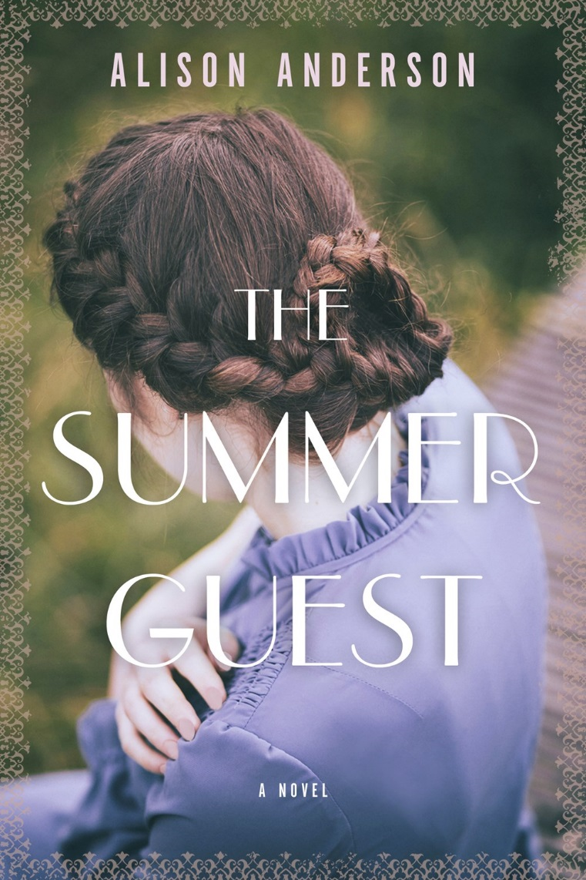

The Summer Guest by Alison Anderson
HarperCollins Canada | 9781443446808 | HC | $29.99
Fiction | 452 pp. | May 2016
“[Anderson’s] prose is the height of elegance. Here’s hoping that she follows this novel with more of her own. An exceptional novel about the transcendent possibilities of literature, friendship, and contemplation.”
—Kirkus Reviews review
“The Summer Guest gives us all of the pleasures of a superb mystery novel, but most of all it is a profound meditation on the power, and necessity, of the imagination. What a deeply moving novel.”
—Ron Rash author of Serena
“Elegant.... This alluring and deceptively ingenuous novel demands close consideration from its readers, contains an internal mystery, and packs a heartbreakingly lovely emotional punch.”
—Booklist review

Slide 12

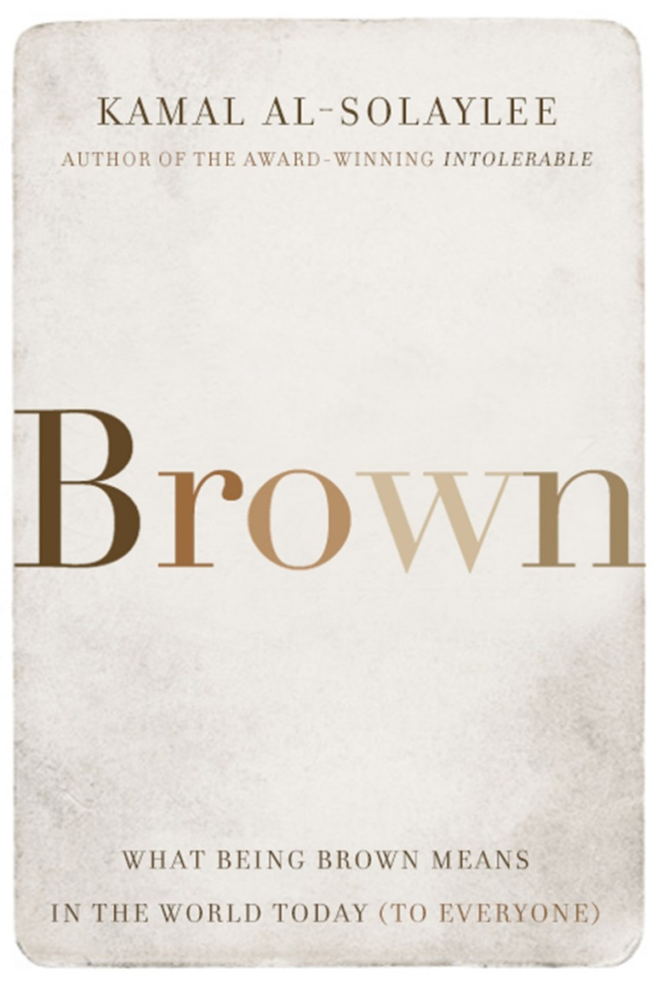
Brown by Kamal Al-Solaylee
HarperCollins Canada | 9781443441438| HC | $29.99
Social Science | 288 pp. | May 2016
“Brown is audacious and original, heartfelt and intrepid. By going behind the scaffolding, Kamal Al-Solaylee raises important questions about the hidden foundations of our unfolding century.” —Charles Foran, author of Mordecai: The Life and Times
“Kamal Al-Solaylee perfectly captures the beauty and heartbreak of being brown. This ambitious and powerful book is mandatory reading for anyone who wants to understand the complexities of race relations in our globalized world.” —Zarqa Nawaz, author of Laughing All the Way to the Mosque and creator of Little Mosque on the Prairie
“Brown is a riveting exploration of the ambiguities of race and a window on a multitude of worlds. It’s also thoroughly researched, beautifully argued, and written with grace and clarity.”—Michael Redhill, award-winning author of Martin Sloane and Consolation
“Brown is a work of such intelligence, depth, uniqueness and compassion. It has the uncanny ability to let the reader slide under the skin of the ‘other’ with such ease and then stay there with growing unease, surprise and sometimes horror. A rare accomplishment—a glimpse into another world from within that world. Masterful, original, insightful and ultimately essential reading.” —Deepa Mehta, award-winning director of Water and Midnight’s Children

Slide 13
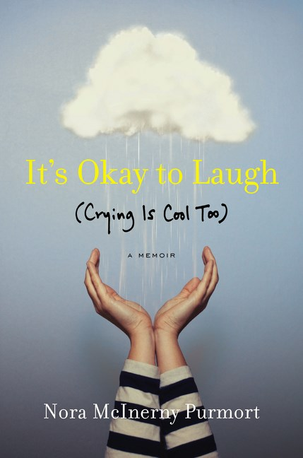
It’s Okay to Laugh (Crying is Cool Too) by Nora McInerny Purmort
William Morrow | 9780062419378| HC | $31.99
Memoir | 288 pp. | May 2016
It’s Okay to Laugh is exactly what a younger generation needs: an unapologetic tale of heartbreak and loss that is devoid of platitudes. I found myself laughing through my tears, but that’s the real experience of profound morning, and she nails it. Nora is the Anne Lamott for the emoji generation.”
— Rebecca Soffer, writer, Modern Loss co-founder
A natural storyteller, Nora’s words will make you laugh and cry all in the same paragraph. She transforms what would be a heart-breaking memoir into a life-affirming anthem.
— David Gallaher, author of The Only Living Boy Series

Slide 14
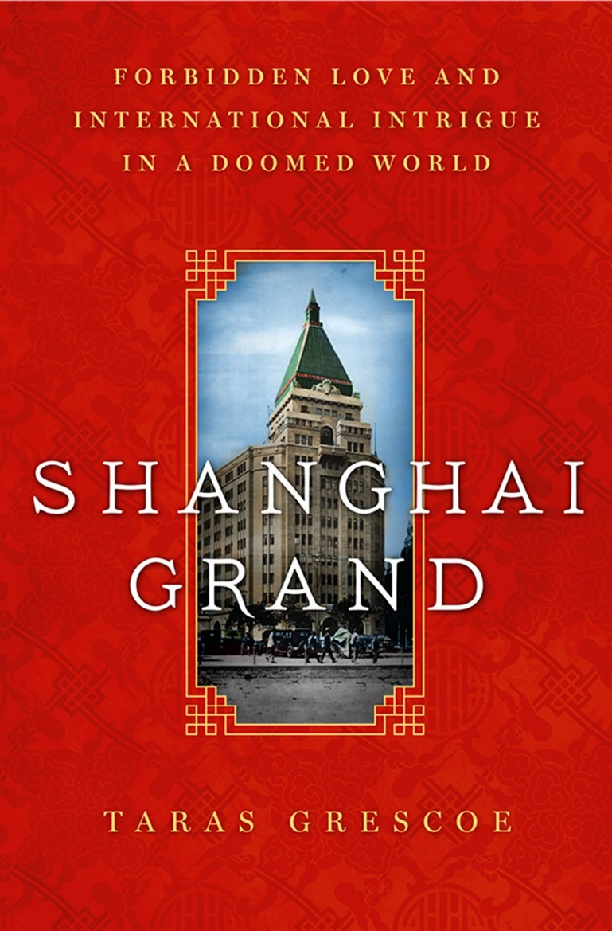
Shanghai Grand by Taras Grescoe
HarperCollins Canada | 9781443425537 | HC| $29.99
History | 352 pp. | June 2016
“A doomed world of glamour and decadence, a clash of cultures, a cast of larger-than-life characters--Shanghai Grand has it all. A riveting tale of lost innocence and lost love. Prepare to be transported to another place and time.”—Dean Jobb, author of Empire of Deception
“Once upon a time, long before the city seemed custom-built to impress and intimidate, Shanghai was most notable for its people--a remarkable mix of refugees and adventurers, poets and fabulists, natives and outsiders. In Shanghai Grand, Taras Grescoe captures this lost world in all its richness.”—Peter Hessler, author of Oracle Bones
“Grescoe exuberantly captures the glamour and intrigue of a lost world.”- Kirkus

Slide 15
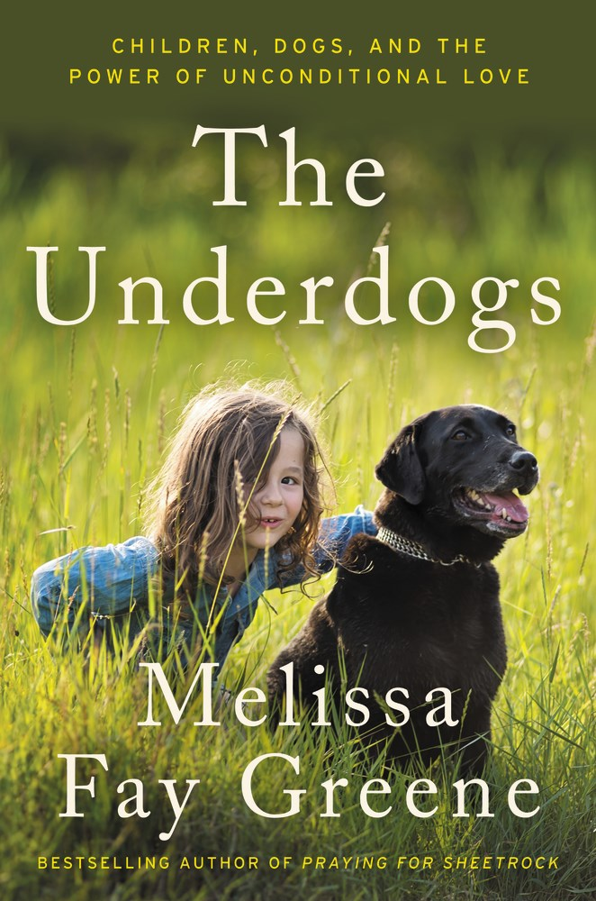
The Underdogs by Melissa Fay Greene
Ecco | 9780062218513 | HC | $34.99
Pets/Dogs | 352 pp. | May 2016
“Through personal interviews and behind-the-scenes tales, Greene (No Biking in the House without a Helmet, 2011, etc.) tells multiple narratives of service dogs that have changed lives…Dog lovers, parents of special needs kids, and those who love feel-good stories will delight in these heartwarming portraits of dogs and their families.” - Kirkus

Slide 16

Contact me at
Rosalyn.Steele@HarperCollins.com
with any Questions
For reviews & info, follow me on

