Slide 1
Get Your Community Moving: Physical Literacy Programs for All Ages
Jenn Carson, Library Director, Yoga Teacher
LP Fisher Public Library, Woodstock, NB Canada

Slide 2
How I got involved with physical literacy…(hint: I like to play. A lot.)
"A library is a miracle. A place where you can learn just about anything, for free. A place where your mind can come alive." ~Josh Hanagarne

Slide 3
My work is dedicated to every tireless programming librarian or paraprofessional who shows up (often in costume and carrying supplies stolen from home) and kicks ass—despite being overworked, underpaid, short-staffed, and overwhelmed. I see you. I am you. You are my people.

Slide 4
What is Physical Literacy …and why should librarians care?
Physical literacy can be thought of as “bodily intelligence.”
Like cognitive intelligence or emotional intelligence, physical intelligence is being aware of our bodies and how they move in time and space. It is something we are born with and is shaped by our early environment, but is also something we can also work to improve at any age.
It has been defined as “the motivation, confidence, physical competence, knowledge and understanding to value and take responsibility for engagement in physical activities for life.”
I would add that it is the motivation, ability, confidence and understanding to move the body throughout the lifecourse as is appropriate to each person’s capacity. The development of fundamental movement skills that permit a person to move with confidence and control in a wide range of actions — such as throwing, skipping or balancing — and environments, like on snow, grass, water, in the air or on ice - also applies to people with disabilities or exceptionalities. The throwing motion of someone in a wheelchair is going to look radically different from the throwing motion of someone who pitches for the big leagues.
*check out your cool bookmarks from Active For Life*
Note: International Physical Literacy Association, Physical Literacy, 2016. https://www.physical-literacy.org.uk/

Slide 5
Physical Literacy Throughout the Lifecourse
Infancy:
Grasp a ball
Early Childhood:
Throw and catch a ball for fun
Middle Childhood:
Throw and catch with precision and accuracy
Young Adulthood:
Be proficient at multiple activities in changing environments, competitive or for fun
Adulthood:
Willingness to try new things that involve throwing and catching (baseball, dodgeball, football, juggling, bowling, disk golf, etc…)
*See Physical Literacy handout for more info*

Slide 6
Let’s try it! Everyone can breathe!

Slide 7
Bringing movement to libraries!
"Have you ever noticed how eager young children are to learn about everything? And how they are constantly moving while doing so? Whether they are painting at an easel, stirring cake batter, or building blocks, their whole body is involved. And learning occurs during this movement." ~Maureen Murdock

Slide 8
Let’s Move in Libraries!
LetsMoveLibraries.org
On Twitter @LetsMoveLibrary

Slide 9
Sign up for the project newsletter
www.letsmovelibraries.org/about/

Slide 10
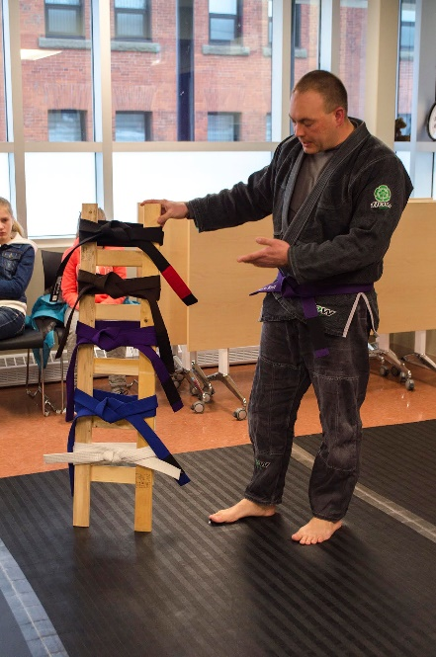
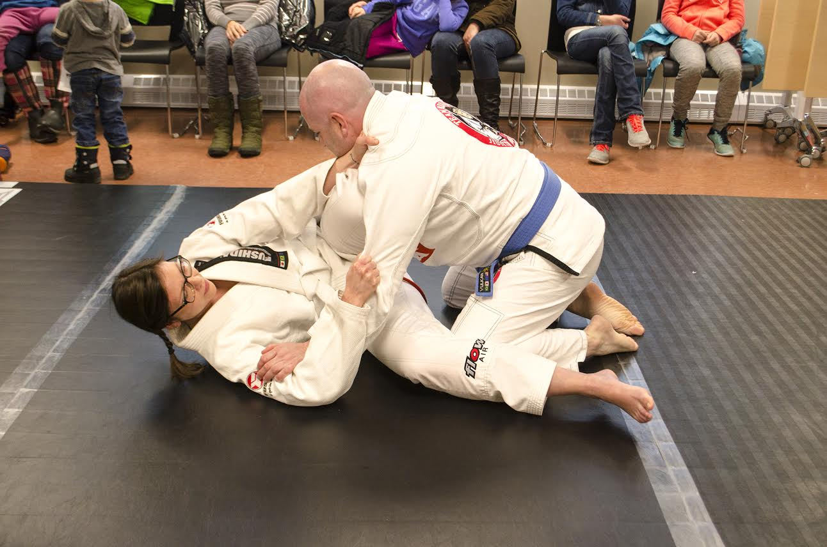
Movement-Based Program Planning
Setting the stage, community partnerships
Budgets, legalities, and logistics
Spreading the word with effective marketing

Slide 11
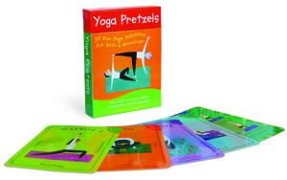
Passive (sometimes sneaky) ways to get people moving….
Stand-up desks (adjustable), bike and treadmill desks
Activity cards (such as yoga cards) left in common areas
Active outdoor equipment (for all bodies)
Alternative collections (pedometers, yoga mats, snowshoes, fit kits, gym passes, board games, etc…)
Movement stations (dress-up centre, sensory tables, puppet theatre, stand-up maker counter, stacking blocks, hopscotch)
Health-related programs (digestion, healthy sleep, meditation, acupuncture, etc…that will encourage people to take better care of their bodies…and then they will want to move more)
Displays of “active” materials (i.e.: how-to running books, movies about runners, runner bios, cookbooks for runners)

Slide 12
Program Models: Fun for the Whole Family
Kids’ Kilometre Fun Run
Bike Clinic

Slide 13
Program Models: Just for Kids
Nerf Battle
Library Mini-Golf

Slide 14
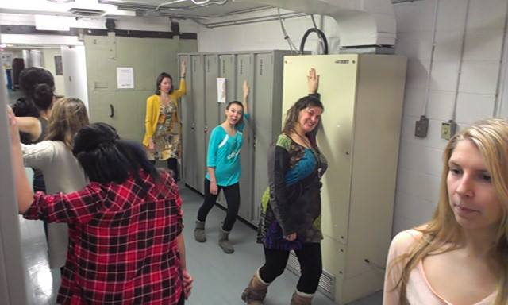
Program Models: Teen-o-rrific
"...All adolescents are saturated with new hormones, new and acute kinds of self-consciousness, new kinds of desires, and ﻿confronted with the avalanche of new responsibilities that are associated with the threshold of adulthood. All of this physical and mental turmoil creates a new kind of muscular tension in the adolescent. They squirm. They chew their fingernails. They tap their feet. They screw themselves up into the damndest kind of postures. They jump up and down and shout at the slightest provocation. They are like tightly wound springs." ~Deane Juhan, Job's Body: A Handbook for Bodywork
Library Guild
Yoga and Meditation for Young Adults

Slide 15
Program Models: Grown-ups Still Play!
Run and Walk Club
International Fibre Enthusiasts

Slide 16
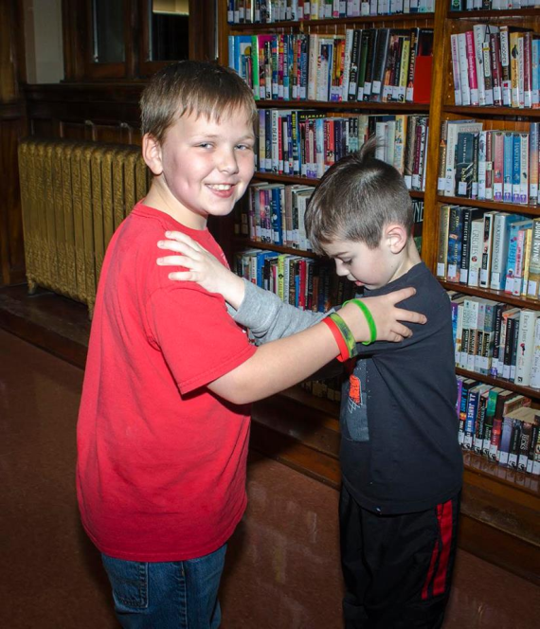
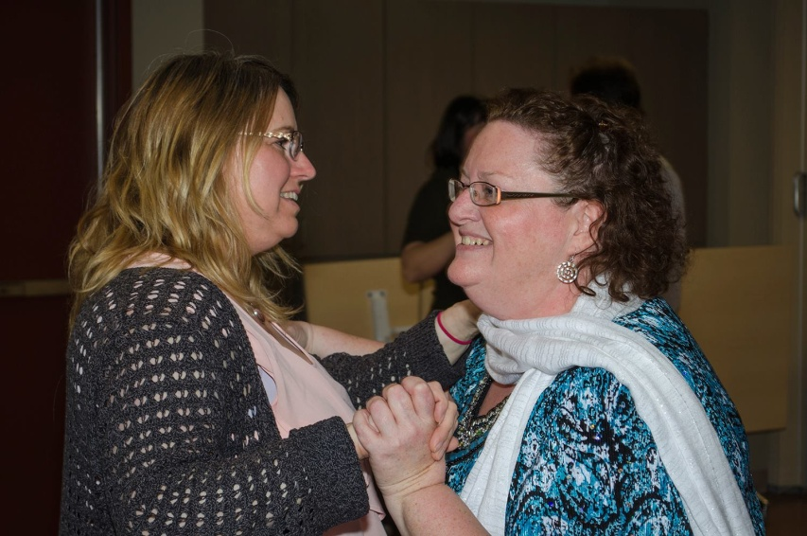
We’re always dancing in the stacks!

Slide 17
Include, Adapt, Adjust, Innovate!
Outreach AND Inreach
Movement-based programs are for everybody!
All programs at the library are FREE.

Slide 18
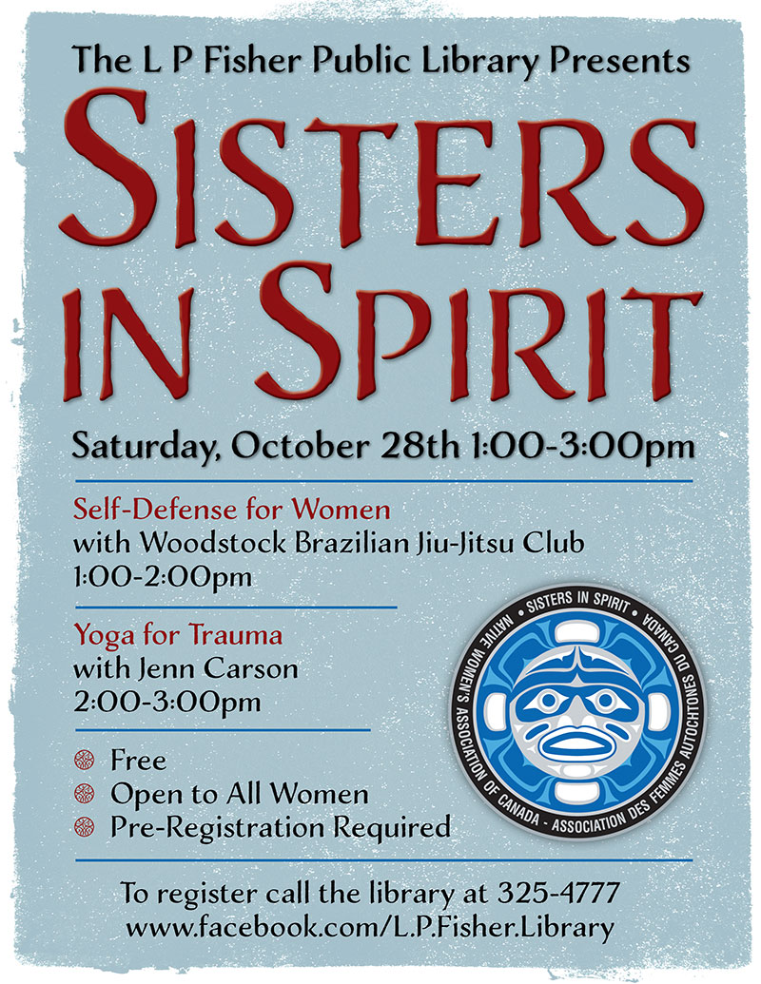
First Nation Outreach

Slide 19
Physical Literacy for Staff
Taking Care of Us
Taking care of us *handout* and webinar: https://www.youtube.com/watch?v=E_HBGZVglv0

Slide 20
Yoga Break Time!
*see handout for desk routine you can take with you*
De-Stress Yoga Video:
https://www.youtube.com/watch?v=484_cJPBmEk

Slide 21
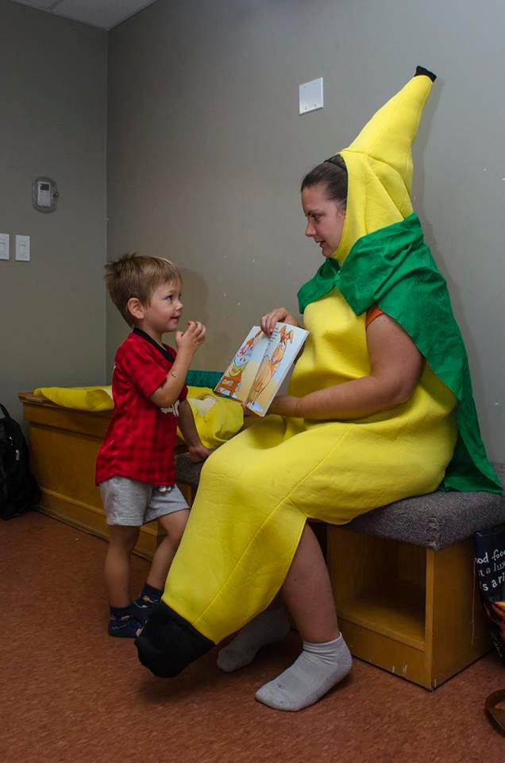
Important Links
www.yogainthelibrary.com Yoga in the Library
www.programminglibrarian.org Programming Librarian
www.activeforlife.com Active for Life
www.letsmovelibraries.org Let’s Move Libraries
www.sportforlife.ca Sport for Life
www.physicalliteracy.ca Physical Literacy for Life

Slide 22
Want to learn more?
With a foreword by Noah Lenstra and afterward by Denise Agosto
Release date: June 2018
https://www.alastore.ala.org/content/get-your-community-moving-physical-literacy-programs-all-ages
Contact: Jennifer.carson@gnb.ca

Slide 23
www.jenncarson.com
Free downloads of all infographics from the book!

Slide 24
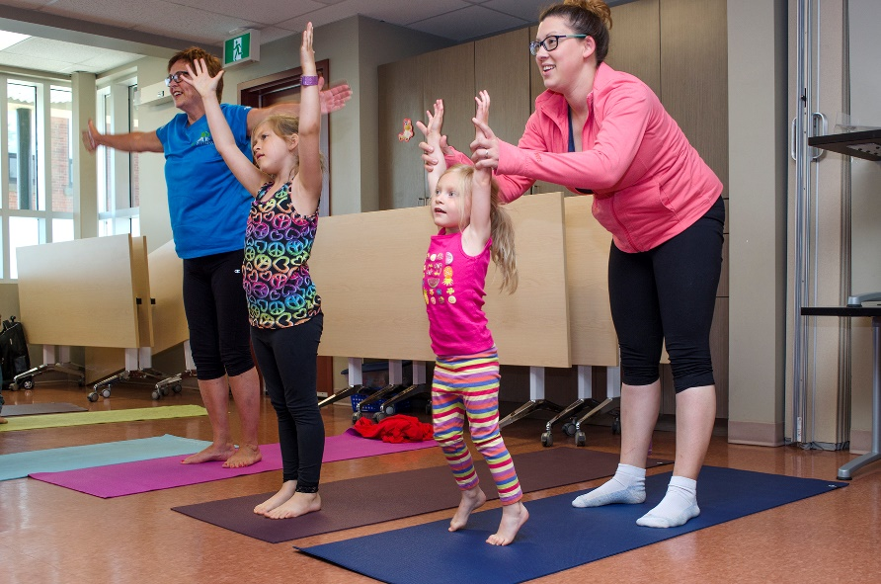
Questions? Stories to share? Dance moves?

