Slide 1
Frames and Games:
Thoughts on Connecting Students with the ACRL Framework for Information Literacy For Higher Education
Ian Fraser, MLIS
May 6th, 2016

Slide 2
About the ACRL Framework
Dramatic update to the former Standards.
Refocus on foundational concepts.
Movement away from “skills”, “tools”, or “outcomes”.
Informed by threshold concepts.

Slide 3
Threshold Concept Framework
Authority is Constructed and Contextual.
Information Creation as a Process.
Information Has Value.
Research as Inquiry.
Scholarship as Conversation.
Searching as Strategic Exploration.
ACRL, 2015.

Slide 4
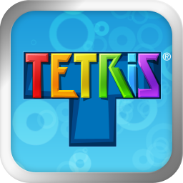
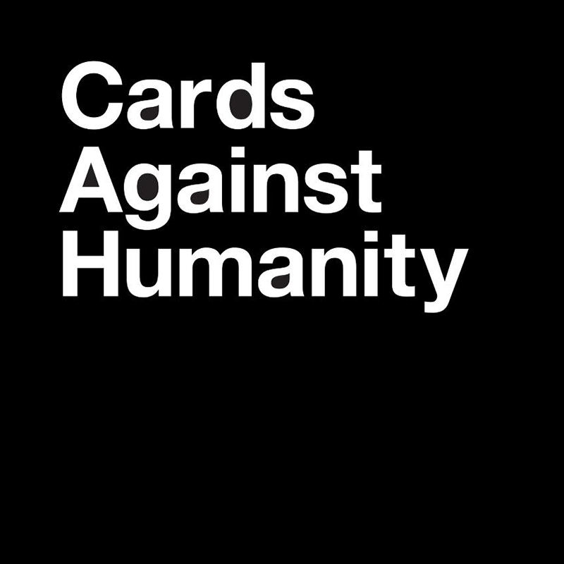

Slide 5
Authority
Influence recognized within a community.
Not universal, but exists in context.
Biases may privilege one form over another.
Choose Again
Continue

Slide 6
Process
Research is iterative.
Different processes are used in different contexts.
In addition to the final product, the process may be a signal of quality.
Requires self-reflection and flexibility.
Choose Again
Continue

Slide 7
Value
Information has different types of value.
Can marginalize, if misused, but can also empower and be used to solve problems.
We make choices in complying/contesting information as property.
Choose Again
Continue

Slide 8
Inquiry
Asking increasingly complex questions.
Looking for open or unresolved issues.
Debate and dialogue work to deepen to conversation.
Choose Again
Continue

Slide 9
Conversation
Discourse and dialogue.
There may be several competing perspectives.
Developing familiarity with the topic lets you enter the conversation.
Providing attribution to other’s ideas.
Choose Again
Continue

Slide 10
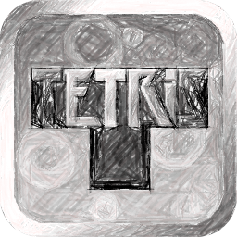
Strategic
Research is nonlinear and iterative.
Requires flexibility to pursue alternatives.
Use multiple methods of searching, instead of only one.
Choose Again
Continue

Slide 11
Lesson Plan

Slide 12
Today is a busy day in the city. Here’s your “To Do” list:
Go to the bank and get your finances in order.
Help your uncle Roger plan his mayoral campaign.
Pay that stupid parking ticket.
Meet a friend at the café down the street.
Visit the Museum of Interesting Things.
Take a tour of that new mega-skyscraper.

Slide 13
Price is what you pay. Value is what you get.
The wise man doesn't give the right answers, he poses the right questions.
I know how to bow down to authority, if it’s authority that I respect.
Ideal conversation must be an exchange of thought, and not, as many of those who worry most about their shortcomings believe, an eloquent exhibition of wit or oratory.
Without leaps of imagination, or dreaming, we lose the excitement of possibilities. Dreaming, after all, is a form of planning.
Living life is like constructing a building: if you start wrong, you’ll end wrong.

Slide 14
process
?
Strategy
inquiry
V
ALUE
100
Conversation

Slide 15
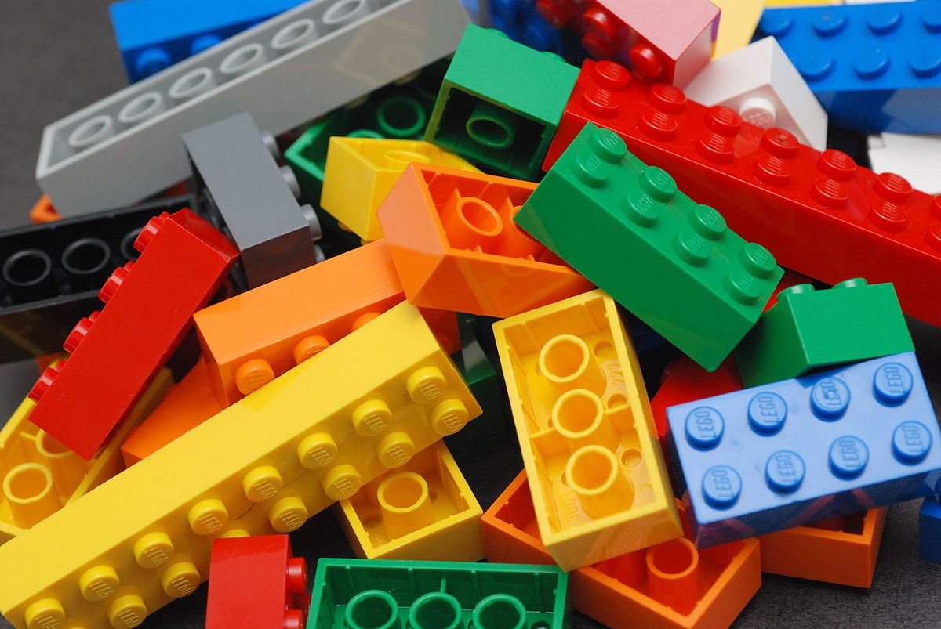
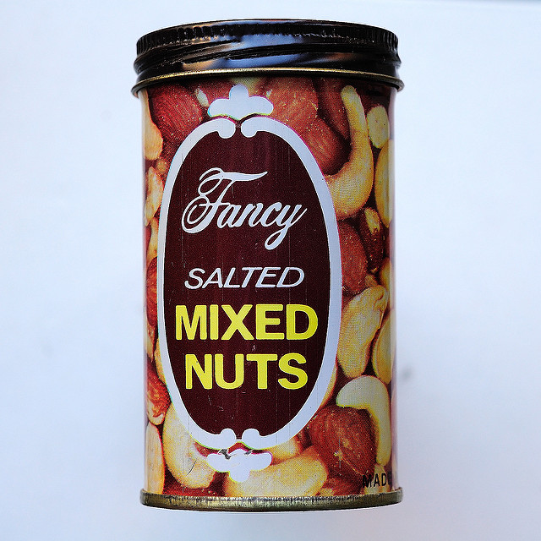
Lego Color Bricks. © Alan Chia. CC BY-SA 2.0
Optimal Prime. © Stu Willis. CC BY-NC-SA 2.0
Fancy Salted Mixed Nuts. © Ralph Hockens. CC BY 2.0
228-365 Colouring Book. © Karen Mardahl. CC BY-SA 2.0
Shape Sorter. © Ella‘s Dad. CC BY 2.0

Slide 16
Transformative
Involves a “shift in the perception of a subject, or part thereof.”
In extreme cases, may even result in changes to personal identity (political or philosophical).
E.g. Students as participants in the research conversation.
Meyer & Land, 2006.
Choose Again
Continue

Slide 17
Irreversible
Unlikely to be forgotten.
Difficult for the expert practitioner to look back across threshold with understanding.
E.g. The privilege and responsibility of having access to such valuable information.
Meyer & Land, 2006.
Choose Again
Continue

Slide 18
Integrative
Shows interrelatedness of concepts.
Clusters discrete bits into a whole.
E.g. Defining peer-review is one key aspect of understanding academic authority.
Meyer & Land, 2006.
Choose Again
Continue

Slide 19
Bounded
Delimits the conceptual space and may even show boundaries to other fields/disciplines.
Exposes new thresholds as yet uncrossed.
E.g. Boundaries of writing and research are demonstrated in the information cycle.
Meyer & Land, 2006.
Choose Again
Continue

Slide 20
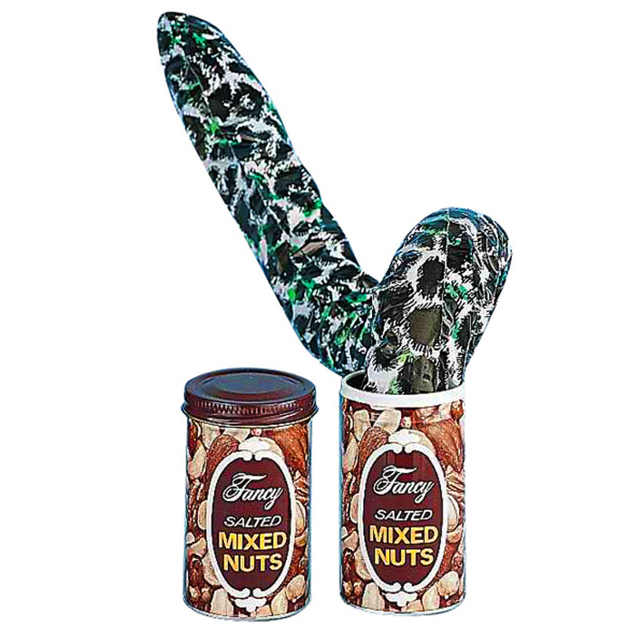
Troublesome
Counterintuitive, nonsensical, alien.
Students may feel like they’ve taken a step backwards in their understanding.
E.g. Research demands that students maintain inquisitiveness when they often are seeking discrete answers.
Meyer & Land, 2006.
Choose Again
Continue

Slide 21
Future Directions
Constant refinements.
New metaphors.
Communication/collaboration with faculty.
Other implementations.
Other models of threshold concepts in IL.
Narrative pedagogy in IL.

Slide 22
Bibliography
Association of College and Research Libraries. (2015, February 2). Framework for Information Literacy for Higher Education. Retrieved from www.ala.org/acrl/standards/ilframework
Meyer, J., & Land, R. (2006). Overcoming barriers to student understanding: Threshold concepts and troublesome knowledge. London: Routledge.

