Slide 1
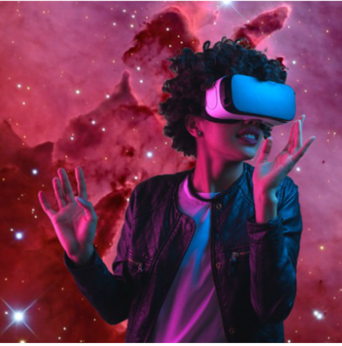
Be Anyone/Anything You Want to Be, While Becoming Information Literate in Virtual Reality
By: Felicia A. Smith, MLIS
Stanford University
http://library.stanford.edu/people/felicias

Slide 2
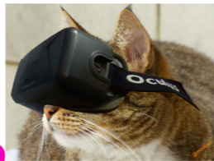
Why use VR ?
VR Technology replaces boring, antiquated lecture format
VR allows for real life situations instead of foreign jargon

Slide 3
1800s Classroom
purl.stanford.edu/ry626jm2552

Slide 4
More details in my article
Use Common Sense Scenarios to show students they already possess the needed skills for Critical Evaluation
"I never teach my pupils. I only attempt to provide the conditions in which they can learn” –Albert Einstein
http://www.infotoday.com/cilmag/jan18/index.shtml

Slide 5
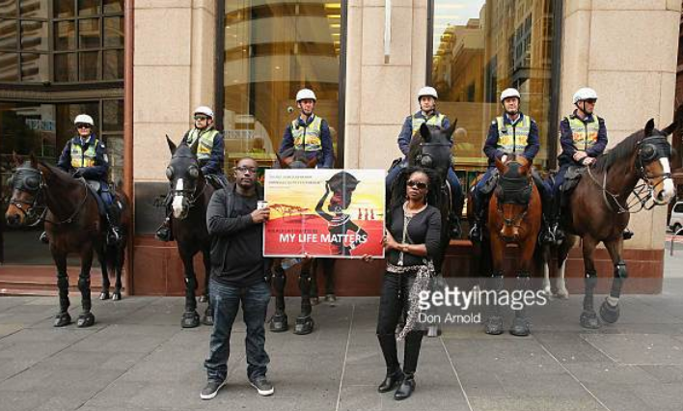
scenarios
Credibility: E.R. Nurse vs Nightclub Stranger
Currency: Breaking News vs. Primary Sources
Fake News: Black Lives Matter Protesters vs Police Horse

Slide 6
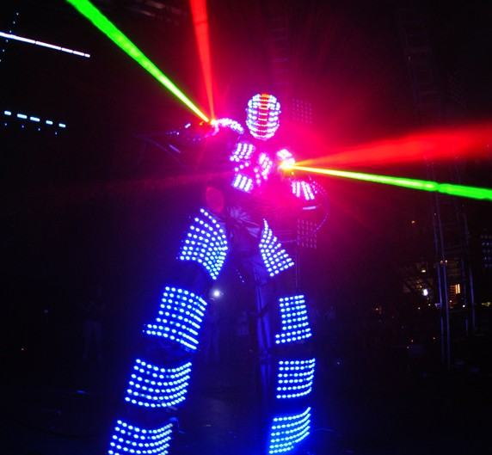
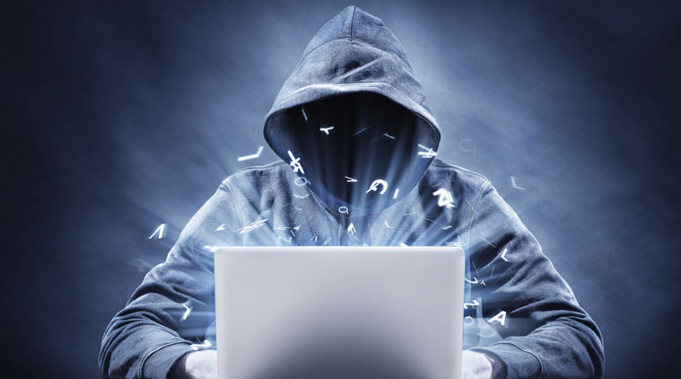
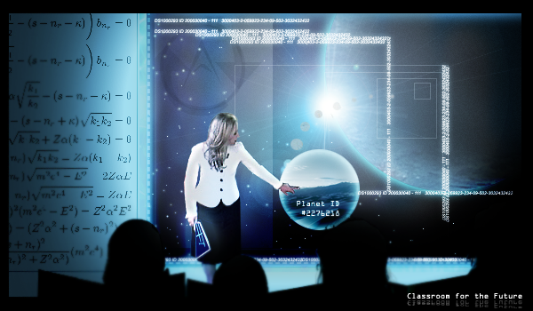
CREDIBILITY

Slide 7
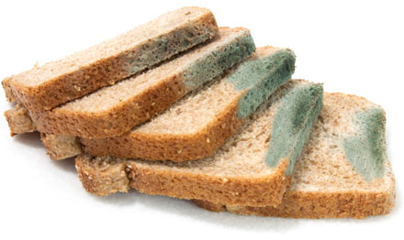
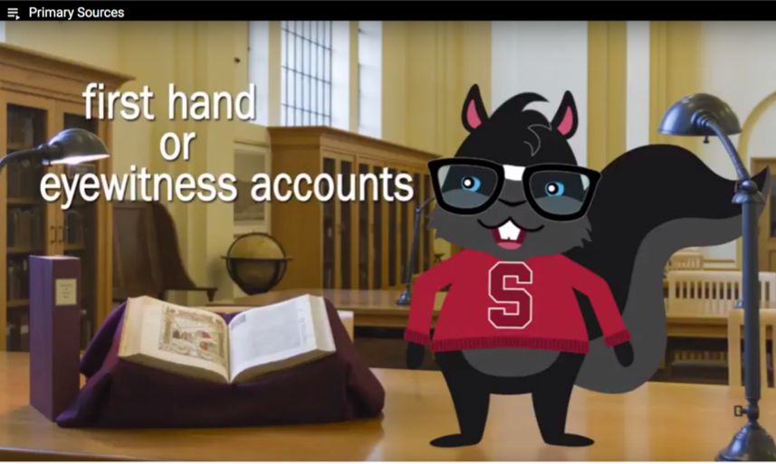
CURRENCY
https://youtu.be/0UX0LWyV6G4

Slide 8
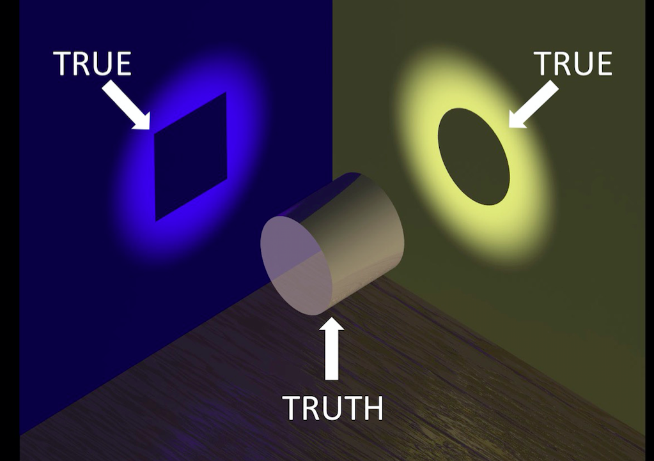
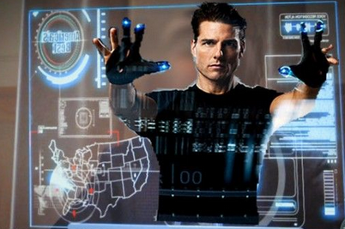
FAKE NEWS
https://www.snopes.com/fact-check/police-horse-kicks-blm-protester/

Slide 9
Cost?

Slide 11
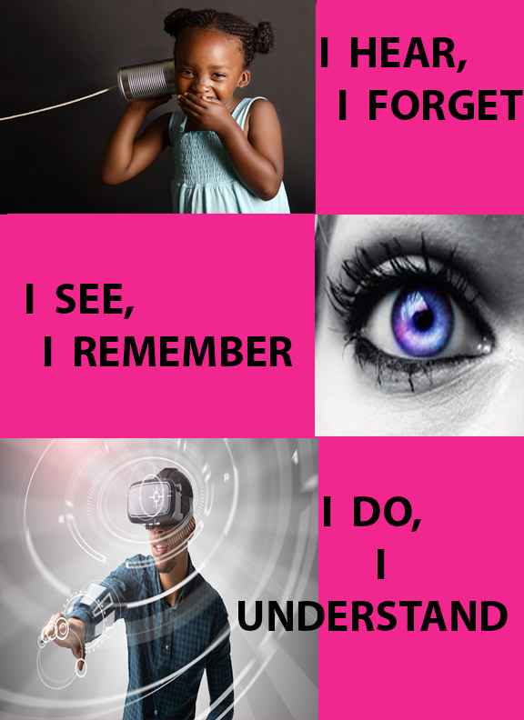
Felicia A. Smith
Stanford University
http://Library.Stanford.edu/People/Felicias

