Slide 1
Don’t Judge a Book by Its Cover: Discover How No Patron is a Bad Patron
Caroline Moynihan and Jonathan Jarvie
April 27, 2019

Slide 2
Why it matters!
Everyone has a story
One experience doesn’t reflect them all
Lifeline
Only resource
Community hub
Value people offer

Slide 3
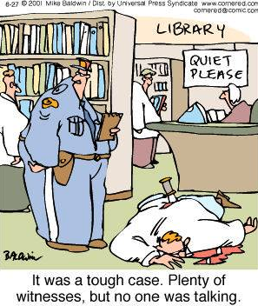
A day in the life of LPL
Groups of Regulars
Those that check emails
Or check Facebook
The one time users
Coming in for tech help
Just passing time
People spending the whole day
Printing things off
Looking for Jobs
Etc….

Slide 4
Start off on the right foot
Be mindful of their situation
Check your biases
Set your boundaries and STICK TO THEM
Remember this is a professional relationship, be friendly not a friend

Slide 5
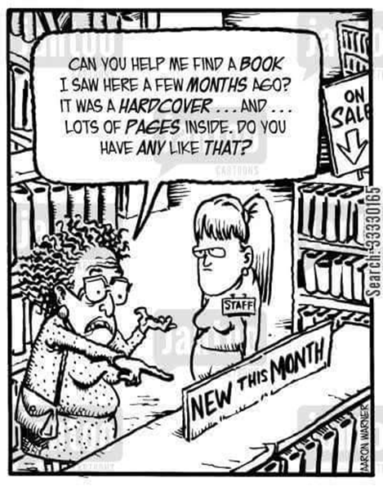
That “Difficult” Computer Patron
Someone who needs your help every two seconds
Wants you to type out their resume/document
Needs you to open websites
Can’t remember their passwords
Forgets how to send an email
Maybe can’t even type

Slide 6
Positive Solutions
Remember they might not have regular access to technology
Use these interactions as “teaching moments”
Remain calm, if you get agitated chances are the patron will follow suit
Walk away from the situation and have a colleague step in
Remember it is ok to say no, or to direct them to services that can help them with their tech needs

Slide 7
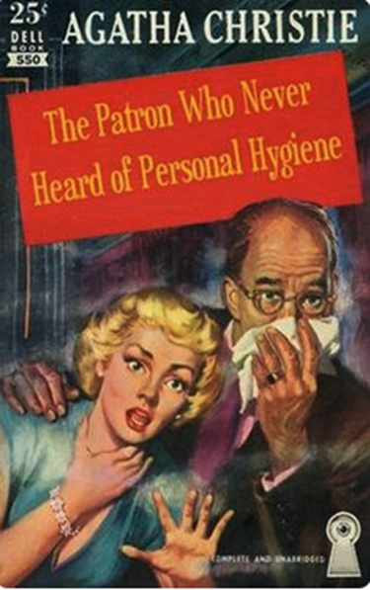
Just “passing the time” patron
Playing “games”
On Facebook
Listening to music
Watching movies
Social interaction

Slide 8
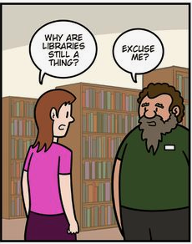
Positive Solutions
They might be using Facebook or other sites as a form of communication, try not to jump to conclusions about why the patron is using the computers
Make sure patrons are given a chance to modify their behaviour if violating library policies and rules
Often it will be other patrons that will create a problem, not the patrons engaging in the behaviour—engage in open dialogue that the library is open to everyone

Slide 9
The “impaired” patron
Might be drunk
Taking Drugs
Tired/sleepy
Mental Issues

Slide 10
Positive Solutions
Ask the patron to take a walk to get some fresh air and then they can come back
If the patron came in with friends, see if they can help manage the patron
Smelling of alcohol or marijuana shouldn’t necessarily be a reason to kick someone out, of course follow your policies and rules, but if the patron is respecting those rules, allow them to sit and use the space
Ultimately use your judgement, if you think the situation is unsafe, then remove the patron from your library.

Slide 11
Those “uncomfortable” patrons
Ask or talk about inappropriate things
Flirtatious
Gets touchy/feely

Slide 12
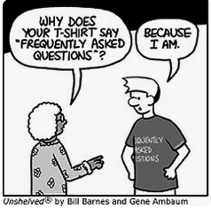
Positive Solutions
These are the situations when it’s ok to say “NO”
Assess the situation if it is making you feel uncomfortable it is ok to tell the patron to stop, or to ask your coworkers to step in
Often when those professional boundaries are set you’ll find the instances of inappropriate behaviours go away

Slide 13
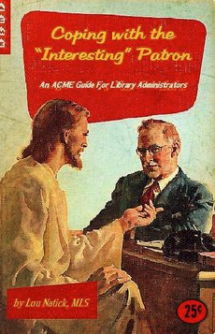
Best Practices
Established set of rules/guidelines
No “flip flopping” on those rules/guidelines—consistency
Same rules/guidelines apply to everyone

Slide 14
Best Practices
Don’t create unreal expectations
Don’t offer services that not every staff member can provide
Don’t make promises you can’t keep

Slide 15
Best Practices Continued …..
Get to know your disadvantaged patrons, it’s easier to find a solution if you know the cause of the problem
Try to remember that everyone has a story, and everyone has bad days some times
Each day is a new day, something bad might have happened the day before, but it doesn’t mean that today has to have the same results

Slide 16
Self Care
You can’t help everyone
Know your limitations
Take time to self reflect
Talk to your coworkers
Remember to take your breaks

Slide 17
Success – “Steve”
Homeless
Occasional Drug User
Can act inapporpriatly
Carpenter
Computer Illiterate
Needs a job
Success through a positive attitude
Able to find a job

Slide 18
Failure – “Derek”
Homeless
Smelt quite badly
Paranoid, trust issues
Doesn’t want/need help
Just wants a quiet place
Failed because staff used the rules as punishment/harassment
Not all staff tried to get to know and understand him
Not everyone took into consideration his personal struggles
Left the library in July has not returned, latest news was he left Lethbridge in October

Slide 19
Failure – “Janet”
Paranoid
Low income housing
Semi-retired
Staff went out of their way to help her, drove her places
Failed we let her cross that professional boundary
She started posting on social media, negative things about staff

Slide 20
Success – “Gary”
Frequent drug user
Violent temper
Unemployed
Success through relationship building
Example of patrons policing the behaviour of other patrons

Slide 21
Failure – “Mary”
Transitioning female
Community advocate
Unemployed
Staff were disrespectful in regards to her situation
Failure to get to know a patron and understand where they are coming from

Slide 22
A final success story…
You may not even be aware of some of the successes you have in dealing with disadvantaged patrons
A story from when we were putting this presentation together…

Slide 23
“The way we communicate with others and with ourselves ultimately determines the quality of our lives.”
- Anthony Robbins

Slide 24
Questions?

Slide 25
Resources
www.homelesslibrary.com
http://publiclibrariesonline.org/2018/11/constructive-confrontation-being-decisive-rather-than-nice/
https://www.folio.ca/a-little-help-from-a-friend/
https://youtu.be/Jpkh41BL0oY?t=46

Slide 26
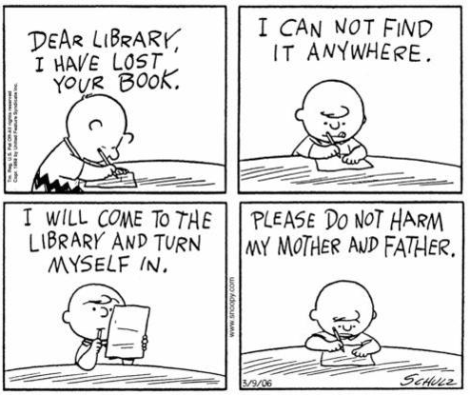
Contact Information
Caroline Moynihan caroline.Moynihan@lethlib.ca 403-320-4799 @youthlibrarian
Jonathan Jarvie jonathan.jarvie@lethlib.ca 403-320-4954

